Slide 1
Socially Disadvantaged Farmers and Ranchers Workshop
Supporting Technical Assistance in the U.S. Southern Region
August 5-6th, 2020

Slide 2
Agenda
*in Eastern Time
Wednesday, August 5th
Welcome!
9:10-9:25 Opening Activity
9:25-10:00 SDFR Definitions and Farm Bill Provision Updates
10:00-10:10 Break
10:10-11:30 Heir’s Property
Wrap up
Thursday, August 6th
Welcome!
9:10-9:30 Opening Activity
9:30-10:00 Identifying Partnerships
10:00-10:30 Innovations in Markets
10:30-10:40 Break
10:40-11:15 Farm Stress Mental Health Resources
11:15-11:45 Discussion on Equity and Justice
Wrap Up
OPPE Workshop – Socially Disadvantaged Farmers and Ranchers

Slide 3
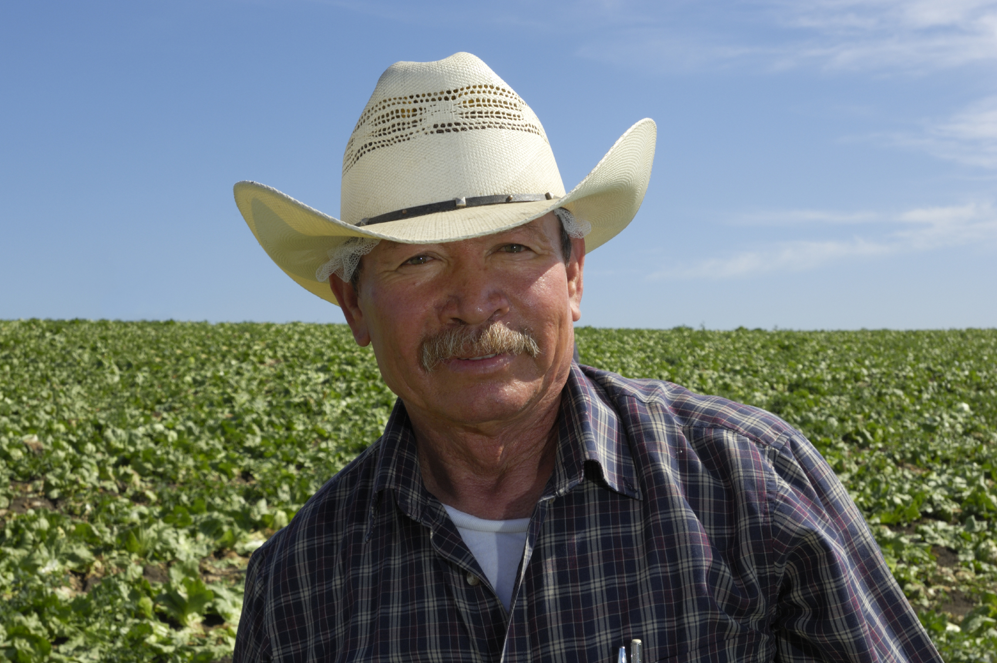
Workshop Objectives
Learn about resources and strategies to meet emergent needs and challenges of socially disadvantaged farmers and ranchers
Examine up-to-date information on USDA programs
Engage in peer-to-peer connections among participants
Learn methods to access public data to assess needs
Develop stakeholder engagement strategies to build partnerships and accomplish shared goals
OPPE Workshop – Socially Disadvantaged Farmers and Ranchers

Slide 4
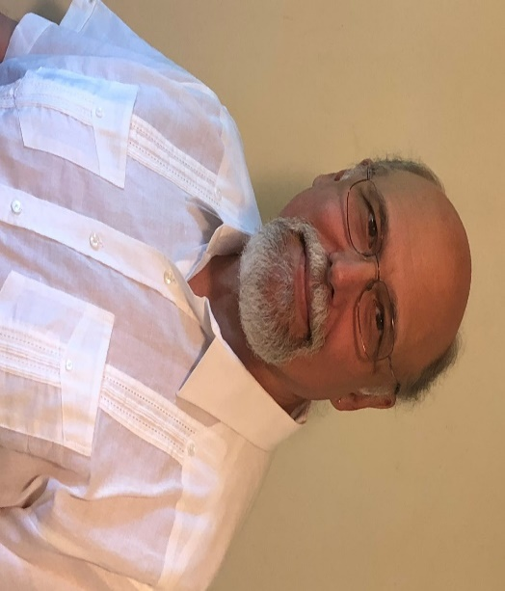
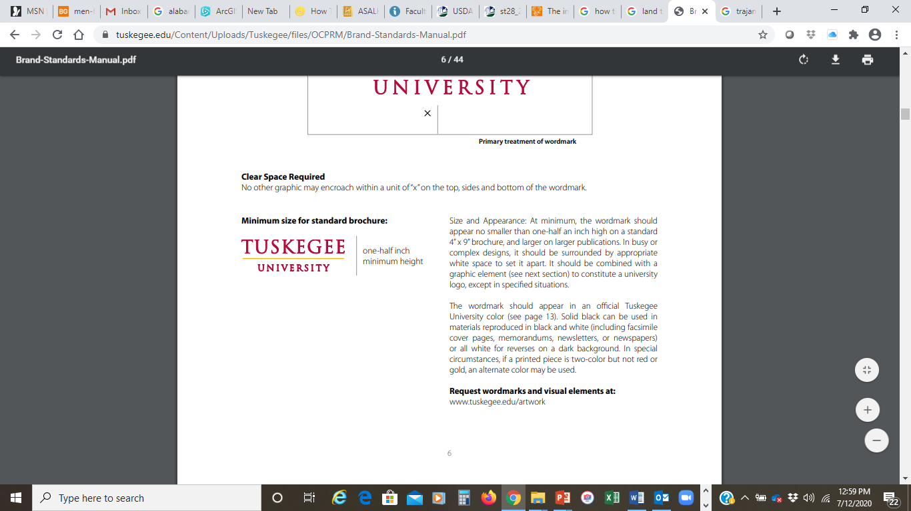
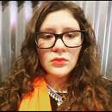

Presenters
Robert Zabawa, PhD, is an anthropologist and research professor at the George Washington Carver Agricultural Experiment Station, Tuskegee University. He is Co-Director of the Integrative Public Policy and Development PhD Program and Coordinator of the Agricultural and Resource Economics MS Program.
Lourdes Elena South is part of the Natural Resource Conservation Service in the Implementation and Stewardship Branch of the Easements Programs Division. She is a sub-team lead for NRCS’ Historically Underserved Working Group. She has a J.D./Legal Masters in Law in Environmental law and justice.
OPPE Workshop – Socially Disadvantaged Farmers and Ranchers
Notes:
Instructions: Give any instructions or talking points to help the presenter with this slide and any related activities.
Time: How long talking through this slide and any related activities will take?
Materials: List any materials needed for any processes that will go with this slide
Handouts: List any handouts, if any

Slide 5
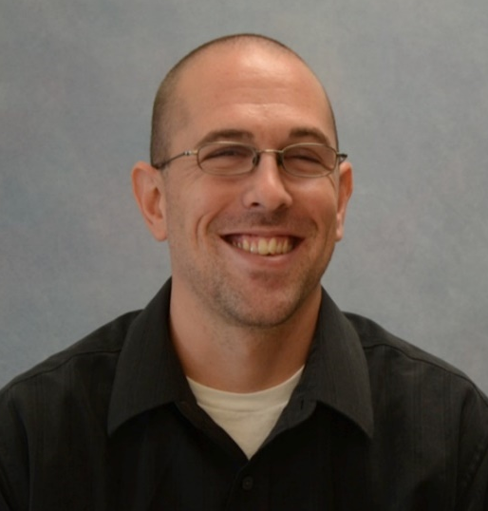
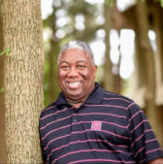

Presenters
Michael Carlo is a Natural Resource Specialist on the Outcomes Team in the Resource Inventory & Assessment Division of the Natural Resources Conservation Services (NRCS). He is the Leader of the NRCS Historically Underserved Farmers and Ranchers Working Group.
Sam Cook is a 35+-year career as a forester and natural resource professional. He coordinates the management of the forest assets owned or managed by the NC State University College of Natural Resources Foundation, Inc. A private forestry consultant and board member for several conservation and forestry organizations.
OPPE Workshop – Socially Disadvantaged Farmers and Ranchers
Notes:
Instructions: Give any instructions or talking points to help the presenter with this slide and any related activities.
Time: How long talking through this slide and any related activities will take?
Materials: List any materials needed for any processes that will go with this slide
Handouts: List any handouts, if any

Slide 6


Presenters
Michael Carlo is a Natural Resource Specialist on the Outcomes Team in the Resource Inventory & Assessment Division of the Natural Resources Conservation Services (NRCS). He is the Leader of the NRCS Historically Underserved Farmers and Ranchers Working Group.
Cynthia Cuellar is a National Outreach Specialist for USDA’s Farm Service Agency. She helps to provide resources and materials to internal and external customers on the awareness and education of FSA Farm Programs.
OPPE Workshop – Socially Disadvantaged Farmers and Ranchers

Slide 7
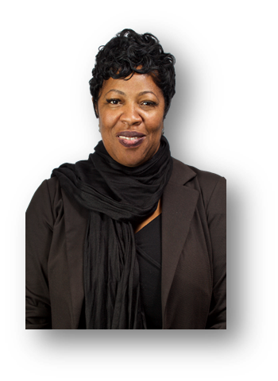
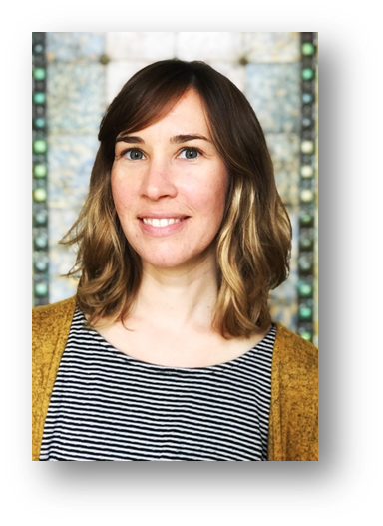
Presenters
Kenya Nicholas is a Program Director with the U.S. Department of Agriculture (USDA) headquartered in Washington, DC. She manages two grant programs that
serve socially disadvantaged and veteran farmers and ranchers (Outreach and Assistance for Socially Disadvantaged and Veteran Farmers and Ranchers Program
(also known as the 2501 Program) and the Socially Disadvantaged Policy Research Center) within the Office of Partnerships and Public Engagement. She works across all USDA agencies to coordinate outreach to USDA’s stakeholder communities. She has worked within the Department for over 29 years.
Dr. Sarah Rocker is a rural sociologist at the Northeast Regional Center for Rural Development at Penn State University. Her primary research areas include regional food value chain coordination for small and mid-scale producers, strategies for place-based community and economic development and stakeholder engagement.
OPPE Workshop – Socially Disadvantaged Farmers and Ranchers

Slide 8
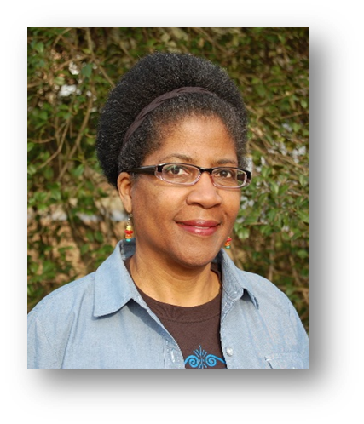
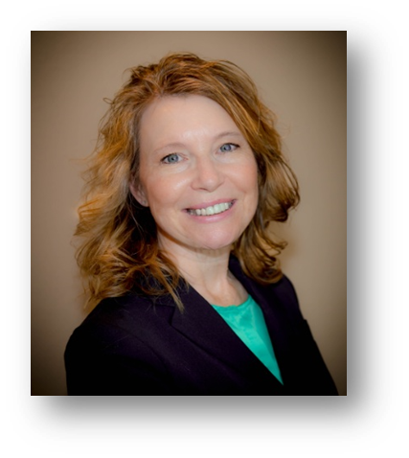
Presenters
Renee Catacalos has been a food system advocate and writer in the Mid-Atlantic region for the past 15 years, and is author of the book, The Chesapeake Table: Your Guide to Eating Local. As member and strategic partnerships director for Sustainable Agriculture and Food Systems Funders, she helps amplify the impact of grantmakers and investors in co-creating more equitable food and agriculture systems.
Christine Sorensen is a Partnership Team member for the USDA Rural Development Innovation Center. She has worked with rural communities for over 25 years on community and economic development, local and regional food systems, food sovereignty, and coalition building for food supply chain development. She lives in South Dakota.
OPPE Workshop – Socially Disadvantaged Farmers and Ranchers

Slide 9
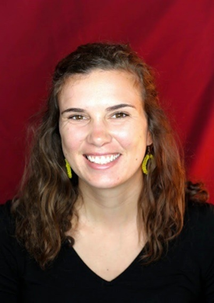
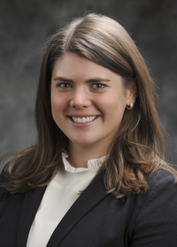
Presenters
Katie Hickey is a Master of Public Administration candidate at Cornell University working with the USDA Office of Partnerships and Public Engagement. She is focusing her studies on agriculture and food policy with emphasis on food access for underserved populations.
Mary Nelson Robertson PhD, CHES, is Extension Associate III and Project Manager for Mississippi State University Extension Service’s Preventing Opioid Misuse In the Southeast: PROMISE Initiative. The PROMISE Initiative focuses on enhancing mental health and preventing opioid misuse among rural communities, especially among agricultural producers and their families.
OPPE Workshop – Socially Disadvantaged Farmers and Ranchers

Slide 10
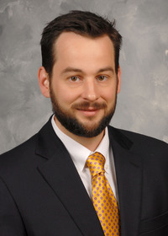
Presenters
David Buys is State Health Specialist and Associate Professor at Mississippi State University where he leads a team of health sciences faculty, staff, and students. Their work focuses on improving mental health, obesity, and other health concerns across the state, with a particular focus on rural communities.
OPPE Workshop – Socially Disadvantaged Farmers and Ranchers

Slide 11
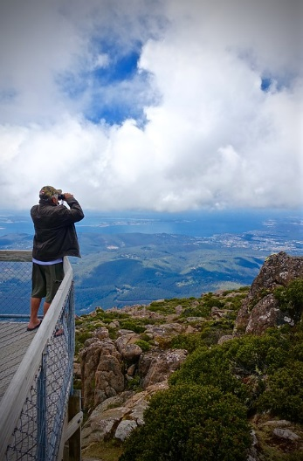
Session Overview
Identifying New Partners:
Thinking Across the Value Chain
What is a Value Chain?
Benefits of Value Chain Strategy
Coordinating and Planning
Support and Resources for Value Chain Coordination
OPPE Workshop – Socially Disadvantaged Farmers and Ranchers
Notes:
Instructions: Welcome participants to the session and briefly review the goals from this slide.
Time: 1 minute
Materials: None
Handouts:

Slide 12

Agenda
Thursday, August 6th
Welcome!
9:10-9:30 Opening Activity
9:30-10:00 Identifying Partnerships
10:00-10:30 Innovations in Markets
10:30-10:40 Break
10:40-11:15 Farm Stress Mental Health Resources
11:15-11:45 Discussion on Equity and Justice
Wrap Up
OPPE Workshop – Socially Disadvantaged Farmers and Ranchers

Slide 13
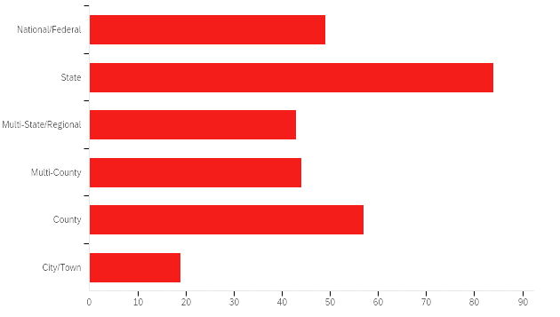
Who Is in the Room?
Non-Profit Organizations
United States Department of Agriculture
Land Grant Institutions
State and Local Government
Public Agencies
Colleges and Universities
Businesses
Faith-Based Organizations
Notes:
Please share your name, organization and where you are from. Answer the question “What are you most eager to learn in today’s workshop?”

Slide 14
Opening Activity
Please share your name, organization and where you are from.
“What are your biggest challenges with programming and planning in serving socially disadvantaged farmers and ranchers?”

Slide 15
Top Challenges Faced by Socially Disadvantaged Farmers and Ranchers
Access to Capital and Credit
  For land, labor, equipment and infrastructure
Access to Information
  Broadband and Technology Limitations
  Limited off-line support resources
Access to Services
  Challenges identifying and communicating with agencies
  Challenges applying for programs
  Differing eligibility requirements of agencies
  Program exclusion and discrimination
Lack of Access to Land
  Heirs property
  Challenges to lease, rent, own and maintain land
Access to Information, Education and Training
  Lack of mentorship opportunities
  Need for linguistically and culturally appropriate information
Safety and Health
  Farmworker rights and safety
  Environmental injustice
  Protection during COVID
Discrimination and Racism
  Structural and institutional racism within agencies, markets, institutions
Market Challenges and Lack of Access to Markets
  Falling market prices
  Food safety barriers to market entry
  Scale barriers to market entry
Disaster Recovery
  COVID
  Natural disasters

Slide 16
Agenda
Thursday, August 6th
Welcome!
9:10-9:30 Opening Activity
9:30-10:00 Identifying Partnerships
10:00-10:30 Innovations in Markets
10:30-10:40 Break
10:40-11:15 Farm Stress Mental Health Resources
11:15-11:45 Discussion on Equity and Justice
Wrap Up
OPPE Workshop – Socially Disadvantaged Farmers and Ranchers

Slide 17
Identifying Partnerships
Value Chain Strategy to Support Socially Disadvantaged Farmers and Ranchers
Notes:
Total Session Time: This is only needed on the title slide
Before the Session: List any instructions for room or material setup that are needed
Instructions: Give any instructions or talking points to help the presenter with this slide and any related activities.
Time: How long talking through this slide and any related activities will take?
Materials: List any materials needed including handouts if any

Slide 18
Session Overview
Identifying New Partners:
Thinking Across the Value Chain
What is a Value Chain?
- Benefits of Value Chain Strategy
- Coordinating and Planning
- Support and Resources for Value Chain Coordination
Notes:
Instructions: Welcome participants to the session and briefly review the goals from this slide.
Time: 1 minute
Materials: None
Handouts:

Slide 19
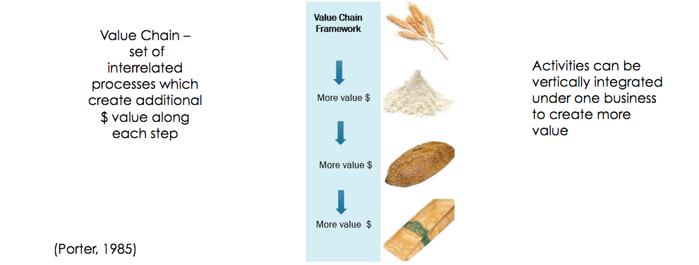
What is a value chain?

Slide 20
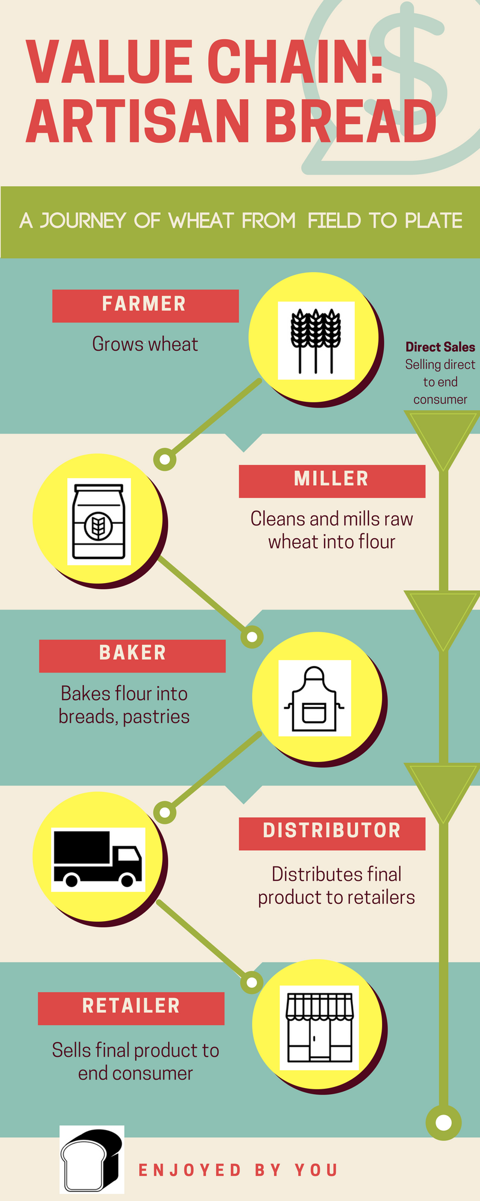
Businesses can also work together to increase value for themselves and each other

Slide 21
Values- Based Supply Chains
Strategic Business alliances that move niche products
Guided by social, cultural or quality values
(Stevenson and Pirog, 2008, 2011; Lev et al. 2015)
Organic
Local
Heritage
Fair

Slide 22
Values- Based Supply Chains
In a values-based model, business actors share:
Transparency of information
Risk
Profits
(Stevenson and Pirog, 2008, 2011; Lev et al. 2015)

Slide 23
Who benefits?
Strategy to help local, small- mid-scale businesses competitive against national commodity markets
Success through cooperation and co-opetition
(Bengtsson and Kock, 2000)
“Rising Tides Lift All Ships” -- JFK

Slide 24
Value Chain Strategy
Working Together to Create Value
WHAT:
  Business partners recognize that maximum value for products depends on interdependence, collaboration, and mutual support
  Alliances form around shared values about the product and conveyed to customer
Diamond, et al., (2014). Food value chains: Creating shared value to enhance marketing success (No. 1470-2016-120664).

Slide 25
Value Chain Strategy
Working Together to Create Value
WHY:
Strategic partnerships needed to move specialized products through non-commodity markets
Important strategy for small and mid-scale producers/processors
Diamond, et al., (2014). Food value chains: Creating shared value to enhance marketing success (No. 1470-2016-120664).

Slide 26

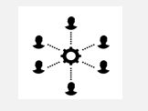
Terminology: Hard and Soft Infrastructure in Regional Food Systems
Hard infrastructure such as aggregation, processing, distribution facilities are important, but not the only resources needed to build local economies
Soft infrastructure in the form of relationships, knowledge and networks, is a necessary key for efficient use of hard infrastructure
Challenge 3
Barham et al., 2015. “Talk is Cheap ... and Efficient! Facilitating value chain development without costly new infrastructure”.Natiional Good Food Network.Webinar.

Slide 27


Funding Initiatives of Hard and Soft Infrastructure
Hard Infrastructure: Investing in Food Hubs
Soft infrastructure: Investing in Value Chain Coordination
Challenge 3
Barham et al., 2015. “Talk is Cheap ... and Efficient! Facilitating value chain development without costly new infrastructure”.NGFN. Webinar.

Slide 28
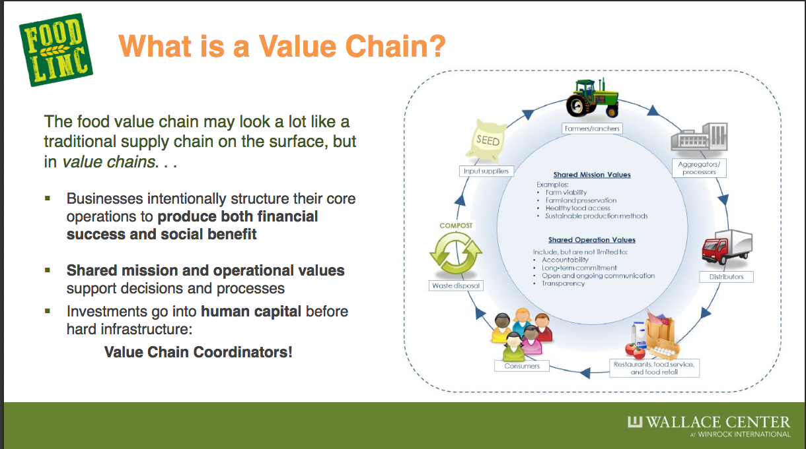
https://www.wallacecenter.org/food-linc

Slide 29
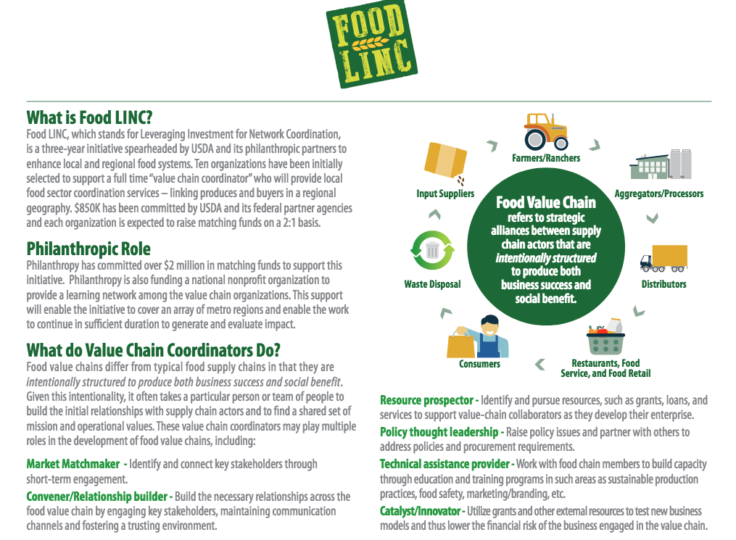

Slide 30
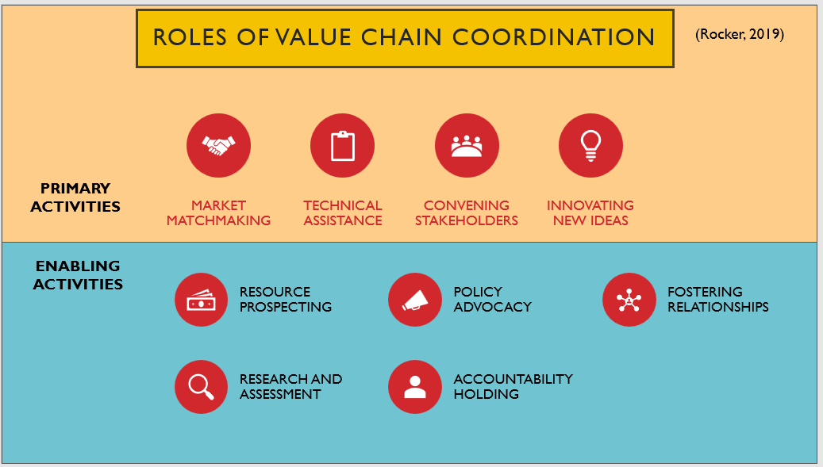

Slide 31
Value Chain Coordination Professional (VCCP)
Business, agency or organization in which Value Chain Coordination Professionals work
Value Chain Coordination (VCC)
Value Chain Entity (VCE)
A set of roles and activities that foster linkages and create added value to individuals, firms, product chains, and the broader regional economies in which these activities take place.
An individual performing value chain coordination roles and activities
(Rocker, 2019)

Slide 32
Who coordinates value chains?
Businesses:
Food Hubs (ie. Purchasing Managers)
Food Distributors, (ie. Brokers, Buyers)
Mid-Tier Processors (i.e. Local Sales Directors)
Retailers (i.e. Procurement Managers)
Organizations, Institutions, Agencies:
Local Government (i.e. Local Food Systems Director, Public Brokers)
Food Policy Councils
Farm and Food Advocacy Non-Profits (ie.Farm to Table Coordinator)
Economic Development Councils (i.e. Regional Food Coordinators)

Slide 33
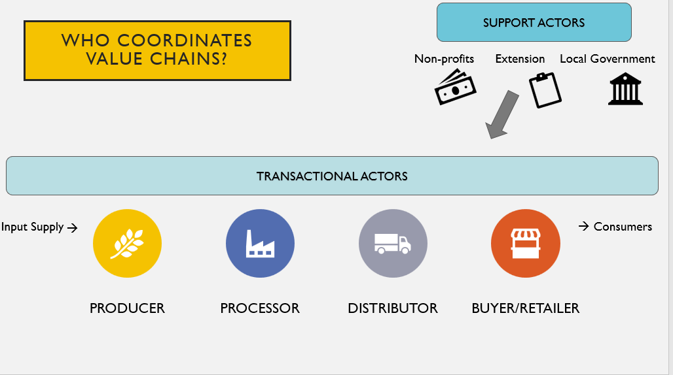


Actors who support the development of individuals, businesses and chains
Actors in the Value Chain
Funders
Actors who are involved in buying/selling transactions

Slide 34
Actors who support the development of individuals, businesses and chains
Actors in the Value Chain
Funders
Actors who are involved in buying/selling transactions
Linkages along the chain

Slide 35
Actors who support the development of individuals, businesses and chains
Actors in the Value Chain
Funders
Linkages from the chains to support actors
Actors who are involved in buying/selling transactions
Linkages along the chain

Slide 36
Actors who support the development of individuals, businesses and chains
Who Coordinates Value Chains?
Funders
Actors who are involved in buying/selling transactions

Slide 37
Actors who support the development of individuals, businesses and chains
Who Coordinates Value Chains?
Funders
Actors who are involved in buying/selling transactions

Slide 38
Actors who support the development of individuals, businesses and chains
Where are you?
Funders
Actors who are involved in buying/selling transactions

Slide 39
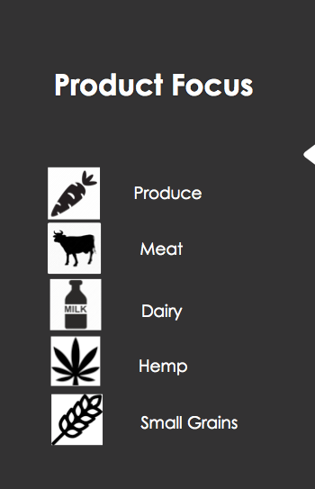
Identifying Value Chain Partners

Slide 40
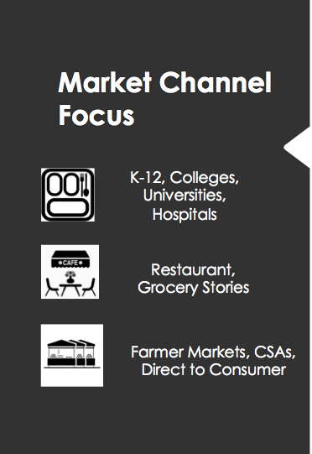
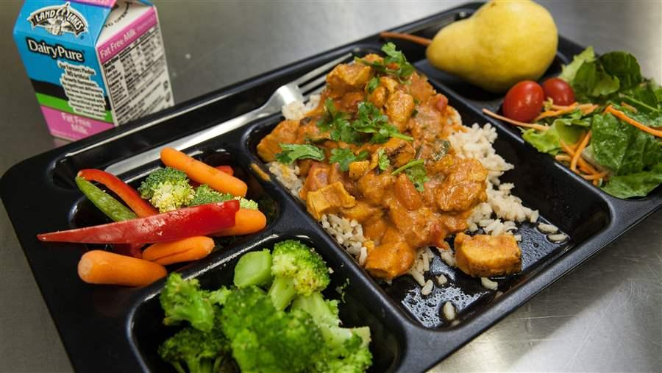
Identifying Value Chain Partners
Photo credit: pew.org

Slide 41
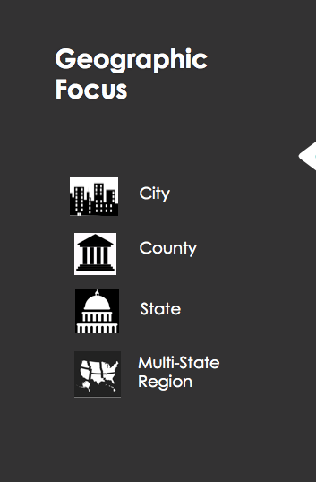

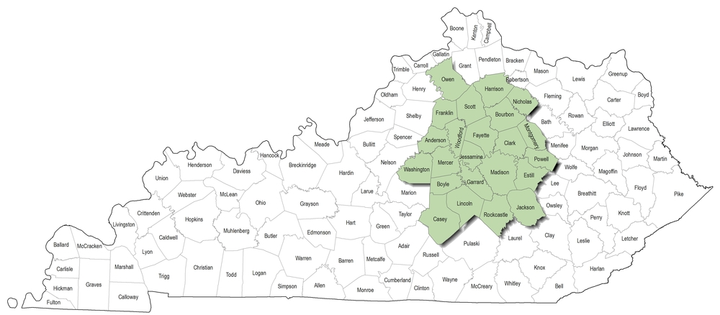
Identifying Value Chain Partners
Photo Credit: Bluegrass Farm to Table

Slide 42
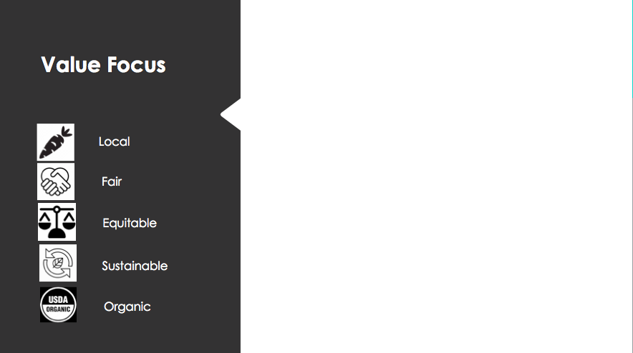
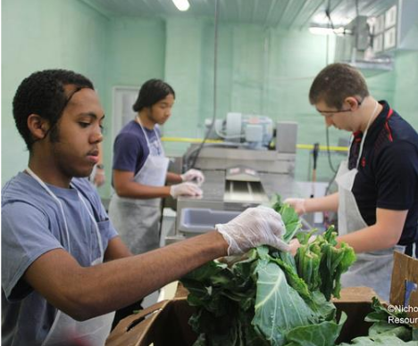
Identifying Value Chain Partners
Photo Credit: Nicholas Johnson, Resourceful Communities

Slide 43
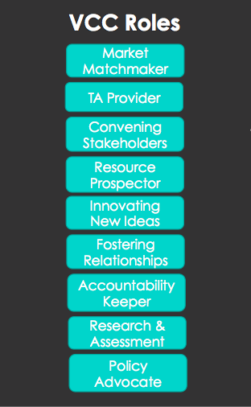
Planning Using Value Chain Strategy
Discussion Questions
Which VCC roles do you perform?
How do you currently plan your work
  Region
  Product
  Market Channel
  Values Based
Who are you partnering with, or could be in the future?

Slide 44

Resources for Value Chain Coordination
National Value Chain Coordination - Online Discussion Group
Food LINC Project Website
Innovations in Markets Module (Grants/Funding Opportunities)
Are you performing this work? Are you willing to share your insights on performing VCC?
If so, be in touch!
Sarah Rocker
srocker@psu.edu
Thank you!

Slide 45
Funding Partners
State agencies or regional authorities
Philanthropic organizations
Private corporations
Institutions of higher education
Commercial, Federal, or Farm Credit System lending institutions

Slide 46
Funding Partners
State agencies or regional authorities
  Agricultural and economic development agencies
  Regional commissions and councils
Philanthropic organizations
  Grantmakers
  Philanthropic investors
  Community Development Finance institutions (CDFIs)

Slide 47
Funding Partner Resources
Regional commissions
  https://narc.org/state-associations/
Philanthropy
  http://www.safsf.org/who/members/
  https://www.unitedphilforum.org/directory
Community Development Financial Institutions (CDFIs)
  https://www.cdfifund.gov/Pages/FAQ.aspx
  https://ofn.org/cdfi-locator
Renee Catacalos
Sustainable Agriculture and Food Systems Funders
renee@safsf.org

Slide 48
Questions and Discussion
Notes:
Wrap up with any questions participants may have.

Slide 49
Agenda
Thursday, August 6th
Welcome!
9:10-9:30 Opening Activity
9:30-10:00 Identifying Partnerships
10:00-10:30 Innovations in Markets
10:30-10:40 Break
10:40-11:15 Farm Stress Mental Health Resources
11:15-11:45 Discussion on Equity and Justice
Wrap Up
OPPE Workshop – Socially Disadvantaged Farmers and Ranchers

Slide 50
Innovations in Markets
OPPE Workshop – Socially Disadvantaged Farmers and Ranchers
Notes:
Instructions: Give any instructions or talking points to help the presenter with this slide and any related activities.
Time: How long talking through this slide and any related activities will take?
Materials: List any materials needed for any processes that will go with this slide
Handouts: List any handouts, if any

Slide 51
Session Overview
The COVID-19
pandemic has disrupted
our country’s food system from farm to fork.
OPPE Workshop – Socially Disadvantaged Farmers and Ranchers
Notes:
Notes: Social distancing and other response strategies have upended agricultural markets throughout the country, including local and regional markets; and transformed the way individuals and families shop for, purchase and consume food.
That transformation has brought with it a big uptick of interest in buying direct from local farmers, ranchers and fisherman as a way to support struggling small and mid-sized farmers and ensure family food security.

Slide 52
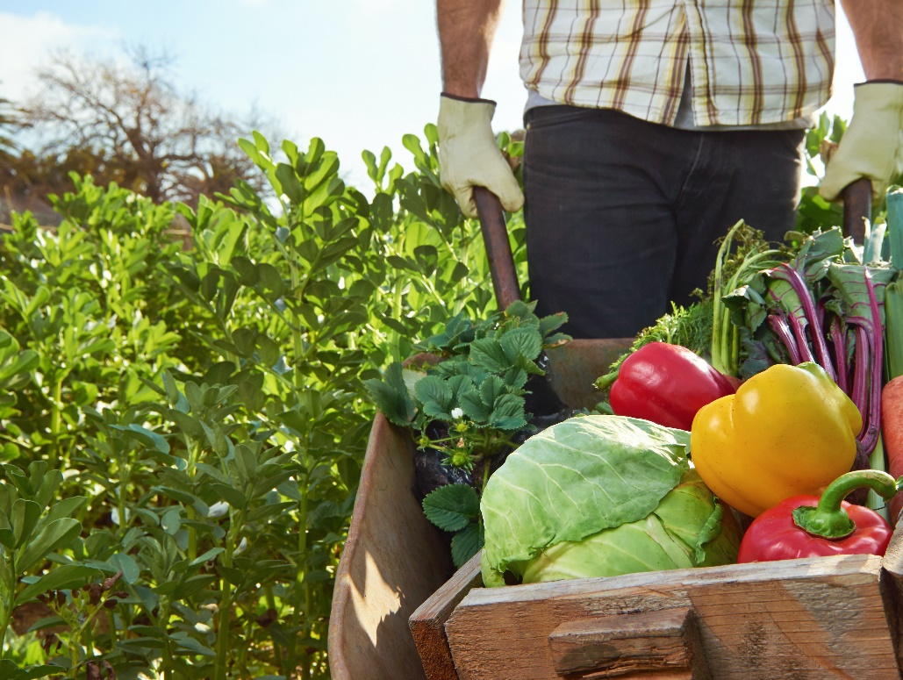
Adapting to Our New Environment…
Individuals:
Systems for finding local food and marketing product
Staying engaged and connecting in a social distancing environment
Value Chain and System Adaptations:
The pivot
Relationships
OPPE Workshop – Socially Disadvantaged Farmers and Ranchers
Notes:
two main types of local/regional food system marketing channels:
Direct-to-consumer (DTC) marketing channels include marketing opportunities where consumers buy directly from producers, including farmers markets, community supported agricultural arrangements (CSAs) roadside stands, pick-your-own, on-farm stores.
Intermediated marketing channels include all marketing opportunities that are not direct-to-consumer sales, such as producers selling to grocers, restaurants, regional aggregators such as food hubs, and buying arrangements with the food service operations of schools, universities, hospitals, and other institutions.
system” nature (interconnected pieces).

Slide 53
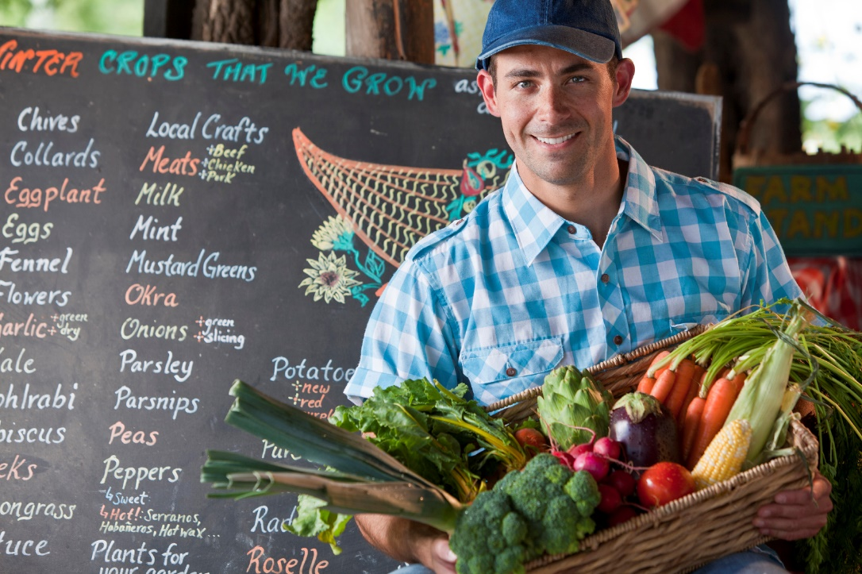
Got Milk?
Pandemic Forces Food Chain Reaction By Small Farmers:
Embracing Home Delivery
Online Sales And Drive-thru Farmers Markets
OPPE Workshop – Socially Disadvantaged Farmers and Ranchers
Notes:
After heightening personal protection equipment protocols, Fantasma got to work finding new
channels of distribution for himself and his farmers, creating ties with online sales outlets and home
delivery partners like Shatto Home Delivery. Shatto Milk Co. is a household name across Kansas City,
but the Shatto family is no stranger to adversity. In 2003, the struggling Osborn, Missouri, dairy almost
went bankrupt before reintroducing the quaint tradition of farm-fresh, hormone- and antibiotic-free
milk in a glass bottle. Milk and more are now dropped off to 4,000 customers between Kearney,
Missouri, and 129th Street, Shawnee to Blue Springs. Meanwhile, the waiting list has ballooned to
1,000.
Though more research is required, it has been posited that smaller enterprises can respond to market disruptions more effectively because a small firm size affords producers more agility in shifting to new markets and products as they gain insights from an engaged customer base, e.g. the Scale paradox (Lucker, O'Dwyer, and Renner 2013). This is especially true with the rise of new technology and media platforms, as consumers increasingly seek to support social causes with their expenditures, and online platforms can be as simple as a link between a social media post and option to purchase (for delivery or curbside pick-up

Slide 54

Farmers Market Adaptations
OPPE Workshop – Socially Disadvantaged Farmers and Ranchers
Notes:
Producers are finding many news was to get products to customers in these uncertain times. Many are leveraging online platforms while others are developing curbside and delivery options.

Slide 55
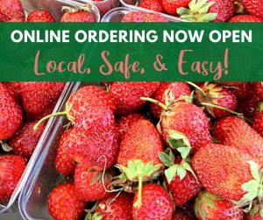
Online Ordering
Pittsfield Township Farmers Market
OPPE Workshop – Socially Disadvantaged Farmers and Ranchers
Notes:
A common adaptation has been a transition to online ordering. Customers order and pay for products before going to the market and then pick up pre-bagged or boxed items.
Tina Lloyd, the Community Outreach and Farmers Market Coordinator for Pittsfield Charter Township, says, “We have modified our market to focus on safe access to local food.” This is Lloyd’s 12th season as a market manager, and she plans to prepare and adapt her market to the changing landscapes. “Our modified programming activities will include Facebook Live cooking demos, and take-home crafts, and projects for the kids.” source: http://mifma.org/2020/06/michigan-farmers-markets-adapt-amid-covid-19-concerns/

Slide 56
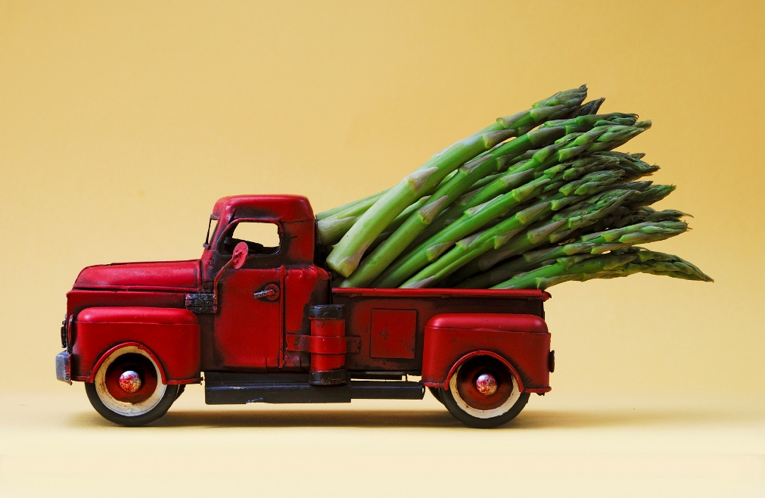
Curbside Pick up and Delivery
Some producers are finding new ways to get products to customers
Producers set up at a conveniently located parking lot
Communicate to customers when they will be there
Customers drive up and orders are loaded directly into their car
OPPE Workshop – Socially Disadvantaged Farmers and Ranchers
Notes:
Discuss cooperatives with FM in front door

Slide 57
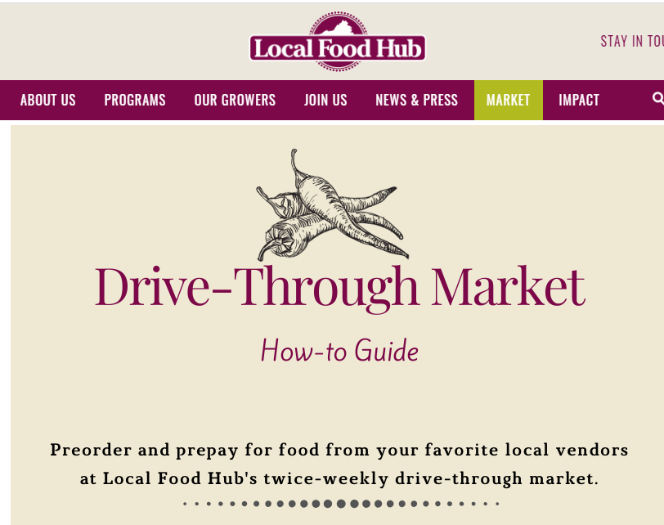
Drive Through
Local Food Hub in Charlottesville, Virginia
Customers pre-order and drive through the market to pick up from vendors during a designated pick-up time
OPPE Workshop – Socially Disadvantaged Farmers and Ranchers
Notes:
https://www.localfoodhub.org/micromarket/

Slide 58
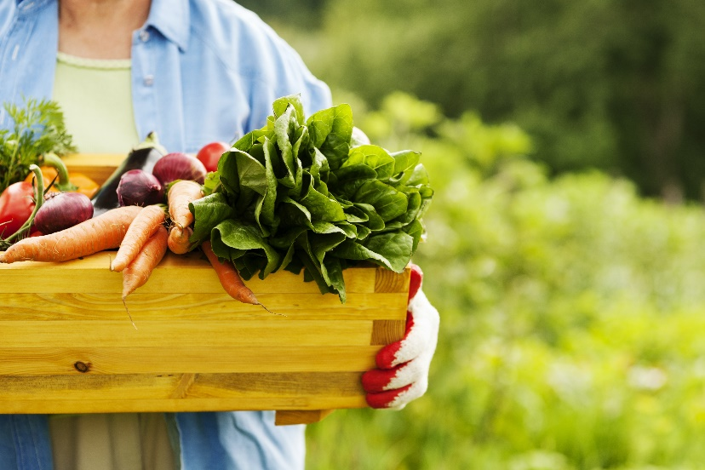
Community Supported Agriculture (CSA)
Customers pay for weekly share of farm products
Anecdotally, CSAs have seen an increase during COVID-19
Producer benefits:
Receive payment early in the season, which helps with the farm's cash flow
Spend time marketing the food early in the year, before their 16-hour days in the field begins
OPPE Workshop – Socially Disadvantaged Farmers and Ranchers

Slide 59

Marketing
Utilize this opportunity! Don’t:
  Assume that the customers will stay after the COVID-19 crisis is over
  Assume that email marketing does not work
  Assume you do not have time to market
Make that personal connection and build trust now.
OPPE Workshop – Socially Disadvantaged Farmers and Ranchers
Notes:
Though more research is required, it has been posited that smaller enterprises can respond to market disruptions more effectively because a small firm size affords producers more agility in shifting to new markets and products as they gain insights from an engaged customer base, e.g. the Scale paradox (Lucker, O'Dwyer, and Renner 2013). This is especially true with the rise of new technology and media platforms, as consumers increasingly seek to support social causes with their expenditures, and online platforms can be as simple as a link between a social media post and option to purchase (for delivery or curbside pick-up
https://www.3cowmarketing.com/freetraining/

Slide 60
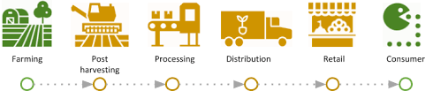
Value Chain and System Adaptation
Value Chain Coordination: Changes in our environment have caused a disruption in the relationships and communication channels that make the food system able to grow, respond, and adapt.
(Source: Sarah Rocker)
OPPE Workshop – Socially Disadvantaged Farmers and Ranchers
Notes:
VCC is a set of activities:
Market matchmaking
Technical assistance
Convening stakeholders
Resource prospecting
Policy advocacy
Fostering relationships
Research and assessment
Accountability holding
Idea Innovation
that supports the development of food systems by helping to ensure strong sets of relationships and communication channels that make the food system able to grow, respond, and adapt.

Slide 61
The Pivot
Finding organizations that you share values and philosophy with creates a foundation for institutionalizing policies. Centering human relationships is as much a part of the value chain as cold storage.
Building connections between organizations and businesses and to communities can lead to a mutually-supportive supply chain based on serving the needs of these communities, ensuring resiliency, and demonstrating our values beyond the pandemic.
(Source: A-dae Briones - First Nations Development Institute)
OPPE Workshop – Socially Disadvantaged Farmers and Ranchers
Notes:
COVID has underlined the need for this “soft infrastructure” or social structures that include relationships, networks and connectivity. It ensures that when there's a shock to the system, like right now, there is a strong set of relationships and communication channels that make it easier to adapt or pivot.
Finding partners that understand that the supply chain is broken
Align with those partners that are philosophically aligned with you-solid messaging
Started with assessments and surveys, not inventing from scratch
More conversations-public and private matching…
Ultimately, COVID-19 represents a test for all engaged in food and agricultural production in the United States. While the local food system is no exception, differences in geographic proximity, shortened supply chains, and limited production capacity has left local food producers uniquely affected, and perhaps, well-positioned to reinforce or grow their place in the portfolio of food offerings and markets.

Slide 62

Systems of Support
America’s Healthy Food Financing Initiative
Find resources to help you understand the issue of healthy food access, advance your project, or advocate for your community’s needs.
Policy Map
Healthy Food Access Portal
USDA Rural Development
Local Foods Local Places
Local Food Promotion Program
Farmers Market Promotion Program
Community Food Projects
Wallace Center
USDA Economic Research Services
Rural Grocery Initiative
The Food Trust
Policy Link
https://www.investinginfood.com/resources/
OPPE Workshop – Socially Disadvantaged Farmers and Ranchers
Notes:
Find resources to help you understand the issue of healthy food access, advance your project or advocate for your community’s needs.

Slide 63
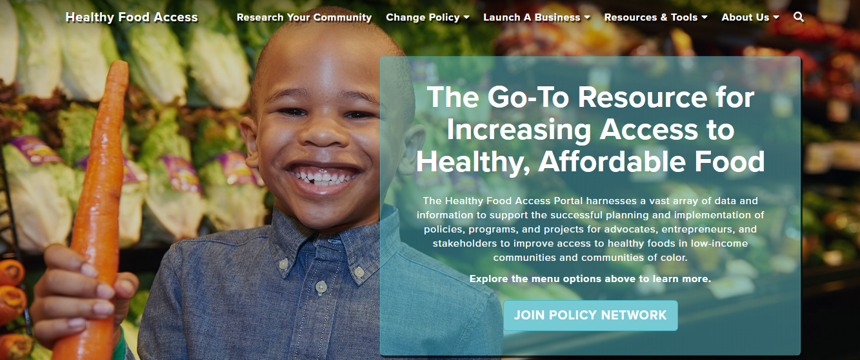
Policy Network
https://www.policylink.org/our-work/community/food-systems
OPPE Workshop – Socially Disadvantaged Farmers and Ranchers
Notes:
Through the approach of Lifting Up What Works, Policy Network programmatic initiatives are organized within three interlocking, mutually reinforcing areas of work. Through these initiatives, they advance policies to enable everyone to participate in an equitable economy, live in a community of opportunity, and thrive in a just society.
In 2019, PolicyLink launched the Equitable Food System Resource Guide, which illustrates the food system continuum -- aggregation and distribution, processing, production, food retail and healthy food business, and food recovery and waste recycling; and provides information on model policies and strategies, policy targets and decision makers, as well as examples of those working, across the country, to produce a more equitable food system.

Slide 64
Socially-Disadvantaged Groups Grant (SDGG)
SDGG program provides technical assistance to socially-disadvantaged groups through cooperatives and Cooperative Development Centers
Examples of technical assistance are feasibility studies, business plans, strategic planning, and leadership training.
APPLICATION DEADLINE: August 10, 2020. Electronic Applications ONLY.
  More information is available here:
  Federal Register Notice
  Program Fact Sheet
  Hoja Informativa del Programa en Español
OPPE Workshop – Socially Disadvantaged Farmers and Ranchers

Slide 65

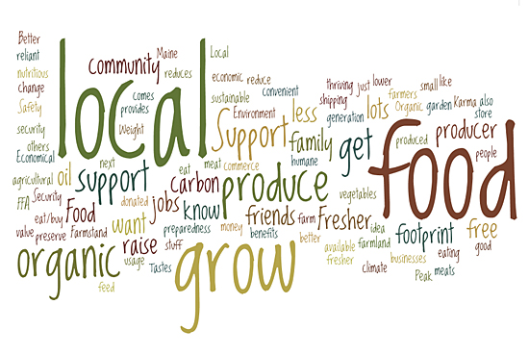

Supporting Policies and Programs: Marketing
Farmers’ Market Promotion Program (FMPP)
Local Food Promotion Program (LFPP)
Specialty Crop Block Grants (SCBG) Program
OPPE Workshop – Socially Disadvantaged Farmers and Ranchers
Notes:
Instructions:
Briefly overview these programs to assist with marketing:
Farmers’ Market Promotion Program (FMPP) - supports marketing through DTC outlets (e.g., farmers’ markets, CSAs, others)
Local Food Promotion Program (LFPP) – support marketing through intermediated channels such as farm-to-institution, food hubs, and other busi­nesses that process, distribute, aggregate, or store locally or regionally marketed food products.
Specialty Crop Block Grants (SCBG) Program - is administered through State departments of agriculture and regularly includes funding for projects related to locally and regionally marketed food (particularly fruit and vegetable produc­tion).
Link to a listing of the resources/information found in the next slide.

Slide 66

Supporting Policies and Programs: Production
Value-Added Producer Grant
Rural Business Development Grants
Business and Industry CARES Funding
Farm Storage Facility Loan Program
National Organic Certification Cost-Share Program
https://www.ams.usda.gov/services/local-regional/food-sector/grants
OPPE Workshop – Socially Disadvantaged Farmers and Ranchers
Notes:
Provide a brief overview of these production focused programs:
The Value-Added Producer Grant program, which is designed to help farmers develop farm-based value-added products (e.g., cheese, jam, packaged meats, sausages)
The Rural Business Development Grants program (Rural Business Opportunity and Rural Business Enterprise) provide business development assistance to local food producers and local food projects.
Business and Industry (B&I) Guaranteed Loan Program to support development of local food system infrastructure (businesses that process, distribute, aggregate, store, and market foods).
The Farm Storage Facility Loan program provides low-interest financing to food producers to purchase storage and processing equip­ment
The National Organic Certification Cost-Share Program helps organic farmers offset the cost of annual certification, which may benefit organic local and regional producers.

Slide 67
Rural Cooperative Development Grant
The Rural Cooperative Development Grant (RCDG) improves the economic condition of rural areas by helping individuals and businesses start, expand or improve rural cooperatives and other mutually-owned businesses through Cooperative Development Centers. Grants are awarded through a national competition.
Other Cooperative Resources:
  Co-ops Programs website
  Rural Utilities Service webpage
Some other USDA agencies also have programs that help cooperatives, including the Agricultural Marketing Service (AMS) and the Cooperative State Research, Education and Extension Service which is now known as the National Institute of Food and Agriculture (NIFA).
OPPE Workshop – Socially Disadvantaged Farmers and Ranchers
Notes:
USDA has long been the leading advocate for cooperatives in rural America. The goal of the Cooperative Programs of USDA Rural Development is to promote understanding and use of the cooperative form of business. This is accomplished through education (including a large library of co-op publications), research and statistics, and technical assistance. We also administer programs that provide financial support to co-ops.
Rural Cooperative Development Grant (RCDG) The Rural Cooperative Development Grant program improves the economic condition of rural areas by helping individuals and businesses start, expand or improve rural cooperatives and other mutually-owned businesses through Cooperative Development Centers. Grants are awarded through a national competition.
Other Cooperative Resources: Please visit the Co-ops Programs website for a more in-depth discussion about USDA's Cooperative Programs. You may also visit the Rural Utilities Service webpage for more information about the Rural Utilities Program of USDA Rural Development and the services it provides to utility co-ops.
Some other USDA agencies also have programs that help cooperatives, including the Agricultural Marketing Service (AMS) and the Cooperative State Research, Education and Extension Service which is now known as the National Institute of Food and Agriculture (NIFA).

Slide 68
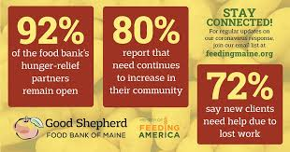
Public/Private Relationships
Good Shepherd Food Bank partners with L.L. Bean to accelerate food access
OPPE Workshop – Socially Disadvantaged Farmers and Ranchers

Slide 69
USDA Programs in the Local Food Supply Chain
Loans
Grants
Other Resources
https://www.ams.usda.gov/services/local-regional/food-sector/grants
OPPE Workshop – Socially Disadvantaged Farmers and Ranchers

Slide 70
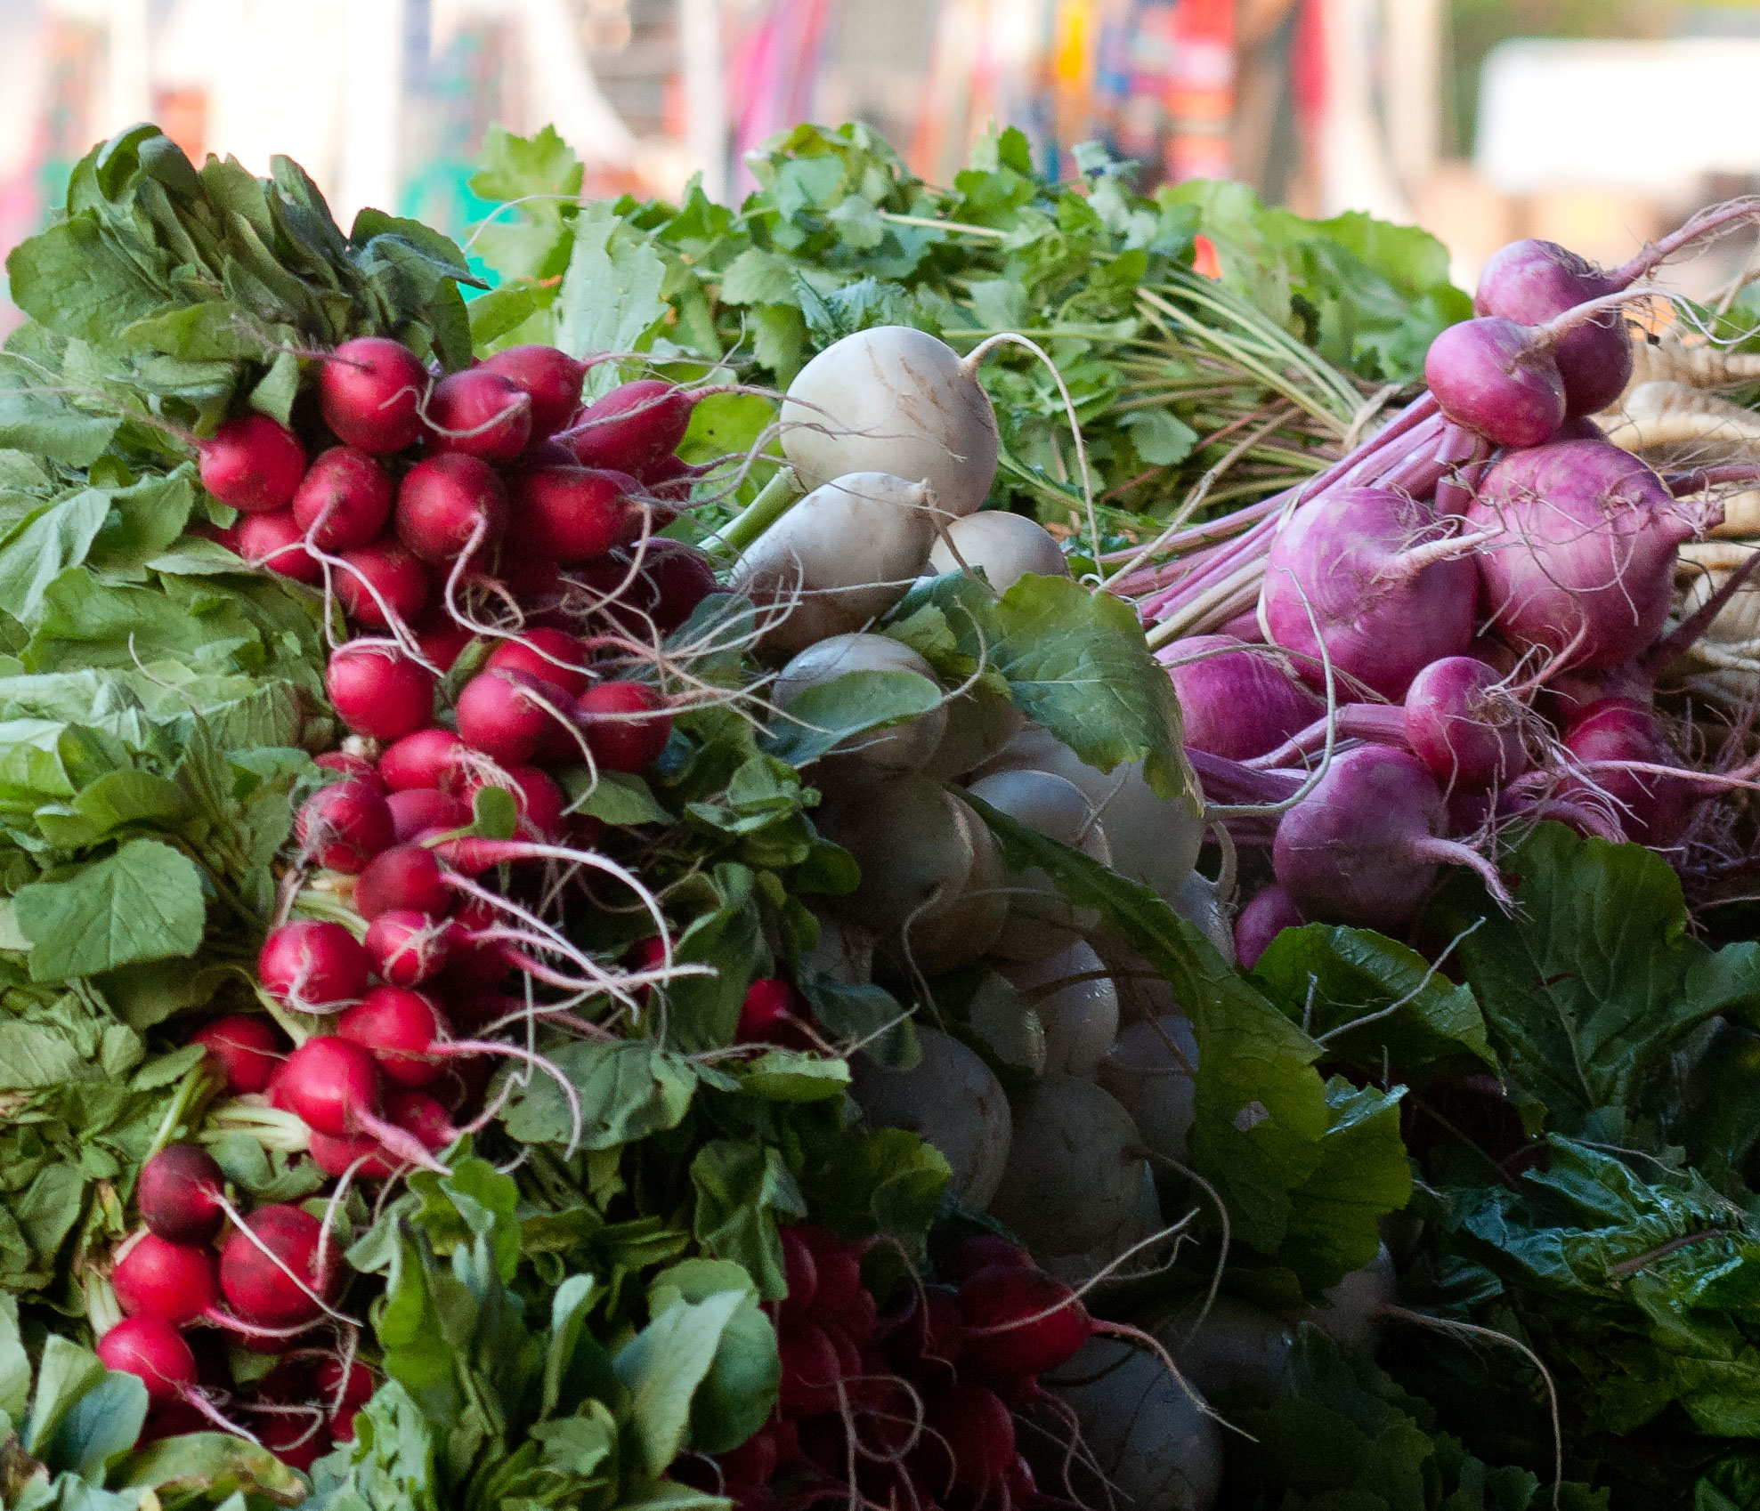
Local Food Directories

Slide 71
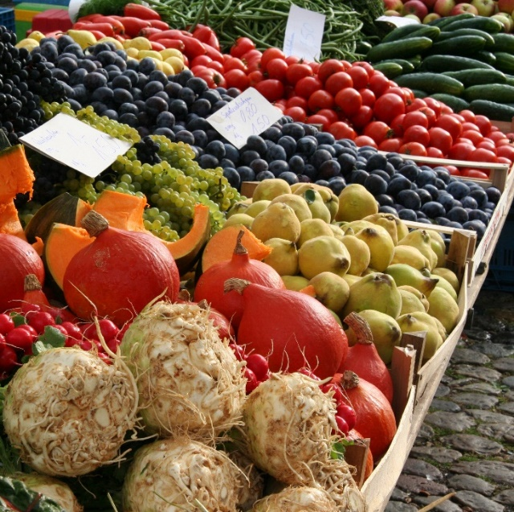
USDA Local Food Directories
Directories for:
  Farmers Markets;
  On-Farm Markets;
  CSAs; and,
  Food hubs.
Help you find local foods close to you or potential markets
Allow you to filter by payment options, products, and location
API available to integrate with other applications and websites
www.ams.usda.gov/localfood

Slide 72
AMS Market News
Specialty Crops Market News disseminates detailed information on marketing conditions for hundreds of agricultural commodities at major domestic and international wholesale markets, production areas, and ports of entry.
Using direct contacts with salespersons, suppliers, brokers, and buyers, Market News reporters collect, validate, analyze, and organize unbiased data on price, volume, quality and condition, making it available within hours of collection at no cost to you.
Publicly available data, allow you to analyze trend and compare prices
www.ams.usda.gov/market-news

Slide 73
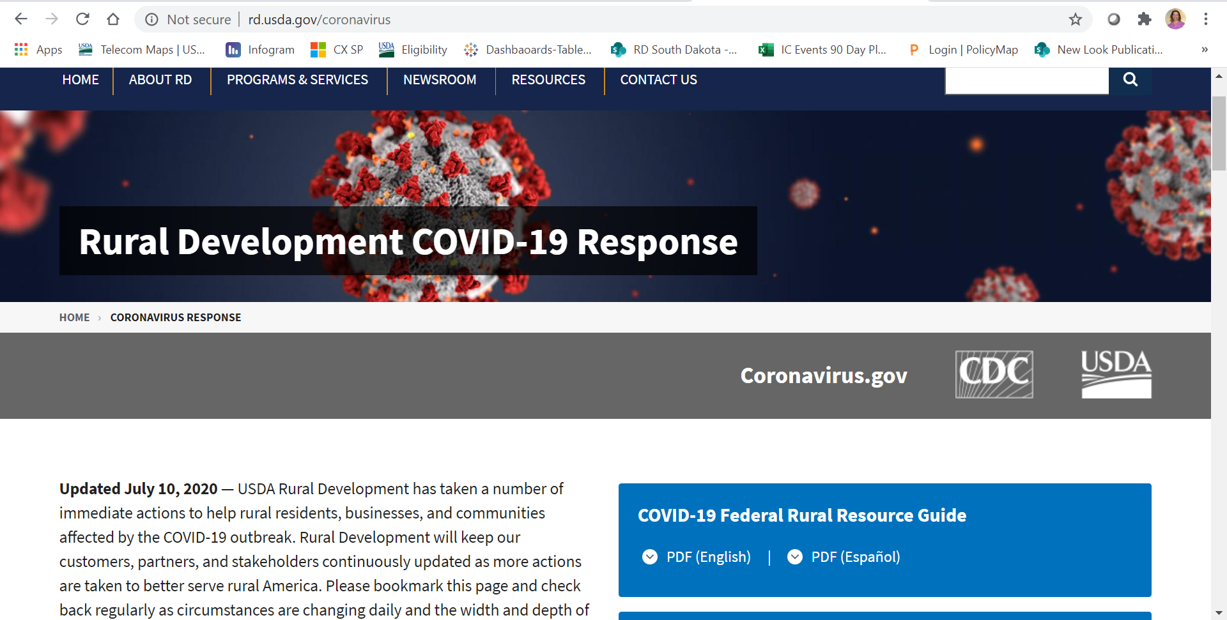
USDA Federal Response
https://www.rd.usda.gov/coronavirus
OPPE Workshop – Socially Disadvantaged Farmers and Ranchers

Slide 74
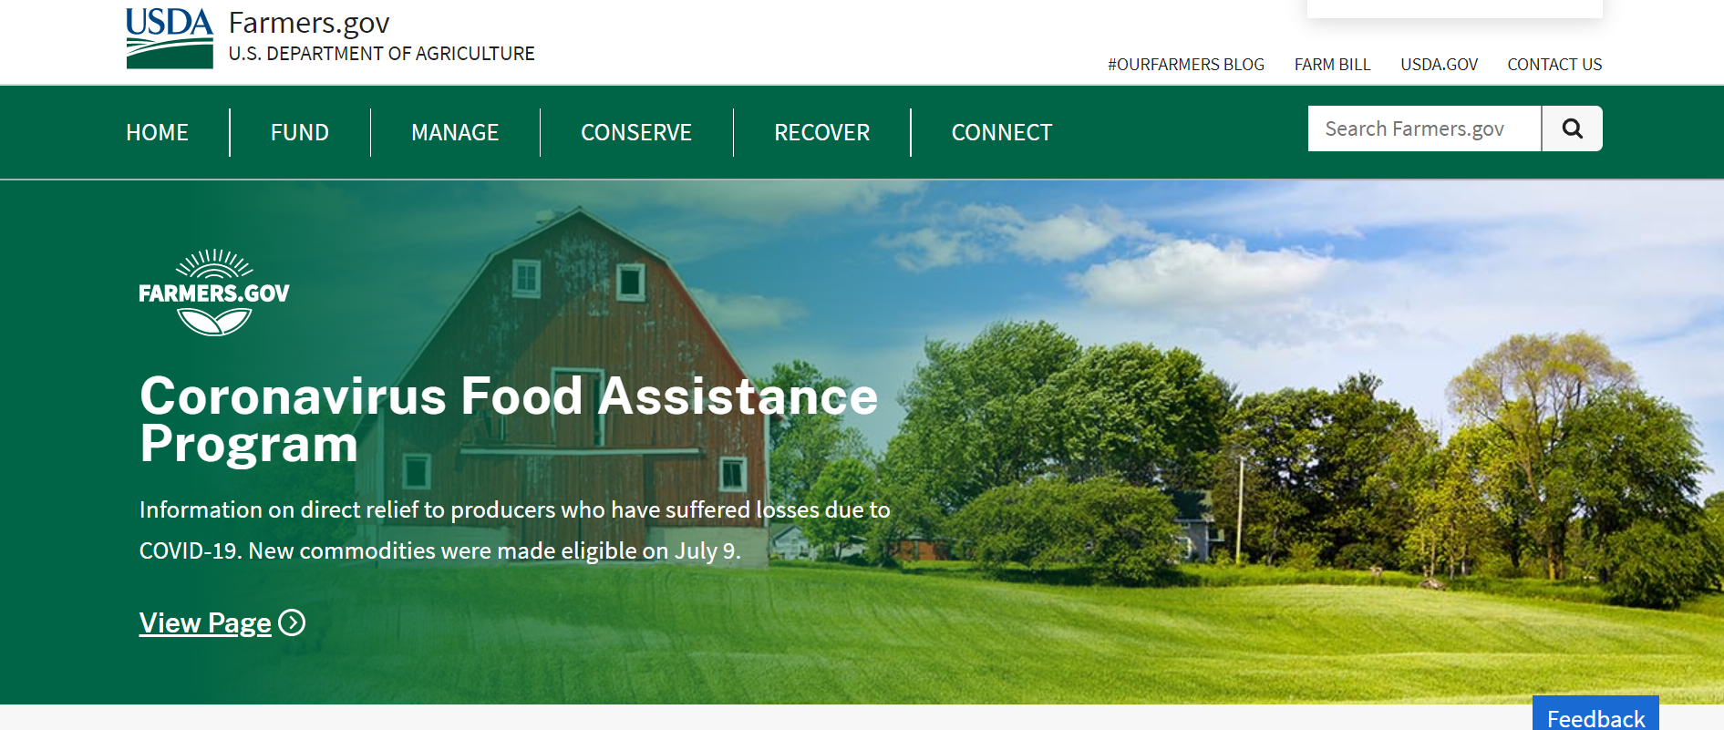
Farmers.gov
Specific Resources for Beginning Farmers and Ranchers
https://www.farmers.gov/manage/newfarmers
Farm Loan Directory Tool
Programs
Find your Local Service Center
https://www.farmers.gov
OPPE Workshop – Socially Disadvantaged Farmers and Ranchers

Slide 75
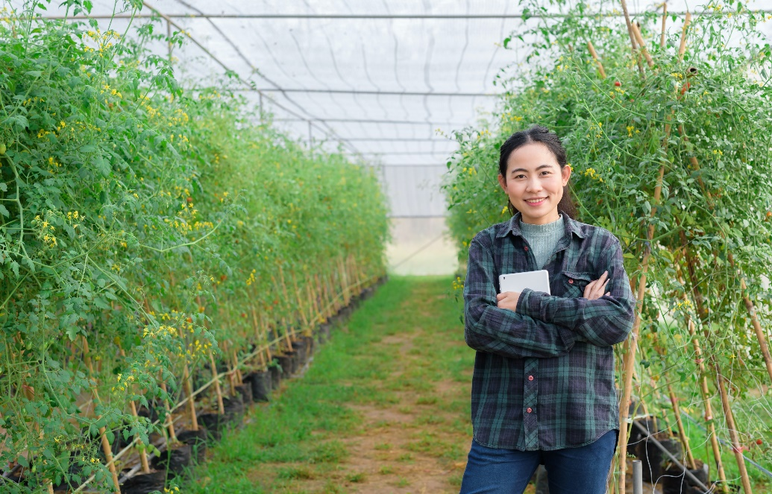
Contacts
Who can answer questions?
Farmer.gov
NRCS and FSA
USDA Rural Development
  Contact your nearest Rural Development office.
Office of Partnerships and Public Engagement
  https://www.usda.gov/partnerships
OPPE Workshop – Socially Disadvantaged Farmers and Ranchers

Slide 76
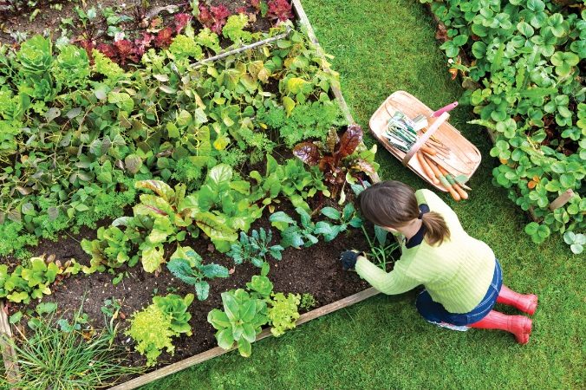
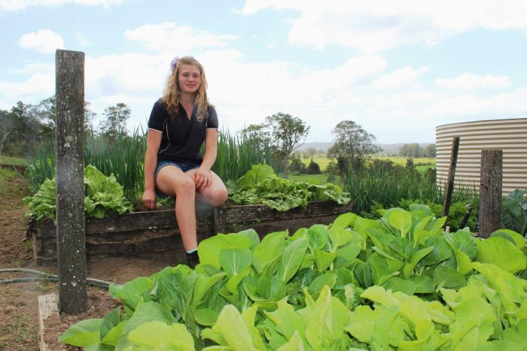
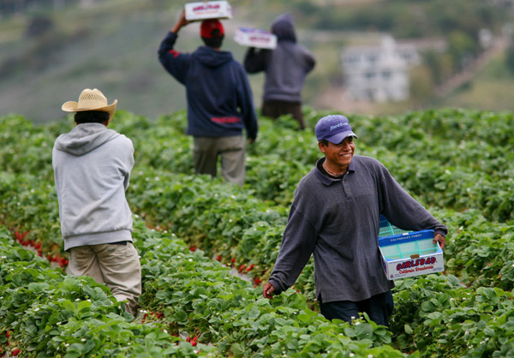
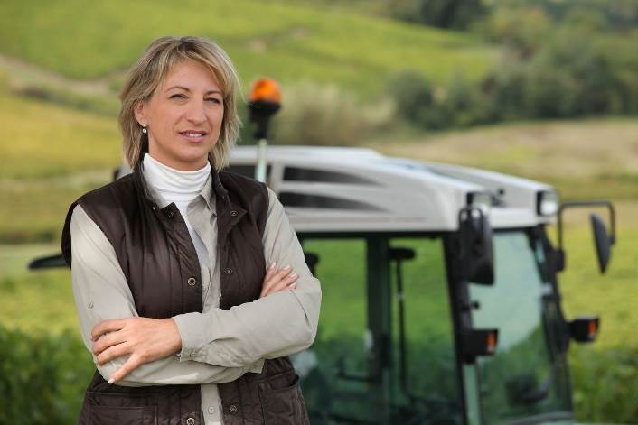
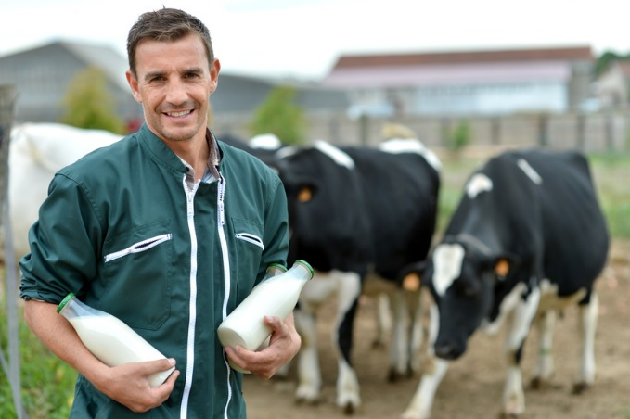

Bottom Line….Relationships and Connections
OPPE Workshop – Socially Disadvantaged Farmers and Ranchers
Notes:
Instructions:
Lead a short discussion of where vendors may be found and how to consider recruiting them.
Vendors are a critical component of a farmers’ market. Potential vendors can be found in diverse groups of individuals with varying degrees of experience in direct-marketing including home gardeners, former farm workers, immigrants or refugees, and beginning farmers and horticulturalists fresh out of high school vocational agriculture programs.
Managing expectations is important to retaining vendors. Farmers have different production costs, which influence their prices. Consequently, farmers can have different expectations regarding their sales and income. New farmers’ markets often face challenges in meeting vendor sales and income expectations. This can also be true for existing markets and new vendors.
Main Point: Vendors are a critical component of a farmers’ market. Generally speaking, the more vendors at the market means more variety of food products available which has the positive effect attracting more buyers. Potential vendors can found in diverse groups of people – home gardeners, former farm workers, immigrants, recent high school vocational agriculture program graduates. Managing vendor sales and income expectations is important to retaining vendors.
Discussion: Does the farmers’ market in your community or region have a large number of vendors? What is being done to attract and retain more vendors? If no farmers markets exist, how can we identify, recruit and retain vendors?
Time: 10 minutes

Slide 77
Questions and Discussion
OPPE Workshop – Socially Disadvantaged Farmers and Ranchers
Notes:
Wrap up with any questions participants may have.

Slide 78
BREAK – See you in 10 minutes!
OPPE Workshop – Socially Disadvantaged Farmers and Ranchers

Slide 79

Agenda
Thursday, August 6th
Welcome!
9:10-9:30 Opening Activity
9:30-10:00 Identifying Partnerships
10:00-10:30 Innovations in Markets
10:30-10:40 Break
10:40-11:15 Farm Stress Mental Health Resources
11:15-11:45 Discussion on Equity and Justice
Wrap Up
OPPE Workshop – Socially Disadvantaged Farmers and Ranchers

Slide 80
Farm Stress and Mental Health Resources
Mary Nelson Robertson, PhD, CHES and David R. Buys, PhD, MSPH, CPH
OPPE Workshop – Socially Disadvantaged Farmers and Ranchers
Notes:
Wrap up with any questions participants may have.

Slide 81

Promise Framework
OPPE Workshop – Socially Disadvantaged Farmers and Ranchers
Notes:
Statistics about suicide
Higher level logistic – 35 minutes

Slide 82

Opioid Crisis: National Perspective
47,600 of the 70,237 drug overdose deaths involved opioids in 2017.
~130 Americans die everyday from an opioid-related overdose.
Source: CDC & NCHS, 2017; Scholl, Seth, Kariisa, Wilson, & Baldwin, 2019
OPPE Workshop – Socially Disadvantaged Farmers and Ranchers
Notes:
First, let’s talk about the opioid crisis. Prescription opioid drugs are a substance (pill or patch) prescribed for pain relief. Prescription opioid drugs include pain reducing medications such as oxycodone, hydrocodone, morphine, and others. Heroin is also an opioid, however for the purpose of this study, opioid refers to prescription opioids only.
More than two-thirds of drug overdose deaths in the United States involved an opioid in 2017. Which is equivalent to approximately 130 Americans dying each day from an opioid-related overdose. That is more than the number of Americans dying from gun homicides and car accidents combined.
While no corner of the United States has gone untouched by this epidemic, Mississippi has been severely impacted by this crisis.
47,600 of 70, 237 drug overdose deaths in 2017 involved opioids
Over 130 people died every day from an opioid related drug overdose in 2016-2017
191 million opioid prescriptions were dispensed in 2017
11.5 million Americans reported misusing opioids in 2016
More than the number of car accidents and gun homicides

Slide 83

Root Causes of Farm Stress
OPPE Workshop – Socially Disadvantaged Farmers and Ranchers

Slide 84


Farms are Suffering from Prices
OPPE Workshop – Socially Disadvantaged Farmers and Ranchers

Slide 85


Farms are Suffering from Prices
OPPE Workshop – Socially Disadvantaged Farmers and Ranchers

Slide 86

Farms are Suffering from Prices
OPPE Workshop – Socially Disadvantaged Farmers and Ranchers

Slide 87

Farm Stress
In 2016, 417 farmers and farm workers died from a work-related injury, resulting in a fatality rate of 21.4 deaths per 100,000 workers.
Every day ~100 farmers suffer an injury, resulting in lost work time.
3 out of 4 farmers report being directly impacted by opioid abuse.
3 out of 4 farmers say it would be easy to access opioids.
OPPE Workshop – Socially Disadvantaged Farmers and Ranchers

Slide 88
What We Know about Farm Stress
Agrarian Imperative:
“…this genetically programmed instinct impels farmers to hang onto their land at all costs. The agrarian imperative instills farmers to work incredibly hard, to endure unusual pain and hardship, and take uncommon risks” Source: Rosmann, 2010, p.72.
“The land means everything to farmers… Losing the family farm is the ultimate loss…” Source: Rosmann, 2010, p.72.
OPPE Workshop – Socially Disadvantaged Farmers and Ranchers

Slide 89
What is stress?
How the brain and body respond to any demand.
Acute→ disruptive life events
Chronic → ongoing challenges
OPPE Workshop – Socially Disadvantaged Farmers and Ranchers

Slide 90

Signs and Symptoms of Chronic, Prolonged Stress
Change in routine
Care of livestock declines
Increase in illness
Appearance of farm declines
Children show signs of stress
OPPE Workshop – Socially Disadvantaged Farmers and Ranchers

Slide 91

Relationship between Farm Stress and Opioid Misuse
OPPE Workshop – Socially Disadvantaged Farmers and Ranchers

Slide 92

Suicide Among Farmers
Farmers and ranchers have a suicide rate that is, on average, 3.5 times that of the general population.
  Access to mental health is more sporadic
  Rural populations tend to earn less
  Overall health factors tend to be lower in rural areas
OPPE Workshop – Socially Disadvantaged Farmers and Ranchers
Notes:
In 2008, Congress approved the Farm and Ranch Stress Assistance Network Act to provide behavioral health programs to agricultural workers via grants to states.

Slide 93

COVID-19 Pandemic
OPPE Workshop – Socially Disadvantaged Farmers and Ranchers
Notes:
Just one more thing I cannot control
Disruption of the supply chain
Financial Stress
Limited access to supplies
Inability to pay employees
Increased workload
Positive aspect → opportunity to re-examine current agricultural practices, just in time model creating bottlenecks and backlogs --- development of new markets increase in farm to consumer
Telehealth
Substance Misuse
Increased stress
Isolation
Reduced coping(lack of recreation, sporting events, and other distractions, spiritual meetings, support groups)

Slide 94

Mental Health First Aid
Decrease mental illness stigma
Increase mental health literacy
Increase First-Aiders’ knowledge, skills, and confidence to recognize when someone may be experiencing a mental health challenge or crisis
Increase likelihood of First-Aiders to use the MHFA Action Plan to help someone experiencing a new or worsening mental health challenge or crisis
OPPE Workshop – Socially Disadvantaged Farmers and Ranchers

Slide 95
Why Mental Health First Aid Can Help
Our communities are innovative and resilient.
  “We do what we need to do.”
We already have the tools.
  Our communities have experience in capacity-building. MHFA is just one more tool.
We look out for each other.
  We care about our community members. MHFA gives us confidence to keep ourselves and our neighbors safe.
OPPE Workshop – Socially Disadvantaged Farmers and Ranchers
Notes:
Citation: MHFA Rural Training Supplement

Slide 96
How Mental Health First Aid Can Help
Knowledge is power.
  We can recognize signs and symptoms of mental health problems and intervene sooner.
  Knowing how mental health problems present gives us the confidence to speak to our neighbors and friends.
Taking the message home.
  Our community volunteers are involved at all levels. They may be responding to friends and loved ones.
  MHFA allows communities to be more open with each other about mental health.
OPPE Workshop – Socially Disadvantaged Farmers and Ranchers
Notes:
Citation: MHFA Rural Training Supplement

Slide 97
Farm Management Training
The language we use is critical in reaching the agricultural community.
Therefore, we are proposing to incorporate resiliency training into a farm management training.
OPPE Workshop – Socially Disadvantaged Farmers and Ranchers

Slide 98

Other Resources and Partnerships
State Department of Mental Health
State Office of Rural Health
Ted Matthews Farm Counseling (MN)
Michigan State University Extension Service Farm Stress Curriculum
Rural Community Toolbox
OPPE Workshop – Socially Disadvantaged Farmers and Ranchers

Slide 99



Opioid Project Funding Information
This project was supported by the FY17 USDA NIFA Rural Health and Safety Education Competitive Grants Program of the National Institute of Food and Agriculture, USDA, Grant # 2017-46100-27225 and the FY18 Substance Abuse and Mental Health Services Administration Rural Opioids Technical Assistance Grants (ROTA) # TI-18-022.
OPPE Workshop – Socially Disadvantaged Farmers and Ranchers

Slide 100
Team Background
Agricultural Communication
Elizabeth Gregory North, MA
Agricultural Economics
Jeff Johnson, PhD
Animal and Dairy Sciences
Amanda Stone, PhD
Communications and Social Science Research Center
Holli H. Seitz, PhD, MPH
Food Science, Nutrition and Health Promotion
David Buys, PhD, MSPH, CPH
Will Evans, PhD, MCHES
Mary Nelson Robertson, PhD, CHES
Ann Sansing, MS
Je’Kylynn Steen, BS
Psychology
Michael Nadorff, PsyD
School of Human Sciences
Laura H. Downey, DrPH, MCHES
Alisha M. Hardman, PhD, CFLE
University of Mississippi Medical Center
Daniel Williams, PhD
OPPE Workshop – Socially Disadvantaged Farmers and Ranchers

Slide 101
Preventing Opioid Misuse in the SouthEast:
PROMISE Initiative
Mary Nelson Robertson, PhD, CHES and David R. Buys, PhD, MSPH, CPH
OPPE Workshop – Socially Disadvantaged Farmers and Ranchers
Notes:
Wrap up with any questions participants may have.

Slide 102

The PROMISE Initiative aims to prevent opioid misuse specifically in rural communities like the many farming areas of Mississippi.
The PROMISE Initiative
OPPE Workshop – Socially Disadvantaged Farmers and Ranchers
Notes:
Geographic focus: southern resources already very familiar with;
Population: invitee list, imagine potential diversity being extension agents, departments of conservation, economic development groups, non-profit farm advocacy groups, policy oriented groups, some will have a very deep touch and direct; economic development council people & access to capital
Drop link in
- https://us02web.zoom.us/j/3927086637
Conservationist of color
Forestry in here
Statistics about suicide
Higher level logistic – 35 minutes

Slide 103
Questions and Discussion
OPPE Workshop – Socially Disadvantaged Farmers and Ranchers
Notes:
Wrap up with any questions participants may have.

Slide 104

Agenda
Thursday, August 6th
Welcome!
9:10-9:30 Opening Activity
9:30-10:00 Identifying Partnerships
10:00-10:30 Innovations in Markets
10:30-10:40 Break
10:40-11:15 Farm Stress Mental Health Resources
11:15-11:45 Discussion on Equity and Justice
Wrap Up
OPPE Workshop – Socially Disadvantaged Farmers and Ranchers

Slide 105
Equity and Inclusion in USDA Programs
OPPE Workshop – Socially Disadvantaged Farmers and Ranchers

Slide 106
Session Overview
What are we talking about?
Why are we talking about this?
What can be done?
OPPE Workshop – Socially Disadvantaged Farmers and Ranchers
Notes:
Instructions: Welcome participants to the session and briefly review the goals from this slide.
Time: 1 minute
Materials: None
Handouts:

Slide 107

What is Equity and Inclusion?
EQUITY:
equal, fair share, unbiased, division of resources
INCLUSION:
access, at the table, involved, empowered
OPPE Workshop – Socially Disadvantaged Farmers and Ranchers
Notes:
Instructions: Give any instructions or talking points to help the presenter with this slide and any related activities.
Time: How long talking through this slide and any related activities will take?
Materials: List any materials needed for any processes that will go with this slide
Handouts: List any handouts, if any

Slide 108
Why are we talking about this?
African American Farms
Full Owners: 1910, 2017
Year | Farm Number | Land In Farms
1910 | 195,809 | 15,961,506
2017 | 21,823 | 1,754,216
% Change | -88.9 | -89.0
OPPE Workshop – Socially Disadvantaged Farmers and Ranchers

Slide 109



USDA in the 1960s – 1980s
OPPE Workshop – Socially Disadvantaged Farmers and Ranchers

Slide 110




USDA in the 1990s
OPPE Workshop – Socially Disadvantaged Farmers and Ranchers

Slide 111

Pigford v. Glickman 1999
OPPE Workshop – Socially Disadvantaged Farmers and Ranchers
Notes:
African American Class Action Lawsuit: $1+ billion

Slide 112


Keepseagle, Garcia & Love v. Vilsack
Keepseagle v. Vilsack
Garcia v. Vilsack & Love v. Vilsack
OPPE Workshop – Socially Disadvantaged Farmers and Ranchers
Notes:
Keepseagle: Native American farmer & rancher class action lawsuit
Garcia: Latino/Hispanic farmer & rancher class action lawsuit
Love: Women farmer and rancher class action lawsuit

Slide 113


Still…
OPPE Workshop – Socially Disadvantaged Farmers and Ranchers

Slide 114

QUESTION
Given court settlements to increase access to USDA programs, why don’t more SDFRs participate in USDA programs?
OPPE Workshop – Socially Disadvantaged Farmers and Ranchers

Slide 115

What Does Some Research Say?
OPPE Workshop – Socially Disadvantaged Farmers and Ranchers

Slide 116
Participation
OPPE Workshop – Socially Disadvantaged Farmers and Ranchers

Slide 117
Reasons for Non-Participation
Reason | Ownership | Operating
I do not think I qualify | 40.0 | 44.0
I or others have been turned down in the past | 31.1 | 20.0
Requirements too complicated | 11.1 | 20.0
Other | 17.9 | 16.0
OPPE Workshop – Socially Disadvantaged Farmers and Ranchers

Slide 118
Participation
OPPE Workshop – Socially Disadvantaged Farmers and Ranchers

Slide 119
Reasons for Non-Participation
Reason | EQIP | VAPG
I do not think I qualify | 37.5 | 46.2
I or others have been turned down | 7.5 | 3.8
Requirements too complicated | 12.5 | 19.2
Other | 42.5 | 30.8
OPPE Workshop – Socially Disadvantaged Farmers and Ranchers

Slide 120
Information Preference
Mode\Program | Loans | EQIP | VAPG
Group Meetings | 15.4 | 21.9 | 12.5
One-on-One at Farm | 17.9 | 17.2 | 12.5
Newsletters/Bulletins | 3.8 | 1.6 | 3.1
Group/One-on-One/News | 44.9 | 42.2 | 53.1
Group/One-on-One | 10.3 | 9.4 | 15.6
Other | 7.7 | 7.8 | 3.1
OPPE Workshop – Socially Disadvantaged Farmers and Ranchers

Slide 121
Assistance – USDA OPPE
The Office of Partnerships and Public Engagement develops and maintains partnerships focused on solutions to challenges facing rural and underserved communities in the United States, and connects those communities to the education, tools, and resources available to them through U.S. Department of Agriculture programs and initiatives. We facilitate partnerships and offer education and resources to foster hope and opportunity, wealth creation, and asset building in rural and underserved communities.
OPPE Workshop – Socially Disadvantaged Farmers and Ranchers

Slide 122

Assistance – USDA Programs
Socially Disadvantaged Farmer and Rancher and Veteran Farmer and Rancher (2501) Program
Beginning Famer and Rancher Development Program (BFRDP)
OPPE Workshop – Socially Disadvantaged Farmers and Ranchers
Notes:
Instructions: Give any instructions or talking points to help the presenter with this slide and any related activities.
Time: How long talking through this slide and any related activities will take?
Materials: List any materials needed for any processes that will go with this slide
Handouts: List any handouts, if any

Slide 123
USDA OPPE 2501 PROJECTS 2019
REGION | % | ENTITY | %
South | 39.4 | 1890 | 15.2
Northeast | 18.2 | 1862 | 3.0
North Central | 15.2 | 1994 | 6.1
West | 27.3 | CBO/Other | 75.8
Total | 100.1 | Total | 100.1
OPPE Workshop – Socially Disadvantaged Farmers and Ranchers

Slide 124


Assistance – Cooperative Extension
1890s
1994s
OPPE Workshop – Socially Disadvantaged Farmers and Ranchers

Slide 125




Assistance - CBOs
OPPE Workshop – Socially Disadvantaged Farmers and Ranchers
Notes:
Instructions: Give any instructions or talking points to help the presenter with this slide and any related activities.
Time: How long talking through this slide and any related activities will take?
Materials: List any materials needed for any processes that will go with this slide
Handouts: List any handouts, if any

Slide 126

Questions
Who are those that need to be included?
  How can I find out?
What do they need?
  How can I find out?
How can I help?
  How can I find out?
OPPE Workshop – Socially Disadvantaged Farmers and Ranchers

Slide 127
Questions and Discussion
OPPE Workshop – Socially Disadvantaged Farmers and Ranchers
Notes:
Wrap up with any questions participants may have.

Slide 128
Wrap Up
Post workshop follow up email
  Workshop Evaluation, Attendee List, Video Recording Links
Office Hours: - Come visit with us!
Monday, August 10th - 10-11am ET
USDA is an equal opportunity lender, provider, and employer
OPPE Workshop – Socially Disadvantaged Farmers and Ranchers
Notes:
11:45-12:00 - Closing “What do you most need moving forward?” (Sam and Christine)
-- Evaluation Link
-- Office Hours (Pre-scheduled Friday or Following Monday)

