Slide 1
Developing Your Vision and Goals
Module Five
Notes:
Instructions:
Show this slide and indicate to the participants that this module will focus on creating a regional vision and key goals.
Script:
“Our session today will address the important ingredients for creating a regional vision and your team’s major goals.
Some may wonder what purpose these will serve. Both represent your team’s calling card – it communicates what your team is focused on achieving in the region.”
Time: 1 minute

Slide 2
Producing a High Quality Plan: The Essential Components
Evidence-Based
Practical
Team’s
Regional Plan
Aligned with Vision & Goals
Broadly Supported
Focused on Regional Economic Development
Notes:
Instructions:
This session on developing the region’s vision and goals has a clear alignment within the HQP elements. Emphasize to the regional team that the vision, goals, and resulting strategies should all define a clear path together.
Script:
“Today, we will begin the process of outlining a path to the region’s vision through its goals. These two initial steps are vital to guiding the regional team’s future path.”
Aligned with the Vision and Goals: The plan must be in synch with the regional team’s vision statement and the specific goals they have developed.
Time: 1 minute

Slide 3
Outline of Module Five
Designing a strong regional vision statement
Writing SMART goals
Deliverable: Draft a regional vision statement
Deliverable: Draft initial SMART goals
HQP: Draft vision and goals for plan
Notes:
Instructions:
Briefly share the content of this module. Today’s work on writing a regional vision statement and drafting initial SMART goals will be significant steps toward the development of the High Quality Plan.
Script:
“The first task of the day will be to write the region’s vision statement. This is an important effort in that it sets the overall direction for the regional plan. With that step complete, the team will then write draft goals based on SMART principles and established on the foundation of the previous sessions’ work (evidence based).”
Time: 1 minute

Slide 4
Something to Think About
Vision without action is a daydream.
Action without vision is a nightmare.
Japanese Proverb
Notes:
Instructions:
Read the statements on this slide, and then ask the participants to share their reactions to the two statements. Can they identify with either (or both) of these statements? Call on a small number of people to share their thoughts.
Script:
“This Japanese proverb really hits at the heart of why having a vision is so crucial to the work of your regional team. The first portion of the proverb states:
‘Vision without action is a daydream’
I’m sure you’ve worked with people, or have served on committees, that have done a superb job of coming up with great ideas, but they struggle in getting things off the ground. They may be great thinkers, but they’re not great doers. Having a vision is great, but if you’re paralyzed in your ability to get things off the ground, then there is little hope you’ll ever achieve your vision. You are simply daydreaming.
Now, let’s look at the second portion:
‘Action without vision is a nightmare.’
Again, many of you have carried out activities but were frustrated because you didn’t know where these efforts were going or what they intended to achieve. Without a vision in place, it’s easy for your actions to lead to chaos. When that happens, you have a nightmare on your hands.”
Time: 2 minutes

Slide 5
What Is Vision?
Vision is the art of seeing the invisible
Jonathan Swift
Focuses on the future you want to achieve
Expresses the hopes and dreams for the region
Describes what you want the region to be
Notes:
Instructions:
Read the statement by Jonathan Swift about vision. Then, share with your participants the characteristics of a vision.
Script:
“So what’s this thing we call vision? According to Jonathan Swift, it is the art of seeing the invisible.
A number of books written over the past several years highlight some of our nation’s most effective and successful public, private, and not-for-profit sector leaders. A common theme associated with many of these individuals is that they seem to be visionary – they see things that others oftentimes cannot see. Even in your own experiences, you may feel energized when you work with someone who seems to have a vision about the direction of his/her company, organization, or agency.
Some important characteristics of a vision:
It focuses on the future – something we hope to achieve someday in the region.
It expresses the hopes, aspirations and dreams you have for the region.
It delineates what you want your region to be – not so much now, but in years to come.”
Time: 2 minutes

Slide 6
Features of a Strong Vision Statement
Vision Statement of a Regional Team
Focuses on the future
Gives shape and direction to the future
Inspires people, groups, communities
Relevant for many years
Highlights its purpose and values
Source: Killam, D. (2003)
Notes:
Instructions:
Having discussed what we mean by a vision, the next step is to put that vision into words that provide local people, organizations, and communities with an understanding of the team’s hopes and aspirations for the region. The slide identifies the various elements that should be incorporated into a strong vision statement. Don’t worry if your participants struggle with this topic, as writing a strong regional vision statement is tough work. However, it is work that is worth the effort.
Script:
“Preparing a vision statement is not easy. It requires some careful thought and discussion on the part of your team and others. Fortunately, we have five core elements that should be captured in a vision statement noted in our slide. As you begin to develop a vision statement for your regional team – or consider ways to refine your existing vision statement – try to make sure the vision statement:
Focuses on the future
Gives attention to the nature and direction of the change you envision for the region
Highlights the purpose of your efforts and includes the values to which you subscribe in the region
Is written in such a way that it inspires people, groups and communities in your region
Represents something that won’t soon become outdated, as it remains relevant for many years
No doubt, it may seem difficult to incorporate all these dimensions into your vision statement, but it’s important to try to capture as many of these components as possible.”
Source:
Killam, D. (2003).Vision, mission, goals and objectives . . . Oh my! Group Works: Getting Things Done in Groups Bulletin (#6107). University of Maine Cooperative Extension, Orono, ME. Retrieved from http://www.umext.maine.edu/onlinepubs/PDFpubs/6107.pdf
Time: 5 minutes

Slide 7
Building a Shared Vision: A Step-by-Step Approach
Determine the Focus of Your Vision Statement
Your Regional Team?
Quality of Life?
Seek Input on Hopes/Aspirations for the Region
Your Team
Key Leaders and Groups
Determine Common Themes then Prioritize
Determine which themes to keep
Economic Development?
Diversity of Residents
Remove ideas less relevant
Draft a Vision Statement from the Key Theme
Share draft with others and seek input
Finalize Your Vision Statement
Source: Mind Tools, LTD (2011)
Notes:
Instructions:
This slide provides SET participants with a good roadmap for developing a vision statement. One important point to convey is that a vision statement is not something that should be developed in isolation from the people, groups and communities likely to be most impacted by the efforts of the regional team. Thus, reaching out to others in the region is important because when others (outside of the team) have had some role in helping create the vision, buy-in is increased.
Walk the team through the five steps of developing a vision statement. The key steps are noted in the green boxes. The gray boxes, located below each major step, provide additional information on completing that specific step.
Script:
“This slide illustrates a step-by-step process for developing a vision statement, which includes five steps.
Step 1: Determine the central focus of your vision statement. For example, will the focus be on the economic vitality of the region, on efforts to build strong and lasting working relationships among local governments in the region, on advancing the region’s overall quality of life, or something else?
Step 2: Seek input from all members of the regional team, colleagues, local leaders and groups, and a diversity of residents. Ask them, ‘What are your future hopes and aspirations for this region with regard to ______ (insert the focus of your vision statement)?’
Step 3: Look for common themes and ideas from the inputs received. Study these inputs and prioritize the ideas/themes. As a team, decide which ones to retain and which ones to remove from the list if they don’t align with the team’s focus from Step 1.
Step 4: Take a stab at drafting a vision statement from the core ideas and themes retained. When you feel you have a good draft of your vision statement, share it with others. These could be the same groups or individuals you tapped in Step 2.
Step 5: Develop a polished version of your vision statement. This should be something your team can use time and time again to inspire others to join or support your efforts in the region.”
Source: Mind Tools, LTD. (2011). Mission statements and vision statements. Unleashing the power of purpose. Mind Tools, Essential Skills for an Excellent Career. Retrieved from http://www.mindtools.com/pages/article/newLDR_90.htm
Time: 5 minutes

Slide 8
Examples of Vision Statements
The Western Potomac Economic Partnership will be a magnet for economic growth by attracting new, diverse businesses and investments from around the world. The region’s economy will enjoy a global status that ensures superior job opportunities for residents.
Notes:
Instructions:
This slide and the next are intended to showcase a few of the excellent vision statements that other SET regions have developed. Briefly review these statements with the participants to give them an idea of how these regions have developed their vision statements.
Script:
“This slide and the next contain actual examples of vision statements developed by previous SET regions.”
[Review the three vision statements highlighted on this slide and the next slide.]
Time: 1 minute

Slide 9
Examples of Vision Statements
New Mexico:
Develop a regionally integrated economy while honoring and protecting natural resources, rural lifestyles, "small town" values, traditions, and culture
Colorado:
The Raton Basin Region is a model of economic prosperity and a healthy rural lifestyle throughout a multi-state and diverse cultural area. The Region thrives by cooperatively and collaboratively embracing cultural, economic, educational, technological, and social endeavors.
Notes:
Instructions:
Continue to highlight the visions statements prepared by states/regions that have been part of SET.
Time: 2 minutes

Slide 10
Group Activity:
Developing a Vision Statement
Notes:
Instructions:
Guide participants in developing their own vision statement as a regional team. Again, if they already have a vision statement, we want them to refine it based on the core elements a strong vision statement should contain (see Slide 6). This slide simply introduces them to the group activity.
Script:
“Hopefully, these sample vision statements from past SET regional teams will prove helpful to you. Now, it is time to begin work on creating a vision statement for your regional team – or refining your vision statement if you have one already developed.”
Time: 1 minute

Slide 11
Steps in Building a Vision Statement
1. Each Person – Reflect on the Following (5 mins):
What does this region look like in 20-30 years?
How and where do people live and work?
What are your hopes/aspirations for the region?
2. In Small Groups – Share Your Ideas (10 mins):
Discuss ideas
Determine common themes
Select most important themes for the regional team’s work
3. Report Small Group Themes to Whole Group (8 mins):
Identify common themes and opportunities
Select most important themes and opportunities
4. Develop an initial draft of vision statement (10 mins) or assign to a Vision Statement Committee
Source: Adapted from The Power of Appreciative Inquiry 2nd Edition. Diana Whitney and Amanda Trosten-Bloom (2010)
Notes:
Instructions:
The team has the opportunity to begin developing their vision statement. The slide outlines the steps, consistent with the step-by-step process presented in an earlier slide.
Step 1: Have each person think through the questions outlined. The key is to have individuals consider their long-term aspirations for the region. In 20-30 years, what does this region look like? What will be the key components of the economy? Are there quality of life factors the group wants to include in its vision? Get them to think long-term.
Step 2: Ask the participants to work in small groups (4-5 people) so each person can share his/her ideas with others in the group. Have each small group agree on common themes/ideas. Assign someone from the group to write their final list of themes/ideas on a flip chart and place the list on the wall. [Make sure each paper is labeled by group, and ask them to number the ideas/themes they generate.]
Step 3: When each group’s poster has been taped to the wall, have the participants study the list of ideas/themes and jot down on Handout One the THREE ideas/themes they feel should be incorporated into a vision statement. Collect the completed forms.
Step 4: Ask for 4-5 volunteers to serve as members of the Vision Statement Committee, who will be responsible for studying the recommendations recorded on the SET team members’ worksheets and determining areas of commonality and clear-cut differences. The group will prepare a solid first draft of the vision statement and share it at the beginning of the regional team’s next meeting or email it to SET regional team members prior to the next meeting to get feedback ahead of time. Remind this committee to use Slide 6 as a guide on what good vision statements should contain.
Script:
“It’s time to focus on a vision statement that aligns with the long-term hopes and aspirations you have for the region. These four steps will guide this process over the next 35-45 minutes. Give some thought to the questions listed under step one. Jot down your ideas on Handout One: Vision Statement Worksheet.
[Give them 5-10 minutes.]
In groups of 4-5 people, please share your thoughts and ideas with the members of your small group. As a group, select a few common ideas or themes and write these on the flip chart provided. Please number each of the major ideas/themes you identify.
[After 10 minutes or so, ask each group to report to the rest of the participants. Have them post their information on the wall for all to see as they present their major ideas/themes. When all reports are completed, ask for some overall comments and reactions. Try to limit this to about 10 minutes.]
Now, select the THREE ideas/themes from the various group reports that you believe are most important to include in your region’s vision statement. Write them on Handout Two: Vision Statement Selection, and turn your completed worksheet in to me.
[Once you collect the handouts:] Do we have 4-5 people willing to serve on the Vision Statement Committee? Your role is to study the input of the SET members (found on the handouts) and develop a good working draft of a vision statement. You should plan to report back to the team at the next SET meeting or email the statement to the team members for them to react to prior to the next meeting.
[If you get people to volunteer, then say:]
Great, thanks for agreeing to do this. We look forward to seeing the results of your committee’s assignment.”
Worksheets:
Handout One: Vision Statement Worksheet Handout Two: Vision Statement Selection
Additional Comments:
If the group already has a vision statement, urge them to still work through this activity. They can determine if the ideas/themes they brainstorm as part of this exercise are consistent with, or are different from, the major ideas/themes incorporated in their current vision statement. Ask them to consider making changes to their vision statement in light of the results of this small group activity.
Source: Adapted from: Whitney, D. & Trosten-Bloom, A. (2010). The Power of Appreciative inquiry: A Practical Guide to Positive Change (2nd ed). San Francisco, CA: Berrett-Koehler Publishers, Inc.
Time: 45 minutes

Slide 12
Thinking of our destination: Being smart!
Notes:
Instructions:
This transition slide sets the stage for the next section on writing SMART goals.
Script:
“When a pilot takes off from an airport, he or she has to have a flight plan in place that indicates where the plane is going and what route will be used to get to the destination. In many respects, you are serving as the pilots for this region. As such, you should have a flight plan – an idea of where you want to take this region. This is where goals come into play.”
Time: 1 minute

Slide 13
A Goal is. . .
An observable and measurable outcome that you want to achieve within a specific period of time
Notes:
Instructions:
Read the definition of a goal, as shown on the slide.
Script:
“Let’s begin by defining what we mean by a goal. It is an observable and measurable outcome that we want to achieve within a specified period of time. Goals focus on accomplishments and shouldn’t include the methods that you plan to use to realize these goals. One of the best ways to meet the requirements of a goal is to make sure they are SMART.”
Time: 1 minute

Slide 14
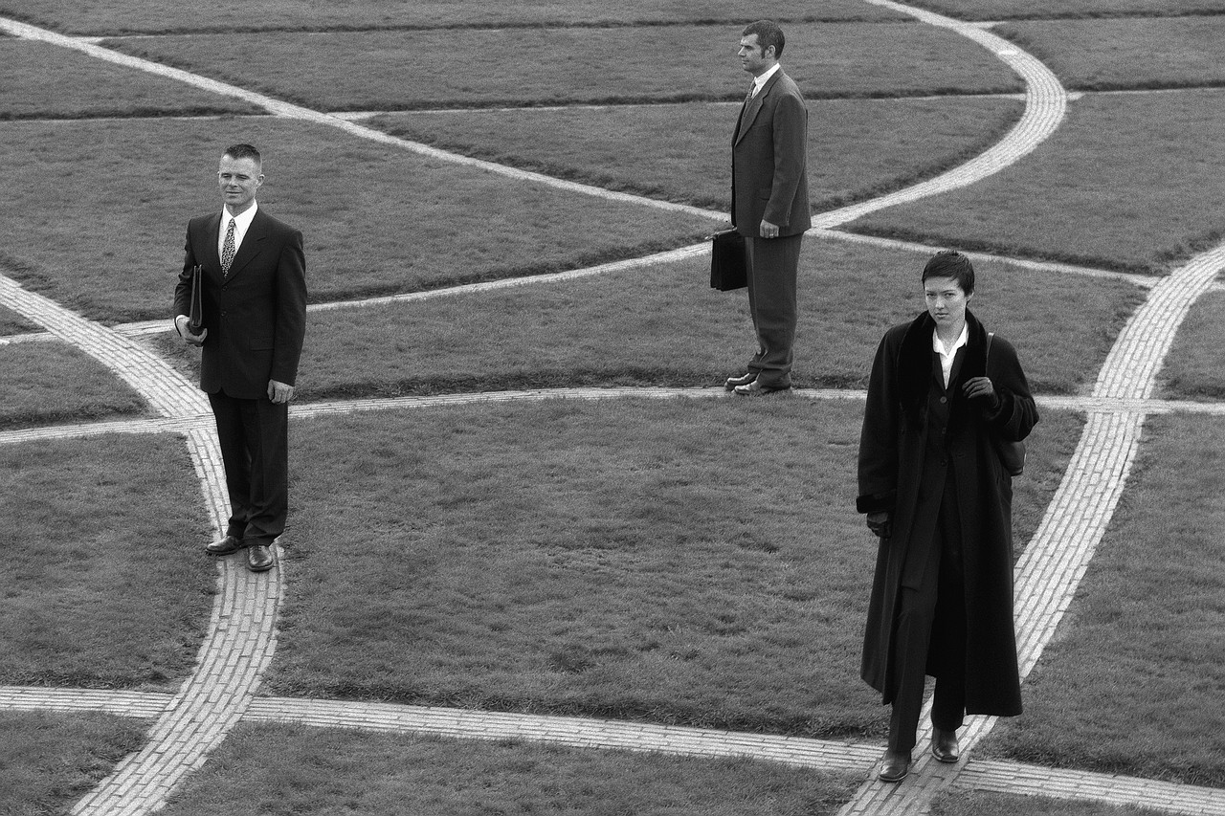
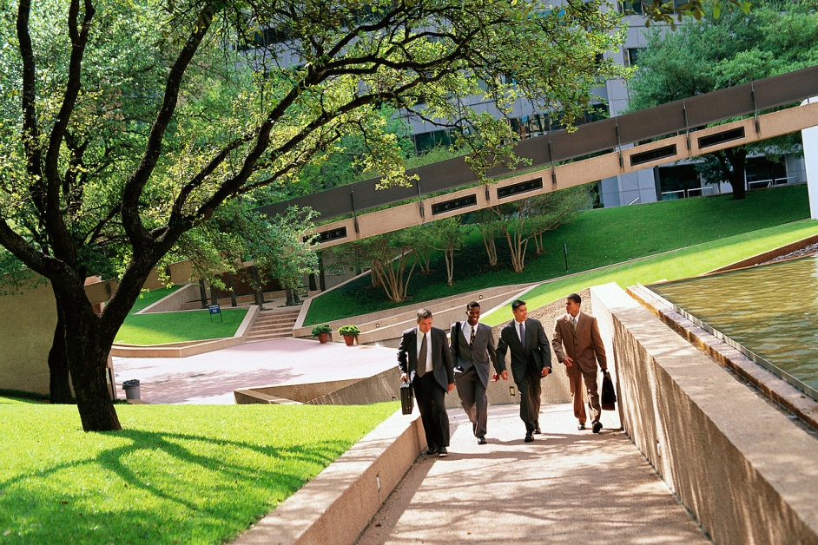
Defining the Goal: Getting on the Same Path
Notes:
Instructions:
During this section, the participants will identify the regional goals they intend to pursue together.
Script:
“Let’s start by thinking about where we want to head as a region. All of you are no doubt able to pursue meaningful goals individually within your own organizations. However, for this regional initiative to be effective, the team needs to determine a direction you can all embrace.”
Time: 1 minute

Slide 15
Considering Potential Goals
Any ideas missing?
Don’t get bogged down in detail.
Consensus is not necessary yet.
Notes:
Instructions:
Over the next few minutes, guide the team through a review of potential ideas developed during the previous exploration of clusters within the region within the context of the C.A.R.E. model. Allow time for discussion of other potential goals that could surface. This is not the time to debate the merits of each possible direction, but rather to get potential ideas on the table.
Script:
We are ready to hone in on the regional goals that make sense for this region. Let’s take a minute to review the ideas suggested during the exploration of regional clusters within the context of the C.A.R.E. model. We want to make sure all potential ideas are considered as we move forward to designing the regional plan. Think about this list for a minute. Are there any missing ideas you would like to suggest for consideration? We won’t worry too much about debating these yet. We just want to make sure all ideas are on the table.” [Allow for responses. Add these to the list.
Depending on the number of potential goals identified, you may need to help the group narrow the list before moving ahead to the next step. Suggestions for accomplishing this task:
Ask the group if there are any similar ideas that could be combined into one goal. If so, work with the group to combine the ideas.
Give each person in the group three sticky dots and have them place them on the chart indicating the top three goals they are interested in helping pursue. Once all the dots are placed, ask the group if they are ok with putting the ones with only a few votes (or no votes) in a “parking lot” for later consideration. Most groups are usually ok with that. However, you can proceed to the next step with any goal(s) the group still wants to consider.]
Time: 5 minutes

Slide 16
The Climate: Elements to Consider
Regional
data
Economic
strength
Regional
Goals
Past history & strategies
Potential barriers
Regional assets
Notes:
Instructions:
This slide organizes the elements that go into goal selection into a practical model that will be used to consider potential goals.
As participants have moved through previous modules – those dealing with assets and barriers, population and economic data, and potential strategies – they have looked at many of the elements depicted on this slide. Now that they have a list of potential goals identified, the next step is to evaluate the goals in light of these elements to see which one(s) seem to be the best fit. The process described in this slide and the next is designed to help the regional group understand the context in which the potential goals would take place. This can be helpful if they seek to prioritize goals or narrow the list of potential goals to a more manageable number. If, however, the group has already settled on one or two goals they plan to pursue, walking through the process described for the selected goal(s) will still be of value in strengthening the planning process.
Script:
“Now that you have narrowed the possible regional goals down to [number identified], the next step is to think about which goal(s) best fit the region. When you think about ‘fit’ to the region, consider these elements: what the data tell you, the region’s economic strengths, potential barriers to overcome, regional assets that can support the goal, and past strategies (and their results) related to the goal. Each element helps form a piece of the climate in which the goal would be pursued.
Let’s consider how this might look for a region.” [Go to next slide.]
Time: 2 minutes

Slide 17
Evaluating a Potential Goal
Regional
Data:
Growing number of small businesses within the regional clusters
Economic Strength:
Evidence of future growth in the clusters gives opportunity for related small business growth
Establish an Entrepreneur-ship Support Network
Past Strategies: Business incubator successfully piloted in 1 county
Potential Barriers: Identifying existing resources
Regional Assets:
Sm. Bus. Development Center, community college, Extension
Notes:
Instructions:
Using this example OR using one of the actual goals identified by the group, walk through each element of the climate related to the potential goal. Help the participants understand what relates to the goal within each of the elements. Once they understand the model and example, have them develop a similar chart for each remaining potential regional goal. If a number of goals are still under consideration, you may want to divide the regional team into small groups to work on each goal separately. If only one goal remains, the process will still be of value in helping the group through the rest of the planning process. If space allows, have group(s) develop the model on flip chart paper so everyone can see the results. A handout version is also available, if needed.
Script:
“Here is an example of how these elements might define the climate of a potential goal. Suppose the region decided to establish an entrepreneurship support network to connect entrepreneurs, who may be willing to fill leakages in a cluster to available resources, and business coaches, who will help them successfully launch their businesses. The slide shows some examples of how these five elements might help define the context for that goal. By thinking through these elements systematically, it becomes easier to see which goals may have the needed support in the region.
For the next few minutes, we will define these elements for each of the potential regional goals you have identified.”
[Break the team into small groups as appropriate for the number of goals under consideration. If only one goal exists, you can either walk through this exercise together or have small groups work individually. Ask group(s) to record their responses on flip chart paper to share, or a worksheet version is available if space does not allow for chart work.
Once groups have completed this assessment, have them report back to the group. Depending on what you need to accomplish from here, talk the group through the debrief below.
If groups need to prioritize and/or narrow goals (i.e. they have too many to consider), ask:
Which of the potential goals seem to have the most support in the current climate?
What are the weak points within the climate for the potential goals?
What are the strong points?
This discussion may lead the group to its own conclusion about which goal(s) to pursue. If it is still not clear:
You may want to ask if there is missing information that would help inform the decision.
Or, you may want to use the sticky dot voting method to see where the group stands.
Finally, if the challenge still exists, it may be helpful to ask the ones NOT supporting a particular goal to tell the group what could be changed in the climate to gain their support.
This information may help identify some strategies or simply lead to refining the goal to gain stronger regional support.
If group has already settled on its goal(s), ask:
What do you learn from this exercise that can help you strengthen the pursuit of this goal?
What other information or resources may be needed to help in the planning process?
How can you plan to address the potential barriers?]
Handout Three: Goal Evaluation Chart
Time: 20 minutes

Slide 18
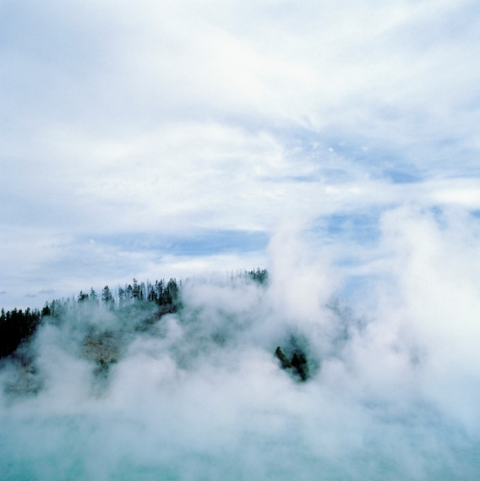
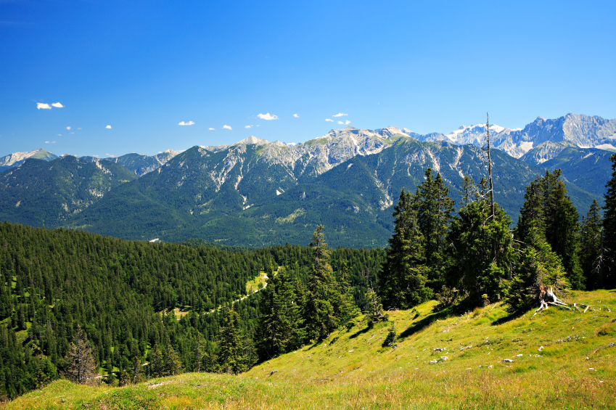
Developing a SMART Goal
Vague Goals = Vague Results
Prepare a goal that’s
crystal clear, concise:
SMART!
Notes:
Instructions:
With the basic goals selected, the team will now begin the work of refining them to be SMART goals.
Script:
“Now that you have selected your basic pool of regional goals, refining them into crystal clear SMART goals is the next task. As this slide points out, vague goals equal vague results. Teams that are serious about making meaningful headway toward their identified goals will benefit from writing them SMART. Let’s explore that further.” [Next slide.]
Time: 1 minute

Slide 19
SMART Goals
Specific
How do you plan to measure progress toward the goal?
What is the end result and milestones along the way?
Attainable
Relevant
Time Framed
When do you want to achieve your goal?
What is the target date for accomplishing the goal?
What do you want to achieve?
Where will you focus your efforts?
Do you have the resources to achieve the goal?
Is this important for your region to pursue?
Does this that matter or bring benefit to the region?
Measurable
What factors might prevent achieving these goals?
Adapted from: Heathfield, S.M. (2011)
Notes:
Instructions:
Distribute Handout Four: SMART Goals. Explain to the participants what the SMART acronym means, and then present the key elements associated with each of the SMART components. For example, the first letter refers to the need for each regional goal to be SPECIFIC. Listed to the right of the word SPECIFIC are ideas on how the team can address this first element. Please make sure you highlight each of the five dimensions of the SMART goals, including a brief description of each.
Script:
“SMART is an acronym that helps define a solid goal. This slide outlines the characteristics of SMART goals and provides a few guiding thoughts for each.
S means Specific: Knowing what the region wants to achieve and where they want to focus their efforts is important. As you develop specific goals, think through exactly what you hope to accomplish. Be clear.
M means Measurable: Develop measures that will allow you to document whether you are moving in the right direction in terms of achieving your goals. Think about the ultimate outcomes you want to achieve and the measures you want to use to document your progress along the way.
A means Attainable: Avoid embracing goals at odds with the current or anticipated resources that will be available in your region. Consider goals that align with the assets of your region. These assets could be people, volunteer groups, local institutions, or physical resources (a topic we’ll cover in a future SET module).
R means Relevant: Is the goal something that the region is truly committed to tackling? Since your region may have a variety of goals it wants to pursue related to regional economic development, taking a hard look at the importance and relevance of each specific goal is vital. Consider whether each goal will benefit the region as a whole and support the identified regional clusters.
T means Time Framed: Having timelines for each of your goals is important. If you don’t have target dates or time frames, then you are likely going to muddle along, having no clear sense of what key actions need to be undertaken and by when. In order to keep things on track, build a timeline of when your team goals are to be accomplished.”
Handout Four: SMART Goals
Adapted from the following source: Heathfield, S. M. (2011). Beyond smart goals. About.com Human Resources. Retrieved from http://humanresources.about.com/cs/performancemanage/a/goalsetting.htm
Time: 5 minutes

Slide 20
SMART Goal Example: An Example
Increase the survival rate of new business start-ups (less than 5-years-old) from 50% to 75% in the Big Coast Region by Dec. 2014
Relevant
Specific
Measurable
Attainable
Time-Framed
Notes:
Instructions:
A SMART goal example is presented on this slide. Share with the participants how the five key elements of a SMART goal are found in this statement.
Script:
“We want to share with you an example of a SMART goal and demonstrate how it can be dissected into its five major parts. Take a look at the five labels that have been assigned to the different parts of the goal statement. This is a good example of how a goal can be concise but still contain all the SMART elements.”
Time: 1 minute

Slide 21
SMART Goal Worksheet
YOUR GOAL: (write your goal in this box and then analyze it using the SMART criteria below)
 | Write Your Comments Below
Specific
Measurable
Attainable
Relevant
Time Framed
REVISION OF YOUR GOAL?
Notes:
Instructions:
This process is crucial in moving through the next sessions. While the team will have opportunity to refine and revisit these goals, they will define much of the remaining work.
Script:
“Using the goals your region has identified, let’s take some time to refine them into SMART goals. You have a handout that looks like the chart on this slide. Begin by writing the goals “as is” in the space at the top. Then use the following rows to examine each aspect to ensure the goal is SMART. If not, what changes do you need to make? Finally, write your refined SMART goal in the bottom row.” [Depending on the size of the group and the overall number of selected goals, you may want to break the group into small teams and ask each team to refine one goal.]
Handout Five: SMART Goal Worksheet
Time: 10 minutes

Slide 22
Homework
Finalize the Vision Statement
Ask 2-3 locals for reactions to the vision statement once complete
Finalize all SMART goals
Other items?
Notes:
Instructions:
Review with the team some specific activities that might need to be completed prior to their next meeting.
Script:
“A lot of significant planning work was done during this session today. However, in order to prepare for the next session, we need to finalize the vision statement and SMART goals. Who would volunteer to work on these and send out to the team before our next session? Are there other items that are needed?”
[Check in with the team to make sure that any previous progress or work toward writing the plan as they go is being completed and vetted with the entire group.]
Time: 1 minute

Slide 23
What Is Ahead
Module Six: Examine regional assets related to goals
People
Institutions
Organizations
Physical Resources
Notes:
Instructions:
Briefly review what will be covered in the next module.
Script:
“In the next module, we will explore the regional assets that can be used in support of the regional goals. These assets can take on a number of forms.”
Time: 1 minute

Slide 24
Final Reflections
What did you find most helpful and valuable in this module?
Are there any items that need to be clarified?
Notes:
Instructions:
Take a few minutes at the end of the module to ask individuals what they felt were the major takeaways. What did they find most valuable and what remains a bit unclear to them? Take time to clarify these items, as appropriate.
Script:
“Let’s take this time to reflect on today’s session. Tell me what you found most useful or valuable. What, if anything, remains a bit fuzzy to you? What needs to be clarified? Any other thoughts or observations about this module?”
Time: 5 minutes

