Slide 1
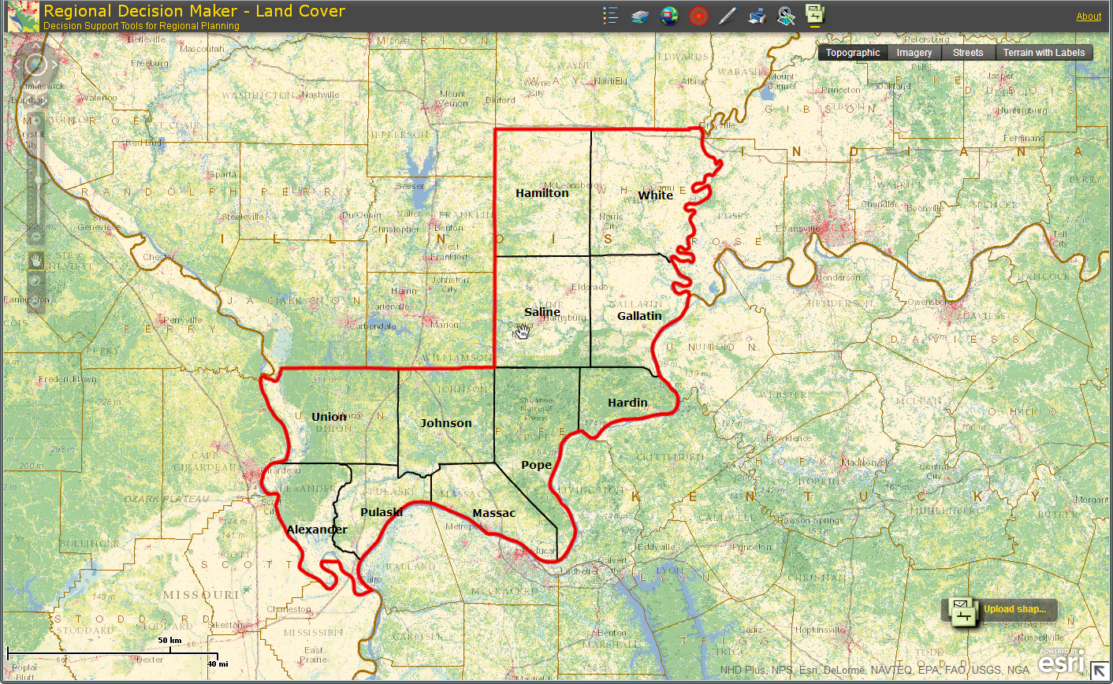
Southern Illinois Communities Region
Region includes the following counties:
Alexander
Gallatin
Hamilton
Hardin
Johnson
Massac
Pope
Pulaski
Saline
Union
White
Source: RDM, PCRD & ESRI

Slide 2
Southern Illinois Communities Region: Economic Attributes
Economic & Demographic Attributes | Value | Remarks | Source
Population (2012) | 121,231 | People living in the region | Census
Jobs (2012) | 51,614 | Full and part-time jobs | EMSI (QCEW, BLS; BEA)
Average Earnings (2012) | $37,253 | Include wages, salaries, supplements and proprietor income | EMSI (BLS; BEA)
Completions (2010) | 1,169 | Students completing a specific course of study | EMSI (NCES; IPEDS)
GRP, Gross Regional Product (2011) | $3,429,365,935 | Final market value of all goods and services produced in the region | EMSI (BEA; QCEW, BLS)
Exports (2011) | $5,487,309,701 | $ earned from selling goods and services to foreign and external domestic regions | EMSI model (BEA)
Imports (2011) | $6,206,862,353 | $ spent on procuring goods and services from foreign and external domestic region | EMSI model (BEA)
Data Source: EMSI 2012.4 & Census

Slide 3
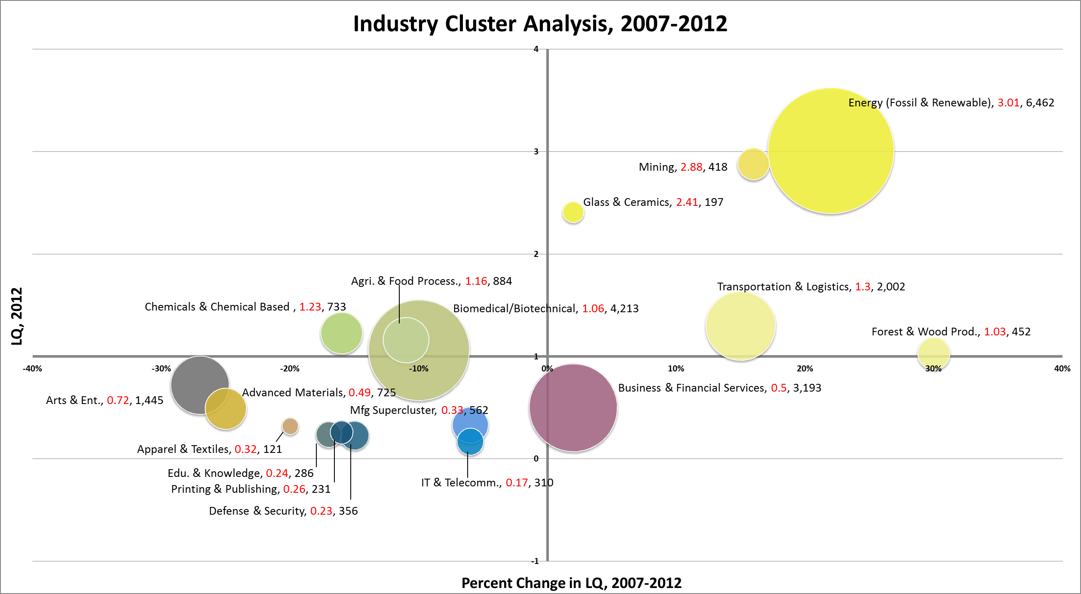
Southern Illinois Communities Region
Mature
Stars
Transforming
Emerging
Note: Label includes cluster name, LQ 2007, and Employment 2007
Data Source: EMSI 2012.4, industry cluster definitions by PCRD

Slide 4
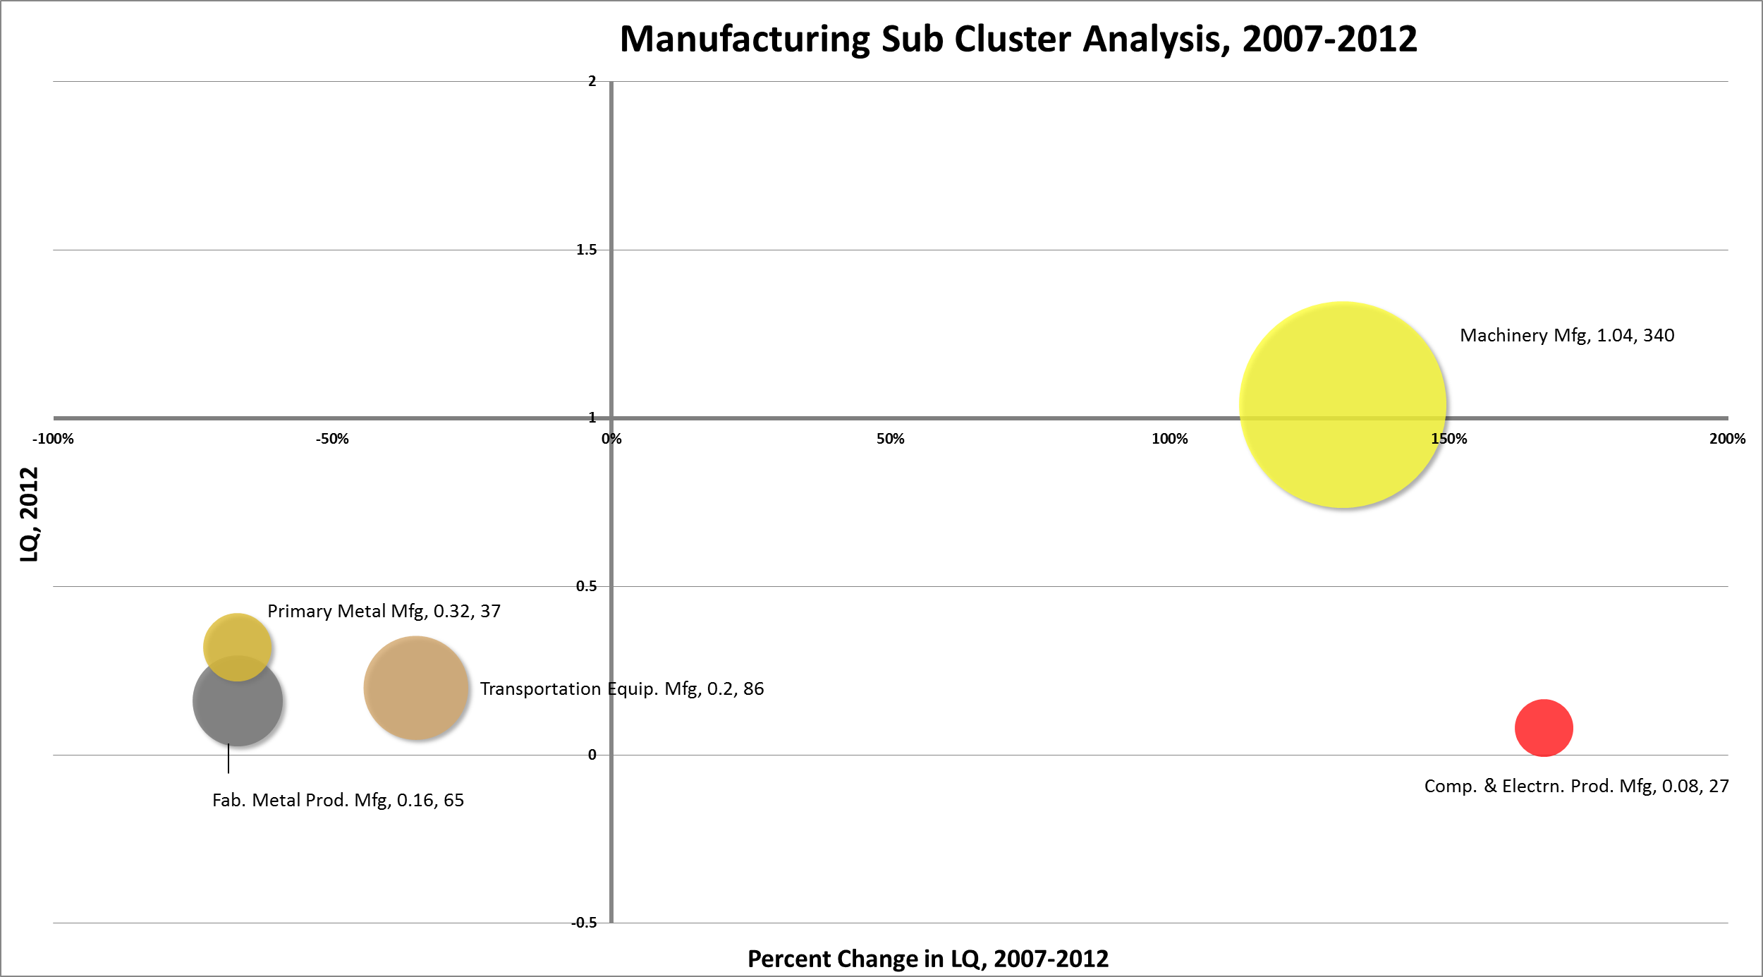
Southern Illinois Communities Region
Mature
Stars
Transforming
Emerging
Note: Label includes cluster name, LQ 2007, and Employment 2007
Data Source: EMSI 2012.4, industry cluster definitions by PCRD

Slide 5
Industry Cluster Analysis, 2007-2012
Mature
L e v e l o f S p e c i a l i z a t i o n
Stars
Biomedical/Biotechnical (Life Sciences)
Agribusiness, Food Processing & Technology
Chemicals & Chemical Based Products
Energy (Fossil & Renewable)
Transportation & Logistics
Forest & Wood Products
Mining
Glass & Ceramics
Machinery Manufacturing
P e r c e n t G r o w t h i n S p e c i a l i z a t i o n
Transforming
Emerging
Arts, Entertainment, Recreation & Visitor Industries
Advanced Materials
Defense & Security
Information Technology & Telecommunications
Education & Knowledge Creation
Printing & Publishing
Apparel & Textiles
Transportation Equipment Manufacturing
Fabricated Metal Product Manufacturing
Primary Metal Manufacturing
Manufacturing Supercluster
Business & Financial Services
Computer & Electronic Product Manufacturing

Slide 6
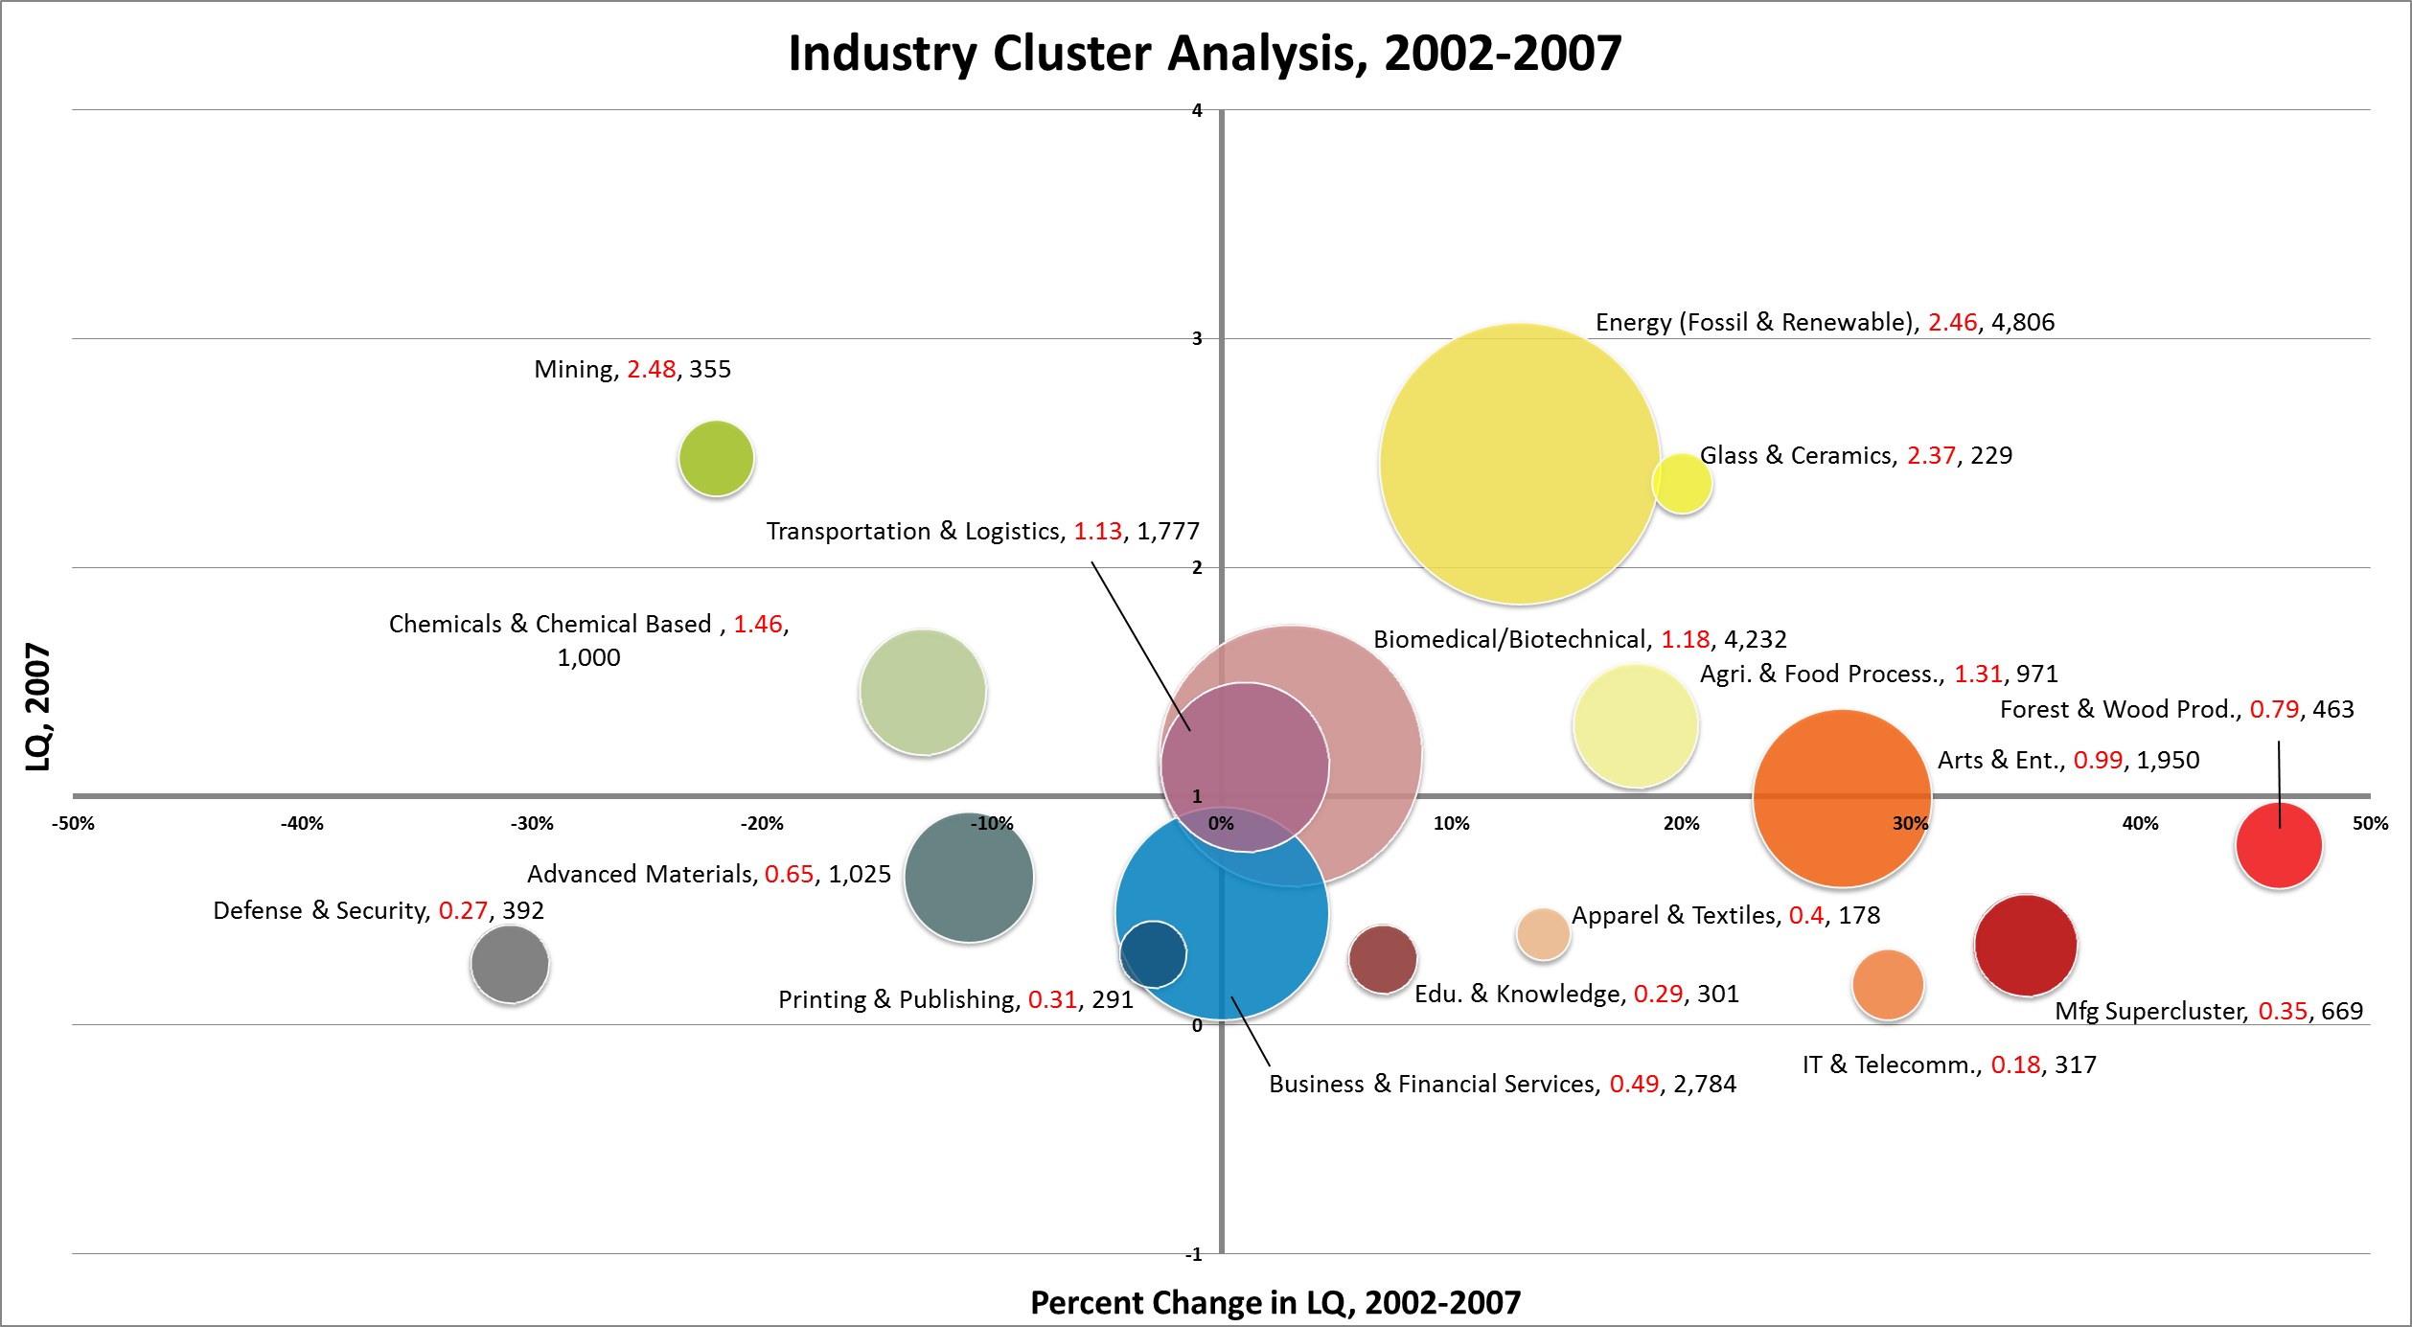
Southern Illinois Communities Region
Mature
Stars
Transforming
Emerging
Note: Label includes cluster name, LQ 2012, and Employment 2012
Data Source: EMSI 2012.4, industry cluster definitions by PCRD

Slide 7
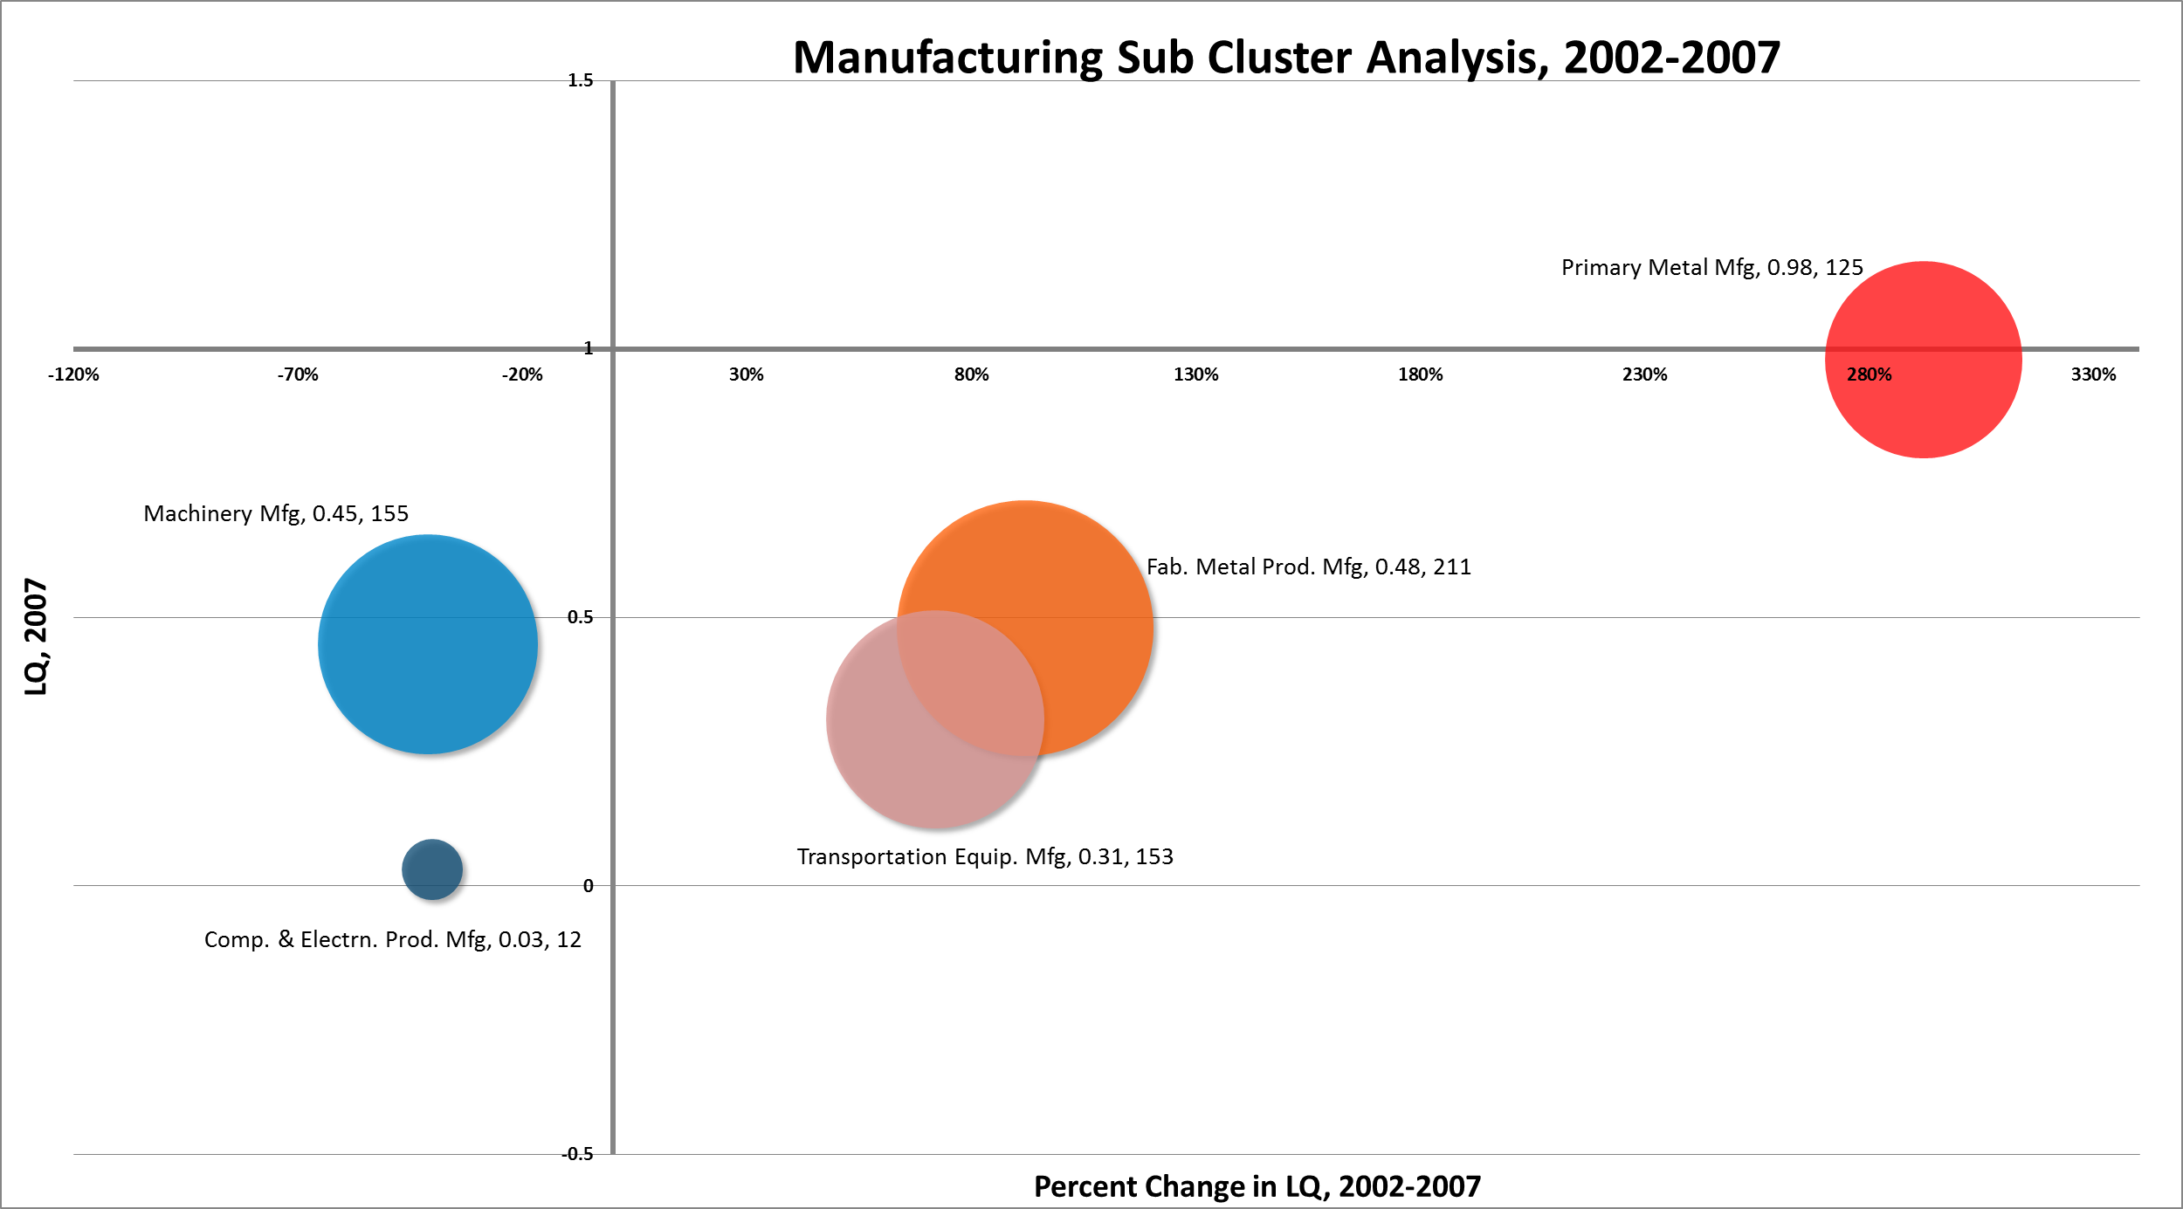
Southern Illinois Communities Region
Mature
Stars
Transforming
Emerging
Note: Label includes cluster name, LQ 2012, and Employment 2012
Data Source: EMSI 2012.4, industry cluster definitions by PCRD

Slide 8
Industry Cluster Analysis, 2002-2007
Mature
L e v e l o f S p e c i a l i z a t i o n
Stars
Chemicals & Chemical Based Products
Mining
Energy (Fossil & Renewable)
Biomedical/Biotechnical (Life Sciences)
Transportation & Logistics
Agribusiness, Food Processing & Technology
Glass & Ceramics
P e r c e n t G r o w t h i n S p e c i a l i z a t i o n
Transforming
Emerging
Business & Financial Services
Advanced Materials
Defense & Security
Printing & Publishing
Machinery Manufacturing
Computer & Electronic Product Manufacturing
Arts, Entertainment, Recreation & Visitor Industries
Education & Knowledge Creation
Information Technology & Telecommunications
Apparel & Textiles
Forest & Wood Products
Fabricated Metal Product Manufacturing
Transportation Equipment Manufacturing
Primary Metal Manufacturing
Manufacturing Supercluster

Slide 9
Average Earnings of Industry Clusters, 2012
Note: Electrical equipment manufacturing did not exist in 2007-2012
Data Source: EMSI 2012.4, industry cluster definitions by PCRD
Star clusters

Slide 10
Southern Illinois Communities Region Industry Clusters, 2012
Note: Electrical equipment manufacturing did not exist in 2007-2012
Data Source: EMSI 2012.4, industry cluster definitions by PCRD

Slide 11
Southern Illinois Communities Region Industry Clusters
Data Source: EMSI 2012.4, industry cluster definitions by PCRD

Slide 12
Purdue Center for Regional Development
Purdue University
Gerald D. and Edna E. Mann Hall, Suite 266
203 Martin Jischke Drive
West Lafayette, IN 47907-2057

