Slide 1
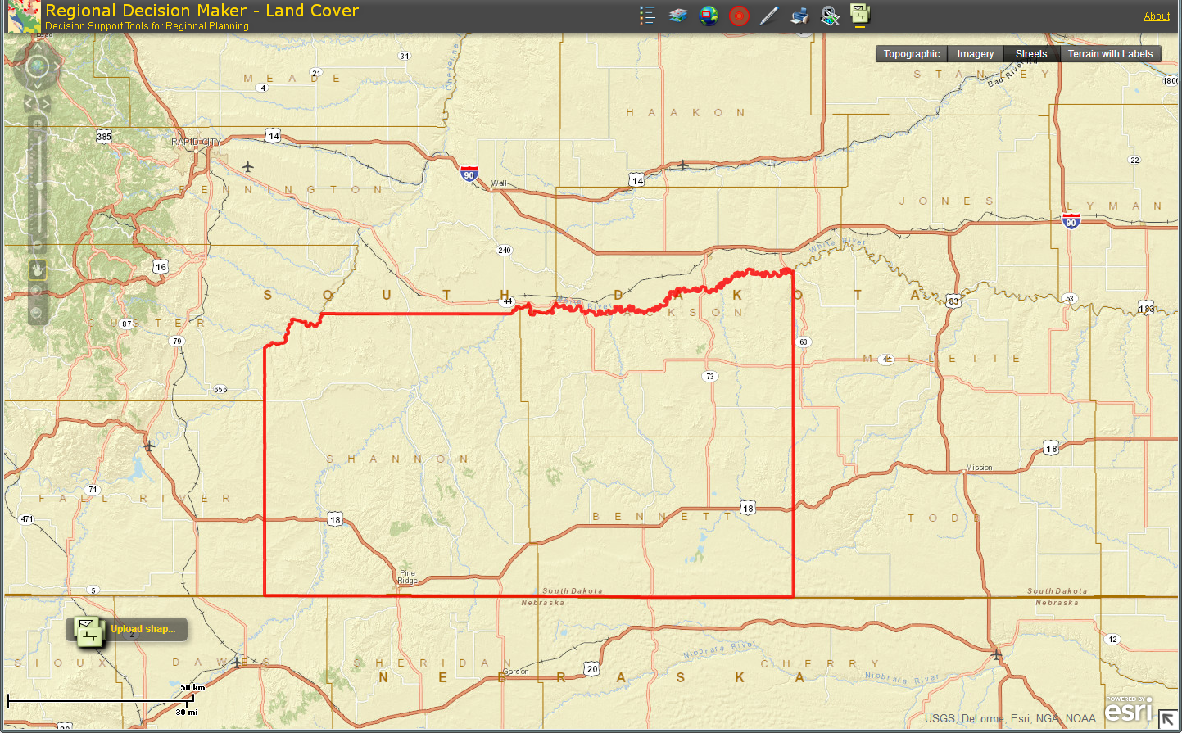
Pine Ridge Indian Reservation, 3 County Region
Jackson
Shannon
Bennett
Pine Ridge Region is within the following counties:
Bennett
Jackson
Shannon
Cluster analysis is conducted for 3-county region
Source: RDM, PCRD & ESRI

Slide 2
Pine Ridge Indian Reservation, 3 County Region: Economic Attributes
Economic & Demographic Attributes | Value | Remarks | Source
Population (2010; 2012) | 20,048; 20,686 | People living in the region | Census
Jobs (2012) | 8,531 | Full and part-time jobs | EMSI (QCEW, BLS; BEA)
Average Earnings (2012) | $36,196 | Include wages, salaries, supplements and proprietor income | EMSI (BLS; BEA)
Completions (2010) | 174 | Students completing a specific course of study | EMSI (NCES; IPEDS)
GRP, Gross Regional Product (2011) | $433,373,900 | Final market value of all goods and services produced in the region | EMSI (BEA; QCEW, BLS)
Exports (2011) | $1,249,231,841 | $ earned from selling goods and services to foreign and external domestic regions | EMSI model (BEA)
Imports (2011) | $971,190,249 | $ spent on procuring goods and services from foreign and external domestic region | EMSI model (BEA)
Data Source: EMSI 2012.4 & Census

Slide 3
Pine Ridge Indian Reservation, 3 County Region
Mature
Stars
Transforming
Emerging
Note: Label includes cluster name, LQ 2012, and Employment 2012
Data Source: EMSI 2012.4, industry cluster definitions by PCRD

Slide 4
Industry Cluster Analysis, 2007-2012
Mature
L e v e l o f S p e c i a l i z a t i o n
Stars
Energy (Fossil & Renewable)
P e r c e n t G r o w t h i n S p e c i a l i z a t i o n
Transforming
Emerging
Biomedical/Biotechnical (Life Sciences)
Transportation & Logistics
Arts, Entertainment, Recreation & Visitor Industries
Defense & Security
Information Technology & Telecommunications
Printing & Publishing
Agribusiness, Food Processing & Technology
Business & Financial Services
Education & Knowledge Creation

Slide 5
Pine Ridge Indian Reservation, 3 County Region
Mature
Stars
Transforming
Emerging
Note: Label includes cluster name, LQ 2007, and Employment 2007
Data Source: EMSI 2012.4, industry cluster definitions by PCRD

Slide 6
Industry Cluster Analysis, 2002-2007
Mature
L e v e l o f S p e c i a l i z a t i o n
Stars
Energy (Fossil & Renewable)
P e r c e n t G r o w t h i n S p e c i a l i z a t i o n
Transforming
Emerging
Biomedical/Biotechnical (Life Sciences)
Arts, Entertainment, Recreation & Visitor Industries
Transportation & Logistics
Agribusiness, Food Processing & Technology
Business & Financial Services
Education & Knowledge Creation
Printing & Publishing
Information Technology & Telecommunications

Slide 7
Pine Ridge Indian Reservation, 3 County Region Industry Clusters
Note: Manufacturing clusters, sub clusters and several other clusters do not exist in this region. Of 23 clusters and sub clusters, only 10 are present in this region
Data Source: EMSI 2012.4, industry cluster definitions by PCRD
Star clusters

Slide 8
Pine Ridge Indian Reservation, 3 County Region Industry Clusters, 2012
Cluster Name | 2012 Jobs | 2012 LQ | Percent Change LQ, 2007-2012 | 2012 EPW | Competitive Effect (shift-share), 2007-2012
Energy (Fossil & Renewable) | 419 | 1.18 | 16% | $ 25,474 | 27
Arts, Entertainment, Recreation & Visitor Industries | 209 | 0.63 | 4% | $ 12,955 | 7
Education & Knowledge Creation | 178 | 0.90 | 192% | $ 7,091 | 109
Business & Financial Services | 163 | 0.16 | 23% | $ 25,950 | 19
Agribusiness, Food Processing & Technology | 93 | 0.74 | 1% | $ 20,553 | -1
Biomedical/Biotechnical (Life Sciences) | 78 | 0.12 | -44% | $ 26,313 | -73
Transportation & Logistics | 51 | 0.20 | -24% | $ 37,699 | -14
Printing & Publishing | 35 | 0.24 | -13% | $ 28,099 | -2
Information Technology & Telecommunications | 27 | 0.09 | -7% | $ 72,318 | -2
Defense & Security | 16 | 0.06 | 23% | $ 42,847 | 2
Data Source: EMSI 2012.4, industry cluster definitions by PCRD

Slide 9
Pine Ridge Indian Reservation, 3 County Region Industry Clusters
Data Source: EMSI 2012.4, industry cluster definitions by PCRD

Slide 10
Purdue Center for Regional Development
Purdue University
Gerald D. and Edna E. Mann Hall, Suite 266
203 Martin Jischke Drive
West Lafayette, IN 47907-2057

