Slide 1
South Plains Region, TX
The region includes the following counties:
Castro, Floyd, Hale, Lamb, and Swisher
Source: RDM, PCRD & ESRI

Slide 2
South Plains Region: Economic Attributes
Economic & Demographic Attributes | Value | Remarks | Source
Population (2012) | 72,815 | People living in the region | Census
Jobs (2012) | 36,797 | Full and part-time jobs | EMSI (QCEW, BLS; BEA)
Average Earnings (2012) | $33,655 | Include wages, salaries, supplements and proprietor income | EMSI (BLS; BEA)
Completions (2010) | 1,969 | Students completing a specific course of study | EMSI (NCES; IPEDS)
GRP, Gross Regional Product (2012) | $1,939,526,721 | Final market value of all goods and services produced in the region | EMSI (BEA; QCEW, BLS)
Exports (2012) | $3,966,991,475 | $ earned from selling goods and services to foreign and external domestic regions | EMSI model (BEA)
Imports (2012) | $4,224,584,568 | $ spent on procuring goods and services from foreign and external domestic region | EMSI model (BEA)
Data Source: EMSI 2013.1 & Census

Slide 3
South Plains Region
Note: Label includes cluster name, LQ 2012, and Employment 2012
Data Source: EMSI 2013. 2, industry cluster definitions by PCRD

Slide 4
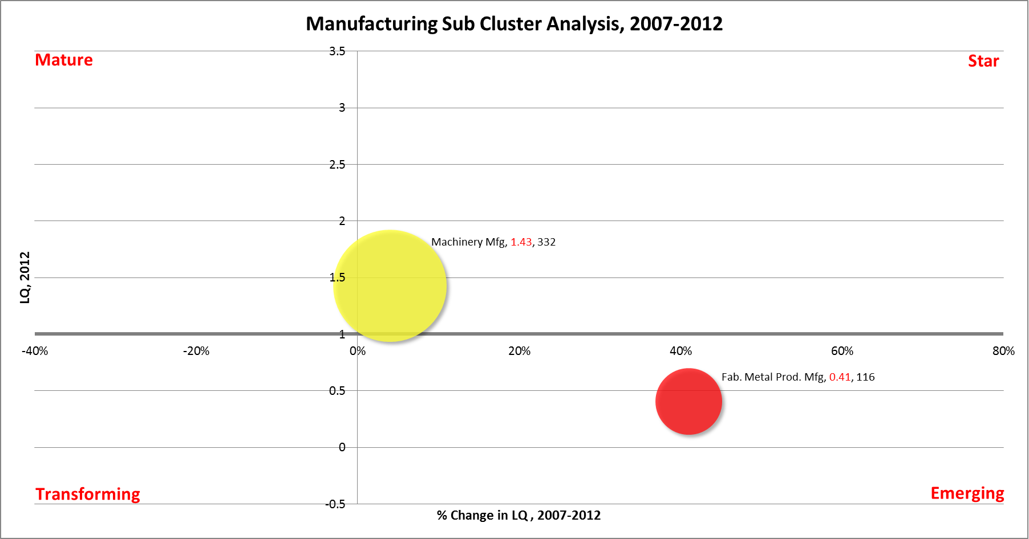
South Plains Region
Note: Label includes cluster name, LQ 2012, and Employment 2012
Data Source: EMSI 2013. 2, industry cluster definitions by PCRD

Slide 5
Industry Cluster Analysis, 2007-2012
Mature
L e v e l o f S p e c i a l i z a t i o n
Stars
Agribusiness, Food Processing & Technology
Apparel & Textiles
Transportation & Logistics
Energy (Fossil & Renewable)
Machinery Manufacturing
P e r c e n t G r o w t h i n S p e c i a l i z a t i o n
Transforming
Emerging
Arts, Entertainment, Recreation & Visitor Industries
Defense & Security
Information Technology & Telecommunications
Advanced Materials
Biomedical/Biotechnical (Life Sciences)
Business & Financial Services
Chemicals & Chemical Based Products
Education & Knowledge Creation
Fabricated Metal Product Manufacturing
Forest & Wood Products
Manufacturing Supercluster
Mining
Printing & Publishing

Slide 6
South Plains Region
Note: Label includes cluster name, LQ 2007, and Employment 2007
Data Source: EMSI 2013. 2, industry cluster definitions by PCRD

Slide 7
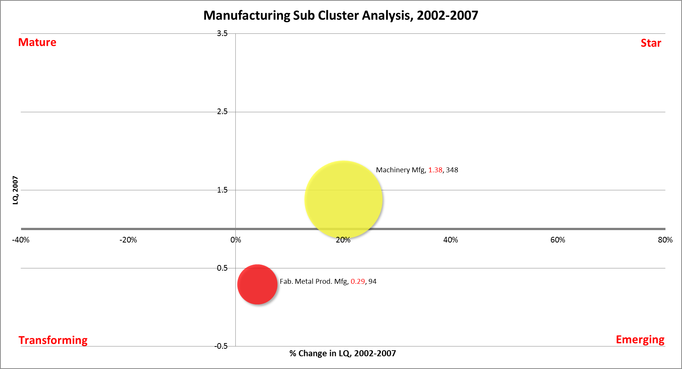
South Plains Group
Note: Label includes cluster name, LQ 2007, and Employment 2007
Data Source: EMSI 2013. 2, industry cluster definitions by PCRD

Slide 8
Industry Cluster Analysis, 2002-2007
Mature
L e v e l o f S p e c i a l i z a t i o n
Stars
Agribusiness, Food Processing & Technology
Apparel & Textiles
Machinery Manufacturing
Transportation & Logistics
P e r c e n t G r o w t h i n S p e c i a l i z a t i o n
Transforming
Emerging
Advanced Materials
Biomedical/Biotechnical (Life Sciences)
Business & Financial Services
Chemicals & Chemical Based Products
Defense & Security
Education & Knowledge Creation
Energy (Fossil & Renewable)
Information Technology & Telecommunications
Mining
Arts, Entertainment, Recreation & Visitor Industries
Fabricated Metal Product Manufacturing
Forest & Wood Products
Manufacturing Supercluster
Printing & Publishing

Slide 9
Average Earnings of Industry Clusters, 2012
Data Source: EMSI 2013.2 & 2013.1, industry cluster definitions by PCRD

Slide 10
South Plains Region, Industry Clusters, 2012
Note: Computer & electronic product mfg, Glass & ceramics, Transportation equipment mfg, Electrical equip mfg, and Primary metal mfg do not exist in the region
Data Source: EMSI 2013.2, industry cluster definitions by PCRD

Slide 11
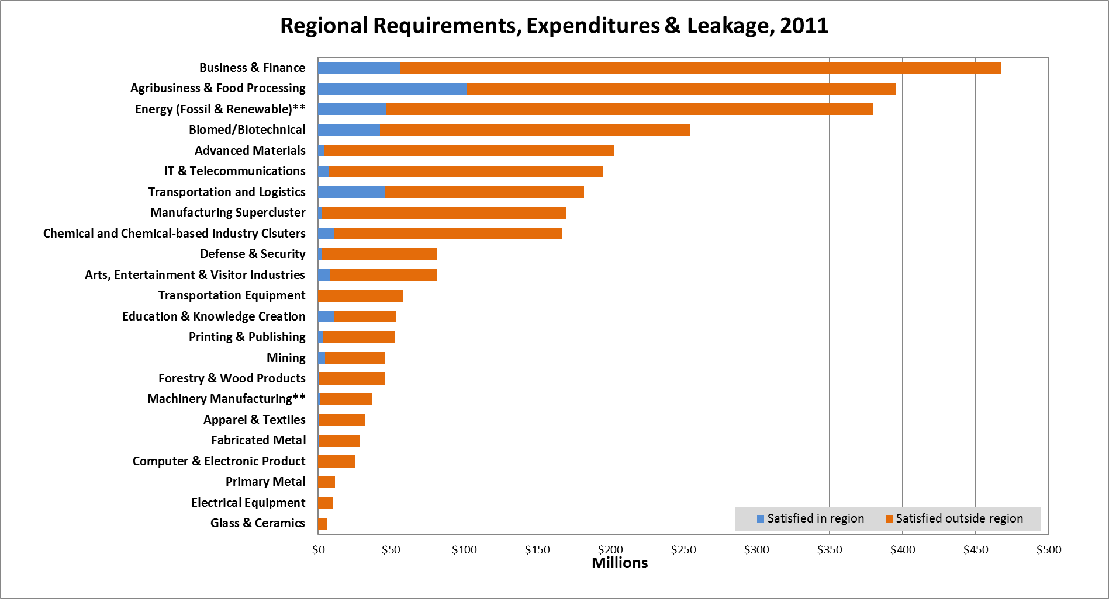
South Plains Region
Note : ** presents “Star clusters”.
Data Source: EMSI 2013. 2, industry cluster definitions by PCRD

Slide 12
Purdue Center for Regional Development
Purdue University
Gerald D. and Edna E. Mann Hall, Suite 266
203 Martin Jischke Drive
West Lafayette, IN 47907-2057

