Slide 1
Target Industry
Cluster Analysis
Eastern Indiana Regional Planning Commission Region, Indiana

Slide 2
Table of contents
01
Overview
02
Industry Cluster Analysis
03
Target Industry Clusters

Slide 3
Eastern Indiana Regional Planning Commission Region, IN
01
overview

Slide 4
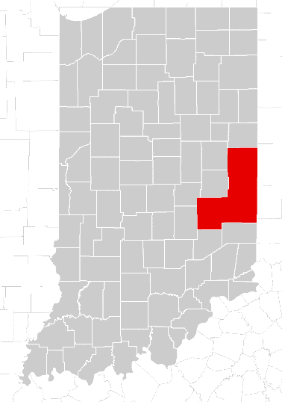
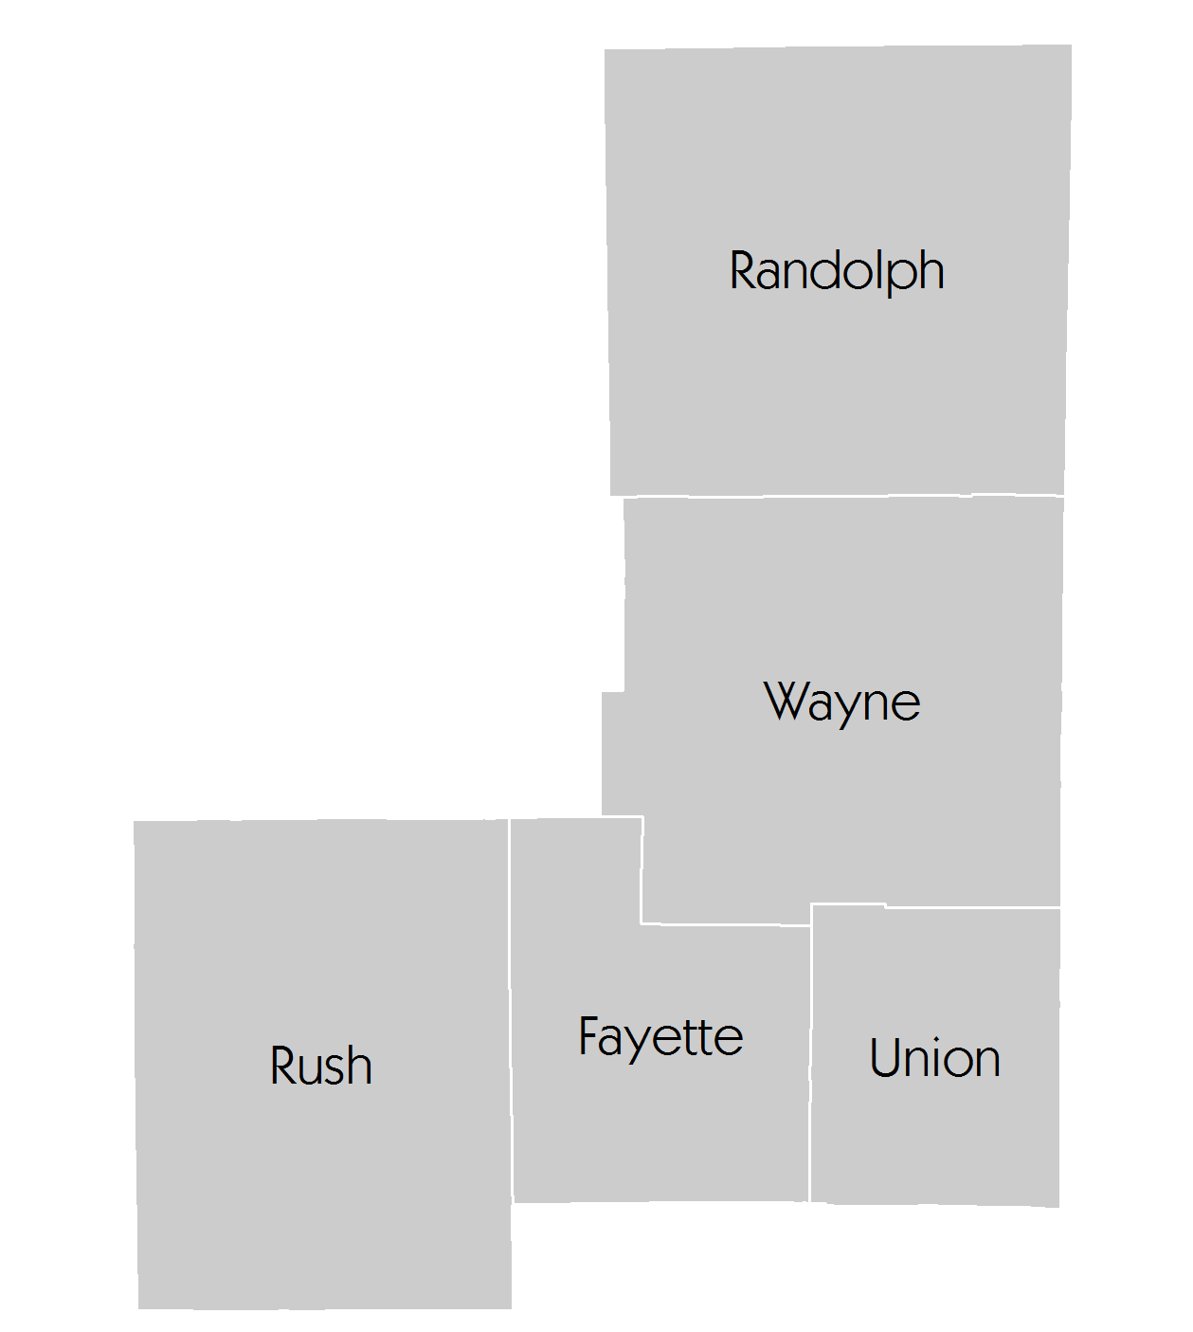
Eastern Indiana Regional Planning Commission Region
Overview
The Eastern Indiana Regional Planning Commission Region is comprised of five Indiana counties. I-70 passes through the central part of the region connecting to Indianapolis to the west and Dayton, OH to the east.
Fayette
Randolph
Rush
Union
Wayne
section 01

Slide 5
Eastern Indiana Regional Planning Commission Region, IN
02
industry cluster analysis

Slide 6
Industry cluster analysis
How to interpret cluster data results The graph’s four quadrants tell a different story for each cluster.
Contains clusters that are more
concentrated in the region but
are declining (negative growth).
These clusters typically fall
into the lower quadrant as
job losses cause a decline
in concentration.
Contains clusters that are more
concentrated in the region and are
growing. These clusters are
strengths that help a region
stand out from the competition.
Small, high-growth clusters
can be expected to become
more dominant over time.
Stars
Top right (strong and advancing)
Mature
Top left (strong but declining)
Emerging
Bottom right
(weak but advancing)
Transforming
Bottom left
(weak and
declining)
Contains clusters that are
under-represented in the
region (low concentration)
and are also losing jobs.
Clusters in this region may
indicate a gap in the workforce
pipeline if local industries anticipate
a future need. In general, clusters in this
quadrant show a lack of competitiveness.
Contains clusters that are
under-represented in the
region but are growing, often
quickly. If growth trends
continue, these clusters will
eventually move into the top right
quadrant. Clusters in this quadrant
are considered emerging strengths
for the region.
section 02
Modified from: http://www.charlestonregionaldata.com/bubble-chart-explanation/

Slide 7
Industry and occupation
Industry cluster bubble chart
Mature
Star
Biomedical/Biotechnical, 1.32, 6,624
≈
100% 110%
Transforming
Emerging
section 02
Source: EMSI Class of Worker 2014.4 (QCEW, non-QCEW, self-employed and extended proprietors).
Note: Label includes cluster name, LQ 2014, and Employment 2014; NAICS 2012 definitions

Slide 8
Industry and occupation
Manufacturing sub-cluster bubble chart
Mature
Star
Transforming
Emerging
Note: Elec. Equipment, App. & Component Mfg. and Computer & Electronic Product Mfg. subclusters have too few jobs.
section 02
Source: EMSI Class of Worker 2014.4 (QCEW, non-QCEW, self-employed and extended proprietors).
Note: Label includes cluster name, LQ 2014, and Employment 2014; NAICS 2012 definition

Slide 9
Industry cluster analysis
Mature Clusters
Glass & Ceramics (4.54; 497)
Machinery Manufacturing (3.32; 1,401)
Agribusiness, Food Processing & Tech (2.38; 4,517)
Star Clusters
Primary Metal Manufacturing (4.76; 695)
Transportation Equipment Mfg. (2.89; 1,624)
Fabricated Metal Product Mfg. (2.56; 1,336)
Chemicals & Chemical Based Products (2.47; 1,920)
Manufacturing Supercluster (2.39; 5,184)
Forest & Wood Products (2.36; 2,164)
Advanced Materials (2.27; 4,334)
Biomed/Biotechnical (Life Science) (1.32; 6,624)
Transportation & Logistics (1.01; 2,037)
Education & Knowledge Creation (1.01; 1,504)
Level of Specialization
Percent Growth in Specialization
Transforming Clusters
Mining (0.72; 138)
Printing & Publishing (0.60; 659)
Business & Financial Services (0.40; 3,412)
Defense & Security (0.34; 925)
Information Technology & Telecom. (0.28; 707)
Elec. Equip., App. & Component Mfg. (0.25; 35)*
Computer & Electronic Product Mfg. (0.24; 93)*
Emerging Clusters
Apparel & Textiles (0.90; 423)
Energy(Fossil & Renewable) (0.59; 2,026)
Arts, Ent, Rec. & Visitor Industries (0.50; 1,306)
* Elec. Equipment, App. & Component Mfg. and Computer & Electronic Product Mfg. subclusters have too few jobs.
section 02
NOTE: The first number after each cluster represents its location quotient while the second number represents the number of total jobs (full and part time jobs by place of work) in that cluster in the region in 2014. The clusters are sorted in decreasing order by location quotient.

Slide 10
Industry and occupation
Bubble chart interpretation
Mature Industries
Three industry clusters in the Eastern Indiana Regional Planning Commission Region are in the Maturing stage: Glass & Ceramics; Machinery Manufacturing; Agribusiness, Food Processing & Technology. These industries are relatively concentrated, but their growth is trending downward. It is worth noting, however, that the Eastern Indiana Regional Planning Commission Region may find it worthwhile to invest in efforts to shore up the concentration of these industries.
Transforming Industries
Transforming clusters capture the mix of industries that are experiencing relative decline and limited export capability. In the Eastern Indiana Regional Planning Commission Region, Mining; Printing & Publishing; Business & Financial Services; Defense & Security; Information Technology & Telecom. are all Transforming clusters. Any amount of growth in these industries would require relatively large investments.
Star Industries
Star industry clusters are highly concentrated, exporting and still experiencing growth in the region. The most highly concentrated of the Star industry clusters in the Eastern Indiana Regional Planning Commission Region is Primary Metal Manufacturing . Its location quotient is 4.76, indicating that the cluster is 5 times more concentrated in the region compared to the U.S. The other strong clusters in the region are Transportation Equipment Mfg.; Fabricated Metal Product Mfg.; Chemicals & Chemical Based Products; Manufacturing Supercluster; Forest & Wood Products and Advanced Materials.
Emerging Industries
Industry clusters that may be poised for future growth are classified as “Emerging.” There are three Emerging clusters in the Eastern Indiana Regional Planning Commission Region: Apparel & Textiles; Energy (Fossil & Renewable); and Arts, Entertainment, Recreation & Visitor Industries.
section 02
Source: EMSI Class of Worker 2014.4 (QCEW, non-QCEW, self-employed and extended proprietors).

Slide 11
Agribusiness, Food Processing and Technology
Advanced Materials
Arts, Entertainment, Recreation And Visitor Industries
03
target industry cluster

Slide 12
Agribusiness, Food Processing and Technology Cluster
Shift-Share Analysis by Top Industry Sectors: EIRPC Region, IN
Industries | Jobs 2014 | National Trend, 2009-2014 | Industry Trend, 2009-2014 | Cumulative Expected Growth | Regional Performance, 2009-2014
Animal Production | 1,722 | 124 | -159 | -35 | 118
Crop Production | 1,166 | 103 | -92 | 11 | -202
Farm Supplies Merchant Wholesalers | 207 | 19 | 0 | 19 | -62
Dog and Cat Food Manufacturing | 204 | 16 | 6 | 22 | -34
Farm and Garden Machinery and Equipment Merchant Wholesalers | 162 | 11 | -1 | 10 | 11
Other Animal Food Manufacturing | 157 | 16 | -16 | 0 | -58
Fluid Milk Manufacturing | 100 | 13 | -18 | -5 | -69
Grain and Field Bean Merchant Wholesalers | 100 | 7 | 3 | 10 | -5
Soil Preparation, Planting, and Cultivating | 99 | 2 | 4 | 6 | 65
Perishable Prepared Food Manufacturing | 94 | 8 | 4 | 12 | -24
Cookie and Cracker Manufacturing | 79 | 12 | -5 | 7 | -93
Farm Labor Contractors and Crew Leaders | 73 | 5 | 5 | 10 | -9
Farm Machinery and Equipment Manufacturing | 67 | 5 | 10 | 15 | -18
Wineries | 64 | 1 | 2 | 3 | 45
Retail Bakeries | 34 | 1 | 2 | 3 | 14
Note: Upward arrow ( ) indicates regional competitiveness.
section 03
Source: EMSI Class of Worker 2014.4 (QCEW, non-QCEW, self-employed and extended proprietors).

Slide 13
Agribusiness, Food Processing and Technology Cluster
Top 15 Inputs by Dollars: EIRPC Region, IN
Industries | Estimated Input ($ Millions), 2013 | % In-Region | % Out of Region
Crop Production | $92.5 | 8.7% | 91.3%
Animal Production and Aquaculture | $75.1 | 9.4% | 90.6%
Other Animal Food Manufacturing | $40.3 | 29.9% | 70.1%
Corporate, Subsidiary, and Regional Managing Offices | $15.3 | 4.0% | 96.0%
Wholesale Trade Agents and Brokers | $13.2 | 5.5% | 94.5%
Soybean and Other Oilseed Processing** | $12.8 | 0% | 100.0%
Animal (except Poultry) Slaughtering* | $11.6 | 0.2% | 99.8%
Rail transportation | $11.0 | 9.2% | 90.8%
Fats and Oils Refining and Blending** | $11.0 | 0% | 100.0%
Wet Corn Milling** | $10.9 | 0% | 100.0%
Meat Processed from Carcasses** | $10.5 | 0% | 100.0%
Flour Milling** | $10.0 | 0% | 100.0%
Metal Can Manufacturing** | $9.9 | 0% | 100.0%
Fluid Milk Manufacturing | $7.6 | 25.5% | 74.5%
General Freight Trucking, Long-Distance, Truckload | $7.5 | 36.1% | 63.9%
Note: * industry sector has less than 10 jobs as calculated by EMSI; ** industry sector is not present in the region.
section 03
Source: EMSI Class of Worker 2014.4 (QCEW, non-QCEW, self-employed and extended proprietors).

Slide 14
Agribusiness, Food Processing and Technology Cluster
Top 15 Inputs by Dollars: EIRPC Region, IN
Note: ** industry sector is not present in the region
section 03
Source: EMSI Class of Worker 2014.4 (QCEW, non-QCEW, self-employed and extended proprietors).

Slide 15
Agribusiness, Food Processing and Technology Cluster
Top Occupations: EIRPC Region, IN
Occupations | Jobs 2014 | % Change, 2009-2014 | Median Hourly Earnings, 2014 | Entry Level Education
Farmers, Ranchers, and Other Agricultural Managers | 2,331 | -1.6% | $12.6 | High school diploma or equivalent
Farmworkers and Laborers, Crop, Nursery, and Greenhouse | 332 | -6.2% | $10.7 | Less than high school
Laborers and Freight, Stock, and Material Movers, Hand | 101 | -11.4% | $11.9 | Less than high school
Packers and Packagers, Hand | 83 | -17.0% | $9.9 | Less than high school
Packaging and Filling Machine Operators and Tenders | 80 | -14.9% | $13.2 | High school diploma or equivalent
Food Batchmakers | 78 | -22.8% | $10.7 | High school diploma or equivalent
Sales Representatives, Wholesale and Manufacturing, Except Technical and Scientific Products | 74 | -7.5% | $22.5 | High school diploma or equivalent
Heavy and Tractor-Trailer Truck Drivers | 59 | -10.6% | $17.3 | Postsecondary non-degree award
Industrial Truck and Tractor Operators | 53 | -11.7% | $15.8 | Less than high school
Animal Trainers | 51 | 37.8% | $11.7 | High school diploma or equivalent
Nonfarm Animal Caretakers | 49 | 81.5% | $10.7 | Less than high school
Farm Equipment Mechanics and Service Technicians | 46 | 15.0% | $14.6 | High school diploma or equivalent
Bookkeeping, Accounting, and Auditing Clerks | 46 | -9.8% | $15.0 | High school diploma or equivalent
First-Line Supervisors of Production and Operating Workers | 43 | -14.0% | $22.1 | Postsecondary non-degree award
Agricultural Equipment Operators | 42 | -2.3% | $16.1 | Less than high school
Note: SOC (Standard Occupation Classification) 5-digit occupations are included by jobs in 2014.
section 03
Source: EMSI Class of Worker 2014.4 (QCEW, non-QCEW, self-employed and extended proprietors).

Slide 16
Advanced Materials Cluster
Shift-Share Analysis by Top Industry Sectors: EIRPC Region, IN
Industries | Jobs 2014 | National Trend, 2009-2014 | Industry Trend, 2009-2014 | Cumulative Expected Growth | Regional Performance, 2009-2014
Machine Shops | 669 | 26 | 50 | 76 | 249
Unlaminated Plastics Film and Sheet (except Packaging) Manufacturing | 534 | 11 | -12 | -1 | 396
Iron Foundries | 392 | 23 | 1 | 24 | 60
Special Die and Tool, Die Set, Jig, and Fixture Manufacturing | 379 | 27 | 26 | 53 | -27
Other Motor Vehicle Parts Manufacturing | 342 | 24 | 68 | 92 | -65
Metal Crown, Closure, and Other Metal Stamping (except Automotive) | 253 | 20 | 13 | 33 | -48
All Other Plastics Product Manufacturing | 231 | 32 | -6 | 26 | -212
Motor Vehicle Electrical and Electronic Equipment Manufacturing | 177 | 8 | -4 | 4 | 65
Synthetic Dye and Pigment Manufacturing | 155 | 8 | -14 | -6 | 58
Copper Rolling, Drawing, Extruding, and Alloying | 152 | 18 | 3 | 21 | -101
Other Aluminum Rolling, Drawing, and Extruding | 132 | 4 | 0 | 4 | 79
Ball and Roller Bearing Manufacturing | 131 | 10 | -4 | 6 | -1
Mineral Wool Manufacturing | 99 | 6 | -4 | 2 | 16
Rubber Product Manufacturing for Mechanical Use | 90 | 3 | 3 | 6 | 46
All Other Converted Paper Product Manufacturing | 74 | 2 | -3 | -1 | 42
Note: Upward arrow ( ) indicates regional competitiveness.
section 03
Source: EMSI Class of Worker 2014.4 (QCEW, non-QCEW, self-employed and extended proprietors).

Slide 17
Advanced Materials Cluster
Top 15 Inputs by Dollars: EIRPC Region, IN
Industries | Estimated Input ($ Millions), 2013 | % In-Region | % Out of Region
Plastics Material and Resin Manufacturing** | $60.9 | 0% | 100.0%
Corporate, Subsidiary, and Regional Managing Offices | $43.4 | 3.5% | 96.5%
Copper Rolling, Drawing, Extruding, and Alloying | $32.6 | 25.7% | 74.3%
Iron and Steel Mills and Ferroalloy Manufacturing** | $28.8 | 0% | 100.0%
Nonferrous Metal (except Aluminum) Smelting and Refining** | $25.3 | 0% | 100.0%
Machine Shops | $15.1 | 11.5% | 88.5%
Petrochemical Manufacturing** | $15.1 | 0% | 100.0%
All Other Basic Organic Chemical Manufacturing | $14.8 | 2.1% | 97.9%
Wholesale Trade Agents and Brokers | $10.7 | 5.2% | 94.8%
Motor Vehicle Metal Stamping | $10.1 | 2.5% | 97.5%
Secondary Smelting and Alloying of Aluminum** | $8.4 | 0% | 100.0%
Rail transportation | $8.1 | 11.2% | 88.8%
Alumina Refining and Primary Aluminum Production** | $8.0 | 0% | 100.0%
Unlaminated Plastics Film and Sheet (except Packaging) Manufacturing | $8.0 | 35.0% | 65.0%
Lessors of Nonfinancial Intangible Assets (except Copyrighted Works)** | $6.7 | 0% | 100.0%
Note: * industry sector has less than 10 jobs as calculated by EMSI; ** industry sector is not present in the region .
section 03
Source: EMSI Class of Worker 2014.4 (QCEW, non-QCEW, self-employed and extended proprietors).

Slide 18
Advanced Materials Cluster
Top 15 Inputs by Dollars: EIRPC Region, IN
Note: ** industry sector is not present in the region
section 03
Source: EMSI Class of Worker 2014.4 (QCEW, non-QCEW, self-employed and extended proprietors).

Slide 19
Advanced Materials Cluster
Top Occupations: EIRPC Region, IN
Occupations | Jobs 2014 | % Change, 2009-2014 | Median Hourly Earnings, 2014 | Entry Level Education
Machinists | 370 | 48.6% | $15.3 | High school diploma or equivalent
Tool and Die Makers | 225 | 6.1% | $30.0 | High school diploma or equivalent
First-Line Supervisors of Production and Operating Workers | 201 | 16.9% | $22.1 | Postsecondary non-degree award
Extruding and Drawing Machine Setters, Operators, and Tenders, Metal and Plastic | 193 | -5.4% | $16.4 | High school diploma or equivalent
Team Assemblers | 191 | 12.4% | $11.2 | High school diploma or equivalent
Inspectors, Testers, Sorters, Samplers, and Weighers | 144 | 15.2% | $15.3 | High school diploma or equivalent
Helpers--Production Workers | 112 | 15.5% | $11.6 | Less than high school
Computer-Controlled Machine Tool Operators, Metal and Plastic | 111 | 37.0% | $14.2 | High school diploma or equivalent
Packers and Packagers, Hand | 110 | 3.8% | $9.9 | Less than high school
Molding, Coremaking, and Casting Machine Setters, Operators, and Tenders, Metal and Plastic | 102 | -5.6% | $14.4 | High school diploma or equivalent
Assemblers and Fabricators, All Other | 100 | 12.4% | $15.2 | High school diploma or equivalent
Cutting, Punching, and Press Machine Setters, Operators, and Tenders, Metal and Plastic | 99 | 1.0% | $13.9 | High school diploma or equivalent
Maintenance and Repair Workers, General | 85 | 18.1% | $16.2 | High school diploma or equivalent
Laborers and Freight, Stock, and Material Movers, Hand | 76 | 10.1% | $11.9 | Less than high school
Industrial Machinery Mechanics | 75 | 23.0% | $23.5 | High school diploma or equivalent
Note: SOC (Standard Occupation Classification) 5-digit occupations are included by jobs in 2014.
section 03
Source: EMSI Class of Worker 2014.4 (QCEW, non-QCEW, self-employed and extended proprietors).

Slide 20
Arts, Entertainment, Recreation and Visitor Industries
Shift-Share Analysis by Top Industry Sectors: EIRPC Region, IN
Industries | Jobs 2014 | National Trend, 2009-2014 | Industry Trend, 2009-2014 | Cumulative Expected Growth | Regional Performance, 2009-2014
Hotels (except Casino Hotels) and Motels | 240 | 18 | 0 | 18 | -13
Independent Artists, Writers, and Performers | 128 | 11 | 6 | 17 | -38
All Other Amusement and Recreation Industries | 112 | 8 | 18 | 26 | -13
Bowling Centers | 111 | 7 | -9 | -2 | 27
Amusement and Theme Parks | 101 | 2 | 2 | 4 | 67
Other Spectator Sports | 84 | 4 | 4 | 8 | 18
Golf Courses and Country Clubs | 77 | 3 | -1 | 2 | 31
Fitness and Recreational Sports Centers | 74 | 5 | 2 | 7 | 3
Radio Stations | 64 | 6 | -3 | 3 | -14
Motion Picture Theaters (except Drive-Ins) | 37 | 5 | -12 | -7 | -22
Racetracks | 33 | 6 | -5 | 1 | -51
RV (Recreational Vehicle) Parks and Campgrounds | 32 | 2 | 2 | 4 | 9
Sporting and Athletic Goods Manufacturing | 31 | 1 | -2 | -1 | 17
Other Performing Arts Companies | 30 | 2 | 1 | 3 | 3
Amusement Arcades | 23 | 1 | 0 | 1 | 11
Note: Upward arrow ( ) indicates regional competitiveness.
section 03
Source: EMSI Class of Worker 2014.4 (QCEW, non-QCEW, self-employed and extended proprietors).

Slide 21
Arts, Entertainment, Recreation and Visitor Industries
Top 15 Inputs by Dollars: EIRPC Region, IN
Industries | Estimated Input ($ Millions), 2013 | % In-Region | % Out of Region
Corporate, Subsidiary, and Regional Managing Offices | $1.50 | 3.7% | 96.3%
Sports Teams and Clubs* | $1.17 | 5.7% | 94.3%
Television Broadcasting | $1.15 | 12.6% | 87.4%
Lessors of Residential Buildings and Dwellings | $0.85 | 19.3% | 80.7%
Lessors of Nonresidential Buildings (except Miniwarehouses) | $0.78 | 15.6% | 84.4%
Independent Artists, Writers, and Performers | $0.62 | 9.4% | 90.6%
Offices of Real Estate Agents and Brokers | $0.60 | 12.2% | 87.8%
Advertising Agencies* | $0.58 | 2.7% | 97.3%
Lessors of Nonfinancial Intangible Assets (except Copyrighted Works)** | $0.51 | 0% | 100.0%
Radio Stations | $0.47 | 81.9% | 18.1%
Internet Publishing and Broadcasting and Web Search Portals | $0.45 | 2.7% | 97.3%
Other Activities Related to Real Estate | $0.42 | 9.3% | 90.7%
Cable and Other Subscription Programming | $0.41 | 0.5% | 99.5%
Offices of Lawyers | $0.39 | 6.3% | 93.7%
Cheese Manufacturing | $0.35 | 6.2% | 93.8%
Note: * industry sector has less than 10 jobs as calculated by EMSI; ** industry sector is not present in the region.
section 03
Source: EMSI Class of Worker 2014.4 (QCEW, non-QCEW, self-employed and extended proprietors).

Slide 22
Arts, Entertainment, Recreation and Visitor Industries
Top 15 Inputs by Dollars: EIRPC Region, IN
Note: ** industry sector is not present in the region
section 03
Source: EMSI Class of Worker 2014.4 (QCEW, non-QCEW, self-employed and extended proprietors).

Slide 23
Arts, Entertainment, Recreation and Visitor Industries
Top Occupations: EIRPC Region, IN
Occupations | Jobs 2014 | % Change, 2009-2014 | Median Hourly Earnings, $ 2014 | Entry Level Education
Amusement and Recreation Attendants | 120 | 46.3% | $9.3 | Less than high school
Musicians and Singers | 67 | 21.8% | $17.0 | High school diploma or equivalent
Maids and Housekeeping Cleaners | 66 | 3.1% | $8.4 | Less than high school
Recreation Workers | 53 | 39.5% | $11.8 | Bachelor's degree
Hotel, Motel, and Resort Desk Clerks | 47 | -2.1% | $8.8 | High school diploma or equivalent
Writers and Authors | 46 | 7.0% | $15.4 | Bachelor's degree
Waiters and Waitresses | 33 | 0% | $9.2 | Less than high school
Coaches and Scouts | 33 | 0% | $10.1 | Bachelor's degree
Landscaping and Groundskeeping Workers | 32 | 0% | $9.3 | Less than high school
Lodging Managers | 32 | 23.1% | $13.0 | High school diploma or equivalent
Cashiers | 26 | -13.3% | $9.3 | Less than high school
Maintenance and Repair Workers, General | 25 | 4.2% | $16.2 | High school diploma or equivalent
Fitness Trainers and Aerobics Instructors | 22 | 29.4% | $11.2 | High school diploma or equivalent
Radio and Television Announcers | 22 | -8.3% | $11.2 | Bachelor's degree
Janitors and Cleaners, Except Maids and Housekeeping Cleaners | 21 | 10.5% | $11.0 | Less than high school
Note: SOC (Standard Occupation Classification) 5-digit occupations are included by jobs in 2014
section 03
Source: EMSI Class of Worker 2014.4 (QCEW, non-QCEW, self-employed and extended proprietors).

Slide 24
Report Contributors This report was prepared by the Purdue Center for Regional Development, in partnership with the Southern Rural Development Center and USDA Rural Development, in support of the Stronger Economies Together program.
Report Authors
Bo Beaulieu, PhD
Indraneel Kumar, PhD
Andrey Zhalnin, PhD
Data Analysis
Ayoung Kim
Francisco Scott
Report Design
Tyler Wright
This report was supported, in part, by grant from the USDA Rural Development through the auspices of the Southern Rural Development Center. It was produced in support of the Stronger Economies Together (SET) program.

Slide 25
For more information,
please contact:
Dr. Bo Beaulieu,
PCRD Director:
ljb@purdue.edu
Or
765-494-7273
The Purdue Center for Regional Development (PCRD) seeks to pioneer new ideas and strategies that contribute to regional collaboration, innovation and prosperity.
December 2015

