Slide 1
Regional Data Snapshot
Commuting breakdown
Uwharrie Region, NC

Slide 2
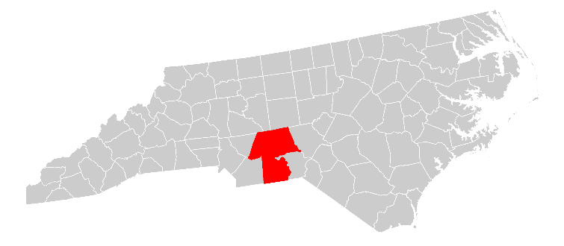
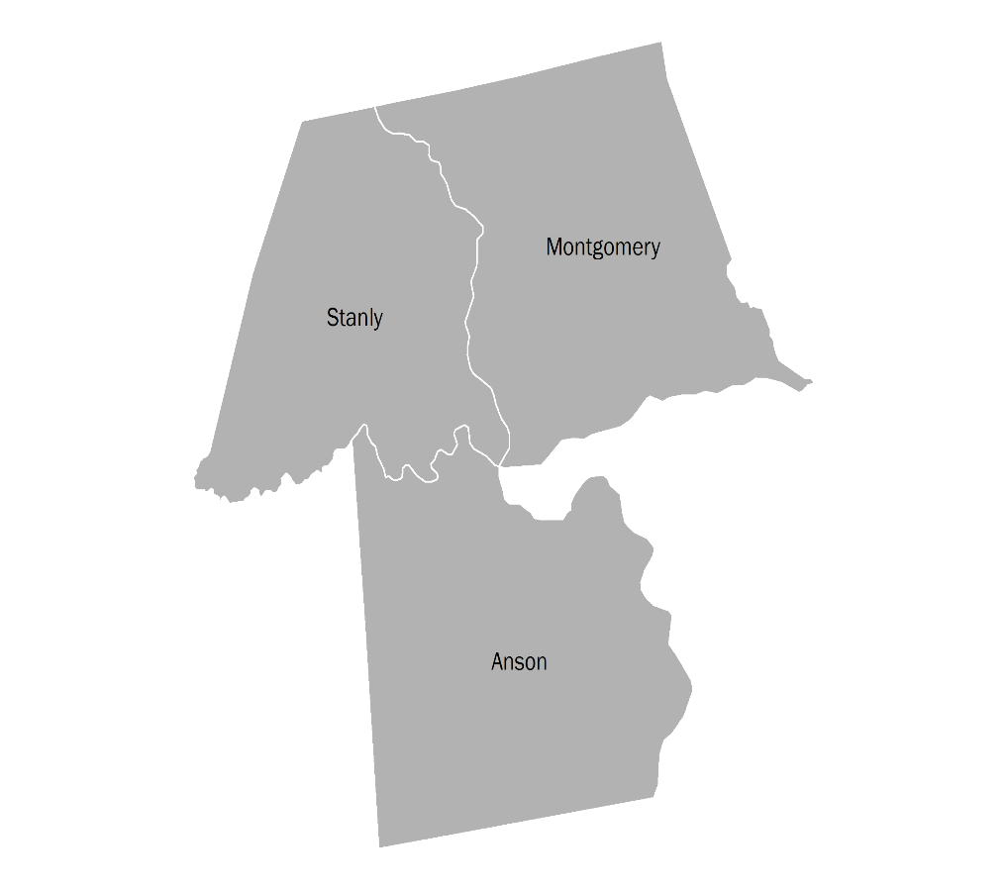
Uwharrie Region
Overview
The Uwharrie Region is comprised of 3 North Carolina counties. Interstate I-73 passes through Montgomery County and connects to Greensboro in the north. State Route 24 connects Stanly County to Charlotte to the west. Major railroads in the region include Aberdeen, Carolina and Western Railway (ACWR) and CSX.
Anson
Montgomery
Stanly
section 01

Slide 3
Worker’s age
Commuting
section 01

Slide 4
Worker’s earnings
Commuting
section 01

Slide 5
Worker’s industry
Commuting
section 01

Slide 6
Report Contributors This report was prepared by the Purdue Center for Regional Development, in partnership with the Southern Rural Development Center and USDA Rural Development, in support of the Stronger Economies Together program.
Report Authors
Bo Beaulieu, PhD
Indraneel Kumar, PhD
Andrey Zhalnin, PhD
Data Analysis
Ayoung Kim
Andrey Zhalnin, PhD
Indraneel Kumar, PhD
Report Design
Tyler Wright
This report was supported, in part, by grant from the USDA Rural Development through the auspices of the Southern Rural Development Center. It was produced in support of the Stronger Economies Together (SET) program.

Slide 7
For more information,
please contact:
Dr. Bo Beaulieu,
PCRD Director:
ljb@purdue.edu
Or
765-494-7273
The Purdue Center for Regional Development (PCRD) seeks to pioneer new ideas and strategies that contribute to regional collaboration, innovation and prosperity.
May 2017

