Slide 1
Regional Data Snapshot
Industry Cluster Analysis
SET Session 1
Southeastern NM, New Mexico

Slide 2
Table of Contents
01
Overview
03
Industry Cluster Analysis
02
Industry and Occupation
04
Occupations

Slide 3
01
overview
Southeastern NM, NM

Slide 4
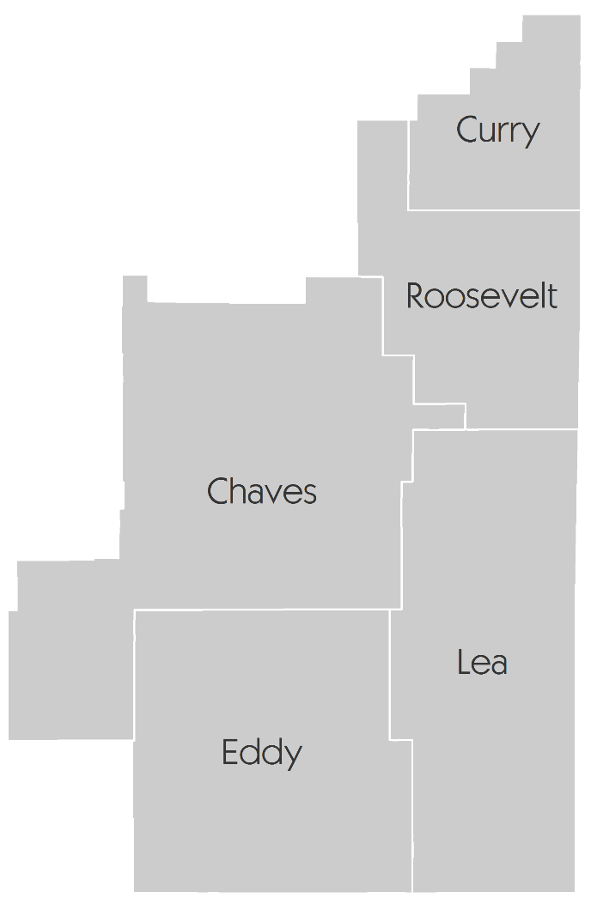
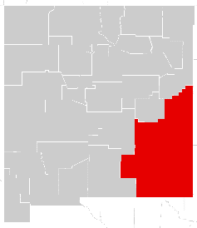
Southeastern New Mexico, NM
Overview
The Southeastern New Mexico Region is comprised of 5 New Mexico counties. State Highway 285 connects the region to I-40, further connecting to Albuquerque to the northwest, and I-20 to the south. U.S. Highway 70 and 60 connect the region to Amarillo, Texas. Major railroads include BNSF and SW, and TNMR, a regional railroad. Major regional airports include Roswell and Lea County regional airports.
Chaves
Curry
Eddy
Lea
Roosevelt
section 01

Slide 5
02
industry
and occupation
Establishments
Employment by industry

Slide 6
Components of changes in Jobs
Industry and occupation
How to Interpret the Accompanying Table
New Startups: A completely new business from births/openings without any affiliation to an existing business.
Spinoffs: New businesses that were spun-off from existing businesses.
Expansions: Existing businesses that have expanded in jobs.
In-migration: Businesses that have moved-in from outside of the county.
Closings: Closure of existing businesses.
Contractions: Existing businesses that have shed/reduced jobs.
Out-migration: Businesses that have moved-out from the county.
Changes in Jobs (2009-2015)
Gained by | New Startups | +29,251
 | Spinoffs | +6,965
 | Expansion | +24,386
 | In-migration | +1,251
Lost by | Closings | -38,693
 | Contractions | -14,863
 | Out-migration | -431
Net change |  | +7,866
section 02
Source: YourEconomy.org
Note: YourEconomy has changed its data source from NETS to InfoUSA on August, 2016. Based on the data available, we can only estimate churn based on jobs and not establishments.
Notes:
Table: Excel 2-1

Slide 7
Company stages
Economy
An establishment is a physical business location. Branches, standalones and headquarters are all considered types of establishments.
Definition of Company Stages
0 1
Self-employed
2-9 employees
3
10-99
employees
100-499
employees
4
500+
employees
Establishment Distribution by Stages
New Mexico, 2015
section 03
Note: Based on Edward Lowe’s research, http://thegrowthsociety.com/links/SecondStage.pdf
Source: Pyramid graphics is courtesy of Nancy Duarte, http://www.duarte.com/diagrammer/
Source: YourEconomy.org

Slide 8
Establishments
Industry and occupation
Number of Establishments by Company Stages
 | 2009 |  | 2015
Stage | Establishments | Proportion | Establishments | Proportion
Stage 0 | 1,686 | 16% | 1,551 | 13%
Stage 1 | 6,600 | 62% | 7,577 | 66%
Stage 2 | 2,160 | 20% | 2,248 | 20%
Stage 3 | 110 | 1% | 112 | 1%
Stage 4 | 11 | 0.1% | 13 | 0.1%
Total | 10,567 | 100% | 11,501 | 100%
Questions:
What stage businesses have shaped the region’s economic growth in the last 6 years?
Which ones are growing or declining the most?
Which stage of establishments are likely to shape the region’s future economic growth?
section 02
Source: Youreconomy.org database
Notes:
Table: Excel 2-1

Slide 9
Jobs and Sales
Industry and occupation
Questions
What establishments are the most numerous based on company stages?
What stages have experienced the largest growth? The greatest decline?
What company stage employs the largest number of people?
What stage captures the most sales?
Which ones have experienced the greatest percentage loss over the 2009-2015 period?
Number of Jobs by Company Stages
Year | 2009 | 2015 | % Change
Stage 0 | 1,686 | 1,779 | 5.5%
Stage 1 | 25,412 | 30,229 | 19.0%
Stage 2 | 55,320 | 55,789 | 0.8%
Stage 3 | 18,568 | 18,449 | -0.6%
Stage 4 | 6,605 | 9,211 | 39.5%
Total | 107,591 | 115,457 | 7.3%
Sales ($Billion, 2015) by Company Stages
Year | 2009 | 2015 | % Change
Stage 0 | 0.37 | 0.9 | 135.1%
Stage 1 | 6.62 | 8.5 | 28.0%
Stage 2 | 12.26 | 13.1 | 7.1%
Stage 3 | 4.32 | 4.4 | 0.8%
Stage 4 | 1.94 | 2.8 | 43.0%
Total | 25.52 | 29.62 | 16.1%
section 02
Source: Youreconomy.org database
Notes:
Table: Excel 2-1

Slide 10
Top ten industry sector employment growth
Industry and occupation
NAICS | Description | 2009 Jobs | 2015 Jobs | Change | Change (%) | State Change (%)
21 | Mining, Quarrying, and Oil and Gas Extraction | 14,193 | 23,704 | 9,511 | 67% | 56%
61 | Educational Services | 664 | 1,034 | 370 | 56% | 9%
48 | Transportation and Warehousing | 4,625 | 5,942 | 1,317 | 28% | 11%
22 | Utilities | 717 | 841 | 124 | 17% | -5%
72 | Accommodation and Food Services | 9,333 | 10,578 | 1,245 | 13% | 11%
42 | Wholesale Trade | 2,945 | 3,273 | 328 | 11% | -3%
31 | Manufacturing | 4,078 | 4,450 | 372 | 9% | -4%
44 | Retail Trade | 13,349 | 14,388 | 1,039 | 8% | 1%
53 | Real Estate and Rental and Leasing | 3,639 | 3,896 | 257 | 7% | -4%
90 | Government | 21,759 | 22,811 | 1,052 | 5% | -3%
Questions:
What regional industry sectors have seen the greatest growth?
Did they grow at the same rate as the state?
What factors are causing the growth?
section 02
Source: EMSI Class of Worker 2016.4 (QCEW, non-QCEW, self-employed and extended proprietors)
Notes:
Table: Excel 2-2

Slide 11
Seven industry sector employment decline
Industry and occupation
NAICS | Description | 2009 Jobs | 2015 Jobs | Change | Change (%) | State Change (%)
51 | Information | 1,184 | 1,037 | -147 | -12% | -9%
54 | Professional, Scientific, and Technical Services | 3,991 | 3,722 | -269 | -7% | -4%
56 | Administrative and Support and Waste Management and Remediation Services | 5,576 | 5,201 | -375 | -7% | -3%
52 | Finance and Insurance | 3,469 | 3,244 | -225 | -6% | -3%
71 | Arts, Entertainment, and Recreation | 1,360 | 1,273 | -87 | -6% | 5%
62 | Health Care and Social Assistance | 13,803 | 13,013 | -790 | -6% | 11%
23 | Construction | 8,476 | 8,471 | -5 | 0% | -10%
Questions:
How does the industry sector make-up of the region compare to the rest of the state?
Which industry sectors are growing and declining the most in employment?
section 02
Source: EMSI Class of Worker 2016.4 (QCEW, non-QCEW, self-employed and extended proprietors)
Notes:
Table: Excel 2-2

Slide 12
03
Industry cluster analysis
Southeastern NM, NM

Slide 13
List of Clusters
Industry cluster analysis
Advanced Materials
Agribusiness, Food Processing & Technology
Apparel & Textiles
Arts, Entertainment, Recreation & Visitor Industries
Biomedical/Biotechnical (Life Sciences)
Business & Financial Services
Chemicals
Computer & Electronic Product Manufacturing
Defense & Security
Education & Knowledge Creation
Electrical Equip, Appliance & Component Manufacturing
Fabricated Metal Product Manufacturing
Energy (Fossil & Renewable)
Forest & Wood Products
Glass & Ceramics
Information Technology & Telecommunications
Machinery Manufacturing
Mining
Primary Metal Manufacturing
Printing & Publishing
Transportation & Logistics
Transportation Equipment Manufacturing
section 03
Notes:
Goal: To provide a list of the clusters used in the data
This slide lists the overarching clusters used in the data. These are not mutually exclusive.
Note that the Manufacturing Super-cluster contains the following:
Primary Metals
Fabricated Metal Products
Machinery
Computer and Electronic Products
Electrical Equipment, Appliance and Components
Transportation Equipment
Time: 5 minutes
http://prodgis2.agriculture.purdue.edu/RDM/Industry_clusters.html#

Slide 14
Industry cluster analysis
How to interpret cluster data results The graph’s four quadrants tell a different story for each cluster.
Contains clusters that are more
concentrated in the region but
are declining (negative growth).
These clusters typically fall
into the lower quadrant as
job losses cause a decline
in concentration.
Contains clusters that are more
concentrated in the region and are
growing. These clusters are
strengths that help a region
stand out from the competition.
Small, high-growth clusters
can be expected to become
more dominant over time.
Stars
Top right (strong and advancing)
Mature
Top left (strong but declining)
Emerging
Bottom right
(weak but advancing)
Transforming
Bottom left
(weak and
declining)
Contains clusters that are
under-represented in the
region (low concentration)
and are also losing jobs.
Clusters in this region may
indicate a gap in the workforce
pipeline if local industries anticipate
a future need. In general, clusters in this
quadrant show a lack of competitiveness.
Contains clusters that are
under-represented in the
region but are growing, often
quickly. If growth trends
continue, these clusters will
eventually move into the top right
quadrant. Clusters in this quadrant
are considered emerging strengths
for the region.
section 03
Modified from: http://www.charlestonregionaldata.com/bubble-chart-explanation/

Slide 15
Industry cluster analysis
Mature Clusters
Mining (5.29; 2,201)
Agribusiness, Food Process & Tech (2.4; 9,878)
Star Clusters
Energy (4.01; 30,420)
Transportation & Logistics (1.27; 5,696)
Defense & Security (1.09; 6,359)
Level of Specialization
Percent Growth in Specialization
Transforming Clusters
Biomedical/Biotechnical (0.8; 8,662)
Glass & Ceramics (0.59; 135)
Business & Financial Services (0.37; 6,407)
Printing & Publishing (0.31; 726)
Forest & Wood Products (0.3; 609)
IT & Telecommunications (0.3; 1,673)
Machinery Manufacturing (0.27; 238)
Fabricated Metal Product Mfg. (0.22; 242)
Computer & Electronic Product Mfg. (0.04; 35)
Transportation Equipment Mfg. (0.03; 40)
Electrical Equip, App. & Comp. Mfg. (0.02; 5)
Emerging Clusters
Chemicals (0.76; 1,276)
Arts, Ent, Rec & Visitor Industries (0.59; 3,345)
Education & Knowledge Creation (0.35; 1,139)
Advanced Materials (0.22; 916)
Apparel and Textiles (0.18; 192)
Primary Metal Mfg. (0.10; 30)
section 03
NOTE: The first number after each cluster represents the number of total jobs (full and part time jobs by place of work) in that cluster in the region in 2015. The clusters are sorted in decreasing order by location quotient as shown in the bubble chart.
Notes:
Table: Excel 3-1

Slide 16
Bubble Chart: What to Look at First
Quadrant Location
Size of Location Quotient
Percentage Change in Last 5 Years
Number of Employees
Start with clusters located in the STARS quadrant
See if the MATURING clusters might have a good chance of growing again
Determine if EMERGING clusters are likely to grow in strength
Avoid clusters that are “TRANSFORMING”
Focus on clusters with an LQ of 1.2 or higher
Clusters with high LQs represent economic activities in which the region is competitive relative to the U.S.
REMEMBER: Clusters only capture industries that have the likelihood of exporting goods and services.
The horizontal line (the x-axis) shows the percentage growth or decline of a cluster over a five-year period.
Make sure to examine the SIZE and DIRECTION of that change.
Dramatic declines in a cluster with a an LQ of 1.2 or higher could be a difficult one to resurrect.
The size of the bubble refers to the number of people employed in that cluster.
It may be worthwhile to focus on clusters that are both competitive and that employ a good number of people.
section 03
Notes:
Goal: To better understand how to interpret the bubble chart
Use this slide to interpret the bubble chart handout of all of the possible clusters in the region (Page 7 of the Targeted Industry Cluster Handout). Have the team ensure that the industries listed as stars, emerging, mature, and transforming, align with the handout. Have the team identify those clusters with larger Location Quotients (LQ) as well as those clusters with large employment.
Time: 4 minutes

Slide 17
Industry and occupation
Industry cluster bubble chart
Mature
Star
Transforming
Emerging
Note: Label includes cluster name, LQ in 2015, and Employment in 2015.
section 03
Source: EMSI Class of Worker 2016.4 (QCEW, non-QCEW, self-employed and extended proprietors)
Notes:
Table: Excel 3-1

Slide 18
The Manufacturing Super-Cluster
Please note that this is not a cluster that a SET region should select. Rather, focus on the manufacturing sub-clusters that are important to that super-cluster.
Manufacturing Super-Cluster
Computer & Electronic Product Manufacturing
Electric Equipment, Appliances & Component Manufacturing
Fabricated Metal Product Manufacturing
Primary Metal Manufacturing
Machinery Manufacturing
Transportation Equipment Manufacturing

Slide 19
Industry and occupation
Manufacturing sub-cluster bubble chart
Mature
Star
Transforming
Emerging
Note: Label includes cluster name, LQ in 2015, and Employment in 2015; Very few regional jobs in Electrical Equipment, Appliance & Component Mfg. Cluster.
section 03
Source: EMSI Class of Worker 2016.4 (QCEW, non-QCEW, self-employed and extended proprietors)
Notes:
Table: Excel 3-1

Slide 20
Industry and occupation
For your region
Mature Industries
Two industry clusters in the Southeastern NM region is in the Matured stage: Mining and Agribusiness, Food Process & Technology. The mature industry is relatively concentrated, but its growth is trending downward. It is worth noting, however, that the Region may find it worthwhile to invest in efforts to shore up the concentration of these industries.
Star Industries
Star industry clusters are highly concentrated, exporting and still experiencing growth in the region. Three Star industry clusters in the Southeastern NM region are
Energy; Transportation & Logistics; and Defense & Security. These clusters indicate that they have a little more jobs concentration in the region compared to the U.S.
Transforming Industries
Transforming clusters capture the mix of industries that are experiencing relative decline and limited export capability. In the Region, Biomedical/Biotech; Glass & Ceramics; Business & Financial Services; Printing & Publishing; Forest & Wood Products; IT & Telecom; Machinery Mfg.; Fabricated Metal Prod Mfg.; Computer & Elec Prod Mfg.; Transportation Equip Mfg.; and Elec Equip, App & Comp Mfg. Eleven industry clusters are all Transforming clusters. Any amount of growth in these industries would require relatively large investments.
Emerging Industries
Industry clusters that may be poised for future growth are classified as “Emerging.” There are six Emerging clusters in total in the Southeastern NM region: Chemicals; Arts, Ent, Rec & Visitor Industries; Education & Knowledge Creation; Advanced Materials; Apparel & Textiles; and Primary Metal Mfg.
section 03
Source: EMSI Class of Worker 2016.4 (QCEW, non-QCEW, self-employed and extended proprietors)

Slide 21
04
occupations
Top occupations
STEM occupations

Slide 22
Top five occupations in 2015
Industry and occupation
Questions:
What are the education and skill requirements for these occupations?
Do the emerging and star clusters align with the top occupations?
What type salaries do these occupations typically provide?
section 04
Source: EMSI Class of Worker 2016.4 (QCEW, non-QCEW, self-employed and extended proprietors)
Notes:
Chart: Excel 3-1

Slide 23
Science, Technology, Engineering & Math
Industry and occupation
Job change in STEM occupations
42,052
40,010
Southeastern NM
3,400
11.4%
3,053
Rest of New Mexico
-4.9%
2009
2015
Change
Questions:
How do STEM jobs compare to the state?
What has been the trend of STEM jobs over time?
How important are STEM jobs to the region’s Star and Emerging clusters?
section 04
*Note: STEM and STEM-related occupation definitions from BLS (2010)
Source: EMSI Class of Worker 2016.4 (QCEW, non-QCEW, self-employed and extended proprietors)

Slide 24
Report Contributors This report was prepared by the Purdue Center for Regional Development, in partnership with the Southern Rural Development Center and USDA Rural Development, in support of the Stronger Economies Together program.
Report Authors
Bo Beaulieu, PhD
Indraneel Kumar, PhD
Data Analysis
Ayoung Kim
Andrey Zhalnin, PhD
Indraneel Kumar, PhD
Report Design
Tyler Wright
This report was supported, in part, by grant from the USDA Rural Development through the auspices of the Southern Rural Development Center. It was produced in support of the Stronger Economies Together (SET) program.

Slide 25
For more information,
please contact:
Dr. Bo Beaulieu,
PCRD Director:
ljb@purdue.edu
Or
765-494-7273
The Purdue Center for Regional Development (PCRD) seeks to pioneer new ideas and strategies that contribute to regional collaboration, innovation and prosperity.
June 2017

