Slide 1
INTERNET USAGE AND COMMUNITY-BASED WEBSITES
Module 1
Lesson A.
Internet Usage and Community-Based Websites
Notes:
Have this slide up as participants enter the room.

Slide 2
PROGRAM GOAL
Help communities develop web-based
strategies for a broad base including:
Government
Business
Education
Community Groups
Notes:
This is the beginning of a journey to help communities consider the overarching goals they may want for reaching a broad base of stakeholders including these listed on the slide.

Slide 3
LESSON OBJECTIVES
Introduce current trends in Internet use
Discuss opportunities and common issues encountered when communities “go online”
Consider goals, objectives and resources for setting up a community website
Introduce program modules and content
Notes:
Go over the lesson objectives and the goals for this specific workshop.

Slide 4
WHO IS USING THE INTERNET?
Notes:
NOTE: Refer to the Corresponding Tables Reference Sheet.
Source: http://www.pewinternet.org/Trend-Data/Whos-Online.aspx
NOTE: For any slide with data, please use the “Source” links to find the most up to date data and update the slides as necessary.
This slide serves as an introduction to the statistics based on demographics displayed on Slide 5. This would be a good point to start a discussion: Ask participants who they think is using the Internet. Any differences by race, gender, age? After a few minutes to do some guess-work, move to the next slide and accompanying handout to look at the Pew Partnership study.
Though basic, this demographic information (Slides 5) should be considered initially to help determine if an online presence is appropriate given your desired audience. Secondly, this information is useful during the design and content development phases of the project.

Slide 5
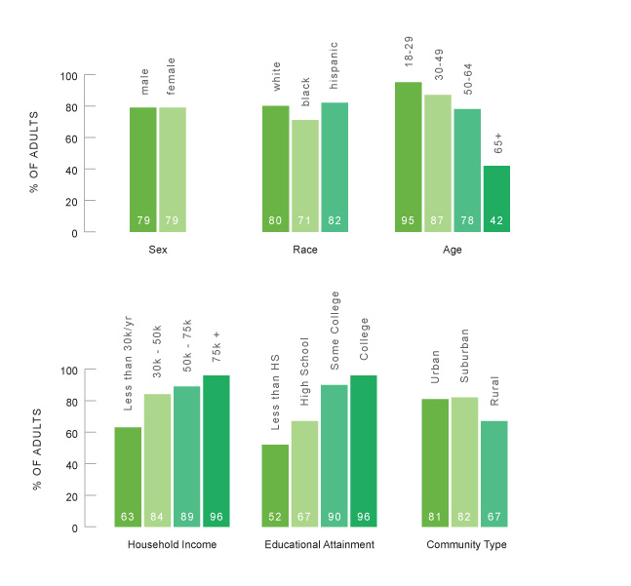
WHO IS USING THE INTERNET?
Source: The Pew Research Center's Internet & American Life Project (May 2010)
Notes:
Source: http://www.pewinternet.org/Trend-Data/Whos-Online.aspx
NOTE: For any slide with data, please use the “Source” links to find the most up to date data and update the slides as necessary.
Though basic, this demographic information should be considered initially to help determine if an online presence is appropriate given your desired audience. Secondly, this information is useful during the design and content development phases of the project.
Go over the statistics by Income, Educational Attainment and Community Type. Higher incomes and higher educational attainment translate into greater internet usage. Interestingly, holding all other factors constant, the data indicate that people living in rural areas access the Internet at a lower rate then their suburban and urban counterparts. This is likely driven by availability of the Internet and computers in the home.
What implications do these two slides have regarding you potential target audience?
For additional data about how community type influences internet usage see: http://www.ntia.doc.gov/data/CPS2009_Tables.html . Are there surprises in the data? What are the implications for your “community”?

Slide 6
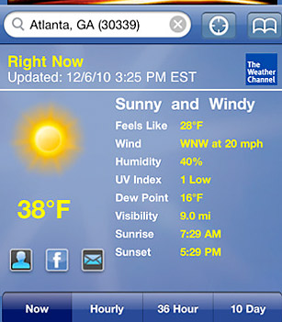
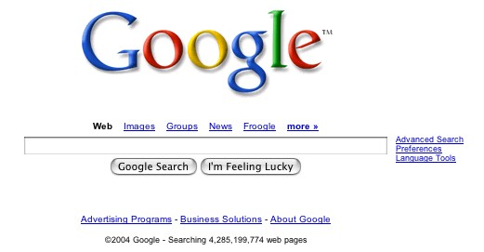
WHY ARE PEOPLE USING THE INTERNET?
Source: The Pew Research Center's Internet & American Life Project (May 2010)
Notes:
NOTE: Refer to the Corresponding Tables reference sheet, which is posted in PDF format at http://srdc.msstate.edu/ecommerce/curricula/egovernment/factools.html.
Source: http://www.pewinternet.org/Static-Pages/Trend-Data/Online-Activites-Total.aspx
This slide serves as an introduction to the statistics displayed on Slide 7. People use the Internet for a wide variety of reasons. These data show some of the most common uses by American users. Communication (email) and information gathering (use of search engines and mapping utilities) are the most common. Information gathering can be broken down further into specific categories such as: health, hobbies, shopping, weather, news, travel, civic engagement, and job-seeking.

Slide 7
WHY ARE PEOPLE USING THE INTERNET?
Activity | Percent of Internet Users
E-Mail | 89
Search Engine | 88
Map/Directions | 86
Health/Medical Info | 83
Hobby/Interest Info. | 83
Research Potential Purchase | 81
Weather | 76
Buy a Product | 75
News | 72
Travel Reservations | 66
Politics/Campaign Info | 60
Government Website | 59
Job Search | 57
Source: The Pew Research Center's Internet & American Life Project (May 2010)
Notes:
Source: http://www.pewinternet.org/Static-Pages/Trend-Data/Online-Activites-Total.aspx
These data are useful when you are thinking about content and uses for your community’s site. Do your goals and objectives align with these common uses or will you need to take an extra step by marketing to and educating your end users so they will embrace the new applications.

Slide 8
A GENERATION GAP?
Source: The Pew Research Center's Internet & American Life Project (2008); total adults n=2,253, total internet users n=1,650
Source*: The Pew Research Center's Internet & American Life Project (2009) - Generations Online
Notes:
Source: http://www.pewinternet.org/~/media//Files/Reports/2009/PIP_Generations_2009.pdf
As we mentioned earlier, the younger your intended audience, the more likely that they will embrace your online presence. While the number of older internet users continues to rise, they still have not embraced the technology in the same way as younger users. The upper table compares each generation and their proportion of the total adult population in the United States and the percent of the total internet-using segment of the population (74% of American adults). In both cases, the younger generations are greater in number and comprise a larger portion.
In the lower table, we see that nearly everyone aged 12-17 is online versus only about one-third of people aged 73 and above. Interestingly, the percentage of people online goes down in each successively older generation.

Slide 9
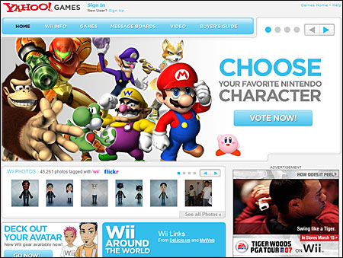
Teen (12-17) and Gen Y (18-34)
Source: The Pew Research Center's Internet & American Life Project (2009) - Generations Online
Notes:
Note: Refer to the Corresponding Tables Reference Sheet.
Source: http://www.pewinternet.org/~/media//Files/Reports/2009/PIP_Generations_2009.pdf
This slide serves as an introduction to the statistics displayed in Slides 10. Not only is the level of adoption different across generations, but the way each generations uses the internet differs. Here we see that younger generations use the internet for entertainment and networking. This should begin to stir thoughts for the participants. As they consider what might be appropriate for their online presence, it is worth noting that a younger audience is likely to embrace – and expect – videos, blogs and opportunities to network.

Slide 10
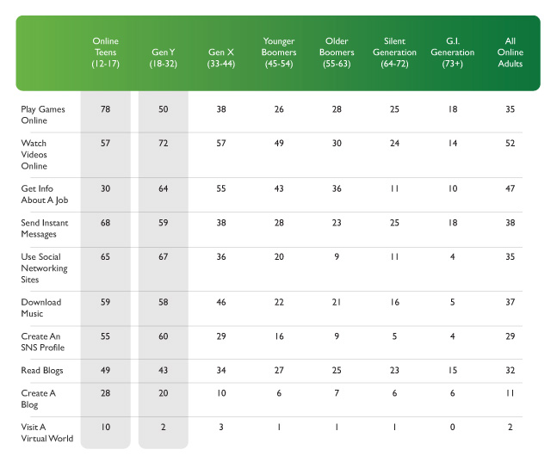
Teen and Gen Y
Source: The Pew Research Center's Internet & American Life Project (2009) - Generations Online
Notes:
Source: http://www.pewinternet.org/~/media//Files/Reports/2009/PIP_Generations_2009.pdf
Not only is the level of adoption different across generations, but the way each generations uses the internet differs. Here we see that younger generations use the internet for entertainment and networking. This should begin to stir thoughts for the participants. As they consider what might be appropriate for their online presence, it is worth noting that a younger audience is likely to embrace – and expect – videos, blogs and opportunities to network.

Slide 11
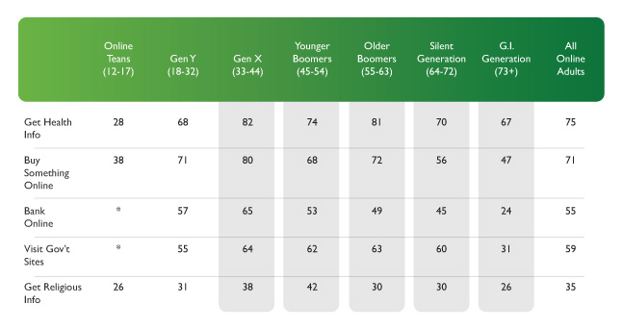
GEN X AND OLDER
Source: The Pew Research Center's Internet & American Life Project (2009) - Generations Online
Notes:
Source: http://www.pewinternet.org/~/media//Files/Reports/2009/PIP_Generations_2009.pdf
In contrast, older generations predominately use the internet to seek out information (health, government, religion, etc.), purchase goods and access services. Again, this indicates that an older audience might be more apt to embrace similar offerings on the community’s site.

Slide 12
HOW DO YOU GET THE WORD OUT?
Currently, how do people find out about your town/county:
Residents
Business owners
Visitors
Notes:
This exercise should take less than five minutes. Facilitator should work with the group to assemble a list of general ways that the community connects with these audiences. Some concrete examples are useful but the group should avoid getting bogged down in the details. Examples should include online and offline sources of information. If the participants concentrate too heavily on one or the other, the facilitator should ensure that they consider all of the different ways that communities deliver information (newspaper, websites, pamphlets, newsletters, billboards, advertisements, public service announcements, radio and television, etc.).

Slide 13
IS YOUR COMMUNITY ‘ONLINE’ ALREADY?
What information will I find?
Where will I find information?
Who is the audience?
Notes:
As with Slide 10, this is exercise provides an opportunity for the participants to step back and consider what is currently available online. This can be accomplished through brainstorming or, even better, actually performing a variety of searches using a search engine to see what different search strings result in what sites being listed. Though this will require an internet connection, it is an extremely effective way for the group to see what this hypothetical person would see when trying to learn more about the community.

Slide 14
COMMON WEBSITE ISSUES
Created/hosted by 3rd party
Owned by 3rd party
Content inadequate
Static for long periods of time
Poor design
Not representative
Lack of branding and marketing
Notes:
This slide lists issues that are commonly faced by community websites.
The first two involve the community’s ability to access and update content or design. The 3rd party in question has too much power and sway over the life of your site. This limits the sustainability of your site and your ability to meet the needs of your audience.
If you content is inadequate, how will you “beef it up”? Is there someone available that can crunch the statistics or tell your community’s story in an efficient AND engaging way? IS your audience finding what they are looking for or is the site of limited usefulness?
If content stays static for a long period of time, people will lose interest and stop visiting your site. Also, to people from outside of your community, an old site can be the difference between visiting or starting a news business in your community or not simply because of the message it conveys. Same for poor design. Remember, the design and content speaks volumes about your community.
If your site is not representative of the community then people are getting an incomplete picture and biased view.
Lastly, if your site is not integrated with a branding and marketing strategy, it will be difficult for the site to be effective.

Slide 15
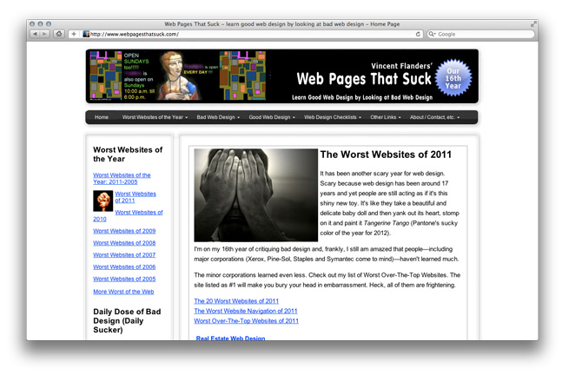
…DO YOUR CURRENT WEBSITES BELONG HERE?
Notes:
This site, despite it’s distasteful name, actually has some very useful information. Several community-oriented sites are listed here (for example, search “County” in the upper right hand corner). The language is brash but many of the helpful hints and suggestions are worth considering.
As another opportunity for experiential learning, have the team look up websites for their state, county, city and/or school district using: http://sunshinereview.org/index.php/Main_Page . While not definitive and certainly with drawbacks, the Sunshine Review can serve as a launching point for discussion about what should be on the community’s site. Special attention should be given to the criteria being used by the reviewers and whether these are applicable to the community’s situation given their current goals. For more information about the Sunshine Review, please see: http://sunshinereview.org/index.php/Sunshine_Review .

Slide 16
POTENTIAL BENEFITS OF YOUR COMMUNITY’S ONLINE PRESENCE
Greater connectivity among community members
Foster civic engagement
Support ‘buy local’
Parent-Teacher-Student relationship
Increase participation in community activities
24/7 access to potential employers, residents, visitors
Increased government service efficiency and access
Notes:
Having an online presence is not necessarily for everyone and every community. However, the potential benefits, along with the potential drawbacks, should be considered before moving forward. This slide highlights some of the potential benefits of having an online presence.
Regarding the first bullet, enhancing connectivity may seem - at first glance - to be of limited use for rural areas. Given their low populations and archetypical “small town, everyone knows each others business” some might balk at needing to address the issue. However, even in the smallest of towns, connectivity problems exist. For example: finding new leaders and engaging the public to participate in government activities (civic engagement), connecting consumers with local producers and purveyors of goods/services (‘buy local’), strengthening the linkage between student/teacher/parent and promoting volunteerism and community participation. Are there other examples from the community where connectivity has been a struggle? Has the internet filled the gap in any way thus far?
Small communities are often not on the interstate (they may not even have the oft-lamented “four-lane”!) or other well beaten paths. Getting noticed by many and often can be challenging. An online presence offer the opportunity for the community to always be “on”.
Lastly, government agencies in rural areas often struggle due to the lack of full time staff. An online presence can make government services more accessible and efficient if the appropriate information and services are available online. However, there are trade-offs such as cost and internet adoption in areas where internet services are limited.

Slide 17
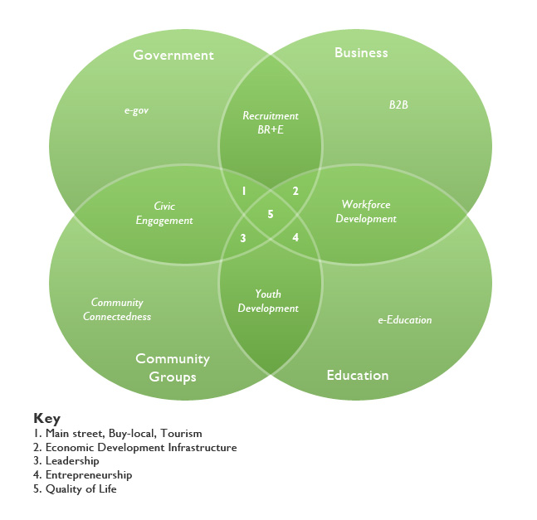
APPLICATION AREAS
Notes:
This slide represents the “conceptual model” for the curriculum. When thinking about an community’s online presence, their site will likely fall into one or more of these categories. For simplicity, we suppose that the community is composed of four main entities: local government, business sector, education (potentially P-16 or Pre-Kindergarten through undergraduate if a local college or university is present) and a variety of community groups (non-profits, religious groups, etc.). Each of these, on their own, may have different online objectives or roles. For Government, there are many examples of “e-gov”. These range from small-scale sites that provide information to constituents all the way to full service sites that allow citizens to conduct much of the government –oriented business (building permits, pay taxes, etc.) online. Business to Business (B2B) is the most common use of e-commerce. These are transactions that occur between businesses as they offer goods and services to one another. Education, in many rural areas, was the first entry point of the internet and they may represent one of the few long term examples of an online presence in a community. Beyond providing information about the school and announcements about upcoming events, the internet is now being used by educational institutions to offer instruction (distance education) and make a stronger connection between the student, teacher, parent and the community at large.
Obviously, these entities do not exist in a vacuum. Their activities overlap and they provide inputs into many different activities. For example, the Government and Business overlap is commonly found in Business Retention and Expansion programs where local government, interested in maintaining their tax-base and ensuring employment of their citizens, keep in close contact with local businesses to ensure that their needs are being met.

Slide 18
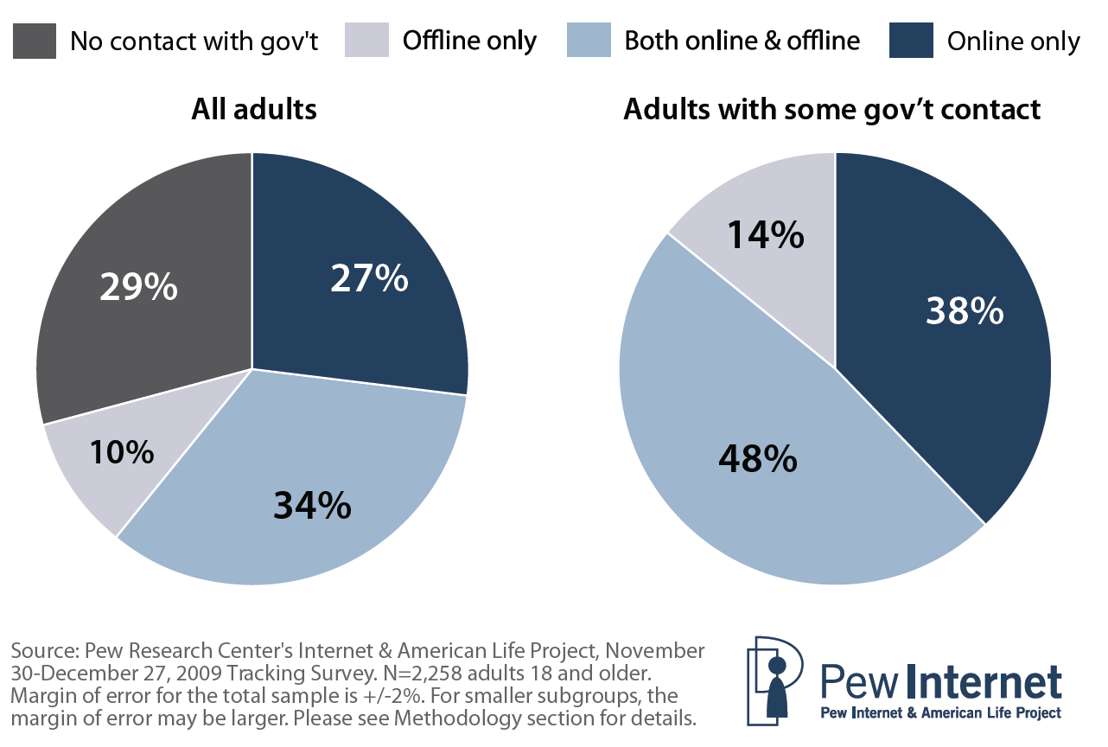
E-GOV: Last 12 Months
Source: The Pew Research Center's Internet & American Life Project (2010) - Government Online
Notes:
Source: http://www.pewinternet.org/~/media//Files/Reports/2010/PIP_Government_Online_2010.pdf
These charts show the proportion of adults in each group who have contacted their local, state, or federal government using online, offline, or a combination of online and offline methods in the last twelve months.
It is interesting to note that of all adults in the survey, 71% made some contact with local, state or federal government using offline, online or a combination of means. Of those adults that contacted government in some way, the majority are using both offline and online means. However, 38% of the adults that contacted their government only used online channels. This trend will likely continue upwards with more and more individuals taking advantage of e-gov offerings at the local, state and federal level.

Slide 19
E-GOV ACTIVITIES
Finding information :
Public policy or issue
Services an agency provides
Documents or statistics
Recreation/tourist information
Health or safety issue
Downloading forms
Applying for/ Renewing:
Driver’s license or auto registration
Government benefits
Government jobs
Recreational license
Paying a Fine
Source:
The Pew Online
Notes:
Source: http://www.pewinternet.org/~/media//Files/Reports/2010/PIP_Government_Online_2010.pdf
This slide provides a list of potential opportunities for your government-oriented website. While not all of these may be applicable to your situation, consider what is listed here and what other options your group would like to see made available to your community.
government forms

Slide 20
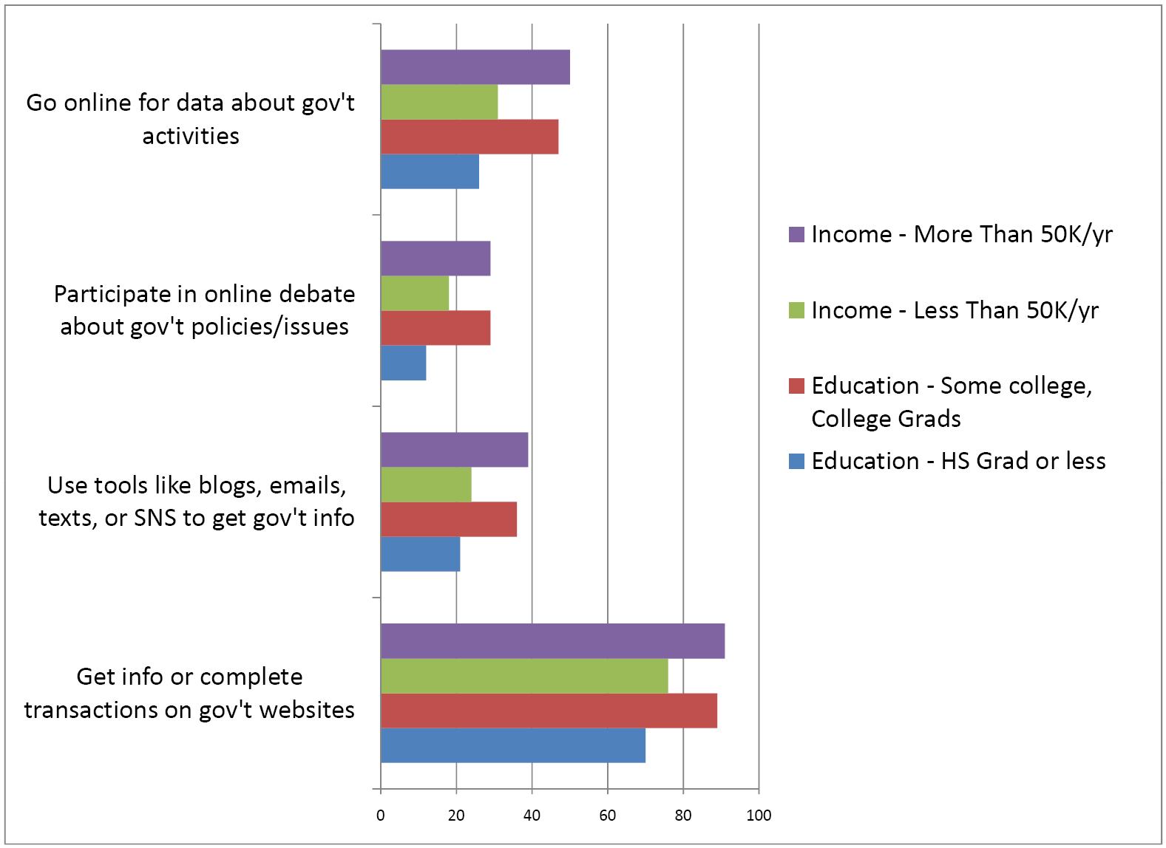
E-GOV - USERS
Source: The Pew Research Center's Internet & American Life Project (2010) - Government Online
Notes:
Source: http://www.pewinternet.org/~/media//Files/Reports/2010/PIP_Government_Online_2010.pdf
The Pew Research Center also examined what activities people commonly engage in when they interface with their government online. Interestingly, people with relatively higher education or higher incomes are more likely to engage in the four activities listed on the figure. Take a moment to go through each activity and discuss with the participants if they personally engage in these activities and determine if such options are currently available in the community.
Note: The numbers (0-100) on the X-axis represent the percent of respondents in each of the groups (by specific income or education level).

Slide 21
E-COMMERCE
In 2008, e-commerce accounted for $3.7 trillion in total sales!
Type | Sector | Percent of Total Sales | Percent of Total e-commerce
B2B | Manufacturing Shipments | 39.3% | 58.1%
B2B | Merchant Wholesale Trade Sales | 20.6% | 34.1%
B2C | Retail Trade Sales | 3.6% | 3.8%
B2C | Selected Services Revenue | 2.1% | 4.0%
 | Total | 16.5% | 100.0%
Source: US Census Bureau (2010) – E-Stats 2008: "Measuring the Electronic Economy"
Notes:
Source: US Census Bureau – E-Stats: Measuring the Electronic Economy - http://www.census.gov/econ/estats/
A summary of findings can be found at - http://www.census.gov/econ/estats/2008/2008reportfinal.pdf
Tables with information about specific sectors can be found at - http://www.census.gov/econ/estats/2008/all2008tables.html
E-Commerce is a major component of the American economy. Accounting for nearly 4 Trillion dollars in total sales. Interestingly, the vast majority (92%) of these sales take place between businesses (B2B). This leaves 8% or $265 Billion in sales between businesses and their customers (B2C). Not a paltry sum! Overall, e-commerce accounts for 16.5% of all sales in these four sectors.
Please note that in the first column of data, these percentages represent the proportion of total sales within that sector that were the result of e-commerce. The last column represents the share of each sector in total e-commerce sales. For example, e-commerce represents nearly 40% of all sales in the manufacturing sector and all of these sales are B2B. In addition, the manufacturing sector plays an important role in overall e-commerce, representing 58% of all e-commerce sales.
Why does this matter? Even if the businesses are not fully engaged in e-commerce, the trend nationally continues to move upward and the competitiveness of your community is at stake. Are there reasons why e-commerce hasn’t taken hold in your community? Given the importance of B2B, could it be that there is more e-commerce in your community than is generally known? Are there constraints that businesses may face in your community (broadband, transport, etc.)?

Slide 22
E-EDUCATION
School e-offering | Level |  | Population
 | Elementary | Secondary | City | Suburban | Town | Rural
Two-way conferencing | 25 | 45 | 24 | 28 | 29 | 36
Telecommunications | 21 | 28 | 18 | 26 | 26 | 21
Online student assessment | 72 | 71 | 73 | 72 | 71 | 72
Distance Ed. access for students | 34 | 65 | 35 | 37 | 44 | 52
Standardized assessment results and data for teachers | 88 | 83 | 91 | 86 | 85 | 85
Data for instructional planning at the school | 86 | 82 | 88 | 84 | 84 | 83
Online professional development | 60 | 57 | 61 | 58 | 60 | 58
High-quality digital content | 64 | 68 | 61 | 69 | 64 | 63
Source: National Center for Education Statistics (2010) - Educational Technology in U.S. Public Schools: Fall 2008
Notes:
National Center for Education Statistics: http://nces.ed.gov/
Source: http://nces.ed.gov/pubs2010/2010034.pdf
As we pointed out earlier, the Education sector in your community may have been one of the first institutions to embrace the internet. Oftentimes, the web sites for the school system are some of the oldest and most developed in rural communities. Adoption of these technologies by local educational institutions can come in a variety of ways. This table outlines a variety of ways and how adoption differs across instruction level and population density (with city being the most dense and rural the least).
What are some of the take home messages? Does there appear to be a higher adoption rate at the elementary or secondary level? Does population density have an effect? How well does this align with the current situation in your community?
One last thing to consider is the fact that, in many rural areas, schools often have several assets that could play a role in the development of your site:
Server space
IT personnel
24/7, secure Internet connectivity
Available and capable faculty and students in the area of web design

Slide 23
E-COMMUNITIES
Source: The Pew Research Center's Internet & American Life Project (2010) - Neighbors Online
Notes:
Source: http://www.pewinternet.org/~/media//Files/Reports/2010/PIP-Neighbors-Online.pdf
Review the statistics below that correspond to the bar graph.
22% of all adults (28% of internet users) signed up to receive alerts about local issues via email or text messaging
11% read a blog dealing with community issues
9% exchanged emails with neighbors about community issues
5% belong to a community email listserv
4% communicated with neighbors by text messaging
4% joined a social network site group connected to community issues
21% discussed community issues over the telephone
In contrast, 46% of Americans talked face-to-face with neighbors about community issues
How engaged is your community, or parts of your community, online? These data represent the findings of a national study. Notice that 67% of Americans rely primarily on conventional methods of engaging in their community. How does your community engage? What electronic methods are available to your community now?

Slide 24
MOVING FORWARD
Trends
What Already Exists
Now What?
Notes:
Now that we have examined some national trends and started a discussion what is available in our community…
…what is next?
First, let’s go through one example…

Slide 25
The Need: Case Study Tennessee 2008
Counties less than 50,000 had lower website quality scores.
Notes:
Let’s take a look at the situation in Tennessee.
A recent study in the state of Tennessee provides an interesting (and rare) look at status of community websites.
32 of the 95 counties did not have a website (mid 2008)
Half of the thirty-two had populations under 25,000.
Counties with populations under 50,000 had significantly lower website quality scores than those with higher populations
These results suggest that rural counties struggle with both the technical knowledge and time / manpower requirements to create and maintain a fully functional site.

Slide 26
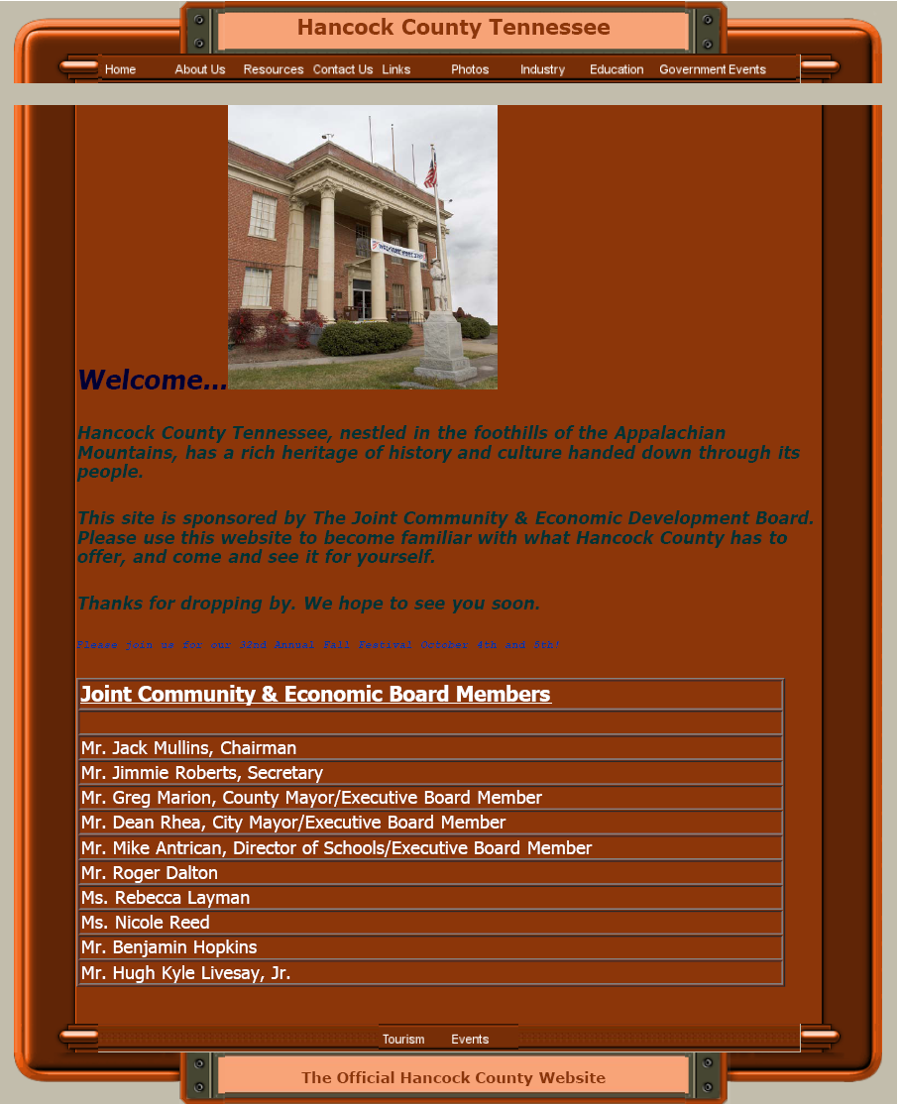
HANCOCK COUNTY, TN: THEN
POPULATION
6,733 persons
% chg (00-07): -0.7%
Pop. Density 30.3 persons/sq. mi.
INCOME
$15,795 per capita personal income
Median household income: $24, 375
Persons below poverty level: 30.8%
Notes:
Welcome to Hancock County, TN! Let’s take a look at their basic statistics and front page of their web site.
Obviously, Hancock County is very rural and there are many people that could use a helping hand. What do you think of their web site?
With very few resources, Hancock County developed their site with help from a local person who pursued web design as a hobby. The county’s Joint Economic and Community Development Board commissioned this person to create and maintain the web site. The designer obtained content from the Board but retained ownership of the site and served as the gatekeeper for updates. The site development process was not coordinated nor deliberate. The process only involved a few Board members. After the site launched, there was very little done to promote the site and no effort to acquire feedback from end users.

Slide 27
HANCOCK COUNTY, TN: NOW
Notes:
After several years, the local Extension office and other community members decided that the site needed some TLC. Actually, they decided that the whole site needed to be redone. They chose to emphasize economic development and civic engagement.
Armed with a few thousand dollars, a core group of dedicated volunteers, assistance from faculty at the University of Tennessee and faculty and two graduating seniors from Pellissippi State Community College’s Communications and Graphics Technology Department the new site is available at: http://www.hancockcountytn.com/ .
To get the job done, they hired someone from the community to put together all of the text (including soliciting text from county/city officials, gathering data, etc.). The students visited the community on several occasions and even went on a photo safari to obtain the necessary images. As the county had no branding pieces in place, a community contest was held to come up with a logo and phrase. The hand-drawn, winning logo design was adapted by the Department of Marketing and Communications in the University of Tennessee’s Institute of Agriculture.
Take a moment to stroll through the site. What do you like about the site? What would you change? What is missing?

Slide 28
SINCE THE LAUNCH
Sustainability issues
Updating content
Committee member turnstile
Marketing the site
Community acceptance
Responsiveness to inquiries
Quantifying impact, implementing changes
Notes:
While not perfect, the site seems to be serving Hancock County well. Since the introduction of the site, several issues persist.
Updating content – with no real successor to the former web designer (and the students graduated), finding a competent and affordable person in this small, rural county was challenging.
Committee member turnstile – Though dedicated, committee membership evolved over time (officials some times aren’t re-elected, other folks get re-directed, etc.). Engaging new members and maintaining the momentum of the site, long after launch, can be a problem.
Marketing the site – The site was promoted through newspapers, newsletters, other local sites, etc. However, institutionalizing the site can be challenging (URL on letterhead and business cards, increasing the number of crosslinks, etc.).
Community acceptance – Though the committee was relatively inclusive, not enough has been done to ensure that all community members feel ownership of the site.
Responsiveness to inquiries – An email was provided in case people has questions or concerns. Depending on the nature of your site, it can be difficult to identify one individual to serve as the “clearinghouse” of questions so they are answered appropriately and in a timely manner.
Quantifying impact, implementing changes – Using Google Analytics or another tool that will allow to “see” how the site is being used requires a bit of handholding and guidance at first. The importance of gathering this information and employing it to guide changes cannot be underemphasized.

Slide 29
WHAT IS ‘RIGHT’ FOR YOU?
Need to consider:
Budget constraints
Technical capacity
Redundancy
Ownership
Timeline
Notes:
With any site, you need to consider the following:
How much money and what resources do we have? Over what timespan?
What technical capacity to do we have, how much will it cost and what else do we need?
What other sites and resources are out there already? Is what we are proposing actually redundant or does it complement current offerings? BE HONEST!
Who will “own the site”? Too many sites (URL’s, files, etc.) are “owned” by the designers and not the content providers. Your community, your site.
What are our short (under a year), medium (1-2 years) and long term (3+ years) goals, objectives and action steps?

Slide 30
WHERE DO YOU GO FROM HERE?
Need to think about:
What will be the focus of proposed web site?
Who is the target audience?
Who will be involved in site development?
How will the site be marketed?
Which content will be delivered?
Where will the site be located?
When will the site be launched?
Notes:
These questions should be discussed, briefly, by the audience…
We will really dive into this in the next workshop!

Slide 31
MODULE 1: THE PROCESS AND CONTENT DEVELOPMENT
Developing site map and content
Common Components
Community
Government
Education
Business
Notes:
Module 1 centers around the process of developing your site including a site map and content. Developing the site map is the goal of Workshop B. Workshop C then focuses on the website’s components.

Slide 32
Common Community Website Components
Notes:
Remember out earlier discussion about this Venn Diagram. Have short discussion with the group and go around the room:
“Right now, if you had one dart and could throw it at this chart, where would you personally like to see the dart land? Why?”

Slide 33
MODULE 2: GETTING YOUR CONTENT ON THE WEB
Topics discussed:
Domain name registration
Hosting options
Typical costs
How to publish various types of content
Developer pros / cons
Marketing your site
Focus is on providing knowledge to
implement the tools discussed under Module 1
Notes:
Module Two has a combination of presentation and video based content. The overarching goal of Module 2 is to provide you with the technical knowhow to create your site, either by yourself or through hiring an outside designer.

Slide 34
THE PROCESS…
Workshop 1 (2 hrs): Background information that will assist with the planning and implementation of the website
Workshop 2 (daylong): As a committee, go over all aspects of the web site project and begin to develop the site map
Workshop 3 (2 hrs): Review content appropriate to your target audience and finalize the site map
Workshop 4 (1.5 hrs): Consider basics on building a website: ownership, domain names, hosting, working with a developer, and what software program to use
Workshop 5 (2 hrs): Understand how search engines work and how using analytics can help improve a website
Workshop 6 (self-paced): Video tutorials on website creation tools if the community is creating its own site
Curriculum Finale: Community celebration to unveil the new website
Notes:
Discuss with the participants the process they will undergo over the upcoming weeks/months. Be sure they understand the time commitment and again reiterate that the reward will be worth the efforts!

Slide 35
HOMEWORK - PARTICIPATION
Engage appropriate cross-section of community members based on goals and objectives of proposed site
Select committee members (<10) who will develop site map, content, buy-in and commit to the entire project
Designate one person as the “point of contact” or facilitator
Seek input from community as necessary
Notes:
Developing a community-oriented website is not the job of one. Having said that, it is not the job of many, either. There can be “too many cooks in the kitchen”. Using a committee structure that includes between 6-10 people allows for representation on behalf of different sectors/groups, enables sub-committees and is the first step towards buy-in from the intended audience (aka constituents, end users, customers, etc.) as they should be represented.
The appropriate cross-section will differ for every community and within the community, depending on the goals and objectives of the site. A successful committee will be diverse, dedicated and deliberative. Why? A diverse group that represents a wide range of relevant interests will help the committee address potential concerns. Since this process can take several months or more, the committee members must be dedicated to seeing the project through. As with any project, maintaining momentum can be a challenge. Lastly, the group should be willing and able to discuss ideas openly and thoughtfully. This deliberative group should seek to build consensus throughout the entire process.
While the committee will be made of some, the entire committee should be facilitated by one. Rather than domineering, this person should serve as the point person regarding contact with outside technical assistance providers and the community at large. The Chairperson should be someone that is very organized, an adept facilitator and willing to shoulder the burden of seeing all aspects of the process through to the end and beyond.
Lastly, the committee should seek input from the community in a variety of ways. For starters, gauging the community’s needs and preferences will go a long way towards creating buy-in and securing traffic once the site is launched. This type of information can be obtained through focus groups, surveys and interviews. In addition, photos and other content can be obtained from the community. Contests can be held and the development and launch of the site promoted throughout.

