Slide 1
Gearing Up to LEAD
Session 2
Notes:
Instructions:
Have this slide up when people enter the room. As you begin, welcome people and explain to participants that you will be leading introductions in just a few minutes, but for now want to provide an overview of LEAD.
Time: 1 minute
Materials: none

Slide 2
What is LEAD?
Leaders – Focuses on building and strengthening leadership skills in the community
Economic – Concentrates on opportunities to enhance the local economy
Alliance – Fosters the development of new partnerships within the community
Development – Gets things done!
Notes:
Instructions:
Review the next three slides for the sake of newcomers to the group.
Building off the LEAD Acronym, discuss the purpose of LEAD.
Ultimately, LEAD is an opportunity for the community to bring together a larger set of partners to focus on 1-3 opportunities for action that can serve to strengthen the community/region for future economic growth.
Time: 5 minutes
Materials: None

Slide 3
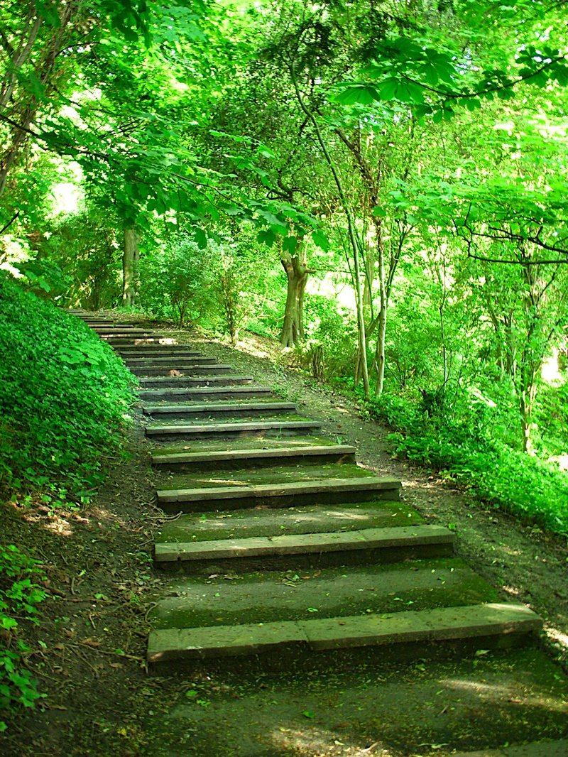
What Are the Steps of LEAD
Identify members for a strong team
Explore the community’s interests and concerns
Generate a plan of action to pursue at least one opportunity
Take action to accomplish the plan
Notes:
Instructions:
Describe the four basic steps to LEAD.
Explain that today’s meeting is a result of the first step in which key LEAD team members were identified and invited to join today’s discussion.
The team’s second task will be to host a civic forum to explore the community’s interests and concerns. This will be discussed in more detail later in this session.
From these, the community’s top opportunities will be identified and a plan of action will be developed to guide future work.
Finally, and most importantly, the team will take action on the plan.
Time: 5 minutes
Materials: none

Slide 4
Goals of the LEAD Team
Build and expand relationships
Explore ways to build the economy through expanded partnerships
Establish a plan of action
Implement
Notes:
Instructions
Working together, the LEAD Team will aim toward these four goals (see slide):
Build and expand relationships that may help strengthen the economic development efforts.
Explore ways to build the economy through expanded partnerships. In today’s economy, successful communities/regions use the strengths of innovative partners to strengthen economic efforts.
Establish a plan of action on a small set (possibly only one) opportunity that can pave the way for future economic growth.
Implement the plan – many plans fall short of this final step. However, by selecting a small, focal point for the work, the team can generate positive movement.
Time: 5 minutes
Materials: None

Slide 5
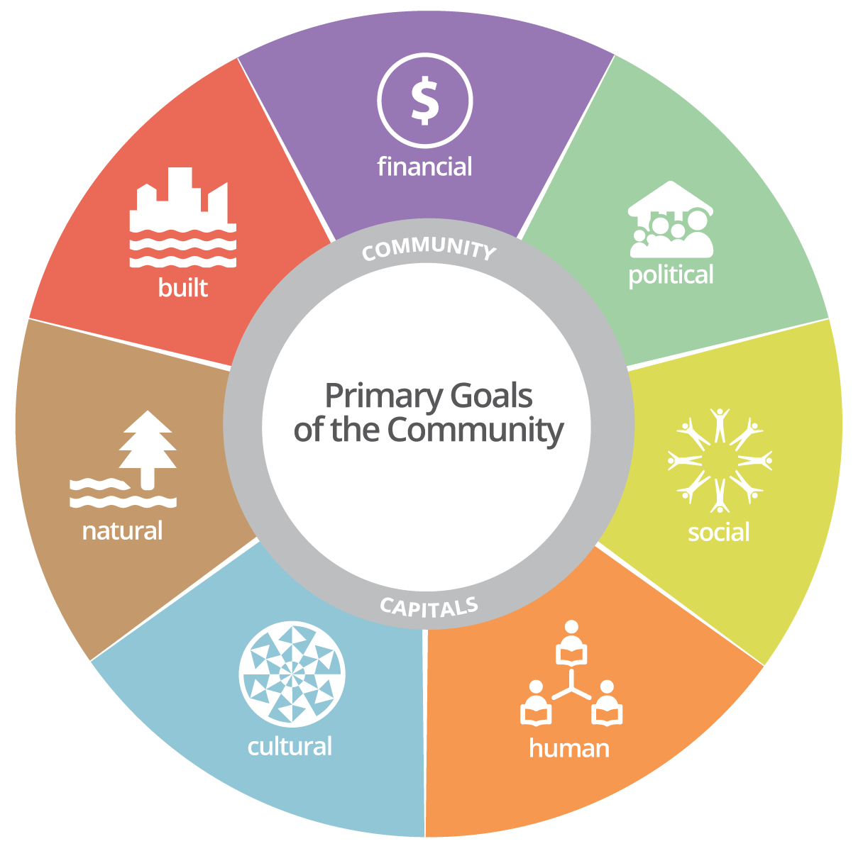
Who is at the Table?
Vibrant and
Economically
Healthy Places
Source: Chart developed by the Purdue Center for Regional Development
Notes:
Instructions: Use the Community Capitals Framework to lead the group introductions and to help newcomers understand the framework in real time.
Briefly explain that the diagram depicts the seven Community Capitals: Natural, Cultural, Human, Social, Political, Financial and Built. Strong and resilient regions are ones that have worked to build and sustain these seven community capitals.
Distribute the handout titled, ‘Promoting Vitality and Sustainability: The Community Capitals Framework’ and have participants follow along as you briefly discuss the different capitals. (Draw attention to page 5 of the document). The article provides participants with more detailed information on each capital, including examples of each type.
Briefly define the capitals and ensure that all have a good understanding before moving forward.
Once the capitals are reviewed, begin the introduction process. Prior to the activity, place the separate emblems (see coaches’ packet) on flip chart pages around the room using one emblem on one chart page (seven total chart pages). Ask individuals to go stand at the chart that best represents the way that they or their organization contributes to the capitals. (If someone sees a connection to more than one, ask them to pick one for now.)
In groups around the capital selected, ask participants to list the resources they/their organizations have that contribute to building that capital.
Going group by group, ask participants to introduce themselves and tell how they/their organizations contribute to the capital.
Once introductions are complete, ask if any of the capitals are underrepresented in the group, or if obvious partners are missing from any one group. Note these at the bottom of each chart paper as potential future partners.
Materials:
Handout: Promoting Community Vitality and Sustainability: The Community Capitals Framework
Capitals emblems on chart paper
Markers
Time: 30 minutes

Slide 6
Spiraling Up
Capitals tend to build upon each other.
Building one leads to building another.
Together the community is strengthened.
Notes:
Instructions:
Explain the “spiraling up” effect that happens among the various community capitals as a way of reinforcing the importance of having all capitals represented. Make the three points on the slide.
Ask participants if they can think of any examples where they have seen that occur (or where it might occur) within their community.
If no one has ideas, be prepared to ask prompts or give an example from your own experience.
Possible prompts:
Imagine that human capital (individual skills or abilities) were improved in this community. What other capitals might be built as a result? (possible answers – financial as people qualified for better jobs; social as the learners may now be connected to more people through the process, etc.)
Frame other similar questions as needed to help participants understand the intricate connections.
Time: 5 minutes
Materials: None

Slide 7
Collaboration Math
1
1
3
The whole is greater than the sum of the parts.
Notes:
Instructions:
This “collaboration math” is a simple way to illustrate how working together across capitals with the spiraling up that occurs results in more than by working individually.
Time: 1 minute
Materials: none

Slide 8
Civic Forum: Why it matters
Notes:
Instructions:
This slide makes a transition for planning for the civic forum, which is the team’s next task.
Briefly explain what a civic forum is: a process by which community members from all walks of life help shape the course of the planning process.
Some may not understand the value of the forum. The next slide guides a brief discussion on the topic.
Time: 1 minute
Materials: none

Slide 9
Finding the Sweet Spot
Notes:
Instructions: On a tennis racket is a place called the “sweet spot.” It is the place on the racket where the player can hit the ball to get the most energy with the least amount of effort. Communities have the same kind of sweet spot.
Time: 1 minute
Materials: none

Slide 10
Finding the Dialogue Sweet Spot
Publically Acceptable
Financially
Viable
Scientifically Compatible
Technically Feasible
Environmentally Responsible
Notes:
Instructions: Explain the sweet spot concept depicted in the diagram above. Note that communities have a variety of interlaced components, all of which matter and help to shape the choices within a community. But like the tennis racket, there is a “sweet spot” that helps maximize power and minimize effort through combined resources and support. Some of these interacting forces include:
What is environmentally responsible – does not destroy the natural resources available to a community
Technically feasible – actually can be done, from a technical standpoint
Scientifically compatible – considers the data and scientific input of the situation
Financially viable – stays within the confines of what the community can afford
Publically acceptable – honors the values, concerns, and interests of the people that live within the community.
Often planning considers a few of these circles, but may disregard others. The “sweet spot” though, looks for the overlap of what works for each of these components together. That interconnection of interests gives the community the most power to move the initiative toward success.
Time: 5 minutes
Materials: none

Slide 11
Who to Invite
Notes:
Instructions:
During the next few minutes, participants need to develop a list of people and groups to invite to the civic forum. Below (and represented on the slide) are a few ideas to get them started. However, the point is to invite as many people from as diverse a perspective as possible to ensure that plans moving forward are very reflective of the community.
Suggested invitation list includes (but not limited to):
Industry and financial leaders
Representatives of faith-based organizations
Entrepreneurs/small business leaders
County Extension Service personnel
State and federal Congressional representatives or staff
Local and regional government representatives
Minority and women-owned business owners
Chamber of Commerce, economic development, and/or tourism organizations
Workforce Development Board representatives from the area
Educational leaders and organizations
Nonprofit, voluntary and civic-minded organizations
Community foundations
Rural cooperatives
Consider, too, how to reach multi-generations, different ethnic and racial groups, varying socio-economic sectors.
Using a flipchart page, generate a list of people, organizations, groups that need to receive an invitation.
Time: 15 minutes
Materials: Flip chart and markers

Slide 12
How to Invite
Specific individuals to invite
Getting the word out to a broader audience
Using media and social media
One Size DOES NOT Fit All
Notes:
Instructions: Using the list just generated, form an invitation strategy. A few guiding thoughts are on the screen. Ultimately, the team needs to determine exactly how to reach out to each of the groups/individuals identified. For each listing, have the group consider the best way to reach that person/group, keeping in mind that no one strategy will work for all groups. For example, while a newspaper advertisement may be a great strategy to reach some sectors of the community, chances are very high that it will not reach them all. Likewise, social media might get attention for some, while others are not engaged. And keep in mind that face-to-face invitations are always better than broad stroke approaches. So encourage the group to consider the right strategies for each group.
Once the strategies are identified, recruit individuals to take ownership of each strategy, whether these are one-on-one contacts (visits, phone calls, etc.) or broad approaches such as posting in the newspaper or social media. Get commitments to cover all aspects.
Time: 10 minutes
Materials: Flip chart list from previous slide and marker to record commitments.

Slide 13
Getting Ready
Where?
When?
How?
Notes:
Instructions:
Discuss these key questions around the civic forum. Consider the guiding questions below. Refer to instructions in the coaches’ guide for the details of these questions, but ensure the local participants take ownership of the steps below and others they may identify.
Where should we host the forum?
Where are people comfortable meeting?
Where can we set up round tables for 6-10 people each?
Where can people get to easily?
Who will take responsibility for securing the location?
When should we host the forum?
When during a normal week are people most likely to come considering your invitation list? Work day? Evenings? Weekends?
When are there big events in the community that might compete for attendance?
How do we prepare for the forum?
Who can manage registration?
Who can manage sign-ins?
Who can take responsibility for gathering the notes from the forum and typing them (they will be on flip charts)
Who can provide a welcome?
Time: 10 minutes
Materials: none

Slide 14
Next Steps
Prepare for the Civic Forum
Review the meeting schedule
Other steps?
Notes:
Instructions:
This slide provides an overview of next steps. Make sure the group is clear on the next meeting date/time.
Time: 5 minutes
Materials: none

Slide 15
Notes:
Instructions: Insert your state logos and coaches’ contact information on this slide.

