Slide 1
Building Disaster-Resilient Places
STEP TWO – Understanding the Situation
Notes:
Display the Welcome Slide so participants see it when they enter the room.
Welcome participants and allow time for introductions if participants are not already acquainted.
Warm up:
Ask each person to share the following information:
Name (If they are not already acquainted)
The first thing that comes to mind when you hear the word resilient (tell them to name something in one or two words – fast)
(Alternate opener – Name one thing that bounces.)
Introduce today’s session.

Slide 2
A Review of What is Involved
Step 1: Form a Collaborative Planning Team
Step 2: Understand the Situation
Step 3: Determine Goals & Actions
Step 4: Plan Development
Step 5: Plan Preparation, Review, & Approval
Step 6: Plan Implementation & Maintenance
Step 1: Form a Collaborative Planning Team
Step 2: Understand the Situation
Step 3: Determine Goals & Actions
Step 4: Develop the Plan
Step 5: Prepare, Review, & Approve the Plan
Step 6: Implement & Maintain the Plan
Notes:
As discussed in Step One, the ReadyCommunity process follows six basic steps as outlined in CPG 101 and shown here.
Today we are beginning our work on Step Two: Understanding the Situation.

Slide 3
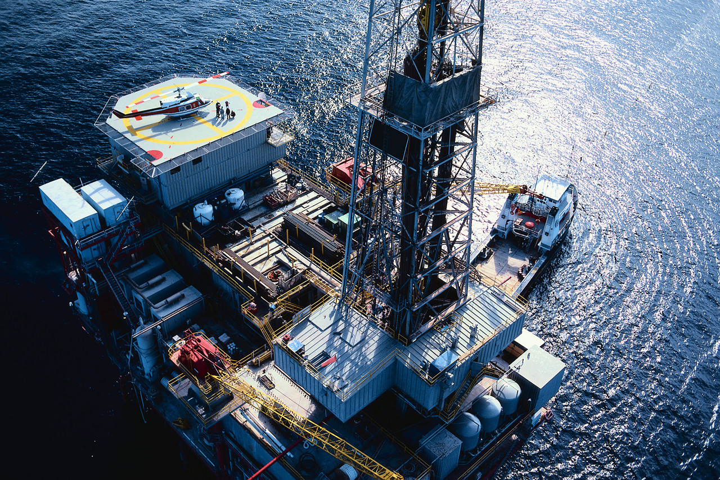
Key Words Defined
According to FEMA:
Vulnerability – Living in the way of something that poses a hazard (a flood plain)
Disadvantaged – Do not have the resources to respond to a hazard or disaster.
Notes:
According to FEMA:
Vulnerability refers to people living in the way of something that poses a hazard (a flood plain). So, for example, a person is vulnerable to flooding if they live in a low lying area in a flood zone.
Disadvantaged is the term used to describe someone that does not have the resources to respond to a hazard or disaster. For example, someone might live on the coast and need to evacuate because of a hurricane, but does not have transportation.
A person can be both vulnerable to disasters AND disadvantaged.

Slide 4
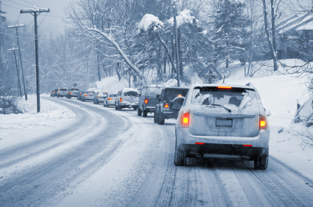
Hazards and Disasters in Your Community
Draw a disaster timeline going as far back as you can remember.
Identify:
Hazards are you likely to face in your community
Source: natural or built (man-made)
Rank by frequency and severity of risk
Notes:
Activity
This activity requires participants to create a disaster timeline.
Groups are to use the brown paper on the wall to develop a timeline of disasters experienced in their community.
Participants will have 10 – 15 minutes to develop a disaster timeline going back as far as they can remember.
Have the group identify the elements listed on the slide:
What hazards are you likely to encounter in your community? List these hazards.
Are these hazards related to the natural environment or the built environment (man-made)?
How would you rank these hazards according to frequency and severity of risk?
Note to facilitator: As the group explains their disaster history, list each disaster on the flip chart.
Keep the timeline up on the wall. Participants will use this information later in the vulnerability assessment.
Handout 1 – After doing the activity, have participants write the disasters on the handout and rank each event. This will help them to see what events are most likely and most catastrophic so they can plan accordingly.

Slide 5
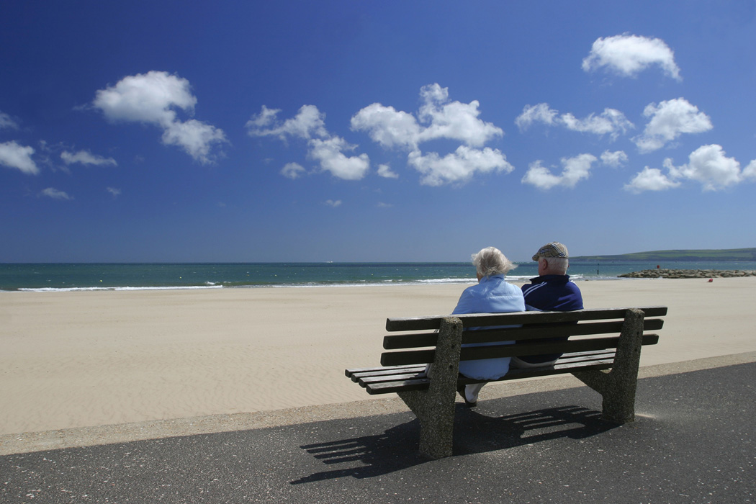
Vulnerability and Resilience
Hazards
+
Community Vulnerability
=
Impacts
Notes:
Not everyone in a community is affected equally by disasters. Pre-existing structures and conditions, including social structures and conditions, are often responsible for responses and impacts to disaster. Attention to vulnerability can reduce the impacts of disasters.
The impacts of hazards will vary according to how vulnerable communities are. For example, a community where there are a large number of poor residents who don’t have the means to evacuate as floodwaters rise, will be hit much harder than a community in which most of the residents can protect their property with sandbags and evacuate.

Slide 6
Vulnerability in Your Community
DISCUSSION:
Use Vulnerable Populations list from Step One.
Who else may be vulnerable in your community?
Why are these groups of people vulnerable?
Notes:
It is important to consider all members of the community, and to do that, we must consider the socially vulnerable.
Ask participants to review the list of Vulnerable Populations that they generated in Step One.
And then ask participants:
Who else may be vulnerable in the community?
Why are these groups of people vulnerable? (Some possible answers listed below.)
Economic conditions?
Social conditions?
Physical disabilities?
Special needs?
Add responses to the flip chart.

Slide 7
How Well Do You Know Your Community?
Demographics help:
Describe the community
Identify most disadvantaged populations during a disaster
Elements of the population to consider:
Race/Ethnicity
Age
Socioeconomic status
Family structure
Notes:
Inform the group that we are going to talk about community demographics.
Demographics help:
Note to coach: You will need to locate information for your community/ county following the directions on Handout 2 “Using Census.gov” before the session. Bring copies of this to the session.
Describe the community
Identify most disadvantaged populations during a disaster
Elements of the population’s demographics to consider:
Race/Ethnicity
Age
Socioeconomic status
Family structure
Demographics can tell us a great deal about the residents of our community and help ensure that all segments of the population are considered in the planning process.
To ensure all segments of the population are represented, it is important to consider race/ethnicity, age, socioeconomic status, and family structure.
Using Handout 2, show participants how to search for relevant data about your community.
Ask participants: What other information do you want to know about your community/county before beginning to plan? Answers will vary by community but should consider unique “at risk” populations for the community. Some elements might include:
Health characteristics
Family structure
Households in poverty
Institutional population
Housing conditions/structures
Literacy
Public transportation
Number of churches, public schools, emergency shelters, etc.
In county and out of county employment
Number of farms

Slide 8
Population Trends: Windows to the Future
Recent national trends show increasing:
Minority populations (especially Hispanics)
Elderly population
Number of economically disadvantaged
Single-parent households
One-person households
DISCUSSION:
Are these trends happening in your area?
Why might these national trends be important to your community as you form the planning team?
Notes:
Considering population trends in disaster preparedness is another way to ensure all populations of the community are included.
Discuss the national trends on the slide.
Recent national trends show increasing:
Minority populations (especially Hispanics)
Elderly populations
Number of economically disadvantaged
Single-parent households
One-person households
Ask participants:
Are these trends happening in your area?
Why might these national trends be important to your community as you form the planning team?
List the responses on the flip chart.

Slide 9
Putting it on a Map
Be sure to map:
Hazards
Vulnerable Populations
Important Places
At-risk Industries
Notes:
Materials: County (or town) map that shows the area with which the group is working
This is where participants will begin to map the community. Be sure to help them think about all of the things that should be included.
When completing the map of the community or county, be sure to include the following relevant places:
Hazards – are there any geographic areas of greater concern?
Flood Zones
Earthquake Faultlines
Landslide Zones
Wildfire Zones
Vulnerable populations – where do at-risk people live?
Special Needs
Elderly
Low-Income
Mobile Home Communities
Important Places – where people gather or might seek help.
Schools
Day Cares
Fire Stations (public and volunteer)
Police Stations
Hospitals
Nursing Homes/ Senior Centers
Churches
Food Banks
Institutions
Shelters
Humane Society
Large Employment Centers
At-risk Industries – where chemicals or other hazardous materials might cause a disaster or make an existing situation worse.
Chemical Plants
Factories

Slide 10
What Else?
What else do we need to know in order to plan effectively?
Notes:
Use this slide to get participants to take a moment to think about anything else they may need to know about in their community to plan effectively.
Use these questions to facilitate discussion:
What do we know?
What do we need to know?
Who or what are we forgetting?

Slide 11
When to Involve the Community
Two Touch-Points in the Planning Process
Step 1: Form a Collaborative Planning Team
Step 2: Understand the Situation
Step 3: Determine Goals & Actions
Step 4: Plan Development
Step 5: Plan Preparation, Review, & Approval
Step 6: Plan Implementation & Maintenance
Verify and strengthen information gathered
Communicate the plan. Involve the community in staying ready.
Notes:
This slide is repeated from Step One as a reminder that the community’s involvement is needed in two places.
This section discusses the first of these:
Verify and strengthen the information gathered.

Slide 12
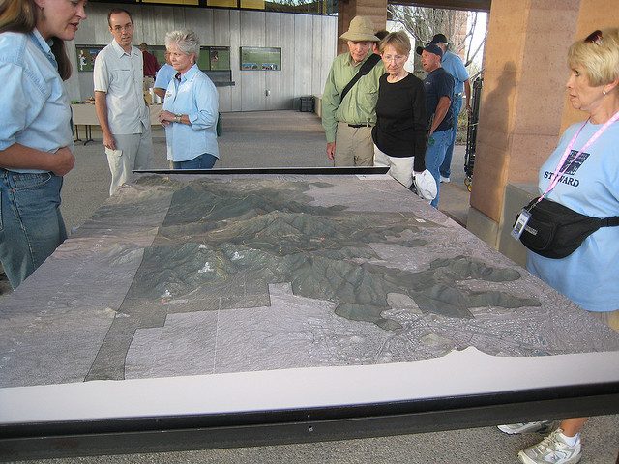
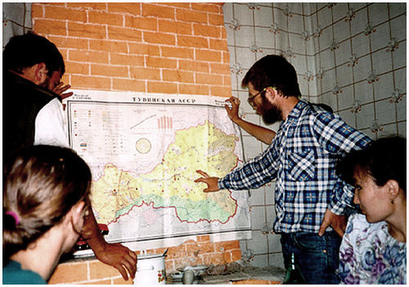
Preparing for the Community Ground-Truthing Open House
Complete gathering all the data that is important to your community
Prepare community maps
Determine locations, dates and times
Send invitations and announcements
Notes:
This slide gives a brief overview of preparing for the Open House. Greater detail is provided in Handout 6 – Ground-Truthing Open House Guide. The information on Handout 3 will be used to prepare the stations for the event, including the community maps that will be used.
Complete all data gathering that is important to your community
Prepare community maps
Determine locations, dates, and times
Send invitations and announcements
Be sure that locations, dates, and times are convenient for a wide range of community members. You may even want to consider hosting the event in multiple locations, dates, and times.

Slide 13
Typical Open House Structure
Station
Station
Station
Welcome Table
Refreshments
Enter
Comment Area
Station
Exit
Table
Station
Exit
Notes:
Note to facilitator: This basic Open House structure is used for both touch-points in the ReadyCommunity Process when the greater community involvement is needed.
Handout Three: Open House Fact Sheet
The information on this slide will help the group visualize the flow of the open house and assist them in making the logistical arrangements.
While the actual room setup can be adapted to the available meeting space, this diagram shows a typical structure, and includes:
A welcome table placed at the entrance to greet and orient guests as they arrive.
Stations placed around the room so that participants can easily move through them to review and add to the maps.
A final comment area placed near the exit table so that participants can post final comments and learn about how to stay involved as they leave.

Slide 14
Where is Everyone?
Where do people in your community…
Gather on a regular basis?
Visit at least once a week?
Feel comfortable meeting?
Answers to these questions guide:
The location of the open house
How to spread the word about the event
Notes:
Note to faciliator: Answers to these questions will give some insights into where to host the Open House event(s) and where to advertise. Some ideas are provided under each category to get the discussion started if needed.
This could be a good “get up and stretch” activity.
Place the three bullet points from the slide on charts around the room and ask people to visit each chart and write down their ideas.
This can be done informally or you can divide the group into three teams and have them visit each chart “round robin” style, asking each group to build on what the previous group has added.
As you consider hosting a ground-truthing open house, keep in mind the following:
Where do people in your community:
Gather on a regular basis? (Church, school, work place, civic clubs, other?)
Visit at least once a week? (Grocery store, beauty shop, gas stations, other?)
Feel comfortable meeting? (Community centers, local restaurants, park, other?)
Bring the group back together and then ask them to go back to their list of vulnerable populations and consider how those individuals would answer the above three questions. Their involvement is crucial to the planning process since they are the ones most likely to suffer. The team needs to reach out to them and ensure their participation in the Open House. Add that information to the flip charts if not already included.

Slide 15
After the Ground-Truthing
Examine the feedback from participants
Adjust the maps and other data
Provide feedback to the participants:
Thank them
Include a summary of how their input helped
Invite them to the next community session
Notes:
The planning team needs to set aside time to examine the feedback received from the Open House participants.
Use the feedback to adjust maps and other assessment data to ensure that planning rests on the most accurate assessment.
Assign a person or team to provide follow up to participants that requested it. At a minimum, a thank you postcard or email would be a nice gesture. This could also include a reminder of the next Open House session if the dates are set. If the dates are not set, at least a “coming soon” note would be in order.
Also include a summary of how the community input helped the planning process. This could be a few short summary bullets such as:
Helped identify additional homes vulnerable to flooding
Added details to the challenges faced in the last flood (or whatever events were on the timeline)
Helped us identify other neighborhoods that could be cut off in bad weather.

Slide 16
Questions & Discussion
Timeline
Next meeting date
“To do” list
Other discussion/questions
Notes:
Next meeting date
To do list
Other discussions/questions

Slide 17
Contact Information
Building Disaster-Resilient Places
Notes:
Thank participants for coming.
Be sure to include your contact information as well as the local point person’s contact information so that all participants can stay connected to the planning process.

