Slide 1
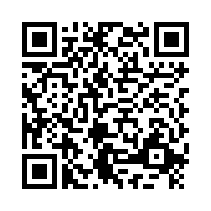
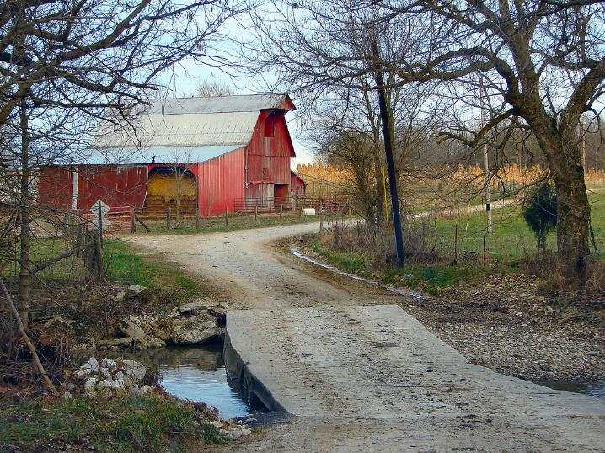
Community Workshop
Understanding
Heirs’ Property at the
Community Level
Workshop Evaluation
Please Scan the QR Code

