Slide 1


ZOOM
Participant Guide
Notes:
Instructions: Have this slide up as participants enter the room.
Materials: Computers with the Zoom application downloaded
Handouts: Copy of presentation slides
Time: 1 Minute
Photo by Thirdman: https://www.pexels.com/photo/a-group-of-people-having-a-discussion-while-looking-at-laptop-5256526/

Slide 2







Bridging the Digital Divide Partners
This project was funded by USDA NIFA award # 2022-68006-36496. The material is based upon work supported by the National Institute of Food and Agriculture, U.S. Department of Agriculture. Any opinions, findings, conclusions, or recommendations expressed in this publication are those of the author(s) and do not necessarily reflect the view of the U.S. Department of Agriculture.
Notes:
Instructions: The presenters of this session are asked to share this acknowledgment of the support provided by the National Institute of Food and Agriculture, U.S. Department of Agriculture
Materials: None
Handouts: None
Time: 1 Minute

Slide 3
Author Acknowledgement
We wish to thank the authors of this training material:
  Dr. Dorothy Brandon, Extension Specialist, Alabama A&M University
  Terrence Wolfork, Assistant Extension Administrator for Communications, Conferencing, and Technology, Fort Valley State University
  Dr. Roseanne Scammahorn, Extension/Research Associate III, Southern Rural Development Center
Notes:
Instructions: The presenters of this session are asked to share this acknowledgment of the work that went into this session.
Materials: None
Handouts: None
Time: 1 minute

Slide 4
Presenter Acknowledgement
Name
Title
Association
Email (Optional)
Phone (Optional)
Webpage (Optional)
Notes:
Instructions: Self introduction
Materials: None
Handouts: None
Time: 1 minute

Slide 5

Today’s Goals
Define what is ZOOM
Identify hardware needed
Identify the difference between joining meetings and hosting meetings
Joining a Zoom Meeting
Navigating a Zoom Meeting
Obtain a free Zoom account
Notes:
Instructions: Before jumping into the lesson, tell the clients what you expect for them to be able to do after the lesson.
This slide shows the six parts of this single lesson. Each of the six point will pulse in descending order so that you can highlight each point.
Materials: None
Handouts: None
Time: 1 Minute

Slide 6
Structure of Today’s Session
What is Zoom
What you need to get started
Join a Zoom meeting - Practice Exercise
Navigate Zoom - Practice Exercise
Open Zoom Account
Notes:
Instruction: State the structure of the lesson and briefly describe content that will be discussed under each heading. Ask for any questions or concerns before starting.
Materials: None
Handouts: None
Time: 2 minutes

Slide 7
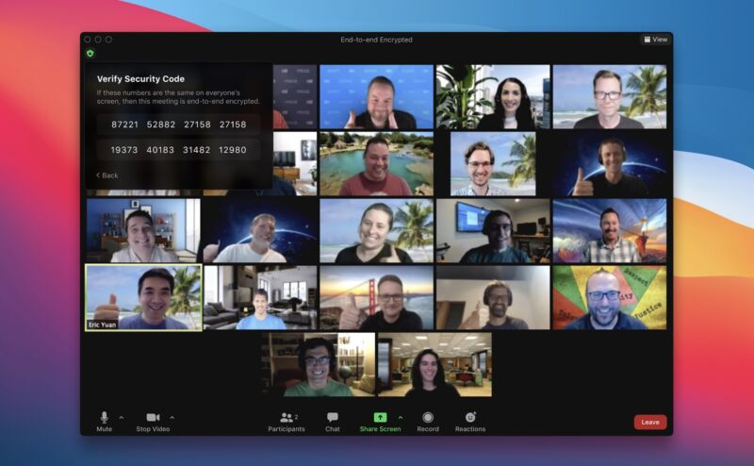
Introductions
Notes:
Instructions: Give time for participants to introduce themselves. You could also include a brief question for them to answer such as what motivated them to take this class? Encourage the 30 second rule: “In 30 seconds, share your name and answer…”
You may also consider using a light-hearted questions such as:
What was your first job?
What hobby takes up most of your free time?
How do you like your coffee?
Materials: None
Handouts: None
Time: 10 Minutes
Image by WikiImages from Pixabay

Slide 8
What is ZOOM?
Zoom is a cloud-based video communications app that allows you to set up virtual video and audio conferencing, webinars, live chats, screen-sharing, and other collaborative capabilities.
Notes:
Instructions: Talk with participants about the use of Skype, FaceTime, or even camcorders/VHS. Relate their responses to video conferencing (this activity is to move the clients from the known to the unknown). Once they understand the concept of video conferencing, ask them to name several tasks that can be performed by using a video conferencing.
What is Zoom? Zoom is a way to communicate and connect with others using video, audio, phone, and chat. It can be used professionally as a conferencing platform and personally for telehealth and socializing with friends and family.
Materials: None
Handouts: None
Time: 1 Minute

Slide 9




Hardware Needed
Mobile Device/Computer
Microphone/Headset
Speakers
Web Camera
Internet Access
Notes:
Instructions: Explain Zoom requires a few things for a successful meeting.
Materials: None
Handouts: None
Time: 1 minute
Photo by Firmbee.com on Unsplash
Photo by Markus Spiske on Unsplash

Slide 10

Hardware Needed
Mobile Device/Computer
Notes:
Instructions: A mobile device such as a tablet or phone or a computer is the primary hardware needed.
Materials: None
Handouts: None
Time: 1 minute
Photo by Firmbee.com on Unsplash
Photo by Markus Spiske on Unsplash
Image by PDPics from Pixabay

Slide 11



Hardware Needed
Microphone/Headset
Notes:
Instructions: You will also want a quality microphone or headset with a microphone built in.
Materials: None
Handouts: None
Time: 1 minute
Photo by Firmbee.com on Unsplash
Photo by Markus Spiske on Unsplash

Slide 12
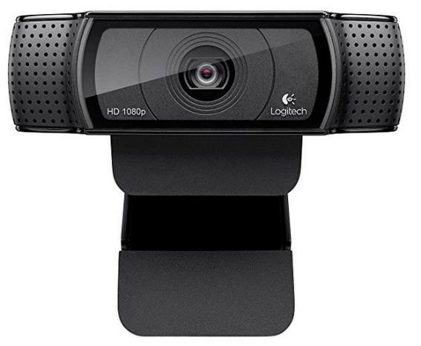


Hardware Needed
Speakers
Notes:
Instructions: Most devices have speakers already built in, but if not, you will need to select an external speaker, headset, or earbuds.
Materials: None
Handouts: None
Time: 1 minute
Photo by Firmbee.com on Unsplash
Photo by Markus Spiske on Unsplash
Image by PDPics from Pixabay

Slide 13

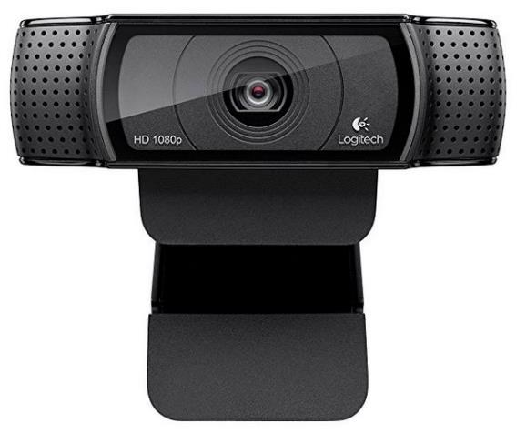

Hardware Needed
Web Camera
Notes:
Instructions: Again, most devices and computers come with a web camera already built in, but if not, a web camera can be easily installed to most devices.
Materials: None
Handouts: None
Time: 1 minute
Photo by Firmbee.com on Unsplash
Photo by Markus Spiske on Unsplash

Slide 14



Hardware Needed
Internet Access
Notes:
Instructions: Lastly, your device must be connected to the internet.
Materials: None
Handouts: None
Time: 1 minute
Photo by Firmbee.com on Unsplash
Photo by Markus Spiske on Unsplash

Slide 15
JOINING a meeting versus HOSTING a meeting
Joining (no account needed)
Hosting (account needed)
Link sent to you
Automatically join meeting using link or type in Meeting ID and Passcode
You are the participant in the meeting
You send link to others
Create the meeting
Copy and Send invitation (Meeting ID and Passcode)
You are the host of the meeting
Notes:
Instructions: Each header and point will fade in with a click.
-Today we are focusing on how to join a meeting. There is additional programming on how to host a meeting. However, for just a moment, let’s look at the key differences between joining a meeting and hosting a meeting.
- As a participant who is joining a scheduled meeting, you are not required to have a Zoom account. The host of the meeting will email, text, or send a calendar invite to give you the link required to join the meeting. You may also see a link on printed materials. Your invitation to join the meeting will also include a Meeting ID and Passcode for that specific meeting. As a participant, you will only have access to the program features that the host has given you permission to use.
- As a host you must have a Zoom account (free or subscription with a fee). A host will have the capabilities to set up the Zoom meeting, create the Meeting ID, Passcode, establish any features used for the meeting, and invite the participants. The host has the capability to control everything in the meeting.
Materials: None
Handouts: None
Time: 5 Minutes

Slide 16

How to JOIN a ZOOM meeting
Notes:
Instructions: Introduce the next section: How to join a meeting.
Materials: None
Handouts: None
Time: 1 minute
Image by Alexandra_Koch from Pixabay

Slide 17
How to JOIN a ZOOM meeting
Prerequisites for joining an online Zoom meeting
  Meeting ID number (typically 9-11 digits)
  Passcode
  “Join Zoom Meeting” link
Prerequisites for joining a Zoom meeting by telephone
  Meeting ID number (typically 9-11 digits)
  Passcode
  Teleconferencing phone number
Notes:
Instructions: Explain to the participants that you will first demonstrate how to perform the task as they observe, and later you will provide time for them to perform the task.
To join an online Zoom meeting there are three things that are needed:
Meeting ID – This is typically a 9 to11 digit number assigned to a specific meeting scheduled by the host.
Passcode – The passcode is a 1 to16 digit numeric code or a word/phrase that the host has created
A URL “Join Zoom Meeting” link
You also have the option to participate in Zoom meeting by calling in. Again, you will need a Meeting ID and passcode in addition to the Teleconferencing phone number.
Materials: None
Handouts: None
Time: 2 Minutes

Slide 18
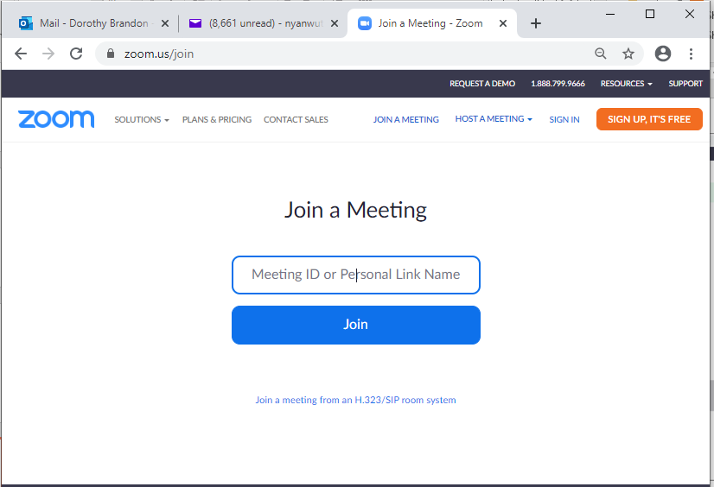





How to JOIN a ZOOM meeting
Browser (open)
  Type join.zoom.us (it changes to zoom.us/join)
  Type the Meeting ID or copy & paste the URL link here
  Click Join
Notes:
Instructions: (Blue arrows will teeter on key areas to highlight each point.)
There are three ways to join a Zoom meeting without having an account. You will use the Zoom invitation you were provided by the host. The first option, open your web browser, go to the webpage at join.zoom.us. There you will be asked to enter the Meeting ID. Once entered, click on join.
Materials: None
Handouts: None
Time: 2 Minutes

Slide 19
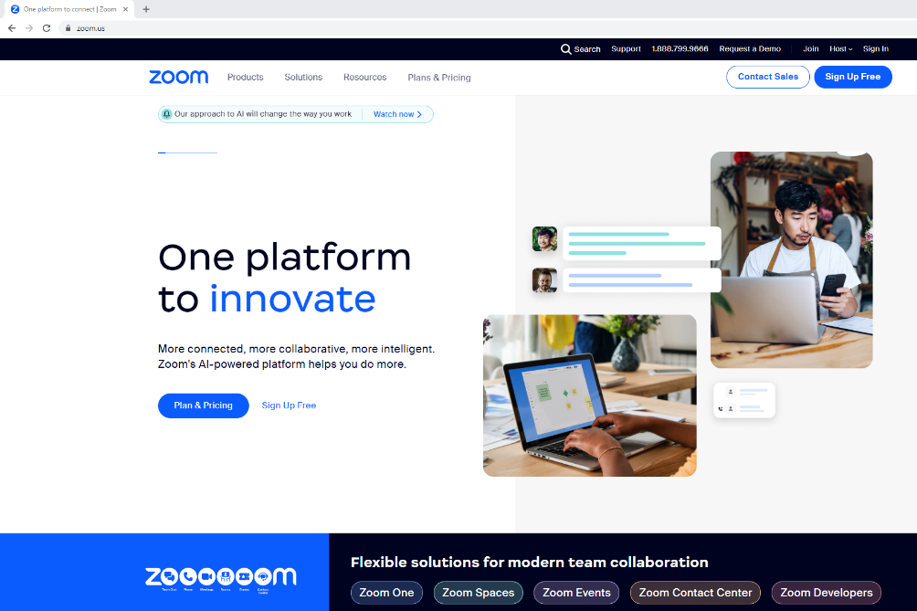
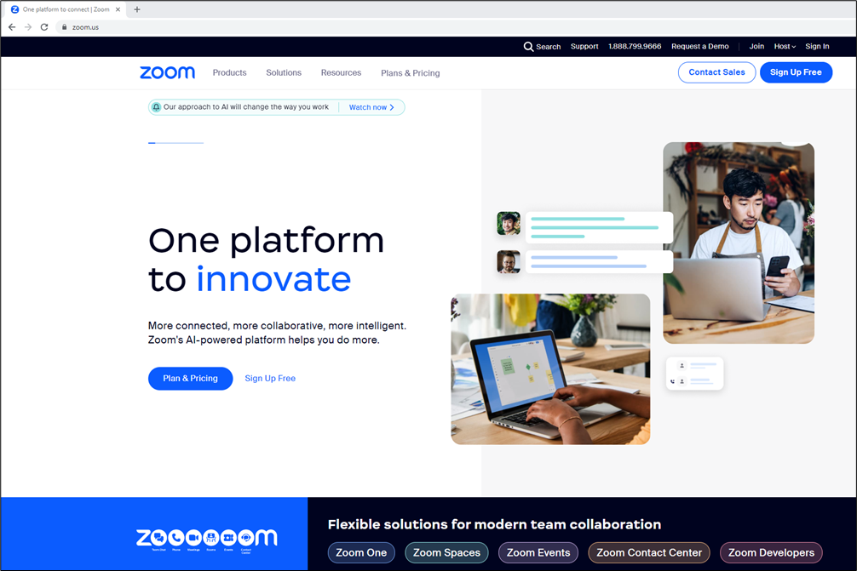
2. Browser (open)
  Type zoom.us
  Click Join
  Type the given Meeting ID or copy & paste URL link here
  Click Join
Notes:
Instructions: (Blue arrows will teeter on each click to highlight each point.)
Option two is to open your web browser and enter zoom.us. This will take you to Zoom’s home page. Click on “Join” in the upper right corner. You will be prompted to enter the Meeting ID provided by the host, and then click on “Join”.
Materials: None
Handouts: None
Time: 1 Minute

Slide 20
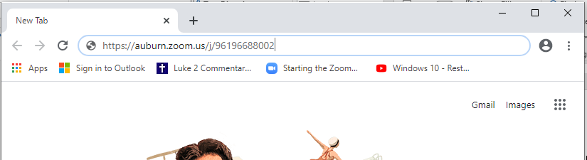
How to JOIN a ZOOM meeting via URL
Copy/Paste URL Link
Click on or Copy/Paste Join Zoom Meeting URL
Dorothy Brandon is inviting you to a scheduled Zoom meeting.
Topic: Learn to Use Zoom
Time: Jul 20, 2023 09:00 AM Central Time (US and Canada)
Join Zoom Meeting
https://msstateextension.zoom.us/j/98998746043?pwd=MHowYjhLM25CdStWRDlJUXplREcwZz09
Meeting ID: 961 9668 8002
Passcode: 175512
Notes:
Instructions: (Word bubble will appear. Red circle will highlight text.)
The third option to join a Zoom meeting is by clicking on the URL provided by the host. If clicking on the link doesn’t work, copy and paste the URL into the address bar of the browser and press the enter button on your keyboard.
Materials: None
Handouts: None
Time: 1 Minute

Slide 21
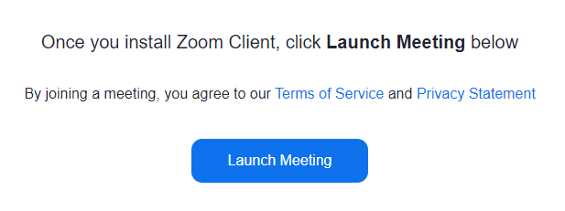
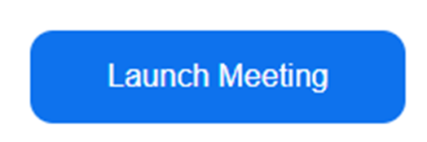
  The computer will automatically install Zoom Client.
  Click on Launch Meeting to continue.
Notes:
Instructions: (Launch Meeting button will grow to highlight.)
If this is the first time attending a Zoom meeting, the computer will automatically install Zoom Client. Click on “Launch Meeting” to continue.
Materials: None
Handouts: None
Time: 1 Minute

Slide 22
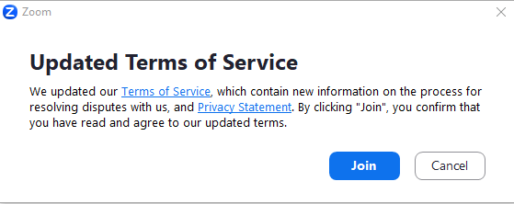
  The Updated Terms of Service pop-up will appear.
  Click on Join
Notes:
Instructions: (Blue arrow will teeter with click to highlight point.)
For first time users, a second window will pop up and you will need to click on “Join” to complete the instillation of Zoom Client.
Materials: None
Handouts: None
Time: 1 Minute

Slide 23
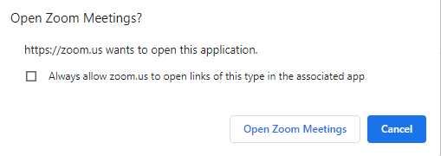
A dialog box will appear.
Click on Open Zoom Meetings to continue.
Notes:
Instructions: (Blue arrow will teeter with click to highlight point.)
A dialog box will appear asking if you want to “Open Zoom Meetings?” Click on “Open Zoom Meetings” if you are on a PC (“Open zoom.us” on a Mac) to proceed.
Materials: None
Handouts: None
Time: 1 Minute

Slide 24
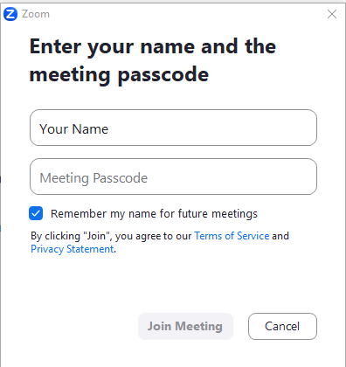

Join a Meeting
Once Open Zoom Meetings has been clicked, you will see this dialog box.
Enter your name as you would like it to appear for everyone to see.
Optional: Checkmark “Remember my name for future meeting”
Notes:
Instructions: (Red circle will appear on click)
After clicking on “Opening Zoom Meetings”, you will be asked if you would like to enter your name. What you type here will be viewed by the host of the meeting, as well as all the participants. First and Last name is appropriate. You may also wish to add the name of your organization after your name.
There is the option to checkmark “Remember my name for future meetings.” This will allow you to skip this step in the future.
Materials: None
Handouts: None
Time: 1 Minute

Slide 25

Dorothy Brandon is inviting you to a scheduled Zoom meeting.
Topic: Learn to Use Zoom
Time: Jul 20, 2023 09:00 AM Central Time (US and Canada)
Join Zoom Meeting
https://msstateextension.zoom.us/j/98998746043?pwd=MHowYjhLM25CdStWRDlJUXplREcwZz09
Meeting ID: 961 9668 8002
Passcode: 175512
Enter the Meeting Passcode
Click Join Meeting
Notes:
Instructions: (Red circles will appear on click. Blue arrow will teeter with click to highlight point.)
Enter the “Meeting Passcode” found in your Zoom meeting invitation. Once entered, click on “Join Meeting”.
Materials: None
Handouts: None
Time: 1 Minute

Slide 26
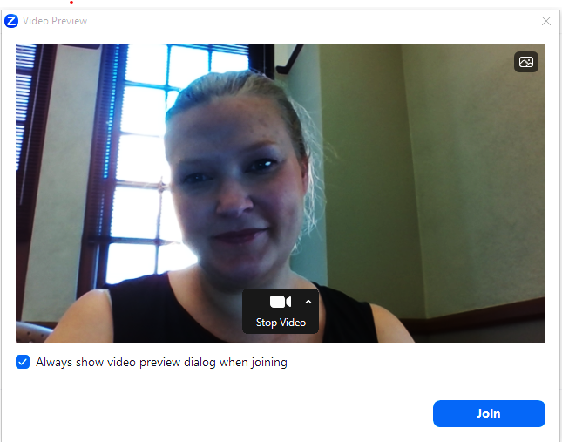
Your Video Preview will appear
Click on Join
Notes:
Instructions: (Blue arrow will teeter with click to highlight point.)
Your Video Preview will appear next. This is where you can adjust your camera angle for others to see you best. This participant is in a shadow. It would be better for them to close the blinds behind them or move the camera and adjust the lighting.
Next click on “Join”.
Materials: None
Handouts: None
Time: 1 Minute

Slide 27
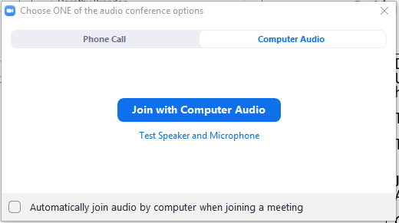
Testing Speaker & Microphone
Click Test Speaker and Microphone
Notes:
Instructions: (Blue arrow will teeter with click to highlight point.)
The final step before joining a room is to test the computer or mobile device speaker and microphone capabilities, by clicking on “Test Speakers and Microphone.” This will prompt a step-by-step process to test these.
Materials: None
Handouts: None
Time: 1 Minute

Slide 28
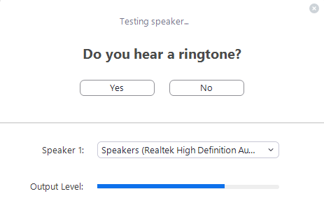
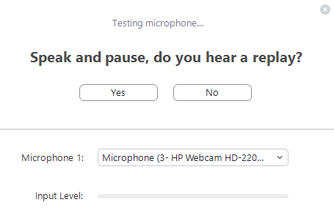
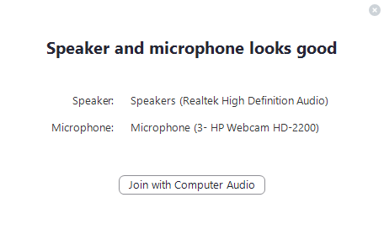
Testing Speaker & Microphone
Notes:
Instructions: Zoom will play a ringtone. If you hear it, click on “Yes”, if you don’t hear it, troubleshoot to see if the volume is too low, the correct speakers are selected, etc. until you can hear the ringtone.
Next test the microphone. Simply speak out loud when prompted and Zoom will replay it to you. If you can hear your recording, then click on “Yes”, if not, again troubleshoot to see if the correct microphone is selected and that it is connected to your device.
Once all is functioning correctly, click on “Join with Computer Audio”.
Materials: None
Handouts: None
Time: 2 Minutes

Slide 29
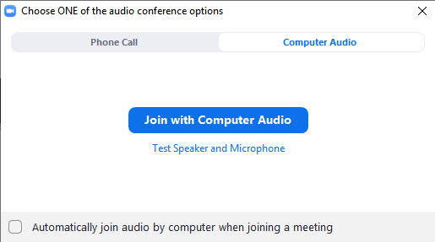

  Click Join with Computer Audio
  Checkmark Automatically join audio by computer when joining a meeting
Notes:
Instructions: (Blue arrows will teeter with click to highlight point.)
To hear others, click “Join with Computer Audio” button.
By check marking “Automatically join audio by computer when joining a meeting” this allows you to skip this step for future meetings.
Materials: None
Handouts: None
Time: 1 Minute

Slide 30
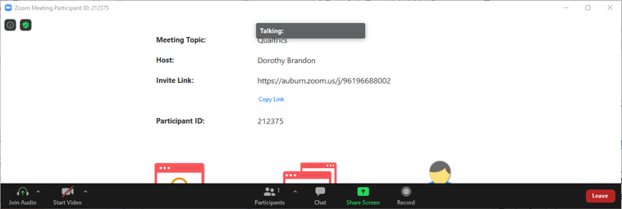
You have successfully joined a meeting
Notes:
Instructions: You have successfully joined a meeting.
Materials: None
Handouts: None
Time: 1 Minute

Slide 31
How to JOIN a ZOOM meeting via TELEPHONE
Dial the provided phone number from the invitation
Enter the Meeting ID when prompted
Dorothy Brandon is inviting you to a scheduled Zoom meeting.
Topic: Learn to Use Zoom
Time: Jul 20, 2023 09:00 AM Central Time (US and Canada)
Join Zoom Meeting
https://msstateextension.zoom.us/j/98998746043?pwd=MHowYjhLM25CdStWRDlJUXplREcwZz09
Meeting ID: 961 9668 8002
Passcode: 175512
Dial by your location
• +1 301 715 8592 US (Washington DC)
• +1 312 626 6799 US (Chicago)
• +1 646 876 9923 US (New York)
• +1 253 215 8782 US (Tacoma)
• +1 346 248 7799 US (Houston)
• +1 669 900 6833 US (San Jose)
Meeting ID: 961 9668 8002
Passcode: 175512
Notes:
Instructions: (Red circles will appear on click.)
Participants also have the option to call in to join the Zoom meeting. A list of phone numbers by area are provided in the Zoom meeting invitation. Select the number for your location. Dial the number (charges may apply for long distance calls), when prompted, enter the Meeting ID and Passcode. You will enter the room muted. To unmute your audio when dialing in on a phone, press *6 (Star, Six) on your phone’s keypad. This will also mute you again when needed.
Materials: None
Handouts: None
Time: 2 Minutes

Slide 32
Let’s see how well you can Join a meeting:
Activity One
Notes:
Instructions: Prior to class set up a Zoom meeting. Email, text, or send a calendar invitation to each participant. Minimize PowerPoint and open Zoom meeting so they can call and log in.
-Ask participants to perform the task. Explain that once they have performed the task using the different methods, decide which method is easier for them and start using that method.
-Ask participants to open the invitation and join the meeting first by phone. Once verified they have joined, they may hang up.
-Then participants need to select one of the ways (browser/URL) demonstrated to join the Zoom meeting and test the device speaker and microphone. Encourage participants to give it a try on their own using the course information provided. Once they are in the meeting have them remain in the meeting for the next section on Navigating the meeting platform.
Materials: None
Handouts: None
Time: 10 Minutes

Slide 33
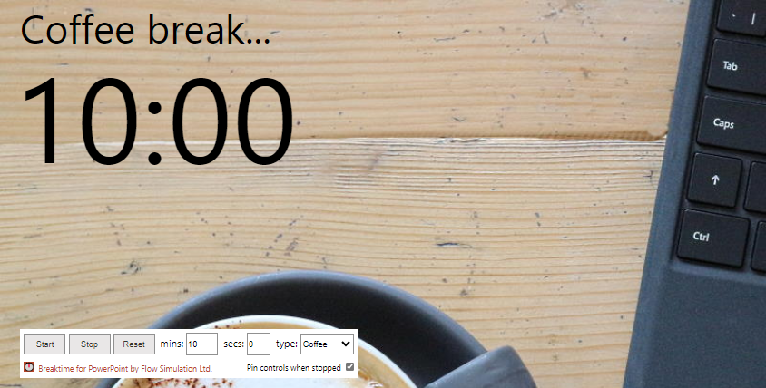
Notes:
Instructions: You are now around the 45-minute mark. You can opt to have a mini stretch break if participants need it. The timer is pre-set for 10 minutes, you can adjust the time if needed.
Materials: None
Handouts: None
Time: 10 Minutes

Slide 34
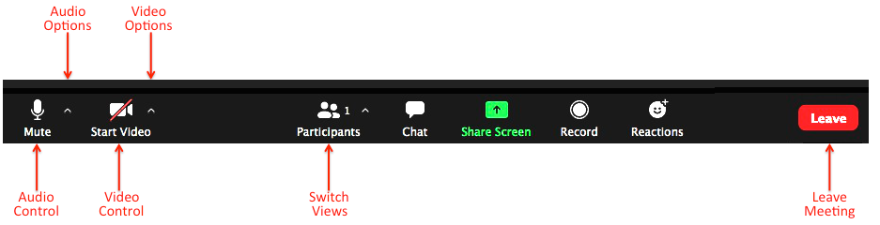
Navigating a Meeting
Let’s look at the Zoom in-meeting controls
Notes:
Instructions: The next 11 slides highlight the buttons at the bottom of an average Zoom screen.
Let’s look at the Zoom in-meeting participant controls found at the bottom of your screen.
Materials: None
Handouts: None
Time: 1 minute

Slide 35
Navigating a Meeting
Mute or unmute your microphone
Notes:
Instructions: Mute/Unmute – Click on this button to unmute (no red line) or mute (red dash through the microphone)
Materials: None
Handouts: None
Time: 1 minute

Slide 36
Navigating a Meeting
Start or stop your video camera
Notes:
Instructions: Start Video – Click on this button to turn on your camera and share your video (no red line) or block others from seeing your video (red line through the camera).
Materials: None
Handouts: None
Time: 1 minute

Slide 37
Navigating a Meeting
List of participants
Notes:
Instructions: List of Participants - See who's currently in the meeting and invite others using this button.
Materials: None
Handouts: None
Time: 1 minute

Slide 38
Navigating a Meeting
Access in-meeting chat
Notes:
Instructions: Chat – By clicking on this icon, you will be given access the chat window to chat with other participants and the host.
Materials: None
Handouts: None
Time: 1 minute

Slide 39
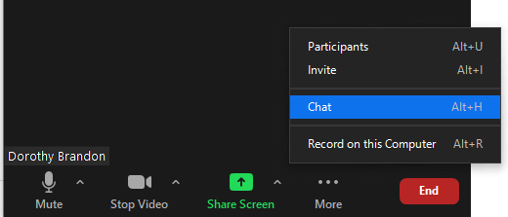

Navigating a Meeting
Let’s look at the Zoom Chat feature
Access the Chat feature by clicking Chat in the ribbon, or by clicking More and clicking on Chat
Notes:
Instructions: (Red circles indicate where to find “Chat” and “More” and a Blue arrow will teeter with click to highlight point.)
If you are unable to locate the chat feature at the bottom of the screen, click on “More” and select “Chat” from the menu.
Materials: None
Handouts: None
Time: 1 minute

Slide 40
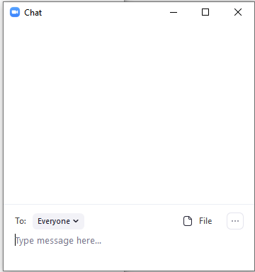
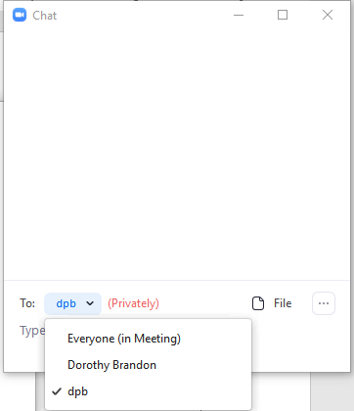
Chatting (private & everyone)
Click the arrow beside To: and select Everyone
(everyone in the meeting will receive the message)
Or
Click the arrow beside To: and select the name of a specific person
(only that person will receive the message)
Or
Notes:
Instructions: (Red circles indicate where to find “To:” and Blue arrows will teeter with click to highlight names.)
When you select “Chat” your chat box will appear to the right of your screen. If this is not adequate space, it will appear in its own box. (Sometimes the chat box will be hidden behind the main screen.)
To chat with all the participants and the host, click on the arrow beside “To:” and select “Everyone” from the dropdown menu. To select a specific person, click on the arrow beside “To:” and select the individual name from the dropdown menu.
Materials: None
Handouts: None
Time: 1 Minute

Slide 41
Navigating a Meeting
Only the Host can grant you permission to share your screen with the group.
Notes:
Instructions: Share Screen – Most of the time the ‘Share Screen” function is used primarily by the host and co-hosts of the meeting. As a participant, you are unlikely to have access to this function. Clicking on it will prompt you to have the Host/Co-Host grant you Share Screen capabilities.
Materials: None
Handouts: None
Time: 1 minute

Slide 42
Navigating a Meeting
Only the Host can record the meeting
Notes:
Instructions: Record – Click on this button to start or stop a local recording. Participants do not have access to start a cloud recording.
Materials: None
Handouts: None
Time: 1 minute

Slide 43
Navigating a Meeting
Choose from a full set of emojis
Notes:
Instructions: Reactions - Meeting reactions, nonverbal feedback, and “Raise Hand” allow you to communicate issues or feedback to the host or presenter without disrupting the meeting. These reactions are shown on your video panel and next to your name on the participant's panel.
Materials: None
Handouts: None
Time: 1 minute

Slide 44
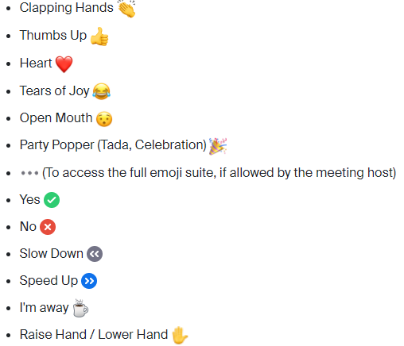
Navigating a Meeting
Notes:
Instructions: Reactions – Here are some examples of Reactions you can select.
Materials: None
Handouts: None
Time: 1 Minute

Slide 45
Navigating a Meeting
Leave the meeting
Notes:
Instructions: Leave – Click here to leave the meeting while it continues for the other participants. Only the host can end the meeting for everyone.
Materials: None
Handouts: None
Time: 1 minute

Slide 46
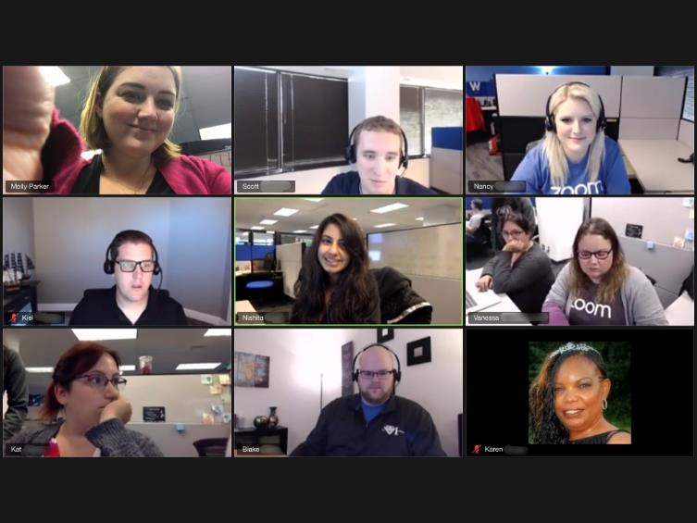
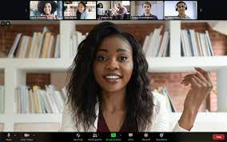
Adjusting Your Video Layout
Gallery view and Speaker view
Notes:
***Carmen, We may need to recreate these images for this PowerPoint****
Instructions: Participants can change the video layout of their screens. This has no impact on the view of any other participant in the classroom. The host or co-host are the only people who can change the view for everyone in the meeting. As a participant you have two options, Gallery View or Speaker View.
Materials: None
Handouts: None
Time: 2 Minutes

Slide 47
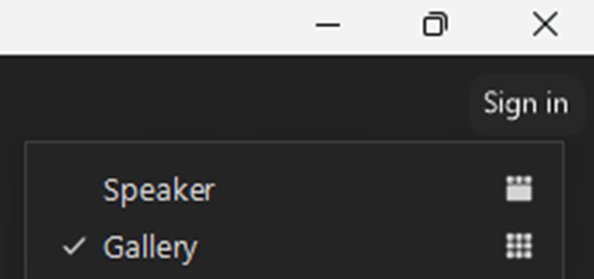
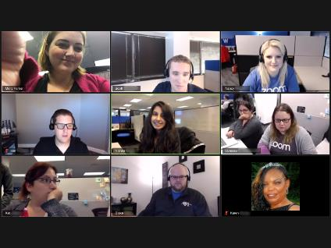
Adjusting Your Video Layout
Gallery view
Notes:
Instructions: (Purple box will indicate where to find ”Gallery”.)
To select “Gallery View”, in the upper right corner of your screen, you will see an icon to open a dropdown menu, click on “Gallery”.
Materials: None
Handouts: None
Time: 1 Minute

Slide 48

Adjusting Your Video Layout
Gallery view
Notes:
Instructions: Gallery View displays up to 25 participants per screen. The active speaker is highlighted in Gallery View, you can see that the speaker in this image is outlined in green. If there are more participants than can fit on the screen, an arrow displays. Click on the right arrow to display the next group of participants on the screen and click the left arrow to display the previous set.
Materials: None
Handouts: None
Time: 1 Minute

Slide 49
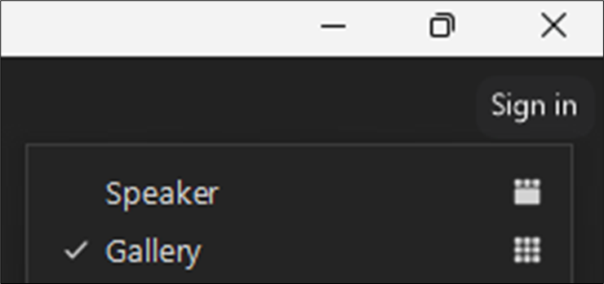
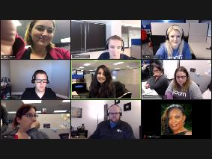

Adjusting Your Video Layout
Speaker view
Notes:
Instructions: (Purple box will indicate where to find ”Speaker”.)
To select “Speaker View”, in the upper right corner you will see an icon to open a dropdown menu, click on “Speaker”.
Materials: None
Handouts: None
Time: 1 Minute

Slide 50
Adjusting Your Video Layout
Speaker view
Notes:
Instructions: In “Speaker View”, the participant that is currently speaking with their audio turned on will appear in the largest box, while all other participants will appear in a ribbon at the top or side of the screen. If there is more participants than spaces in the ribbon, you can arrow left or right to view additional participants.
Materials: None
Handouts: None
Time: 1 Minute

Slide 51

Let’s see how well you can
Navigate a meeting:
Activity Two
Notes:
Instructions: Minimize PowerPoint and display the previously opened Zoom meeting.
With the previously opened Zoom meeting ask participants, as a group, to complete the following list of items:
Mute/Unmute
Start/Stop video
Using the Chat feature:
- Share your favorite food in the chat box with everyone
- Share your favorite color with one person in class
Click on Share Screen – note what happens
Click on Record – note what happens
Click on Reactions and select the following:
- Raise your hand / Lower your hand
- Give a Thumbs Up
- Clapping Hands
- Celebrate all you have learned today with the Party Popper!
Adjust your video layout between Gallery and Speaker
Leave the Zoom Meeting
Materials: None
Handouts: None
Time: 10 Minutes

Slide 52
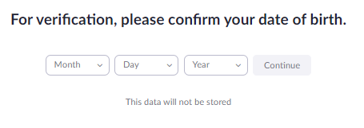
Obtain a Free Zoom Account
Type Zoom.us
Click Sign Up Free
Enter Date of Birth
Click Continue
Notes:
Instructions: (Red box will indicate where to find ”Sign up free” and “Continue”.)
From any browser, type in zoom.us. This will take you to main page for Zoom. In the upper right-hand corner, click on “Sign Up Free”. A dialog box will appear, enter your date of birth for verification and click on “Continue”.
Materials: None
Handouts: None
Time: 1 Minute

Slide 53
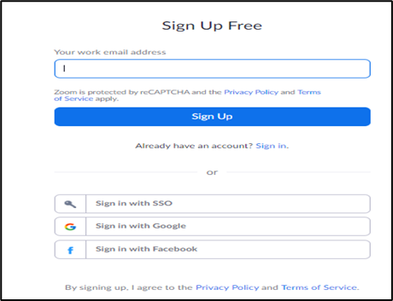
Obtain a Free Zoom Account
Enter Email Address
(It is recommended you use a personal email address)
Click Sign Up
Go to your email and confirm/activate Zoom password
Notes:
Instructions: (Red box will indicate where to enter email address and “Sign Up”.)
Enter the email address you would like to have Zoom associated with. This will become your username, and you will need to have access to this email to confirm your account and create your Zoom password. A personal email is recommended.
Click on “Sign Up”.
You may also select to create your free account linked to Google or Facebook. Log in to your email address and confirm your account and set up your password.
Materials: None
Handouts: None
Time: 1 Minute

Slide 54
Let’s see how well you can create a free ZOOM account:
Activity Three
Notes:
Instructions: Open your browser to zoom.us and create your free Zoom account.
Materials: None
Handouts: None
Time: 5 Minutes

Slide 55
ZOOM Pricing Structure
Free
Host up to 100 participants
40 minutes time limit
Zoom Whiteboard (3)
Breakout Rooms
Screen Sharing
Waiting Room
Pro (149.90 per year per license)
Group Meetings up to 30 hours
Social media streaming
5 GB cloud recording
Telephone Dial In
Polling
Live transcription
Business (199.90 per year per license)
Host up to 300 participants
Recording transcripts
Unlimited whiteboards
Enterprise (contact sales for pricing)
Webinars 500 / Zoom Sessions 1000
Unlimited Cloud Storage
5 GB cloud recording
Business Plus ($250 per year license)
Host up to 300 participants
10 GB cloud recording
Translated Captions
Unlimited Regional Calling
Unlimited boards
Company branding
Phone - Power Pack
Workspace Reservation
Notes:
Instructions: Today you signed up for a free Zoom account. If you find that you need more from your Zoom experience, there are additional options for purchase ranging from $150 per year and higher.
Materials: None
Handouts: None
Time: 1 Minute

Slide 56

Zoom Meeting Etiquette
Come prepared
Be up to date
Log in early
Be camera ready – Office space
Keep it muted
Decrease the distractions
Look at your camera
Stay on track
Be business professional
Notes:
Instructions: As with any meeting, proper behavior or etiquette is essential to a meeting running smoothly. Here are some tips to keep in mind:
Be prepared – Before the meeting starts be proactive by reviewing any materials in advance.
Have the latest version – Operating systems update often, make sure you log in with enough time to update as needed before the meeting starts.
Log in early – Log in a few minutes early to make sure you have the correct URL Link, Meeting ID, Passcode and that your microphone, speakers, and video are all working.
Camera Ready – Make sure your area is cleaned up or put on a background and make sure your lighting doesn’t cast you in a shadow.
Mute – Typically, participants remain on mute until they are ready to share something. This decreases disruptions and background noise.
Distractions – It is easy to get distracted while in a Zoom meeting. To decrease distractions, close all extra screens on your computer, close email, silence your cell phone, place business phone on do not disturb, put away materials from other projects, etc.
Look at your camera – when speaking, look at the camera and not at yourself or other participants on the screen. Looking at the camera helps to focus your attention and gives the impression of making eye contact with fellow participants.
Stay on track – Time is precious, so stick to the purpose of the meeting. Having an agenda is helpful and ensures the topics needed are addressed. Remember you want to be respectful of everyone’s time and accomplish the goals of the meeting.
Keep it professional – Zoom naturally creates a more relaxed atmosphere than an in-person meeting. However, keep yourself professional by dressing appropriately and maintaining proper posture and appearance.
Materials: None
Handouts: None
Time: 5 Minutes
Source: 4-HTECH Changemakers Guidebook – Communication: Video Conferencing
Image by Alexandra_Koch from Pixabay

Slide 57



Questions
Discussion
Next Steps
Notes:
Instructions: Before the session begins, add any text to promote next educational opportunity.
Thank participants for attendance, allow for questions and discussion, promote the next lesson, encourage evaluation participation.
Materials: None
Handouts: None
Time: 10 minutes

