Slide 1

Internet Safety for Kids
Notes:
Instructions: Have this slide up as participants enter the room.
Materials: Encourage participants to bring personal laptops or tablets for activities. Additional devices can be provided by instructor or through partnerships. If devices are not available for all, instructor will need to demonstrate activities for all participants to see.
Handouts: Copy of presentation slides and
Handout: Saving, Recovering, and Sharing Data and Files
Time: 1 Minute
* Do not move or delete pictures/content off to the sides of the PowerPoint slide.

Slide 2







Bridging the Digital Divide Partners
This project was funded by Extension Foundation, New Technologies in Ag Education award #342090 and USDA NIFA award # 2022-68006-36496. The material is based upon work supported by the National Institute of Food and Agriculture, U.S. Department of Agriculture. Any opinions, findings, conclusions, or recommendations expressed in this publication are those of the author(s) and do not necessarily reflect the view of the U.S. Department of Agriculture.
Notes:
Instructions: Share this acknowledgment of the partnerships in the Bridging the Digital Divide.
Materials: None
Handouts: None
Time: 1 Minute

Slide 3
Author Acknowledgement
We wish to thank the author of this training material:
  Dr. Hunter P. Goodman, Assistant Professor,
  University of Arkansas System, Division of Agriculture, Cooperative Extension Service
Notes:
Instructions: The presenters of this session are asked to share this acknowledgment of the work that went into this session.
Materials: None
Handouts: None
Time: 1 Minute

Slide 4
Presenter Acknowledgement
Name
Title
Association
Email (Optional)
Phone (Optional)
Webpage (Optional
Notes:
Instructions: Self introduction
Materials: None
Handouts: None
Time: 2 Minutes

Slide 5
Structure of Today’s Session
Define internet safety for children
Practice safe internet practices with your children
Explore how children are using the internet
Understand how to set boundaries and rules
Notes:
Instruction: This will be a general lesson about the following areas.
Materials: None
Handouts: None
Time: 2 Minutes

Slide 6

Introductions
Notes:
Instructions: Give time for participants to introduce themselves. You could also include a brief question for them to answer such as what motivated them to take this class? Encourage the 30 second rule: “In 30 seconds, share your name and answer…”
You may also consider using a light-hearted questions such as:
If they have a particular question about saving or have encountered problems when trying to save and find their files.
What was your first job?
What hobby takes up most of your free time?
How do you like your coffee?
Materials: None
Handouts: None
Time: 5 Minutes
Photo by Joshua Sortino on Unsplash
Image by WikiImages from Pixabay

Slide 7

What is Internet Safety for Children?
  What children are using on the internet?
  How to set boundaries and protections?
  What are simple, easy to use steps to keep children safe while maximizing the best of the internet?
Notes:
Instructions: We will now briefly discuss what is Internet Safety for Children?
Raising the awareness of how children are accessing the internet so that parents and caregivers may understand:
What children are using on the internet?
How to set boundaries and protections?
What are simple, easy to use steps to keep children safe while maximizing the best of the internet?
Materials: None
Handouts: None
Time: 1 Minute

Slide 8

What is positive about children accessing the internet?
Educational games
Homework/schoolwork
Exploring new things
Teaching and alternate forms of learning (homeschooling)
Communicating with parents when away from home
Connecting with friends online
Notes:
Instructions: What is positive about children accessing the internet?
Ask participant to name any other positives they can think of.
Then click to review list of items on the slide:
Educational games
Homework/schoolwork
Exploring new things
Teaching and alternate forms of learning (homeschooling)
Communicating with parents when away from home
Connecting with friends online
Materials: None
Handouts: None
Time: 2 Minutes

Slide 9
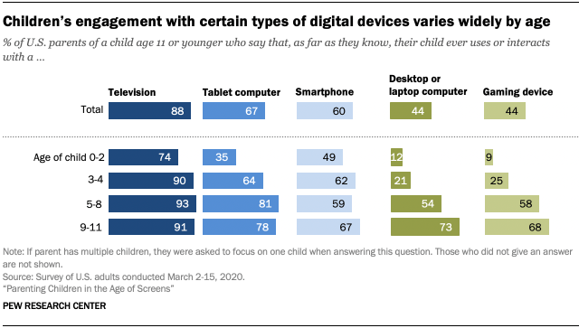
What type of devices do children use?
https://www.pewresearch.org/internet/2020/07/28/parenting-children-in-the-age-of-screens/
Notes:
Instructions: This graph from the PEW Research Center shows the engagement of children with different digital devices.
Highlight key areas on this graph such as ages associated with each device.
Source: Auxier, B., Anderson, M., Perrin, A., and Turner, E. (2020). Parenting Children in the Age of Screens. Pew Research Center. Retrieved from https://www.pewresearch.org/internet/2020/07/28/parenting-children-in-the-age-of-screens/
Materials: None
Handouts: None
Time: 2 Minutes

Slide 10
Children’s Online Privacy
Protection Rule, 1998
Creates safeguards like keeping children off of social media under the age of 13.
  “prohibits unfair or deceptive acts or practices in connection with the collection, use, and/or disclosure of personal information from and about children on the Internet.”
Notes:
Instructions: Children’s Online privacy protection rule, 1990, was established in 1998 to create a safeguard like keeping children off social media under the age of 13.
The full act reads: This Act protects children's privacy by giving parents tools to control what information is collected from their children online. The Act requires the Commission to promulgate regulations requiring operators of commercial websites and online services directed to children under 13 or knowingly collecting personal information from children under 13 to: (a) notify parents of their information practices; (b) obtain verifiable parental consent for the collection, use, or disclosure of children’s personal information; (c) let parents prevent further maintenance or use or future collection of their child’s personal information; (d) provide parents access to their child’s personal information; (e) not require a child to provide more personal information than is reasonably necessary to participate in an activity; and (f) maintain reasonable procedures to protect the confidentiality, security, and integrity of the personal information. In order to encourage active industry self-regulation, the Act also includes a "safe harbor" provision allowing industry groups and others to request Commission approval of self-regulatory guidelines to govern participating websites’ compliance with the Rule.
Source: “The Federal Register.” Federal Register : Request Access, www.ecfr.gov/current/title-16/chapter-I/subchapter-C/part-312. Accessed 21 Jan. 2024.
U.S. Federal Trade Commission. (2015, March 20). Complying with COPPA: Frequently Asked Questions. Retrieved from https://www.ftc.gov/tips-advice/business-center/guidance/complying-coppa-frequently-asked-questions-0.
Materials: None
Handouts: None
Time: 2 Minutes

Slide 11

What are the dangers for children?
Inappropriate content
Cyberbullying
Malware
Frauds and scams
Sexting and harassment
Notes:
Instructions: What are the dangers for children? Allow participants to list some potential answers before clicking to reviel the following list:
Websites with content not appropriate for kids
Cyberbullying
Malware on devices that is harmful or not appropriate for kids
Frauds and scams aimed at children
Sexting and harassment
Source: Turner, T. (2023, May 20). Internet Safety for Kids: Parents' Guide to Keeping Kids Safe Online. Consumer Notice. Retrieved from https://www.consumernotice.org/data-protection/internet-safety-for-kids/.
Materials: None
Handouts: None
Time: 2 Minutes

Slide 12


Internet safety by age
The forms of dangers advance as children age.
Younger Children: Pop-ups, malware, and inappropriate content
Teens: Cyberbullying, harassment, and sexting
Notes:
Instructions: The forms of dangers advance as children age. Where pop-ups, malware, and inappropriate content may be the dangers for younger children, cyberbullying, harassment, and sexting can be more present for teens.
Source: Anderson, M. and Jiang, J. (2018, May 31). Teens, Social Media & Technology 2018. Pew Research Center. Retrieved from https://www.pewresearch.org/internet/2018/05/31/teens-social-media-technology-2018/.
Materials: None
Handouts: None
Time: 1 Minute

Slide 13
What is the best way to set boundaries and rules?
Create an online safety contract
Establish timeframes when your children can use the internet.
Keep internet usage in sight.
Set ground rules regarding internet use.
Notes:
Instructions: What is the best way to set boundaries and rules?
Create an online safety contract with your children of what to do and not do on the internet.
Establish timeframes when your children can use the internet.
Keep children’s internet usage in sight.
Set ground rules with your children regarding internet use.
Go to link and show participants how to access the Family Contact for Online Safety.
Source: SafeKids.com. (n.d.). Family Contract for Online Safety https://www.safekids.com/family-contract-for-online-safety/.
Materials: None
Handouts: None
Time: 2 Minutes

Slide 14
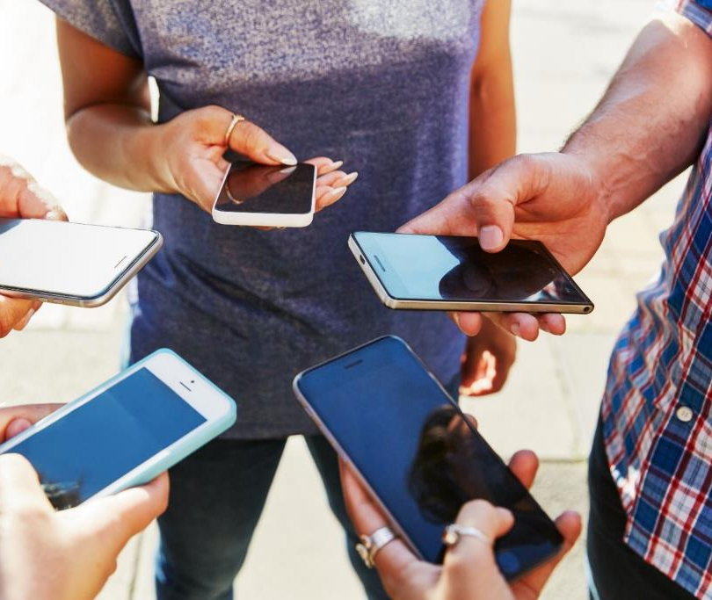
Sample ground rules
Don’t text with strangers.
Don’t share personal information
Don’t open an email from someone you do not know.
If the message is hurtful or harassing, don’t respond!
If you feel uncomfortable with something online, tell a parent/caregiver.
Notes:
Instructions: Here are some sample ground rules:
Don’t text with strangers.
Don’t share personal information (your name, address, SSN, phone #).
Don’t open an email from someone you do not know.
If the message is hurtful or harassing, don’t respond!
If you feel uncomfortable with something online, tell a parent/caregiver.
Ask participants if they have any additional examples of some good ground rules.
Source: NetSmartz. (n.d.). Overview. National Center for Missing and Exploited Children. Retrieved from https://www.missingkids.org/netsmartz/resources.
Materials: None
Handouts: None
Time: 2 Minutes

Slide 15

How do we use safe internet practices with our children?
Computer time is family time
Set an example of safe use
Monitor browser history and know passwords
Set up password protection
Update devices regularly
Notes:
Instructions: Here are some ways you can incorporate safe internet practices with children:
Make computer time a part of family time
Set an example of safe use for your kids
Be clear that you will monitor browser history and know passwords
Set up password protection on the device
Update devices regularly
Source: Scholastic Parents. (n.d.). Keeping Kids Safe Online. Retrieved from https://www.scholastic.com/parents/family-life/social-emotional-learning/technology-and-kids/keeping-kids-safe-online.html.
Materials: None
Handouts: None
Time: 2 Minutes

Slide 16
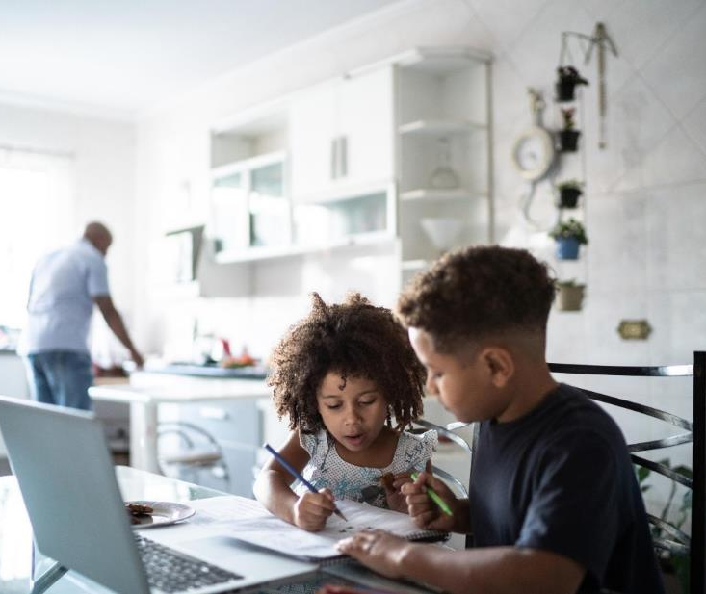
Safety Steps
Keep the computer in an area where parents can monitor activity
Install parental control software
Use security software to protect against viruses
Notice any changes in behavior for signs of cyberbullying or harassment
Take action with your child and support him/her if you see harmful action
Notes:
Instructions: Here are some safety step you can take:
Keep the computer for children’s access in an area where parents can monitor activity
Install parental control software
Use security software to protect against viruses.
Notice any changes in behavior for signs of cyberbullying or harassment.
Take action with your child and support him/her if you see harmful action.
Source: ConnectSafely. (2018, May 6). Online Safety Tips. Retrieved from https://www.connectsafely.org/safetytips/.
Materials: None
Handouts: None
Time: 2 Minutes

Slide 17

Summary
Internet use for kids can be positive with a few safety precautions.
Unchecked and unmonitored, there are dangers to children using the internet.
Set boundaries and practices to keep children safe.
Remain engaged in how children are using devices.
Notes:
Instructions: Summarize content covered in this lesson.
Internet use for kids can be positive with a few safety precautions.
Unchecked and unmonitored, there are dangers to children using the internet.
Set boundaries and practices to keep children safe.
Remain engaged in how children are using devices.
Materials: None
Handouts: None
Time: 2 Minutes

Slide 18



Questions
Discussion
Next Steps
Notes:
Instructions: Before the session begins, add any text to promote next educational opportunity.
Thank participants for attendance, allow for questions and discussion, promote the next lesson, encourage evaluation participation.
Materials: None
Handouts: None
Time: 10 Minutes

