Slide 1
Internet Safety, Ethics, and Identifying Credible Sources
Notes:
Instructions: Have this slide up as participants arrive.
Materials: None
Handouts: None
Time: 1 minute
Photo by Thirdman: https://www.pexels.com/photo/a-group-of-people-having-a-discussion-while-looking-at-laptop-5256526/

Slide 2
Bridging the Digital Divide Partners
This project was funded by USDA NIFA award # 2022-68006-36496. The material is based upon work supported by the National Institute of Food and Agriculture, U.S. Department of Agriculture. Any opinions, findings, conclusions, or recommendations expressed in this publication are those of the author(s) and do not necessarily reflect the view of the U.S. Department of Agriculture.
Materials as of: December 2023
Notes:
Instructions: The presenters of this session are asked to share this acknowledgment of the support provided by the National Institute of Food and Agriculture, U.S. Department of Agriculture
Materials: None
Handouts: None
Time: 1 Minute

Slide 3
Author Acknowledgement
We wish to thank the authors of this training material:
Terrence Wolfork, Assistant Extension Administrator, Fort Valley State University
Dr. Roseanne Scammahorn, Extension Research Associate III, Southern Rural Development Center
Notes:
Instructions: The presenters of this session are asked to share this acknowledgment of the work that went into this session.
Materials: None
Handouts: None
Time: 1 minute

Slide 4
Presenter Acknowledgement
Name
Title
Association
Email (Optional)
Phone (Optional)
Webpage (Optional)
Notes:
Instructions: This is where the presenter(s) will provide a self introduction.
Materials: None
Handouts: None
Time: 1 minute

Slide 5
Objectives
Internet Safety
Impersonation
Malware
Passwords
Identifying Credible Sources
Digital Ethics
Notes:
Instructions: Before jumping into the lesson, share with the participants what you expect for them to be able to do after the lesson.
This slide shows the three parts of this single lesson. Each of the six points will pulse in descending order so that you can highlight each point.
Materials: None
Handouts: None
Time: 1 Minute

Slide 6
Structure of Today’s Session
Impersonation
Passwords – Safety Activity
Identify Creditable Sources
Ransomware Activity
Digital Ethics - Activity
Notes:
Instruction: Share the structure of the class and briefly describe content that will be discussed under each heading. Ask for any questions or concerns before starting.
Notes: Based on adult learning theories, it is important to show or explain to adult learners how the class will be conducted.
Materials: None
Handouts: None
Time: 2 minutes

Slide 7
Introductions
Notes:
Instructions: Ask participants to introduce themselves. You could also include a brief question for them to answer such as what motivated them to take this class? Encourage the 30 second rule: “In 30 seconds, share your name and answer…”
You may also consider using a light-hearted questions such as:
What was your first job?
What hobby takes up most of your free time?
How do you like your coffee?
Materials: None
Handouts: None
Time: 5 Minutes

Slide 8
Internet Safety
Notes:
Instructions: “Being online exposes us to cyber criminals and others who commit identity theft, fraud, and harassment. Every time we connect to the Internet either at home, at school, at work, or on our mobile devices, we make decisions that affect our cybersecurity. Emerging cyber threats require engagement from the entire American community to create a safer cyber environment from government and law enforcement to the private sector and, most importantly, members of the public.”
In 2004, President George W. Bush and Congress declared October to be Cybersecurity Awareness Month, to raise cybersecurity awareness nationally and internationally. Being aware of and practicing internet safety is the primary way to decrease online threats.
Source: CISA, (2023, January 26) https://www.cisa.gov/news-events/news/cyber-safety
Materials: None
Handouts: None
Time: 5 minutes

Slide 9
Impersonation
Phishing
Spear Phishing
Smishing
Vishing
Whaling
Notes:
Instructions: Impersonation is one of the most common forms of internet safety on a personal level. Online impersonation refers to creating an online presence or profile using a likeness that is not your own, or that of someone else.
Impersonation falls under the Identity Theft and Assumption Deterrence Act of 1998, which amended the Federal criminal code to make it unlawful for anyone to knowingly transfer or use, without lawful authority, a means of identification of another person with the intent to commit, or otherwise promote, carry on, or facilitate any unlawful activity that constitutes a violation of Federal law or a felony under State or local law.
Source: Congress.gov (1998, July 30). S.512 - Identity Theft and Assumption Deterrence Act of 1998
Materials: None
Handouts: None
Time: 3 minutes

Slide 10
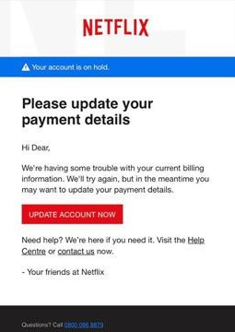
PHISHING
Request for payment information
Generic greeting
Invitation to click on link
Examples provided by Federal Trade Commission
Notes:
Instructions: Phishing is the fraudulent practice of sending emails messages purporting to be from reputable companies to trick individuals to reveal personal information, such as passwords and credit card numbers. Phishing looks very realistic but has several red flags such as a generic greeting, request for private information, and an invitation to click on a provided link.
Examples are:
Say they’ve noticed some suspicious activity or log-in attempts — they haven’t.
Claim there’s a problem with your account or your payment information — there isn’t.
Say you need to confirm some personal or financial information — you don’t.
Include an invoice you don’t recognize — it’s fake.
Want you to click on a link to make a payment — but the link has malware.
Say you’re eligible to register for a government refund — it’s a scam.
Offer a coupon for free stuff — it’s not real.
Source: FTC, (2022). How to Recognize and Avoid Phishing Scams, Retrieved from https://consumer.ftc.gov/articles/how-recognize-and-avoid-phishing-scams
Materials: None
Handouts: None
Time: 2 minute

Slide 11
Spear Phishing
Fake websites
CEO Fraud
Malware
Notes:
Instructions: Spear Phishing is phishing method that targets specific individuals or groups within an organization to trick users to divulge personal information or perform actions that cause network compromise, data loss, or financial loss.
Examples are:
Fake websites linked to a carefully worded email or text.
Using an email address that would be familiar to an employee such as their CEO, Human Resource Manager, or IT Administrator.
Malware – tricking a person to click on a malicious email attachment.
Red flags are high pressure language with emphasis of significant negative impact if not acted upon immediately.
Materials: None
Handouts: None
Time: 2 minutes
Image by 3D Animation Production Company from Pixabay

Slide 12
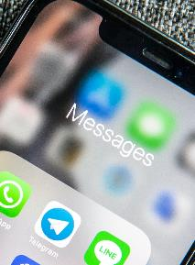
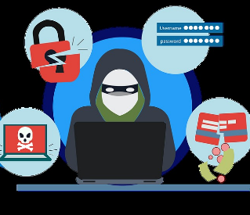
Smishing
Attacker sends text
User opens text, clicks on link, gives away private information
Attacker uses information to commit fraud
Notes:
Instructions: Smishing is the fraudulent practice of sending text messages purporting to be from reputable companies to induce individuals to reveal personal information, such as passwords or credit card numbers. Typically, the text message will include a link which will take them to a fake site where they will be asked to enter more details to prove identity or to pay a non-existent fee. Clicking the link could also potentially download malware on the user’s device.
Examples include:
Delivery notification
Bank/Credit card text
Raffle winner
Password reset (without you requesting)
Tax season – Refund or owing money to IRS
The ridiculous message – Nigerian Prince, long lost family member, bail money
Red flags:
You didn’t initiate request
Spelling and grammar mistakes
Materials: None
Handouts: None
Time: 2 minute
Photo by Adem AY on Unsplash
Photo by ROBIN WORRALL on Unsplash
Image by Fakhruddin Memon from Pixabay

Slide 13
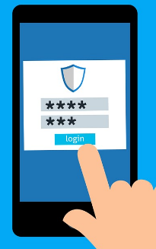
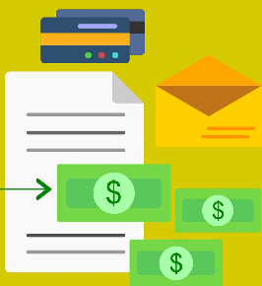
Vishing
Scammer calls
User answers and give personal information
Scammer uses information to steal money
Notes:
Instructions: Vishing is the fraudulent practice of making phone calls or leaving voice messages purporting to be from reputable companies to tempt individuals to reveal personal information, such as bank details and credit card numbers.
Examples are calls from:
Government representatives – threaten to suspend social security, tax refunds, etc. if information is not “confirmed”.
Tech Support fraud – pretends to be from wireless provider, Amazon, etc. Hold on account, suspicious activity.
Bank impersonation – unusual activity on account, need to confirm account details.
Telemarking attack – free prize, offer, etc. just pay for shipping.
Materials: None
Handouts: None
Time: 2 minutes
Image by Daniel Neiva Dan Neiva from Pixabay
Image by Mohamed Hassan from Pixabay
Image by Megan Rexazin from Pixabay

Slide 14
Whaling
Notes:
Instructions: Whaling is when someone impersonates a senior player at an organization and directly target senior or other important individuals at an organization, with the aim of stealing money or sensitive information or gaining access to their computer systems for criminal purposes. The term whaling stems from the size of the attacks, and the whales are thought to be picked based on their authority within a company such as a senior executes, CEO, CFO, government officials, etc.
Red flags:
Email address – any extra letters, numbers? Change in domain name?
Formatting of the email – does is seem correct, normal?
Colors – is branding correct?
Threatening language, urgency of action?
Materials: None
Handouts: None
Time: 2 minutes
Image by Clker-Free-Vector-Images from Pixabay

Slide 15
Let’s Do It
Phishing Activity
Notes:
Instructions: Go to website and have participants take quiz. After quiz, you may need to further explain the topics.
https://www.ftc.gov/business-guidance/small-businesses/cybersecurity/quiz/phishing
Materials: None
Handouts: None
Time: 10 minutes

Slide 16
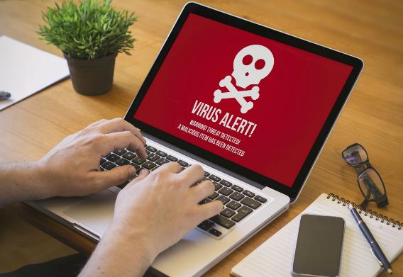
Malware
Malware is software that intentionally inflicts damage on its users who typically have no idea that they are running it.
Computer Virus
Worms
Trojans
Ransomware
Scareware
Spyware
Notes:
Instructions: Malware is software that intentionally inflicts damage on its users who typically have no idea that they are running it.
Computer Virus replicate by inserting their own code into computer systems.
Worms are stand-alone pieces of malware that replicate themselves without the need for hosts to spread.
Trojans is malware that is either disguised as non-malicious software or hidden within a legitimate, non-malicious application.
Ransomware is malware that demands that a ransom be paid in exchange for the infected party not suffering some harm.
Scareware is malware that scares people into taking some action.
Spyware is software that surreptitiously, and without permission, collects information from a device.
Materials: None
Handouts: None
Time: 5 minutes

Slide 17
Malware – How Devices Get Infected
Downloading free stuff – illegal downloads (movies, TV shows, games)
Phishing emails
Fake security pop-ups
Downloading content available on file-sharing sites
Clicking on ads placed by scammers
Notes:
Instructions: How do most computers get infected with Malware? Malware can get onto a device by opening or downloading attachments or files, or by visiting a scammers website.
Downloading free stuff – illegal downloads (movies, TV shows, games), phishing emails, clicking on fake security pop-ups, downloading content available on file-sharing sites, or clicking on ads placed by scammers are all common ways to download malware.
Materials: None
Handouts: None
Time: 5 minutes

Slide 18
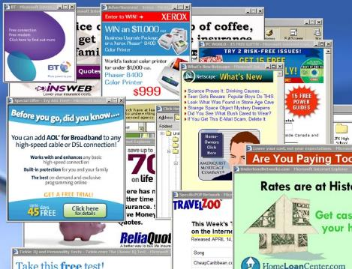
Signs of Malware on a Device
Slows down, crashes, displays error messages
Won’t shut down or restart
Pop-ups, inappropriate ads, or ads that interfere with page content
Send emails you didn’t write
New toolbars or icons
New tabs, websites, search engines you didn’t open
Notes:
Instructions: Unusual behavior from the phone, tablet, or computer such as:
Suddenly slows down, crashes, displays error messages
Won’t shut down or restart
Lots of pop-ups, inappropriate ads, or ads that interfere with page content
Send emails you didn’t write
New toolbars or icons
New tabs, websites, search engines you didn’t open
Materials: None
Handouts: None
Time: 5 minutes

Slide 19
Malware – How to Avoid It
Install and update security software and use a firewall.
Read the screen before you install new software.
Get only well-known software – directly from the source.
Pay attention to security warnings.
Don’t click on provided links – go to site directly.
Scan external devices before using them.
Notes:
Instructions: Here are some recommendations from the Federal Trade Commission on how to avoid Malware.
Install and update security software and use a firewall.
Read the screen before you install new software
Get only well-known software – directly from the source
Pay attention to security warnings
Don’t click on provided links – go to site directly
Scan external devices before using them
Source: FTC (2021). How To Recognize, Remove, and Avoid Malware. https://consumer.ftc.gov/articles/how-recognize-remove-avoid-malware#avoid
Materials: None
Handouts: None
Time: 5 minutes

Slide 20
Let’s Do It
Ransomware Activity
Notes:
Instructions: Go to website and have participants take quiz. After quiz, you may need to further explain the topics.
https://www.ftc.gov/business-guidance/small-businesses/cybersecurity/quiz/ransomware
Materials: None
Handouts: None
Time: 10 minutes

Slide 21
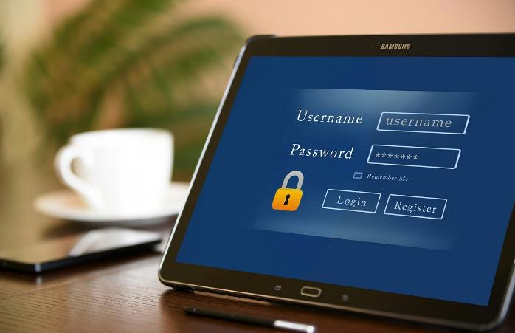
Passwords
Notes:
Instructions: A password is a secret word or phrase that must be used to gain admission to something.
Materials: None
Handouts: None
Time: 1 minute
Image by Mohamed Hassan from Pixabay

Slide 22
Top Ten Password
123456
123456789
Qwerty
Password
12345
Qwerty123
1q2w3e
12345678
111111
1234567890
Notes:
Instructions: Passwords are the locks on your account doors. You want to make sure the lock is big and strong. The DDTC recommends at least 12 characters long. This list of the top ten passwords are riddled with issues; too short, not unique, easy to guess, in a sequential order. If you notice “Qwerty” is the first six keys on the left top row of the keyboard. These are weak passwords and should be avoided.
Materials: None
Handouts: None
Time: 3 minutes

Slide 23
Passwords Strategy
Prioritize password length
Include a combination of letters, numbers, and symbols
Avoid using real words
Never use personal information
Never repeat passwords
Multi-factor authentication
Something you have
Something you are
Notes:
Instructions: These are recommendations on how to keep your password secure.
Prioritize password length. The longer the password is generally the easiest way to make it stronger. Consider using a passphrase of random words so that your password is more memorable but avoid using common words or phrases. Don’t use names or numbers directly associated with you such as maiden name, year of birth/wedding/graduation, pets name, home address, phone number, etc.
Don’t reuse passwords you’ve used on other accounts. That way, if a hacker gets your password for one account, they can’t use it to get into your other accounts.
Use multi-factor authentication when available. This is when you must have two or more verifications in place and must be used together to access the device/account. The “something extra” you need to log in to your account fall into two categories:
Something you have — like a passcode you get via an authentication app or a security key.
Something you are — like a scan of your fingerprint, your retina, or your face.
Change passwords quickly if there’s a breach. If a company tells you there was a data breach where a hacker could have gotten your password, change the password you use with that company right away, and on any account that uses a similar password.
Materials: None
Handouts: None
Time: 5 minutes
FTC, (2021). Password Checklist. https://consumer.ftc.gov/articles/password-checklist#secure

Slide 24
Let’s Do It
Password Safety Activity
Notes:
Instructions: If participants have smart devices have them go to the website and enter passwords, (not their real ones), to see how secure they are.
https://www.security.org/how-secure-is-my-password/
Materials: None
Handouts: None
Time: 5 minutes

Slide 25
Digital Estate Planning
Uniform Fiduciary Access to Digital Assets Act, Revised - RUFADAA
Share Passwords with at least Two Family Members
List Digital Assets and What Actions to take
Legacy Accounts
Facebook Legacy Account https://www.facebook.com/help/1568013990080948
Google Inactive Account Manager https://support.google.com/accounts/answer/3036546?hl=en
Apple Legacy Account https://support.apple.com/en-ca/102631
Notes:
Instructions: Now that we have gone through password security, what happens when someone needs to get access to your electronic devices after you pass.
RUFADAA
Digital property can be managed, conserved and, in certain instances, accessed by third parties. As of June 2023, 45 states have adopted. (Would not try to go too legal, but just give a general overview)
Sharing Passwords
You can create a document and store it somewhere such as a safe or password protect a document and give the password hint to at least two family members. (Ex. Password Hint can be first dog name plus favorite sports player number) Or, you can use password manager with a family plan.
List Digital Assets
This master list should contain usernames, passwords, associated email address. Remember to create a secure password. Actions to take include delete accounts, keeping them open. Follow up with examples of legacy accounts.
Legacy Accounts
Review the links and explain.
Activity: Have participants create a draft digital estate guide including social media accounts, hardware such as computer, tablets, phones, and actions on what to take upon death such as keep open, delete, or other actions.
Handouts: None
Time: 10 minutes

Slide 26
Identifying Credible Sources – CRAAP Test
Currency
Relevancy
Authority
Accuracy
Purpose
Notes:
Instructions: How to identify a credible source; when you search for information you are going to find a lot of it, so how do you know which on is legitimate? California State University, Meriam Library produced this method to test it out. Ask yourself does the source pass the currency, relevancy, authority, accuracy, and purpose test?
Used under the Licensed Creative Commons Attribution 4.0 International License. A Creative Commons license is one of several public copyright licenses that enable the free distribution of an otherwise copyrighted "work". A CC license is used when an author wants to give other people the right to share, use, and build upon a work that the author has created.
Materials: None
Handouts: CRAAP TEST: https://library.csuchico.edu/sites/default/files/craap-test.pdf.
Time: 1 minute

Slide 27
Currency Timeliness of the Information
When was the information published or posted?
Has the information been revised or updated?
Does your topic require current information, or will older sources work as well?
Are the links functional?
Notes:
Instructions:
C – Currency: The timeliness of the information.
When was the information published or posted?
Has the information been revised or updated?
Does your topic require current information, or will older sources work as well?
Are the links functional?
Materials: None
Handouts: None
Time: 3 minutes

Slide 28
Relevance Importance of the Information for Your Needs
Does the information relate to your topic or answer your question?
Who is the intended audience?
Is the information at an appropriate level
Have you looked at a variety of sources before determining this is one you will use?
Would you be comfortable citing this source in your research paper?
Notes:
Instructions:
Relevance: The importance of the information for your needs.
Does the information relate to your topic or answer your question?
Who is the intended audience?
Is the information at an appropriate level (i.e. not too elementary or advanced for your needs)?
Have you looked at a variety of sources before determining this is one you will use?
Would you be comfortable citing this source in your research paper?
Materials: None
Handouts: None
Time: 3 minutes

Slide 29
Authority Source of the Information
Who is the author/publisher/source/sponsor?
What are the author's credentials or organizational affiliations?
Is the author qualified to write on the topic?
Is there contact information, such as a publisher or email address?
Does the URL reveal anything about the author or source? examples: .com .edu .gov .org .net
Notes:
Instructions:
Authority: The source of the information.
Who is the author/publisher/source/sponsor?
What are the author's credentials or organizational affiliations?
Is the author qualified to write on the topic?
Is there contact information, such as a publisher or email address?
Does the URL reveal anything about the author or source? examples: .com .edu .gov .org .net
.com-.com domain mainly use for commercial website.
.net- This domain is for network providers
.org- This domain name very fit for any organization
.int- This domain name intend for international organization
.gov- This domain name only content any governmental office or agent
.edu- This domain mainly for all educational institute
Materials: None
Handouts: None
Time: 3 minutes

Slide 30
Accuracy Reliability, Truthfulness and Correctness of the Content
Where does the information come from?
Is the information supported by evidence?
Has the information been reviewed or refereed?
Are there spelling, grammar or typographical errors?
Can you verify any of the information in another source or from personal knowledge?
Does the language or tone seem unbiased and free of emotion?
Notes:
Instructions:
Accuracy: The reliability, truthfulness and correctness of the content.
Where does the information come from?
Is the information supported by evidence?
Has the information been reviewed or refereed?
Are there spelling, grammar or typographical errors?
Can you verify any of the information in another source or from personal knowledge?
Does the language or tone seem unbiased and free of emotion?
Materials: None
Handouts: None
Time: 3 minutes

Slide 31
Purpose Reason the Information Exists
What is the purpose of the information?
Is it to inform, teach, sell, entertain or persuade?
Do the authors/sponsors make their intentions or purpose clear?
Is the information fact, opinion, or propaganda?
Does the point of view appear objective and impartial?
Are there political, ideological, cultural, religious, institutional, or personal biases?
Notes:
Instructions:
Purpose: The reason the information exists.
What is the purpose of the information? Is it to inform, teach, sell, entertain or persuade?
Do the authors/sponsors make their intentions or purpose clear?
Is the information fact, opinion or propaganda?
Does the point of view appear objective and impartial?
Are there political, ideological, cultural, religious, institutional or personal biases?
Materials: None
Handouts: None
Time: 3 minutes

Slide 32
Other Sources of Evaluation
RADAR - Rationale, Authority, Date, Accuracy, Relevance
SIFT – Stop; Investigate the source; Find better coverage; Trace claims, quotes, and media to the original context
5Ws - Who, What, When, Where, Why
Notes:
Instructions:
RADAR - Rationale, Authority, Date, Accuracy, Relevance
SIFT - Stop; Investigate the Source; Find Better Coverage; Trace Claims, Quotes and Media to the Original Context
5Ws - Ask the 5W questions (Who, What, When, Where, and Why) to help determine if a sources is reliable, credible, and appropriate for your assignment.
Materials: None
Handouts: None
Time: 3 minutes

Slide 33
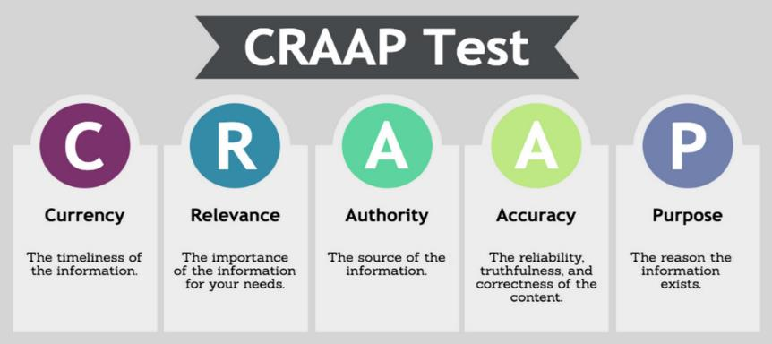
CRAAP Activity
Let’s Do It
Identify Creditable Sources Activity
Notes:
Instructions: Do a Google search for a topic of your choice. Using what you learned about the CRAAP test, find two
websites, one that you would be able to use as a source and one that you wouldn’t use as a reliable source.
Fill in the chart for each website.
Materials: None
Handouts: CRAAP Test: https://oercommons.s3.amazonaws.com/media/courseware/relatedresource/file/CRAAPtest.pdf
Time: 10 minutes

Slide 34
Digital Ethics
Notes:
Instructions: Digital ethics is the acceptable behavior standards to be followed by digital users while using the internet. They help digital citizens stay safe online by setting up a set of moral principles that govern the usage of Computers and Internet.
Materials: None
Handouts: None
Time: 1 minute

Slide 35
Digital Ethics Activity
How should people treat each other online?
Should a person download media without paying for it?
How should a person respond when he or she realizes someone else is being bullied?
Can internet users post whatever they want online?
What about spreading false information or pretending they are someone else?
Notes:
Instructions: One questions at a time will appear with a click. Ask questions and get feedback from participants.
How should people treat each other online?
Should a person download media without paying for it?
The Digital Millennium Copyright Act (DMCA) is a piece of legislation signed into law in 1998 defining the illegal downloading and/or sharing of copyrighted material. Copyright holders (or organizations acting on their behalf) actively monitor for devices sharing their content. Examples include movies, music, and software. If you download or distribute copyrighted media without authorization from the copyright owner, you are breaking the law.
Distribution can mean anything from “sharing” media files on the Internet, to burning multiple copies of copyrighted media.
How should a person respond when he or she realizes someone else is being bullied?
Cyber bullying is the use of electronic communications to bully a person, typically by sending messages of an intimidating or threatening nature. (stopbullying.gov)
Can internet users post whatever they want online? (Use appropriate examples such as current figures and how posting gets them in trouble.)
What about spreading false information or pretending they are someone else? (Refer back to how to find false information i.e. CRAAP test, also refer to how when you search for items it appears on your social media feeds)
Materials: None
Handouts: None
Time: 10 minutes

Slide 36
Questions
Discussion
Next Steps
Notes:
Instructions: Before the session begins, add any text to promote next educational opportunity.
Thank participants for attendance, allow for questions and discussion, promote the next lesson, encourage evaluation participation.
Materials: None
Handouts: None
Time: 10 minutes

