Slide 1
DIGITAL MARKETING: Harnessing the Power of Digital Media in the Workplace

Slide 2
SOCIAL MEDIA
The interactions among people in which they create, share, and/or exchange information and ideas in virtual communities and networks.

Slide 3
SOCIAL MEDIA
Personal Level
Communicate with family,
learn new things,
develop interests,
entertainment
Professional Level
Broaden knowledge,
Networking,
finding similar interests
Company Level
Conversations with audience,
gain customer feedback,
elevate your brand

Slide 4
SOCIAL MEDIA PEOPLE
The user is the person that is interacting with the social media account.
A profile is a short description of someone's life, work, character, etc. that is posted on social media platforms. For a business, this is usually a short description about the business, goods/services, location, contact information, etc.
The audience is the group of people you can reach with your content. This includes all your direct followers, plus anyone who sees or interacts with your posts in their feed.

Slide 5
POSTS
A post on social media is simply the content shared through a user's profile.
Here are some tips for creating effective social media post:
Keep post short and to the point
Use visuals to capture attention
Ask questions to engage audience
Use relevant hashtags to help people find your post
Promote post on other social media platforms

Slide 6
MORE TERMINOLOGY
A like is a form of engagement on social media. It's a quick way of showing that you like or enjoy the content posted by simply clicking a button.
A follow represents a user who chooses to see all of another user's posts in their content feed.
A feed is an updated list of all the new content posted by the accounts a user follows on social media.

Slide 7
MORE TERMINOLOGY
Analytics
Algorithms
Analytics are the metrics on social media performance and using that data to improve strategy for developing and promoting content.
The analytics can include information such as:
how many people directly saw the post
how many people shared it
how many people saw it because someone else shared it, etc.
An algorithm (or feed algorithm) is the set of rules/processes a social network uses to automatically decide which posts come first in a user’s feed.
Factors that influence how posts are ranked in a user’s feed may include:
the time and date the post was published
the number of people who have liked, commented, or shared the post
the user’s interest
the user’s location

Slide 8
POP QUIZ!
User or Audience?
The person that is interacting in the social media account
Answer: User!

Slide 9
POP QUIZ!
Post or Profile?
A short description of someone’s life, work, character, etc. that is posted on social media platforms
Answer: Profile!

Slide 10
POP QUIZ!
Feed or Sharing?
An updated list of all the new content posted by the accounts a user follows on social media.
Answer: Feed!

Slide 11
POP QUIZ!
Social Media or Analytics?
The interactions among people in which they create, share, and/or exchange information and ideas in the virtual communities and networks
Answer: Social Media!

Slide 12
POP QUIZ!
Like or Sharing?
A form of engagement on social media where a user indicates they enjoy content that’s been posted.
Answer: Like!

Slide 13
Common Social Media Platforms

Slide 14
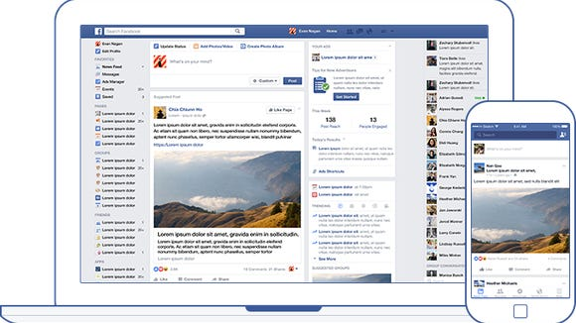
FACEBOOK
Some benefits of using Facebook include:
Free platform
Lots of users
Simple
Events
Paid Advertising

Slide 15
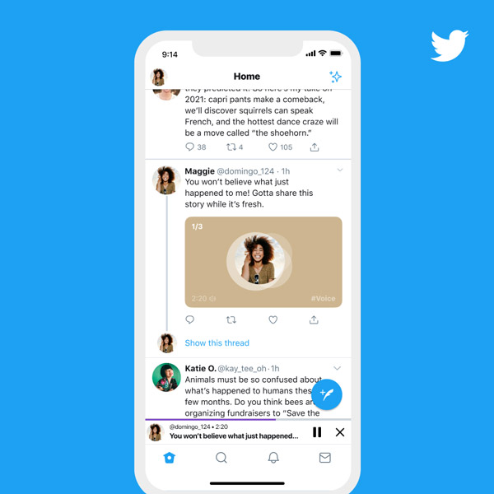
TWITTER
Some benefits of using Twitter include:
Free platform
Engaging with customers

Slide 16
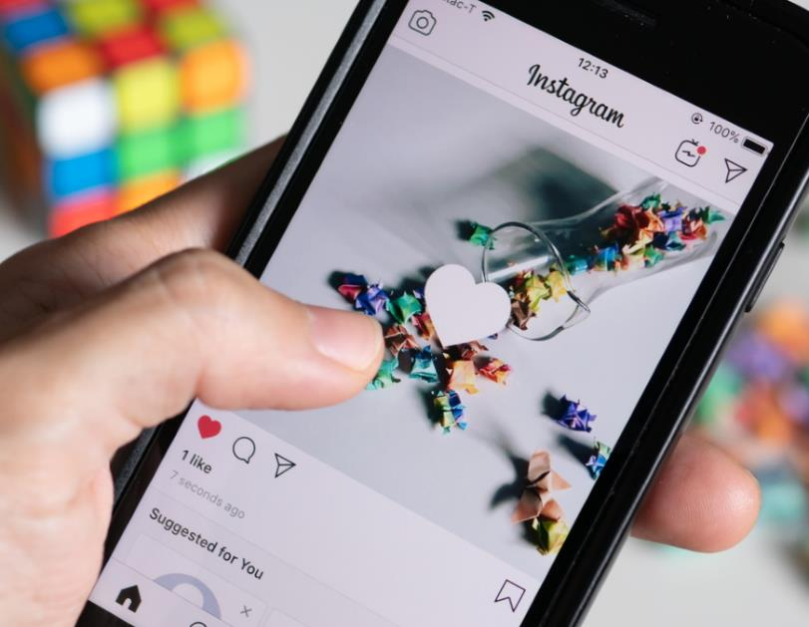
INSTAGRAM
Some benefits of using Instagram include:
Free platform
Simple
Similar advertising as Facebook

Slide 17
Activity

Slide 18
Reflections & Questions

Slide 19
Thank You!

