Slide 1
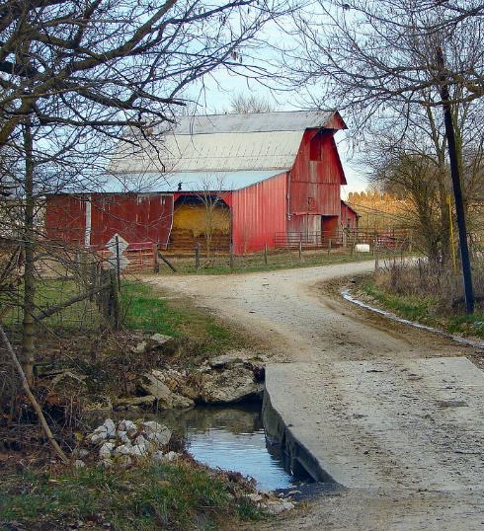



Community Workshop
Understanding
Heirs’ Property at the
Community Level
DATE
LOCATION
Notes:
Instructions: Before the session begins, insert the date and location for your event. Have this slide up as participants enter the room.
Please acknowledge that this material was developed in partnership with National Policy Center at Alcorn State University, the Southern Extension Risk Management Education Center, and the Southern Rural Development Center through funding in part from USDA.
Mississippi State University is an equal opportunity institution. Discrimination is prohibited in university employment, programs or activities based on race, color, ethnicity, sex, pregnancy, religion, national origin, disability, age, sexual orientation, genetic information, status as a U.S. veteran, or any other status to the extent protected by applicable law.
Questions about equal opportunity programs or compliance should be directed to the Office of Civil Rights Compliance, 231 Famous Maroon Band Street, P.O. 6044, Mississippi State, MS 39762, (662) 325-5839.
NOTE: If you do not do all three segments at the same event, insert slides 1-4 at the beginning of your other sessions as they provide the overarching foundation for the training.
Time: 1 minute
Materials: none
Handouts: None

Slide 2


Purpose:
To provide training on heirs’ property to communities and individuals.
Funding to develop this training provided by:
Notes:
Instructions: Explain the purpose of the overall curriculum.
Time: 1 minute
Handouts: None
Materials: none

Slide 3


Partnering Organizations
Notes:
Instructions: This slide highlights the partnering organizations that have worked together to develop materials and host trainings.
This material was developed and training for trainers was provided as a partnership with the National Policy Research Center at Alcorn State University, the Southern Extension Risk Management Education Center, and the Southern Rural Development Center hosted at Mississippi State University through funding in part from USDA.
Time: 1 minute
Materials: None
Handouts: None

Slide 4
Acknowledgements
Primary Authors
Andrea’ Barnes, Esquire
Mississippi Center for Justice
Gloria Bromell Tinubu, PhD
GBT Associates, LLC
Robert Zabawa, PhD
Tuskegee University
Kara Woods, PhD
Policy Analyst, The Policy Research Center, Alcorn State University
Contributors and Reviewers
Conner Bailey, PhD, Professor Emeritus, Auburn University
Sam Cook, Executive Director of Forest Assets, North Carolina State University
Savi Horne, Esquire, Executive Director, Land Loss Prevention Project
Lorette Picciano, Executive Director, Rural Coalition
Notes:
Instructions: Please acknowledge the primary and contributing authors to this material as well as the funding stream through the Southern Rural Development Center and the National Policy Research Center at Alcorn State University.
Time: 1 minute
Materials: none
Handouts: none

Slide 5
Presenters
Name
University
Name
University
Name
University
Notes:
Instructions: Add presenter information and introduce yourselves.
You can add your logos and institutional equal opportunity statement to the “Understanding Heirs’ Property lessons flyer template”.
Time: 1 minute
Materials: none
Handouts: none

Slide 6
Topics to Explore
OVERVIEW | What is Heirs’ Property?
 | Impacts of Heirs’ Property
 | Legal and Cultural Considerations
 | Fractional Ownership
 | Locating Heirs’ Property
 | Land Loss
 | Preventing Land Loss
PREVENTION | Basics of estate and succession planning
 | Steps to prevent heirs’ property when establishing a will
RESOLUTION | Review some of the challenges of owning heirs’ property
 | Importance of working with other family members
 | Steps to take to understand who legally owns the property
 | Legal structures that can hold land owned by heirs’ property owners
Notes:
Instructions: This slide shows the three parts of the curriculum and gives a quick view of the components covered in each section.
Time: 1 minute
Materials: none
Handouts: None

Slide 7
Warm Up and Introductions
Notes:
Instructions: Give time for participants to introduce themselves and their interest in learning about heirs’ property.
Have participants give their name and affiliation, etc.
Possible prompts: What brings you to this workshop? What are you curious about when it comes to heirs’ property?
If in tables, have people share for a maximum of a minute. If in rows, have them form dyads or triads and share.
Time: 10 minutes
Materials: none
Handouts: None

Slide 8
OVERVIEW OF HEIRS’ PROPERTY
Notes:
Instructions: This slide begins the Overview section.
Time: 1 minute
Materials: None
Handouts: None

Slide 9
Important notes before we begin:
These materials are intended to present general information as to preventing heirs’ property. They primarily draw upon information in the southern United States. The information may not be applicable to every state or territory. These materials do not provide legal advice. Specific advice should be obtained from an attorney or another professional well versed in the facts and circumstances related to the individual seeking advice and the jurisdiction where the property is located.
Notes:
Instructions: Read the disclaimer and answer any questions that may arise.
Time: 1 minute
Materials: none
Handouts: None

Slide 10
Protecting Your Information
No personal stories
General questions are welcome.
Personal questions should be asked outside of the group setting.
Notes:
Instructions: Go over these guidelines with participants to ensure that participants understand the reasons for not including stories or questions of a personal nature.
Time: 1 minute
Materials: none
Handouts: None

Slide 11
Part I: What is Heirs’ Property?
Notes:
Instructions: This is the section opener for discussing what heirs’ property is.
Time: 1 minute
Materials: none
Handouts: none

Slide 12

What is Heirs’ Property?
Refers to property passed down informally from generation to generation. Also known as “Fractured,” “Tangled,” “Clouded”
The original landowner dies without a will, or the will was not probated or administered
State laws determine who inherits your land.
Can potentially include multiple generations and hundreds of relatives
No single heir has clear title to the entire parcel. Each owner has an interest in the entire asset rather than each heir having their own piece of the asset
Notes:
Instructions: Using the talking points on the slide, give a brief overview of what is meant by heirs’ property.
Everyone gets their interest in the property. The interest amount is determined by heirship.
A person is not an heir until their previous generation has passed.
No matter what the interest size, each person is a co-owner, and all co-owners have the same amount of right (legally) to do or not do anything to the land. This will be explained more in the family tree section later in this presentation.
Time: 2 minutes
Materials: none
Handouts: none

Slide 13

Each Heir…
Has equal rights to full use and possession
Is legally responsible for taxes and other property-related expenses
May transfer by gift or sale their interest to another heir or non-heir
May seek physical division of the property
Must agree to any major decisions about the property
Notes:
Instructions: Go over the rights that each heir has a co-owner as described on this slide.
Time: 2 minutes
Materials: none
Handouts: none

Slide 14
Common Terms for Heirs’ Property Ownership:
“Clouded”
“Fractured”
“Without a clear title”
“Tangled”
“Family Land”
Notes:
Instruction:
As these examples demonstrate, heirs’ property is referred to by a lot of different names. These variations sometimes even appear within the same county.
The heirs’ own the property “without a clear title”
Sometimes referred to as “Family Land”, “Fractured”, “Tangled”, or “Clouded”
This restricts being able to manage the property and use the asset to accumulate wealth
Discussion: What challenges do you think this might cause?
Time: 5 minutes
Materials: None
Handouts: None

Slide 15
Common Terms
The heirs’ own the property without a “clear title”
Sometimes referred to as “Family Land", "Fractured”, “Tangled”, or “Clouded”
This restricts being able to manage the property and use the asset to accumulate wealth
Notes:
Instruction: As these examples demonstrate, heirs’ property is referred to by a lot of different names. These variations sometimes even appear within the same county.
Discussion: What challenges do you think this might cause?
Time: 5 minutes
Materials: None
Handouts: None

Slide 16

Important
If you do not decide
how you want your estate divided,
the state where your estate (property) is located will decide for you.
Notes:
Instructions: This important note helps set the stage for why this education is needed. No one wants the state to make the final decision on how their estate is divided after their death.
Time: 1 minute
Materials: None
Handouts: None

Slide 17
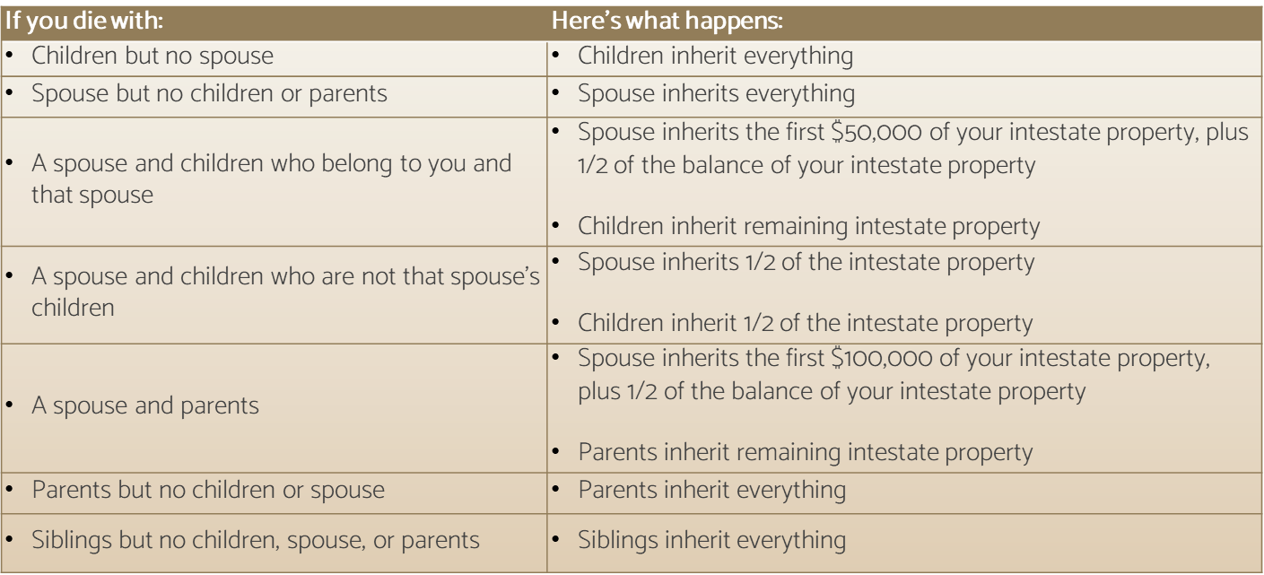
For example, if you die without a will in Alabama…
Notes:
Instructions: This chart shows the complexity of what could happen in just one state. State laws vary, making for a very complicated system.
Note: If participants begin asking a lot of “what if” questions about specific situations, use caution in responding. Rather remind participants that these are general statements intended to demonstrate the complexity of the situation.
Also, remember, and remind the participants, that you are not a lawyer, and detailed questions are better answered by a lawyer.
Time: 5 minutes
Materials: None
Handouts: None
Source: https://www.nolo.com/legal-encyclopedia/intestate-succession-alabama.html

Slide 18
Part II: Impacts of
Heirs’ Property
Notes:
Instructions: This is the section opener for discussing what heirs’ property is.
Time: 1 minute
Materials: none
Handouts: none

Slide 19
Impacts
On personal assets
On family decision making
On community development
Notes:
Instructions: Heirs’ property impacts multiple levels from the personal/family to community levels.
Time: 1 minute
Materials: None
Handouts: None

Slide 20

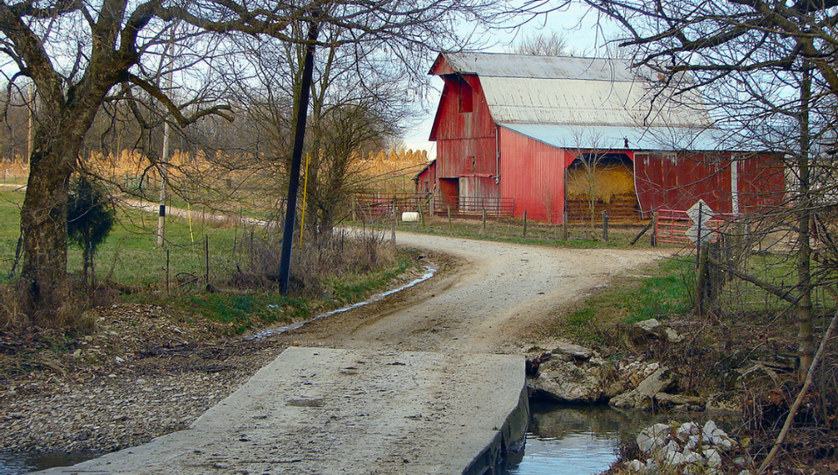
Impact of Heirs’ Property:
On the Landowner
Heirs’ property restricts how land can be managed.
Examples of management decisions:
Timber harvesting and reforestation
Farm planting and harvesting
Mineral rights
Mortgages and other loans
USDA programs
Conservation easements
Notes:
Instructions: Heirs’ property may restrict what the land can be used for, including generating income or improving it, e.g., getting a loan to build a permanent structure such as a house.
Heirs’ property restricts how land can be managed. Heirs need to agree on any decision concerning the land, including division of profits, for example:
Timber harvesting and reforestation
Farm planting and harvesting
Mineral rights
Mortgages and other loans
USDA programs
Conservation easements
Time: 5 minutes
Materials: None
Handouts: None

Slide 21

Impact on Personal and Family Assets:
Promoting intergenerational poverty
Cannot open a line of credit or apply for a mortgage
Cannot sell the property
Inhibiting full use of the land
Asset cannot be used as collateral for example, for a loan, to start a business
Cannot generate income by leasing the land or selling its natural resources
Hindering insuring property
Blocking access to some federal programs
Challenges in getting a farm number to be able to participate in USDA and state programs
Notes:
Instructions: While owners of heirs' property have an asset, it is an asset with very limited capability. Stress these shortcomings of this asset.
Promoting intergenerational poverty – the lack of personal ownership of the land inhibits wealth creation.
Inhibiting full use of the land– some potential uses of the land require all heirs to agree, which can be challenging
Hindering insuring property – May require proof of ownership, which is challenging for heirs
Blocking access to some federal programs – some federal programs require proof of ownership to participate
Time: 4 minutes
Materials: None
Handouts: None

Slide 22
Impact on Participation in Federal Programs:
Historically lack of title has made it difficult to participate in federal agricultural programs offered by (USDA)
Recent positive policy changes address some of those challenges (ex: heirs’ property owners can now get farm numbers and participate in USDA programs under certain conditions).
Notes:
Instructions: While owners of heirs' property have an asset, it is an asset with very limited capability. Stress these shortcomings of this asset. Especially when trying to participate in federal programs like USDA or FEMA.
Time: 4 minutes
Materials: None
Handouts: None

Slide 23




Impact of Heirs’ Property:
On the Community
Affects how land is managed
Land cannot be developed to full potential
Community loses taxes
Lost opportunities for improvements
Notes:
Instruction:
This slide shows how limits in use of heirs’ property land ultimately impact the community.
If heirs’ property affects how land is managed, and it cannot be developed to its full potential, then the community loses on potential taxes based on increased development and improvements. This impacts:
Roads and Bridges
Fire and Safety
Sanitation
Education
Time: 5 minutes
Materials: None
Handouts: None

Slide 24
SUMMARIZING
Up to this point we know that…
Heirs’ property land is held without marketable title
Heirs’ property is passed from one generation to the next due to lack of probated will or judicial proceeding
Heirs’ property has limited investment potential and is at risk for loss through legal and other means
Notes:
Instructions: Review these summary points to prepare for the next section.
Time: 1 minute
Materials: None
Handouts: None

Slide 25
Part III:
Legal and Cultural Considerations:
Both are Important
Notes:
Instructions: This is the section opener for discussing legal and cultural barriers that heir property owners may face. Both legal and cultural considerations are Important in determining how land is passed down and used from one generation to the next.
Time: 1 minute
Materials: None
Handouts: None

Slide 26

Question:
To prevent the problems associated with heirs’ property, all you need is a Will?
YES and NO
Notes:
Instructions: Some might quickly assume that all that is needed is a will. However, several points come into the picture as families navigate this space.
Time: 1 minute
Materials: None
Handouts: None

Slide 27
Competing Strategies
YES: a properly executed will, written according to state law, that divides land into specific acreages or parcels, can secure title to land from one generation to the next. (No “all my children” without specific acreage.)
NO: a properly executed will is not the only way that property can be transferred from one generation to the next.
The first action is a legal consideration and the second is a cultural consideration.
Notes:
Instructions: This slide discusses the “yes/no” in more detail. Note that in addition to the slides in this overview section, this curriculum includes a more detailed section on prevention of heirs’ property through estate planning.
Time: 2 minutes
Materials: None
Handouts: None

Slide 28

Legal Considerations
Barriers to transferring land as a legal
strategy include:
Lack of knowledge about wills
Expense of hiring an attorney
Mistrust of a legal system that has often helped take away land
Notes:
Instructions: Several barriers exist to transferring land. Some of the most often noted ones are listed here.
Previous studies have found that a large percentage of Americans in general do not have a will (often as high as 50%). The percentage of African Americans without a will is significantly higher, approaching 70% or more. The reasons for not writing a will or other forms of estate planning include misinformation about how, when or who to include in a will; the avoidance of family disputes on who will receive what assets; to even beliefs that writing a will indicates that a person is ready to die or will bring on death.
The expense for an attorney is not insignificant, though some may provide a sliding scale.
Many landowners have past experiences or heard stories dealing with lawyers, judges, and other county officials who participated in land takeaway schemes.
Time: 5 minutes
Materials: None
Handouts: None

Slide 29

Cultural Considerations
Barriers to transferring land as a cultural
strategy include:
Land is not a commodity to be sold.
Taboo Death Talk
Land provides a homestead where everyone can come back
Land gives a religious connection that should be respected. The history of the land should be respected.
Notes:
Instructions:.
Culture may also play a part in creating barriers. For instance,
Land is not a commodity to be sold. Some consider land to be a part of the family in a different way than other financial assets. Thus, it isn’t considered a commodity to be sold.
Taboo Death Talk. In some cultures, talking about death is considered “taboo,” which can hinder discussions about prevention or resolution.
Land provides a homestead where everyone can come back. Having a family “homestead” where all generations can gather is valued in some cultures.
Land gives a religious connection that should be respected. The history of the land should be respected.
Time: 5 minutes
Materials: None
Handouts: None

Slide 30

Cultural Considerations, continued
Barriers to transferring land as a cultural
strategy include:
Heirs further away in distance may place less priority on keeping the land intact.
All heirs may not agree on proper land use and access.
Generations may value land differently.
Notes:
Instructions: Other cultural barriers include:
Heirs that live further away in distance from the land may place less priority on keeping the land intact
All heirs may not agree on how the land should be used and accessed.
Younger generations may value land differently than older generations.
Time: 5 minutes
Materials: None
Handouts: None

Slide 31
Consider this Quote: Valuing Land in Common
“For [the family], the commitment to heir land remained in force, enforced not by law – where the practice and concept was vulnerable – but by shared understanding… The land should stay undivided, open to and for all the heirs.
Land is not a commodity that is sold, but a right that is transferred to kin as needed.
The land was for open access and undivided family use, and not to be restricted by deeds.”
A Mind to Stay: White Plantation, Black Homeland, Sydney Nathans (2017)
Notes:
Instructions: On the other hand, some families prefer that all family members have equal access to family land. Unfortunately, besides the economic consequences of heirs’ property (provided previously), having unsecured title means that the land is vulnerable to partition sales (upcoming slides).
Read this quote.
Pair/share: What do you hear in this quote that is similar to your family’s thoughts about land ownership? What is different?
Time: 5 minutes
Materials: None
Handouts: None

Slide 32
Consider this quote: Changing Values
“When young people grow up…they don’t see the necessity of owning land….My parents, my grandparents, suffered all their lives to buy eleven hundred acres of land…[Land] had a sentimental value to it, ‘cause we had to get a livelihood, we had to get our bread from the land….Now children think that milk comes from the store….They don’t see the relevance of the land….[They] have no idea what it took for black folks to own land.”
A Mind to Stay: White Plantation, Black Homeland, Sydney Nathans (2017)
Notes:
Instructions: Read this quote.
Pair/share – Do you see this situation in your family? What interest do you see in younger generations in maintaining the land?
What challenges could be created if any of the heirs are no longer interested in keeping the land?
Time: 10 minutes
Materials: None
Handouts: None

Slide 33


How Property Law is Used to Appropriate Black Land
Notes:
Instructions: Search Title: “How Property Law Is Used to Appropriate Black Land”
Before playing the video let people know this video could raise difficult emotions, which we will have time to talk about after the video.
After viewing the video, ask participants what they have learned from this family’s experience?
Time: 22 minutes
Materials: None
Handouts: None
Link: https://www.youtube.com/watch?v=ls3P_FicO7I

Slide 34
Video Debrief
What comes up for you?
Does it bring to the light the significance of the problem?
Do you see where you can act to avoid this situation?
Questions
Notes:
Instructions: Guide a discussion about the film and give the audience a chance to speak on thoughts and feelings.
Time: 5 minutes
Materials: None
Handouts: None

Slide 35
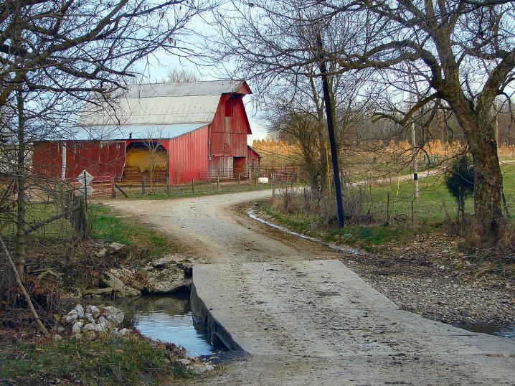
Part IV: Fractional Ownership: Challenges of Time, Distance, and Knowledge
Notes:
Instructions: This is the section opener for discussing how fractional ownership begins and challenges associated with the increase of owners.
Time: 1 minute
Materials: None
Handouts: None

Slide 36
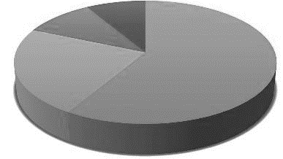
Fractional Ownership
The SIZE of each heirs’ fractional
ownership interest depends on
several factors such as:
How many generations removed is an heir from the original deceased landowner?
How many heirs can rightfully take their inheritance at a specific point in time?
Notes:
Instructions: Heirs’ property means that heirs have an undivided fractional interest in the land. Fractional here means a percentage interest as opposed to actual acreage. Note these two key factors that influence fractional interest. These are discussed further in the next slide.
Time: 1 minute
Materials: None
Handouts: None

Slide 37
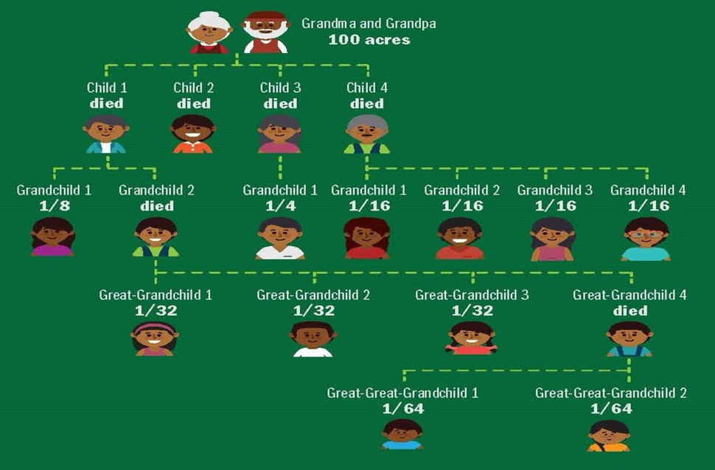
Time: Across Generations, Things Get Complicated!
Parents
Children
Grandchildren
Great-grandchildren
Rounded
Great-great-grandchildren
Notes:
Instructions: In this example, the diagram shows four generations of heirs, with more people in each generation having a smaller fractional interest. Each generation gets a percentage of their parents’ share. So, in this example, the four children each had 25%. But as they pass away, their percentage is divided among their respective children.
In all, there are 17 heirs, 11 heirs surviving, across four generations, with fractional interests ranging from 1/4 to 1/64.
NOTE: Remember, although not depicted here, a spouse of a deceased heir may inherit that person’s share.
Time: 10 minutes
Materials: none
Handouts: none
Source: https://www.atlantafed.org/-/media/documents/news/conferences/2017/0615-heirs-property-in-the-south/infographic.pdf

Slide 38
Fractional Ownership: Example of 40 Acres
and a Mule
Notes:
Instructions: This slide begins another example of land fractionation over time.
Time: 1 minute
Materials: None
Handouts: None

Slide 39
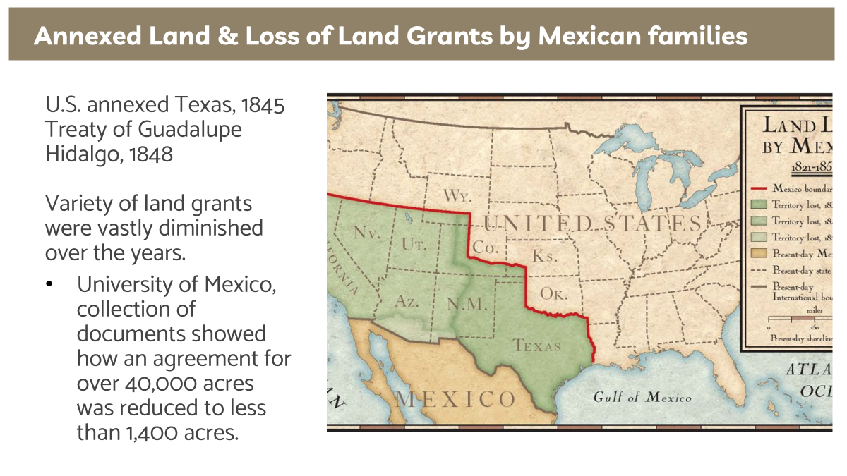
Land Grants Example
Notes:
Facilitators can share all three options or the option that is most relevant to the audience.
Option 1: Example of Land Grant States
Instructions: An example of annexed land and land grant lands.
Time: 3 minutes
Materials: None
Handouts: None

Slide 40

Homestead Act of 1862
Opened up millions of acres in the American West
Requirements:
US citizen
21 years old
Not taken up arms against the US
160 acres
5 years of improvements (production)
House
Notes:
Option 2: Example of Midwest States
Instructions: An example of the Homestead Act of 1862. .
Time: 3 minutes
Materials: None
Handouts: None

Slide 41

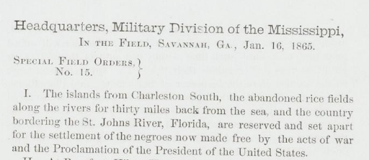
40 Acres and a Mule
“Sherman’s Field Order No. 15
“Pertain only to South Carolina, Georgia and Florida coastline and was based on the redistribution of 40,000 acres into 40 acres segments”
Notes:
Instructions: A famous example is land taken by the advancing Union armies and distributed to the formerly enslaved.
Time: 5 minutes
Materials: None
Handouts: None

Slide 42

40 Acres: 1865
If a farmer and spouse with 4 children died intestate in 1865, each child would have 25% share in the 40 acres or an interest equivalent to 10 acres.
Farmer & Spouse
Child 25%
Child 25%
Child 25%
Child 25%
Notes:
Instructions: Walk participants through this example that might have happened in 1865.
Time: 2 minutes
Materials: None
Handouts: None

Slide 43
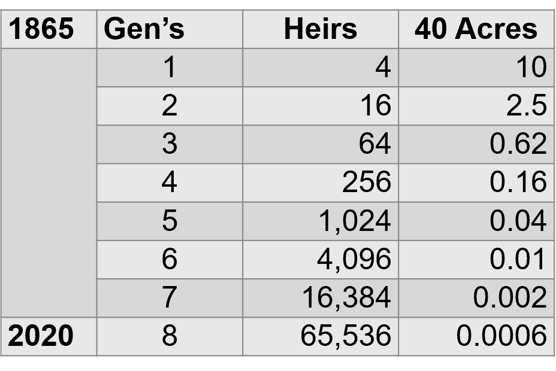
40 Acres: 1865 - 2020
If each child had 4 children across the 8 generations until 2020, there would be 65,536 heirs, each with a shared interest equivalent to 0.0006 acres, or about 26 square feet.
Notes:
Instructions: “Fast forward” the story to 2020. How would the story be different?
Time: 5 minutes
Materials: None
Handouts: None

Slide 44
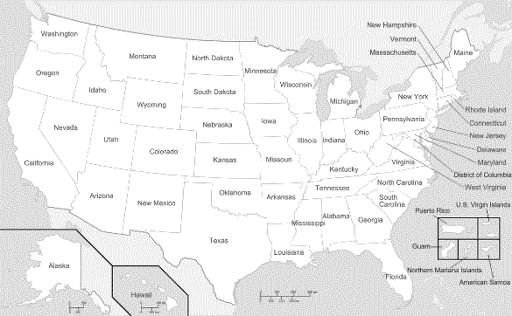
Distance Causes Challenges
Heirs may not all live on or near the land.
Distance can lead to disinterest.
(Stars are just an example showing how families can become geographically scattered.)
Notes:
Instructions: As time goes on, heirs may move to different places and no longer have strong connections to the land. Yet they are still heirs. The lack of connections may leave the land vulnerable as remote heirs may be more willing to sell their share in the land to someone outside the family.
Time: 2 minutes
Materials: None
Handouts: None

Slide 45


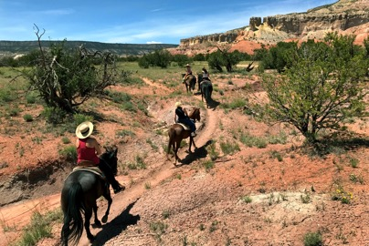
Management Challenges:
Over time, heirs may not:
Live on or near the land
Live near each other
Know one another
Know how to locate one another
Have a connection to the land
Notes:
Instructions: In sum, family land is hard to manage. Here are reasons why.
With numerous co-owners, the following can occur, which can impede proper management of the land:
Heirs do not live on or near the land
Heirs do not live near each other
Heirs do not know one another
Heirs do not how to locate one another
Heirs do not have a connection to the land
Time: 2 minutes
Materials: None
Handouts: None

Slide 46
Part V: Locating Heirs’ Property
Notes:
Instructions: This is the section opener for discussing how landowners can find out if their family land is considered heir property in the county system.
Time: 1 minute
Materials: none
Handouts: none

Slide 47
Is there Heirs’ Property in my…
Region and State
County
Family
Notes:
Instructions: Heirs’ property is a phenomenon that has personal and regional implications. The next few slides will walk participants through some data on heirs’ property on different levels, helping to create understanding on the extent of the problem.
Time: 1 minute
Materials: none
Handouts: none

Slide 48
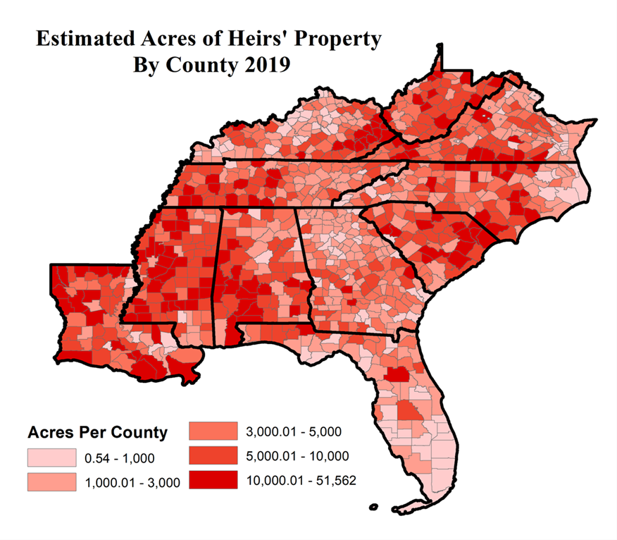
Heirs’ Property in the
Southeast
Source: Thomson, R. and Bailey, C., 2023. Identifying Heirs’ Property: Extent and Value Across the South and Appalachia. Journal of Rural Social Sciences, 38(2), p.2.
Notes:
Instructions: While there are concentrations of heir's property across the United States, African American heirs' property is found mainly within the Southeast region.
Time: 1 minute
Materials: None
Handouts: None
Source: Thomson, R. and Bailey, C., 2023. Identifying Heirs’ Property: Extent and Value Across the South and Appalachia. Journal of Rural Social Sciences, 38(2), p.2.

Slide 49
Is there Heirs’ Property in my…
Region and State
County
Family
Notes:
Instructions: Many families of one county may have heirs’ property. Also, in many cases, those with heirs' property may not even live in the same community, county, or even state, where the property is located.
Time: 1 minute
Materials: None
Handouts: None

Slide 50
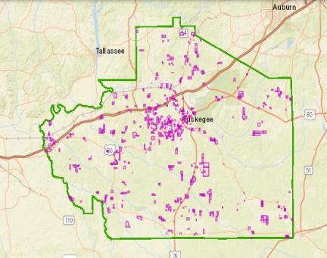
Heirs’ Property in Macon County, AL
Notes:
Instructions: Local GIS websites can allow you to see heirs’ property at the county level in some states. This example is from Macon County, Alabama, with heirs’ property in red.
Time: 1 minute
Materials: None
Handouts: None

Slide 51
Is there Heirs’ Property in my…
Region and State
County
Family
Notes:
Instructions: Now, let’s focus on your family.
Time: 1 minute
Materials: None
Handouts: None

Slide 52

Looking Online
Locate the county revenue commissioner’s office online
Connect with GIS site (online mapping tool)
Type in your family’s name
Notes:
Instructions: Online records are sometimes available through the county revenue commissioner’s office (or similar office in other states). The next few slides will demonstrate an example of what might be available online.
You may find it helpful to find the local office for this training and be ready to discuss differences. Instructions for doing this are on the next slide.
Time: 5 minutes
Materials: none
Handouts: none

Slide 53
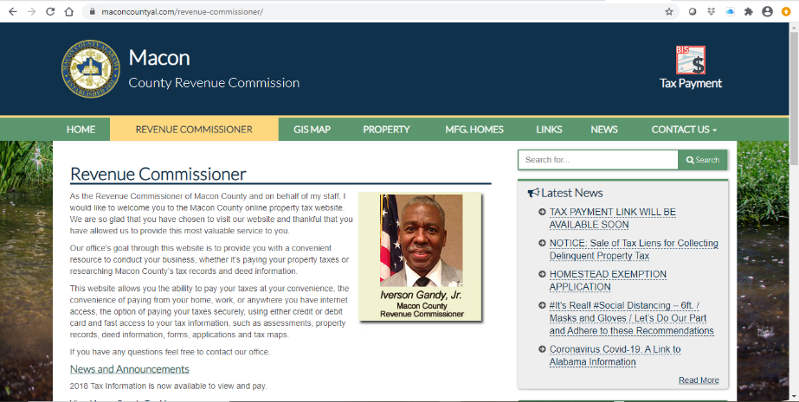
An Example: Your county will look different.
Notes:
Instructions: This slide shows how Macon County, Alabama’s site looks.
Notice the link to the GIS Map as the starting point.
Activity:
Searching your county records online
Open your browser on your computer, phone, or other web-based device.
Search for your county, state, GIS
Is it accessible? If so, can you type in a search?
If you can type in a search, type in your last name. Did anything show up?
Discussion: Take a few minutes for different participants to share what they found or anything they noticed.
Time: 10 minutes
Materials: None
Handouts: None

Slide 54
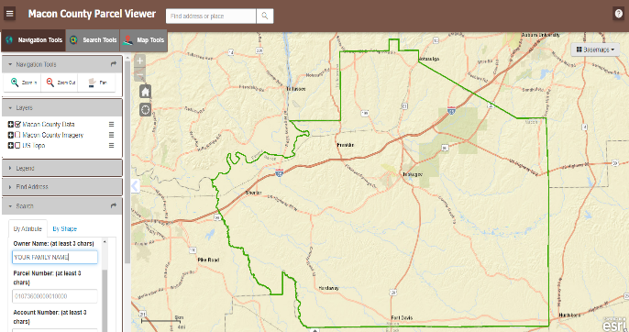
Insert Your Family Name
Notes:
Instructions: A family name can be entered to begin the search.
Time: 1 minute
Materials: None
Handouts: None

Slide 55

If your family name is followed by
“heirs of…”
“estate of…”
“et al. …”
“% interest…”
“care of…”
Then you may have heirs’ property
Notes:
Instructions: These words will sometimes appear in the search for a family name. Seeing any of these may indicate you have heirs’ property. The next slide shows how those might appear.
Time: 2 minutes
Materials: None
Handouts: None

Slide 56

Label Challenges – Searching for terms
Term | Examples of how it might be written
Heir | Heir
Deceased | Deceased, Dec., Dec’d.
Estate | Estate, Est.
Et al | Et al, etal
Other search challenges:
The word “heirs” is also part of the word “their”
“Estate” may be part of a proper name (i.e. “Garden Estate”)
Notes:
Instructions: In addition to the challenges of having different terms for heirs’ property, inconsistencies in how they are written create even more challenges. Additionally, search terms also may be part of larger terms, “heir” is inside “their” and “estate” may be a proper name for a residential community, or the name of a road.
Also, while all the land tracts listed under et al, or estate, etc. may not be heirs’ property, a significant percentage may be.
Therefore, it may be necessary to ask your county official, the Tax Assessor, the Revenue Commissioner, etc., what term(s) they use to indicate heirs’ property.
Time: 5 minutes
Materials: None
Handouts: None

Slide 57
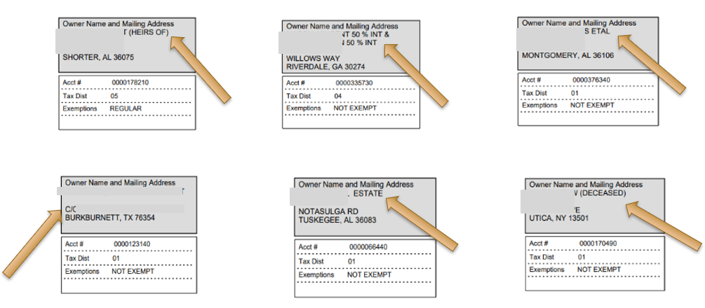
Examples of How This Might Look
Notes:
Instructions: Point out how the different designations show up on these examples.
Time: 5 minutes
Materials: None
Handouts: None

Slide 58

Access Challenges
Complete open access
Open access with limited numbers
Manual open access
Blocked access
Payment
Notes:
Instructions: Different counties have differing levels of access to on-line land parcel information. Some information is easily accessible, while some may require a login and password, or even a fee.
Time: 5 minutes
Materials: None
Handouts: None

Slide 59
Part VI: Land Loss
Because heirs’ property is land without
secured title,
it is often the target of predatory strategies, many legal.
Notes:
Instructions: Because heirs’ property is land without secured title, it is often the target of takeaway strategies, many legal. This next section explores some of the common ways in which the land is lost.
Time: 1 minute
Materials: None
Handouts: None

Slide 60
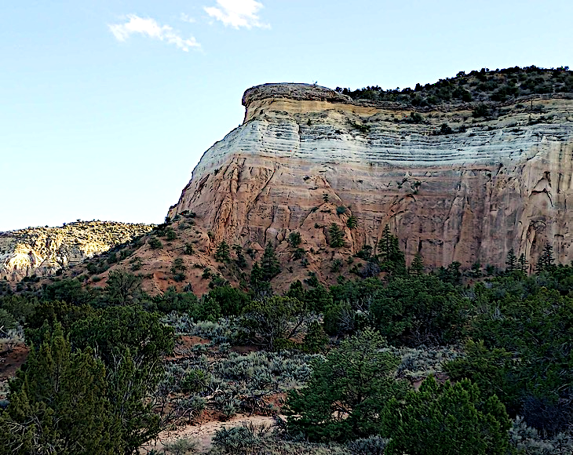
Part VI: Land Loss
Because heirs’ property is land without
secured title,
it is often the target of predatory strategies, many legal.
Notes:
Instructions: Because heirs’ property is land without secured title, it is often the target of takeaway strategies, many legal. This next section explores some of the common ways in which the land is lost.
Time: 1 minute
Materials: None
Handouts: None

Slide 61

Heirs’ Property and Land Loss
89% Decline in U.S. Black Ag Land
Ways heirs’ property can be lost:
Tax Sales
Partition Sales
Notes:
Instructions: This slide outlines some of the ways heirs’ property can be lost.
In 1910, there were 15,961,506 acres on Black-owned farms in full-ownership (with no additional rented acres or part-ownership, or land used by tenants or sharecroppers). By the last agricultural census in 2022, this number has declined by 89% to 1,840,788 acres on Black-owned farms in full-ownership.
Major cause of this land loss was through land as heirs' property.
Ways heirs’ property can be lost:
Partition Sales
Tax Sales
…and some heirs have no interest in the land at all.
Time: 10 minutes
Materials: None
Handouts: None
Sources:
US Department of Commerce, Bureau of Census. 1914. 1910 Census: Volume 5. Agriculture, 1909 and 1910, General Report and Analysis. Chapter IV, Table 16, p. 182. Washington, DC.
https://agcensus.library.cornell.edu/wp-content/uploads/41033898v5ch03.pdf
US Department of Agriculture, National Agricultural Statistics Service. 2022. Census of Agriculture, United States Data, Table 61, p. 80.
https://www.nass.usda.gov/Publications/AgCensus/2022/Full_Report/Volume_1,_Chapter_1_US/usv1.pdf

Slide 62

Tax Sales
Alabama Example: From Non-payment of Taxes:
Taxes due in October
Delinquent after December 31st
Tax sales on May 3, 2021
Auction for payment of back taxes and fees, with bidding for interest starting at 12% and going down, to receive a tax lien certificate
After 3 years, owns the property (land, house)
Up to 3 years, owner has chance to buy back the tax deed by paying past taxes plus interest, up to 12%
Notes:
Instructions: If you don’t pay your property taxes, the county auctions your tax bill and interest in a “bid down” process starting at 12%. If you don’t reclaim your tax lien within three years, which includes repaying the tax bill plus interest, then the land will go to the bidder.
There are always investors who look for these tax sales as a way of either getting land for just the tax value, or as a way to invest their capital at a high interest rate.
This means that all heirs/landowners, particularly absentee landowners, need to keep track of who is paying the property taxes on their heirs' property.
Time: 10 minutes
Materials: None
Handouts: None

Slide 63

Partition Sales
One or more co-owners of the property sell their fractional interest to an entity; i.e. a developer
The entity files a “partition action” asking a court to order the whole property be sold so that the developer can get the value of their interest
The property gets sold.
Proceeds from the sale are distributed among co-tenants based on their fractional interest.
Result: family loses the land
Notes:
Instructions: A partition action may be brought against the co-tenants of heirs’ property, either family members or non-family members.
While a co-tenant cannot “sell” the land, they can sell their interest in the land. In this case, an outside party can gain access to the land as if they were a part of the original family unit, with all the rights and obligations.
In many cases, the point of gaining access to the land is to file a partition action with the final objective of gaining the whole piece of land.
Partition sales are a common way African-American landowners have lost, and continue to lose, their land.
A partition sale is a court-ordered sale of land.
A partition action may be brought by any co-tenant, regardless of their percent interest.
With a partition sale, at public auction, the highest bidder becomes the owner. The proceeds from the sale are then distributed among all the co-tenants of the property according to the size of their fractional interest.
The end result is that the land is lost to the family.
Time: 10 minutes
Materials: None
Handouts: None

Slide 64
Preventing Land Loss -
Uniform Partition
of Heirs Property Act
(UPHPA)
Notes:
Instructions: For decades, state partition laws contributed to widespread and devastating land loss among families who owned land as tenants-in-common. As a result of class action lawsuits and the publication of an article on partition action abuses, a task force was formed to start efforts to reform partition law. The next few slides give an overview of what this means to heirs’ property owners.
Time: 1 minute
Materials: None
Handouts: None

Slide 65
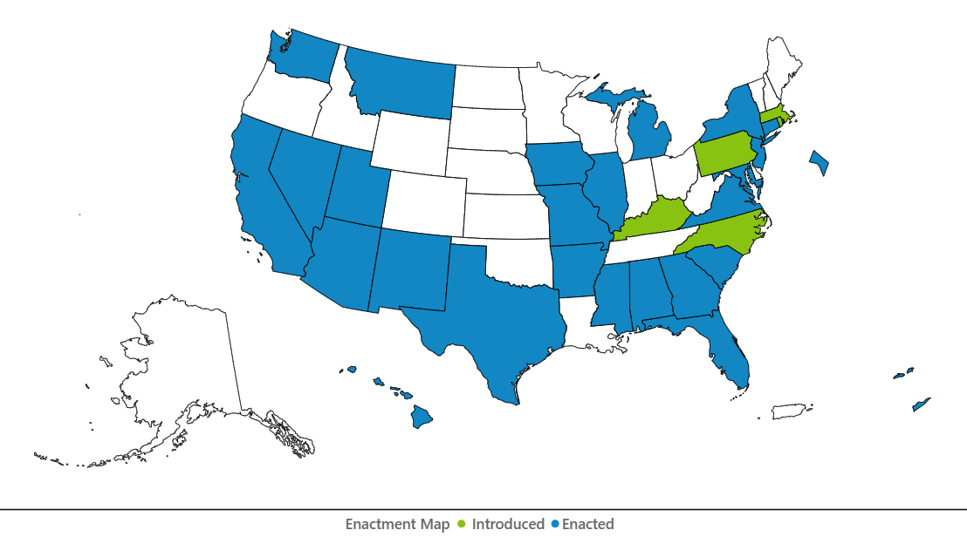
Uniform Partition of Heirs Property Act (UPHPA)
Uniform Partition of Heirs Property Act (UPHPA) is a model law that state legislatures can adopt. It creates fair procedures for heirs’ property owners when a partition action is filed.
Under the UPHPA, heirs’ property owners have rights that protect them from losing their land and if the land is sold, it is sold for a fair value.
We’ll talk more about this in a later section of this training.
Where the Uniform Partition of Heirs Property Act has been adopted or introduced
May 2024
Uniform Law Commission site at uniformlaws.org
Notes:
Instructions: The American Bar Association’s (ABA) Section of Real Property, Trusts and Estates Law formed a task force and submitted a proposal in 2006 to the Uniform Law Commission. The Uniform Law Commission also known as the National Conference of Commissioners on Uniform State Laws worked to develop a model State statute that would address partition laws. The Uniform Law Commission approved the Uniform Partition of Heirs Property Act (“UPHPA”) in the summer of 2010.
Note: It is important to note that the Uniform Law is not effective until adopted by state legislature. This is a map of states who have enacted the Uniform Partition of Heirs Property Act, highlighted in blue. It also shows states where the UPHPA was introduced, and those states are highlighted in green.
Time: 2 minutes
Materials: None
Handouts: None
Source: https://www.uniformlaws.org/committees/community-home?CommunityKey=50724584-e808-4255-bc5d-8ea4e588371d

Slide 66
How Does the UPHPA Help? Provides the following protections in partition actions:
01
Enhances Notice
02
03
Independent Appraisal
Right of First Refusal
04
Preference for Partition-in-Kind
05
Open-Market Sale
06
Partition in Kind- Dividing land into pieces of equal value for co-tenants
Notes:
Instructions: This slide gives a snapshot of the specific protections included. The following slides go into more detail.
Time: 1 minute
Materials: None
Handouts: None

Slide 67
How Does the UPHPA Help?
Applies only to heirs’ property
May help heirs’ property landowners maintain ownership of their property
Provides additional protections against the forced sale of heirs’ property
Preserves the right of a co-tenant to buy out the co-owner who wants to sell their interest
Restructures the way partition sales occur so if the land is sold, a fair value is obtained
Notes:
Instructions: This slide gives an overview of how the UPHPA helps heirs’ property owners. The UPHPA contains legal protections for heirs’ property landowners designed to address the devastating effects of partition sales while balancing the interest of all owners of the property. In order for a partition action to be governed by the UPHPA, the property in question must constitute “Heirs Property” as defined by the UPHPA.
NOTE: A co-tenant is defined as a person having a fractional ownership interest in property.
The next few slides give more detail.
Time: 2 minutes
Materials: None
Handouts: None
Source: The Uniform Partition of Heirs Property Act, Section 2. Definitions

Slide 68

Critical Step to determine how the UPHPA can help you…
Speak with an attorney licensed to practice law in the state where your land (real property) is located about the UPHPA, its enactment in your state, and how it can help resolve your heirs’ property issue.
Notes:
Instructions: Be sure to emphasize that for your audience to understand how the UPHPA can help resolve their heirs’ property issue, it is important to speak with an attorney licensed to practice law in the state where the land (real property) is located.
Points to discuss include:
The ethical rules concerning representing a family or one or more members
Whether UPHPA is enacted in your state, and if not, how the heirs’ property law is governed
How the UPHPA or other applicable real property law may help resolve your heirs’ property issue.
Time: 1 minute
Materials: None
Handouts: None

Slide 69
Quick Survey
Do you understand why heir property is an important issue?
What got you fired up?
What is something you wish you had more information on?
Notes:
Instructions: Take a quick hand survey to see how the participants feel about the information they just learned.
Time: 1 minute
Materials: None
Handouts: None

Slide 70
Thank You!
Notes:
Instructions: Thank the participants and ask for any additional questions.
Time: 1 minute
Materials: None
Handouts: None

Slide 71




Community Workshop
Understanding
Heirs’ Property at the
Community Level
Workshop Evaluation
Please Scan the QR Code
Notes:
Instructions: This slide is to prompt the evaluation process. If you are using paper copies, please hand them out at this time. If you are using the online Qualtrics evaluation, use the QR code for the Heirs’ Property Community Workshop Survey.
Note: Check to make sure the QR code is working properly before sharing with participants.
Time: 10 minutes
Materials: none
Handouts: Paper copies of the Heirs’ Property Community Workshop Survey and/or the QR code on this slide.

