Slide 1
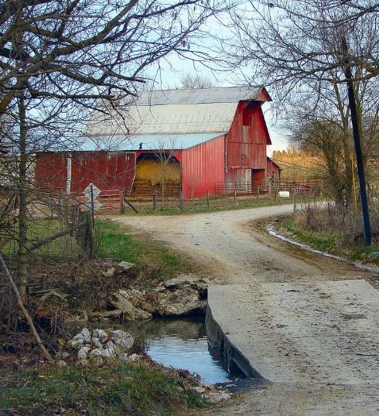



Community Workshop
Understanding
Heirs’ Property at the
Community Level
Date
Location
Notes:
Instructions: Before the session begins, insert the date and location for your event. Have this slide up as participants enter the room.
This material was developed and training for trainers was provided as a partnership with the National Policy Research Center at Alcorn State University, the Southern Extension Risk Management Education Center, and the Southern Rural Development Center hosted at Mississippi State University through funding in part from USDA.
Mississippi State University is an equal opportunity institution. Discrimination is prohibited in university employment, programs or activities based on race, color, ethnicity, sex, pregnancy, religion, national origin, disability, age, sexual orientation, genetic information, status as a U.S. veteran, or any other status to the extent protected by applicable law.
Questions about equal opportunity programs or compliance should be directed to the Office of Civil Rights Compliance, 231 Famous Maroon Band Street, P.O. 6044, Mississippi State, MS 39762, (662) 325-5839.
NOTE: If you do not do all three segments at the same event, insert slides 1-4 at the beginning of your other sessions as they provide the overarching foundation for the training.
Time: 1 minute
Materials: none
Handouts: None

Slide 2


Purpose:
To provide training on heirs’ property to communities and individuals.
Funding to develop this training provided by:
Notes:
Instructions: Explain the purpose of the overall curriculum.
Time: 1 minute
Handouts: None
Materials: none

Slide 3


Partnering Organizations
Notes:
Instructions: This slide highlights the partnering organizations that have worked together to develop materials and host trainings.
This material was developed and training for trainers was provided as a partnership with the National Policy Research Center at Alcorn State University, the Southern Extension Risk Management Education Center, and the Southern Rural Development Center hosted at Mississippi State University through funding in part from USDA.
Time: 1 minute
Materials: None
Handouts: None

Slide 4
Acknowledgements
Authors:
Conner Bailey, PhD
Professor Emeritus
Auburn University
Francine Miller, Esq.
Center for Agriculture and Food Systems
Vermont Law and Graduate School
Ryan Thomson, PhD
Assistant Professor of Rural Sociology
Auburn University
Contributors and Reviewers
Sam Cook, Executive Director of Forest Assets, North Carolina State University
Dãnia Davy, Esq., Federation of Southern Cooperatives
April Love, Esq., SDFR Policy Research Center, Alcorn State University
Sandra Thompson, EdD, Lady Heirs Property, LLC.
Michael Trusclair, USDA Liaison, Alcorn State University
Notes:
Instructions: Please acknowledge the primary and contributing authors to this material as well as the funding stream through the Southern Rural Development Center and the National Policy Research Center at Alcorn State University.
Time: 1 minute
Materials: none
Handouts: none

Slide 5
Presenters
Name
University
Name
University
Name
University
Notes:
Instructions: Add presenter information and introduce yourselves.
You can add your logos and institutional equal opportunity statement to the “Understanding Heirs’ Property lessons flyer template”.
Time: 1 minute
Materials: none
Handouts: none

Slide 6
Topics to Explore
OVERVIEW | Heirs’ property definition
 | How heirs’ property is identified
 | Factors associated with the prevalence of heirs’ property
 | Impacts of heirs’ property
 | Relationship between tax sales, partition sales, and land loss
 | Laws, policies, and programs relevant to heirs’ property
PREVENTION | Basics of estate and succession planning
 | Steps to prevent heirs’ property when establishing a will
RESOLUTION | Review some of the challenges of owning heirs’ property
 | Importance of working with other family members
 | Steps to take to understand who legally owns the property
 | Legal structures that can hold land owned by heirs’ property owners
Notes:
Instructions: This slide shows the three parts of the curriculum and gives a quick view of the components covered in each section.
Time: 1 minute
Materials: none
Handouts: none

Slide 7
Warm Up and Introductions
Notes:
Instructions: Give time for participants to introduce themselves. You could also include a brief question for them to answer such as what is one question or curiosity you have about heirs’ property. Don’t take time to answer those at this point. Rather this is about acknowledging where their curiosities are, and how the group can share this time together to learn and support each other.
Time: 1 minute
Materials: none
Handouts: none

Slide 8
HEIRS’ PROPERTY:
RESOLUTION
Notes:
Instructions: This slide begins the resolution section.
Time: 1 minute
Materials: None
Handouts: None

Slide 9
Important notes before we begin:
These materials are intended to present general information as to preventing heirs’ property.
They primarily draw upon information in the southern United States.
The information may not be applicable to every state or territory.
These materials do not provide legal or tax advice. Specific advice should be obtained from an attorney, tax, or another professional well versed in the facts and circumstances related to the individual seeking advice and the jurisdiction where the property is located.
Notes:
Instructions: Read the disclaimer and answer any questions that may arise.
Time: 2 minutes
Materials: none
Handouts: none

Slide 10
Protecting Your Information
No personal stories
General questions are welcome.
Personal questions should be asked outside of the group setting.
Notes:
Instructions: Go over these guidelines with participants to ensure that participants understand the reasons for not including stories or questions of a personal nature.
Time: 1 minute
Materials: none
Handouts: None

Slide 11
SESSION OVERVIEW
Review some of the challenges of owning heirs’ property
Importance of working with other family members
Steps to take to understand who legally owns the property
Discuss different legal structures that can hold land owned by heirs’ property owners
Notes:
Instructions:
During this session, participants will better understand:
The challenges of heirs' property but also understand why some families might choose to continue holding their land and homes as heirs' property
The importance of working with other family members to consider how best to manage and enjoy their heirs' property
The steps necessary should heirs decide to turn their heirs' property into a different legal form and what advantages such a change might bring
The different legal forms available to owners of heirs' property should they decide to change
Time: 2 minutes
Materials: None
Handouts: none

Slide 12
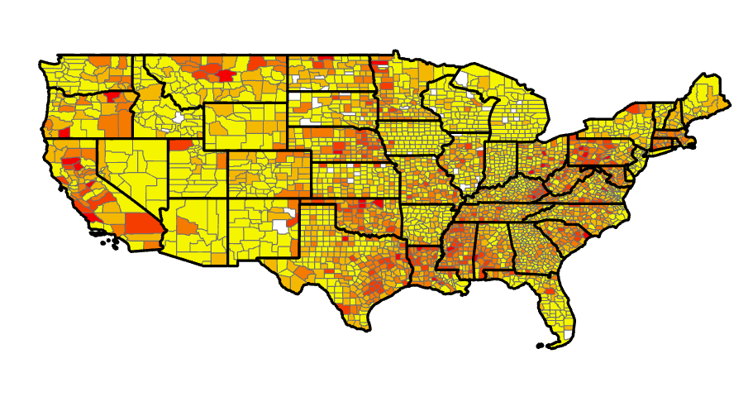
Heirs’ Property Nationally
Notes:
Instructions:
Map indicating the current number of heirs’ property lands in the United States. For instructional use only, do not disseminate.
Time: 2 minutes
Materials: None
Handouts: none

Slide 13

Review of Challenges for Heirs’ Property Owners
Partition Sale
Lack of Access to Loans
No Access to Government Programs
Forced Tax Sales
Limited Wealth Generation
Notes:
Instructions: First, we’ll do a review of things you have heard in previous sections.
Time: 3 minutes
Materials: None
Handouts: none

Slide 14
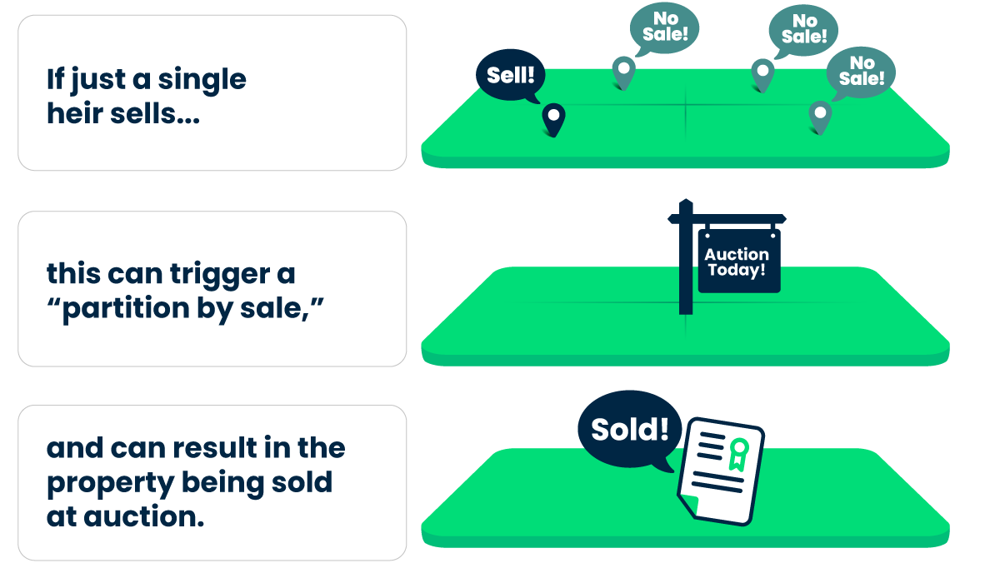
Partition Sales and Other Problems
What is a Partition Sale?
Farmland Access Legal Toolkit, https://farmlandaccess.org/heirs-property/.
Notes:
Instructions:
In previous sessions, heirs’ property has been generally described as a form of ownership which has several serious problems. The problem which has attracted the most attention is the danger that the family may lose the property because of a court-ordered sale of the property, a so-called “partition sale.”
Two kinds of partition actions:
Partition in kind: land is divided according to the percentage of ownership held by each heir. This may occur if all the land is similar in quality and value, the number of heirs is small, and the heirs agree on how the land should be divided. Heirs involved in voluntary partitioning should check with appropriate local government offices to be sure they are following all necessary procedures, and they should also consult with a lawyer to be sure all documents are properly filed.
Partition by sale, where the property is sold, and proceeds of the sale are divided among heirs according to their respective shares. Some forms of property (e.g., a house) do not lend themselves to partitions in kind.
Heirs may agree that partition by sale is the best way to divide the property, or one heir (or the purchaser of an heirs’ interest) may force the sale on other members of the family. There are numerous examples of partition actions brought about by an outsider such as a real estate developer who purchases the share of one heir and then goes to a local court and demands that the property be sold, and proceeds distributed. (Like in the Lewis family in the VICE video we watched during the “prevention” portion of this training.) Such sales historically often resulted in an auction of the property on the courthouse steps, and the property is sold for much less than it is worth. With the passage of the Uniform Partition of Heirs Property Act, which we’ll talk about next, advocates hope that this has changed.
Time: 7 minutes
Materials: None
Handouts: none

Slide 15
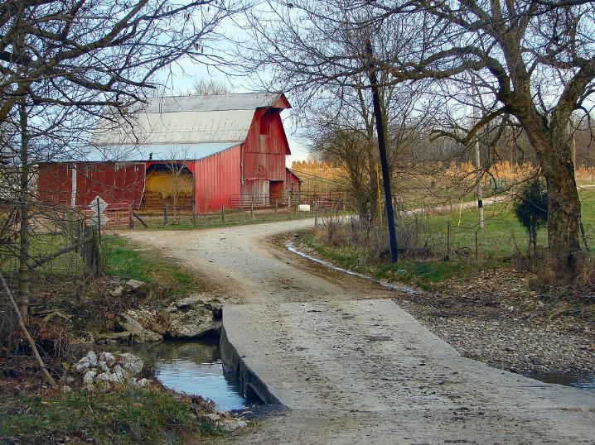
Uniform Partition
of Heirs Property Act
(UPHPA)
Notes:
Instructions: For decades, state partition laws contributed to widespread and devastating land loss among families who owned land as tenants-in-common. As a result of class action lawsuits and the publication of an article on partition action abuses, a task force was formed to start efforts to reform partition law. The next few slides give an overview of what this means to heirs’ property owners.
Time: 1 minute
Materials: None
Handouts: None

Slide 16
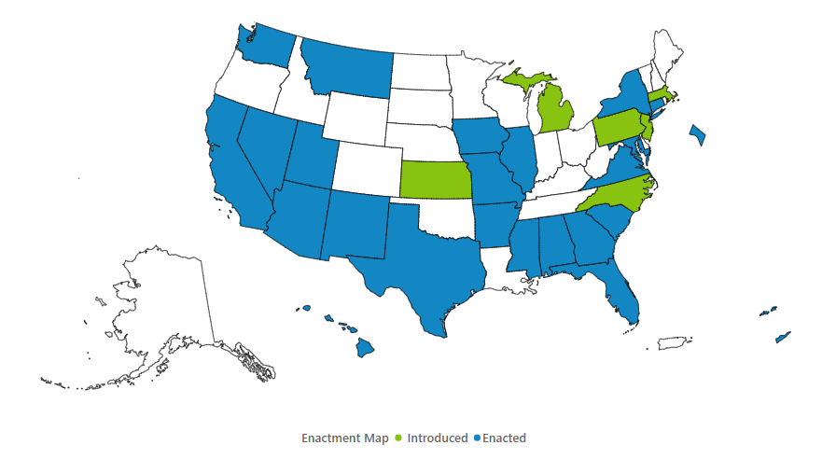
Uniform Partition of Heirs Property Act (UPHPA)
Uniform Partition of Heirs Property Act (UPHPA) is a model law that state legislatures can adopt. It creates fair procedures for heirs’ property owners when a partition action is filed.
Under the UPHPA, heirs’ property owners have rights that protect them from losing their land and if the land is sold, it is sold for a fair value.
Where the Uniform Partition of Heirs Property Act has been adopted or introduced
May 2024
Uniform Law Commission site at uniformlaws.org
Notes:
Instructions: The American Bar Association’s (ABA) Section of Real Property, Trusts and Estates Law formed a task force and submitted a proposal in 2006 to the Uniform Law Commission. The Uniform Law Commission also known as the National Conference of Commissioners on Uniform State Laws worked to develop a model State statute that would address partition laws. The Uniform Law Commission approved the Uniform Partition of Heirs Property Act (“UPHPA”) in the summer of 2010.
Note: It is important to note that the Uniform Law is not effective until adopted by state legislature. This is a map of states who have enacted the Uniform Partition of Heirs Property Act, highlighted in blue. It also shows states where the UPHPA was introduced, and those states are highlighted in green.
Time: 2 minutes
Materials: None
Handouts: None
Source: https://www.uniformlaws.org/committees/community-home?CommunityKey=50724584-e808-4255-bc5d-8ea4e588371d

Slide 17

Critical Step to Determine How the UPHPA Can Help You…
Speak with an attorney licensed to practice law in the state where your land (real property) is located about the UPHPA, its enactment in your state, and how it can help resolve your heirs’ property issue.
Notes:
Instructions: Be sure to emphasize that for your audience to understand how the UPHPA can help resolve their heirs’ property issue, it is important to speak with an attorney licensed to practice law in the state where the land (real property) is located.
Points to discuss include:
The ethical rules concerning representing a family or o one or more members
Whether UPHPA is enacted in your state, and if not, how the heirs’ property law is governed
How the UPHPA or other applicable real property law may help resolve your heirs’ property issue.
Time: 1 minute
Materials: None
Handouts: None

Slide 18
How Does the UPHPA Help?
Provides the following protections in partition actions:
01
Enhances Notice
02
03
Independent Appraisal
Right of First Refusal
04
Preference for Partition-in-Kind
05
Open-Market Sale
06
Partition in Kind-Dividing land into pieces of equal value for co-tenants
Notes:
Instructions: This slide gives a snapshot of the specific protections included. The following slides go into more detail.
Time: 1 minute
Materials: None
Handouts: None

Slide 19

Enhances Notice
Co-tenant requesting a partition MUST:
        Provide notice of the partition action to all co-tenants; and
        Post a conspicuous sign on the heirs’ property.
Notes:
Instructions: The new sales procedure is designed to mirror the traditional procedures real estate brokers use when they market properties and provides enhanced notice regarding the partition sale. In addition to sending notice of filing of a partition action to all known heirs' who are locatable, the plaintiff shall post a conspicuous sign on the heirs' property.
The sign must state that an action for partition has commenced and list the name and address of the court.
The court may require the plaintiff to publish on the sign the name of the plaintiff and of any known cotenants.
Time: 2 minutes.
Materials: None.
Handouts: None.
Source: The Uniform Partition of Heirs Property Act, Section 4: Service; Notice by Posting.

Slide 20

Independent Appraisal
Unless all parties agree on the value of the property, the court determines the property’s fair market value.
A disinterested, licensed real estate appraiser in state where the property is located is usually appointed or the judge may determine that the value of the property does not justify the expense.
Notes:
Instructions: Co-tenants can agree on the value of the property. If; however, all co-tenants do not agree on the value of the property, the court will order a disinterested licensed real estate appraiser to determine the fair market value of the property.
Time: 1 minute
Materials: None.
Handouts: None.
Source: Uniform Partition of Heirs Property Act, Section 6. Determination of Value.

Slide 21

Right of First Refusal or Buy-Out Provision
Any co-tenant not seeking partition by sale may buy the interest of the co-tenant(s) seeking partition by sale.
If more than one co-tenant wants to purchase the property, the court will divide the seller’s interest between the buyers according to their existing ownership shares.
Notes:
Instructions: The Right of First Refusal or Buy-Out Provision allows a co-tenant who did not request a partition by sale to purchase the property. Any cotenant who does not request a partition sale may purchase the share of the cotenants who petitioned the court for a sale. If two or more cotenants want to purchase the property, the court will divide the seller’s interest between the buyers according to their existing ownership shares.
Time: 1 minute.
Materials: None.
Handouts: None.
Source: Uniform Partition of Heirs Property Act, Section 7. Co-tenant Buyout.

Slide 22
Preference for Partition-in-Kind
If no co-tenant decides to purchase the shares from the co-tenant who petitioned the court to sell the property, or there is a co-tenant who has requested partition in kind, the court must use the “totality of the circumstances” test to determine whether a partition-in-kind is appropriate, considering:
Economic factors such as the value of total land compared to value if sold as parcels
Sentimental attachment to the land
Lawful use of the land (Residing on the land)
Paid property taxes, maintenance, and other expenses associated with the land
Notes:
Instructions:
A co-tenant may elect to have his or her share of property awarded in kind where the court divides the property into physically distinct and separately titled tracts. The UPHPA requires a court to determine whether a partition-in-kind is appropriate when a co-tenant chooses to partite the property in kind or when no co-tenant decides to purchase the shares from the co-tenant who petitioned the court to sell the property. A preference exists to divide the property in kind unless the court using the “totality of the circumstances” test and considering economic and non-economic factors finds a partition in kind will result in manifest prejudice to the cotenants as a group.
Economic factor: The total fair market value of the parcels resulting from the division would be materially less than the value of the property if it were sold as a whole.
Non-economic factors considered by the court are:
Sentimental attachment to the land
Lawful use of the land (Residing on the land)
Paid property taxes, maintenance, and other expenses associated with the land
Time: 2 minutes.
Materials: None.
Handouts: None.
Source: Uniform Partition of Heirs Property Act, Section. 9. Considerations for Partition in Kind.

Slide 23

Open-Market Sale
If the property is sold, it must be listed with a licensed real estate broker for sale at a price no lower than the court-determined value for a reasonable period of time.
The court may order a sale by another method if the open market sale is unsuccessful.
Notes:
Instructions: If the property is to be sold, it must be listed with a licensed real estate broker for sale at a price no lower than the court-determined value for a reasonable time. If another method will produce a better price, the Court may waive the open-market sale procedure.
Time: 1 minute.
Materials: None.
Handouts: None.
Source: Uniform Partition of Heirs Property Act, Section 10. Open-Market Sale, Sealed Bids, or Auction.

Slide 24
Effect on Liens
A partition or sale for division under the UPHPA doesn't mean you won't be responsible for existing mortgages or liens on the property. You will likely still be obligated to satisfy/pay them.
Notes:
Instructions: This is important to note to participants.
Legal language per Alabama Code:
“A partition, sale or other disposition of property pursuant to this chapter shall not affect or displace a mortgage or other lien on the property and shall not affect or displace the obligations of any person who is a party to the mortgage or other lien or who is obligated on any note or other agreement secured by the mortgage or other lien.” Ala. Code 35-6A-12
Time: 1 minute
Materials: None
Handouts: None

Slide 25

Effect on Liens
A partition or sale for division under the UPHPA doesn't mean you won't be responsible for existing mortgages or liens on the property. You will likely still be obligated to satisfy/pay them.
Notes:
Instructions: This is important to note to participants.
Legal language per Alabama Code:
“A partition, sale or other disposition of property pursuant to this chapter shall not affect or displace a mortgage or other lien on the property and shall not affect or displace the obligations of any person who is a party to the mortgage or other lien or who is obligated on any note or other agreement secured by the mortgage or other lien.” Ala. Code 35-6A-12
Time: 1 minute
Materials: None
Handouts: None

Slide 26
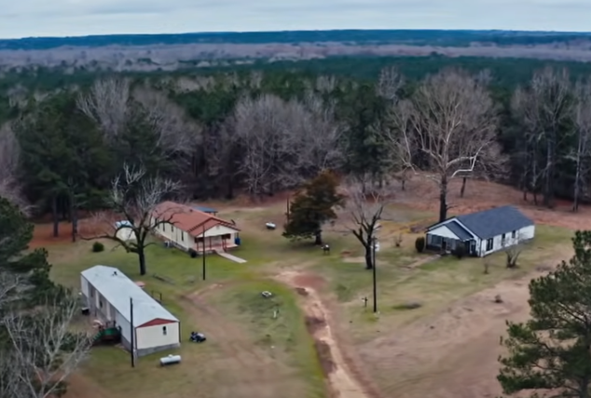


Breakout Discussion:
How might the example of the Lewis family in the Vice News video have played out differently if the UPHPA had been in effect?
Could the heirs living on the property have found out about the lawsuit earlier than they did?
Could the court have just moved forward with the sale of the property as it did, without doing other things first? What would the court have to do?
If the court went forward with a sale, would the sale have been conducted differently than through auction?
Notes:
Instructions: Reminder re the facts of the Lewis story: Lewis family owned 480 acres in Louisiana since the late 1800s. There were multiple heirs, not all in touch. Some family members lived on the property; many had raised kids there. A lot of the family was dispersed, in New York and other places. The family living on the land was unaware that heirs could sell their interests to people outside the family.
A timber developer was able to purchase about 20% of the family’s shares from distant heirs and brought an action for partition in the local court in Louisiana, asking the court to sell the property so he could get the value of his shares. The “notice” provided by the court was solely in a local newspaper; no notice of the partition lawsuit was delivered to the property or given to any of the heirs living on the land.
Ultimately the property was sold at auction for $550,000. (The VICE story did not say whether the timber developer was the one who bid at auction, but he did end up owning all the land.)
Questions for discussion:
If the Uniform Partition of Heirs Property Act was law in Louisiana,
Could the heirs living on the property have found out about the lawsuit earlier than they did?
Better notice would have been given to all tenants, including a sign with notice on the property.
Could the court have just moved forward with the sale of the property as it did, without doing other things first? What would the court have to do?
The family members who did not bring the action would have the right to buy out (the right of first refusal) those members who want to sell their interests.
If the court went forward with a sale, would the sale have been conducted differently than through auction?
The property would have been appraised to determine its fair market value. The property would be sold by an impartial broker on the open market rather than at auction.
Time: 15 minutes
Materials: none
Handouts: none

Slide 27

Financial challenges due to owning land as
Heirs’ Property
Possibility of forced tax sale of property
Unable to use property as collateral for a loan
Dead Capital
No access to some government programs (USDA)
Notes:
Instructions:
Other challenges of owning land as heirs’ property include:
Heirs’ property owners can also lose their properties through tax sales if real estate taxes are not paid in a timely way. This has often happened because there can be confusion about who is responsible for paying property taxes, and people often don’t understand they have legal rights to reclaim property within a certain time period even if the property is taken by the government.
Unwillingness of banks and other lenders to accept heirs’ property as collateral for a loan because who owns the property is not clear. As a result, heirs’ property owners cannot use the land as collateral to get low-interest loans to start a business, pay for schooling, or even build a house on land owned as heirs’ property. This limits the ability of owners of heirs’ property to build wealth that can be passed from generation to generation. Research has shown that Black Americans have been less successful in building intergenerational wealth, and heirs’ property is one reason.
Dead Capital, which is an economic term related to property which is informally held, is not legally recognized, and cannot be exchanged for financial capital. So you have the burden but not the benefit of the property.
Unable to participate in government programs that could help on the farm. For example, in order to participate in most USDA programs, farmers must get a “farm number” from the Farm Service Agency of USDA. Because people have to show clear ownership of land to get a farm number, many heirs’ property owners were left out. This changed recently (see next slide).
Time: 4 minutes
Materials: none
Handouts: none

Slide 28

Some Progress for Heirs’ Property Owners
Progress:
Farm Service Agency - new ways to obtain a farm number
FEMA – new policies allowing access to emergency assistance after a disaster
Notes:
Instructions:
Progress:
Farm Service Agency (FSA) of USDA: has now issued guidance listing alternative documentation heirs’ property owners can use to show they are in control of the farm operation and obtain a farm number. However, heirs’ property owners are generally unable to get help from USDA programs designed to assist homeowners because they do not have clear title to their homes.
FEMA: Only very recently has the federal government changed its policies so that heirs’ property owners can get emergency assistance after a hurricane or other natural disaster. For those with heirs’ property that need emergency assistance, FEMA and the states have recently expanded the criteria to be eligible for disaster relief. Heirs’ property owners can certify that they own the property damaged.
Time: 5 minutes
Materials: none
Handouts:
Guidance for Heirs’ Property Operators Participating in Farm Service Agency (FSA) Programs. Fact Sheet, July 2020. Available at: https://www.fsa.usda.gov/Assets/USDA-FSA-Public/usdafiles/FactSheets/guidance_heirs_property_operators_participating_in_fsa_programs-factsheet.pdf
Update to FEMA’s Individual Assistance Program and Policy Guide, Version 1.1 available at: https://www.fema.gov/sites/default/files/documents/fema_updated-iappg-version-1.1.pdf
FEMA Makes Changes to Individual Assistance Policies to Advance Equity for Disaster Survivors available at: https://www.fema.gov/press-release/20210902/fema-makes-changes-individual-assistance-policies-advance-equity-disaster#:~:text=FEMA%20is%20amending%20its%20current,the%20survivor's%20home%20before%20the

Slide 29
Questions?
Notes:
Instructions: Use this time to answer any questions from the previous section.
Time: 10 minutes
Materials: none
Handouts: none

Slide 30

Navigating Family Conflict
Family conflicts are common but need not end the process of resolving the issues
Right of First Refusal (UPHPA States)
Keep communication open and transparent
Gain agreement on goals
Hire facilitators, mediators, or even arbitrators, if necessary, to help work through decision-making process
Notes:
Instructions:
Conflict: Family conflicts and disagreements are common in resolving heirs’ property. However, they should not stop families from moving forward.
Communication and transparency within the family is going to be critical. Is there someone in the family who can lead this as a project? Is it you?
Families will need to discuss these important points together:
Discussing the issues
Understanding the property as a resource, a potential source of wealth, and its cultural importance
Figuring out how to deal with conflicts that will inevitably arise, these are all things that the family will have to discuss.
Members of the family should decide how best to be in touch with one another, as the process of resolving heirs’ property is generally long and complicated, and questions will arise, and discussion will be needed. Many one-on-one conversations will be held but there may be need for a family gathering/reunion where the family can work out issues together.
In some cases, it may be useful to consider using facilitators or mediators (or even arbitrators) to help conversations be productive. Some non-government organizations that focus on heirs' property might be valuable sources of assistance in identifying facilitators or mediators to work with you and your family.
Facilitators are neutral individuals whose job it is to help a group engage in dialogue, ensuring that all participants can share equally, and that the group’s dialogue leads to a decision or resolution. Even where there is no conflict, having a skilled, neutral person outside of the family be tasked with helping family members have conservations about the property, ensuring that co-owners feel empowered to speak, and keeping the group focused on the task at hand can help tremendously.
Similar to a facilitator, a mediator is a neutral third party who facilitates conversation aimed at resolution of a dispute. Like facilitators, they do not make any decisions; rather they facilitate the conversation and make sure all parties are heard and understood. They can identify issues and interests and help guide the parties to a resolution.
Using a facilitator or mediator can be advantageous for numerous reasons. The burden of making sure the conversation happens is placed on the neutral third party. It also is typically more affordable than either inaction, which leads to its own challenges, or going to court. You can choose a professional who has deep knowledge about heirs’ property, but this is not necessary since the person is not tasked with making a decision, but rather helping family members come to agreement.
Arbitration, like mediation, is a dispute resolution process. The arbitrator is neutral like a facilitator or mediator, but they do make a decision. Their role is similar to a judge. However, unlike a judge, the parties choose the arbitrator, which allows them to choose someone with subject matter expertise. Parties present their “case,” similar to court litigation, and then the arbitrator makes a decision to which all parties agree in advance, ruling for one party or the other.
Time: 5 minutes
Materials: none
Handouts: none

Slide 31

Different Strokes for Different Folks
Property decisions are nuanced often involving disagreement over what’s the best course of action.
With increased numbers of heirs, the likelihood of disagreement increases.
Clearing a title requires a lot of time, effort, and money, especially if there are dozens of owners, so it’s not always the best course of action.
Families’ choices must be honored.
Notes:
Instructions:
Because of these challenges, the most common advice that owners of heirs’ property receive is that they need to change the way the property is owned. However, owners of heirs’ property may decide no change is necessary.
Following are important things that families must consider in deciding whether to change the way heir’s property is held. Resolving heirs’ property requires a lot of time, effort, and money to identify all potential heirs, get unanimous agreement on what to do, and hire a lawyer to change the legal status of the property. If many generations have passed since the original property owner died, there may be hundreds of heirs, some of whom have moved away and may no longer be in contact with others in the family and may have no idea that they are owners of heirs’ property. Even so, these individuals have the same rights of ownership as those living on the land and paying taxes on the property. Because ownership is so complex and family members may have many different opinions on what should be done with the property, there may be advantages to changing the way the property is owned or even, in some cases, selling the property (including to a sub-set of heirs who are most interested in or emotionally attached to the property).
Or it could be that there are a relatively small number of heirs, who all get along, and who all agree on how the property should be used. This might represent a situation where leaving the property as heirs’ property, at least for this generation, works. However, as the number of heirs increases, and different generations with different family lines are represented among the heirs, the likelihood of disagreements increases. That is where changing property ownership to a different legal status could make sense.
Some case studies illustrate the complex family dynamics associated with heirs’ property. These case studies are drawn from research done in rural Alabama by Janice Dyer at Auburn University.
Time: 5 minutes
Materials: none
Handouts: none

Slide 32
Navigating Family Conflict Skit
Notes:
Instructions: Using either volunteers from the participants or training staff, act out the “First Meeting of the Family Skit.”
Time: 5 minutes
Materials: none
Handouts: Four copies of the “First Meeting of the Family Skit”

Slide 33
Case Studies
Notes:
Instructions: The following three case studies give some pictures into why families may make different choices about their heirs’ property. We will look at risks and resolution strategies for each.
Time: 2 minutes
Materials: none
Handouts: none

Slide 34

Case Study: The Owens Family
Darleen inherited a share of the 20-acre family land which she co-owns with 34 relatives.
While there is currently no threat of loss, 3 cousins are over 80 years old.
At the next family reunion, she hopes to clear the title in hopes of keeping it in the family.
Notes:
Instructions: Read or summarize the case study.
Darleen and 34 relatives each inherited a share of 20 acres of property purchased by Darleen’s ancestors. The three largest interests are controlled by cousins who are over 80 years old with a total of 12 children between them. Nobody currently lives on the property, but the family regularly uses the cabin for family reunions and retreats. While there is currently no threat of development and all interests are held by the 35 family members, she wants to clear the title before the three elderly cousins pass away further fractionalizing the interest and making resolution more difficult. She is planning the next family reunion to have all interests in attendance in hopes of starting the process to clear the title. The lesson here is that time is of the essence when older relatives hold large interests which will become further divided should they pass.
Time: 6 minutes
Materials: none
Handouts: none

Slide 35

Case Study: Gwen
The joys (and costs) of collective ownership of family land
Notes:
Instructions: Read or summarize the case study.
There are both joys and costs of collective ownership of family land. For example, Gwen moved from Michigan back to rural Alabama to care for her ailing mother. The condition of her home is deteriorating, and she is not eligible for government loan programs that could provide assistance. Gwen says her grandfather “fixed it” so that the 102 acres of heirs’ property could not be sold, meaning that the land was not divided among individual heirs but rather passed down to the whole family with the understanding that the land was to be kept together for the family. Making decisions on what to do with the land has created tensions within the family. For example, one family member took it upon himself to sell some timber off the land and pocket the proceeds rather than sharing with other heirs. In another case, a family member wanted to build a fence around their house, but other heirs objected. It is difficult to manage and maintain the property and fulfill the desire of her grandparents for the land to remain in the family if the land continues to be owned in common by so many people who have to agree on everything.
A possible resolution could be for the co-owners to agree to put ownership of the land into an entity, either a trust or an LLC, for example, and work out how to make decisions and manage the land on behalf of the family. (Or they could enter into a tenants-in-common agreement. We’ll discuss these entities later.) Doing this would require family members to talk to each other and come to agreement about how to manage and maintain the land, for everyone’s benefit.
Time: 6 minutes
Materials: none
Handouts: none

Slide 36

Case Study: Ronnie and Angela
Unable to get bank loan for home to improve the house.
Unwilling to change family dynamics to clear title and manage the land.
Use an attorney to alter family dynamics.
Notes:
Instructions: Read or summarize the case study.
Ronnie and his wife, Angela, along with other members of the family, live in homes on land they inherited as heirs’ property. They all pitch in and pay property taxes. Ronnie and Angela had income that qualified them to build a new house if they had clear title. But despite the efforts of a housing organizer in the area, they declined to take this step, not wanting to take any action that might ‘disturb the peace’ and affect the close family relationships that exist. To overcome this barrier, Ronnie and Angela request assistance from their attorney on how to best proceed. The attorney, serving as a neutral party beyond family dynamics, sends a notification letter informing co-heirs’ of their interest in the property and that an anonymous family member is seeking to clear title and why this would be of benefit to the owner since the land could be improved.
This sets up Ronnie and Angela to have other family members involved or to simply have their interests purchased outright without any conflict. A letter on legal letterhead can go a long way. By having the attorney initiate the conversation, it saves Ronnie and Angela from potential conflict while giving the attorney the opportunity to explain the situation removed from the interpersonal context. It also opens the door for Ronnie and Angela to begin building their next home.
Furthermore, the Heirs Property Relending Program has financial resources available for Ronnie and Angela to buy out their co-heirs’, which might be an option. We’ll talk about this more shortly; this is a loan program that USDA is sponsoring, available to heirs’ property owners who are close to resolving their issues but need financial assistance.
Time: 6 minutes
Materials: none
Handouts: none

Slide 37

Family Wants to Clear Title, What’s Next?
Big picture questions
Has a family tree been created? Are all the heirs known and contacted?
How does the family want to use the property?
How (in what legal form) should the family own the property?
Time and patience!
Notes:
Instructions:
Understanding that some families will choose to continue owning their property as heirs' property, the remainder of this presentation will focus on how owners of heirs’ property might proceed to resolve their heirs’ property issues to overcome some of the known constraints that limit the ability of heirs' property owners to effectively use, manage, and generate wealth from their property.
Resolving heirs’ property issues takes time and patience. Ultimately, you’ll need to figure out who all the heirs are, come to an agreement among all the heirs regarding what to do with the land, and clear the title to the land so that ownership is controlled by the current generation.
In this section we’ll talk about some general themes, and then discuss how you can gather as much information as possible before getting legal help.
Time: 4 minutes
Materials: none
Handouts: none

Slide 38

Family Conversations
Identify your goals and limitations
Start with heirs you know
Identify other heirs
Decide on goals
Recognize different heirs may have different interests
Be aware of your own limitations – emotional, financial, time
Notes:
Instructions:
Family Conversations: Ultimately, all or most of the heirs to the property are going to have to reach agreement regarding what to do with the land. Understanding your own goals and limitations is important before having a conversation with other family members about their goals and limitations.
What are your goals? Do you want to continue to be an owner? Do you want to make sure the land stays in the family? Do you plan to improve the economic value of the land?
What are your limitations? How much time and money are you willing to invest? What about emotional limits? Family dynamics can be complicated, especially when it comes to shared assets. Are there family members with whom you cannot work well or don’t want to engage? Knowing your goals and limitations is important and should help inform any strategy you pursue. It can be useful to check back on them if things get difficult and you need to decide whether to stick with the strategy you have developed.
Once you have your own goals and limits in mind, reaching out to other family members is next. Identifying heirs is an important first step. Then you can begin discussing goals. Having clear goals for addressing the challenges involved in owning land as heirs’ property is important to be able to develop a strategy that leads to family agreement and, hopefully, resolution of title issues (meaning, getting the title in the name of the current owners). The goals can vary depending on your circumstances. They can include figuring out how to get qualified for USDA and other programs for agriculture and conservation, ensuring the family always has a place to live, or simply taking care of the same land your ancestors cared for. Discussing all goals of all heirs is important because they may not be the same and may even conflict. Some heirs may have no interest in the property and may not want the burden of ownership. Other heirs might need money and would be happy to sell their share to others. (This, of course, can be a problem if that other person is not a member of the family.)
Time: 8 minutes
Materials: none
Handouts: none

Slide 39

Getting Started
Start small – identify a do-able task
Build capacity gradually
Notes:
Instructions:
Getting Started: Often when a family decides to change the legal status of their heirs' property, one person might lead the process. Maybe that is you. You are motivated by whatever goal or set of goals you have established. You are aware of your limitations and feel that the challenges ahead can be overcome. So now we are going to talk about how to proceed.
Resolving heirs’ property issues can be overwhelming. This presentation is going to include a lot of information, but you will not be able to take action on everything all at once. START SMALL.
But don’t procrastinate because you don’t know where to start. START SMALL.
Time: 3 minutes
Materials: none
Handouts: none

Slide 40

Creating a Family Tree
Start with who
originally bought
the land
Notes:
Instructions:
One of the first things the family must do to resolve heirs' property issues is to identify all the heirs who have an interest in the land, from the person who initially bought the property to the youngest in the family. If only one or two generations are involved, this can be a relatively simple task and you may be able to draw the family tree based on your own personal knowledge.
But imagine the property was bought by an ancestor three or four generations in the past. There could be hundreds of heirs, including many whose whereabouts (or even existence) may not be known. That sounds daunting, and it does make things difficult. But it is not impossible, and there are ways to satisfy courts that honest efforts have been made to identify all heirs. A court may allow an “heirship affidavit” to be filed, in which the family shows the information it does have about the heirs and demonstrates that it made a diligent search for anyone missing. Simply do the best you can and keep records of your efforts. Consult family Bibles, birth certificates and death certificates, or use the various ancestry tracing websites that are available. Other ways to find information to create the family tree: cemeteries, obituaries, family Bible, social media. Make sure to add birth and death dates to the family tree, and if someone died whether they died with or without a will.
Talk with family members, including those you are getting to know for the first time. Tell them what you are doing and why and ask them what they want to do. Use these conversations to build a consensus, or at least a common understanding that something should be done.
Creating a family tree involves developing a list of all family members, their dates of birth and death, if they married, if they divorced, if they divorced and then remarried, and if they had any children from those marriages (or otherwise). For those who are living, write down their contact information (phone numbers, residential addresses, email addresses).
Time: 5 minutes
Materials: none
Handouts: none

Slide 41
Activity: Build Your 3-Generation Family Tree
Pick one set of your grandparents
How many children did they have?
How many siblings and cousins do you have?
How many total heirs?
  (Don’t forget spouses of deceased heirs.)
Grandparents
Your mom/dad
Aunts/Uncles
You
Your siblings
Your cousins
Notes:
Instructions: This is an activity for each participant to complete. Consider the option of making this an assignment to all participants before start of the session and have them answer the first three questions posed in the slide.
Activity: Imagine one of your own grandparents owned 100 acres of land and died with no will. Build a family tree showing your own parent and your parents' siblings. Are they all alive? How many children and grandchildren do they have? Add up the number of potential heirs. Do you know how to contact all of them? Are they likely to be of one mind regarding what to do with 100 acres?
Time: 15 minutes (if participants complete activity during session, 5-7 minutes otherwise)
Materials: Paper and pencils
Handouts: none
Create a family tree:
Note: Consider using “Family Tree Builder” a free software program, at www.myheritage.com
OR
National Genealogical Society: https://www.ngsgenealogy.org/free-resources/build-family-tree/

Slide 42
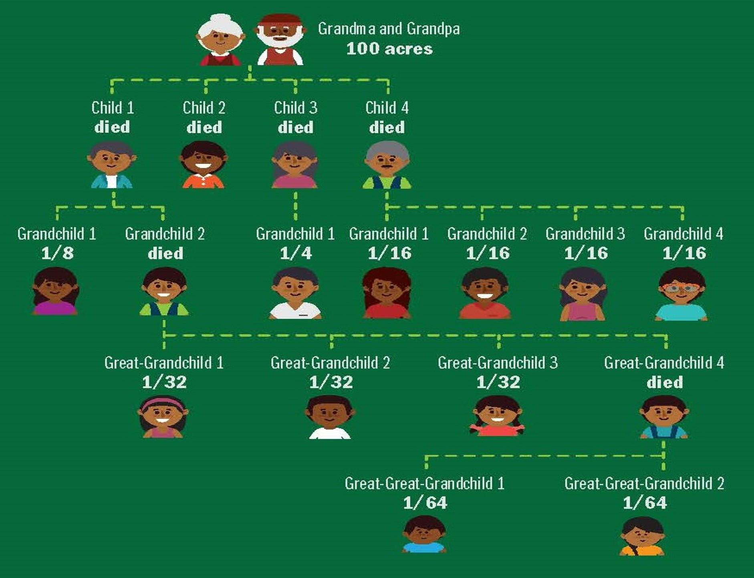
Looking at an Example
https://www.atlantafed.org/-/media/documents/news/conferences/2017/0615-heirs-property-in-the-south/infographic.pdf
Notes:
Instructions: A slide to illustrate the fractionalization of shares. This process of intestate succession – when someone dies without a will, who inherits – differs by state and is even more complex if you include siblings from other marriages and children born to parents who aren’t married
Time: 1 minute
Materials: none
Handouts: none
Source: https://www.atlantafed.org/-/media/documents/news/conferences/2017/0615-heirs-property-in-the-south/infographic.pdf

Slide 43
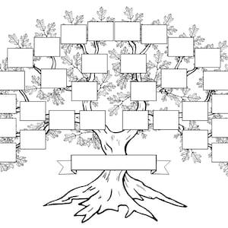
Your Family Tree
Notes:
Instructions: A slide for participants to draw in their tree.
Potential Questions
Could you go beyond your grandparents?
What was the more challenging aspects? Where did it get to be more complex?
Could you get in contact with all of the respective branches today?
Could you get all of these people on the same page?
What lessons did you learn?
Time: 15 minutes
Materials: none
Handouts: none

Slide 44

What Does the Land Mean to the Family?
Emotionally & Culturally:
  Why purchased
  How used
  Family Legacy
Economically:
  Land appraisal
  Income opportunities:
    Timber
    Leases
    Agriculture
    Other
Notes:
Instructions: Can you locate two individuals in your family tree who view or assess the value of land differently? Placed-based attachment and cultural significance largely differ between family members and across generations.
The Land
What is the value of your land, economically, emotionally, and culturally? Can you have an appraisal done to determine the economic value of the land? Do you have timber on your land that can be sold to generate income? Can you lease the land for agriculture or other activities? Do you know the history of the land, how your ancestor acquired it, and what it was used for? All of this information will be important to share with family members and help determine next steps.
Time: 5 minutes
Materials: none
Handouts: none

Slide 45

Things a Family Should Do While Resolving Heirs’ Property Issues
Secure the property (avoid adverse possession claims)
Make sure property taxes are paid (avoid losing land due to tax sale)
Establish and maintain communication among all heirs
Don’t sign anything without speaking to a trusted advisor!
Notes:
Instructions:
So, the family is working on the family tree, thinking about what the land means to them. While these things are happening, there are still things that need to be done regarding the land.
The property must be secured and protected from outside threats such as trespassers and squatters. Otherwise, they can assert a legal claim to your land. Legally this is generally called “adverse possession”. Each state’s laws differ, but generally, in order to be able to claim adverse possession, trespassers or squatters have to show they have been living on the land for a certain number of years, they don’t have permission to be living there, they have been living there openly, not in secret, and they had exclusive use of the land.
Property taxes must be paid. Otherwise, the town or county can seize the land and slap a tax lien on it and ultimately, sell the land. Again, every state’s procedures for this are different, but if the taxes are not paid, you will lose the land.
Establish and maintain communication with known heirs/family members. You do not want an heir to sell their interest to an outsider, and then you and the other heirs will be subject to a partition action. Each state’s laws differ, but generally any co-owner of the land can bring an action in court to obtain the value of their interest in the property, and then a court can order that the property either be physically divided or sold. Family members should all be reminded not to sign anything, especially from someone outside the family, without discussing the matter with a trusted advisor.
Time: 5 minutes
Materials: none
Handouts: none

Slide 46
Documenting Ownership: Things to Do Before Seeing an Attorney
Gather all documents regarding the property – wills, tax documents, deeds, leases, easements
Search the office where land records are kept (generally this office is in the county where the land is located) for deeds and maps
Explore the office where records of property liens are kept for liens (debts) or other judgements against the property
Notes:
Instructions: Gathering documentation before visiting with an attorney is critical.
Examples of documents to bring include:
Most recent deed to the land
Wills
Tax documents
Deeds
Any contracts or leases on the property
Easements
Searching county offices:
This differs by state, but there’s usually a county office that holds land records including deeds and maps. You will find maps of the property and the history of ownership of the property.
Clerk of Court records (or whatever office keeps land records in the county where your land is located) for any liens (debts) or other judgements and documents associated with the property.
Title search: Ultimately, you will have to conduct a title search to confirm the current owners of the family land. A title search is the formal process of retrieving the necessary documentation and information to determine the current ownership interests in a piece of land. This can be done by a title abstractor but will need to be confirmed by an attorney. A title search reveals all the past owners of the property, a legal description of the property, and any liens on or other unresolved issues concerning the property.
Time: 4 minutes
Materials: none
Handouts: none

Slide 47

Selecting an Attorney – Considerations:
Lawyer has appropriate experience in estate planning and real estate law
Lawyer is recommended by trusted advisors – has a good reputation
Lawyer explains costs for every stage of resolving the issues
Notes:
Instructions:
Selecting an attorney: Lawyers who help families with heirs’ property matters must have experience in estate planning (also known as succession planning), real estate, and business law. Choose someone with appropriate experience and with a good reputation. Asking trusted advisors can help.
Also, understanding costs for every stage of the process is helpful. Ask the attorney to explain potential costs along the way. A lawyer can review documents provided, review available records, and recommend next steps. These recommendations should include estimated costs for each stage of resolving the heirs’ property issues and should also include estimated costs for advice regarding what the family can do to prevent further distribution of heirs’ property, such as creating a trust or a business entity to hold the land.
Time: 3 minutes
Materials: none
Handouts: none

Slide 48
Title to Real Property
Notes:
Instructions: Understanding how your property is titled is vital to drafting your will. This next session explores some things to consider.
Time: 1 minute
Materials: none
Handouts: none

Slide 49

Property Ownership: Key Terms
Title - Legal term regarding ownership of the property
Deed - Legal document that transfers title from one person to another
“Cloudy” Title - when the deed remains in the name of ancestors who have passed & there is not a clear chain of title
Notes:
Instructions: Review these key terms related to property ownership:
Title - a legal term concerning ownership of property.
Deed - a legal document that transfers title from one to person to another and should be recorded in the courthouse or other office of land records (depends on the state).
Cloudy Title - Heirs’ property owners generally have what’s called “cloudy” title to their property, because the deed remains in the name of ancestors who are no longer alive, rather than in the name of the current owners.
Time: 4 minutes
Materials: none
Handouts: none

Slide 50

Title to Real Property: Examining Title
A title certificate or report will generally specify the:
                Record title owner(s)
                Type of shared ownership, if applicable (e.g., Joint Tenancy with Survivorship Rights or Tenancy in Common)
                Legal description
                Tax parcels and status of payment
                Encumbrances (e.g., easements, covenants)
                Title claims or unresolved issues
Title should be examined by a lawyer or a title company.
Notes:
Instructions: This slide depicts the types of information typically found on a title certificate or report.
A few things to note:
Generally, only the surface title is examined (not mineral title).
The examiner reviews all instruments for a period of years required by the law of the applicable state.
Type of shared ownership - your interest may be limited by the form of the deed to you if you hold title by:
Joint Tenancy with right of survivorship (typical for husband and wife) that vests title in the survivor of the decedent.
Tenancy in Common (typical for siblings) that vests title in the heirs of the decedent at law (in the absence of a will).
Time: 5 minutes
Materials: none
Handouts: none

Slide 51
Questions?
Notes:
Instructions: Use this time to answer any questions from the previous section.
Time: 10 mins
Materials: none
Handouts: none

Slide 52
Legal Strategies for
Protecting Heirs’ Property
Notes:
Instructions: Legal Strategies for Protecting and Maintaining Heirs’ Property: The next few slides will introduce different structures that may be useful in securing heirs’ property land. Protecting and maintaining family land is important. Sometimes family members will want to leave the status quo and not change any of the legal arrangements, but different legal structures can help protect lands from loss.
Time: 1 minute
Materials: none
Handouts: none

Slide 53

Examples of Legal Structures to Hold Land:
Trusts
Limited Liability Company (LLC)
Tenant-in-Common Agreement
Notes:
Instructions: Now we’re going to talk about different legal structures for holding land. We’re talking about this so you have some familiarity with the terms; obviously, it’s not your job to give legal advice, but it is important that you have some sense of what these things are.
Time: 1 minute
Materials: none
Handouts: none

Slide 54
Legal Strategies: Trusts
Heirs’ property owners can transfer their interest in the land to the trust and then name one or more people to serve as the trustee(s).
The remaining heirs’ property owners can be the beneficiaries of the trust.
The trustee would manage and control the land, and be responsible for maintenance and tax payments, according to terms set out in a trust agreement.
Notes:
Instructions: Sometimes, creating a single entity that owns the land, in which each family member effectively owns an interest, can be a more secure way of owning the property and transferring it to future generations. So, rather than each family member owning a share of the land directly, they would own a share in the entity that owns the land.
Trusts:
Heirs’ property owners can deed their interest in the land to the trust and then name one or more people to serve as the trustee(s).
The remaining heirs’ property owners can be the beneficiaries of the trust.
The trustee would manage and control the land, and be responsible for maintenance and tax payments, according to terms set out in a trust agreement.
Time: 4 minutes
Materials: none
Handouts: none

Slide 55
Legal Strategies: Limited Liability Company (LLC) or Corporation
Heirs’ property owners can form a business entity such as an LLC or corporation and transfer the property to it.
An operating agreement or bylaws can establish:
  What happens to a member’s share when they die
  What happens if a member wants to sell
  How decision-making and management will be handled
  Who is responsible for maintenance, tax payments, and other duties
  How profits and costs are shared
Notes:
Instructions:
LLCs or corporations:
Heirs’ property owners can form a business entity such as an LLC (limited liability company) or corporation and transfer the property to the LLC or corporation. There are fees for the initial filing and annual reports.
An operating agreement or by-laws can establish:
What happens to a member’s share when they die
What happens if a member wants to sell
How decision-making and management will be handled
Who is responsible for maintenance, tax payments, and other duties
How profits and costs are shared
Time: 4 minutes
Materials: none
Handouts: none

Slide 56
Legal Strategies: Tenant-in-Common Agreement
The legal structure remains the same; the co-heirs all own the land as tenants in common.
Sets out the rights and responsibilities of all the property owners.
Can help address:
  Who will manage the property
  How it will be used
  How the taxes will be paid
  What happens if a co-tenant wants to sell their interest
Notes:
Instructions:
Tenant-in-Common Agreement
The legal structure remains the same; the co-heirs all own the land as tenants in common.
Instead of creating a new entity that governs the family’s ownership of the property, family members could enter into a “tenant-in-common agreement.” Here, each family member still owns a share in the land itself, but they reach an agreement that does the following:
Sets out the rights and responsibilities of all the property owners.
Can help address who will manage the property, how it will be used, how the taxes will be paid, and what happens if a co-tenant wants to sell their interest.
Time: 4 minutes
Materials: none
Handouts: none

Slide 57
Material Covered
Some of the challenges of owning heirs’ property
The importance of working with all family members
Creating a family tree
Considerations relevant to a family’s decision about how to resolve heirs’ property issues
Title to Real Property
Different legal structures to hold heirs’ property
Notes:
Instructions:
During this session, we have discussed:
The challenges of owning heirs' property, including financial and litigation challenges
Legal improvements and progress to protect heirs' property owners
The importance of working with other family members to consider how best to manage and enjoy their heirs' property
Creating a family tree to identify the family members you need to bring to the table
The different legal structures and strategies to hold and protect heirs' property
What "Title" to real property means
Time: 1 minute
Materials: none
Handouts: none

Slide 58
Questions and Discussion
Notes:
Instructions: Wrap up with any questions participants may have.
Time: 10 minutes
Materials: none
Handouts: none

Slide 59


Community Workshop
Understanding
Heirs’ Property at the
Community Level
Workshop Evaluation
Please Scan the QR Code
Notes:
Instructions: This slide is to prompt the evaluation process. If you are using paper copies, please hand them out at this time. If you are using the online Qualtrics evaluation, use the QR code for the Heirs’ Property Community Workshop Survey.
Note: Check to make sure the QR code is working properly before sharing with participants.
Time: 10 minutes
Materials: none
Handouts: Paper copies of the Heirs’ Property Community Workshop Survey and/or the QR code on this slide.

