Slide 1
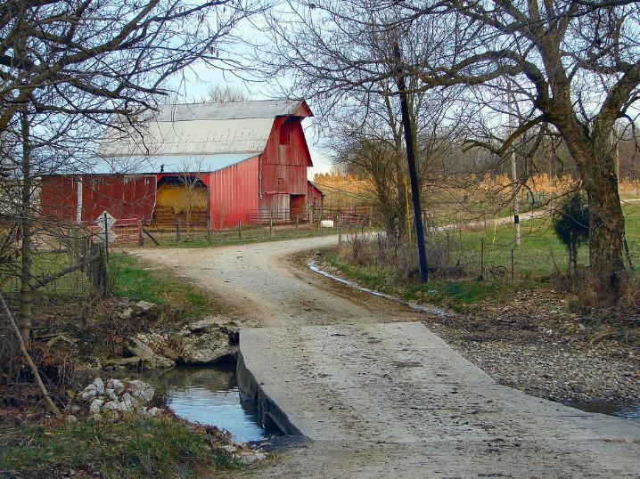




Heirs’ Property
Trivia
Questions

Slide 2
Rules of the Game

Slide 3
Listen to the questions carefully.
Work together in teams to select the correct term.
Round 1 = 1pt Round 2 = 2pts Round 3 = 3pts Quick Answer = DOUBLE POINTS
The team who has the most points is the winner.

Slide 4
Let’s Practice

Slide 5


a life partner in a marriage, civil union, or
common-law marriage as recognized by state law

Slide 6

a life partner in a marriage, civil union,
or common-law marriage as recognized by state law
Parent
Spouse
Sibling
Ancestor

Slide 7

Spouse
Spouse - a life partner in a marriage, civil union, or common-law marriage as recognized by state law

Slide 8

Are you ready?

Slide 9
ROUND 1 = 1 PT
EASY

Slide 10
the appointment of a guardian or conservator by a judge to manage the financial affairs and/or daily life of another person due to old age or physical or mental limitations

Slide 11
the appointment of a guardian or conservator
by a judge to manage the financial affairs
and/or daily life of another person
due to old age or physical or mental limitations
Conservatorship
Guardianship
Healthcare Directive
Living Will

Slide 12

Conservatorship and/or Guardianship
Conservatorship and/or Guardianship - the appointment of a guardian or conservator by a judge to manage the financial affairs and/or daily life of another person due to old age or physical or mental limitations

Slide 13
A legally binding document that allows you to appoint someone to manage your property, medical, or financial affairs

Slide 14
A legally binding document that allows you to appoint someone to manage your property, medical, or financial affairs
Living Will
Guardianship
Conservatorship
Power of Attorney

Slide 15
Power of Attorney
Power of Attorney (POA) - a legally binding document that allows you to appoint someone to manage your property, medical, or financial affairs

Slide 16
a person who has died or is deceased

Slide 17
a person who has died or is deceased
Decedent
Beneficiary
Heir
Executor

Slide 18
Decedent
Decedent - a person who has died

Slide 19

Leaderboard
1
2
3
6 pt max score

Slide 20
ROUND 2 = 2 PT
MEDIUM

Slide 21
person legally entitled by law to inherit the property of a decedent

Slide 22
person legally entitled by law to inherit the property of a decedent
H
4 letters

Slide 23
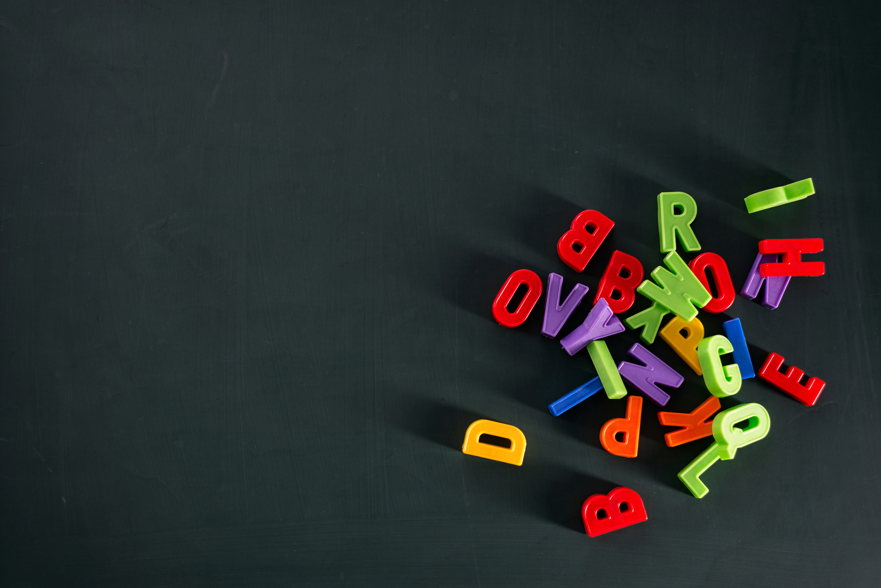
Heir
Heir - a person legally entitled by law to inherit the property of a decedent

Slide 24
Real or personal property (including cash/liquidity) owned by a person or company, regarded as having value and the ability to meet debts, commitments, or legacies.

Slide 25
Real or personal property (including cash/liquidity) owned by a person or company, regarded as having value and the ability to meet debts, commitments, or legacies.
A
S
6 letters

Slide 26
Assets
Real or personal property (including cash/liquidity) owned by a person or company, regarded as having value and the ability to meet debts, commitments, or legacies.

Slide 27
a person's property or net worth.

Slide 28
a person's property or net worth.
E
E
6 letters

Slide 29
Estate
a person's property or net worth. When the person is deceased, their estate goes through probate and is distributed according to the terms of their Last Will & Testament. If there is no will, the estate is “administered” in accordance with the state’s laws of intestate succession

Slide 30
a court-administered process in which a court confirms the validity of a Last Will & Testament and allows other people the option to challenge the will. The estate is then administered in accordance with the Last Will & Testament.

Slide 31
a court-administered process in which a court confirms the validity of a Last Will & Testament and allows other people the option to challenge the will. The estate is then administered in accordance with the Last Will & Testament.
P
E
7 letters

Slide 32
Probate
Probate - a court-administered process in which the probate court confirms the validity of a Last Will & Testament and allows other people the option to challenge the will. The estate is then administered in accordance with the Last Will & Testament.

Slide 33
a legal entity that is separate and distinct from its owners.

Slide 34
a legal entity that is separate and distinct from its owners.
C
P
T
11 letters

Slide 35
Corporation
Corporation - a legal entity that is separate and distinct from its owners. For profit corporations act through a board of directors selected by its shareholders (owners).

Slide 36
Leaderboard
1
2
3
26 pt max score

Slide 37
ROUND 3 = 3 pts
HARD

Slide 38
property owned jointly by numerous co-owners, most of whom may be related

Slide 39
property owned jointly by numerous co-owners, most of whom may be related
2 words
5 / 8 letters

Slide 40

Heirs’ Property
Heirs’ Property - property owned jointly by numerous co-owners, most of whom may be related

Slide 41
Latin term meaning “by roots” or “by branch.” A way of distributing the estate of a decedent where each branch of the family receives an equal share of an estate.

Slide 42
Latin term meaning “by roots” or “by branch.” A way of distributing the estate of a decedent where each branch of the family receives an equal share of an estate.
2 words
3 / 7 letters

Slide 43
Per Stirpes
Latin term meaning “by roots” or “by branch.” A way of distributing the estate of a decedent where each branch of the family receives an equal share of an estate.

Slide 44
co-owners who jointly own property without rights of survivorship; the co-owners may or
may not be related

Slide 45
co-owners who jointly own property without rights of survivorship; the co-owners may or
may not be related
3 words
7/ 2 / 6 letters

Slide 46
Tenants In Common
Tenants-In-Common - co-owners who jointly own property without rights of survivorship; the co-owners may or may not be related

Slide 47
a court-appointed person or institution who is responsible for carrying out the terms of a Last Will & Testament and overseeing the probate of the Will & administration of the assets/estate

Slide 48
a court-appointed person or institution who is responsible for carrying out the terms of a Last Will & Testament and overseeing the probate of the Will & administration of the assets/estate
1 words
8 letters

Slide 49
Executor
Executor/Executrix - a court-appointed person or institution who is responsible for carrying out the terms of a Last Will & Testament and overseeing the probate of the Will & administration of the assets/estate

Slide 50
Winner’s Circle
50 pt max score

Slide 51

Thank you
for
playing!

Slide 52
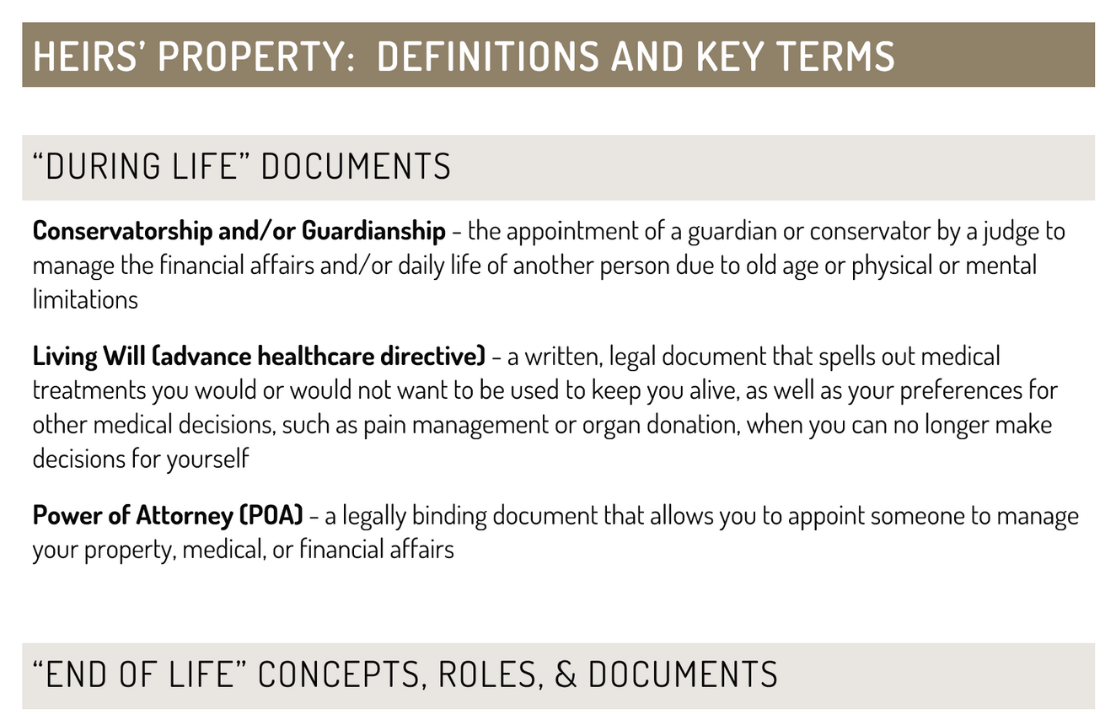
When in doubt
Refer to the handout!

