Slide 1

Indian Land Primer - Estate Planning Tips and Tricks for Working in Indian County
Emily S. Eleftherakis
Executive Director – Tribal Sovereignty Institute
Oklahoma City University School of Law
Of Counsel, Krahl Goerke Meyer & Behenna

Slide 2
Part I – Indian Country History and Overview

Slide 3
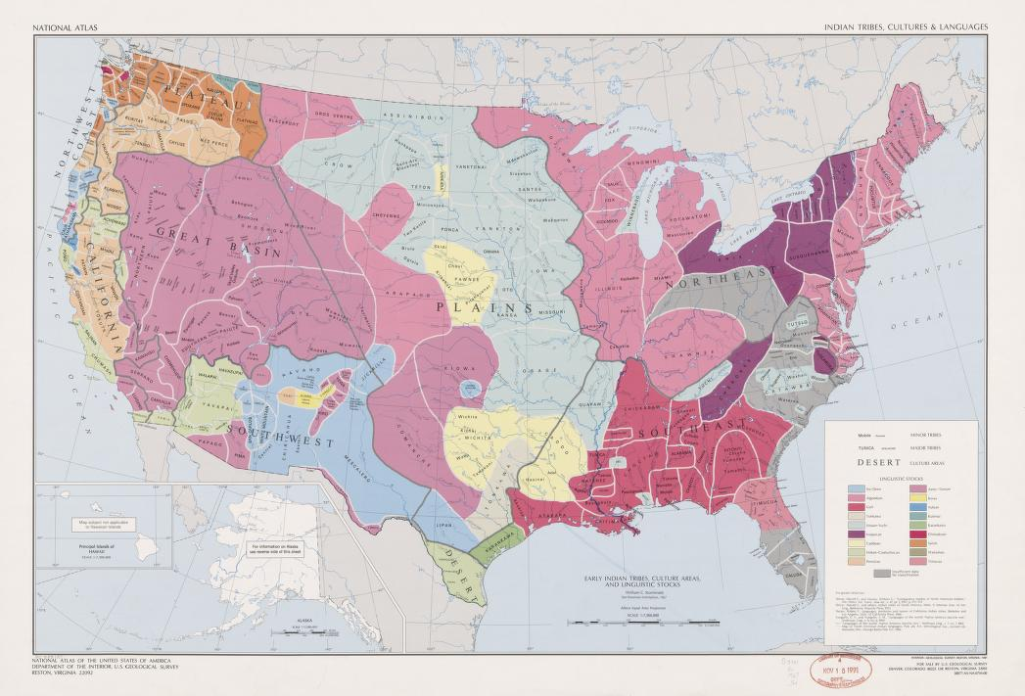

Slide 4
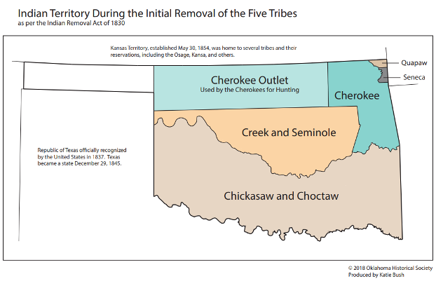

Slide 5
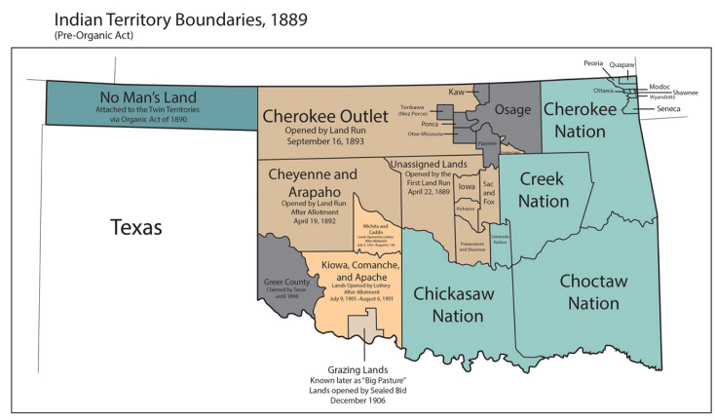

Slide 6
What is Indian Land?
18 U.S.C. § 1151
All land within the limits of any Indian reservation
All Dependent Indian communities
All Indian allotments

Slide 7

Indian Land in Oklahoma
Land within former existing reservation boundaries (e.g., Muskogee Creek Nation under McGirt).
Land within a tribal jurisdictional service area
Trust and Restricted allotments

Slide 8
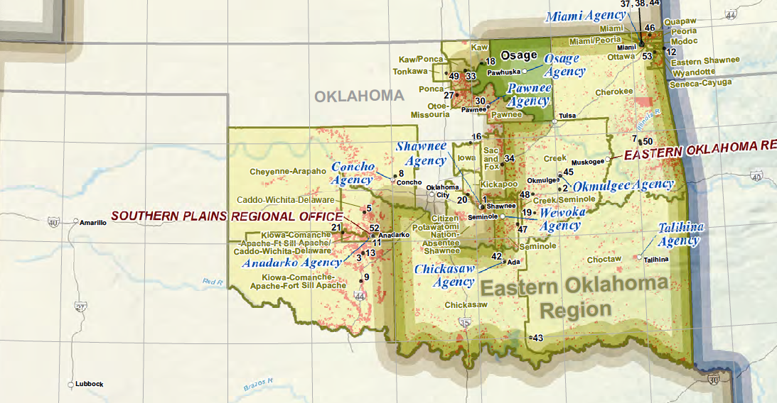
Bureau of Indian Affairs, Indian Lands of Federally Recognized Tribes (2016)

Slide 9

Implications for Planning & Distribution of Indian Estates
Trust and Restricted Allotments
Lands within former existing reservation boundaries
Land within a tribal jurisdictional service area
Government or tribal services
Tribal authority
Criminal and civil jurisdiction
Tax status

Slide 10
What are Trust and Restricted Allotments?

Slide 11
Trust Allotments
Restricted Allotments
Distributed pursuant to the General Allotment Act of 1887 (Dawes Act)
Land owned by the U.S. Government
Department of the Interior (through the Bureau of Indian Affairs) serves as Trustee
The individual Indian is a beneficial owner only
Land allotted to the Five Tribes
Land owned in fee by the individual Indian owner
Restrictions on conveyances, and leasing
Previously based on blood quantum

Slide 12
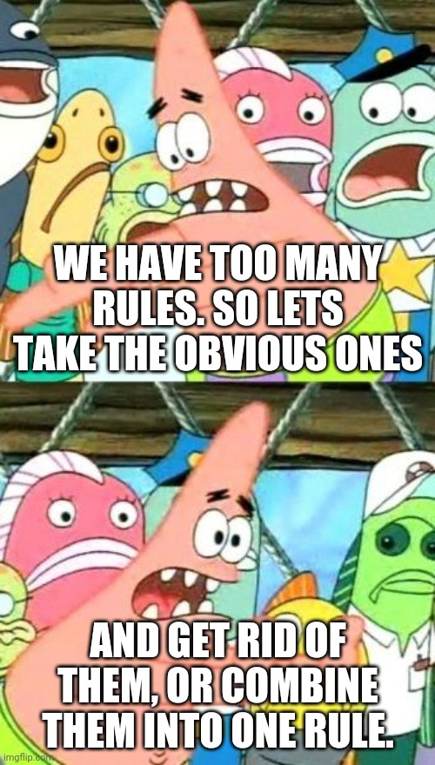
Trust Allotments
Initially governed by law of the state/territory where the property was located.
Now governed exclusively by federal law.
Restricted Allotments
Legal roulette of federal and state law
Stigler Act of 1947 consolidated vested jurisdiction to state courts.

Slide 13
Convoluted laws create convoluted problems: Fractionation - An Example
Original Allottee Interest
100%
Heir 1
33.3%
Heir 2
33.3%
Heir 3
33.3%

Slide 14
Heir 1
33.3%
Child 1
1/3 of 33.3%
Child 2
1/3 of 33.3%
Child 3
1/3 of 33.3%
Grandchild 1
1/3 of 1/3 of 33.3%
Grandchild 2
1/3 of 1/3 of 33.3%
Grandchild 3
1/3 of 1/3 of 33.3%
Grandchild 4
1/2 of 1/3 of 33.3%
Grandchild 5
1/2 of 1/3 of 33.3%
Grandchild 6
1/4 of 1/3 of 33.3%
Grandchild 8
1/4 of 1/3 of 33.3%
Grandchild 9
1/4 of 1/3 of 33.3%
Grandchild 7
1/4 of 1/3 of 33.3%

Slide 15


Slide 17

Why does it matter?
Specific laws governing who can own allotments
Different statutory schemes for intestate succession
Specific procedures for wills disposing of allotted property
Jurisdictional requirements for probate of allotted property
Can Indian property be placed into trust?
Short cut procedures for probate avoidance?

Slide 18
Part II – Prevention & Planning

Slide 19

Step One – What law applies?
Sometimes federal,
sometimes tribal,
sometimes state.

Slide 20
Who gets Trust Property?

Slide 21

American Indian Probate Reform Act of 2004 (AIPRA) 25 U.S.C. § 2201, et seq.

Slide 22
AIPIRA Intestate Succession for Trust Property 25 U.S.C. § 2206
Interest in Parcel > 5%
Surviving Spouse?
Eligible Heirs?
Interest in Parcel < 5%
Surviving spouse living on parcel?
Single Heir Rule
Who is an eligible heir?
25 U.S.C. § 2201(9)
Indian (further defined in subsection (2);
Lineal descendant within 2 degrees of consanguinity of an Indian; or
Owners of an interest in the same parcel of land as decedent

Slide 23

Disposing of Trust Property by Will
Will Execution requirements
Over 18 with testamentary capacity
Own Trust property
In writing witnesses by 2 disinterested adults
Can be self-proving
Holographic will?
To maintain the interest in Trust status, Trust property must be distributed to:
A lineal descendant;
A co-owner in the same parcel of property;
The Tribe;
Any Indian

Slide 24

Life estates for non-Indians
Don’t forget to designate joint tenancy or tenancy in common
AIPRA presumption of joint tenancy if not specified
Understand your clients and their culture!
What does “family” mean to you?
Who are you “children”?
Name your devisees
AIPRA specifically excludes cousins, uncles, aunts, nieces, or nephews unless specifically included.
No probate bypass!
No transfer on death
Trust property cannot go into trust

Slide 25
Who gets Restricted Property?

Slide 26
Act of August 4, 1947 (Stigler Act)
Removed restrictions for any person 1/2 blood or less*
Full blood will approval
Jurisdiction vested in Oklahoma District Courts
Oklahoma will and intestacy statutes control
*Stigler Act Amendments of 2018
One-half blood quantum requirements removed
Not retroactive
61 Stat. 731
Will validity for Restricted Property?
Look to Oklahoma Statutes Title 63
Over 18 with capacity
2 disinterested adults witnesses
Holographic wills specifically authorized!

Slide 27

IIM Account
Any Indian owning an interest in Trust or Restricted Property also owns an Individual Indian Money Account (a/k/a trust personalty) housing any revenues generated from the land.
Can distribute to anyone
AIPRA
Indian → proceeds go into existing IIM or new account is created
Non-Indian → get a check

Slide 28
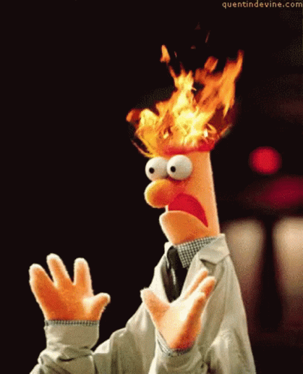

Slide 29
Part III - Resolution

Slide 30
Where do I probate?
Trust Property
Restricted Property
Administrative process through the Bureau of Indian Affairs Office of Special Trustee
BIA serving Tribe with jurisdiction over the property
Governed by federal administrative procedural rules
No probate bypass!
Only covers Trust property
State court process, county where the property is located
Oklahoma state court procedure
Field solicitor must be noticed!
Transfer on death?

Slide 31

Our Native clients are often subject to a dual probate process.
How can you help?

Slide 32
Plan creatively!
There is no mechanism to avoid probate of an interest in Trust Property.
Gift deeds during lifetime?
Joint ownership during lifetime?
No transfer on death process – call your senators!
Probate through the BIA is a time-consuming and lengthy process – plan to avoid a state court probate if possible.

Slide 33
Indian Property Cannot be Placed into a Private Trust
Know your clients’ assets and plan to avoid a state court probate.
Trust for non-Indian assets
Transfer on death for non-Indian property
Payable on death for non-Indian financial accounts

Slide 34
Osage Headrights?
Contact the Osage Nation Minerals Council
813 Grandview Ave.
Pawhuska, OK
minerals@osagenation-nsn.gov
(918) 287-5346

Slide 35

American Indian Wills Clinic at OCU Law Est. 2009
Under the supervision of a faculty clinician, students in the wills clinic provide wills and estate planning services to American Indians owning trust or restricted property in Oklahoma.
Clinic students are primarily responsible for all case-related work including fact gathering, developing legal theories, and initial document drafting.
During the semester, students are expected to provide legal services for an average of 6 to 10 hours per week outside of class time. The classroom component complements students’ fieldwork.

Slide 36

16 years of serving native clients in and out of Oklahoma
1,303 clients
1,051 Wills executed
193 powers of attorney
184 medical advance directives
46 transfer on death deeds for non-Indian property
Serving 29 of the 39 Tribes of Oklahoma
12 out-of-state Tribes assisted, including:
Tlingit
Tohono O’odham
Three Tribes Affiliated (Mandan, Hidatsa, Arikara Nation),
Blackfeet
Chehalis
Chippewa
Choctaw Mississippi
Ho Chunk
Inupiat
Oglala Sioux
Laguna Pueblo
Navajo

Slide 37
