Slide 1
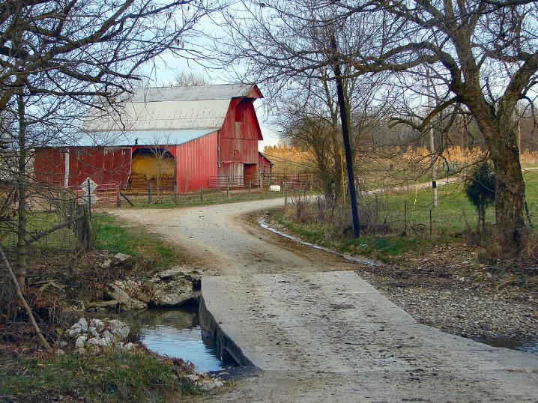



Understanding
Heirs’ Property at the
Community Level
DATE, 2025
LOCATION
Notes:
Instructions: Before the session begins, insert the date and location for your event. Have this slide up as participants enter the room.
Please acknowledge that this material was developed in partnership with the National Policy Research Center at Alcorn State University, the Southern Extension Risk Management Education Center, and the Southern Rural Development Center hosted at Mississippi State University through funding in part from USDA.
Mississippi State University is an equal opportunity institution. Discrimination is prohibited in university employment, programs or activities based on race, color, ethnicity, sex, pregnancy, religion, national origin, disability, age, sexual orientation, genetic information, status as a U.S. veteran, or any other status to the extent protected by applicable law. Questions about equal opportunity programs or compliance should be directed to the Office of Civil Rights Compliance, 231 Famous Maroon Band Street, P.O. 6044, Mississippi State, MS 39762, (662) 325-5839.
NOTE: If you do not do all three segments at the same event, insert slides 1-4 at the beginning of your other sessions as they provide the overarching foundation for the training.
Time: 1 minute
Materials: none
Handouts: None

Slide 2

Purpose:
To provide training on heirs’ property to communities and individuals.
Funding to develop this training provided by:
Notes:
Instructions: Explain the purpose of the overall curriculum.
Time: 1 minute
Handouts: None
Materials: none

Slide 3

Partnering Organizations
Notes:
Instructions: This slide highlights the partnering organizations that have worked together to develop materials and host trainings.
This material was developed and training for trainers was provided as a partnership with the National Policy Research Center at Alcorn State University, the Southern Extension Risk Management Education Center, and the Southern Rural Development Center hosted at Mississippi State University through funding in part from USDA.
Time: 1 minute
Materials: None
Handouts: None

Slide 4
Acknowledgements
Primary Authors
Gee Ogletree, Esquire
Adams and Reese, LLP
Becky Smith, PhD
Mississippi State University Extension
Carolyn Banks
Alcorn State University Extension Program
Manola Erby
Alcorn State University Extension Program
Jacy Fisher, Associate Attorney
Gregory Varner & Associates
Portia Johnson, PhD
Auburn University
Kara Woods, PhD
National Policy Research Center
Contributor and Reviewer
Laura Hendrix, PhD, University of Arkansas
Notes:
Instructions: Please acknowledge the primary and contributing authors to this material as well as the funding stream through the Southern Rural Development Center hosted at Mississippi State University and the National Policy Research Center at Alcorn State University.
Time: 1 minute
Materials: none
Handouts: none

Slide 5
Presenters
Name
University
Name
University
Name
University
Notes:
Instructions: Add presenter information and introduce yourselves.
You can add your logos and institutional equal opportunity statement to the “Understanding Heirs’ Property lessons flyer template”.
Time: 1 minute
Materials: none
Handouts: none
Sam Cook
North Carolina State University
College of Natural Resources
Jacy Fisher
Associate Attorney
Gregory Varner & Associates, P.C.
Eduardo Medina
New Mexico State University
Francine Miller, Esq.
Center for Agriculture and Food Systems
Vermont Law and Graduate School
Kara Woods, PhD
National Policy Research Center
Alcorn State University
Portia Johnson, PhD
Auburn University
Becky Smith, PhD
Mississippi State University Extension
Sandra Thompson, EdD
South Carolina State University
Ryan Thomson, PhD
Auburn University
Robert Zabawa, PhD
Tuskegee University

Slide 6
Topics to Explore
OVERVIEW | What is Heirs’ Property?
 | Impacts of Heirs’ Property
 | Legal and Cultural Considerations
 | Fractional Ownership
 | Locating Heirs’ Property
 | Land Loss
 | Preventing Land Loss
PREVENTION | Basics of estate and succession planning
 | Steps to prevent heirs’ property when establishing a will
RESOLUTION | Review some of the challenges of owning heirs’ property
 | Importance of working with other family members
 | Steps to take to understand who legally owns the property
 | Legal structures that can hold land owned by heirs’ property owners
Notes:
Instructions: This slide shows the three parts of the curriculum and gives a quick view of the components covered in each section.
Time: 1 minute
Materials: none
Handouts: None

Slide 7
Warm Up and Introductions
Notes:
Instructions: Give time for participants to introduce themselves. You could also include a brief question for them to answer such as what is one question or curiosity you have about heirs’ property. Don’t take time to answer those at this point. Rather this is about acknowledging where their curiosities are, and how the group can share this time together to learn and support each other.
Time: 1 minute
Materials: none
Handouts: None

Slide 8
PREVENTING HEIRS’ PROPERTY
Notes:
Total Session Time: 4 hours
Instructions: Have this slide up when participants enter the room.
Time: 1 minute
Materials: none
Handouts: none

Slide 9
Important Notes before We Begin:
These materials are intended to present general information as to preventing heirs’ property. They primarily draw upon information in the southern United States. The information may not be applicable to every state or territory. These materials do not provide legal advice. Specific advice should be obtained from an attorney or another professional well versed in the facts and circumstances related to the individual seeking advice and the jurisdiction where the property is located.
Notes:
Instructions: Read the disclaimer and answer any questions that may arise.
Time: 1 minute
Materials: none
Handouts: none

Slide 10
Protecting Your Information
No personal stories
General questions are welcome.
Personal questions should be asked outside of the group setting.
Notes:
Instructions: Go over these guidelines with participants to ensure that participants understand the reasons for not including stories or questions of a personal nature.
Time: 1 minute
Materials: none
Handouts: None

Slide 11
SESSION OVERVIEW
Contemplating Estate Planning
Important Terms
Basics of Estate Planning/Succession Planning
Working with an Attorney
Avoiding Heirs’ Property When Writing Your Will
Other Planning Strategies to Prevent HP
Notes:
Instructions: Use the talking points on the slide to provide an overview of this session.
Time: 1 minute
Materials: none
Handouts: none

Slide 12
Describe what comes up for you when you hear “estate planning.”
Notes:
Instructions:
Ask the participants: What is an estate? Do you have an estate plan? Asking your audience this will help you get an idea of the “mental models” in the minds of the audience. Many people do not feel like the term “estate planning” is far removed from their lives because “estate” signals a high level of wealth.
Time: 3 minutes
Materials: none
Handouts: none

Slide 13

Estate Planning
What do you know?
What do you want to know?
Notes:
Instructions: Ask the participants the questions on slide. Asking these questions will help you get to know where the audience is and what they are interested in learning.
Time: 4 minutes
Materials: none
Handouts: none

Slide 14

How many of you have used an attorney to get an estate plan in place?
Notes:
Instructions: Ask the question on the slide. Asking this question will help you see who in the audience might be able to share their experiences.
Time: 1 minute
Materials: none
Handouts: none

Slide 15

What are the costs of not having an estate plan in place?
Notes:
Instructions: Ask the participants the question on the slide. Most people are focused on the monetary and time costs of getting a will in place. This will help people think about the hidden costs of not having one.
Probate can be very costly
Incapacitation and the need to obtain guardianship can be expensive
Higher taxes without a trust
Time: 3 minutes
Materials: none
Handouts: none

Slide 16

What are the reasons for not having an estate plan in place?
Notes:
Instruction: Ask the participants the question on the slide. This will give you an understanding of obstacles your audience feels or experiences.
Time: 2 minutes
Materials: none
Handouts: none

Slide 17
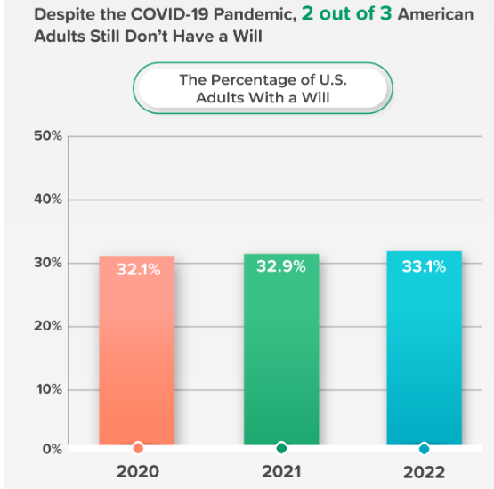
Did COVID Change the Picture?
Notes:
Instructions: Discuss the slide. It is possible that the most important thing that an Extension educator can do in the space of estate planning is to provide motivation for taking action.
Time: 2 minutes
Materials: none
Handouts: none
Source: https://www.caring.com/caregivers/estate-planning/wills-survey/

Slide 18
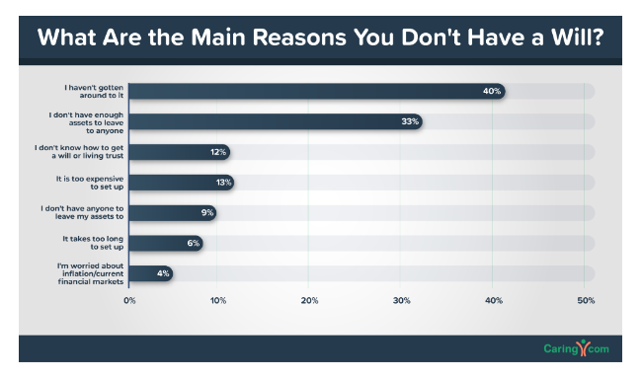
What Are the Main Reasons You Don’t Have a Will?
Source: https://www.caring.com/caregivers/estate-planning/wills-survey/
Notes:
Instruction: Discuss the slide. This will give you an understanding of obstacles your audience feels or experiences.
Time: 2 minutes
Materials: none
Handouts: none
Source: https://www.caring.com/caregivers/estate-planning/wills-survey/
Background: Extension has an opportunity to improve the completion rate of wills after workshops by increasing motivation. Tackling the fear of death as one of the main obstacles for having a will is an opening.
In 2005-2006, Minnesota Extension had twelve farm transition and estate planning workshops with 524 family members making up 301 farm family businesses. 152 (50.4%) farm family businesses completed a six-month follow-up survey. After the workshop itself, 81% intended to begin the process. However, of the 152 that completed the six-month follow-up, 57.4% reported they had begun the process of an estate plan with only 7.3% having completed it. For those who had not begun the process, time was the reported obstacle. For those who had made some progress, developing goals and consensus among family were the most reported obstacles.
Hachfeld, G. A., Bau, D. B., Holcomb, C., Kurtz, J. N., Craig, J., & Olson, K. D. (2009). Farm Transition and Estate Planning: Farmers' Evaluations and Behavioral Changes Due to Attending Workshops. The Journal of Extension, 47(2), Article 8. https://tigerprints.clemson.edu/joe/vol47/iss2/8

Slide 19
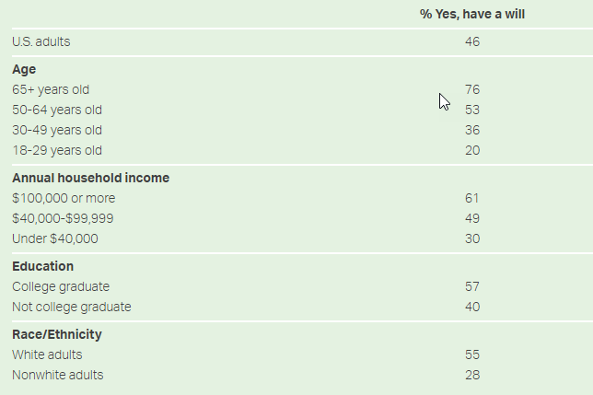
Percentage of Americans Having a Will by Subgroup
Do you have a will that describes how you would like your money and estate to be handled after your death?
Source: https://news.gallup.com/poll/351500/how-many-americans-have-will.aspx
Notes:
Instruction: Discuss the slide.
What do you notice?
What surprises you?
Time: 2 minutes
Materials: none
Handouts: none
Source: https://news.gallup.com/poll/351500/how-many-americans-have-will.aspx

Slide 20
How comfortable are you talking about death?
1 2 3 4 5 6 7 8 9 10
“Anything that’s human is mentionable, and anything that is mentionable can be more manageable. When we can talk about our feelings, they become less overwhelming, less upsetting, and less scary. The people we trust with that important talk can help us know that we are not alone.”
-- Mr. Fred Rogers
Notes:
Instructions: Ask the participants the question on the slide and discuss.
While not in the survey of reasons people do not have a will, when talking to people casually about establishing a will, they often mention being worried that if they write a will, it is like they are inviting their death. Many people are not comfortable talking about death.
Helping people reframe the topic of death is very powerful. Once the audience shares, you can ask about upsides about talking about death, including that it helps us live more fully.
This quote from Mr. Rogers is applied to a scene in “A Beautiful Day in the Neighborhood” movie about Mr. Rogers’ life.
Discussion: What do you think about this quote as it relates to estate planning?
Time: 5 minutes
Materials: none
Handouts: none

Slide 21

Helping people share their wishes for care through the end of life.
Conversation Starter Guide
Guide to Choosing a Health Care Proxy
Free Guides:
Guide to Being a Health Care Proxy
Guide for Talking with a Health Care Team
Notes:
Instruction: The Conversation Project has talking points and worksheets to help families having hard conversations.
Time: 2 minutes
Materials: none
Handouts: none
Background:
“Relationships are the main challenge facing farm families. Participants often pointed out that many programs teach management and planning strategies, but few focus on communication and family dynamics. Treating family members fairly and equally, dealing with off-farm heirs, and addressing in-law relationships are often the largest obstacles farm families face when building estate plans.”
Hogge, J., Eborn, B., Packham, J., Findlay, R., & Harrison, S. (2017). Multiyear Succession and Estate Planning for Farm and Ranch Families. Journal of Extension, 55(4), Article 19. https://tigerprints.clemson.edu/joe/vol55/iss4/19
The Conversation Project: https://theconversationproject.org/

Slide 22
Estate Planning Matching Game
Notes:
Instructions: There are some common terms you will hear during this training. Let’s see who can guess their meaning. We are going to play a Vocabulary Exercise called “What’s My Meaning?”
Prepare a vocabulary exercise that matches terms with definitions by having attendees fill in the blanks for each term. Attendees can work independently or in groups. Give the attendees 5-10 minutes to fill in the blanks with the term that matches each definition.
After everyone is finished, spend 10-15 minutes reviewing the terms and definitions with the group, asking a different person at random to provide their answer to each "blank." Discuss the differences in certain similar definitions, as the terms/definitions are grouped together for that purpose. Attendees can take the completed sheets home with them as a reference for future trainings.
Time: 20 minutes
Materials: Vocabulary fill-in-the-blank sheets and pencils/pens
Handout: Definitions and Key Terms
Virtual Ideas for the What’s My Meaning Game:
Quizlet: Use online flashcards and quizzes to learn the terms
Jamboard: Write the terms and definitions on sticky notes and participants work in a group to match them up
Flippity: Can create online games to facilitate vocabulary quizzes
Alternative Activity:
Instructions: There are some common terms that you have heard during this training. Let’s see who remembers their meaning. We are going to play a Card Game entitled “What’s My Meaning.”
Prepare index cards before the training (Print index card template on card stock and cut to make the card deck)
Have participants to select a card from the stack & place it face down on the table.
Review the most common terms with the group.
Ask for a volunteer to start the game.
Have the volunteer to read their term and tell the group the meaning.
To end the game, have everyone turn over the cards, answer if they know and understand the meaning of the term on their card.
Time: 10 minute
Materials: Card deck with meanings and terms
Handout: Definitions and Key Terms

Slide 23
Basics of Estate Planning
(called “Succession Planning” in LA)
Notes:
Instructions: This is a section divider to introduce the next topic.
Time: 1 minute
Materials: none
Handouts: none

Slide 24

We All Need an Estate Plan
This session will focus on questions of property.
Estate planning guides your loved ones in decision-making in the event you are no longer capable or if you die.
Notes:
Instructions: Most people take care of their property while living, but many of these same people make no plans for its management after their death.
Despite concern for families, friends, and property during their lifetimes, they fail to provide guidance when it is most needed—when they are no longer present to make decisions.
As a result, the state decides how their belongings will be distributed. Therefore, everyone should consider having an estate/succession plan.
Time: 1 minute
Materials: none
Handouts: none
Source: https://www.investopedia.com/terms/e/estateplanning.asp

Slide 25

Important
If you do not decide
how you want your estate divided,
the state where your estate (property) is located will decide for you.
Notes:
Instructions: This important note helps set the stage for why this education is needed. No one wants the state to make the final decision on how their estate is divided after their death.
Time: 1 minute
Materials: None
Handouts: None

Slide 26
Living Will
A Last Will and Testament
Is a written statement that details medical treatment preferences in the event the person is not able to express his/her wishes
Includes a Healthcare Power of Attorney and Advance Health Directive in some states
No longer is in effect after the person has died
Is a legal document that designates how property, assets, and dependent responsibilities are distributed after death.
Does not take effect until a person has died
Notes:
Instructions: Explain these definitions and key differences between a living will and a simple will or last will and testament.
Time: 5 minutes
Materials: none
Handouts: none
Source: https://www.americanbar.org/groups/law_aging/resources/health_care_decision_making/power_atty_guide_and_form_2011/

Slide 27

Holographic Will
Handwritten and signed by the testator
Not witnessed
Highly vulnerable to challenge
Not valid in all states
Notes:
Instructions: Review the definition of a holographic will. Holographic wills are not recognized in some states. In states that permit the documents, the will must meet minimal requirements, such as proof that the testator wrote it and had the mental capacity to do so. This type of will can slow the process down and may impact other benefits as well. We strongly suggest that no trainers recommend to anyone that they use holographic wills. These are highly vulnerable to challenge and are not valid at all in many states.
Time: 5 minutes
Materials: none
Handouts: none

Slide 28
BENEFITS OF A LAST WILL & TESTAMENT
Specifies wishes for your funeral Chooses who you want to carry out your wishes (Executor) Limits inheritance disputes Clarifies the gifting of possessions and money (subject to state laws pertaining to spousal rights) Identifies who should care for your children/dependents Helps your heirs access your assets faster and easier May reduce inheritance tax
01
02
03
04
05
06
07
Notes:
Instructions: Review these potential benefits of a will.
Time: 5 minutes
Materials: none
Handouts: none
Sources:
http://extension.msstate.edu/publications/publications/planning-your-estate-part-2-where-theres-will-theres-way
https://www.investopedia.com/articles/pf/07/estate_plan_checklist.asp

Slide 29
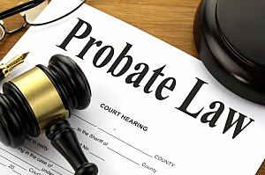
Probate Process
Process of validating a will
Executor files in local court after Testator/Decedent’s death
Not all wills must be probated
Probate will likely be needed if:
Real estate is involved
Beneficiaries are minors
Disputes over asset distribution occur
Assets are complex and high in value
Will is not written well
Notes:
Instructions: This slide describes the process for validating a will. It also describes situations where probate likely will be needed. Each state will have a specific process for estate administration/succession. Some states file copies of probated wills in the land records. Other states have the executor or administrator file a deed on behalf of the estate.
Time: 3 minutes
Materials: none
Handouts: none

Slide 30

What Could Make a Will Invalid?
Each state has its own requirements for a “valid” will.
Generally, it will be invalid if it:
Was not properly executed
Was not properly witnessed (does not apply to holographic wills)
Fails to include appropriate language
Fails to address spouse and children (states vary as to the right to exclude a spouse or child)
Is a product of undue influence, fraud or was executed at a time when the testator was not competent
Notes:
Instructions: Discuss the points on the slide that can cause a will to be deemed invalid.
Time: 3 minutes
Materials: none
Handouts: none

Slide 31
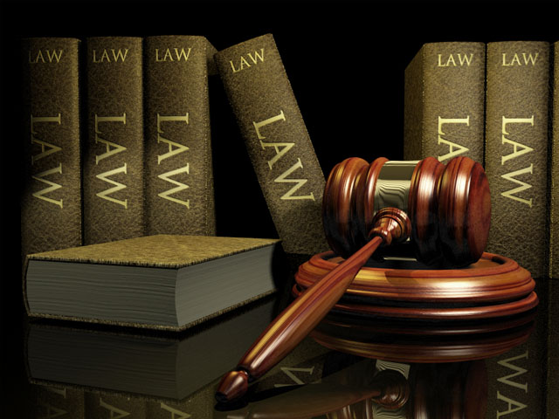



Intestate: Dying Without a Will
Distribution
Children
Time
Taxes
State law determines distribution
Court appoints children’s guardian
Takes longer to settle estate
May have tax consequences
Notes:
Instructions:
If someone dies without a will, it is called “intestate,” which means
The state uses established rules to determine distribution.
Dying intestate can add significant time to the process of distribution.
If your children are minors, the court will appoint a representative to look after their interests.
Dying intestate may have tax consequences.
Time: 10 minutes
Materials: none
Handouts: none

Slide 32

Updating Your Will
When someone named in your will dies
When circumstances change
Notes:
Instructions: Updating a will after the death of someone named is important to prevent later difficulties. For instance, if a child is deceased and the will conveys property to more than one unnamed grandchild, it creates a risk for difficulties arising from lack of unanimous consent. Updating wills after the death of a spouse or child may avoid this problem. Similarly, a change in circumstances surrounding people or things named in the will should lead to the will being updated.
Time: 2 minutes
Materials: none
Handouts: none

Slide 33
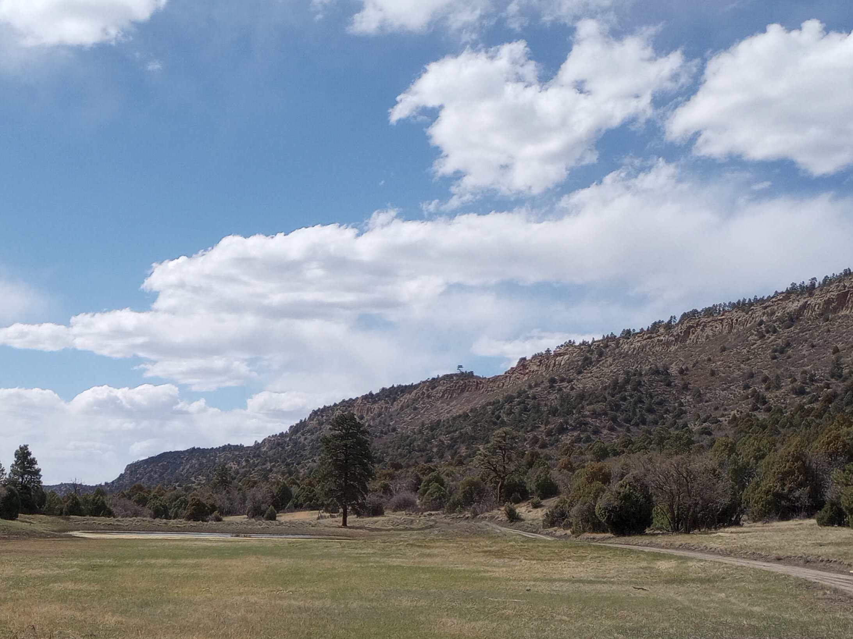
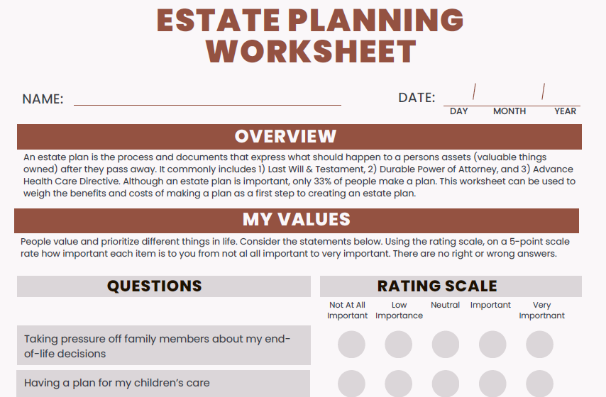
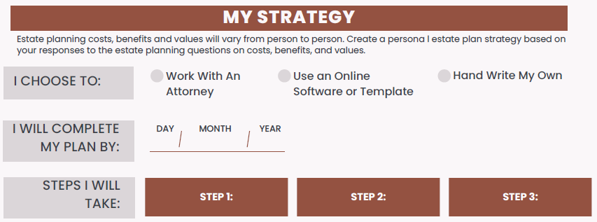
Estate Planning Worksheet
Notes:
Instructions:
The purpose of this worksheet is to help you take action once you leave this workshop. Most people who go to workshops do not finish the process. This worksheet will help you clarify your values and help you get the plan that works for you.
Estate planning can seem like a daunting task. But it’s an important way to help ensure that your wishes are honored, and your loved ones are cared for. Creating a strategy (or plan of action) is a wise first step for managing and distributing your assets after death.
Having a clear strategy might include having a checklist of tasks and tackling them across a manageable time. Using a checklist, like the worksheet on the screen can streamline the process of setting up your estate plan. Remember to set deadlines to complete each step.
An important first step in creating a strategy is to take some time to think about WHAT YOU VALUE. Knowing your values and priorities help determine what matters most in your legacy. For example, if you treasure your antique clock passed down from a parent, you’ll want to ensure that your will states who should receive the heirloom. You may even want to provide instructions on how to care for it.
Activity 1: Provide copies of the Estate Planning Worksheet and go over it with the participants.
Activity 2: In the resource materials is a role-play skit about meeting with a lawyer for the first time. You may use this skit to reinforce learning.
Time: 15 minutes
Materials: Sample Role Play Scripts
Handouts: Estate Planning Worksheet

Slide 34
Working with an Attorney
Notes:
Instructions: The next section explores important considerations in working with a lawyer in the planning process.
Time: 1 minute
Materials: None
Handouts: none

Slide 35

Benefits to Working with an Attorney
While working with an attorney for an estate/succession plan is not required:
An attorney can prevent the problem of incorrect wording, or an invalid will
Incorrect wording can lead to the will being contested, which adds to:
Family turmoil
Length of time for distribution
Notes:
Instructions: Note these important benefits to working with an attorney to develop your estate/succession plan.
Time: 5 minutes
Materials: none
Handouts: none

Slide 36

Cost of a Will
Factors that influence cost:
State
Flat fee vs. time
Complexity of the situation
Simple may be as low as $500 - $600 per person.
Nationwide average is $900 - $1,500 for an individual will created by an attorney or firm.
Lawyers sometimes charge a flat fee to write a will and other estate planning documents, ranging from $300 to a more common $1,000
Notes:
Instructions: The cost of having a will developed varies widely. This slide gives some very general ideas of what someone might find locally.
Simple Will generally is around $500-$600 per person
Nationwide, the average cost for an attorney or firm to create a will is $940 to $1,500 for an individual person. Most firms will reduce their price to a few hundred dollars when adding on a second nearly identical will for a spouse.
It's very common for a lawyer to charge a flat fee to write a will and other basic estate planning documents, Ranging from $300 to a more common $1,000.
If specific tax planning is needed, the will and tax advice will be more expensive.
Other factors that can influence cost include these:
Cost will vary from state to state and from attorney to attorney.
Some attorneys charge by their time and others have a flat rate.
The more complicated your situation is, the more expensive the fee.
Time: 5 minutes
Materials: none
Handouts: none

Slide 37
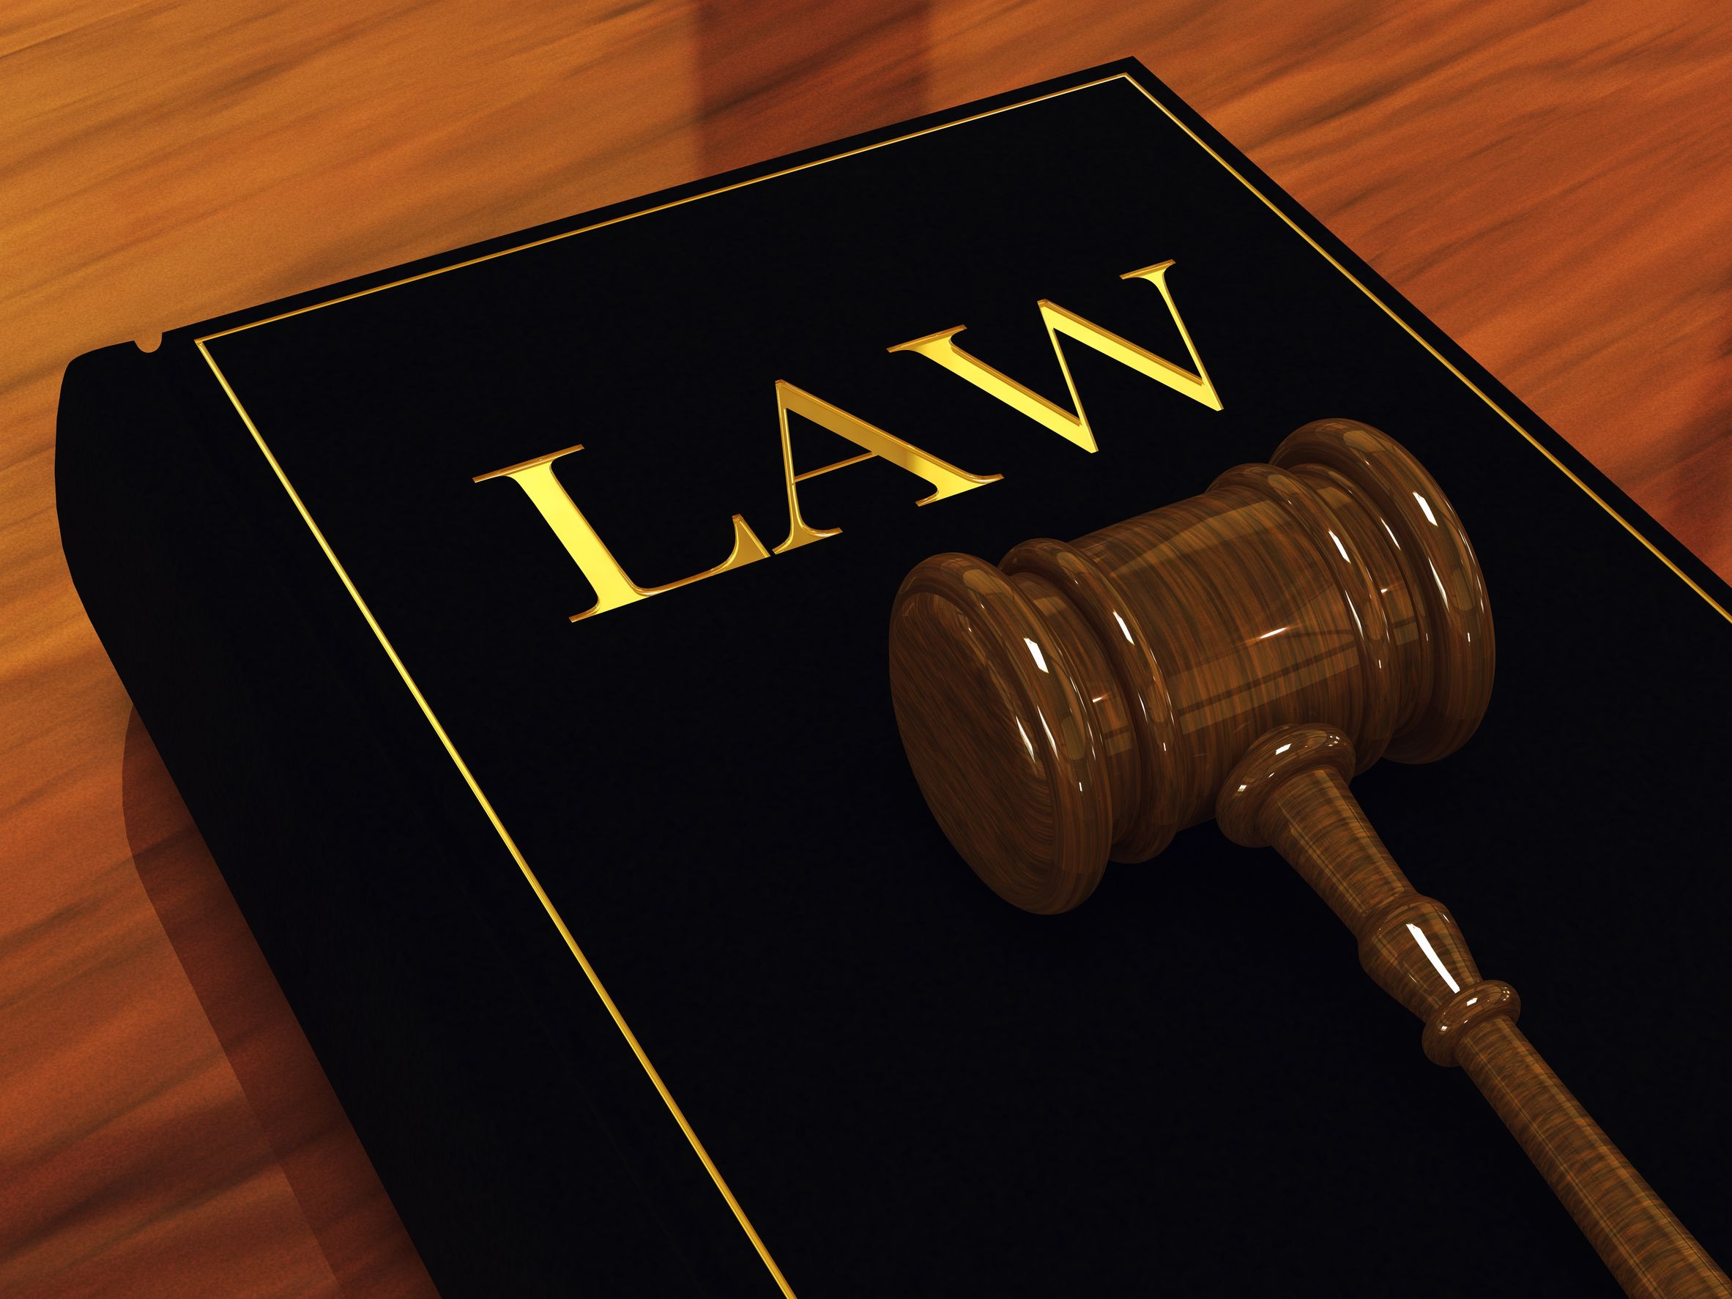
Specialty Areas of Lawyers
Not all lawyers know all parts of the law
One part is “Trusts and Estates”
Some states recognize specialization and certify lawyers.
For example: Florida bar recognizes the specialty of, “Wills, Trusts, and Estates”
Some lawyers have advanced degrees (e.g. LLM in taxation)
Notes:
Instructions: Lawyers can have a variety of specialties. This is important to understand so you are choosing one with the best training and experience.
Time: 5 minutes
Materials: none
Handouts: none
Source:
Here are specialties recognized by the American Bar Association for the chart: https://www.americanbar.org/topics/
21 specialty areas of law are listed by the American Bar Association

Slide 38
Specialty Areas of Lawyers – Just a Sample!
Trusts & Estates
Health
Family
International
Taxation
Criminal
Real Estate
Corporate
Trials and Litigation
Notes:
Instructions: This slide gives just a sample of different kinds of specialty areas for lawyers. It helps provide an idea of why finding one with the right expertise is important.
Time: 1 minute
Materials: none
Handouts: none
Source: Here are specialties recognized by the American Bar Association for the chart: https://www.americanbar.org/topics/

Slide 39

Choosing an Attorney
Like buying other products and services, you are looking for a “good fit”
Comparison shop
Ask for referrals
Look for experience in estate/succession
Be sure they are licensed in your state
Notes:
Instructions: Choosing an attorney is similar to other good shopping. This slide offers some key points to guide the decision.
Time: 5 minutes
Materials: none
Handouts: none
Sources:
https://extension.tennessee.edu/publications/Documents/SP743-B.pdf
https://www.uaex.uada.edu/life-skills-wellness/personal-finance/retirement-and-estate-planning/
https://401kcalculator.net/retirement-calculator/

Slide 40

Questions to Ask
What percentage of your practice involves estate planning?
Do you have any conflicts of interests that I should know about before I hire you?
What documents will be prepared and how long will it take?
How will you keep me informed of progress?
What is the ballpark figure of my total bill and what would cause the bill to change?
Notes:
Instructions: When meeting to interview an attorney about possibly hiring him or her, listen and give the best information so that the attorney can assess your needs in the best way possible. Some questions to ask before deciding who to hire are depicted on this slide.
Time: 5 minutes
Materials: none
Handouts: none

Slide 41
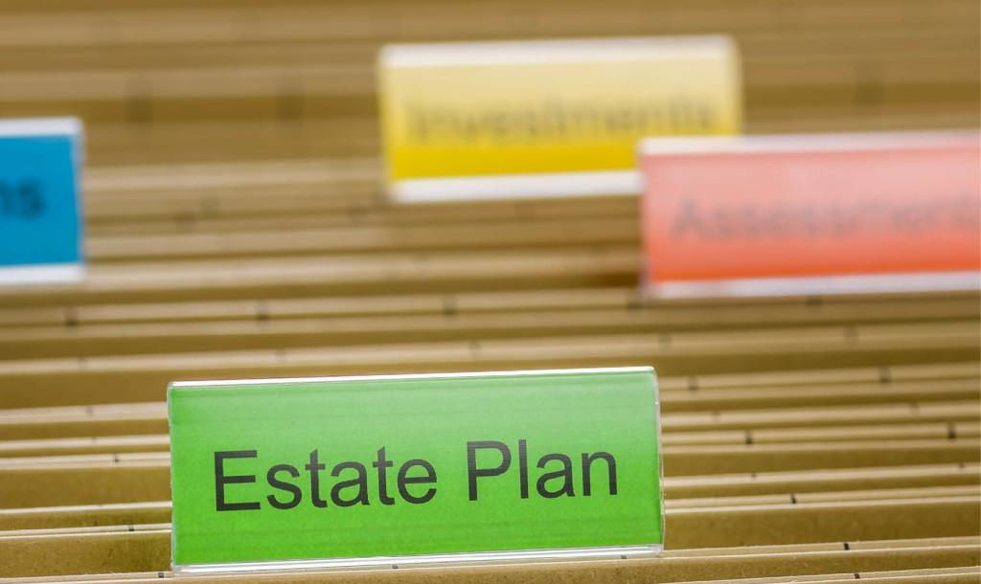
Documents to Bring
Written summary of what you plan to achieve with your estate plan
Documents with the full names and addresses for you, your spouse, children, and anyone else you plan to include in your will
Complete income tax returns, previous 3-5 years
Balance sheet: assets and liabilities owed to you
Deeds and mortgages
Detailed list of any other oral or written agreements
Marital agreements and/or divorce decrees
Beneficiary designations (insurance, retirement plans, etc.)
Prior wills, power of attorneys, any other pre-existing versions
Notes:
Instructions: Being prepared is likely to save you time and money.
Attorneys may have you fill out a form and give you a list of documents to bring with you on your first appointment, which may include:
Written summary of what you hope to achieve with your estate plan
Document with your full name and address and the full names and addresses of your spouse and children and anyone you plan to include in your will
Complete personal income tax returns for 3-5 years
Balance sheet with assets and liabilities owned by you
Deeds and mortgages
List and details of any other oral or written agreements that you have with a lender, creditor, landlord, tenant or other party
Marital agreements and/or divorce decrees
Beneficiary designations (insurance, retirement plans, etc.)
Prior wills, power of attorneys, any other pre-existing versions
Time: 5 minutes
Materials: none
Handouts: none

Slide 42
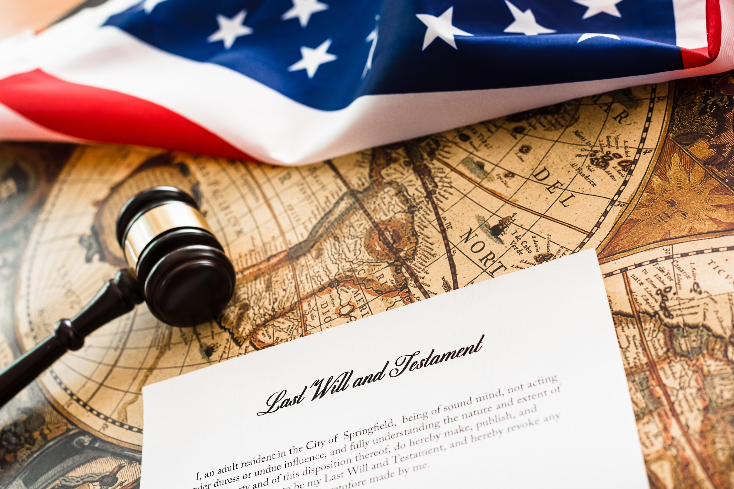
Originals and Copies of Your Will
Store the original will in a safe place.
Let your executor know where the original will is stored.
Give duplicate signed copies to the executor and your attorney.
Notes:
Instructions: Ensure that your will is safe by following these three steps.
Store the original will in a safe place.
Let your executor know where the original will is stored, along with needed information such as the password for the safe.
Give duplicate signed copies to the executor and your attorney if you have one.
Time: 5 minutes
Materials: none
Handouts: none

Slide 43
Big Picture Quiz: True or False?
True or False?
Making a will prevents heirs’ property.
Notes:
Instructions: False. Having a will does not necessarily mean you avoided creating heirs’ property..
Time: 5 minutes
Materials: none
Handouts: none

Slide 44
Avoiding Heirs’ Property in a Will
Notes:
Instructions: This section will discuss important considerations in preventing heirs’ property when writing a will.
Time: 1 minute
Materials: none
Handouts: none

Slide 45
Simple Will: How It May Create Similar Issues to Heirs’ Property
A simple will often leaves all assets including real property:
First, to a spouse
Second, if the spouse is deceased, equally to children.
If children inherit under this type of simple will, they hold an undivided interest in the property.
Unlike heirs’ property, the property is titled in their name
Like heirs’ property, they cannot use it without unanimous consent of all siblings involved.
Notes:
Instructions: Having a will does not mean you avoided creating issues similar to heirs’ property. Decisions have to be made by owners to manage property and put it to productive use. If property is held jointly by
children, all the children as owners must consent to the use of the property. This may lead to disagreements and a deadlock.
Time: 5 minutes
Materials: none
Handouts: none

Slide 46

Tips to Avoid Heirs’ Property
Issues in a Will
Put in writing how the land would be divided among spouse and children if they inherit. Common ways to divide:
Physically divided into separate parcels for each person using valid legal descriptions.
Financially divided based on equal value of parcels by a process specified in the will.
Ask your lawyer to advise you on:
How to provide for the payment of debts and taxes so the property division is not affected by claims of creditors or required tax payments.
What is needed in terms of a temporary process to manage the farm, ranch or forest to avoid interruption in the business.
Notes:
Instructions: Review these tips for handling property distribution among multiple children. Additional talking points are below:
Physical division of property may require a survey.
Properties of the same acreage may have different values. For example, some properties having higher value are those having greater road frontage, more fertile soils, having utilities present, etc. Thus, some choose to have the property divided after death based on equal value of parcels (perhaps divided by an appraiser or other person) .
Sometimes, if an appraiser or other person is asked to divide property after the death of the property owner, they might first divide the overall property into pieces of equal value (not necessarily equal size) and then there may be a drawing where each child obtains a parcel at random.
Your lawyer should advise you on:
How provide for the payment of debts and taxes so the property division is not affected by claims of creditors or required tax payments
What is needed in terms of a temporary process to manage the farm, ranch or forest to avoid interruption in the business
Other problems are created if the children are under the age of majority when they inherit the property.
Time: 5 minutes
Materials: none
Handouts: none

Slide 47

Other Planning Strategies to Prevent Heirs’ Property
Notes:
Instructions: This section will discuss important considerations in preventing heirs’ property when writing a will.
Time: 1 minute
Materials: none
Handouts: none

Slide 48

Transferring Title by Deed
Real Property can be conveyed by deed rather than by will.
A recorded deed takes precedence over a will disposing the same property.
Deeds should be prepared by a licensed attorney.
Options for transferring include:
Conveying real property before death
Reserving or granting a life estate
Conveying title by a transfer on death deed (in some states)
Notes:
Instructions: Discuss these key points related to transferring land by deed.
These options have been noted earlier but are repeated here to weave the connections.
Conveying real property before death
Reserving or granting a life estate when conveying property to allow limited use by the life tenant prior to death
Conveying title by a transfer on death deed that transfers full title on death
Time: 5 minutes
Materials: none
Handouts: none

Slide 49

Granting a Spouse or a Child a Life Estate
One spouse/parent may prefer to leave real property as a life estate to a spouse or a child in the event of circumstances important to that parent. Examples include:
Planning for property management if a spouse needs to go to a nursing home after inheriting.
Ensuring a child receives the property after the death of a spouse.
Providing for the care of someone with special needs.
Allowing someone earning their livelihood from the property (farm/ranch) to remain there.
Your lawyer should advise you on rights/obligations of a life estate based on the state laws where the property is located.
Notes:
Instructions:
One spouse/parent may prefer to leave real property as a life estate to a spouse or a child in the event of circumstances important to that parent.
A life estate may be limited so as to require the holder to live on the property for a specified number of months each year if there is a concern that commitment to a nursing home or other facility would not enable the holder to manage the property. The property could be managed by others in order to keep the income stream benefitting the nursing home resident. This may have implications on eligibility for the government benefit.
A life estate ensures the parent that the children receive the property after the death of the person holding the life estate. For instance, if property solely owned by one person is first left by that person to their spouse, the surviving spouse may later remarry and change their will or for other reasons cut a child out of their will (as allowed by law).
Life estates may provide for a child with special needs so that they may remain in the family home if it is in their best interest.
Life estates may also allow a child who earns their livelihood on the farm/ranch to continue living there for their life.
Your lawyer should advise you as to what rights/obligations pass under a life estate under the law of the state where your property is located so that you could make changes to match your desires.
In most states, a life tenant has exclusive control of the property during their life. They generally must keep property in good repair.
Time: 10 minutes
Materials: none
Handouts: none

Slide 50
Placing Property in an Entity – An Alternative Approach to Physically Dividing Property
Your property can be conveyed to a trust, corporation, limited liability company or other entity
Prior to your death – Seek advice on property taxes (if homestead)
Upon death if designated in your will
Be sure to seek a lawyer’s assistance.
Notes:
Instructions:
Using a trust or business entity can avoid partition and the decedent can determine the use and management of the property after his or her death.
Generally, interests in entities could include shares of stock in a corporation, membership interests in a limited liability company, partnership shares/units in a partnership, etc.
Some trusts are created by a will. Other trusts are created prior to the owner’s death by a trust instrument.
Prior to your death:
If the trust is created prior to the owner’s death, the owner will deed their property to the trust. Trusts are managed by one or more trustees who have broad discretionary powers. Prior to the death of either spouse, your lawyer may help you convey property to a trust, corporation, limited liability company or other entity.
NOTE: Seek advice as to the effect on property taxes, if the property is your homestead.
If property is placed in an entity prior to your death, your will provides for the interests in the entity you created to be left to a spouse or children.
Upon death through a will:
Upon death, if you have kept the property in your name, a will may place property in a trust for the benefit of a spouse or children.
Time: 5 minutes
Materials: none
Handouts: none

Slide 51
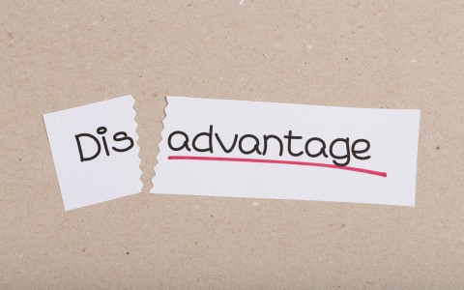
Placing Property in an Entity – An Alternative Approach to Physically Dividing Property
Advantages:
Property stays together in one undivided tract.
Unanimous consent is not required for most management actions
There may be a prohibition on sale of property or interests
Disadvantages:
Restrictions may make sale of a person’s interest difficult.
Disagreements on management decisions may cause friction.
Notes:
Instructions:
Discuss these advantages and disadvantages of placing property in an entity
Advantages include:
The property stays together in one undivided tract and is managed by a trustee (if held in a trust) or a board, manager(s) or general partner(s) if held in another entity.
This does not require unanimous consent for most management actions.
There may be a prohibition on sale of property or interests.
Disadvantages include:
Restrictions placed on transfer of interests in the entity may make a sale difficult when a child needs to sell for health, financial or other personal reasons.
Disagreements over management decisions made by others may cause family dissention.
In entities other than a trust, unanimous consent of the owners of an interest in the entity may be required to sell the property or place a mortgage on it. General day-to-day affairs are decided by majority vote of the board of directors (for a corporation), the manager(s) (for a limited liability company) and the partners (for a partnership). A holdout will usually not create a deadlock.
A common requirement may include restrictions on transfer of interest in the family-owned entities. A proposed sale may first be required to be offered to the other owners or the entity before being sold to a third-party.
Time: 5 minutes
Materials: none
Handouts: none

Slide 52
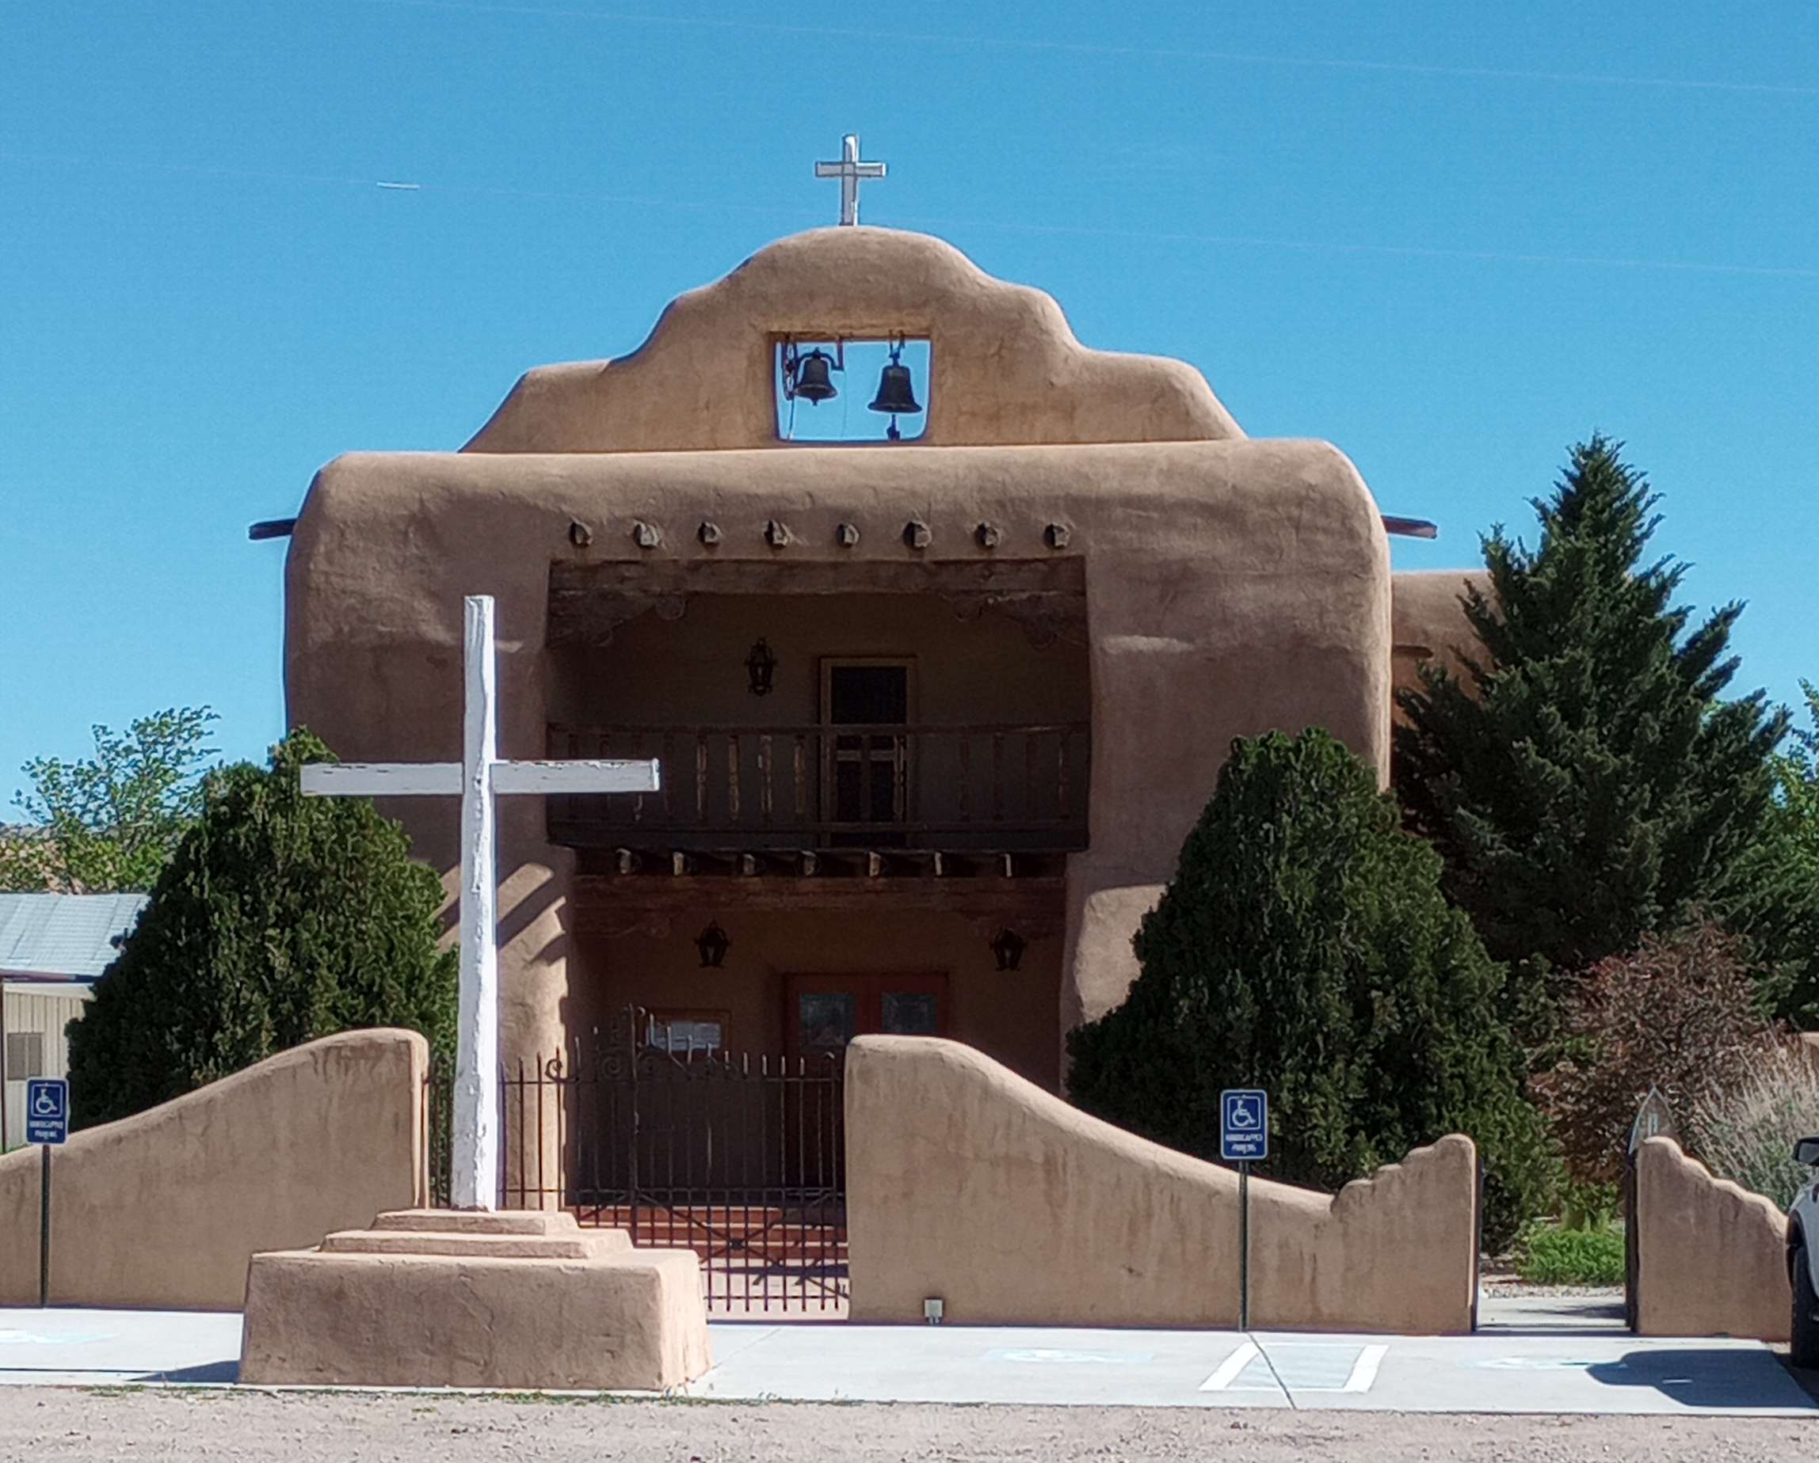
Maintaining Property as Heirs’ Property through Current Marketable Title
After title is examined, the names and percentage interests of each family member should be determined.
Record. Title should be updated to reflect current ownership and percentage interest according to the law of the states where the property is located which may include:
Affidavit of Heirship
Probate of wills
Administration of Estates
Judicial Determination of Heirship
Notes:
Instruction: Discuss these key elements involved in keeping a title current.
Time: 5 minutes
Materials: none
Handouts: none

Slide 53
Maintaining Property as Heirs’ Property through Current Marketable Title (cont’d.)
Advantages
Keeps family current as to names and percentage of ownership of family members
Keeps relationships between family members
Disadvantages
Must be updated upon the death of each heir
Does not address disabilities (incompetence) during lifetime
Does not prevent an heir from selling their fractional interest
Does not prevent any heir or purchaser from seeking partition of the property
Notes:
Instruction: Discuss the advantages and disadvantages of this approach using the talking points on the slide.
Time: 3 minutes
Materials: none
Handouts: none

Slide 54
Questions and Discussion
Notes:
Instructions: Wrap up this session with any questions participants may have.
Time: 5 minutes
Materials: none
Handouts: none

Slide 55
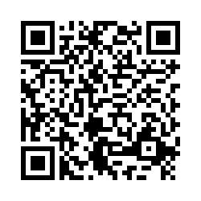
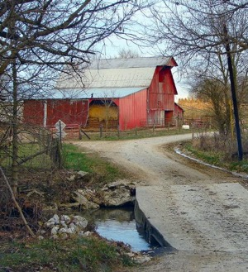


Community Workshop
Understanding
Heirs’ Property at the
Community Level
Workshop Evaluation
Please Scan the QR Code
Notes:
Instructions: This slide is to prompt the evaluation process. If you are using paper copies, please hand them out at this time. If you are using the online Qualtrics evaluation, use the QR code for the Heirs’ Property Community Workshop Survey.
Note: Check to make sure the QR code is working properly before sharing with participants.
Time: 10 minutes
Materials: none
Handouts: Paper copies of the Heirs’ Property Community Workshop Survey and/or the QR code on this slide.

