Slide 1


DIGITAL MARKETING: A Deeper Dive into Facebook

Slide 2
In accordance with Federal law and the U.S. Department of Agriculture (USDA) civil rights regulations and policies, this institution is prohibited from discriminating on the basis of race, color, national origin (including English proficiency), limited religion, sex, disability, age, marital status, family/parental status, income derived from a public assistance program, political beliefs, reprisal or retaliation for prior civil rights activity in any program or activity conducted or funded by USDA. (Not all prohibited bases apply to all programs)
Program information may be made available in languages other than English. Persons with disabilities who require alternative means of communication for program information (e.g., braille, large print, audiotape, American Sign Language) should contact the responsible State or local Agency that administers the program or contact USDA through the Telecommunications Relay Service at 711 (voice and TTY).

Slide 3
To file a program discrimination complaint, a complainant should complete a Form AD-3027, USDA Program Discrimination Complaint Form, which can be obtained online at https://www.usda.gov/sites/default/files/documents/ad-3027.pdf, from any USDA office, by calling (866) 632-9992, or by writing a letter addressed to USDA. The letter must contain the complainant’s name, address, telephone number, and a written description of the alleged discriminatory action in sufficient detail to inform the Office of the Assistant Secretary for Civil Rights (OASCR) about the nature and date of an alleged civil rights violation. The completed AD-3027 form or letter must be submitted to USDA by: mail: U.S. Department of Agriculture Office of the Assistant Secretary for Civil Rights 1400 Independence Avenue, SW Washington, D.C. 20250-9410; or email: program.intake@usda.gov
This institution is an equal opportunity provider.

Slide 4
Title IX of the Education Amendments Act of 1972 (Title IX) prohibits discrimination on the basis of sex, pregnancy, or parental status - in educational programs and activities that receive Federal financial assistance. The law also prohibits individuals from exclusion from such programs or activities or from denial of benefits from such programs or activities based on sex. This prohibition applies to a wide array of public and private schools at the K-12 grade levels, as well as colleges and universities which receive federal funding. A school that is controlled by a religious organization is exempt from Title IX when the law’s requirements would conflict with the organization’s religious tenets. The law requires federally funded education institutions or programs to disseminate Title IX information widely, including the name, address, and telephone number (or other contact information) of the designated Title IX Coordinator.
Program information is available in languages other than English. Persons with disabilities who require alternative means of communication (e.g., braille, large print, audiotape, American Sign Language) should contact the responsible State or local Agency that administers the program or contact USDA through the Federal Telecommunications Relay Service at 711 (voice and TTY).

Slide 5
Prior to filing a Title IX complaint with USDA against an institution, a potential complainant may want to find out about the institution’s grievance process and use that process to have the complaint resolved. However, a complainant is not required by law to use the institutional grievance process before filing a complaint with the Office of the Assistant Secretary of Civil Rights (OASCR). If a complainant uses an institutional grievance process and chooses to file the complaint with OASCR, the complaint must be filed with OASCR within 60 days after completion of the institutional grievance process.

Slide 6
To file a USDA program discrimination complaint, a complainant should complete Form AD-3027, USDA Program Discrimination Complaint Form, which can be obtained online at https://www.usda.gov/sites/default/files/documents/ad-3027.pdf; from any USDA office; by calling (866) 632-9992; or by writing a letter addressed to the USDA office listed below. The letter must contain the complainant’s name, address, telephone number, and a written description of the alleged discriminatory action in sufficient detail to inform OASCR about the nature and date of an alleged civil rights violation. The completed AD3027 form or letter must be submitted to USDA via: mail: U.S. Department of Agriculture Office of the Assistant Secretary for Civil Rights 1400 Independence Avenue, SW Washington, D.C. 20250-9410; or email: program.intake@usda.gov
This institution is an equal opportunity provider.

Slide 7
FACEBOOK BENEFITS
Social connection
Information and news
Content sharing
Networking opportunities
Business promotion
Community engagement
Events and invitations

Slide 8
FACEBOOK FOR BUSINESS
Create pages
Interact with customers
Promote products or services
It's important to note that while Facebook offers various benefits, it's essential to use it responsibly and be mindful of privacy and security settings to protect personal information.

Slide 9
FACEBOOK PAGE KEY FEATURES
Page information
Posts and updates
Page followers
Engagement tools
Insights and analytics
Advertising and promotions

Slide 10
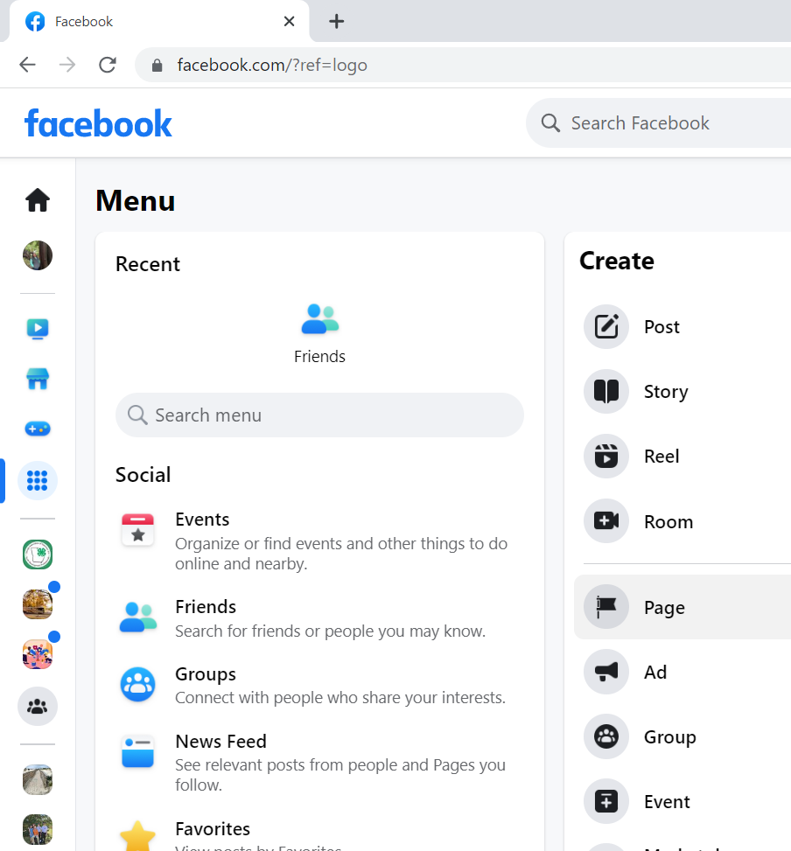

Slide 11
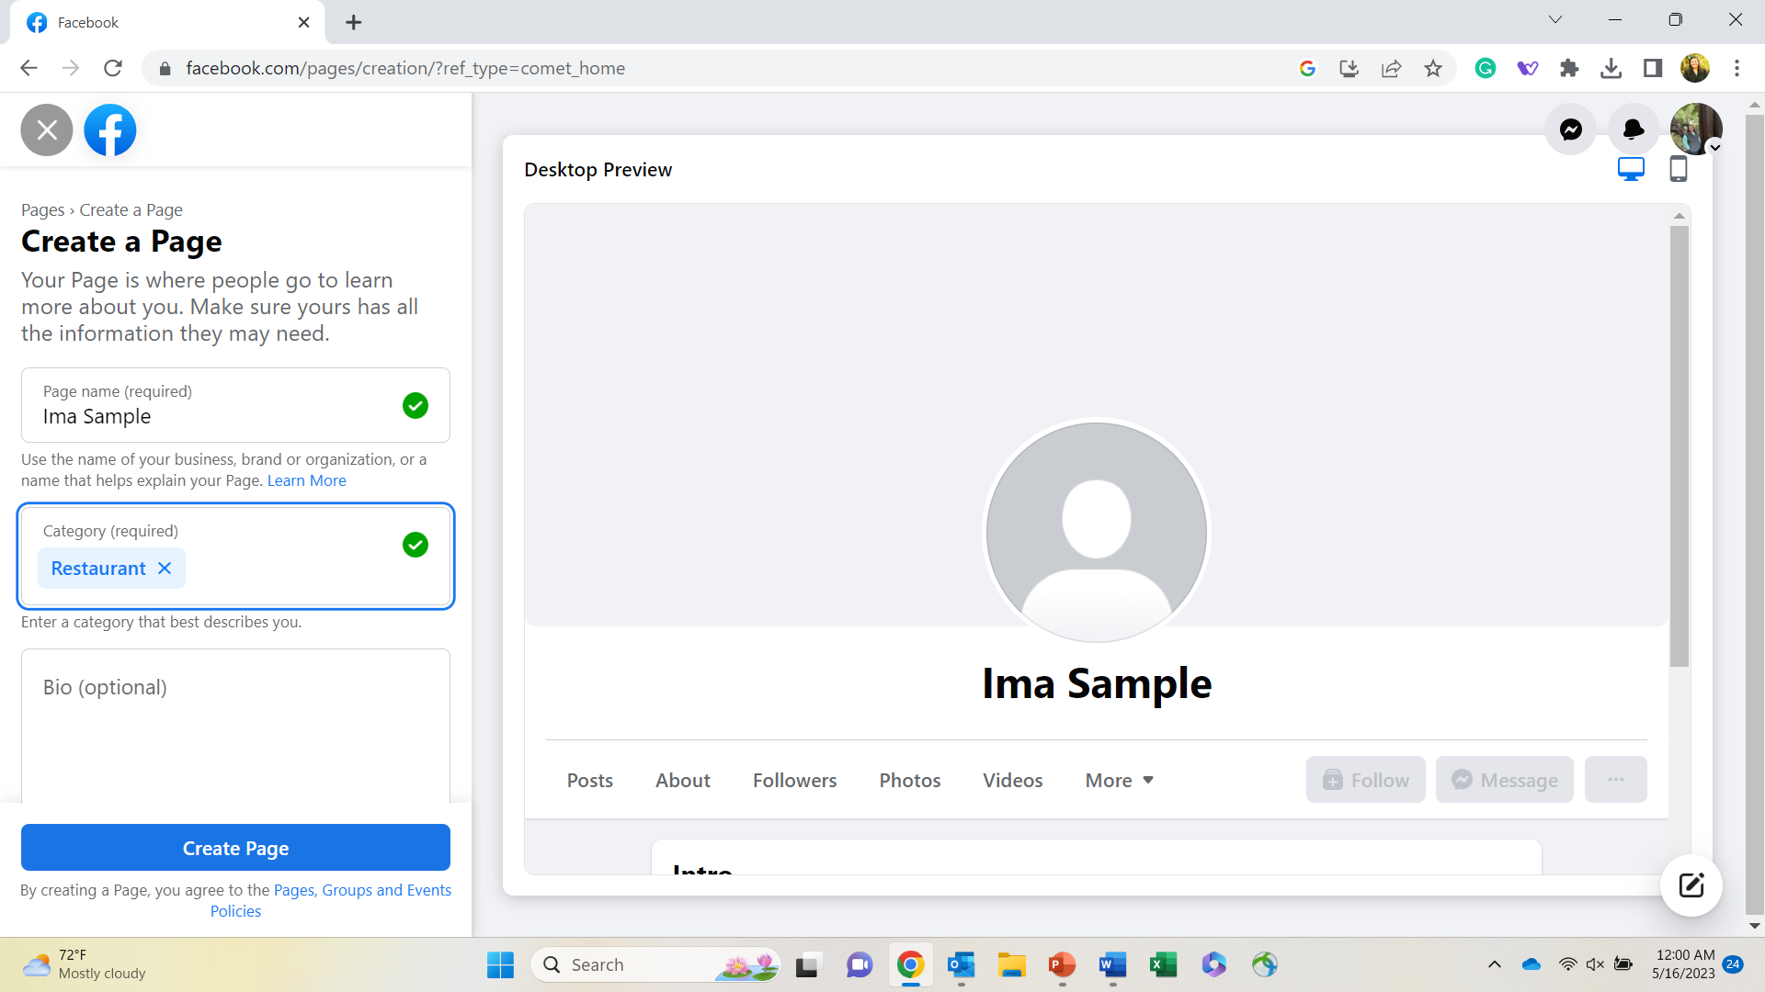

Slide 12
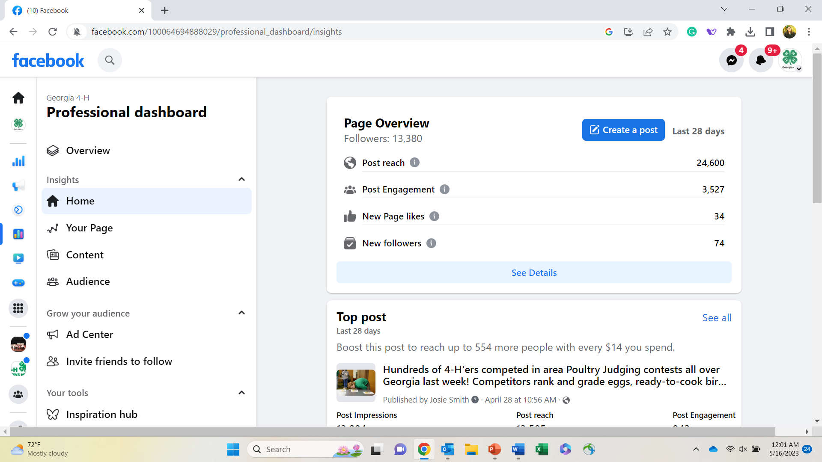

Slide 13
Content for Facebook Pages

Slide 14
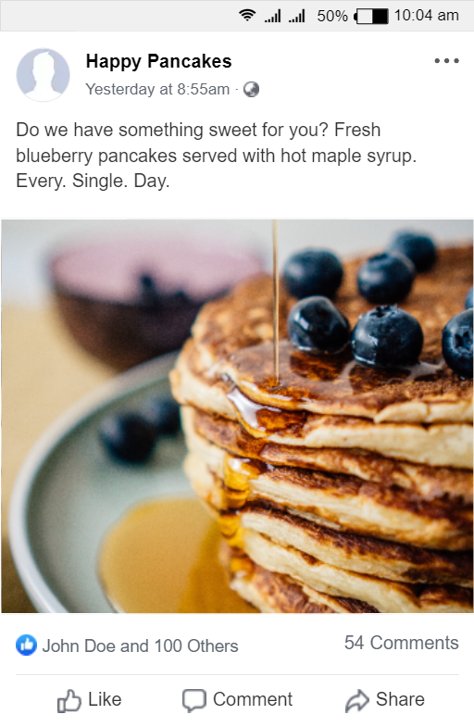
PRODUCT OR SERVICE HIGHLIGHTS
Showcase your products or services through high-quality photos, videos, and descriptions. Highlight their features, benefits, and unique selling points to generate interest and drive sales.

Slide 15

BEHIND THE SCENES
Offer a glimpse into your business operations, such as your manufacturing process, team members, or workspace. This humanizes your brand and builds trust with your audience.

Slide 16
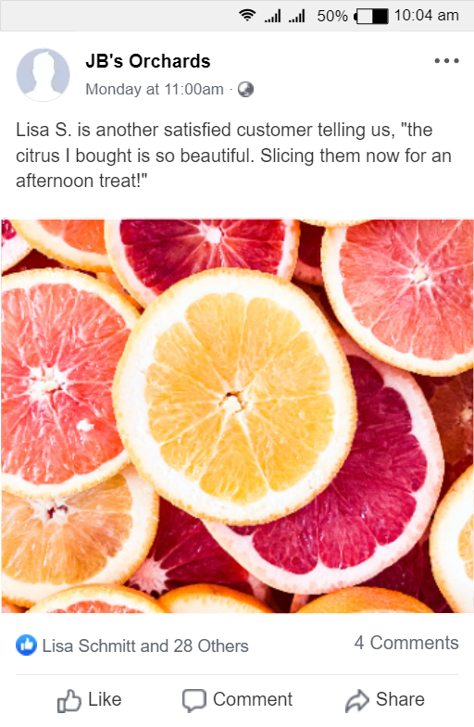
CUSTOMER REVIEWS
Share positive feedback and testimonials from satisfied customers. This builds social proof and helps potential customers gain confidence in your products or services.

Slide 17
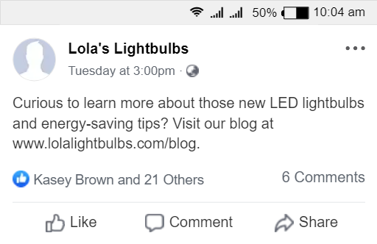
HOW-TO GUIDES
Provide helpful guides, tips, and tutorials related to your industry or offerings. This positions your business as an authority and provides value to your audience.

Slide 18
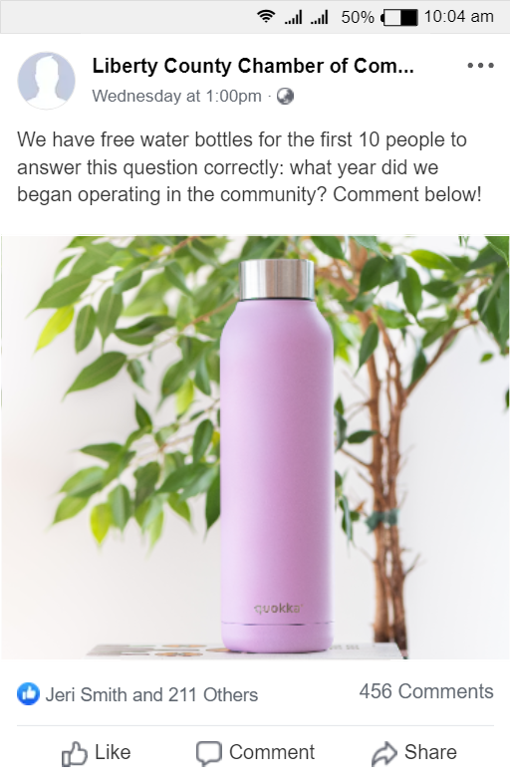
CONTESTS & GIVEAWAYS
Engage your audience by hosting contests, giveaways, or sweepstakes. Encourage users to participate by liking, commenting, or sharing your post for a chance to win prizes. This increases brand awareness and encourages interaction.

Slide 19
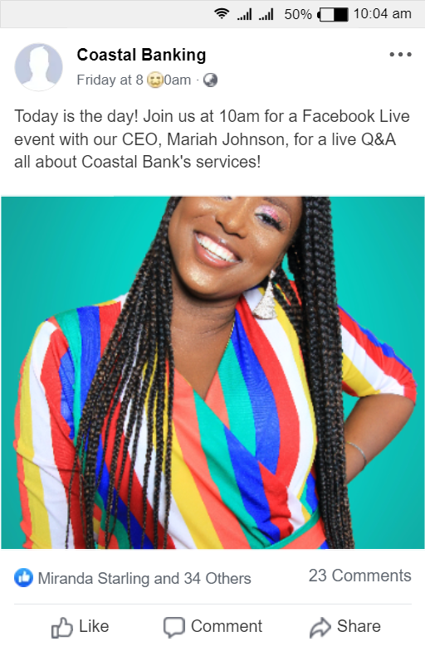
EDUCATIONAL CONTENT
Tailor your content to specific seasons, holidays, or events. This helps you stay current and tap into the festive spirit, creating a sense of connection with your audience.

Slide 20
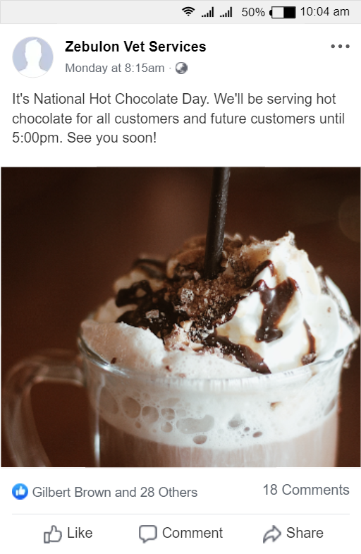
SEASONAL POSTS
Create informative and educational content that addresses common questions, challenges, or interests of your target audience. This can be in the form of blog posts, videos, infographics, or live Q&A sessions.

Slide 21
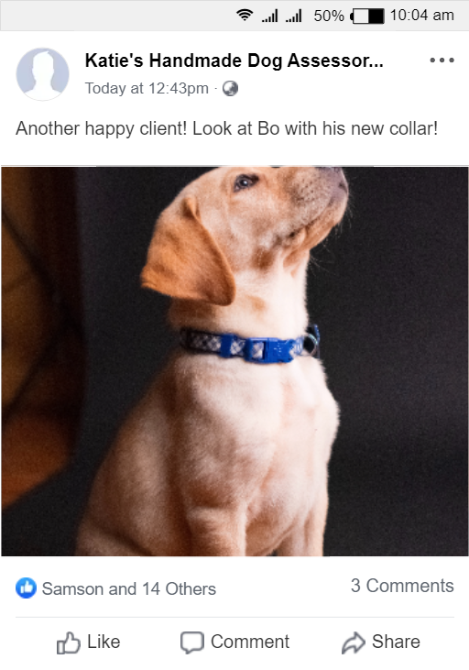
USER-GENERATED CONTENT
Encourage your customers to share their experiences with your products or services by using a branded hashtag or tagging your page. Repost and highlight user-generated content to foster engagement and authenticity.

Slide 22

EVENT ANNOUCEMENTS
Promote upcoming events, workshops, webinars, or conferences related to your business or industry. Provide details and encourage followers to attend or participate.

Slide 23
ACTIVITY
Create 3 different social media posts using the categories below:
product or service highlights
behind-the-scenes
customer testimonials and reviewers
how-to guides and tutorials
contests and giveaways
educational content
seasonal and holiday-themed posts
user-generated content
event announcements

Slide 24
Reflections & Questions

Slide 25
Thank You!

