Slide 1


DIGITAL MARKETING:
Harnessing the Power of Digital Media in the Workplace

Slide 2
In accordance with Federal law and the U.S. Department of Agriculture (USDA) civil rights regulations and policies, this institution is prohibited from discriminating on the basis of race, color, national origin (including English proficiency), limited religion, sex, disability, age, marital status, family/parental status, income derived from a public assistance program, political beliefs, reprisal or retaliation for prior civil rights activity in any program or activity conducted or funded by USDA. (Not all prohibited bases apply to all programs)
Program information may be made available in languages other than English. Persons with disabilities who require alternative means of communication for program information (e.g., braille, large print, audiotape, American Sign Language) should contact the responsible State or local Agency that administers the program or contact USDA through the Telecommunications Relay Service at 711 (voice and TTY).

Slide 3
To file a program discrimination complaint, a complainant should complete a Form AD-3027, USDA Program Discrimination Complaint Form, which can be obtained online at https://www.usda.gov/sites/default/files/documents/ad-3027.pdf, from any USDA office, by calling (866) 632-9992, or by writing a letter addressed to USDA. The letter must contain the complainant’s name, address, telephone number, and a written description of the alleged discriminatory action in sufficient detail to inform the Office of the Assistant Secretary for Civil Rights (OASCR) about the nature and date of an alleged civil rights violation. The completed AD-3027 form or letter must be submitted to USDA by: mail: U.S. Department of Agriculture Office of the Assistant Secretary for Civil Rights 1400 Independence Avenue, SW Washington, D.C. 20250-9410; or email: program.intake@usda.gov
This institution is an equal opportunity provider.

Slide 4
Title IX of the Education Amendments Act of 1972 (Title IX) prohibits discrimination on the basis of sex, pregnancy, or parental status - in educational programs and activities that receive Federal financial assistance. The law also prohibits individuals from exclusion from such programs or activities or from denial of benefits from such programs or activities based on sex. This prohibition applies to a wide array of public and private schools at the K-12 grade levels, as well as colleges and universities which receive federal funding. A school that is controlled by a religious organization is exempt from Title IX when the law’s requirements would conflict with the organization’s religious tenets. The law requires federally funded education institutions or programs to disseminate Title IX information widely, including the name, address, and telephone number (or other contact information) of the designated Title IX Coordinator.
Program information is available in languages other than English. Persons with disabilities who require alternative means of communication (e.g., braille, large print, audiotape, American Sign Language) should contact the responsible State or local Agency that administers the program or contact USDA through the Federal Telecommunications Relay Service at 711 (voice and TTY).

Slide 5
Prior to filing a Title IX complaint with USDA against an institution, a potential complainant may want to find out about the institution’s grievance process and use that process to have the complaint resolved. However, a complainant is not required by law to use the institutional grievance process before filing a complaint with the Office of the Assistant Secretary of Civil Rights (OASCR). If a complainant uses an institutional grievance process and chooses to file the complaint with OASCR, the complaint must be filed with OASCR within 60 days after completion of the institutional grievance process.

Slide 6
To file a USDA program discrimination complaint, a complainant should complete Form AD-3027, USDA Program Discrimination Complaint Form, which can be obtained online at https://www.usda.gov/sites/default/files/documents/ad-3027.pdf; from any USDA office; by calling (866) 632-9992; or by writing a letter addressed to the USDA office listed below. The letter must contain the complainant’s name, address, telephone number, and a written description of the alleged discriminatory action in sufficient detail to inform OASCR about the nature and date of an alleged civil rights violation. The completed AD3027 form or letter must be submitted to USDA via: mail: U.S. Department of Agriculture Office of the Assistant Secretary for Civil Rights 1400 Independence Avenue, SW Washington, D.C. 20250-9410; or email: program.intake@usda.gov
This institution is an equal opportunity provider.

Slide 7
SOCIAL MEDIA
The interactions among people in which they create, share, and/or exchange information and ideas in virtual communities and networks.

Slide 8
SOCIAL MEDIA
Personal Level
Communicate with family,
learn new things,
develop interests,
entertainment
Professional Level
Broaden knowledge,
Networking,
finding similar interests
Company Level
Conversations with audience,
gain customer feedback,
elevate your brand

Slide 9
SOCIAL MEDIA PEOPLE
The user is the person that is interacting with the social media account.
A profile is a short description of someone's life, work, character, etc. that is posted on social media platforms. For a business, this is usually a short description about the business, goods/services, location, contact information, etc.
The audience is the group of people you can reach with your content. This includes all your direct followers, plus anyone who sees or interacts with your posts in their feed.

Slide 10
POSTS
A post on social media is simply the content shared through a user's profile.
Here are some tips for creating effective social media post:
  Keep post short and to the point
  Use visuals to capture attention
  Ask questions to engage audience
  Use relevant hashtags to help people find your post
  Promote post on other social media platforms

Slide 11
MORE TERMINOLOGY
A like is a form of engagement on social media. It's a quick way of showing that you like or enjoy the content posted by simply clicking a button.
A follow represents a user who chooses to see all of another user's posts in their content feed.
A feed is an updated list of all the new content posted by the accounts a user follows on social media.

Slide 12
MORE TERMINOLOGY
Analytics
Algorithms
Analytics are the metrics on social media performance and using that data to improve strategy for developing and promoting content.
The analytics can include information such as:
  how many people directly saw the post
  how many people shared it
  how many people saw it because someone else shared it, etc.
An algorithm (or feed algorithm) is the set of rules/processes a social network uses to automatically decide which posts come first in a user’s feed.
Factors that influence how posts are ranked in a user’s feed may include:
  the time and date the post was published
  the number of people who have liked, commented, or shared the post
  the user’s interest
  the user’s location

Slide 13
POP QUIZ!
User or Audience?
The person that is interacting in the social media account
Answer: User!

Slide 14
POP QUIZ!
Post or Profile?
A short description of someone’s life, work, character, etc. that is posted on social media platforms
Answer: Profile!

Slide 15
POP QUIZ!
Feed or Sharing?
An updated list of all the new content posted by the accounts a user follows on social media.
Answer: Feed!

Slide 16
POP QUIZ!
Social Media or Analytics?
The interactions among people in which they create, share, and/or exchange information and ideas in the virtual communities and networks
Answer: Social Media!

Slide 17
POP QUIZ!
Like or Sharing?
A form of engagement on social media where a user indicates they enjoy content that’s been posted.
Answer: Like!

Slide 18
Common Social Media Platforms

Slide 19
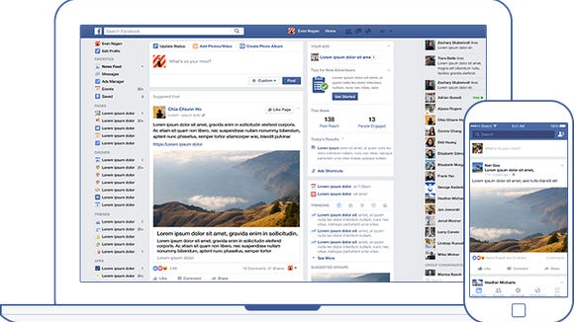
FACEBOOK
Some benefits of using Facebook include:
  Free platform
  Lots of users
  Simple
  Events
  Paid Advertising

Slide 20
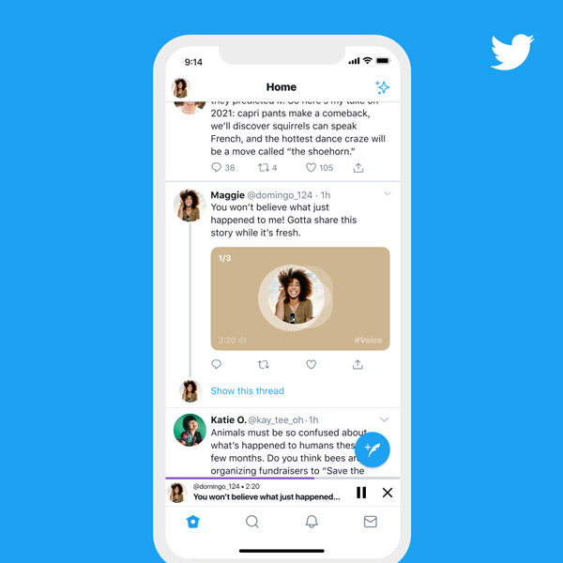
TWITTER
Some benefits of using Twitter include:
  Free platform
  Engaging with customers

Slide 21
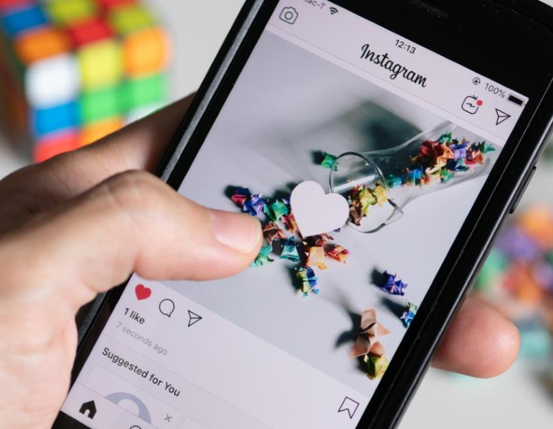
INSTAGRAM
Some benefits of using Instagram include:
  Free platform
  Simple
  Similar advertising as Facebook

Slide 22
Activity

Slide 23
Reflections & Questions

Slide 24
Thank You!

