Slide 1

Computer Basics
Notes:
Instructions: Have this slide up as participants enter the room
Materials: None
Handouts: None
Time: 1 minute
Photo by Thirdman: https://www.pexels.com/photo/a-group-of-people-having-a-discussion-while-looking-at-laptop-5256526/

Slide 2







Bridging the Digital Divide Partners
This project was funded by USDA NIFA award # 2022-68006-36496. The material is based upon work supported by the National Institute of Food and Agriculture, U.S. Department of Agriculture. Any opinions, findings, conclusions, or recommendations expressed in this publication are those of the author(s) and do not necessarily reflect the view of the U.S. Department of Agriculture.
Materials as of: November 2023
Notes:
Instructions: Share this acknowledgment of the partnerships in the Bridging the Digital Divide.
Materials: None
Handouts: None
Time: 1 Minute

Slide 3
In accordance with Federal law and the U.S. Department of Agriculture (USDA) civil rights regulations and policies, this institution is prohibited from discriminating on the basis of race, color, national origin (including English proficiency), limited religion, sex, disability, age, marital status, family/parental status, income derived from a public assistance program, political beliefs, reprisal or retaliation for prior civil rights activity in any program or activity conducted or funded by USDA. (Not all prohibited bases apply to all programs)
Program information may be made available in languages other than English. Persons with disabilities who require alternative means of communication for program information (e.g., braille, large print, audiotape, American Sign Language) should contact the responsible State or local Agency that administers the program or contact USDA through the Telecommunications Relay Service at 711 (voice and TTY).

Slide 4
To file a program discrimination complaint, a complainant should complete a Form AD-3027, USDA Program Discrimination Complaint Form, which can be obtained online at https://www.usda.gov/sites/default/files/documents/ad-3027.pdf, from any USDA office, by calling (866) 632-9992, or by writing a letter addressed to USDA. The letter must contain the complainant’s name, address, telephone number, and a written description of the alleged discriminatory action in sufficient detail to inform the Office of the Assistant Secretary for Civil Rights (OASCR) about the nature and date of an alleged civil rights violation. The completed AD-3027 form or letter must be submitted to USDA by: mail: U.S. Department of Agriculture Office of the Assistant Secretary for Civil Rights 1400 Independence Avenue, SW Washington, D.C. 20250-9410; or email: program.intake@usda.gov
This institution is an equal opportunity provider.

Slide 5
Title IX of the Education Amendments Act of 1972 (Title IX) prohibits discrimination on the basis of sex, pregnancy, or parental status - in educational programs and activities that receive Federal financial assistance. The law also prohibits individuals from exclusion from such programs or activities or from denial of benefits from such programs or activities based on sex. This prohibition applies to a wide array of public and private schools at the K-12 grade levels, as well as colleges and universities which receive federal funding. A school that is controlled by a religious organization is exempt from Title IX when the law’s requirements would conflict with the organization’s religious tenets. The law requires federally funded education institutions or programs to disseminate Title IX information widely, including the name, address, and telephone number (or other contact information) of the designated Title IX Coordinator.
Program information is available in languages other than English. Persons with disabilities who require alternative means of communication (e.g., braille, large print, audiotape, American Sign Language) should contact the responsible State or local Agency that administers the program or contact USDA through the Federal Telecommunications Relay Service at 711 (voice and TTY).

Slide 6
Prior to filing a Title IX complaint with USDA against an institution, a potential complainant may want to find out about the institution’s grievance process and use that process to have the complaint resolved. However, a complainant is not required by law to use the institutional grievance process before filing a complaint with the Office of the Assistant Secretary of Civil Rights (OASCR). If a complainant uses an institutional grievance process and chooses to file the complaint with OASCR, the complaint must be filed with OASCR within 60 days after completion of the institutional grievance process.

Slide 7
To file a USDA program discrimination complaint, a complainant should complete Form AD-3027, USDA Program Discrimination Complaint Form, which can be obtained online at https://www.usda.gov/sites/default/files/documents/ad-3027.pdf; from any USDA office; by calling (866) 632-9992; or by writing a letter addressed to the USDA office listed below. The letter must contain the complainant’s name, address, telephone number, and a written description of the alleged discriminatory action in sufficient detail to inform OASCR about the nature and date of an alleged civil rights violation. The completed AD3027 form or letter must be submitted to USDA via: mail: U.S. Department of Agriculture Office of the Assistant Secretary for Civil Rights 1400 Independence Avenue, SW Washington, D.C. 20250-9410; or email: program.intake@usda.gov
This institution is an equal opportunity provider.

Slide 8
Author Acknowledgement
We wish to thank the authors of this training material:
Authors:
  Dr. Dorothy Brandon, Extension Specialist, Alabama A&M University
  Terrence Wolfork, Assistant Extension Administrator for Communications, Conferencing, and Technology, Fort Valley State University
Contributor:
Dr. Roseanne Scammahorn, Research Extension Associate, Southern Rural Development Center
Notes:
Instructions: The presenters of this session are asked to share this acknowledgment of the work that went into this session.
Materials: None
Handouts: None
Time: 1 minute

Slide 9
Presenter Acknowledgement
Name
Title
Association
Email (Optional)
Phone (Optional)
Webpage (Optional)
Notes:
Instructions: Before the session begins, insert presenter(s) name, title, association, email (optional), phone (optional) and webpage (optional).
Materials: None
Handouts: None
Time: 1 minute

Slide 10
Objectives
Identify the basic components of the computer and their use
Determine the difference between hardware and software
Identify the type of operating system used
Determine features needed when purchasing a computer
Notes:
Instruction: State the structure of the lesson and briefly describe content that will be discussed under each heading. Ask for any questions ask concerns before starting.
After completing this lesson, you should be able to:
identify the basic components of the computer and their use
determine the difference between hardware and software
identify the type of operating system used
determine features needed when purchasing a computer
Materials: None
Handouts: None
Time: 2-3 minutes
Image by LUM3N from Pixabay

Slide 11
Structure of Today’s Session
What is a computer
Types of computers
Computer System: Hardware & Software
Purchasing a Computer
Notes:
Instruction: State the structure of the lesson and briefly describe content that will be discussed under each heading. Ask for any questions ask concerns before starting.
Materials: None
Handouts: None
Time: 2 minutes

Slide 12

Introductions
Notes:
Instructions: Give time for participants to introduce themselves. You could also include a brief question for them to answer such as what motivated them to take this class? Encourage the 30 second rule: “In 30 seconds, share your name and answer…”
You may also consider using a light-hearted questions such as:
What was your first job?
What hobby takes up most of your free time?
How do you like your coffee?
Materials: None
Handouts: None
Time: 5 Minutes
Image by toodlingstudio from Pixabay

Slide 13
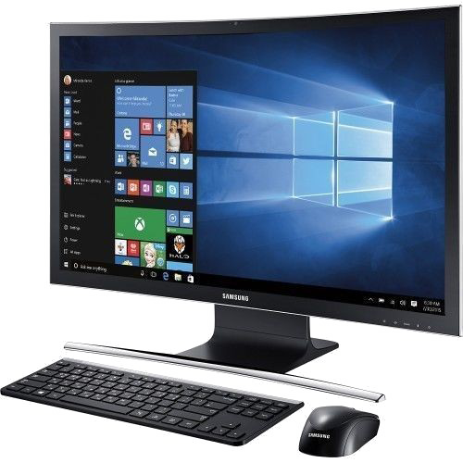
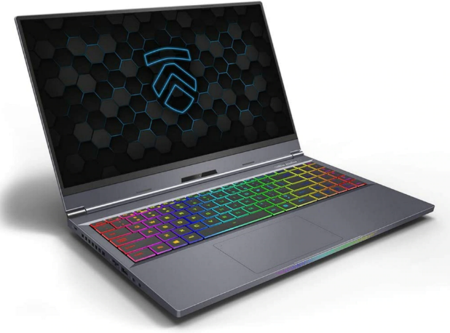
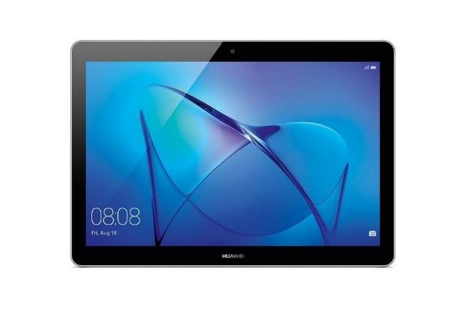
What is a Computer?
This Photo by Unknown Author is licensed under CC BY-SA-NC
This Photo by Unknown Author is licensed under CC BY-NC-ND
This Photo by Unknown Author is licensed under CC BY-NC
Notes:
Instructions: An electronic device that accepts input from a user, performs calculations on the input, and provides and output to the user. (Computer Hope)
A device that stores, retrieves, and processes data into useful information.
Materials: None
Handouts: None
Time: 1 Minute

Slide 14
What ways are you using computers in your daily life?
Refrigerator
Washing Machine
Car
ATM
Dishwashers
Microwave
Thermostats
Phone
Game Consoles
Television Streaming Services
Wearables
Security
Vacuum
Self Check Out
Notes:
Instruction: (Possible answers will appear with a click) Ask the participants to identify ways in which they or others use computers in their daily living (this activity is to help individuals understand that they are already using computers and to also help reduce their fears.) Be sure to state that computers perform various functions that help make our lives easier. For example, you can monitor your home and property from a distance, or you can vacuum your floor without ever touching the vacuum.
“Smartphones: Many cell phones can do a lot of things computers can do, including browsing the Internet and playing games. They are often called smartphones.
Wearables: Wearable technology is a general term for a group of devices—including fitness trackers and smartwatches—that are designed to be worn throughout the day. These devices are often called wearables for short.
Game consoles: A game console is a specialized type of computer that is used for playing video games on your TV.
TVs: Many TVs now include applications—or apps—that let you access various types of online content. For example, you can stream video from the Internet directly onto your TV.”
GCFGlobal, (2023). What is a computer? Retrieved from https://edu.gcfglobal.org/en/computerbasics/what-is-a-computer/1/#
Materials: None
Handouts: None
Time: 5 minutes

Slide 15

Describe the first computer you ever saw or worked with
Notes:
Instruction: Before discussing the types of computer, ask the participants to describe the first computer they ever saw or worked with. Follow-up with a brief discussion of what are some of the differences between those computers and the ones we have today. After the discussion, be sure to share with participants that there are many types of computers, but today we will discuss only personal computers.
Ask a questions such as:
What is happening to the size of computers?
What is happening to the power of computers?
What is the major difference between a desktop and a laptop or between a notebook and a tablet?
Materials: None
Handouts: None
Time: 5 minutes
Image by Gerhard Bögner from Pixabay

Slide 16

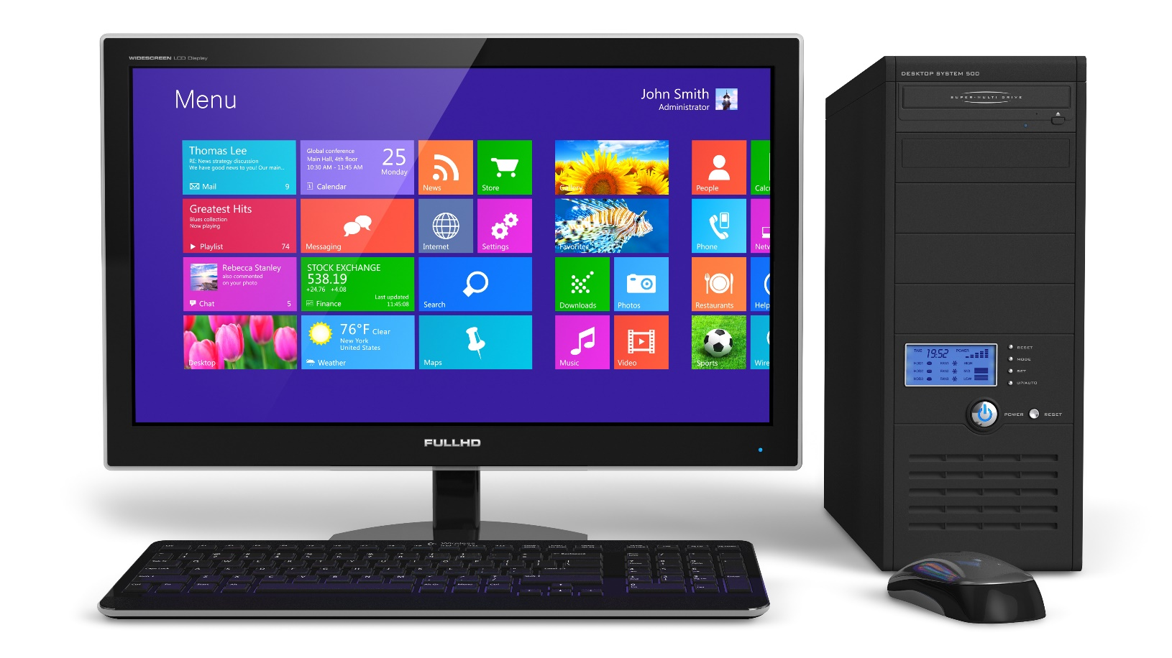
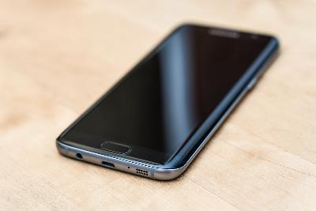


Types of Personal Computers
Desktop Computers
Notes:
Instruction: Explain the major types of personal computers. As you explain the types be sure to relate the size and power of the computers back to their earlier discussion about differences between earlier computers and those today.
Desktop Computers - created to sit on a table or desk
Materials: None
Handouts: None
Time: 5 minutes
Photo by Sebastian Bednarek on Unsplash
Photo by Sincerely Media on Unsplash
Photo by The image is released free of copyrights under Creative Commons CC0.
Image by stokpic from Pixabay
Image by Arek Socha from Pixabay

Slide 17
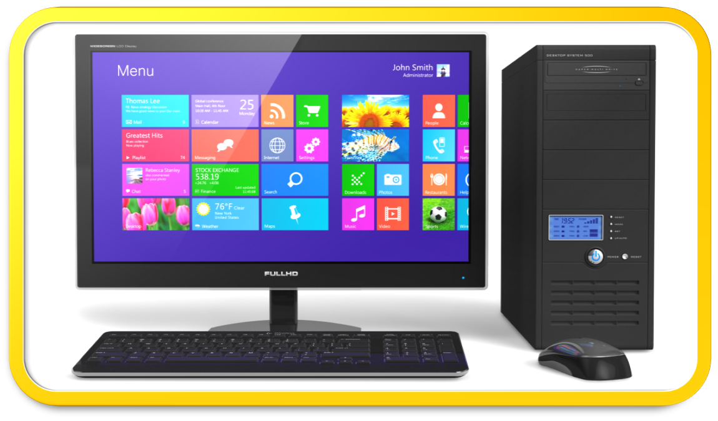

Types of Personal Computers
Laptop Computers
Notes:
Instruction: Explain the major types of personal computers. As you explain the types be sure to relate the size and power of the computers back to their earlier discussion about differences between earlier computers and those today.
Laptop Computers - power of desktop computer, but smaller in size and portable, designed to fit on lap
Materials: None
Handouts: None
Time: 5 minutes
Photo by Sebastian Bednarek on Unsplash
Photo by Sincerely Media on Unsplash
Photo by The image is released free of copyrights under Creative Commons CC0.
Image by stokpic from Pixabay
Image by Arek Socha from Pixabay

Slide 18
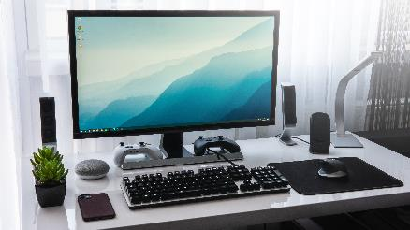

Types of Personal Computers
Notebook Computers
Notes:
Instruction: Explain the major types of personal computers. As you explain the types be sure to relate the size and power of the computers back to their earlier discussion about differences between earlier computers and those today.
Notebook Computers - smaller and lighter than laptops but can be as powerful, designed to fit on lap
Materials: None
Handouts: None
Time: 5 minutes
Photo by Sebastian Bednarek on Unsplash
Photo by Sincerely Media on Unsplash
Photo by The image is released free of copyrights under Creative Commons CC0.
Image by stokpic from Pixabay
Image by Arek Socha from Pixabay

Slide 19

Types of Personal Computers
Tablet Computers
Notes:
Instruction: Explain the major types of personal computers. As you explain the types be sure to relate the size and power of the computers back to their earlier discussion about differences between earlier computers and those today.
Tablet Computers - smaller than notebook and it does not have a physical keyboard (uses stylus or finger on touch screen), designed to be held in hand (similar to a slate)
Materials: None
Handouts: None
Time: 5 minutes
Photo by Sebastian Bednarek on Unsplash
Photo by Sincerely Media on Unsplash
Photo by The image is released free of copyrights under Creative Commons CC0.
Image by stokpic from Pixabay
Image by Arek Socha from Pixabay

Slide 20

Types of Personal Computers
Smart Phones
Notes:
Instruction: Explain the major types of personal computers. As you explain the types be sure to relate the size and power of the computers back to their earlier discussion about differences between earlier computers and those today.
Smart Phones - smaller than a tablet but similar, major purpose is for sending and receiving calls
Materials: None
Handouts: None
Time: 5 minutes
Photo by Sebastian Bednarek on Unsplash
Photo by Sincerely Media on Unsplash
Photo by The image is released free of copyrights under Creative Commons CC0.
Image by stokpic from Pixabay
Image by Arek Socha from Pixabay

Slide 21

Hardware and
Software
Notes:
Instructions: This section discusses the differences between hardware and software
Materials: None
Handouts: None
Time: 1 Minute

Slide 22
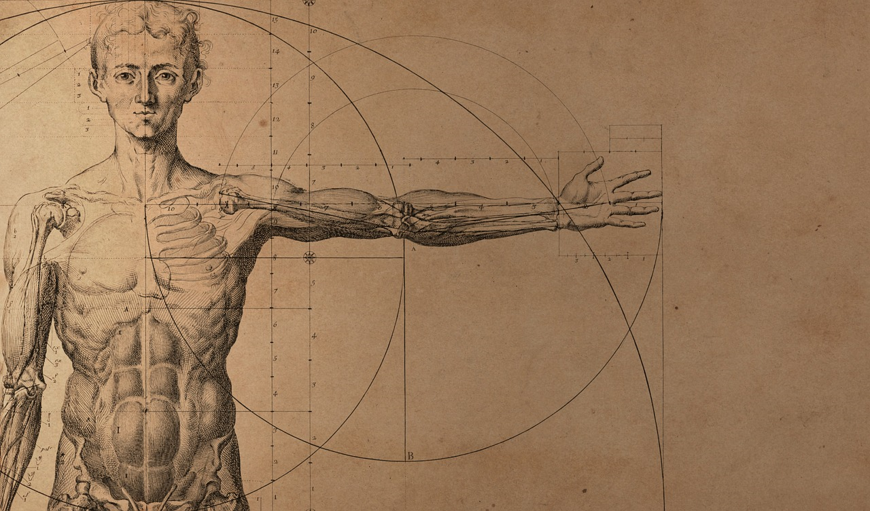
Computer System…
SOFTWARE
…is the hardware and software needed to accept the input of data, process the data into useable information, store, retrieve and output the information into a useable format.
instructions given to the hard-ware to tell each piece what to do and how to do it
3 categories of software
HARDWARE
parts of the computer system that you can touch
4 categories of hardware
Software – tells hardware what/how to do something
Hardware – does what the software tells it to do
Notes:
Instruction: Introduce the computer system (hardware, software and the user). When discussing the computer system be sure to start with what they already know and move them to the unknow. You can do this by relating the computer system to the human body. Explain that the human body is made up of different kinds of organs that are arranged together to perform certain functions. For example, the skeletal system which provides the framework and protects soft organs works together with the muscular system to produce movement. The different categories of hardware work together with the software to perform certain functions.
A computer system is the hardware and software needed to accept the input of data, process the data into useable information, store, retrieve and output the information into a useable format.
Materials: None
Handouts: None
Time: 2 minutes
Image by Daniel from Pixabay

Slide 23

Computer System
SOFTWARE
HARDWARE
instructions given to the hard-ware to tell each piece what to do and how to do it
3 categories of software
is the hardware and software needed to accept the input of data, process the data into useable information, store, retrieve and output the information into a useable format.
Parts of the computer system that you can touch
4 categories of hardware
Software – tells hardware what/how to do something
Hardware – does what the software tells it to do
Notes:
Instruction: When explaining hardware help your participants understand that devices that you can touch are generally known as hardware. Now ask the partcipants to point to or touch a hardware device. Tell them that the different devices/hardware are grouped according to their function. There are four categories of hardware that will be discussed.
Hardware refers to all the physical parts that make up a computer. For example, on a desktop computer, you have the main unit that contains the central parts like the Central Processing Unit (CPU), the RAM or memory, and the hard drive. With desktop computers, you also need an external monitor, also called a display, and devices for inputting information like a keyboard and a mouse.
On computers like laptops, tablets, or mobile devices, the display is built into the device, and they all generally have built in keyboards or, as is the case with many tablets and mobile devices, the keyboard appears on screen when needed. Computer hardware can also refer to any number of accessories you can connect to the computer such as printers, scanners, speakers, and so on, which give additional functionality to the computer.
Materials: None
Handouts: None
Time: 2 minutes
Image by Daniel from Pixabay

Slide 24

Computer System
is the hardware and software needed to accept the input of data, process the data into useable information, store, retrieve and output the information into a useable format.
SOFTWARE
HARDWARE
Instructions given to the hardware to tell each piece what to do and how to do it
3 categories of software
parts of the computer system that you can touch
4 categories of hardware
Software – tells hardware what/how to do something
Hardware – does what the software tells it to do
Notes:
Instruction: Software refers to the programs that run on the computer. Software are instructions that tells the hardware and the computer what to do and how to do it.
Another way to form this statement is that: You cannot touch the instructions.
For example, when a person says to you move over, you cannot touch the words/instructions coming from the person’s mouth, but you understand them well enough to know what to do and how to do it.
Another example is a program CD; a CD containing certain programs/software is the hardware, but the instructions on the CD is the software. Software programs are the parts of the computer you can't physically touch. Examples of software are a word processing application, an email program, and even the computer's operating system is software.
There are three types of software we will discuss.
Materials: None
Handouts: None
Time: 2 minutes
Image by Daniel from Pixabay

Slide 25
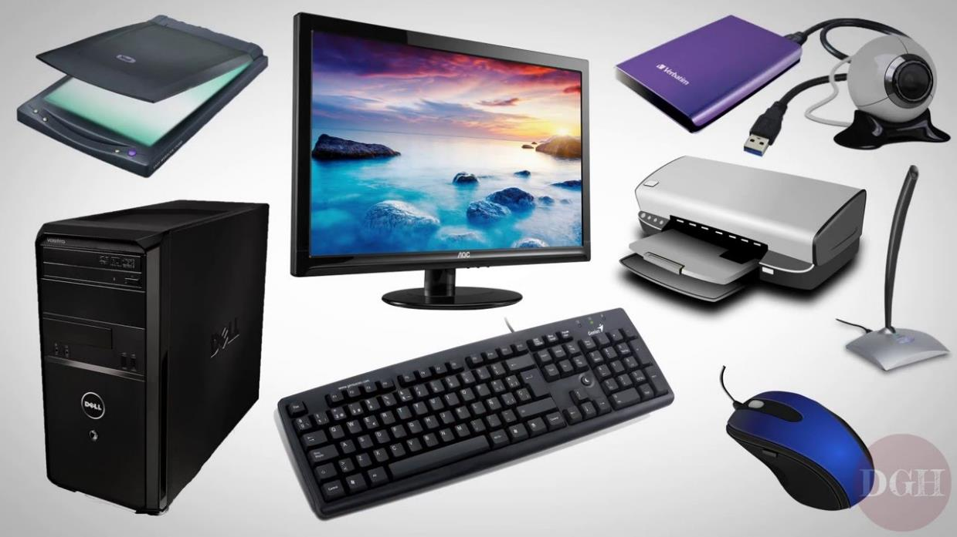
Hardware Categories
Input Devices
  Keyboard
  Mouse
  Microphone
  Controller
  Scanner
  Camera
Notes:
Instruction: There are 4 categories of hardware based on their functions. Going back to the human body analogy, your eyes, nose, and ears put data/information into your brain; your mouth and hands put information out for others to see or hear; so is the same with hardware, each category has a specific function of the overall system.
The first category is input devices. Input devices are used to put data into the computer. Examples are a keyboard, mouse, microphone, controller, scanner, and camera.
Materials: Keyboard, mouse, microphone, controller, scanner, and camera. Try not to use pictures of the devices, if possible, use the actual devices.
Handouts: None
Time: 6 minutes

Slide 26
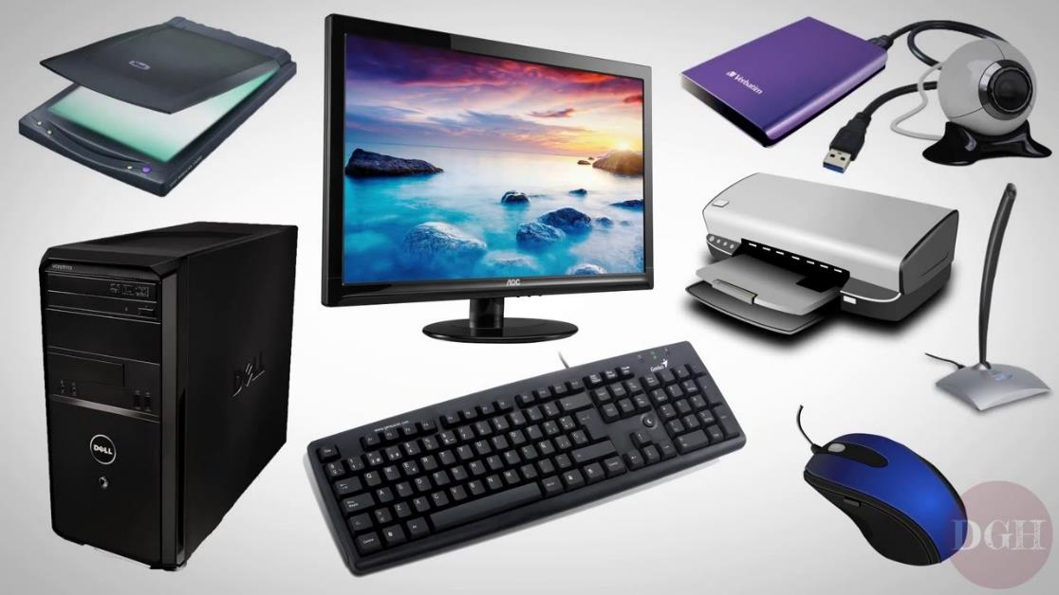


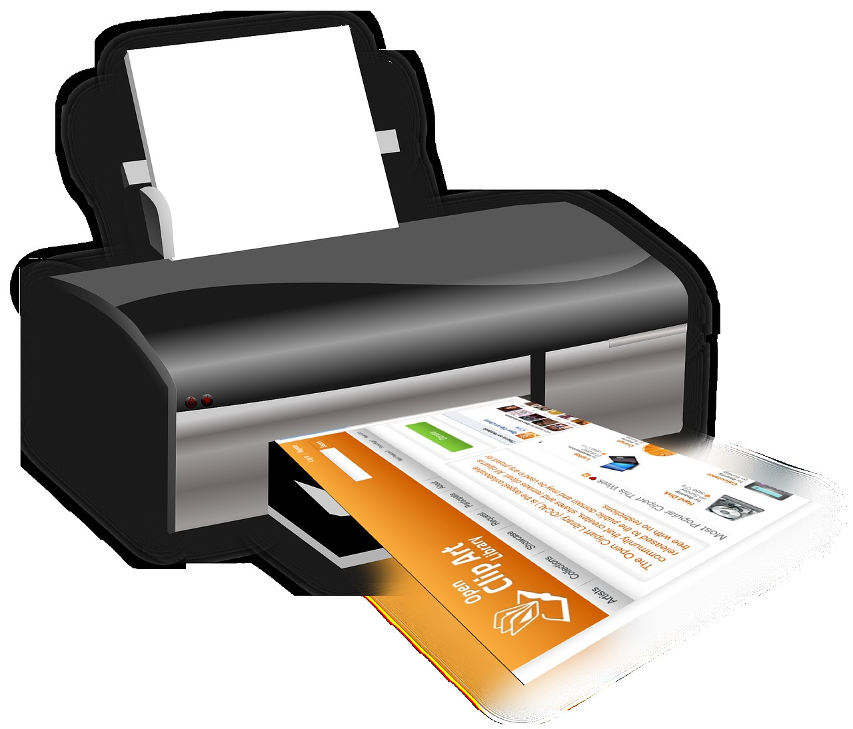
Hardware Categories
2. Output Devices
  Monitor/Screen
  Printer
  Speaker/Headphones
  Projector
Notes:
Instruction: The second category is output devices. Output devices are used to show or display information. Examples are a monitor or screen, printers, speakers or headphones, and a projector.
An easy way to remember the difference between an input and an output device is this: There are two words in input (IN and PUT) and two words in output (OUT and PUT), if you reverse the two words (PUT IN and PUT OUT) you can better understand the purposes of the two categories.
Materials: Monitor, printer, speakers, headphones, and a projector. Try not to use pictures of the devices, if possible, use the actual devices.
Handouts: None
Time: 6 minutes

Slide 27
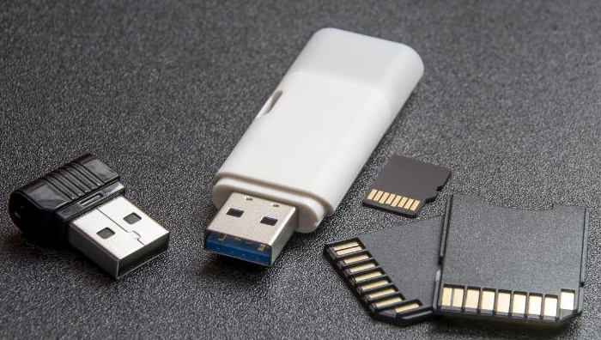
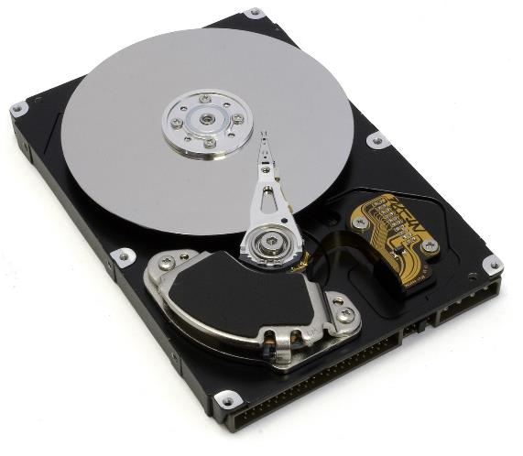

Hardware Categories
Storage Devices
  Hard Drive
  USB
  Compact Disk (CD)
  Cloud Storage
    Dropbox
    One Drive
Processing Devices
  Central Processing Unit (CPU)
  Memory
Notes:
Instruction: Categories three and four are “storage” and “processing”. Storage refers to where you store and retrieve your information such as pictures, videos, or documents. You can select to store your information on a hard drive, which is the high capacity , self-contained storage device that is housed inside your computer. A USB (universal serial bus) plug and play portable storage device also referred to as a “flash drive.” Another storage device is a compact disc (CD). To save (also known as burning) data to a CD, you will need either a CD-R (write – think vinyl record) a single use CD or a CD-RW (rewritable – think cassette tape) a CD that you can save, erase, and resave data to. Lastly, you can save data using a cloud storage service. Cloud storage services such as Dropbox, Google Drive, and One Drive offer digital data storage at off-site locations that you can access from any device.
The final category is processing devices. These are used to calculate and process raw data into information. Before information is transmitted to an output device, it must first pass through a piece of hardware inside the device that interprets and modify the data. This processing device is referred to as the central processing unit or memory of the device.
Materials: Flash drive, CD-R or CD-RW, and hard drive. Try not to use pictures of the devices, if possible, use the actual devices.
Handouts: None
Time: 10 minutes
Image by Welcome to All ! ツ from Pixabay
Image by Pexels from Pixabay
Image by Mahesh Patel from Pixabay

Slide 28
Software Categories
Application Software
  instructions or a group of instructions (program) that help users perform specific tasks
  also called a “program” or “app”
  for meeting business, educational, or personal needs
Notes:
Instructions: Remember, software is instructions that tells the hardware what to do and how to do it. There are three software categories. The fist one is application software. When I say the word “app,” what thoughts come to mind? Which apps do you use on your computer or phone? Why do you use these apps? (Connect their responses to emphasize the purpose of application software is to help users perform a specific task.)
Names for application software can vary, application software is also referred to as program software, program, app, etc.
Application software can be used for business, educational and personal needs. Examples are word processor, spreadsheet, database, publishing, and presentation. (click to reveal table with types and uses.)
Materials: None
Handouts: None
Time: 5 minutes

Slide 29
Software Categories
Type | Used for:
Word Processer | typing letters, resume, flyers, essays, reports, etc.
Spreadsheet | calculating figures & manipulating data
Database | maintaining large datasets and creating forms/applications
Publishing | creating brochures, greeting cards, newsletters, etc.
Presentation | representing content in a visual way
Notes:
Instructions: Remember, software is instructions that tells the hardware what to do and how to do it. There are three software categories. The fist one is application software. When I say the word “app,” what thoughts come to mind? Which apps do you use on your computer or phone? Why do you use these apps? (Connect their responses to emphasize the purpose of application software is to help users perform a specific task.)
Names for application software can vary, application software is also referred to as program software, program, app, etc.
Application software can be used for business, educational and personal needs. Examples are word processor, spreadsheet, database, publishing, and presentation. (click to reveal table with types and uses.)
Materials: None
Handouts: None
Time: 5 minutes

Slide 30
Software Categories
System Software
  Instructions(software) that tells the computer, and the hardware what to do
  interface between the hardware and the application software (i.e. the middleman, communicating with both)
  preloaded on most computers
  also called “Operating System”
    Computer OS: Microsoft Windows, Google Chrome, and MacOS
    Mobile device OS: Apple iOS and Android OS
Notes:
Instructions: How many of you have a computer or a smart phone? What operating system does it use? Knowing which operating system used is one of the first questions asked when seeking help regarding a computer. So, whenever “operating system” is used, remember two things: (a) it refers to software (instructions) and (b) it refers to system software.
Remember, software is the instructions that tells the hardware what to do and how to do it. For example, an interpreter interfaces between the individual who knows only English and the individual who knows only Spanish, the interpreter is middleman or software. Basically, the application software communicates with the system software and the system software then communicates with the hardware.
Unlike application software, system software usually comes preloaded on most computers. There are many different types of operating systems, but the most common types for a computer are Microsoft Windows and MacOS. The most common types of operating systems for mobile devices are Apple iOS and Android OS. Some applications or software can work on both operating systems (Windows and MacOS) while some can work on only one OS (Windows or MacOS).
Materials: None
Handouts: None
Time: 5 minutes

Slide 31
Software Categories
Utility Software
  instructions within the system software that keeps the computer running smoothly (e.g. anti-virus, system cleanup, file backup, defragmentation, file compression)
  small programs
  built into Operating System (system software)
  preloaded
  accessible mainly through the control panel or settings
Notes:
Instructions: Utility software are instructions or small programs within the system software that keeps the computer running smoothly. These program are also preloaded onto the computer. They are usually accessed through the control panel or settings. An example of a utility software is a backup and restore program that is preloaded on your computer for the purpose of backing up your data files and restoring your Systems software.
Materials: None
Handouts: None
Time: 3 minutes

Slide 32

Group Activity:
Hardware & Software
Items in your envelope:
  pictures of various computer devices and the name of various computer programs.
  Two large strips of paper with the headings: HARDWARE and SOFTWARE
Notes:
Instruction: Read the instructions to the class. Demonstrate what they are to do. Ask if there are any questions, if not, give each group an envelop and ask them to follow the directions. Be sure to have the groups evaluate other groups and explain why something might be incorrect. This shows a higher level of learning.
In pairs, give each pair a prepared envelop containing pictures of various computer devices and the name of various computer programs. Also, in the envelop there should be two large strips of papers. On one strip the heading HARDWARE should be written and on the other strip SOFTWARE.
Ask the participants to group the content in the envelop under either HARDWARE or SOFTWARE
After grouping the content, ask each group (pair) to assess another group’s work and discuss any differences.
Discuss as a whole group
Materials: Locate picture of devices found in the 4 categories of hardware and names/pictures of programs for each of the 3 categories of software. Based on the number of participants in the class, create an envelope that contains the two labels (hardware and software) and pictures and or names of the hardware and software for each group (pair).
Handouts: None
Time: 10 minutes
Image by OpenClipart-Vectors from Pixabay

Slide 33
Things to Consider when Purchasing a Computer
Your Budget
dictates price range, price range impacts features
Purpose
major use (email, gaming, searching the Internet, creating documents, etc.)
type (mobile, stationary, size, weight, etc.)
Processing Power
greater the speed (GHz), the higher the price
greater number of cores (processing units), the higher the efficiency and price
Notes:
Instruction: When purchasing a computer there are many factors to consider. We will discuss five basic factors related to purchasing a computer. By knowing as much as you can about what factors to look for when buying a computer while also keeping in mind general consumer education practices will help in making a more informed decision. And by making a more informed decision, you are more likely to be happier with your decision.
First consider your budget. Why should your budget be considered? Knowing what you are comfortable spending impacts the features, type of device, and timeline to purchasing the device.
Next what is the purpose of purchasing a computer? What will be its primary use? What are your needs versus wants in a computer?
What level of processing power will you need? The greater the speed (also called gigahertz) the higher the price will be. The greater the number of cores (which are processing units that can complete multiple tasks at the same time, and ability to switch easily from one program to the next) the higher the efficiency and price.
Materials: None
Handouts: None
Time: 5 minutes

Slide 34
Things to Consider when Purchasing a Computer
RAM/Temporary Storage Space/Memory
the larger the size of RAM, the higher the price
the more multitasking or gaming, the more RAM needed
Warranties and Returns
know the policies before purchasing
Notes:
Instruction: Next what size of RAM (Random Access Memory), or main memory of the device, will you need?
According to DigitalTrends (July 5, 2023) eight gigabytes is fine for basic Windows, 16 is excellent for Windows and Mac systems and gamers, 32 is ideal for professionals and high-end gamers, 64 and more is for purpose-built professional devices.
Ask what are the warranties and return policies before you purchase. Being informed can protect you from defects and malfunctions in the device purchased.
Materials: None
Handouts: None
Time: 5 minutes

Slide 35
Summary
A computer system is made up of software and hardware.
Hardware refers to devices you can touch.
The 4 categories of hardware are: Input, Output, Storage, and Processing Devices
Software refers to instructions that tell the computer what to do and how to do it.
The 3 categories of software are: Application, System, and Utility
Make informed decisions when purchasing a computer.
Notes:
Instruction: Summarize the major points discussed. Do not reteach the lesson.
Computer system is made up of hardware and software
Hardware refers to those devices that you can touch, and they are broken down into 4 categories: input, output, processing, and storage devices.
Software refers to instructions that tells the computer and the hardware what to do and how to do it. It is broken down into 3 categories: application, system and utility software.
Make informed decisions when purchasing a computer.
Also, you can ask several of your participants to summarize each major concept. For example, ask one participant to summarize what was discussed relative to hardware, another participant summarize software, etc.
Materials: None
Handouts: None
Time: 5 minutes

Slide 36
Questions
Discussion
Next Steps
Notes:
Instructions: Before the session begins, add any text to promote next educational opportunity.
Thank participants for attendance, allow for questions and discussion, promote the next lesson, encourage evaluation participation.
Materials: None
Handouts: None
Time: 10 minutes

