Slide 1

Connecting to Government Resources
Notes:
Instructions: Have this slide up as participants enter the room.
Materials: None
Handouts: Copy of presentation slides
Time: 1 Minute
Photo by Thirdman: https://www.pexels.com/photo/a-group-of-people-having-a-discussion-while-looking-at-laptop-5256526/

Slide 2







Bridging the Digital Divide Partners
This project was funded by USDA NIFA award # 2022-68006-36496. The material is based upon work supported by the National Institute of Food and Agriculture, U.S. Department of Agriculture. Any opinions, findings, conclusions, or recommendations expressed in this publication are those of the author(s) and do not necessarily reflect the view of the U.S. Department of Agriculture.
Notes:
Instructions: Share this acknowledgment of the partnerships in the Bridging the Digital Divide.
Materials: None
Handouts: None
Time: 1 Minute

Slide 3
In accordance with Federal law and the U.S. Department of Agriculture (USDA) civil rights regulations and policies, this institution is prohibited from discriminating on the basis of race, color, national origin (including English proficiency), limited religion, sex, disability, age, marital status, family/parental status, income derived from a public assistance program, political beliefs, reprisal or retaliation for prior civil rights activity in any program or activity conducted or funded by USDA. (Not all prohibited bases apply to all programs)
Program information may be made available in languages other than English. Persons with disabilities who require alternative means of communication for program information (e.g., braille, large print, audiotape, American Sign Language) should contact the responsible State or local Agency that administers the program or contact USDA through the Telecommunications Relay Service at 711 (voice and TTY).

Slide 4
To file a program discrimination complaint, a complainant should complete a Form AD-3027, USDA Program Discrimination Complaint Form, which can be obtained online at https://www.usda.gov/sites/default/files/documents/ad-3027.pdf, from any USDA office, by calling (866) 632-9992, or by writing a letter addressed to USDA. The letter must contain the complainant’s name, address, telephone number, and a written description of the alleged discriminatory action in sufficient detail to inform the Office of the Assistant Secretary for Civil Rights (OASCR) about the nature and date of an alleged civil rights violation. The completed AD-3027 form or letter must be submitted to USDA by: mail: U.S. Department of Agriculture Office of the Assistant Secretary for Civil Rights 1400 Independence Avenue, SW Washington, D.C. 20250-9410; or email: program.intake@usda.gov
This institution is an equal opportunity provider.

Slide 5
Title IX of the Education Amendments Act of 1972 (Title IX) prohibits discrimination on the basis of sex, pregnancy, or parental status - in educational programs and activities that receive Federal financial assistance. The law also prohibits individuals from exclusion from such programs or activities or from denial of benefits from such programs or activities based on sex. This prohibition applies to a wide array of public and private schools at the K-12 grade levels, as well as colleges and universities which receive federal funding. A school that is controlled by a religious organization is exempt from Title IX when the law’s requirements would conflict with the organization’s religious tenets. The law requires federally funded education institutions or programs to disseminate Title IX information widely, including the name, address, and telephone number (or other contact information) of the designated Title IX Coordinator.
Program information is available in languages other than English. Persons with disabilities who require alternative means of communication (e.g., braille, large print, audiotape, American Sign Language) should contact the responsible State or local Agency that administers the program or contact USDA through the Federal Telecommunications Relay Service at 711 (voice and TTY).

Slide 6
Prior to filing a Title IX complaint with USDA against an institution, a potential complainant may want to find out about the institution’s grievance process and use that process to have the complaint resolved. However, a complainant is not required by law to use the institutional grievance process before filing a complaint with the Office of the Assistant Secretary of Civil Rights (OASCR). If a complainant uses an institutional grievance process and chooses to file the complaint with OASCR, the complaint must be filed with OASCR within 60 days after completion of the institutional grievance process.

Slide 7
To file a USDA program discrimination complaint, a complainant should complete Form AD-3027, USDA Program Discrimination Complaint Form, which can be obtained online at https://www.usda.gov/sites/default/files/documents/ad-3027.pdf; from any USDA office; by calling (866) 632-9992; or by writing a letter addressed to the USDA office listed below. The letter must contain the complainant’s name, address, telephone number, and a written description of the alleged discriminatory action in sufficient detail to inform OASCR about the nature and date of an alleged civil rights violation. The completed AD3027 form or letter must be submitted to USDA via: mail: U.S. Department of Agriculture Office of the Assistant Secretary for Civil Rights 1400 Independence Avenue, SW Washington, D.C. 20250-9410; or email: program.intake@usda.gov
This institution is an equal opportunity provider.

Slide 8
Author Acknowledgement
We wish to thank the authors of this training material:
Authors:
Jimmy Henry, Prairie View A&M University,
John Green, PhD, Director, Southern Rural Development Center
Contributor:
Roseanne Scammahorn, PhD, Extension Research Associate, Southern Rural Development Center
Notes:
Instructions: The presenters of this session are asked to share this acknowledgment of the work that went into this session.
Materials: None
Handouts: None
Time: 1 minute

Slide 9
Presenter Acknowledgement
Name
Title
Association
Email (Optional)
Phone (Optional)
Webpage (Optional)
Notes:
Instructions: Self introduction
Materials: None
Handouts: None
Time: 1 minute

Slide 10
Structure of Today’s Session
Defining e-government
Identifying legitimate portals
Common search topics
Social services
Voter registration
Notes:
Instructions: State the structure of the lesson and briefly describe content that will be discussed under each heading. Ask for any questions or concerns before starting.
Materials: None
Handouts: None
Time: 2 minutes

Slide 11

Introductions
Notes:
Instructions: Give time for participants to introduce themselves. You could also include a brief question for them to answer such as what motivated them to take this class? Encourage the 30 second rule: “In 30 seconds, share your name and answer…”
You may also consider using a light-hearted questions such as:
What was your first job?
What hobby takes up most of your free time?
How do you like your coffee?
Materials: None
Handouts: None
Time: 5 Minutes
Image by dcandau from Pixabay

Slide 12
Government Information and Resources
Topics Covered
Defining e-government
Identifying legitimate portals to start your search
Exploring three common search areas – local, state, and federal
Social services
Voter registration
  Food assistance
  Housing and utility assistance
  Telephone and internet assistance
  Caring for family across the life course
  Emergency services
  State specific benefits
  Federal benefits
Notes:
Instructions: Provide overview of the topics to be covered during this workshop session, emphasizing the big picture of e-government coupled with example common search terms.
Materials: None
Handouts: None
Time: 3 minutes

Slide 13
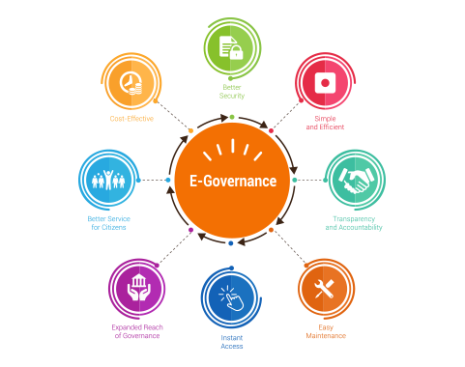
Defining
E-Government
Notes:
Instructions: This slide begins the defining e-government section.
Materials: None
Handouts: None
Time: 1 Minute

Slide 14
E-Government
Resident/Citizen
Local
Federal
State
E-government is the term used for making government information and services available to the public via the internet.
Notes:
Instructions: E-government is the term used for making government information and services available to the public via the internet. The e-government objective is to create a new dynamic relation between government entities, services, and citizens: a cycle that will become simpler and more participative for citizens.
There are multiple levels of government involved: local (e.g. city and county), State, and Federal. E-gov allows information to be posted to the internet (schedule of public hearings, issue briefs, notifications) enhances two-way communication, allows for transactions to be conducted (applying for services and grants), and enables citizens to move from passive information access to active participation (information, representing, encouraging to vote, consulting, and involving citizens).
The types of information and services available, and the digital platforms being used, are changing rapidly. Examples of e-gov are applying for a birth certificate, building permit, business license, social protection programs, paying utilities, registering a motor vehicle, submitting taxes, and applying for a marriage certificate.
Materials: None
Handouts: None
Time: 3 minutes

Slide 15

Identifying Legitimate Portals to Start Your Search
Notes:
Instructions: This slide begins the identifying legitimate portals to start your search section.
Materials: None
Handouts: None
Time: 1 Minute

Slide 16

Identifying Legitimate Information
Official U.S. government websites have two key features:
  .gov websites belong to official U.S. government organizations
  A lock symbol or https:// (note the "s") indicates secure websites
  https://www.whitehouse.gov/live/
https://www.usa.gov/
Notes:
Instructions: When identifying legitimate information, official websites associated with the U.S. government have two key features to look for: .gov websites belong to official U.S. government organizations and a lock symbol or https:// (note the "s") indicates secure websites. Federal and state government websites will have these two features.
Materials: None
Handouts: None
Time: 5 minutes

Slide 17
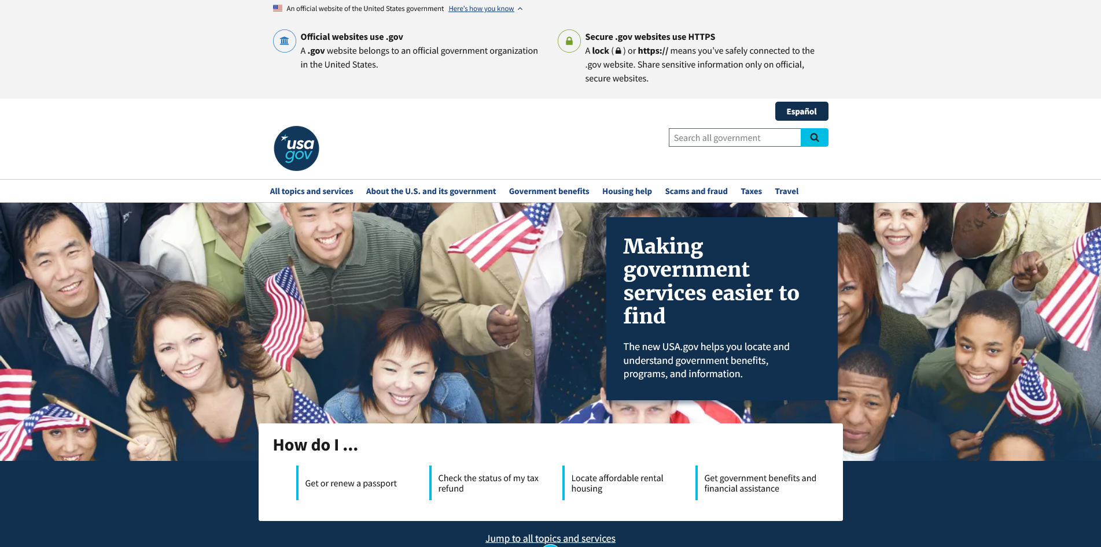
Identifying Legitimate Information
OFFICIAL
Notes:
Instructions: Display the reference to the usa.gov webpage indicating the two signs of an official US government webpage.
Materials: None
Handouts: None
Time: 5 minutes

Slide 18
Exploring Three Common Search Areas
Local
State
Federal
Notes:
Instructions: This slide begins the exploring three common search areas section.
Materials: None
Handouts: None
Time: 1 minute

Slide 19
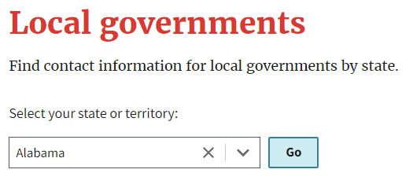
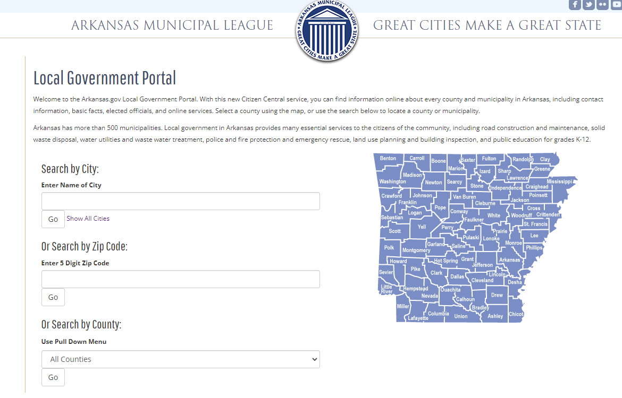
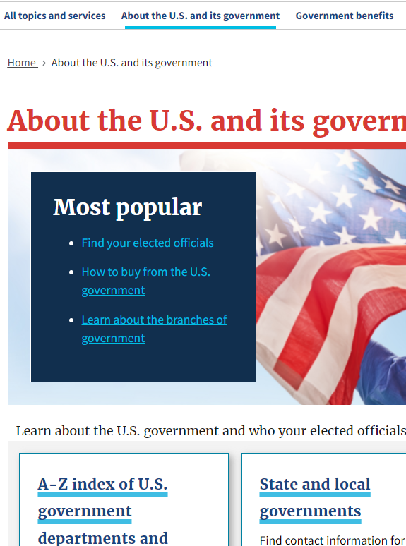
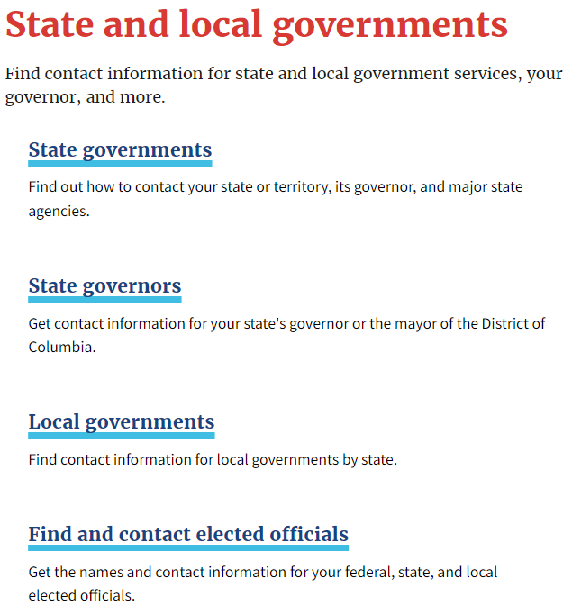
Starting Your Search – Local
Local-level (town, city, county) e-government resources are the most variable
www.usa.gov
Notes:
Instructions: The local level of government is the most variable in terms what is available online. USA.gov is a good place to start. From the home page, click on “About the U.S. and its government”, click on “State and local governments”, click on “Local governments”
Materials: None
Handouts: Extension instructor can do a local resources scan to make resource list available to participants – what e-government resources are available at the local (city, county) level?
Time: Slides 14-16: 5 to 10 minutes, depending on breadth of local e-government resources that are available.

Slide 20
Local Governments
Notes:
Instructions: Select your state from the dropdown menu.
Materials: None
Handouts: Extension instructor can do a local resources scan to make resource list available to participants – what e-government resources are available at the local (city, county) level?
Time: Slides 14-16: 5 to 10 minutes, depending on breadth of local e-government resources that are available.

Slide 21
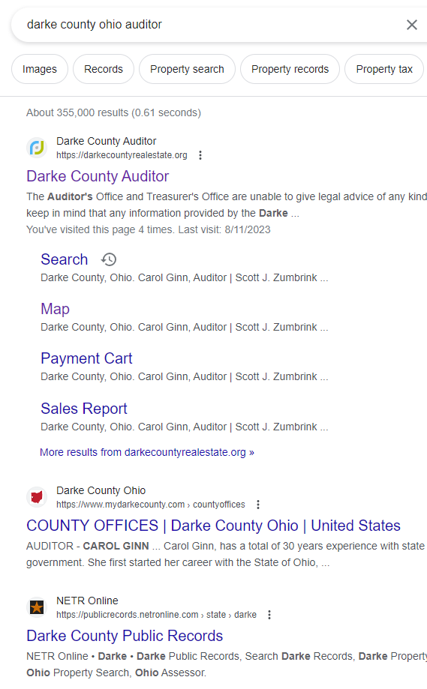
Starting Your Search Local
Search using key words for the agency or service
Notes:
Instructions: Not all states offer direct links from this source, and you may need to use a search engine, using key words for the agency/service you are looking for.
Materials: None
Handouts: Extension instructor can do a local resources scan to make resource list available to participants – what e-government resources are available at the local (city, county) level?
Time: Slides 14-16: 5 to 10 minutes, depending on breadth of local e-government resources that are available.

Slide 22
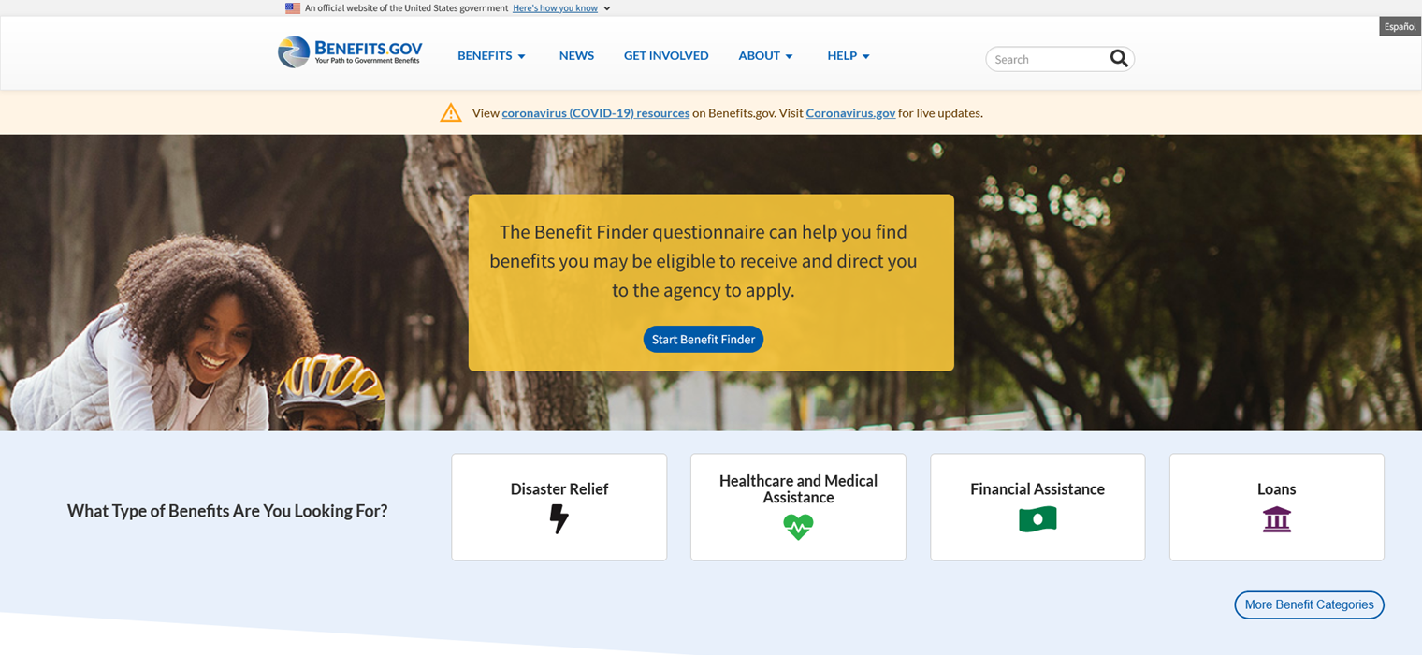
Starting Your Search
Federal & State
https://www.benefits.gov/
Notes:
Instructions: Benefits.gov is a great resource to locate state and federal resources. This website’s goal is to increase people's access to government benefits in an easy-to-use, single source of benefit information to help citizens understand which benefit programs they may be eligible for, and how to apply.
Materials: None
Handouts: None
Time: 3 minutes

Slide 23
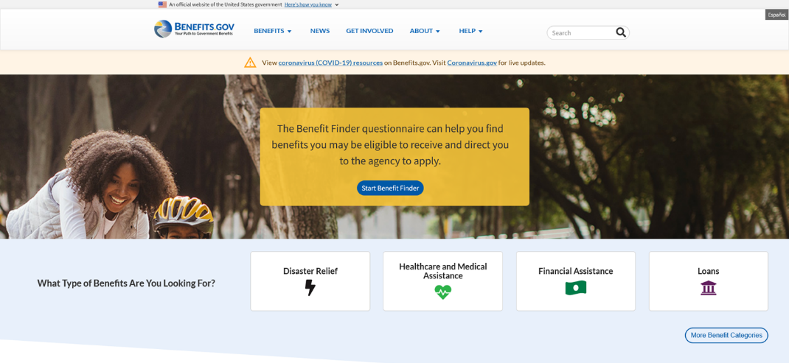
Starting Your Search
Federal & State
Benefits.gov
  Search options include:
    General search via questionnaire to narrow options
    Search by agency
    Search by category
SEARCH
https://www.benefits.gov/
Notes:
Instructions: The website has multiple search options. Use the search bar to conduct a general search via questionnaire to narrow options, search by agency, or search by category.
Materials: None
Handouts: None
Time: 1 minute

Slide 24
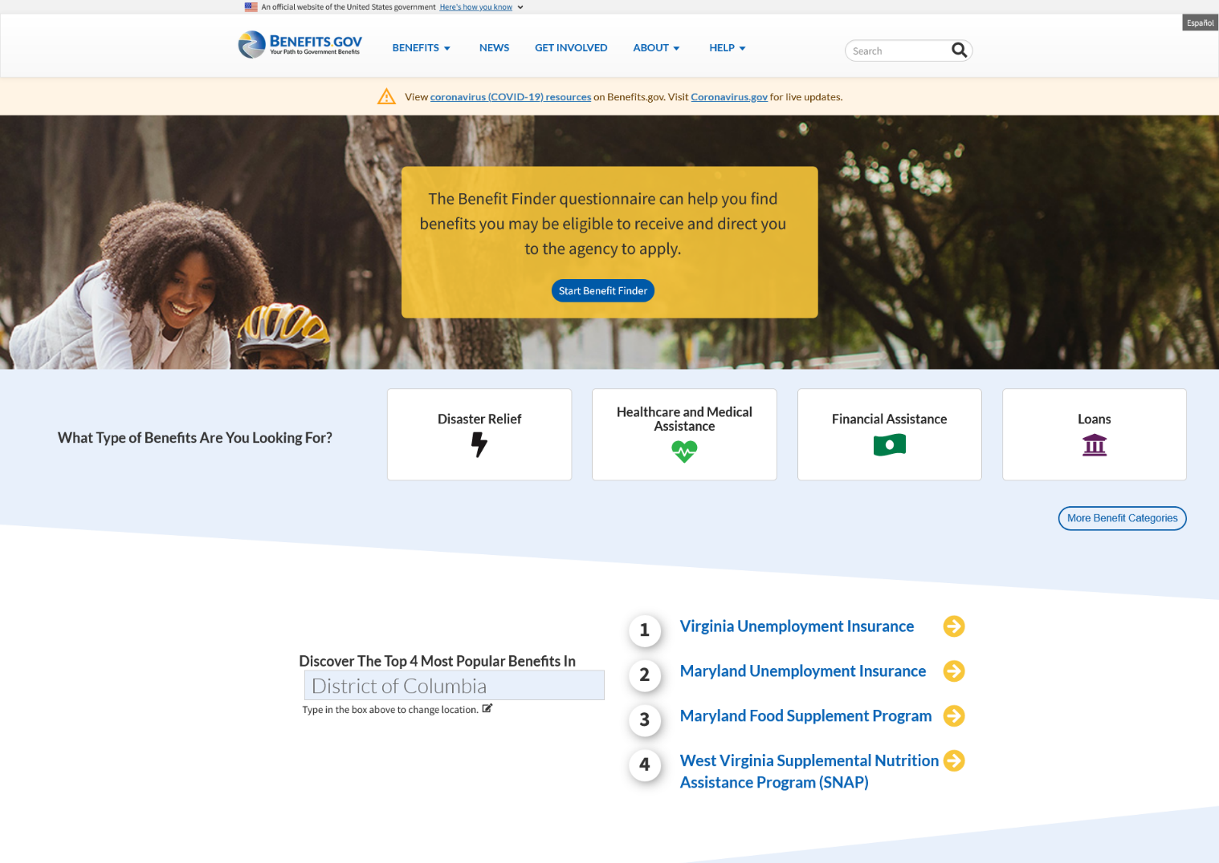

Starting Your Search
Federal & State
SEARCH
SEARCH
SEARCH
https://www.benefits.gov/
Notes:
Instructions: If you are unsure which benefit you quality for, click on “Start Benefit Finder” of a step-by-step guide, click on “More Benefit Categories” to access a larger list of benefit options, or select a state from the drop-down menu to narrow the search.
Materials: None
Handouts: None
Time: 3 minutes

Slide 25

Social Services
Notes:
Instructions: This slide begins the social services examples section.
Materials: None
Handouts: None
Time: 1 Minute

Slide 26
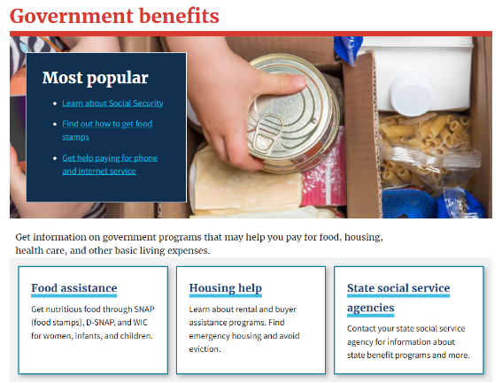
Social Services
www.usa.gov
Government benefits | USAGov, www.usa.gov/benefits
Notes:
Instructions: usa.gov provides direct links to several social services by clicking on “Government Benefits” a directory of the most searched government programs.
Common search topics concerning social services include:
Food assistance
Housing and utility assistance
Telephone and internet assistance
Caring for family across the life course
Emergency services
State specific benefits
Federal benefits
Materials: None
Handouts: None
Time: 3 minutes

Slide 27
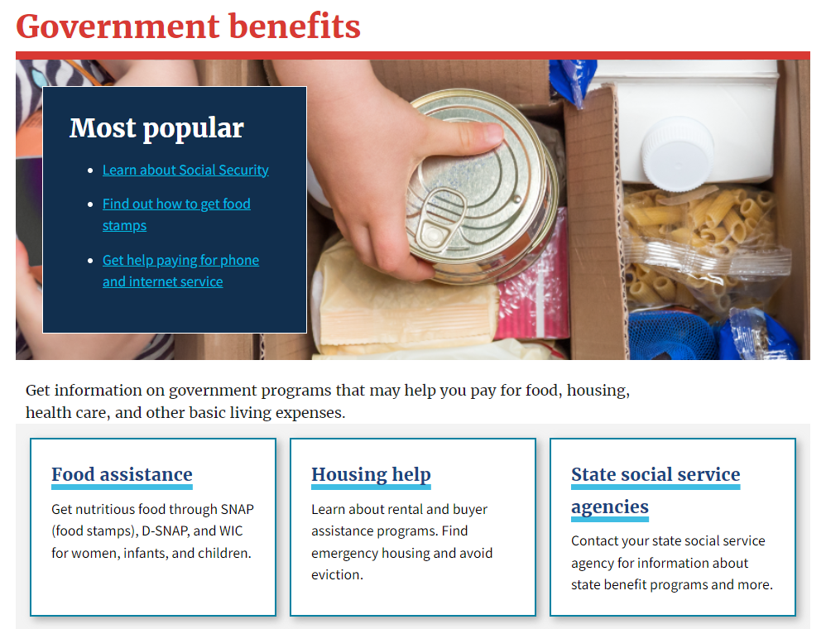
Social Services
www.usa.gov
Government benefits | USAGov, www.usa.gov/benefits
Notes:
Instructions: usa.gov provides direct links to several social services, including food assistance, housing help, utility assistance, disability and retirement benefits, and social security, just to name a few.
Materials: None
Handouts: None
Time: 2 minutes

Slide 28
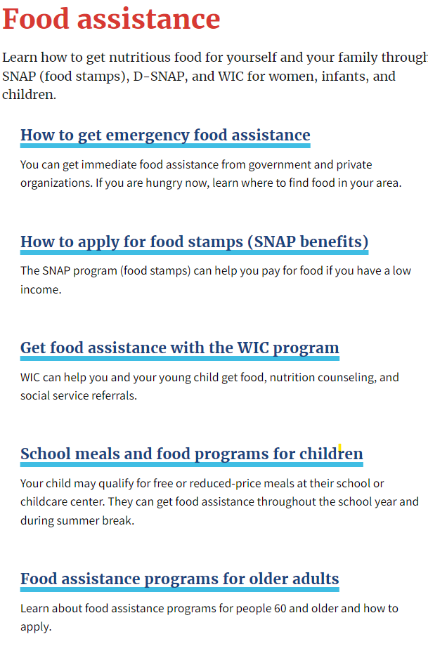
Food Assistance
  Emergency food assistance
  Supplemental Nutrition Assistance Program (SNAP, formerly food stamps)
  Special Supplemental Nutrition Program for Women, Infants, and Children (WIC)
  School meals and food programs for children
  Food assistance programs for older adults
  Food assistance for Native Americans
Let's
explore
https://www.usa.gov/food-help
Notes:
Instructions: (Highlighted items on these slides are thought to be of common interest and thereby good for showing links, etc. as part of the workshop. Each point is a hyperlink for facilitators to go live to the webpage.)
Here is a list of commonly search food assistance services. We will highlight Supplemental Nutrition Assistance Program or SNAP benefits.
Links for food assistance resources:
Emergency food assistance: https://www.usa.gov/emergency-food-assistance
Supplemental Nutrition Assistance Program (SNAP, formerly food stamps): https://www.usa.gov/food-stamps
Special Supplemental Nutrition Program for Women, Infants, and Children (WIC): https://www.usa.gov/food-assistance
School meals and food programs for children: https://www.usa.gov/school-meals
Food assistance programs for older adults: https://www.usa.gov/senior-food-programs
Food assistance for Native Americans: https://www.usa.gov/native-american-food-programs
Materials: None
Handouts: None
Time: 3 minutes

Slide 29
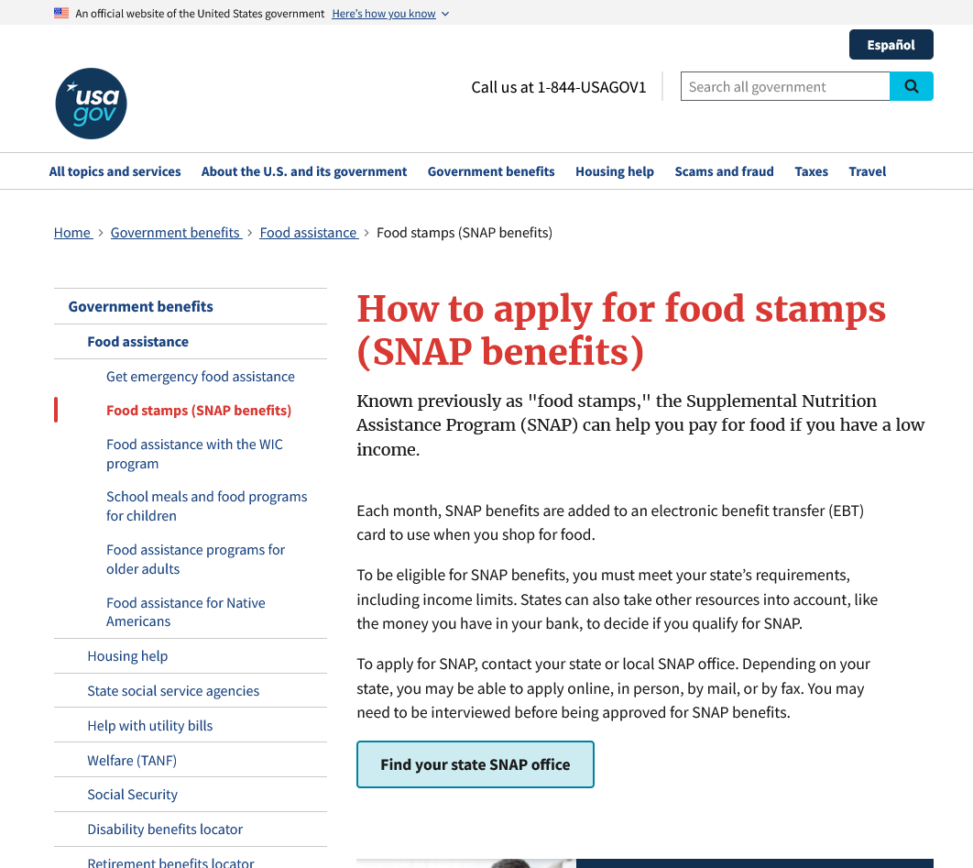
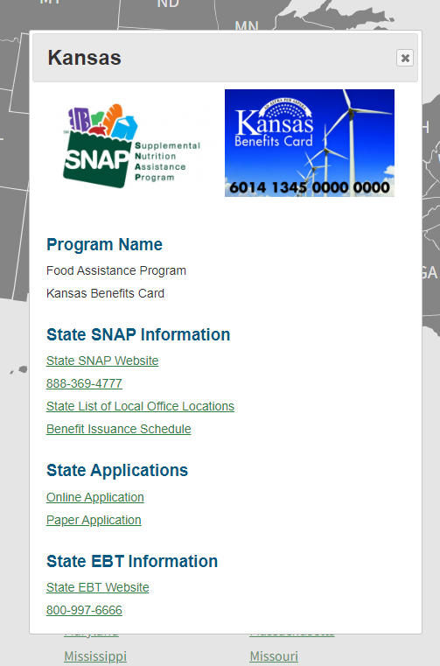
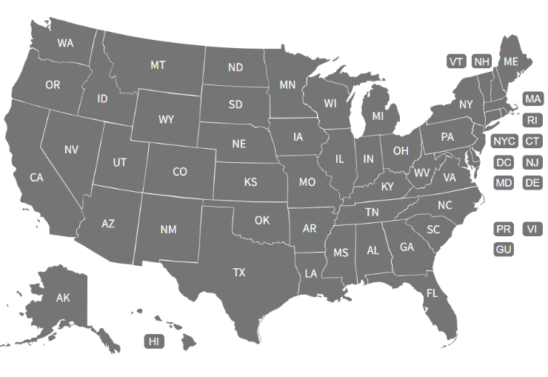
Food Assistance
SEARCH
https://www.usa.gov/food-stamps
Notes:
Instructions: (Facilitators can visit actual website if there is adequate internet service available at training location.) Click on “How to apply for food stamps (SNAP benefits)” to be taken to this screen, where you can click on “Find your state SNAP office”.
Materials: None
Handouts: None
Time: 2 minutes

Slide 30
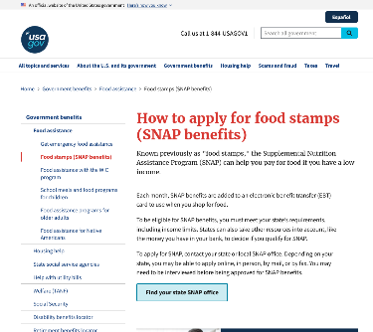
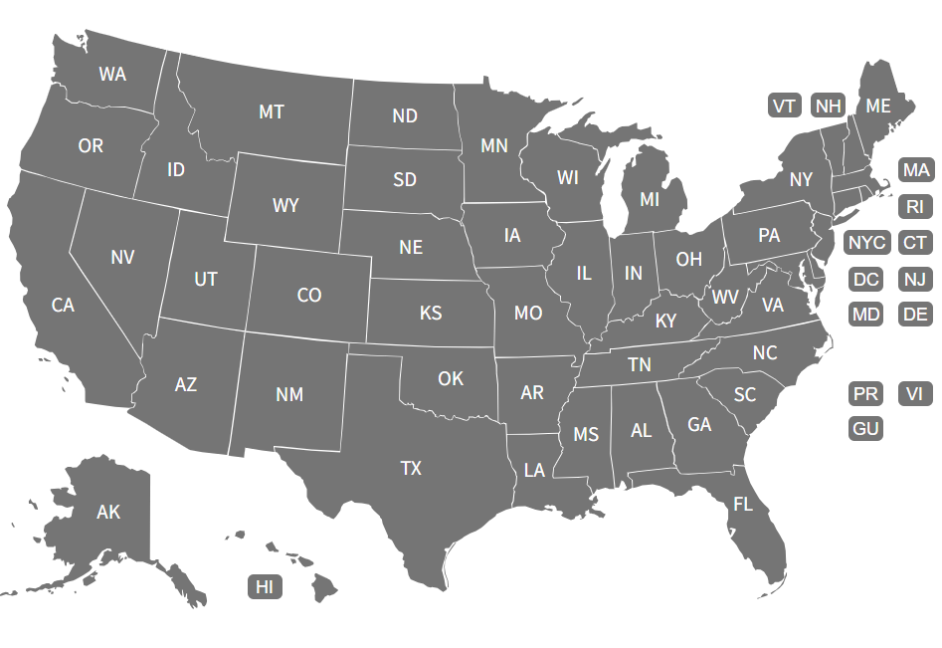

Food Assistance
SEARCH
https://www.usa.gov/food-stamps
Notes:
Instructions: Click on a state and a pop-up window will display the state office information with additional links.
Materials: None
Handouts: None
Time: 1 minute

Slide 31
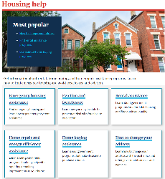
Housing & Utility Assistance
Emergency housing assistance
Eviction and foreclosure
Rental assistance
Home buying assistance
Home repair and energy efficiency assistance
  Low-Income Home Energy Assistance Program (LIHEAP)
How to change your address
Tenant rights
https://www.usa.gov/housing-help
Notes:
Instructions: (Highlighted items on these slides are thought to be of common interest and thereby good for showing links, etc. as part of the workshop. Each point is a hyperlink for facilitators to go live to the webpage.)
Here is a list of commonly search housing/rental assistance services.
Links to housing and utility assistance resources:
Emergency housing assistance: https://www.usa.gov/emergency-housing-assistance
Eviction and foreclosure: https://www.usa.gov/eviction-and-forclosure
Rental assistance: https://www.usa.gov/rental-housing-programs
Home buying assistance: https://www.usa.gov/buying-home-programs
Home repair and energy efficiency assistance: https://www.usa.gov/repairing-home
Low-income home assistance program (LIHEAP): https://www.acf.hhs.gov/ocs/low-income-home-energy-assistance-program-liheap
How to change your address: https://www.usa.gov/change-address
Tenant rights: https://www.usa.gov/tenant-rights
Materials: None
Handouts: None
Time: 2 minutes

Slide 32


Housing & Utility Assistance
Emergency housing assistance
Eviction and foreclosure
Rental assistance
Home buying assistance
Home repair and energy efficiency assistance
  Low-Income Home Energy Assistance Program (LIHEAP)
How to change your address
Tenant rights
Let's
explore
https://www.usa.gov/housing-help
Notes:
Instructions: Let’s explore highlight Rental Assistance and Home Buying Assistance.
Materials: None
Handouts: None
Time: 1 minute

Slide 33
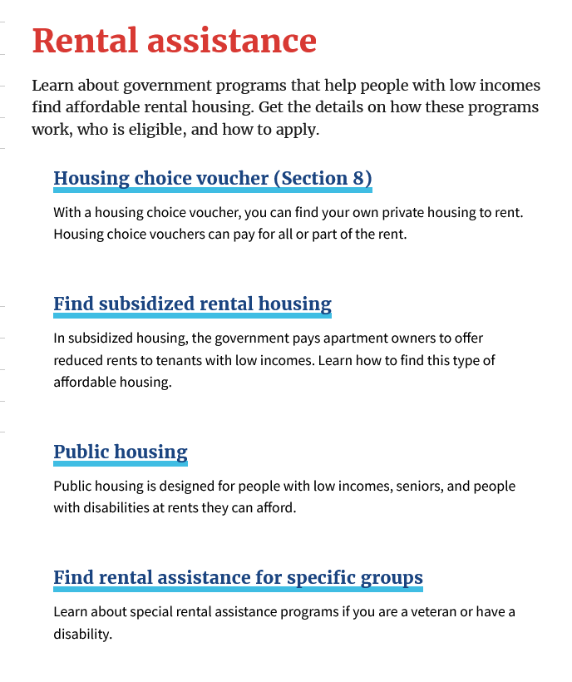
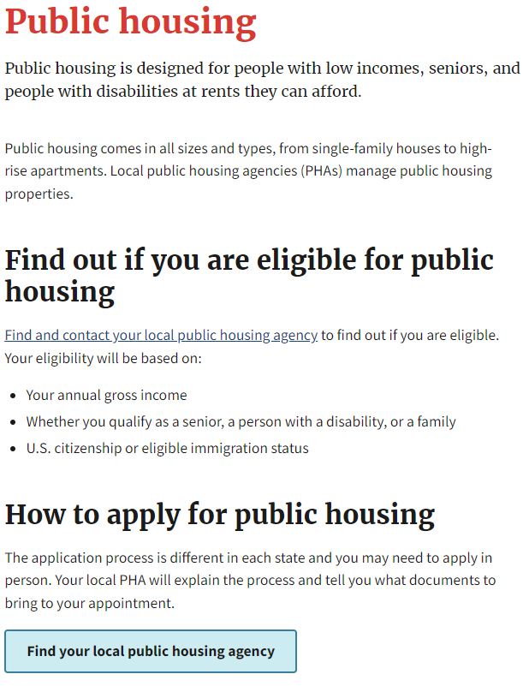
Housing & Utility Assistance
https://www.usa.gov/rental-housing-programs
Notes:
Instructions: Each of the rental assistance sections links to how to find out if you are eligible for assistance and how to apply for each service. Under rental assistance for specific groups information on assistance for veterans and individuals under age 62 with disabilities is located.
Materials: None
Handouts: None
Time: 2 minutes

Slide 34
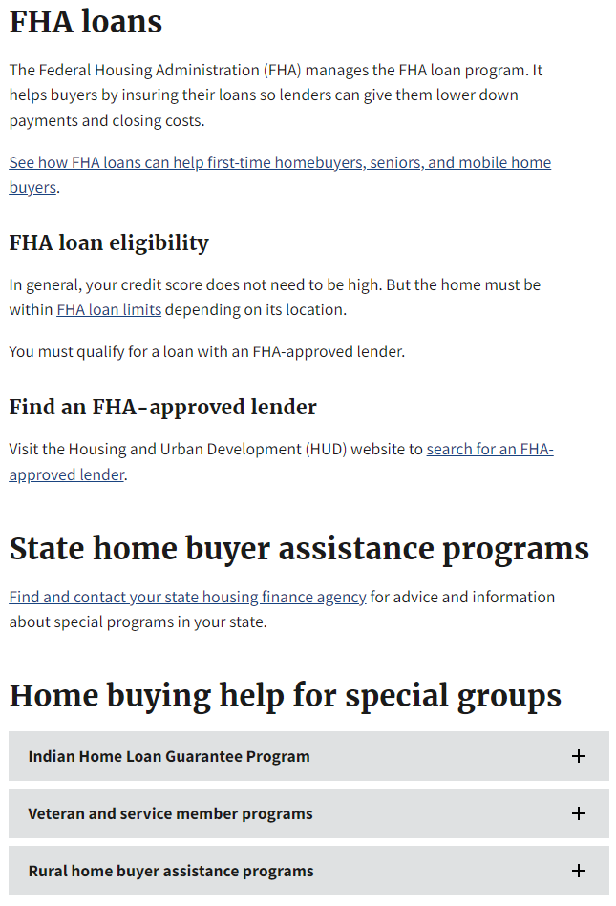
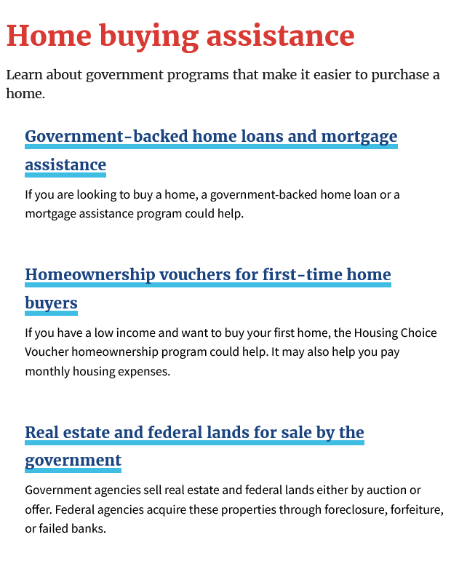
Housing & Utility Assistance
https://www.usa.gov/buying-home-programs
Notes:
Instructions: Under “Home buying assistance” information about government programs that make it easier to purchase a home are located. Here you learn more about Federal Housing Administration (FHA) loans, veterans’ assistance, rural home buyer assistance, Indian Home Loan guarantee program, and first-time homeownership vouchers.
Materials: None
Handouts: None
Time: 3 minutes

Slide 35

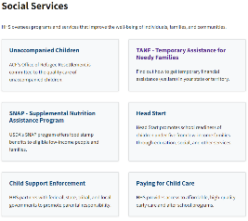
Caring for Family Across the Life Course
Unaccompanied children
Temporary Assistance for Needy Families (TANF)
  State-specific map
Head Start
Child support enforcement
Paying for childcare
Foster care
Adoption
Home visiting
Persons with disabilities
Programs for seniors
Homelessness
Military families
https://www.hhs.gov/programs/social-services/index.html
Notes:
Instructions: (Each point is a hyperlink for facilitators to go live to the webpage.)
The U.S. Department of Health and Human Services has several programs and services addressing holistic wellness across the life course. These include support services for children, military families, senior support, and for individuals living with disabilities.
Links for caring for family across the life course resources:
Unaccompanied children: https://www.hhs.gov/programs/social-services/unaccompanied-children/index.html
Temporary Assistance for Needy Family (TANF): https://www.acf.hhs.gov/ofa/map/about/help-families
State-specific maps: https://www.acf.hhs.gov/ofa/map/about/help-families
Head start: https://www.acf.hhs.gov/ohs
Child support enforcement: https://www.acf.hhs.gov/css
Paying for childcare: https://childcare.gov/consumer-education/paying-for-childcare
Foster care: https://www.acf.hhs.gov/cb/focus-areas/foster-care
Adoption: https://www.acf.hhs.gov/cb/focus-areas/adoption
Home visiting: https://www.acf.hhs.gov/occ/home-visiting
Persons with disabilities: https://www.hhs.gov/programs/social-services/programs-for-people-with-disabilities/index.html
Programs for seniors: https://www.hhs.gov/programs/social-services/programs-for-seniors/index.html
Homelessness: https://www.hhs.gov/programs/social-services/homelessness/index.html
Military families: https://www.hhs.gov/programs/social-services/supporting-military-families/index.html
Materials: None
Handouts: None
Time: 3 minutes
Photo by Humphrey Muleba on Unsplash

Slide 36
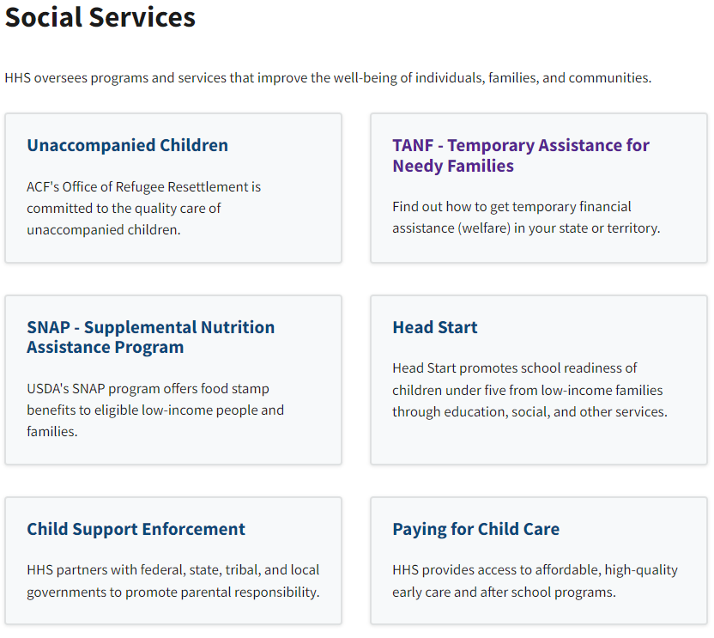
Caring for Family Across the Life Course
https://www.hhs.gov/programs/social-services/index.html
Notes:
Instructions: We will highlight the Temporary Assistance for Needy Families, paying for childcare, and programs for seniors. Start by clicking on the link to “TANF – Temporary assistance for needy families.”
Materials: None
Handouts: None
Time: 3 minutes
Photo by Humphrey Muleba on Unsplash

Slide 37
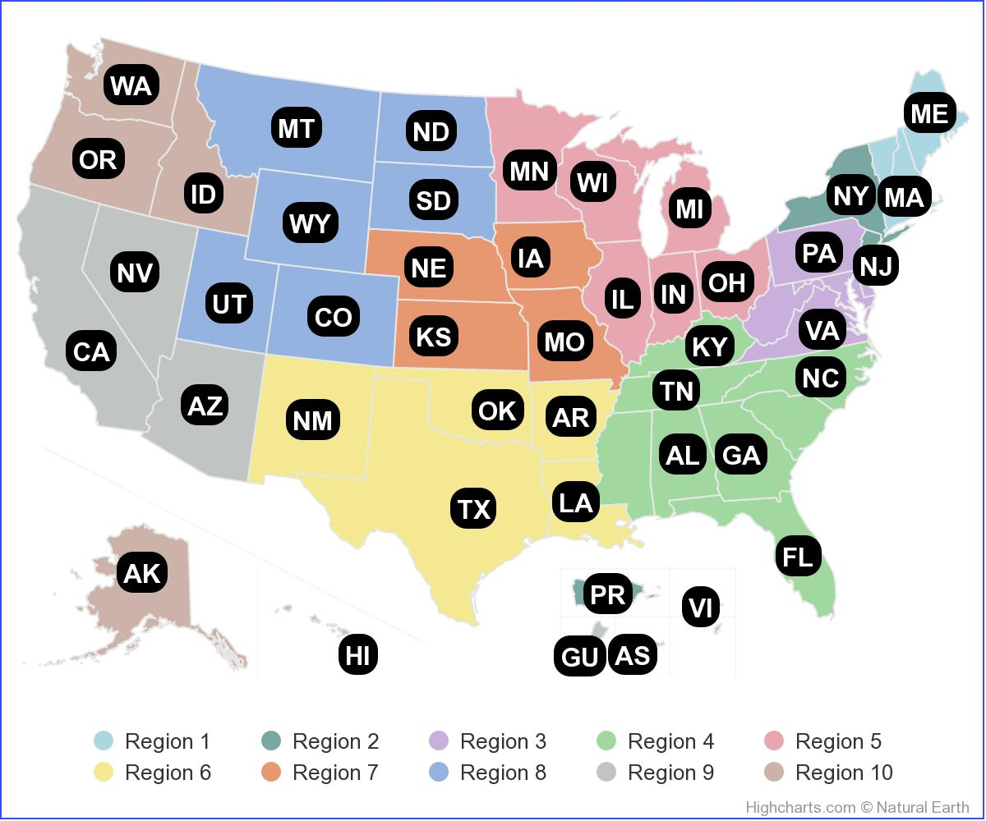
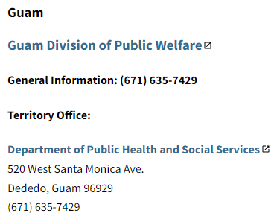
TANF Program Contact Information
TANF Program Contact Information
CLICK ON ANY LOCATION
https://www.acf.hhs.gov/ofa/map/about/help-families
Notes:
Instructions: By selecting a state or territory on the map, the local TANF and Tribal TANF help, policies, and other program information will be displayed. General Benefits links provide access to centralized benefit portals with information about programs beyond TANF cash assistance.
Materials: None
Handouts: None
Time: 3 minutes

Slide 38
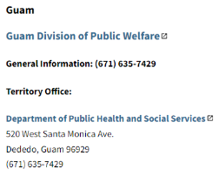
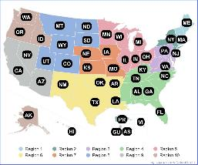
Paying for Childcare
Paying for Childcare
https://childcare.gov/consumer-education/paying-for-childcare
Notes:
Instructions: Next, we will highlight paying for childcare, click on the link to “Paying for childcare.”
Materials: None
Handouts: None
Time: 1 minute

Slide 39
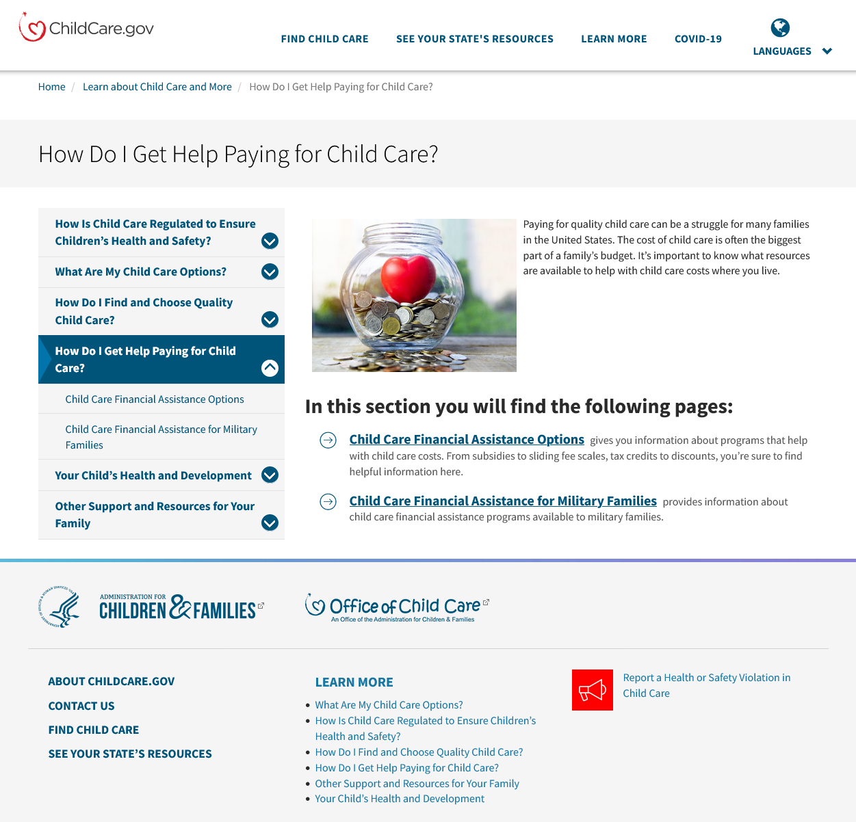
Paying for Childcare
Paying for Childcare
Government programs
    Financial assistance
    Headstart/Early Start
    Pre-K
    Military care
Local & provider specific
    Employer
    College/university
Native Hawaiian, Native Alaskan, and American Indian programs
https://childcare.gov/consumer-education/paying-for-childcare
Notes:
Instructions: This section defines and provides links to information on government sponsored programs, employer dependent care flexible spending account, and programming for military families.
Materials: None
Handouts: None
Time: 3 minutes

Slide 40
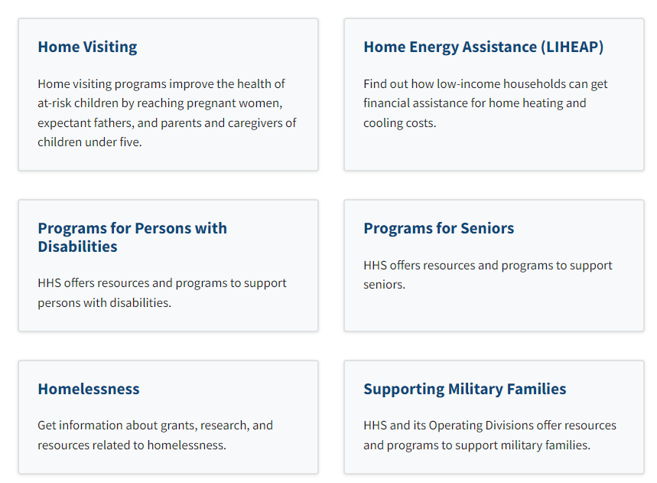
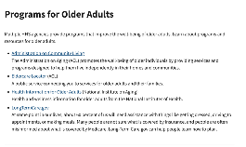
Programs for Seniors
https://www.hhs.gov/programs/social-services/index.html
Notes:
Instructions: Next, click on programs for seniors.
Materials: None
Handouts: None
Time: 1 minute

Slide 41
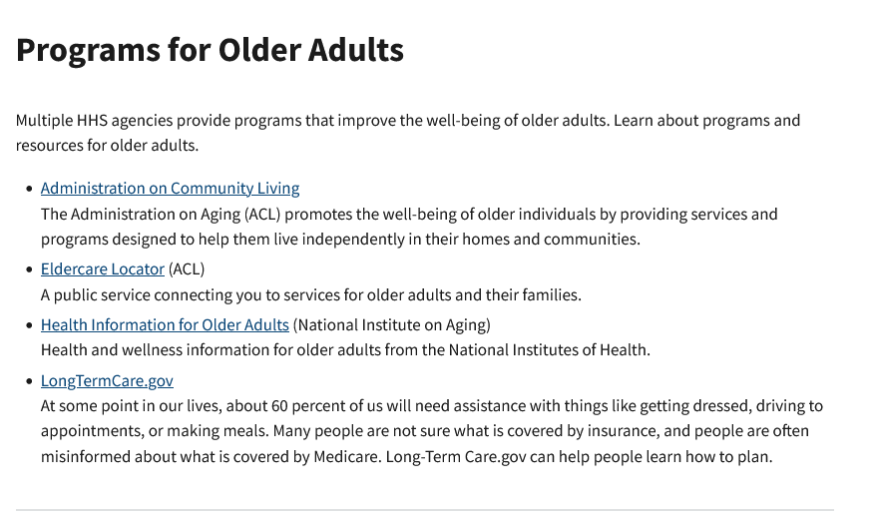
Programs for Older Adults
Programs for Seniors | HHS.gov
Notes:
Instructions: There are multiple Health and Human Service agencies provide programs that improve the well-being of older adults. Each link takes you to a partner site to discover more information about the services provided.
Materials: None
Handouts: None
Time: 2 minutes

Slide 42

Telephone & Internet Access
Lifeline for telephone and internet services
  www.usa.gov/help-with-phone-internet-bills
Affordable Connectivity Program for broadband internet
  www.fcc.gov/acp
Notes:
Instructions: (Each point is a hyperlink for facilitators to go live to the webpage.) Both USA.gov and the Federal Communications Commission had assistance programs.
Lifeline: Get help paying for phone and internet service | USAGov (https://www.usa.gov/help-with-phone-internet-bills)
Affordable Connectivity: Affordable Connectivity Program | Federal Communications Commission (fcc.gov) (https://www.fcc.gov/acp)
Materials: None
Handouts: None
Time: 1 minute

Slide 43
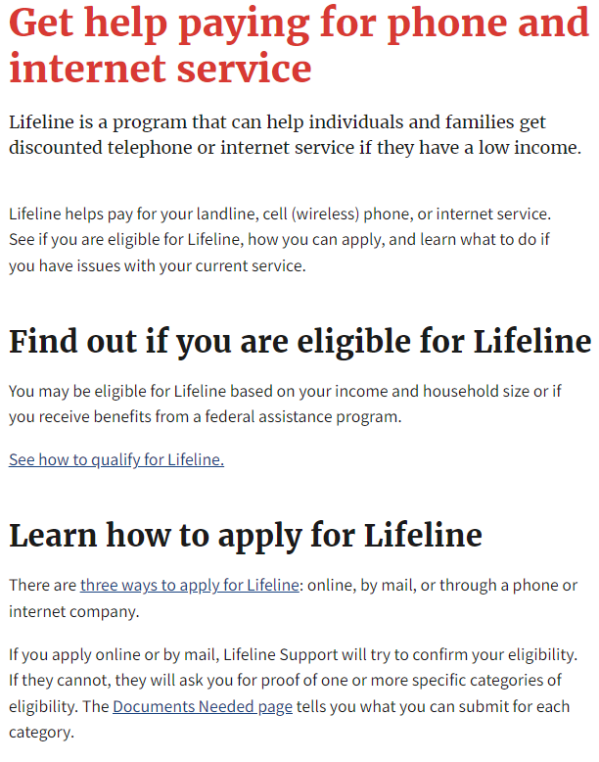
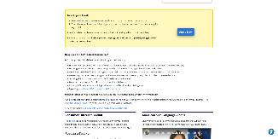
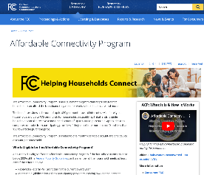
Lifeline for Telephone and Internet Services
USA.gov
Get help paying for phone and internet service | USAGov
Notes:
Instructions: Lifeline is a program that can help individuals and families get discounted telephone or internet service if they have a low income. From this website, there is information on eligibility, how to apply, and service for current participants.
Direct link to “Get help paying for phone and internet service” https://www.usa.gov/help-with-phone-internet-bills
Materials: None
Handouts: None
Time: 1 minute

Slide 44

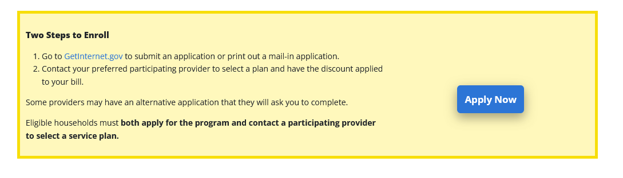
Affordable Connectivity Program for broadband internet
fcc.gov/acp
https://www.fcc.gov/acp
Notes:
Instructions: The Affordable Connectivity Program is a Federal Communications Commission benefit program that helps ensure that households can afford the broadband they need for work, school, healthcare and more. From this website, there are definitions, program details, and the link to enroll in two steps.
Materials: None
Handouts: None
Time: 1 minute

Slide 45

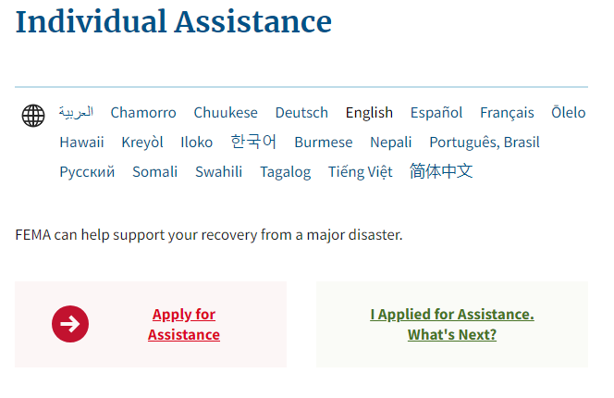
Emergency Services
Emergency assistance from Federal Emergency Management Agency (FEMA)
https://www.fema.gov/assistance/individual
Notes:
Instructions: (FEMA is a hyperlink for facilitators to go live to the webpage.) FEMA’s Individuals and Households Program (IHP) provides financial assistance and direct services to eligible individuals and households affected by a disaster. Through this website, there are materials to support individual assistance, fact sheets, and information for small business owners.
Materials: None
Handouts: None
Time: 2 minutes

Slide 46
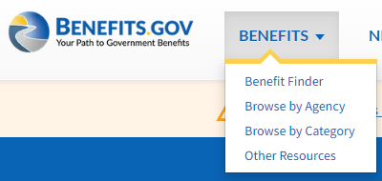
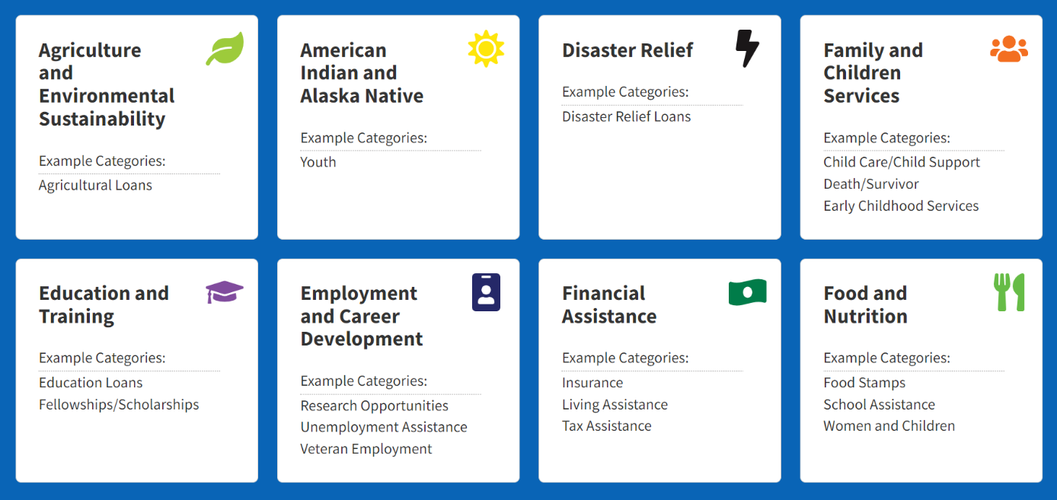
Apply to Federal Benefits
benefits.gov
Notes:
Instructions: To apply for federal benefits using the benefits.gov webpage, click on “benefits” at the top of the screen and select “Browse by Category.” This will highlight 16 categories. Select which the category needed. For this example, “Food and Nutrition” will be selected.
Materials: None
Handouts: None
Time: 3 minutes

Slide 47
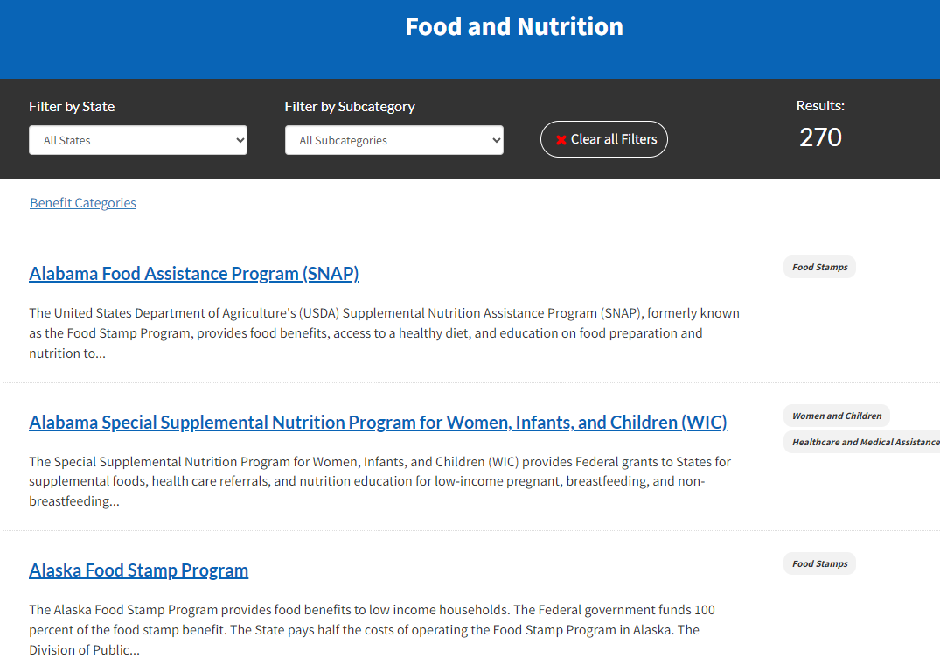

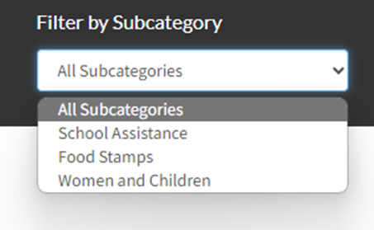
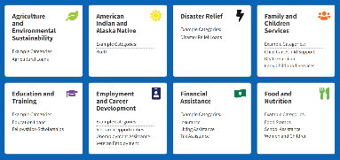
Food and Nutrition
Notes:
Instructions: Here the list can be filtered by State or Subcategory. In this example, there are three subcategories: School Assistance, Food Stamps, and Women and Children. Click on the link to the desired article.
Materials: None
Handouts: None
Time: 3 minutes

Slide 48
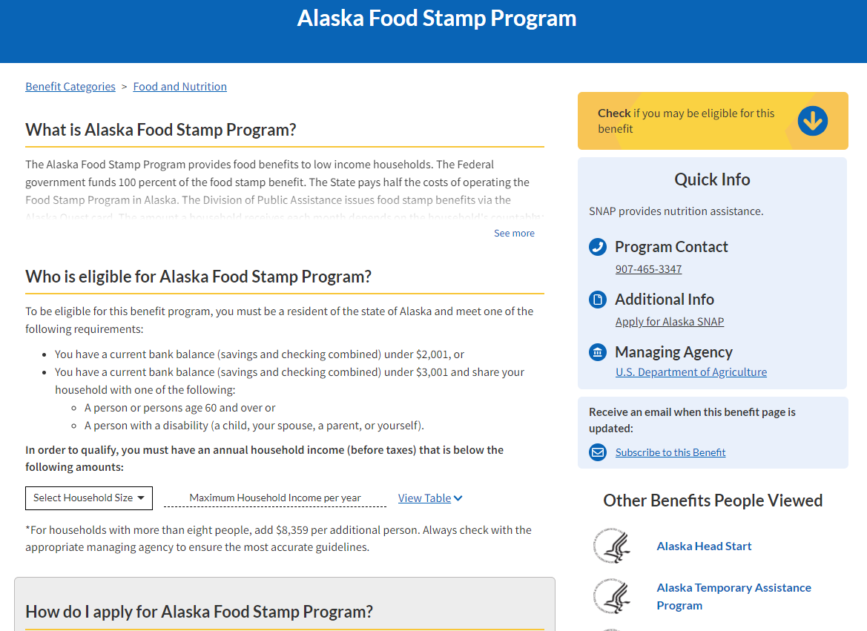

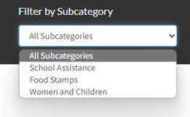
Alaska Food Stamp Program
Notes:
Instructions: For Alaska Food Stamp Program, the program description is provided, eligibility requirements are shared, a link to apply for Alaska SNAP is provided, and a Quick Information box gives contact information.
Materials: None
Handouts: None
Time: 3 minutes

Slide 49

Voter Registration
Notes:
Instructions: This slide begins the voter registration section.
Materials: None
Handouts: None
Time: 1 Minute

Slide 50
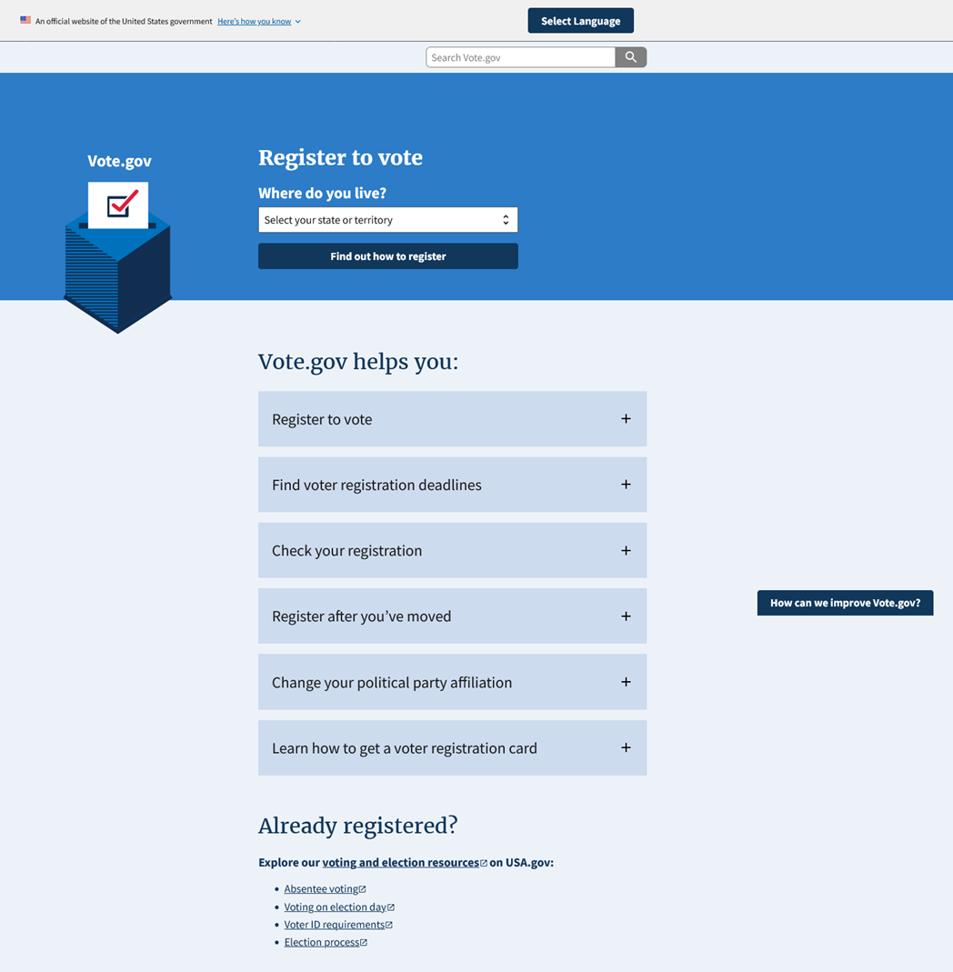
Voter Registration vote.gov
https://vote.gov/
Notes:
Instructions: Although there are federal laws and oversight, states set many of the options and procedures for online voter registration. Vote.gov provides an informative portal for identifying information for each state such as: Is online registration available in your state? How to register to vote (even when online is not an option) and deadlines.
Materials: None
Handouts: None
Time: 3 minutes

Slide 51
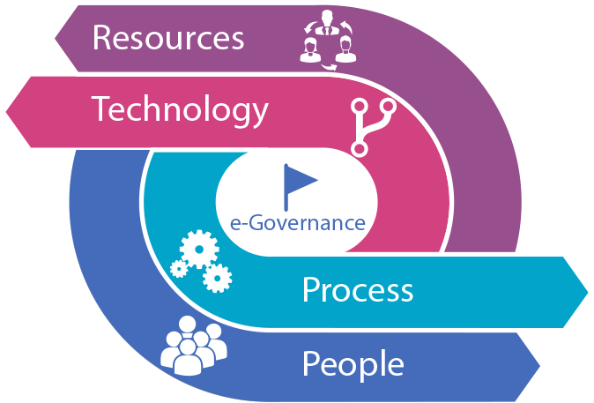
Summary of Connecting to
Government Resources
Notes:
Instructions: This slide begins the summary section.
Materials: None
Handouts: None
Time: 1 Minute

Slide 52
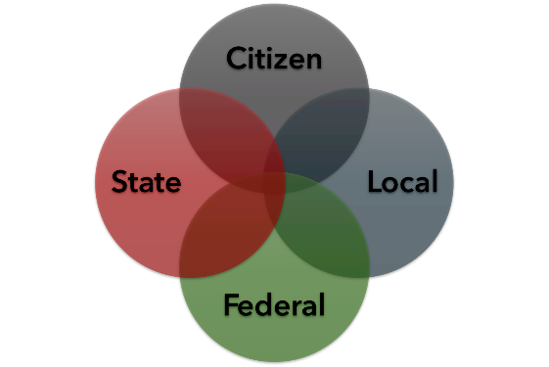






Final Points Connecting to
Government Resources
Connecting resources and citizens
Making sure it is secure
Multiple Levels collaborating
Notes:
Instructions: E-government efforts have made information and assistance programs more accessible and efficient.
Materials: None
Handouts: None
Time: 5 to 10 minutes

Slide 53
Final Points Connecting to
Government Resources
Connection resources and citizens
Making sure it is secure
Multiple levels collaborating
Notes:
Instructions: Using legitimate (.gov) and safe websites.
Materials: None
Handouts: None
Time: 5 to 10 minutes

Slide 54
Final Points Connecting to
Government Resources
Resident/Citizen
Local
Federal
State
Connecting resources and citizens
Making sure it is secure
Multiple levels collaborating
Notes:
Instructions: Connecting multiple levels of government to citizens. By being ever-evolving, e-government is making relevant and up-to-date government information and services available to the public via the internet.
Materials: None
Handouts: None
Time: 5 to 10 minutes

Slide 55
Questions, Discussion, Next Steps
Questions
Discussion
Next Steps
Notes:
Instructions: Before the session begins, add any text to promote next educational opportunity. Thank participants for attendance, allow for questions and discussion, promote the next lesson, encourage evaluation participation.
Materials: None
Handouts: None
Time: 10 minutes

