Slide 1

Saving, Recovering, and Sharing Data and Files
Notes:
Instructions: Have this slide up as participants enter the room.
Materials: Encourage participants to bring personal laptops or tablets for activities. Additional devices can be provided by instructor or through partnerships. If devices are not available for all, instructor will need to demonstrate activities for all participants to see.
Handouts: Copy of presentation slides and
Handout: Saving, Recovering, and Sharing Data and Files
Time: 1 Minute
* Do not move or delete pictures/content off to the sides of the PowerPoint slide.

Slide 2







Bridging the Digital Divide Partners
This project was funded by USDA NIFA award # 2022-68006-36496. The material is based upon work supported by the National Institute of Food and Agriculture, U.S. Department of Agriculture. Any opinions, findings, conclusions, or recommendations expressed in this publication are those of the author(s) and do not necessarily reflect the view of the U.S. Department of Agriculture.
Notes:
Instructions: Share this acknowledgment of the partnerships in the Bridging the Digital Divide.
Materials: None
Handouts: None
Time: 1 Minute

Slide 3
In accordance with Federal law and the U.S. Department of Agriculture (USDA) civil rights regulations and policies, this institution is prohibited from discriminating on the basis of race, color, national origin (including English proficiency), limited religion, sex, disability, age, marital status, family/parental status, income derived from a public assistance program, political beliefs, reprisal or retaliation for prior civil rights activity in any program or activity conducted or funded by USDA. (Not all prohibited bases apply to all programs)
Program information may be made available in languages other than English. Persons with disabilities who require alternative means of communication for program information (e.g., braille, large print, audiotape, American Sign Language) should contact the responsible State or local Agency that administers the program or contact USDA through the Telecommunications Relay Service at 711 (voice and TTY).

Slide 4
To file a program discrimination complaint, a complainant should complete a Form AD-3027, USDA Program Discrimination Complaint Form, which can be obtained online at https://www.usda.gov/sites/default/files/documents/ad-3027.pdf, from any USDA office, by calling (866) 632-9992, or by writing a letter addressed to USDA. The letter must contain the complainant’s name, address, telephone number, and a written description of the alleged discriminatory action in sufficient detail to inform the Office of the Assistant Secretary for Civil Rights (OASCR) about the nature and date of an alleged civil rights violation. The completed AD-3027 form or letter must be submitted to USDA by: mail: U.S. Department of Agriculture Office of the Assistant Secretary for Civil Rights 1400 Independence Avenue, SW Washington, D.C. 20250-9410; or email: program.intake@usda.gov
This institution is an equal opportunity provider.

Slide 5
Title IX of the Education Amendments Act of 1972 (Title IX) prohibits discrimination on the basis of sex, pregnancy, or parental status - in educational programs and activities that receive Federal financial assistance. The law also prohibits individuals from exclusion from such programs or activities or from denial of benefits from such programs or activities based on sex. This prohibition applies to a wide array of public and private schools at the K-12 grade levels, as well as colleges and universities which receive federal funding. A school that is controlled by a religious organization is exempt from Title IX when the law’s requirements would conflict with the organization’s religious tenets. The law requires federally funded education institutions or programs to disseminate Title IX information widely, including the name, address, and telephone number (or other contact information) of the designated Title IX Coordinator.
Program information is available in languages other than English. Persons with disabilities who require alternative means of communication (e.g., braille, large print, audiotape, American Sign Language) should contact the responsible State or local Agency that administers the program or contact USDA through the Federal Telecommunications Relay Service at 711 (voice and TTY).

Slide 6
Prior to filing a Title IX complaint with USDA against an institution, a potential complainant may want to find out about the institution’s grievance process and use that process to have the complaint resolved. However, a complainant is not required by law to use the institutional grievance process before filing a complaint with the Office of the Assistant Secretary of Civil Rights (OASCR). If a complainant uses an institutional grievance process and chooses to file the complaint with OASCR, the complaint must be filed with OASCR within 60 days after completion of the institutional grievance process.

Slide 7
To file a USDA program discrimination complaint, a complainant should complete Form AD-3027, USDA Program Discrimination Complaint Form, which can be obtained online at https://www.usda.gov/sites/default/files/documents/ad-3027.pdf; from any USDA office; by calling (866) 632-9992; or by writing a letter addressed to the USDA office listed below. The letter must contain the complainant’s name, address, telephone number, and a written description of the alleged discriminatory action in sufficient detail to inform OASCR about the nature and date of an alleged civil rights violation. The completed AD3027 form or letter must be submitted to USDA via: mail: U.S. Department of Agriculture Office of the Assistant Secretary for Civil Rights 1400 Independence Avenue, SW Washington, D.C. 20250-9410; or email: program.intake@usda.gov
This institution is an equal opportunity provider.

Slide 8
Author Acknowledgement
We wish to thank the author of this training material:
Dr. Roseanne Scammahorn, Research/Extension Associate III, Southern Rural Development Center
Notes:
Instructions: The presenters of this session are asked to share this acknowledgment of the work that went into this session.
Materials: None
Handouts: None
Time: 1 Minute

Slide 9
Presenter Acknowledgement
Name
Title
Association
Email (Optional)
Phone (Optional)
Webpage (Optional
Notes:
Instructions: Self introduction
Materials: None
Handouts: None
Time: 2 Minutes

Slide 10
Structure of Today’s Session
Saving files - Activity
Sharing files
Finding files
Recovering files - Activity
Notes:
Instruction: This will be a general lesson on saving, finding, recovering, sharing data and files.
Materials: None
Handouts: None
Time: 2 Minutes

Slide 11

Introductions
Notes:
Instructions: Give time for participants to introduce themselves. You could also include a brief question for them to answer such as what motivated them to take this class? Encourage the 30 second rule: “In 30 seconds, share your name and answer…”
You may also consider using a light-hearted questions such as:
If they have a particular question about saving or have encountered problems when trying to save and find their files.
What was your first job?
What hobby takes up most of your free time?
How do you like your coffee?
Materials: None
Handouts: None
Time: 5 Minutes
Photo by Joshua Sortino on Unsplash
Image by WikiImages from Pixabay

Slide 12

What are data and files?
Notes:
Instructions: We will now briefly discuss what data is and how we use it in files.
Materials: None
Handouts: None
Time: 1 Minute
Photo by Markus Spiske on Unsplash

Slide 13

Data
Data is information that is meant to be read or viewed.
Notes:
Instructions: Data is information that is meant to be read or viewed. For example, a letter written in a Word document is data, an image created in Canva, or content of a webpage. These are all data or information.
Materials: None
Handouts: None
Time: 2 Minutes

Slide 14

File
A file is a self-contained piece of information or any saved information on a device.
Notes:
Instructions: A file is a self-contained piece of information or any saved information on your device. One way to think of a computer file is like a receipt. The receipt has all the information (data) about your purchase, written on one slip of paper (the file). Files can be pictures you save from your phone (JPG, pronounced jay-peg), excel document that outlines your household budget, or your favorite song saved as a MP3 file.
Files can be created on a device or downloaded from the Internet.
Materials: None
Handouts: None
Time: 2 Minutes
Photo by Ilya Pavlov on Unsplash

Slide 15

How to save files
Notes:
Instructions: Now we will look more specifically at how to save a file to a device.
Materials: None
Handouts: None
Time: 1 Minute

Slide 16
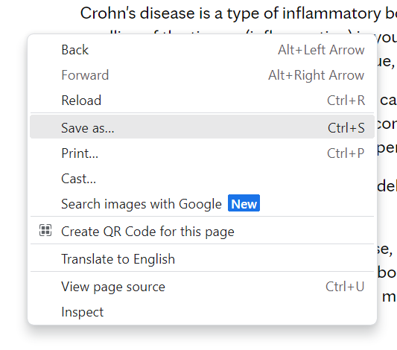



Saving or Downloading a New File
To save a file from the internet
Also know as a download
Notes:
Instructions: To save a file from the internet, also known as downloading a file from the internet, select the document you want to save. This can be a picture, video, music, PDF, or almost anything. Look for a down arrow or a picture of a floppy disk. These are typically found at the top right or bottom right of the document. Sometimes there will be a button that says “download.” Be careful to download files from only trusted Internet sources.
If you don’t see these options, right click on the document and select “Save File or Save as”.
Materials: None
Handouts: None
Time: 3 Minutes

Slide 17
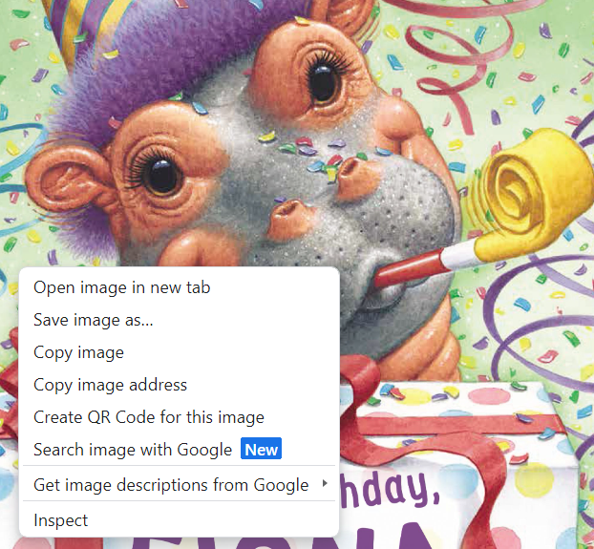
Saving a Picture as a New File
To save a picture from the internet
Notes:
Instructions: To save a picture from the internet, right click on the image. This will bring up a menu of options. Select “Save image as…”
Materials: None
Handouts: None
Time: 2 Minutes

Slide 18
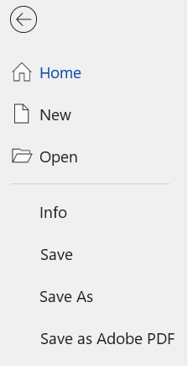
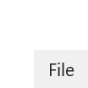
Saving a Document as a New File
To save a document you have created
Notes:
Instructions: To save a document you have created, using a Microsoft Office program such as Word, Excel, or PowerPoint, click on “File” in the upper left corner of the document, from the menu click on, “ Save As.”
For an Apple, Inc device, from the “File” menu at the top of the screen, click on “Save As”.
Materials: None
Handouts: None
Time: 2 Minutes

Slide 19
Should I use Save or Save As?
SAVE: When the file already exists on the device, and you do not want to change the name or the location of the file.
SAVE AS: The first time saving the file on the device, or when you do want to change the name, location, or format of the file.
Notes:
Instructions: When to use the “Save” and the “Save As” options: Use “Save” if you have already saved the file to your device. This will update the existing file. Use “Save As” if this is the first time you are saving the file to your device, or if you want to change the name, where it is saved, or the format of the file.
Materials: None
Handouts: None
Time: 2 Minutes

Slide 20
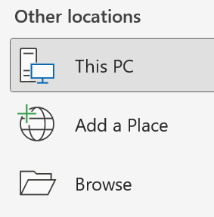
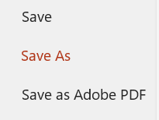
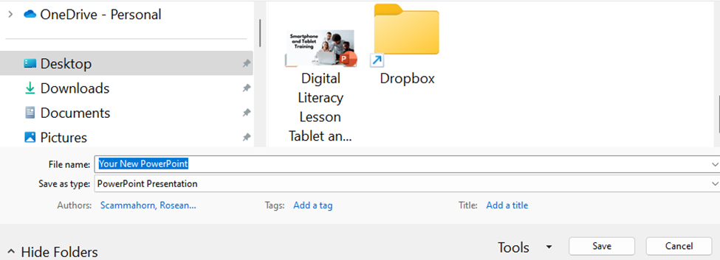
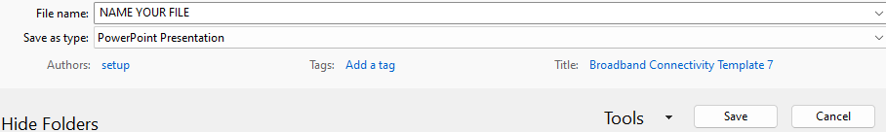
Select where to save the file
Notes:
Instructions: When saving a new document, once you click on “Save As” for both Android and Apple devices, you will need to designate where on the computer you would like the file to be located. Click on “Browse”. This will give you access to all the locations on the device or drives. In the example, “Desktop” is selected, and the folders already located on the desktop appear to the right. Select a folder by left clicking on the folder icon. In this example, the “Dropbox” folder is selected. If you don’t want to save the document in a folder do not click on any folders, just type in the name of your file and click on “Save.” This file is now saved in the “Dropbox” folder.
Materials: None
Handouts: None
Time: 5 Minutes
Source: https://www.denverlibrary.org/ctc/computer-basics-saving-finding-files

Slide 21
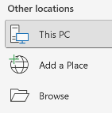

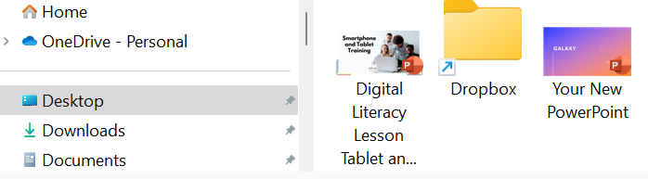
Select where to save the file
https://www.denverlibrary.org/ctc/computer-basics-saving-finding-files
Notes:
Instructions: In this example there is a folder labeled “Dropbox”, but we do not want to save it to this folder. Therefore, no folder is selected. Rather, the PowerPoint presentation is named “Your New PowerPoint” and saved to the desktop. A new icon will now be visible when saving file and will appear as an icon on the desktop.
Materials: None
Handouts: None
Time: 2 Minutes

Slide 22

Try it! Save a New File
Open a blank Microsoft Word document
Add Data (words) to the File
Name and Save the File to the Desktop
Notes:
Instructions: Have participants open a blank “Word” document on their device (or demonstrate if devices are not available).
Type the Pledge of Allegiance, a favorite song, or lines from a book. (Encourage participants not to type personal information if they are using public devices.)
Name and save the document to the desktop.
Once done, look on the desktop and locate the icon for the new file.
Right click on the file and select delete (or the trash can icon) to remove it from the device.
Materials: None
Handouts: None
Time: 5 Minutes

Slide 23
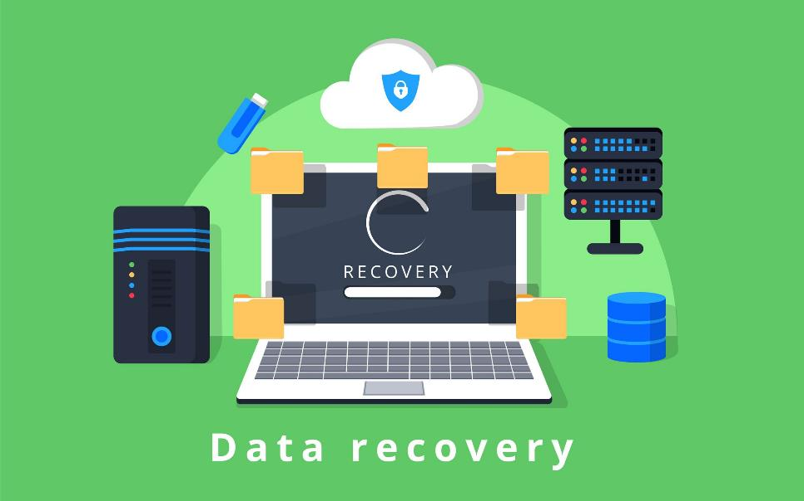
How to find and recover files
Notes:
Instructions: Now we will look at how to find a file when you can’t remember which folder you saved a file in and how to recover a file if you accidently deleted it.
Materials: None
Handouts: None
Time: 1 Minute

Slide 24

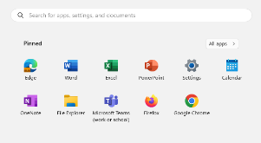

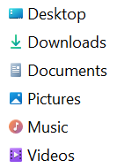
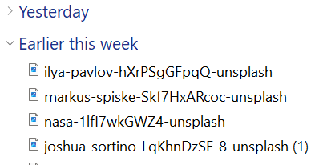
Finding Files
Windows Explorer
Notes:
Instructions: To find a file saved on a device, but aren’t sure where it was saved, start by clicking on the Windows Explorer icon. This icon is either pinned to the taskbar along the bottom of the screen or as an icon on the desktop. Next, click on “Downloads.” On the right a list of items downloaded on this device will be listed in chronological order. Once the file is located, left click on the name to open the file. You can also click on any folder on the left side: Desktop, Pictures, Music, etc. to search for a file.
Materials: None
Handouts: None
Time: 2 Minutes

Slide 25




Finding Files
Android:
Control + F
Apple:
Command + F
Start
Apple: Finder
Notes:
Instructions: Another option is to click on the “Start” button. Again, this button is typically found in the toolbar at the bottom of the screen. A new window will appear. At the top is a search bar. Search by file name, key words in the file, or by the type of file it is (Word, Excel, JPEG, PowerPoint, etc.)
Apple devices have a specific icon, “Finder”, located at the bottom left of the screen in the toolbar. Finder works like the Start button on Microsoft devices.
Materials: None
Handouts: None
Time: 2 Minutes

Slide 26

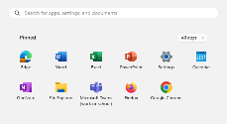

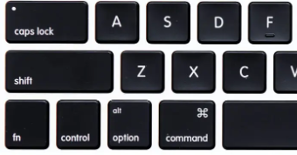

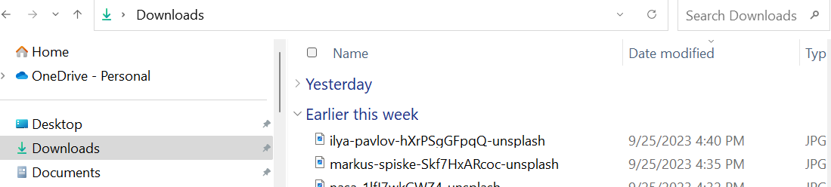
Finding Files
Start Button
Android:
Control + F
Apple:
Command + F
Notes:
Instructions: Use the Control plus the letter F (or Command plus the letter F for Apple, Inc. devices), to search for a word or phrase within a file, on a webpage, and in the drives and folder on a device. To search within a drive or folder, this area must be opened on the device. In this example, the “Downloads” drive is open, “Control +F” opened the “Search Downloads” box in the upper right corner of the screen.
Materials: None
Handouts: None
Time: 2 Minutes

Slide 27

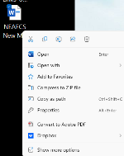


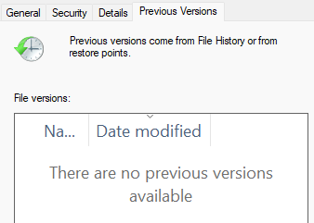

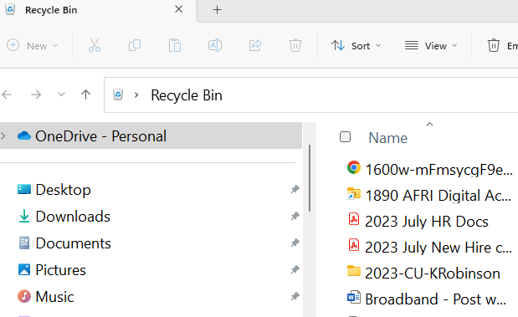
Recovering a File
Notes:
Instructions: If a file is accidentally deleted, look first in the Recycle Bin. Double click on the Recycle Bin icon. Here you can view everything that has been deleted in order from most recent to oldest. Here you can use the Control + F (Command + F) search option to search for the deleted file. Once the file is located, right click and hold the button to drag it back onto the desktop. From here you can open it and save it in the correct file.
Additional Support: If the device doesn’t have an icon, Select “Start”, “Settings”, “Personalization”, “Themes”, “Desktop icon settings”. Make sure the check box for “Recycle Bin” is checked, then select “OK”. You should see the icon displayed on your desktop.
Materials: None
Handouts: None
Time: 2 Minutes
Source: https://www.intel.com/content/www/us/en/tech-tips-and-tricks/recover-deleted-files.html

Slide 28



Recovering a File
Notes:
Instructions: If you have made changes to a document and saved it but didn’t intend to (sometimes this happens when “AutoSave” option is activated), you can go back to the previous version IF you have “System restore” activated on the device.
In Windows, right-click on a file, and select “Properties,” and select the tab titled “Previous Versions.” This option can help you revert to a version of your file before the overwrite occurred, allowing you to get your data back.
In this example, you can see that system restore wasn’t activated and there are no previous versions available.
Materials: None
Handouts: None
Time: 2 Minutes

Slide 29
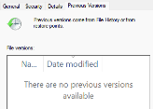
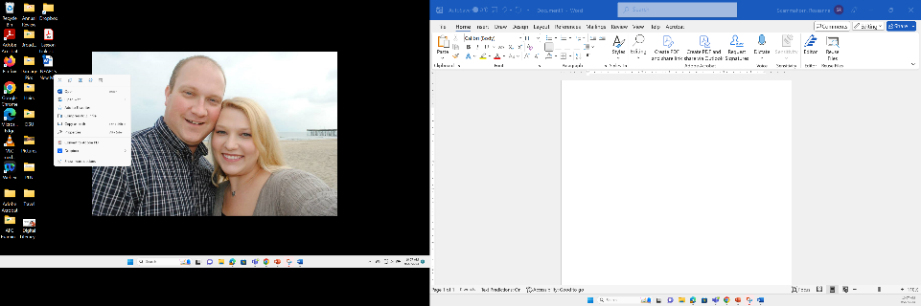
Try it! Recover a Deleted File
Open Recycle Bin
Locate deleted file
Save to the Desktop
Open the file
Notes:
Instructions: In the previous activity, participants created, saved, and deleted a file. Using the Recycle Bin method, retrieve the deleted file, place it back on to the desktop and open the file.
Materials: None
Handouts: None
Time: 5 Minutes

Slide 30


How to share files
Notes:
Instructions: There are several file-sharing services. File-sharing is the practice of allowing others to have access to specific files. With your permission, several people can access and modify documents, audio, video, graphics, and images.
Materials: None
Handouts: None
Time: 1 Minute

Slide 31
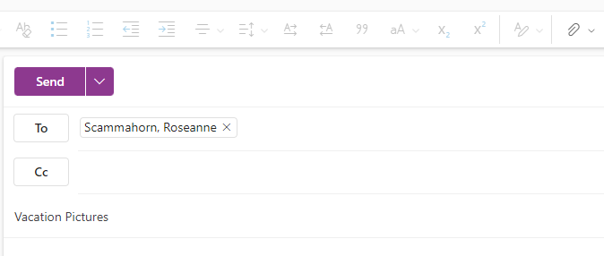
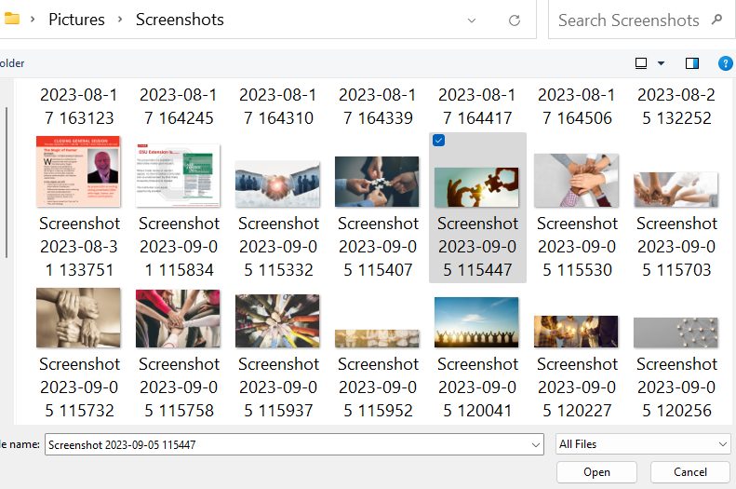
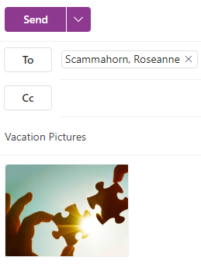
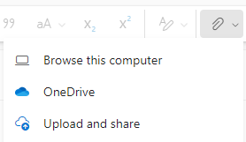
Send it in an Email
Notes:
Instructions: The most basic way to share a file is to email it to those you wish to have a copy of the file. Open a “New Mail”, click on the “Share” icon, and then click “Browse this computer”.
(Please note some email systems label the Share icon as “Attach” or “Attach files”.)
Select the file or image you would like to email and click on “Open”. This will attach it to the email being sent. Then enter the email address, add a subject (vacation pictures), and click on “Send”.
This is a form of one-way sharing. Any changes the receiver makes to the file, they will have to save to their device, and email back to you.
Materials: None
Handouts: None
Time: 2 Minutes

Slide 32
File Sharing Services
Box
Dropbox
Google Drive
iCloud
Microsoft OneDrive
Notes:
Instructions: Google Drive, Dropbox, Microsoft OneDrive, Box, and iCloud are some examples of online file sharing services. A file-sharing service allows users to access files securely from any device because all the files are saved in the cloud. The cloud is a “mode of computer storage in which digital data is stored on servers in off-site locations” (What is Cloud Storage?, 2023). Changes made to files saved and shared using a file-sharing service happen in real-time, improving productivity and efficiently.
Materials: None
Handouts: None
Time: 3 Minutes
Source: What is Cloud Storage? (n.d.). Google. Retrieved September 27, 2023, from https://cloud.google.com/learn/what-is-cloud-storage

Slide 33
Summary
What are data and files?
Data is information that is meant to be read or viewed
A file is a self-contained piece of information or any saved information on a device
Saving a file - Download and created files
Finding a file - Windows Explorer, the Start button, & Control + F
Recovering a file - Recycle Bin & previous version
Sharing a file - Email & file-sharing service
Notes:
Instructions: Briefly review the topics covered in this lesson:
What are data and files? Data is information that is meant to be read or viewed. A file is a self-contained piece of information or any saved information on a device.
Saving a file - Download and created files
Finding a file - Windows Explorer, the Start button, & Control + F
Recovering a file - Recycle Bin & previous version
Sharing a file - Email & file-sharing service
Materials: None
Handouts: None
Time: 2 Minutes

Slide 34
Questions
Discussion
Next Steps
Notes:
Instructions: Before the session begins, add any text to promote next educational opportunity.
Thank participants for attendance, allow for questions and discussion, promote the next lesson, encourage evaluation participation.
Materials: None
Handouts: None
Time: 10 Minutes

