Slide 1

Smartphone and Tablet Training
Notes:
Instructions: Have this slide up as participants arrive
Materials: None
Handouts: None
Time: 1 minute
Photo by Thirdman: https://www.pexels.com/photo/a-group-of-people-having-a-discussion-while-looking-at-laptop-5256526/

Slide 2







Bridging the Digital Divide Partners
This project was funded by USDA NIFA award # 2022-68006-36496. The material is based upon work supported by the National Institute of Food and Agriculture, U.S. Department of Agriculture. Any opinions, findings, conclusions, or recommendations expressed in this publication are those of the author(s) and do not necessarily reflect the view of the U.S. Department of Agriculture.
Materials as of: November 2023
Notes:
Instructions: Share this acknowledgment of the partnerships in the Bridging the Digital Divide.
Materials: None
Handouts: None
Time: 1 Minute

Slide 3
In accordance with Federal law and the U.S. Department of Agriculture (USDA) civil rights regulations and policies, this institution is prohibited from discriminating on the basis of race, color, national origin (including English proficiency), limited religion, sex, disability, age, marital status, family/parental status, income derived from a public assistance program, political beliefs, reprisal or retaliation for prior civil rights activity in any program or activity conducted or funded by USDA. (Not all prohibited bases apply to all programs)
Program information may be made available in languages other than English. Persons with disabilities who require alternative means of communication for program information (e.g., braille, large print, audiotape, American Sign Language) should contact the responsible State or local Agency that administers the program or contact USDA through the Telecommunications Relay Service at 711 (voice and TTY).

Slide 4
To file a program discrimination complaint, a complainant should complete a Form AD-3027, USDA Program Discrimination Complaint Form, which can be obtained online at https://www.usda.gov/sites/default/files/documents/ad-3027.pdf, from any USDA office, by calling (866) 632-9992, or by writing a letter addressed to USDA. The letter must contain the complainant’s name, address, telephone number, and a written description of the alleged discriminatory action in sufficient detail to inform the Office of the Assistant Secretary for Civil Rights (OASCR) about the nature and date of an alleged civil rights violation. The completed AD-3027 form or letter must be submitted to USDA by: mail: U.S. Department of Agriculture Office of the Assistant Secretary for Civil Rights 1400 Independence Avenue, SW Washington, D.C. 20250-9410; or email: program.intake@usda.gov
This institution is an equal opportunity provider.

Slide 5
Title IX of the Education Amendments Act of 1972 (Title IX) prohibits discrimination on the basis of sex, pregnancy, or parental status - in educational programs and activities that receive Federal financial assistance. The law also prohibits individuals from exclusion from such programs or activities or from denial of benefits from such programs or activities based on sex. This prohibition applies to a wide array of public and private schools at the K-12 grade levels, as well as colleges and universities which receive federal funding. A school that is controlled by a religious organization is exempt from Title IX when the law’s requirements would conflict with the organization’s religious tenets. The law requires federally funded education institutions or programs to disseminate Title IX information widely, including the name, address, and telephone number (or other contact information) of the designated Title IX Coordinator.
Program information is available in languages other than English. Persons with disabilities who require alternative means of communication (e.g., braille, large print, audiotape, American Sign Language) should contact the responsible State or local Agency that administers the program or contact USDA through the Federal Telecommunications Relay Service at 711 (voice and TTY).

Slide 6
Prior to filing a Title IX complaint with USDA against an institution, a potential complainant may want to find out about the institution’s grievance process and use that process to have the complaint resolved. However, a complainant is not required by law to use the institutional grievance process before filing a complaint with the Office of the Assistant Secretary of Civil Rights (OASCR). If a complainant uses an institutional grievance process and chooses to file the complaint with OASCR, the complaint must be filed with OASCR within 60 days after completion of the institutional grievance process.

Slide 7
To file a USDA program discrimination complaint, a complainant should complete Form AD-3027, USDA Program Discrimination Complaint Form, which can be obtained online at https://www.usda.gov/sites/default/files/documents/ad-3027.pdf; from any USDA office; by calling (866) 632-9992; or by writing a letter addressed to the USDA office listed below. The letter must contain the complainant’s name, address, telephone number, and a written description of the alleged discriminatory action in sufficient detail to inform OASCR about the nature and date of an alleged civil rights violation. The completed AD3027 form or letter must be submitted to USDA via: mail: U.S. Department of Agriculture Office of the Assistant Secretary for Civil Rights 1400 Independence Avenue, SW Washington, D.C. 20250-9410; or email: program.intake@usda.gov
This institution is an equal opportunity provider.

Slide 8
Author Acknowledgement
We wish to thank the authors of this training material:
Terrence Wolfork, Assistant Administrator, Fort Valley State University
Dr. Roseanne Scammahorn, Research Extension Associate III, Southern Rural Development Center
Notes:
Instructions: The presenters of this session are asked to share this acknowledgment of the work that went into this session.
Materials: None
Handouts: None
Time: 1 minute

Slide 9
Presenter Acknowledgement
Name
Title
Association
Email (Optional)
Phone (Optional)
Webpage (Optional)
Notes:
Instructions: Self introduction
Materials: None
Handouts: None
Time: 1 minute

Slide 10

SmartPhone and
Tablet Training
Laptop, Tablets, and Smartphones
The Operating System
Securing your Smartphone or Tablet With Biometrics and PIN
The Basics
  Turing on the device
  The home screen
  Using Gestures on IOS
Notes:
Instructions: Review the goals of today’s training.
The Basics of smartphones and tablets
Getting Online
Communications and Social Media
Materials: None
Handouts: None
Time: 3 Minute

Slide 11
Structure of Today’s Session
Laptop, tablets, and smartphone description
Security Basics
Gestures on IOS – Practice Opportunity
The Home Screen – Group Activity
The Basics – Powering on – Practice Opportunity
Operating Systems
Notes:
Instruction: State the structure of the lesson and briefly describe content that will be discussed under each heading. Ask for any questions or concerns before starting.
Materials: None
Handouts: None
Time: 3 minutes

Slide 12

laptop, tablets, and smartphones
Notes:
Instructions: Introduction of section on laptops, tablets, and smartphones.
Materials: None
Handouts: None
Time: 1 Minute

Slide 13
 | Laptop | Tablet | Smartphone
Makes Calls | No | No | Yes
Text | With an app | With an app | Yes
Touchscreen | Maybe | Yes | Yes
Keyboard | Yes | Can attach | No
Mouse | Yes | Can attach | No
Can take photos | No | Yes, but can be awkward due to size | Yes
Battery Life | Great | Good | OK
Screen size for entertainment | Great | Great | OK
Reading documents/books | Great | Great | OK
Primary Function | Serious computing | Computing/multimedia | Communication
Portability | OK | OK | Great
Notes:
Instructions: Explain differences and similarities between laptop, tablets, and smartphone including advantages and disadvantages for each.
Materials: None
Handouts: None
Time: 5 Minutes

Slide 14
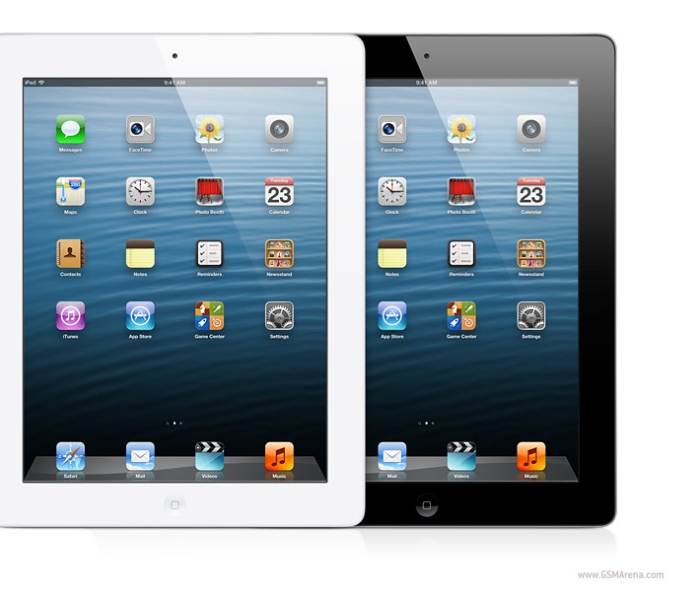
iPad – Made by Apple
This Photo by Unknown Author is licensed under CC BY
Notes:
Instructions: There are four basic versions of the iPad. The Ipad, Ipad Mini and two versions of the IPad Pro. The iPhone comes in four versions also. The iPhone, iPhone plus, iPhone Pro, iPhone Pro Max
Materials: Device or photo of device
Handouts: iPad and Android button examples.
Time: 2 Minutes

Slide 15
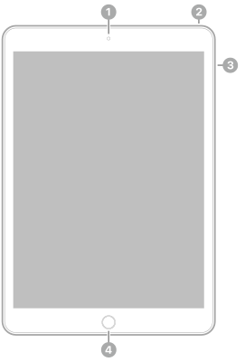
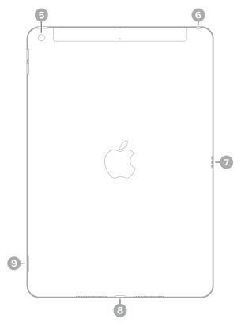
Front Camera
Top Button
Volume Buttons
Home Button/Touch ID
Rear Camera
Headphone Jack
Smart Connector
Lightening Connector
SIM Tray (Wi-Fi & Cellular)
iPad (9th generation): https://support.apple.com/guide/ipad/ipad-9th-generation-ipada6b7a0b6/ipados
Notes:
Instructions: Briefly highlight each of the buttons.
Power button/Top button (on some iPhones this button is on the right side) – Press and hold - Powers the iPad on or off. Press briefly – puts iPad to sleep or wakes it up.
Volume up and down buttons (can be located on either the right or left side depending on model) - Adjust the Sounds Effects or Listening volume by pressing either button. Can also mute the iPad by holding the Volume Down button.
Home button – Returns the user to the home screen, but can also wake the iPad up, double click to change apps, or hold it down to speak to Siri.
Camera – iPad has two cameras, front facing for selfies and videoconferencing, and back for taking pictures and video.
Lightening Connector - The Lightning connector is used to connect Apple mobile devices like iPhones, iPads, and iPods to host computers, external monitors, cameras, USB battery chargers, and other peripherals.
Materials: Device or photo of device
Handouts: iPad and Android button examples.
Time: 10 Minutes

Slide 16
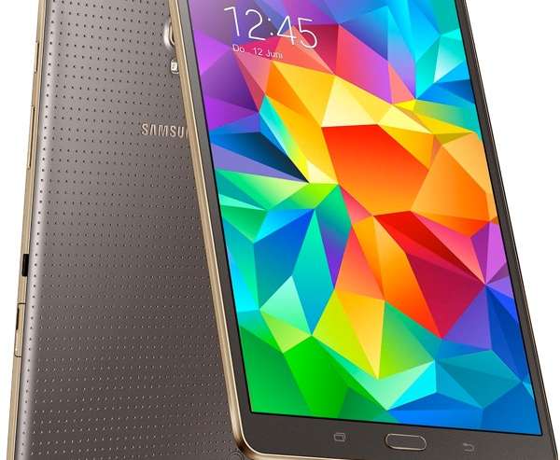
Android – Made by Google
Android – Made by Google
This Photo by Unknown Author is licensed under CC BY-SA
Notes:
Instructions: There are many versions of the android-based tablets with the most common being made by Google and Samsung.
Materials: None
Handouts: iPad and Android button examples.
Time: 1 Minute

Slide 17
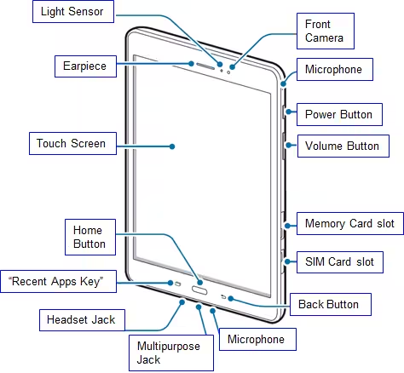
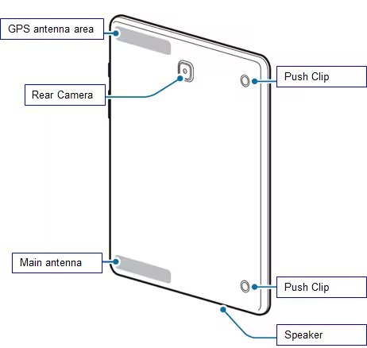

Slide 18
The Operating System
IOS
Android
Notes:
Slide 14 & 18: Use if teaching overview of iOS and Android lesson
Slides 14-17: Use for more advanced iOS lesson
Slides 18-21: Use for more advanced Android lesson
Instructions: Transition to operating system discussion between Ios and Android.
Tablets will run either an Apple or an Android operating system. The operating system is the base software that controls the tablet. The operating system is the “base” software that runs the tablet and controls how it functions.
Materials: None
Handouts: None
Time: 1 Minute

Slide 19

IOS – iPhone Operating System
Limited customization
Has widgets
Safari browser
Apple Maps
SIRI Virtual Assistant
iMessage and FaceTime
App Store
Fingerprint and Face Recognition Biometrics
Notes:
Instructions: Explain what the operating system is and explain the operating system differences. May demonstrate the Maps, Play Store, and Virtual Assistants.
iOS is the operating system developed by Apple Inc. for its hardware including the company’s mobile devices such as the iPhone, and some software systems for iPads and iPod Touch devices.
iOS operating systems have limited customization options (to decrease the odds of issues, glitches in animation, and system crashes), uses widgets to show current information from the user's favorite apps (at a glance), offers digital assistance with their SIRI platform, and has fingerprint and face recognition biometrics for security.
Materials: None
Handouts: None
Time: 5 Minutes

Slide 20

Safari Browser
Finding Safari Browser
  Apple.com/safari
Entering Web Address
Setting Bookmarks and Favorites
Searching Within A Webpage
Open a New Tab
Private Browsing
Notes:
Slides 14-17: Use for more in-depth iOS lesson
Slide 14: Use if teaching iOS overview lesson
Instructions: Explain what a browser is and explain functionality of the Safari Browser. https://support.apple.com/guide/iphone/browse-the-web-iph1fbef4daa/ios
Safari browser is the platform used to browse the internet on Apple devices.
Demonstrations:
Demonstrate on finding it with the icon or searching for the apps
Demonstrate on inputting web addresses
Demonstrate setting bookmarks and favorites
Demonstrate searching within a webpage
Demonstrate Opening a New Tab including in a new window
Demonstrate and explain private browsing
Materials: Device
Handouts: None
Time: 10 Minutes

Slide 21

Apple Maps
Finding Apple Maps
Setting Favorites
Changing View
Searching Apple Maps
Getting Directions
Adding a Stop
Notes:
Instructions: Explain the functionality of Apple Maps.
Apple Maps is a web mapping service for Apple devices. It provides directions and estimated times of arrival for driving, walking, cycling, and public transportation navigation. https://support.apple.com/guide/iphone/get-driving-directions-ipha84a94043/ios
Demonstrations:
Demonstrate on finding it with the icon or searching for the apps
Demonstrate adding favorites addresses such as home and work
Demonstrate changing the view: Map, Satellite, Transit
Demonstrate searching using categories or specific address
Demonstrate getting directions using drive, walk, transit, cycle, or ride share
Demonstrate adding a stop along a route
Materials: Device
Handouts: None
Time: 10 Minutes

Slide 22

App Store
Finding App Store
Searching the App Store
Installing and uninstalling apps
Notes:
Instructions: Explain what the App Store is. https://support.apple.com/guide/iphone/get-apps-iphc90580097/ios
The App Store is a platform to discover and download nearly 2 million apps. Apple ensure that the apps offered are held to the highest standards for privacy, security, and content. 100% of apps are automatically screened for known malware. Over 900K apps have secure payment technologies for goods and services.
Demonstrations:
Demonstrate on finding it with the icon or searching for the apps
Demonstrate searching the App Store
Demonstrate and explain installing and uninstalling apps
Materials: Device
Handouts: None
Time: 5 Minutes

Slide 23
ANDROID
Very customizable
Has widgets
Google Chrome browser
Google Maps
Google Virtual Assistant
Google Message
Google Play Store
Fingerprint and Face Recognition Biometrics
Notes:
Slides 18-21: Use for more in-depth Android lesson
Slide 18: Use if teaching Android overview lesson
Instructions: Explain what the operating system is and explain the operating system differences. May demonstrate the Maps, Play Store, and Virtual Assistants.
Android is the operating system that runs smartphones and tablets. The Android system allows for the user to customize their device to their specific needs, uses widgets to show current information from the user's favorite apps (at a glance), has biometric security such as fingerprint and face recognition, and uses the Google suite for the browser, maps, messaging, and virtual assistance (AI).
Materials: None
Handouts: None
Time: 5 Minutes

Slide 24

Google Chrome Browser
Finding Google Chrome Browser
Entering Web Address
Setting Bookmarks and Favorites
Searching Within A Webpage
Open a New Tab
Private Browsing
Notes:
Instructions: Explain what a browser is and explain functionality of the Google Chrome Browser. https://support.google.com/chrome/answer/9795973?hl=en
The Google Chrome Browser is the default browser for Google devices including Android and Chromebook laptops. The browser is updated every 4 weeks so end users have the newest features to make it faster and easier to use and create a safer experience. Users can customize the browser with themes, dark mode, and allows users to access bookmarks, saved passwords, and more across many devices.
Demonstrations:
Demonstrate on finding it with the icon or searching for the apps
Demonstrate on inputting web addresses
Demonstrate setting bookmarks and favorites
Demonstrate searching within a webpage
Demonstrate Opening a New Tab including in a new window
Demonstrate and explain private browsing
Materials: Device
Handouts: None
Time: 10 Minutes

Slide 25

Google Maps
Finding Google Maps
Setting Favorites or Labeled Places
Changing View
Searching Google Maps
Getting Directions
Adding a Stop
Notes:
Instructions: Explain the functionality of Google Maps. https://support.google.com/maps/answer/144349?hl=en&co=GENIE.Platform%3DAndroid
Google maps is a web-based mapping platform that uses satellite imagery, aerial photography, street maps, 360° panoramic photos from street level. Google maps offers search options such as restaurants, stores, hotels, gas stations enroute, along with real-time traffic conditions.
Demonstrations:
Demonstrate on finding it with the icon or searching for the apps
Demonstrate adding favorites addresses such as home and work
Demonstrate changing the view: Map, Satellite, Terrain, Public Transit, Traffic, Bicycling, Wildfires, Air Quality
Demonstrate searching using categories or specific address
Demonstrate getting directions using drive, walk, transit, cycle, or ride share
Demonstrate adding a stop along a route
Materials: Device
Handouts: None
Time: 10 Minutes

Slide 26

Google Play Store
Finding Google Play Store
Searching the Google Play Store
Installing and uninstalling apps
Notes:
Instructions: Explain what the Google Play Store is. https://support.google.com/googleplay/answer/4355207?hl=en&co=GENIE.Platform%3DAndroid
Google play, also known as, Google Play Store, is an online app store for devices using the Android system. It is where digital media, games, music, books, movies, and TV programs can be downloaded for free or purchase. Google security scans 125 Billion apps per day to maintain security of users.
Demonstrations:
Demonstrate on finding it with the icon or searching for the apps
Demonstrate searching the Google Play Store
Demonstrate and explain installing and uninstalling apps
Materials: Device
Handouts: None
Time: 5 Minutes

Slide 27
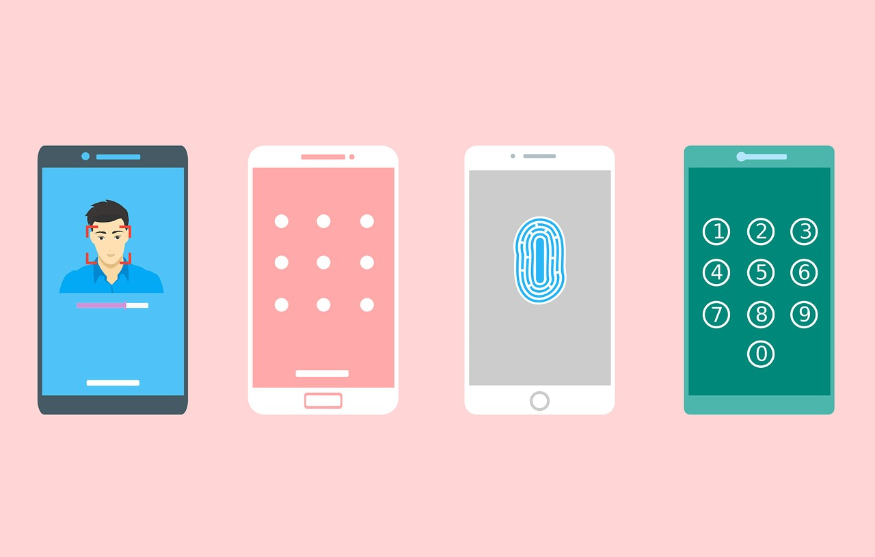
Securing your Smartphone or Tablet With Biometrics and PIN
Notes:
Instructions: Explain benefits of locking your device.
Your device may store personal information. Some apps require passwords or authentication, but typically most apps don’t. If someone gets hold of a smartphone or tablet, and there is no security measures in place, that person will have access to everything on the device. Examples of basic security options are, a pin code, pattern lock, fingerprint and facial recognition.
A pin code is an identifying number a user creates to validate user authenticity. This is like a pin number used for an ATM card.
Pattern lock is a pattern used by connecting a series of dots in a specific order to unlock access to a phone or device.
Fingerprint and facial recognition is a method of biometric identification that uses the user's specific fingerprint or body measurements to verify identification.
Materials: None
Handouts: None
Time: 2 Minutes
Image by 200 Degrees from Pixabay

Slide 28

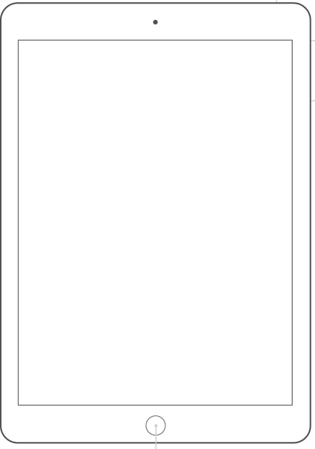
The Basics
Turning on the Smartphone or Tablet
Notes:
Instructions: The first thing to do is to turn on your smartphone or tablet. To do this, Press and Hold the “Power Button” until it turns on. (Refresh the power button location based on the type of device)
Now you are ready to turn your Smartphone or Tablet off. Press and Hold the “Power Button” until the Menu is displayed. When prompted, tap on the screen where it says, “Power Off”.
Smartphones and tablets can lock automatically in a certain number of minutes/when the screen times out. This is a normal feature built into most devices and is a security feature and a power-saving feature. You can also lock it yourself by pressing the “Power Button” once.
Materials: Device
Handouts: None
Time: 5 Minutes

Slide 29
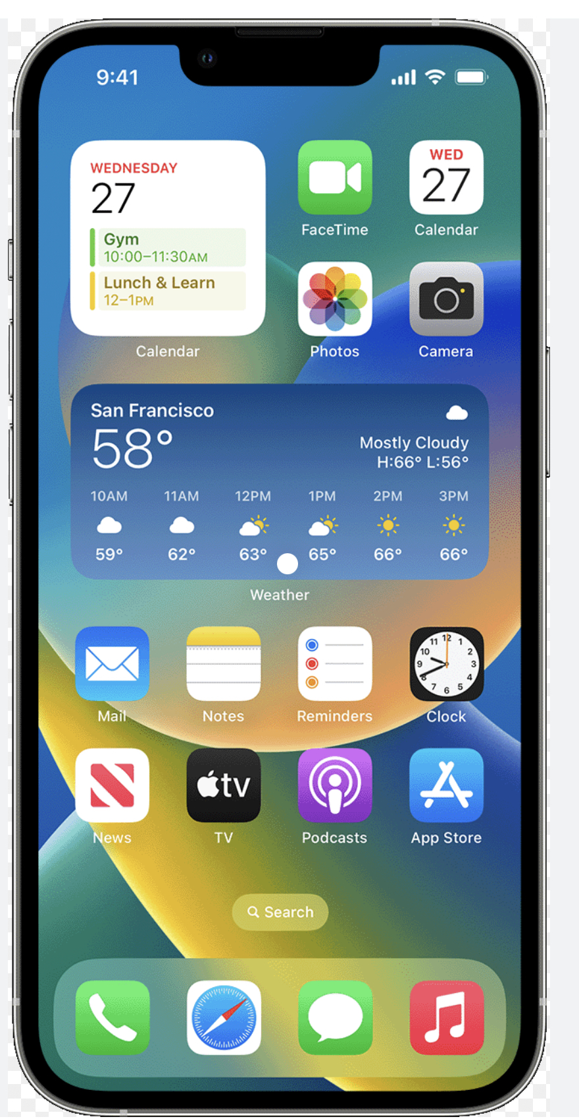
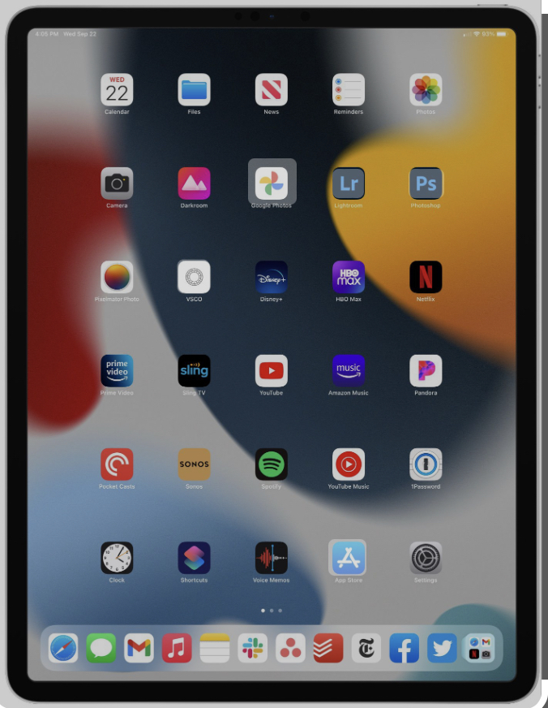
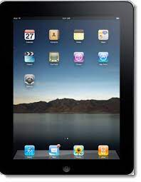
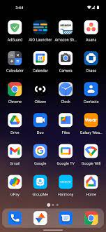
The Home Screen
Apple (iOS) Android
Notes:
Instructions: Once the tablet/smartphone is switched on, you should find yourself at what is called the Home Screen. This is the starting point for using your tablet. This is where you launch your apps. (Apps are mini programs that add functionality, such as a calendar, clock, or game.) Tablets come with some apps pre-installed, and you can also download new apps from online stores. There are more than a million apps to choose from and download.
The home screen can be seen as the “home” of the tablet. If you get lost in your tablet you can always hit the “home” key to re-orient yourself and start over. When you turn your tablet on, you will always have the home screen on the display.
On the screen, you’ll see several icons (these are graphical images, each representing a different app). You could see a letter envelope icon for your email program, a browser icon for your web browser, a camera icon for taking photos and so on.
You may also see extra things on the Home screen, like a clock, local weather, a Google Search bar or notifications window. On the top of the screen on most Android tablets you’ll also see the Status/ Notifications bar. It will have a clock, battery indicator and several indicator lights, such as wireless signal strength and little icons for notifications for specific apps. Often, if a notification appears, such as a new email or a calendar event that is about to happen, tapping on the notification icon will bring you to the relevant app.
Materials: Device
Handouts: None
Time: 10 Minutes

Slide 30

Let’s Do It
Home screen, Status/Notifications Bar, Notification panel, Battery, and Clock
Notes:
Instructions: If participants have access to tablets/smartphones they can utilize their personal devices for this activity. If not able to use personal devices, facilitator can use supplemental materials
Activity: Ask participants to demonstrate new material.
As a group, turn on your tablets and look at the Home Screen. Complete the following tasks (it is recommended to do each step together and wait for each learner to accomplish each step before moving on as a group):
List everything you see on the Home Screen (using proper terminology).
As a group, discuss what you think each icon will be used for.
Locate the Status/Notifications Bar.
Explore the Notification Panel.
Determine how much of your battery power is left.
Find the clock to see what time it is.
Materials: None
Handouts: None
Time: 10 Minutes

Slide 31
Using Gestures on IOS
Tap
Tap and hold and drag
Scroll
Swipe
Pinch to zoom
Double tap
Notes:
Instructions: Explain what gestures are.
Gestures are what you'll use to interact with your device's touchscreen. For instance, instead of clicking something with your mouse, you'll tap the screen with your finger or using a Stylus.
Tap: This is simply a quick touch of the screen with one finger. Tap is used to launch apps, select items, follow web links and so on. Tap is the equivalent of a left-click on your desktop computer.
Tap and hold (and drag): Touch a part of the screen and keep your finger in contact with the screen. The effect of this varies, depending on the application. Tap and hold is often the equivalent of a right mouse click on your computer, bringing up a content menu. On your Home screen, tap and hold can be used to move icons and widgets around. Tap and hold so that the icon appears to “wiggle”, then drag it to where you want it.
Scroll: Simply touch a part of the screen that doesn’t have a button or link. Keep your finger in contact with the screen and move it up or down, left or right. This is most used for scrolling documents or web pages. If you visit a web page that’s too long to see on the screen, for example, touch any part of the page that’s not a link near the bottom of the screen, then push your finger up the screen, as if you were pushing the web page up to reveal the rest of it. This will cause the web page to scroll. Obviously, you can do the same in reverse – or left and right if the page or image is too wide.
Swipe: Swipe is a quick slash across the screen. It can be in whatever direction is required. Swipe is most used when flipping between pages (in a book) or images (in a slideshow). The swipe is like flinging the current page or image aside to reveal to the next page. In an image program for example, swipe right to left to move to the next image. Swipe is also used on your tablet’s home page - if you have a lot of apps installed (too many to fit on one screen), you can have several Home pages. You swipe left or right to switch between them. Swipe can also be used for fast scrolling – you can fling a web page up or down. The velocity of the swipe determines how far it scrolls.
Pinch-to-zoom: Pinch-to-zoom requires more than one finger. Place two fingers (usually the thumb and forefinger, but it doesn’t really matter) around a part of the screen you want to zoom out of or enlarge. Then move the two fingers apart to zoom in (enlarge that part of the screen) or pinch them closer together to zoom out (make that part of the screen smaller). You can think of it like squeezing or expanding the screen. Pinch-to zoom is often used in web browsers, allowing you to zoom in on part of the page that might not be clear, is too small, or might have a link that’s difficult to tap. It’s also used in image programs to zoom in and out of a photo.
Double tap: This gesture involves simply tapping on the screen twice in quick succession. It most often serves a similar function as pinch to zoom: in your web browser, double tap on a part of the page you want to zoom in on (which makes it easier to touch hyperlinks); double tap again to zoom out.
Materials: Device
Handouts: None
Time: 10 Minutes

Slide 32
Let’s Do It
Gestures on iOS
Notes:
Instructions: If participants have access to tablets/smartphones they can utilize their personal devices for this activity. If not able to use personal devices, facilitator can use supplemental materials
Activity: Ask participants to demonstrate new material.
Demonstrate how to launch the photo application with the tap gesture.
Scroll through pictures.
Use pinch to zoom on photos.
Materials: Device
Handouts: None
Time: 5 Minute

Slide 33
Questions
Discussion
Next Steps
Notes:
Instructions: Before the session begins, add any text to promote next educational opportunity.
Thank participants for attendance, allow for questions and discussion, promote the next lesson, encourage evaluation participation.
Materials: None
Handouts: None
Time: 10 minutes

Slide 34
Smartphone and Tablet Training
Advanced
Features
Notes:
Slides 29-36: Optional slides to use for more advanced features lesson.
Instructions: Have this slide up as participants arrive
Materials: None
Handouts: None
Time: 1 minute
Photo by Thirdman: https://www.pexels.com/photo/a-group-of-people-having-a-discussion-while-looking-at-laptop-5256526/

Slide 35
Structure of Today’s Session
The Calendar App- Practice Opportunity
Accessibility
Voice Typing – Practice Opportunity
Notes:
Instruction: State the structure of the lesson and briefly describe content that will be discussed under each heading. Ask for any questions or concerns before starting.
Materials: None
Handouts: None
Time: 3 minutes

Slide 36

Calendar App
Add events
Search events
Reminders
Notes:
Instructions: Facilitator will demonstrate how to access the calendar, add events, search events, repeat events, and set up reminders.
Apple: https://support.apple.com/guide/iphone/create-and-edit-events-in-calendar-iph3d110f84/ios
Google: https://support.google.com/calendar/answer/2465776?hl=en&co=GENIE.Platform%3DDesktop
Calendar apps assist the user to create, manage, and view tasks, appointments, and projects. Both the iOS and Android applications works on both phones and tables, allow for calendars to be shared, can layer calendars to be able to view many calendars in one app, and can be published on the web. The calendar app also sets reminders to notify the user of upcoming appointments and events.
Demonstrations:
Demonstrate how to find the calendar app either by searching for it or using the icons.
Demonstrate how to create an event including all day event or a specific time.
Demonstrate on how to repeat an event and invite others.
Demonstrate how to set up reminders
Demonstrate how to search the calendar for events
Materials: None
Handouts: None
Time: 10 Minutes

Slide 37
Let’s Do It
Calendar Events and Reminders
Notes:
Instructions: If participants have access to tablets/smartphones they can utilize their personal devices for this activity. If not able to use personal devices, facilitator can use supplemental materials
Activity: Ask participants to demonstrate how to add a calendar event and set up a reminder.
Materials: Device
Handouts: None
Time: 5 Minute

Slide 38

Accessibility
Using Magnifier
Setting Brightness
Increasing Font Size
Using Screen Reader/VoiceOver
Using Voice Typing and Commands
Notes:
Instructions: The facilitator will demonstrate the accessibility options in either IOS and/or Android
Sometimes the font size is difficult to read, especially on phones with a small screen. Adjusting the font size will allow one to be able to read the text better. Most devices offer an accessibility menu to implement screen readers, adjust font size, display size, brightness, and magnification, found under settings.
Demonstrations:
Demonstrate how to use the phone as a magnifying glass to zoom in on objects or text using the magnifier app. Settings, accessibility,
Demonstrate on how to adjust font size.
Demonstrate how to turn on Screen Reader (Android) VoiceOver (iOS). On Android, settings, accessibility, talkback. On iOS, settings, accessibility, Spoken Content, Speak Screen. Demonstrate by going to website and swipe down with two fingers. (Google version is a little more cumbersome to utilize)
Demonstrate voice typing through using the microphone feature or dictation.
Materials: Device
Handouts: None
Time: 15 Minute

Slide 39
Let’s Do It
Screen Brightness and Voice Typing/Commands Activity
Notes:
Instructions: If participants have access to tablets/smartphones they can utilize their personal devices for this activity. If not able to use personal devices, facilitator can use supplemental materials.
iOS: https://support.apple.com/guide/iphone/get-started-with-accessibility-features-iph3e2e4367/ios
Android: https://support.google.com/accessibility/android/answer/9078941?hl=en
Activity: Ask participants to demonstrate how to adjust screen brightness.
Utilizing voice typing and commands activity is on the next slide.
Materials: Device
Handouts: None
Time: 5 Minute

Slide 40
Voice Typing Activity
What will the temperature be on Saturday?
Set an alarm for 3 o’clock pm.
Navigate to an address
Create an appointment for next Tuesday at 1:00 p.m.
Notes:
Instructions: If participants have access to tablets/smartphones they can utilize their personal devices for this activity. If not able to use personal devices, facilitator can use supplemental materials.
Ask participants to demonstrate voice typing activity.
Materials: Device
Handouts: None
Time: 5 Minute

Slide 41
Questions
Discussion
Next Steps
Notes:
Instructions: Before the session begins, add any text to promote next educational opportunity.
Thank participants for attendance, allow for questions and discussion, promote the next lesson, encourage evaluation participation.
Materials: None
Handouts: None
Time: 10 minutes

