Slide 1




ZOOM
Host Basics
Notes:
Instructions: Have this slide up as participants enter the room.
Materials: Computers with Microsoft Word
Handouts: Copy of presentation slides
Time: 1 Minute
Photo by Thirdman: https://www.pexels.com/photo/a-group-of-people-having-a-discussion-while-looking-at-laptop-5256526/

Slide 2







Bridging the Digital Divide Partners
This project was funded by USDA NIFA award # 2022-68006-36496. The material is based upon work supported by the National Institute of Food and Agriculture, U.S. Department of Agriculture. Any opinions, findings, conclusions, or recommendations expressed in this publication are those of the author(s) and do not necessarily reflect the view of the U.S. Department of Agriculture.
Materials as of: December 2023
Notes:
Instructions: Share this acknowledgment of the partnerships in the Bridging the Digital Divide.
Materials: None
Handouts: None
Time: 1 Minute

Slide 3
In accordance with Federal law and the U.S. Department of Agriculture (USDA) civil rights regulations and policies, this institution is prohibited from discriminating on the basis of race, color, national origin (including English proficiency), limited religion, sex, disability, age, marital status, family/parental status, income derived from a public assistance program, political beliefs, reprisal or retaliation for prior civil rights activity in any program or activity conducted or funded by USDA. (Not all prohibited bases apply to all programs)
Program information may be made available in languages other than English. Persons with disabilities who require alternative means of communication for program information (e.g., braille, large print, audiotape, American Sign Language) should contact the responsible State or local Agency that administers the program or contact USDA through the Telecommunications Relay Service at 711 (voice and TTY).

Slide 4
To file a program discrimination complaint, a complainant should complete a Form AD-3027, USDA Program Discrimination Complaint Form, which can be obtained online at https://www.usda.gov/sites/default/files/documents/ad-3027.pdf, from any USDA office, by calling (866) 632-9992, or by writing a letter addressed to USDA. The letter must contain the complainant’s name, address, telephone number, and a written description of the alleged discriminatory action in sufficient detail to inform the Office of the Assistant Secretary for Civil Rights (OASCR) about the nature and date of an alleged civil rights violation. The completed AD-3027 form or letter must be submitted to USDA by: mail: U.S. Department of Agriculture Office of the Assistant Secretary for Civil Rights 1400 Independence Avenue, SW Washington, D.C. 20250-9410; or email: program.intake@usda.gov
This institution is an equal opportunity provider.

Slide 5
Title IX of the Education Amendments Act of 1972 (Title IX) prohibits discrimination on the basis of sex, pregnancy, or parental status - in educational programs and activities that receive Federal financial assistance. The law also prohibits individuals from exclusion from such programs or activities or from denial of benefits from such programs or activities based on sex. This prohibition applies to a wide array of public and private schools at the K-12 grade levels, as well as colleges and universities which receive federal funding. A school that is controlled by a religious organization is exempt from Title IX when the law’s requirements would conflict with the organization’s religious tenets. The law requires federally funded education institutions or programs to disseminate Title IX information widely, including the name, address, and telephone number (or other contact information) of the designated Title IX Coordinator.
Program information is available in languages other than English. Persons with disabilities who require alternative means of communication (e.g., braille, large print, audiotape, American Sign Language) should contact the responsible State or local Agency that administers the program or contact USDA through the Federal Telecommunications Relay Service at 711 (voice and TTY).

Slide 6
Prior to filing a Title IX complaint with USDA against an institution, a potential complainant may want to find out about the institution’s grievance process and use that process to have the complaint resolved. However, a complainant is not required by law to use the institutional grievance process before filing a complaint with the Office of the Assistant Secretary of Civil Rights (OASCR). If a complainant uses an institutional grievance process and chooses to file the complaint with OASCR, the complaint must be filed with OASCR within 60 days after completion of the institutional grievance process.

Slide 7
To file a USDA program discrimination complaint, a complainant should complete Form AD-3027, USDA Program Discrimination Complaint Form, which can be obtained online at https://www.usda.gov/sites/default/files/documents/ad-3027.pdf; from any USDA office; by calling (866) 632-9992; or by writing a letter addressed to the USDA office listed below. The letter must contain the complainant’s name, address, telephone number, and a written description of the alleged discriminatory action in sufficient detail to inform OASCR about the nature and date of an alleged civil rights violation. The completed AD3027 form or letter must be submitted to USDA via: mail: U.S. Department of Agriculture Office of the Assistant Secretary for Civil Rights 1400 Independence Avenue, SW Washington, D.C. 20250-9410; or email: program.intake@usda.gov
This institution is an equal opportunity provider.

Slide 8
Author Acknowledgement
We wish to thank the authors of this training material:
Dr. Dorothy Brandon, Extension Specialist, Alabama A&M University
Terrence Wolfork, Assistant Extension Administrator for Communications, Conferencing, and Technology, Fort Valley State University
Dr. Roseanne Scammahorn, Extension/Research Associate III, Southern Rural Development Center
Notes:
Instructions: The presenters of this session are asked to share this acknowledgment of the work that went into this session.
Materials: None
Handouts: None
Time: 1 minute

Slide 9
Presenter Acknowledgement
Name
Title
Association
Email (Optional)
Phone (Optional)
Webpage (Optional)
Notes:
Instructions: Self introduction
Materials: None
Handouts: None
Time: 1 minute

Slide 10

Today’s Goals
Add a profile picture
Insert virtual background
Schedule a meeting
Invite others to a meeting
Share a screen
Create a poll
Notes:
Instructions: Before jumping into the lesson, tell the clients what you expect for them to be able to do after the lesson.
This slide shows the six parts of this single lesson. Each of the six point will pulse in descending order so that you can highlight each point.
Materials: None
Handouts: None
Time: 1 Minute
Image by Free Photos from Pixabay

Slide 11
Structure of Today’s Session
Profile Picture
Virtual Backgrounds - Practice Exercise
Schedule a Meeting - Practice Exercise
Share Your Screen
Create A Poll – Practice Exercise
Invite Others to a Meeting
Notes:
Instruction: State the structure of the lesson and briefly describe content that will be discussed under each heading. Ask for any questions or concerns before starting.
Materials: None
Handouts: None
Time: 5 minutes

Slide 12
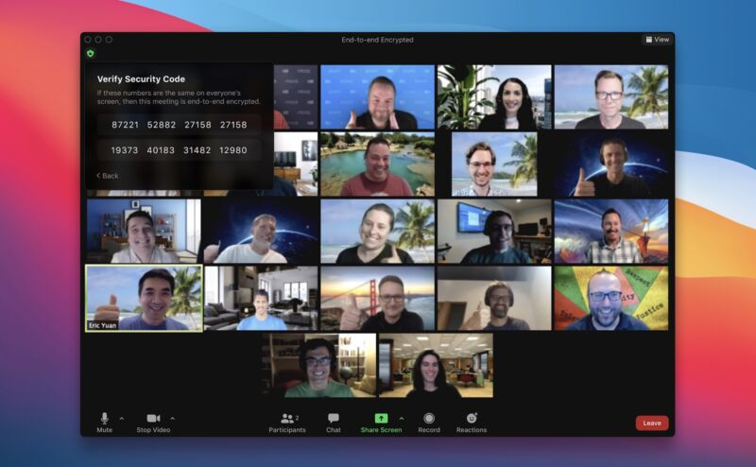
Introductions
Notes:
Instructions: Give time for participants to introduce themselves. You could also include a brief question for them to answer such as what motivated them to take this class? Encourage the 30 second rule: “In 30 seconds, share your name and answer…”
You may also consider using a light-hearted questions such as:
What was your first job?
What hobby takes up most of your free time?
How do you like your coffee?
Materials: None
Handouts: None
Time: 10 Minutes
Image by WikiImages from Pixabay

Slide 13
Notes:
Instructions: Talk with participants about the use of Skype, FaceTime, or even camcorders/VHS. Relate their responses to video conferencing (this activity is to move the clients from the known to the unknown). Once they understand the concept of video conferencing, ask them to name several tasks that can be performed by using a video conferencing.
Materials: None
Handouts: None
Time: 5 Minutes

Slide 14

Adding a Profile Picture
Notes:
Instructions: Introduce the next section: Adding a profile picture
Materials: None
Handouts: None
Time: 20 Minutes for the section and activity
Image by Sara Torda from Pixabay

Slide 15
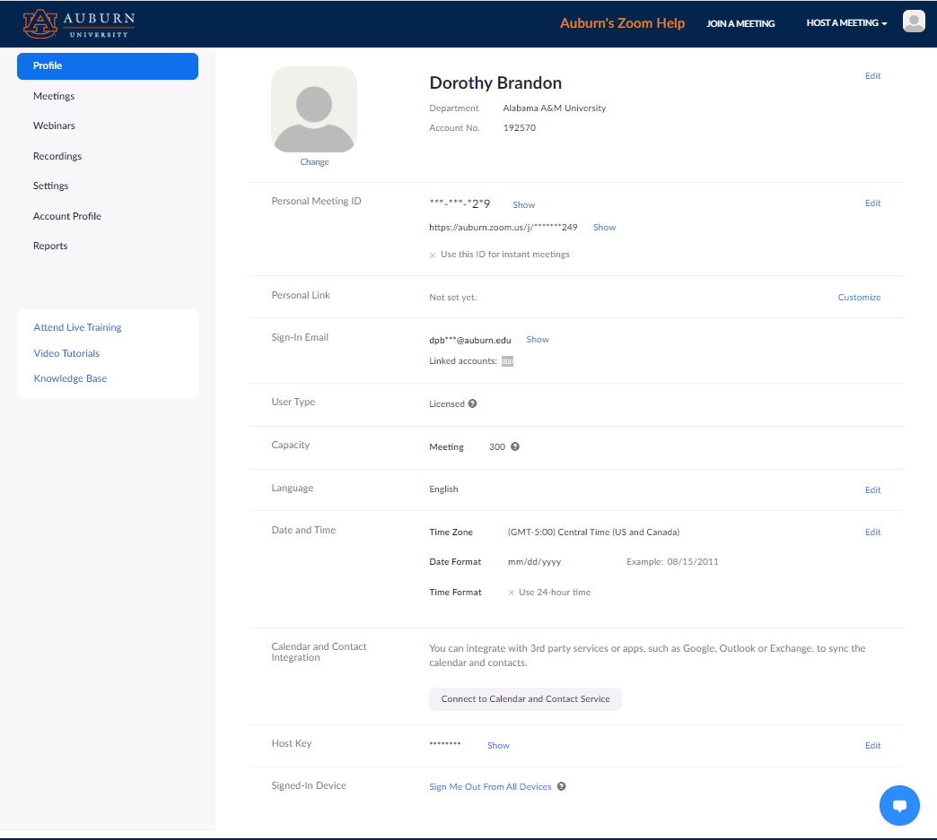
Adding a Profile Picture
Open your Zoom Account
Your account opens on the Profile page
Profile
Notes:
Instructions: Explain to the participants that you will first demonstrate how to perform the task as they observe, and later you will provide time for them to perform the task.
Ask participants why all hosts should have a profile picture displayed? Is this good practice for the safety of the participants?
Sign into the Zoom web portal at zoom.us. Your account opens on the “Profile” page. (2 second delay and the word Profile will highlight)
Materials: None
Handouts: None
Time: 2 minutes

Slide 16
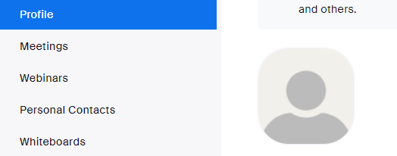
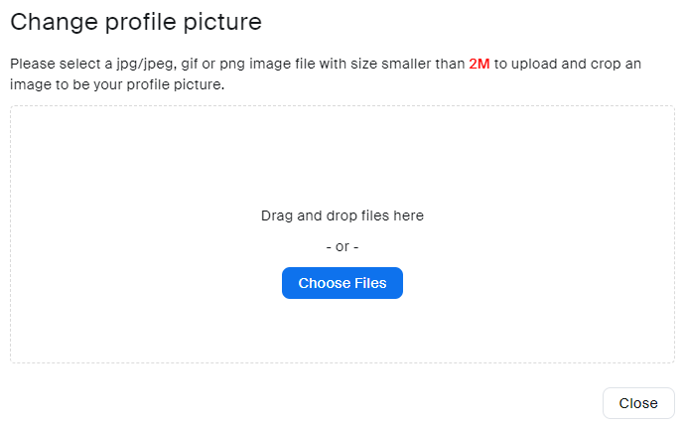
Zoom opens on PROFILE page
Click the
PENCIL ICON
Click
CHOOSE FILES
In the navigation menu, click Profile.
In the section with your name and other personal details, click the pencil icon in the picture frame.
Drag and drop the file or click Choose Files to upload your picture.
Note: Please select a jpg/jpeg, gif, or png image file with a size smaller than 2MB.
Notes:
Instructions: (Word bubbles automatically highlight in descending order)
In the “Profile” section your name and other personal details are displayed, to add a photo click the “pencil icon” in the picture frame. Select from “Drag and Drop the file here” or click ”Choose Files” to upload a picture. Note: Please select a jpg/jpeg, gif, or png image file with a size smaller than 2MB.
Materials: None
Handouts: None
Time: 2 minutes

Slide 17
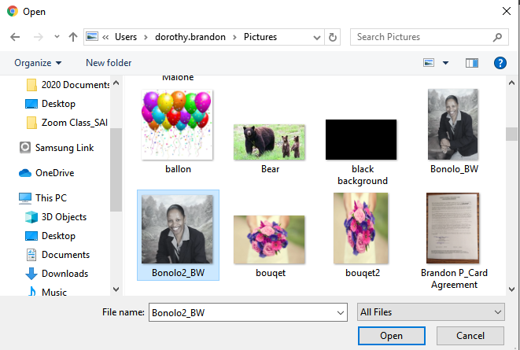

Select picture from personal files (Click the picture of your choice)
Click Open
Profile Picture appears
Notes:
Instructions: (Selection boxes automatically highlight in descending order)
After selecting “Choose Files” a dialog box will appear for you to navigate your computer and locate the picture you would like to upload. Click the picture, click “Open” and your picture will appear in the Zoom picture box.
Materials: None
Handouts: None
Time: 2 minutes

Slide 18
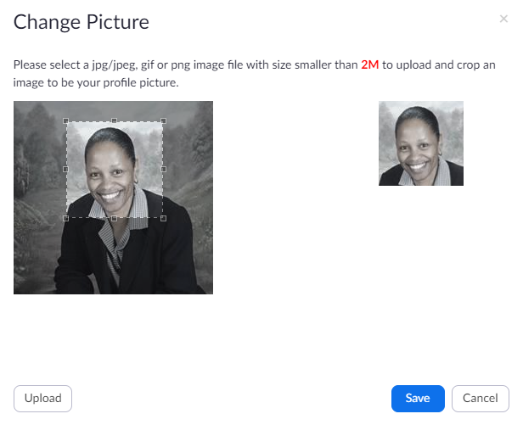
Adjust the crop area as needed (in the change picture window)
Click Save
3. Drag or Open Square to desired Picture size
4. Click Save
Notes:
Instructions: You may click and drag the square open and close (widen or zoom) in on the picture to align it in the box to your desired picture size. Click “Save” to continue.
Materials: None
Handouts: None
Time: 2 minutes

Slide 19

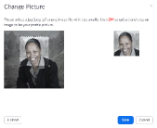
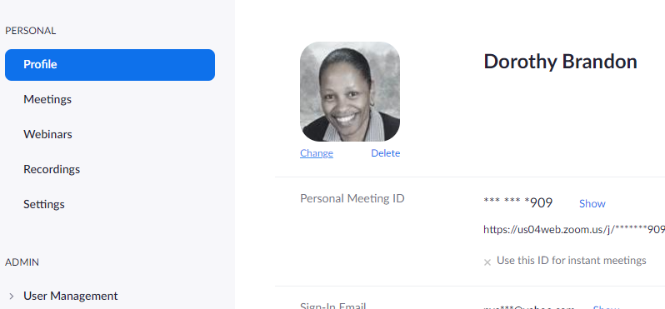
Your profile picture appears
Notes:
Instructions: Your picture is now saved and will be displayed when you log in to future Zoom meetings.
Materials: None
Handouts: None
Time: 2 minutes

Slide 20



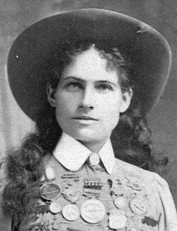
TIME TO PRACTICE
Add a
Profile Picture
Notes:
Instructions: Ask participants to perform the task. Explain that once they have performed the task using the different methods, decide which method is easier for them and start using that method.
Have participants upload their picture. If they finish early, they can take a mini-stretch break.
Materials: A personal picture and a background picture saved to computer or portable drive.
Handouts: None
Time: 10 Minutes

Slide 21

Virtual Backgrounds
Notes:
Instructions: Introduce the next section: Virtual Backgrounds
Materials: None
Handouts: None
Time: 25 Minutes for the section and activity.
Image by José Augusto Camargo from Pixabay

Slide 22
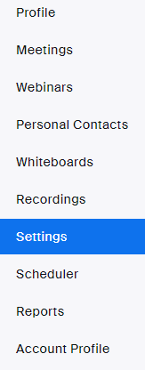
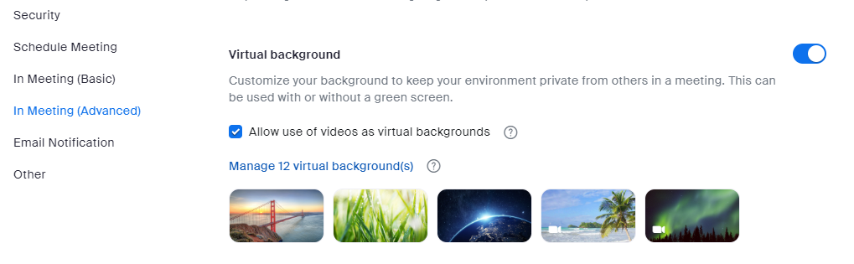
Insert Virtual Background
Click on Settings. A new window will appear. At the top of the screen make sure you are on the “Meeting” Tab.
Click on In Meeting (Advanced)
Scroll to Virtual Background
Make sure the radio button is turned on.
Click on Manage Virtual Backgrounds
Notes:
Instructions: (Selection circles automatically move in and out in descending order)
Ask participants why hosts should use a background? Benefits? Downfalls?
1. To add Zoom backgrounds, from your “Sign in” page, in the blue ribbon on the left side of the screen, select “Settings”. A new window will appear.
2. At the top make sure you are on the “Meeting” Tab. Click on “In Meeting (Advanced)” in the menu list on the left side of your page.
3. Scroll down until you see ”Virtual Background”
4. Make sure the radio button on the right side is turned on.
5. Then click on “Manage virtual Backgrounds”
Shortcut: After clicking on Settings (Step 1), the new screen has a search bar at the top. Search for “Virtual Background” and it will take you directly there.
Materials: None
Handouts: None
Time: 3 Minutes

Slide 23
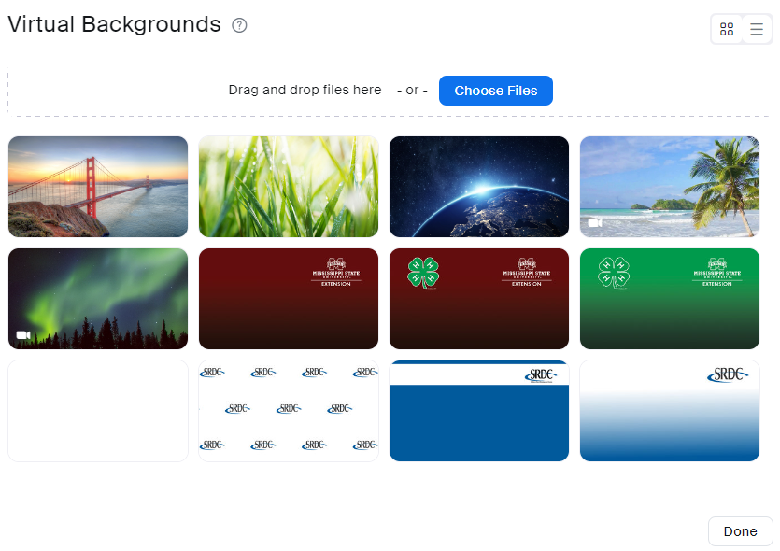
Insert Virtual Background
Notes:
Instructions: (Red circle will automatically highlight “Choose Files”)
Any background pre-loaded will be displayed in this window. You can add additional backgrounds either by dragging and dropping the files or by clicking on “Choose Files”.
Materials: None
Handouts: None
Time: 1 Minute

Slide 24

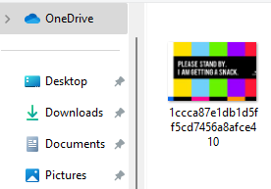

Insert Virtual Background
Select an Image from your computer
Notes:
Instructions: (Word bubble will automatically appear and the red circle will automatically highlight “Open”)
After clicking on “Choose Files” a dialog box will appear where you can select a saved photo from your desktop and click on “Open”
Materials: None
Handouts: None
Time: 1 Minute

Slide 25
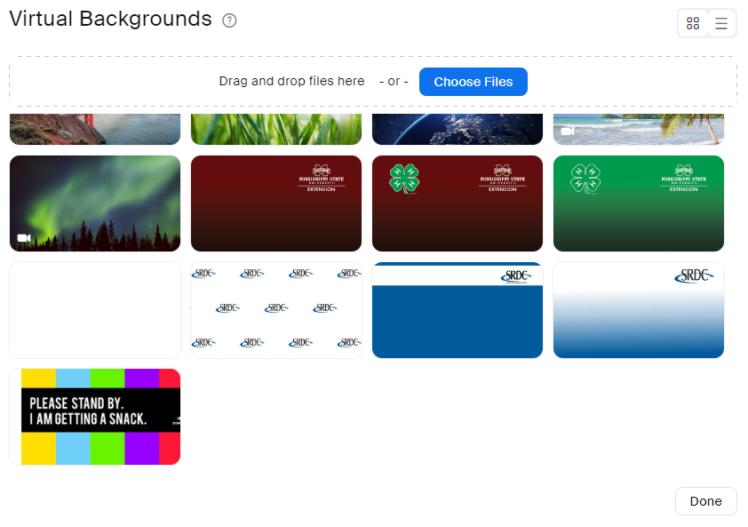
Insert Virtual Background
Notes:
Instructions: (Red circles will automatically highlight the new image and “Done”)
Your new background will now show in your list.
Click on “Done” to close the window.
Materials: None
Handouts: None
Time: 1 Minute

Slide 26
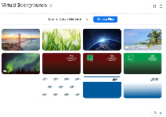
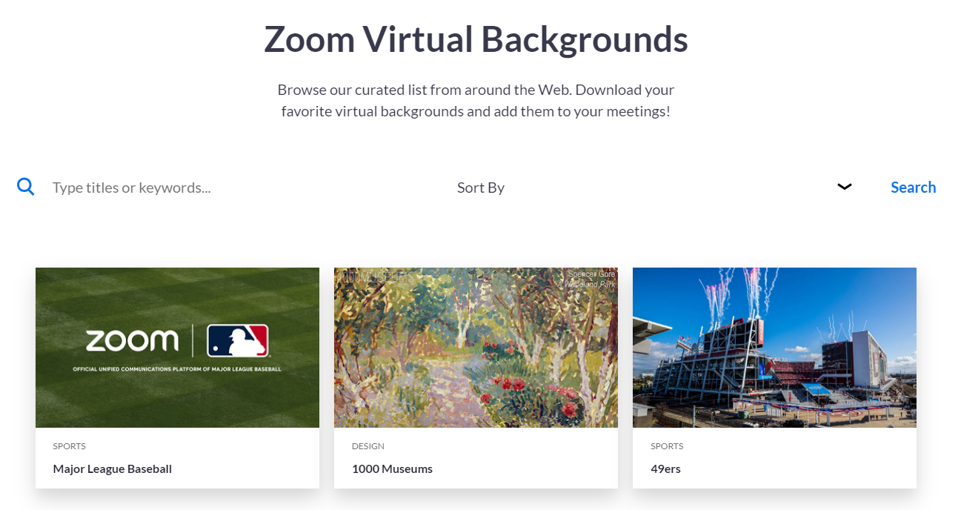
Insert Virtual Background
Notes:
Instructions: Zoom has hundreds to choose from and you can find them on the internet for free. From Zoom’s main page (zoom.us), type “Virtual Backgrounds” in the search bar to access Zoom’s curated list from around the Web.
Materials: None
Handouts: None
Time: 2 minutes

Slide 27
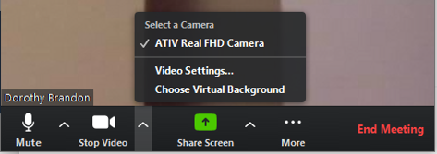
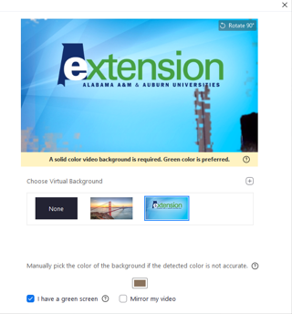
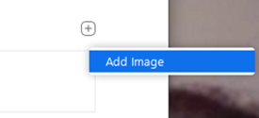
Add a virtual background once you start a meeting
Click the up arrow ^ beside Stop Video
Click Choose Virtual Background
Click the plus sign (+)
Click Add Image
Notes:
Instructions: (Red circle will highlight key items in descending order)
To add a virtual background once you have started the meeting do the following:
1. Click on the arrow up (carrot) next to the video control button.
2. From the menu, select “Choose Virtual Background”
A dialog box will appear with available backgrounds.
3. Click on the “plus” (+) sign to add an image
4. Select “Add Image”
Materials: None
Handouts: None
Time: 2 minutes

Slide 28
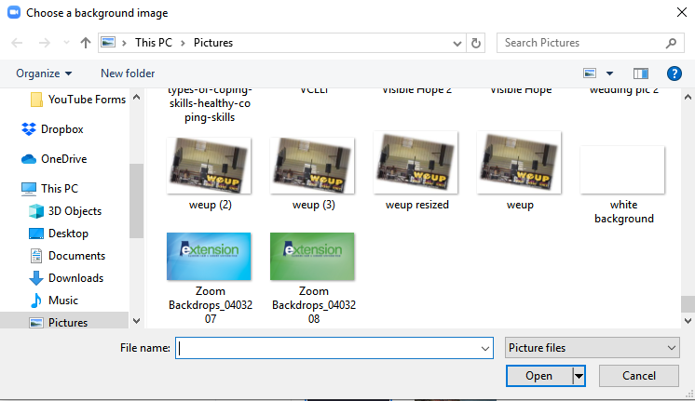
Add a virtual background once you start a meeting
Click on the background
Click on Open
Background will pop into the options and on screen
Notes:
Instructions: (Red circle will highlight key items in descending order)
After selecting “Add Image” a dialog box will appear for you to navigate your computer and locate the picture you would like to upload. Highlight the picture, click “Open” and the background picture will appear in the menu of available Zoom backgrounds.
Click on the “X’ in the upper right corner to close the window.
Materials: None
Handouts: None
Time: 2 minutes

Slide 29
Select a virtual background once you start a meeting
Click the up arrow ^ beside Stop Video
Click Choose Virtual Background
Click on the background you want
Indicate if you have a green screen
Click the X to close the box
Notes:
Instructions: (Red circle will highlight key items in descending order)
To change your background once you start the meeting do the following:
1. Click on the arrow up (carrot) next to the video control button.
2. From the menu, select “Choose Virtual Background”
3. A new window will appear with available backgrounds. Click on the picture of the one you want to display. For best effects, be sure to have a solid wall to the back of you and lighting in front of you. if your background contains text and it appears backward, remove the check mark from Mirror my video.
4. Click to checkmark if you have a green screen.
5. Click on the “X’ in the upper right-hand corner to close this window.
You now have your background image active.
Materials: None
Handouts: None
Time: 2 minutes

Slide 30


WAIT!
Time to practice!
Add a
Virtual Background
Notes:
Instructions: Ask participants to perform the task. Explain that once they have performed the task using the different methods, decide which method is easier for them and start using that method.
Have participants upload a new background. If they finish early, they can take a mini-stretch break.
Materials: A personal picture and a background picture saved to computer or portable drive.
Handouts: None
Time: 10 Minutes

Slide 31

Schedule a Meeting
Notes:
Instructions: Introduce the next section: How to schedule a meeting.
Materials: None
Handouts: None
Time: 45 Minutes for the section and activity.
Image by Alexandra_Koch from Pixabay

Slide 32
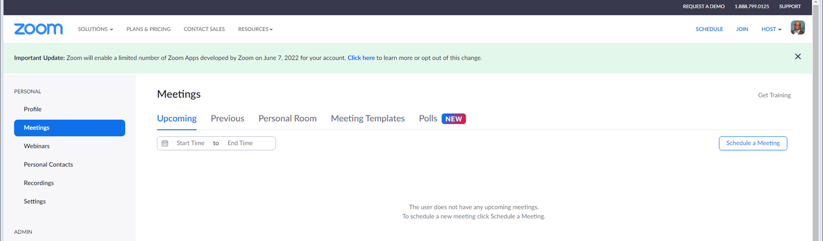
Sign into your Zoom account
From the Meetings tab - Click on Schedule a Meeting
Notes:
Instructions: (Red Circles highlight key items in descending order)
Ask participants what are some types of meetings that you would need to schedule? How will they use this platform?
First you must be signed into your Zoom account. From the “Meetings” screen, (Meetings will be highlighted in the blue ribbon on the left side of your screen), click the ”Schedule a Meeting” button located on the right side of the screen. This will open the scheduler window.
Materials: None
Handouts: None
Time: 2 Minutes

Slide 33
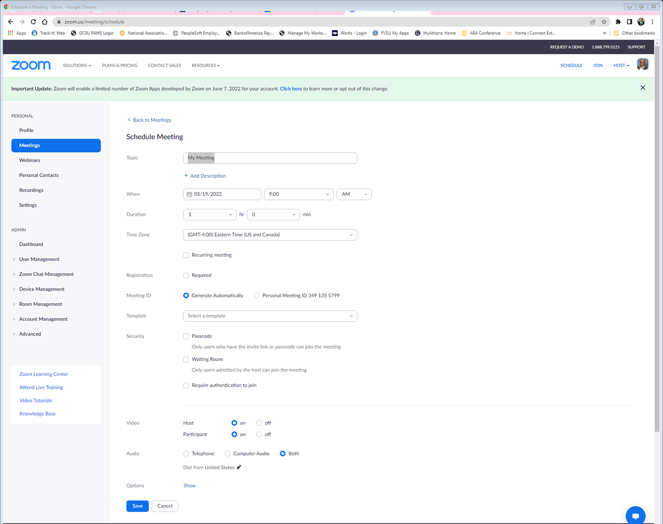
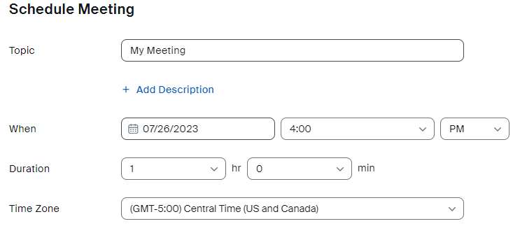
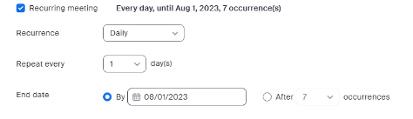
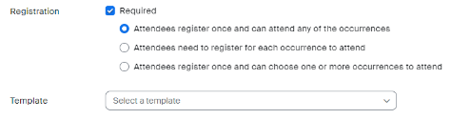
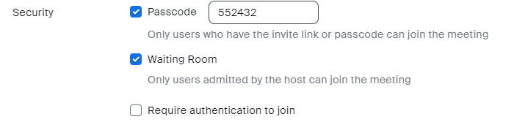


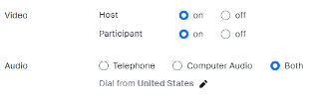
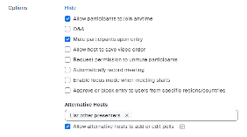
Topic – Name the meeting
When – Date and Time
Duration – Zoom Basic (Free plan) 40 minutes maximum
Time Zone – Defaults to your computer time zone
Notes:
Instructions: (Red Circles highlight key items in descending order)
Enter your meeting information.
Topic - Enter a topic or name for your meeting. To add some additional context and description for this event, click on “Add Description” for a script box.
When – Enter the date and time for your meeting. You can start your meeting at any time before the scheduled time. This can be helpful if you want to meet with your co-host before the participants log in. You can also manually enter any time for the start of the meeting. For example, you can enter 10, 22, 48, etc. in the minutes field.
Duration – Length of time the meeting will last. With the Zoom Basic, the Free option, you have up to 40 minutes per meeting with unlimited number of group meetings per year.
Time Zone - By default, Zoom will use your computer's time zone. Click the drop-down menu to select a different time zone.
Materials: None
Handouts: None
Time: 2 Minutes

Slide 34
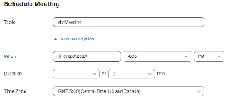
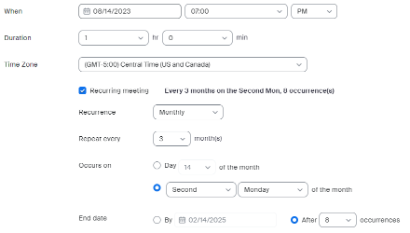
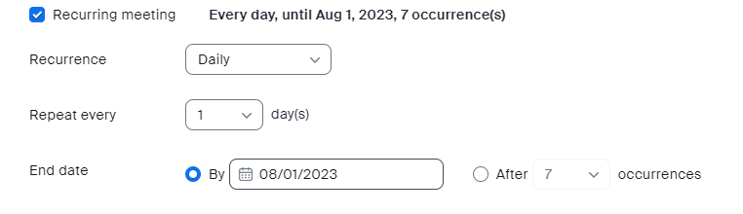
Optional – For Recurring Meetings, check this box
Set up multiple meetings with the same group at once
Meeting ID, Passcode, URL Link, and Dial in numbers will remain the same for each meeting
Notes:
Instructions: Optional – If this is recurring meeting; you can set up all the meetings at once allowing for the Meeting ID, Passcode, and URL Link to remain the same for every meeting in the series. Click on “Recurring meeting” and enter the recurrence (Daily, Weekly, Monthly, No Fixed Time), Repeat every (enter number) days (up to 15), and End Date. For the end date, you can either select a specific date on the calendar, or after so many occurrences (up to 20).
Materials: None
Handouts: None
Time: 2 Minutes

Slide 35
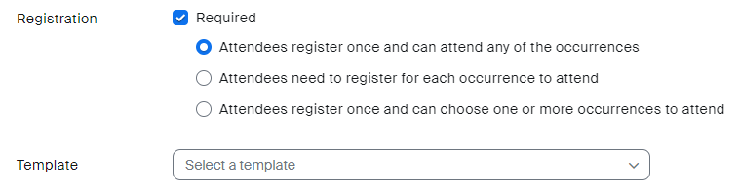
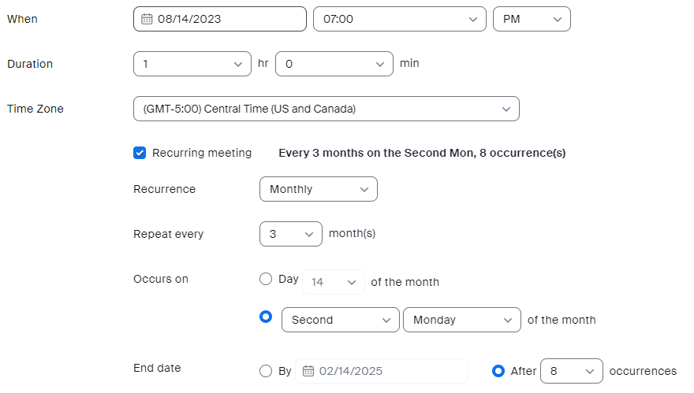
Example:
Quarterly meeting held the second Monday at 7 PM. Starting in August.
Term length, two years.
Items underlined in the example image are where the content is to be placed from the example.
Notes:
Instructions: This is an example of how to set up quarterly Advisory Committee meetings that are held the second Monday at 7PM, for 1 hour, starting in August. The committee serves for two years.
Recurrences: Monthly
Repeat: 3 months
Occurs on: Second, Monday of the Month
End date: After 8 Occurrences
Materials: None
Handouts: None
Time: 2 Minutes

Slide 36

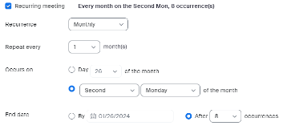
Optional – Registration, check this box to require participants to provide specific information to attend the meeting.
Name, Email address, Phone number, etc.
Host can download a list of people that registered and their information
Notes:
Instructions: Scheduling a meeting that requires registration means registrants must provide some additional information such as their email and name to register for the event. You can include customized questions on the registration form, which allows you to capture more information about your registrants.
Materials: None
Handouts: None
Time: 1 Minute

Slide 37

Meeting ID - Zoom automatically generates a unique Meeting ID for each meeting or series of recurring meetings.
Personal Meeting ID – Your permanent personal meeting room. You can use at any time or schedule it for a future meeting.
Notes:
Instructions: Zoom automatically defaults to “Generate Automatically” and will create a unique ID number for each of your scheduled meetings.
A scheduled, non-recurring Meeting ID number will expire 30 days after the scheduled meeting. If you restart the meeting within the 30 days, it will automatically renew the Meeting ID for another 30 days.
A recurring Meeting ID will expire 365 days after the last active meeting. You can re-use the Meeting ID for future meetings, which will reset the 365-day timer.
A Personal Meeting ID (PMI) is assigned to you as a permanent personal meeting room. You can use this meeting at any time or schedule it for a future meeting. Your PMI will remain the same if you use it at least once every 365 days. If not, it will expire and a new one will automatically be created for you.
Materials: None
Handouts: None
Time: 2 Minutes

Slide 38
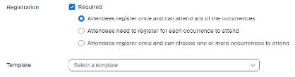
Notes:
Instructions: (Red Circles highlight key items in descending order)
Security – Zoom offers many ways to make sure your meeting is safe. Three of the options are listed in this example.
Passcode – Zoom automatically creates a meeting passcode. Joining participants will be required to input this before joining the scheduled meeting. As host, you do have the option to change the passcode. Note – If you opt to change the passcode, it must meet the complexity requirements set by your administration.
Waiting Room – Activating the Waiting Room option allows the host to control when a participant joins the meeting. As the meeting host, you can admit participants one by one, or hold all participants in the waiting room and admit them all at once.
Require authentication to join – Only those who are signed into their personal Zoom accounts will be able to join the meeting. To activate this option, you must have a Pro, Business, Education, or Enterprise Zoom account.
Materials: None
Handouts: None
Time: 2 Minutes

Slide 39
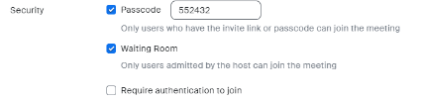

Video – As Host, choose if you would like your video on or off when joining the meeting. For the participants, choose if you would like the participants' videos on or off when joining the meeting.
Audio - Allow users to call in using Telephone only, Computer Audio only, or Both.
Notes:
Instructions:
Video – As host, choose if you would like your video on or off when joining the meeting. For the participants, choose if you would like the participants' videos on or off when they are joining the meeting. Even if you choose off, both you as host and the participants will have the option to start and stop their video.
Audio - Allow users to call in using Telephone only, Computer Audio only, or Both. If Telephone or Both is enabled for this meeting, click “Edit” to select the “dial-in countries” to include in the invitation. By default, this includes your Global Dial-In Countries listed in your meeting settings. In this example is United States only.
Materials: None
Handouts: None
Time: 2 Minutes

Slide 40
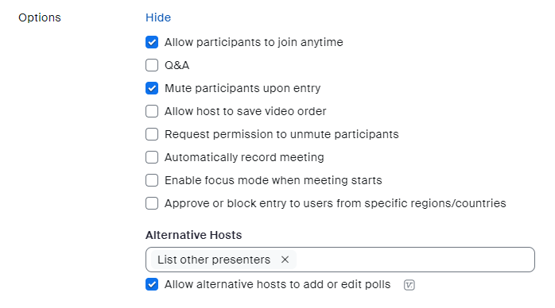
Notes:
Instructions: (Click to remove red box and reveal the next item on the list. A red circle appears to highlight the “Save” button)
Zoom has several options to select from to customize your meeting.
Allow participants to join anytime – This feature allows participants to join before the host or when the host cannot attend the meeting.
Q&A – the Question and Answer feature creates an additional button at the bottom of the participant’s screen. Like the chat box feature, the Q&A will allow participants to type in their questions directly to the Host/Co-Host, rather than for everyone to see. As host you can use this feature to generate a report after the meeting.
Mute participants upon entry – this will automatically mute all participants when they enter the room. This is recommended to reduce possible distractions and hearing things the participant may not have intended for the room.
Allow host to save video order – As host you can click and drag videos and place them in a specific order that only you can see, or you can cast it so that all participants see the order you created. For example, you can sort participants alphabetically by first or last name, time they entered the meeting, or a custom arrangement.
Request permission to unmute participants – Activating this option helps the host to manage participation in a meeting. Upon entering the meeting, participants will be asked if the host has permission to mute or unmute them during the meeting.
Automatically record meeting – Automatic cloud recording will automatically start whether the host joins by computer, mobile device, or telephone dial-in.
Enable focus mode when meeting starts - This feature gives the host and co-hosts view of all participants’ videos without other participants seeing each other. This extends into screen sharing, as the host and co-host can view and switch between each participant’s shared screen, while the participants can only view their own content. More ideal for a classroom setting.
Approve or block entry to users for specific regions/countries - If you are targeting a meeting to an audience in a specific location, approving access for your participants’ specific countries/regions will provide additional privacy and security to your meeting.
Alternative hosts - A host can designate another Licensed user on the same account to be the alternative host. The alternative host can start the meeting on the host's behalf. To add a co-host, type in their email address in the box.
Make sure to click on “Save”
Materials: None
Handouts: None
Time: 5 Minutes

Slide 41
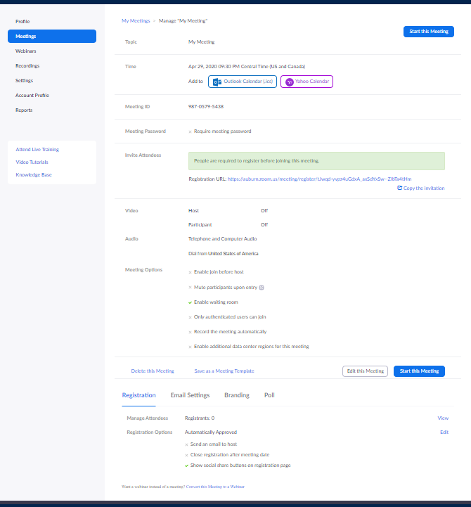
Notes:
Instructions: After creating a meeting, the form will look like this.
Materials: None
Handouts: None
Time: 1 Minutes

Slide 42
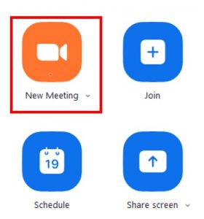
WAIT!
Time to practice!
Set up a basic meeting
Topic: What is a boombox
When: Next Monday at 9 AM Pacific
Duration: 30 minutes
Meeting ID: Generate Automatically
Passcode: IHeart80’s
Video: Host – On, Participant – On
Audio: Both
Notes:
Instructions: Ask participants to perform the task. Explain that once they have performed the task using the different methods, decide which method is easier for them and start using that method.
Encourage participants to work individually to create the meeting on this slide and additional ones if they have time. If they have extra time, they can take a mini-stretch break
Materials: None
Handouts: None
Time: 15 Minutes
Image by Kevin Sanderson from Pixabay

Slide 43

Invite others to a meeting
From the Zoom Web Portal
From the Desktop Application
From in the meeting
Notes:
Instructions: There are many ways to invite participants to a scheduled Zoom meeting. We will highlight the three easiest. Start by logging in to your Zoom account.
Materials: None
Handouts: None
Time: 16 Minutes for this section
Image by Gerd Altmann from Pixabay

Slide 44
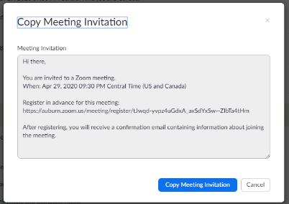
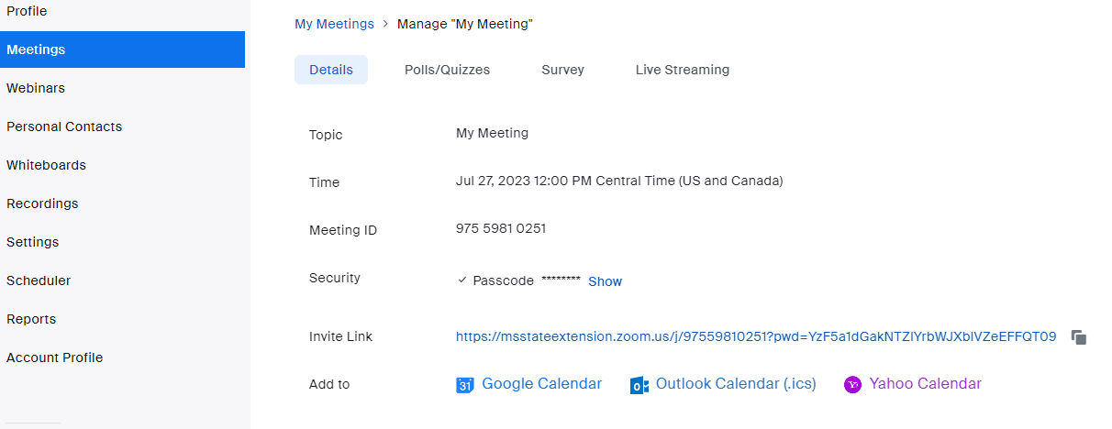
Zoom Web Portal
Notes:
Instructions: (Red Circle highlight key item)
In the blue ribbon on the left, click on “Meetings”. This will show you all the scheduled meetings you are the host of. Select the meeting you would like to send the invitation to.
The meeting detail screen will appear as you see on the screen. At the bottom of the screen click “Copy invitation”.
Materials: None
Handouts: None
Time: 1 Minute

Slide 45
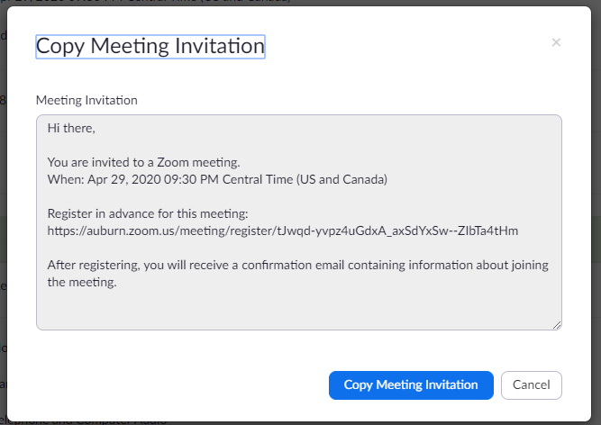
Zoom Web Portal
Notes:
Instructions: (Red Circle highlight key item)
A new screen will appear with all the details needed for a participant to log in or call into your meeting.
Click on “Copy Meeting Information”. You can now open any form of messenger or email and paste the invitation to send to an individual or listserv.
Materials: None
Handouts: None
Time: 1 Minute

Slide 46
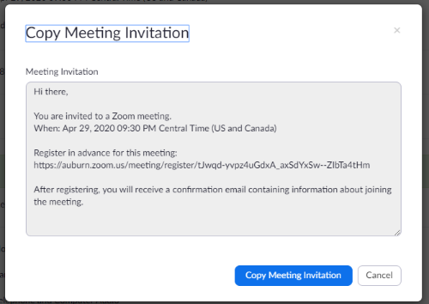
Zoom Web Portal
Notes:
Instructions: (Red Circle highlight key item)
If you don’t need the whole invitation, you can click on the “Copy” icon next to “Invite Link”. This will copy only the URL for you to send to participants.
Materials: None
Handouts: None
Time: 1 Minute

Slide 47
Zoom Web Portal
Notes:
Instructions: (Red Circle highlight key item)
Lastly, if you use Google, Outlook, or Yahoo calendar you can send the link to your calendar and then use the calendar’s invitation process to forward the calendar invitation to others.
Materials: None
Handouts: None
Time: 1 Minute

Slide 48
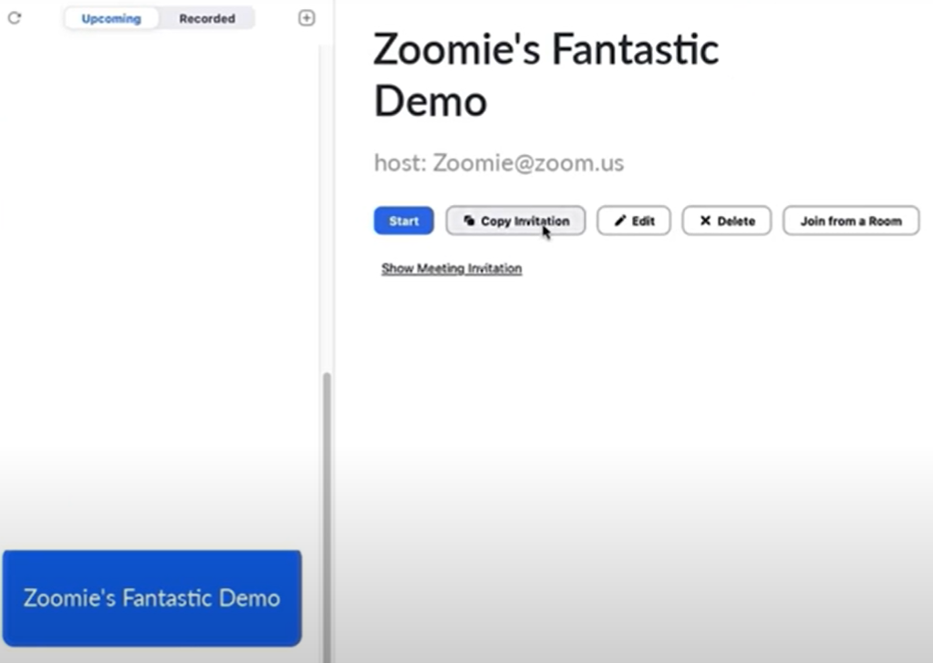
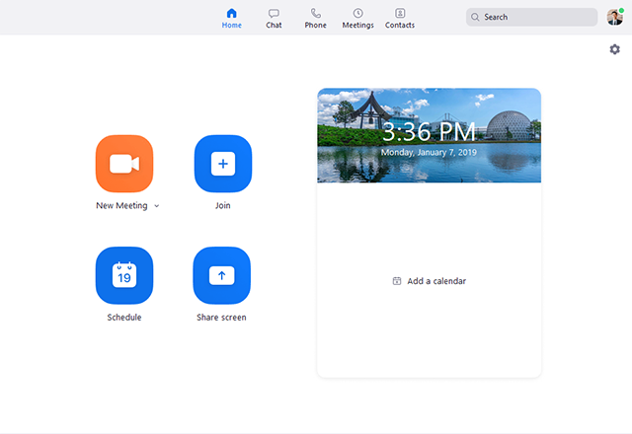
Desktop Application
Open App
Click on Meetings
Select an upcoming meeting
Click on Copy Invitation
Paste to email, calendar, or messenger to share invitation
Notes:
Instructions: (Red Circles highlight key items)
From the desktop application, click “Meetings”, select the meeting you want to invite participants to and click “Copy Invitation”. From here, you can open any form of messenger or email and paste the invitation to the individual.
Materials: None
Handouts: None
Time: 2 Minutes

Slide 49

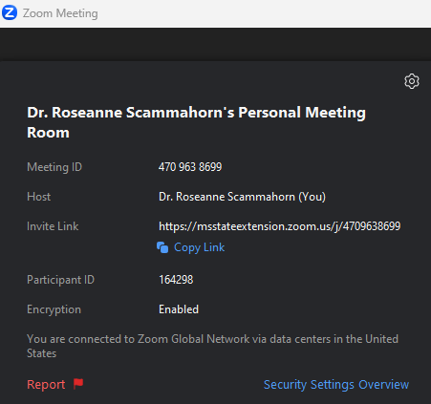
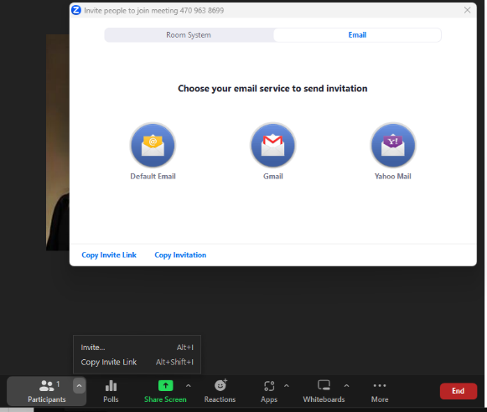
From in the meeting
Click on Meeting Information icon
Click on Copy Link
Notes:
Instructions: (Red Circles highlight key items)
While in a meeting you have two options to invite participants. Option one: Click on Zoom “Meeting Information” icon found in the upper left corner of the screen. From there you can copy the URL and send the link to those you need to quickly invite. Depending on the security features you set up, you may also need to send them the passcode.
Materials: None
Handouts: None
Time: 2 Minutes

Slide 50

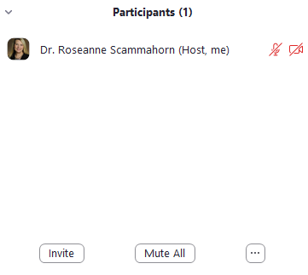
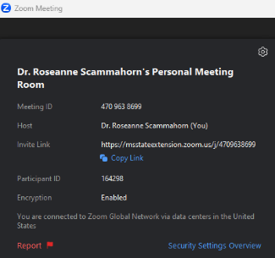
From in the meeting
Notes:
Instructions: (Red Circles highlight key items)
Option two: In the meeting controls found at the bottom of the screen, click on the arrow up (carrot) next to ”Participants”. From this menu you can “Copy Invite Link” and forward it in a calendar invite, email, or messenger or click on “Invite”. Clicking on “Invite” brings up all the options you have available to you according to your plan. In this example their options are to email it using their Personal (Default) email, Gmail, or Yahoo mail. They also have the option to “Copy Invite Link” or “Copy Invitation” and open another option such as their work email. Lastly, you can click on “Participants” and the list of all participants will appear to the right of the screen. Form this you can also click on “Invite”, and you will gain access to the same invitation box.
Materials: None
Handouts: None
Time: 2 Minutes

Slide 51

Share Screen
Notes:
Instructions: Introduce the next section: How to share your screen.
Materials: None
Handouts: None
Time: 8 Minutes for the section
Image by Stefan Schweihofer from Pixabay

Slide 52

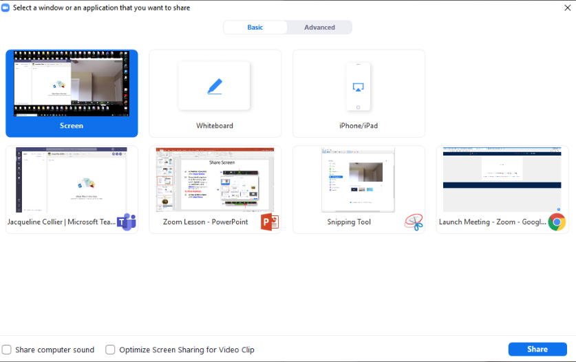

Share a screen
At bottom of screen click Share Screen
From the dialog box click the screen you want shared (highlighted in blue) and then click Share (the screen highlighted in blue will be shared)
To STOP SHARING:
At top of the screen, click Stop Share
Notes:
Instructions: (Red Circles highlight key items)
Ask participants situations that they would need to share a screen? Why is sharing a screen helpful/beneficial?
As host you can share your screen with the room. This feature allows for a more collaborative environment, allowing videos, PowerPoints, and documents to be viewed by all in real time. To share a screen, click on “Share Screen” the green button at the bottom of the screen. A dialog box will appear with all the options available to be shared. Select the screen you would like to share, it will become highlighted in blue, and click on “Share”. Once you start sharing your screen all control buttons will now appear at the top of the screen and the document/screen you are sharing will be highlighted in green on your device/desktop.
To stop sharing, look at the control buttons at the top of the screen and click on “Stop Share”.
Materials: None
Handouts: None
Time: 2 Minutes

Slide 53

Share a screen
To share SOUND from video
Click Share computer sound at the bottom of the share screen.
To share Video in FULL SCREEN
Click Optimize Screen Sharing for Video Clip
Notes:
Instructions: (Red Circles highlight key items)
If you are sharing a video or PowerPoint with an embedded video or audio, make sure to check both “Share computer sound” and “Optimize Screen Sharing for Video Clip”. These are found at the bottom of the screen in the dialog box. Without these checked, participants will not hear any sound from the video and for many the video will appear pixilated. If you are not showing a video, and only sharing an audio clip, do not click “Optimize Screen Sharing for Video Clip” because it can make the screen blurry.
Materials: None
Handouts: None
Time: 2 Minutes

Slide 54

Switching between windows as you present
At top of the screen, click New Share
A dialog box opens, click on the new window you want to share (it will be highlighted blue) and click Share
* To quickly bring down the menu bar from top of your screen, place your pointer on the green ID button.
Notes:
Instructions: (Red Circles and arrow highlight key items)
Sometimes the host will need to change between many documents during a meeting. To switch between windows while presenting, click “New Share” the green icon. Remember, once you start sharing, the controls will be at the top of the page. A dialog box will appear with all the options available to be shared. Select the screen you would like to share, it will become highlighted in blue, and click on “Share”.
Host tip: if you aren't sure which screen you are sharing, click on the green ID button and click the down arrow. A mini widow of the screen you are sharing will drop down.
To stop sharing, look at the control buttons at the top of the screen and click on “Stop Share”.
Materials: None
Handouts: None
Time: 2 Minutes

Slide 55

Creating Polls
Notes:
Instructions: Introduce the next section: How to create polls.
Materials: None
Handouts: None
Time: 30 Minutes for this section and activity
Image by Mohamed Hassan from Pixabay

Slide 56

Creating polls before meeting
Click Meetings (left column)
From the list of scheduled meetings, click on the name/topic of the meeting
Notes:
Instructions: (Red Circles highlight key items)
Ask participants why polls would be useful? How have they seen them used? How would they use them?
Next, we will discuss, how to create polls before you start a meeting. Log in to your Zoom account. Click on “Meetings” in the blue ribbon on your left. Any previously scheduled meetings will be listed on your right. From this list select the meeting you would like to add a poll to.
Materials: None
Handouts: None
Time: 2 Minutes

Slide 57


Click on Polls/Quizzes located at the top of the screen.
Click on +Create
Notes:
Instructions: (Red Circles highlight key items)
Once you have selected your meeting, there will be a “Polls/Quizzes” tab at the top of your screen. Click on “+Create”. A new dialog box will appear.
Materials: None
Handouts: None
Time: 1 Minute

Slide 58

Click on Polls
Click on Next
Notes:
Instructions: (Red Circles highlight key items)
Click on “Polls” and then “Next”.
Materials: None
Handouts: None
Time: 1 Minute

Slide 59



Select from: Single Choice or Multiple Choice
Click on + Add Choice
Click on +Add Question to add additional questions
Click on Save
Notes:
Instructions: (Red Circles highlight key items)
Add a title to the Poll, Enter your first poll question, select from “Single Choice” (they can only pick on answer) or “Multiple Choice” (they can select as many answers as they like).
You can add from 2 – 10 answers by clicking on “+Add choice”. From the ellipsis button at the bottom of the screen (Next to Save), you can select that the answers be anonymous and to add this poll question to your library for future use. Click on “+Add Question” to add up to 50 questions per meeting. Click on “Save” once you have entered all your questions.
Materials: None
Handouts: None
Time: 3 Minutes

Slide 60



Retrieving polls during meeting
To access Poll questions, click Polls
Dialog box opens. Click Name of the Poll you would like to launch
Click Launch (allows participants to see the poll/questions)
If you click EDIT, it will take you out of this screen and to the meeting page.
Notes:
Instructions: (Red Circles highlight key items)
To launch your poll while in your meeting, click on “Polls” at the bottom of your screen. When the dialog box opens, click on the name of the poll you previously created, and click on “Launch”. If you need to make a last-minute change, you can edit your poll. Clicking on “Edit” will take you out of this screen and to your meeting page where you can make additions or corrections.
Materials: None
Handouts: None
Time: 3 Minutes

Slide 61



Poll is launched - participants see and answer questions
Poll is stopped – answers are no longer accepted
Notes:
Instructions: (Red Circles highlight key items)
Once your poll is launched, you can watch the as participants submit their answers. At the top of the box, you can see the number (and percentage) who have submitted their answer and the time elapsed. Once a satisfactory number of participants have completed the poll, click on “End Poll”. You have the option then to “Share Results” with the participants in the meeting.
Materials: None
Handouts: None
Time: 2 Minutes

Slide 62



Allows participants to see results.
Click on Stop sharing.
Click X to close the poll
Ellipses (…) button allows host to re-launch, view or download polling results
Notes:
Instructions: (Red Circles highlight key items)
Allow participants to see the results. Once done, click on “Stop Sharing” and then the “X” to close the box. If needed, you can click on the ellipses box (next to Share Results) to relaunch the poll, download results, or view results from a browser.
Materials: None
Handouts: None
Time: 2 Minutes

Slide 63

Polls: Created during meeting While presenting, you decide to poll your participants.
To create Questions, click Polls
Click on Plus Sign (+)
Click Polls
Click Next
Goes to dialog box opens for entering questions (follow instructions for Creating Polls before Meeting)
Notes:
Instructions: (Red Circles highlight key items)
As host you can create polls while presenting by clicking on “Polls”, click on the “+” Plus Sign, select “Polls” and then “Next”.
Materials: None
Handouts: None
Time: 2 Minutes

Slide 64

Polls: Created during meeting While presenting, you decide to poll your participants.
Opens the dialog box for entering questions
follow instructions for Creating Polls before Meeting
Notes:
Instructions: (Red Circles highlight key items)
You will then add your poll information following the same instructions for Creating Polls before a Meeting presented earlier
Materials: None
Handouts: None
Time: 1 Minute

Slide 65

WAIT!
Time to Practice: Create a Poll
Poll Name: Trivia
Question 1
A "leg lamp" is a pivotal item in what 1983 holiday classic movie?
A Christmas Story
Elf
Polar Express
Question 2
Which musical group became famous with the 1985 hit song "Take On Me?“
A-ha
Culture Club
The Bangles
Notes:
Instructions: Encourage participants to work individually to create a poll using the 2 questions on this slide, or their own questions and answers if they wish. Practice launching, sharing results, and closing the poll.
Materials: None
Handouts: None
Time: 10 Minutes
Image by Rahul Yadav from Pixabay

Slide 66
Questions
Discussion
Next Steps
Notes:
Instructions: Before the session begins, add any text to promote next educational opportunity.
Thank participants for attendance, allow for questions and discussion, promote the next lesson, encourage evaluation participation.
Materials: None
Handouts: None
Time: 10 minutes

